Slide 1
Portfolio Project
Rebecca Martinez

Slide 2
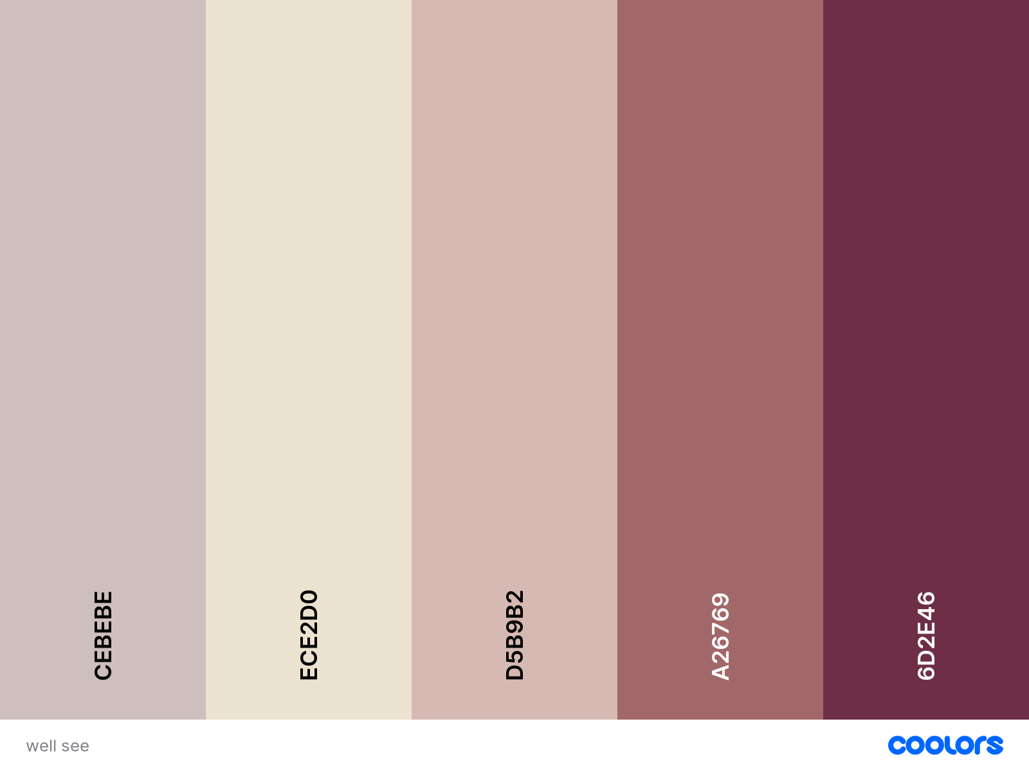
Color Pallet & Font
Color Codes
CDBEBE
ECE2D0
D5B9B2
A26769
6D2E46
Font
Dosis: FW: 300, 400, 500, 700
Satisfy: Regular
Link: <link href="https://fonts.googleapis.com/css2?family=Dosis:wght@300;400;500;700&family=Satisfy&display=swap" rel="stylesheet">

Slide 3


