Slide 1

BakeWise
Aakriti Parajuli
Rebecca Ghimire
Sambhawi Baral

Slide 2
CONTENTS
INTRODUCTION 3
PROBLAM STATEMENT 4
OBJECTIVE 5
METHODOLOGY 6
PROJECT GANTT CHART 7
DELIVERABLES 8

Slide 3
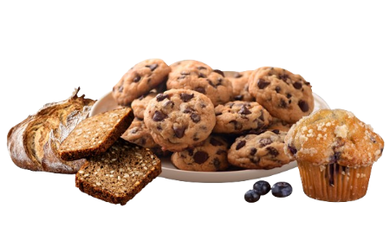
INTRODUCTION
A Bakery System Management platform is a valuable tool for bakery businesses looking to improve efficiency, enhance customer satisfaction and drive growth. Bakery System Management is the way of reducing the workload environment and enhancing the working system.
This project involves creating an e-commerce platform for a bakery. The website will allow users to browse bakery products, add items to a cart, and place orders. The system will also handle user registration, payments, and order tracking.

Slide 4
PROBLAM STATEMENT
Customer Service Challenges: difficulty in managing in customer orders providing timely customer support and maintaining their satisfaction.
Poor navigation(Interface): user struggle to find their way around interface.
Inefficient Manual Operations: time consuming and error prone manual processes for orders.

Slide 5
OBJECTIVE
Build a user-friendly bakery e-commerce website.
Allow customers to view and purchase bakery items online.

Slide 6
METHODOLOGY
The spiral model emphasizes iterative development, which means the project is built in phases with continuous feedback and refinement.
Planning: Define requirements, such as product categories, payment gateways, and user types.
Risk Analysis: Identify risks like payment security, user data privacy, etc.
Engineering: Develop the website in phases, starting with product listing, then cart, and finally, order management.
Evaluation: Test each feature after it's developed to ensure it meets user requirements before moving to the next phase.

Slide 7
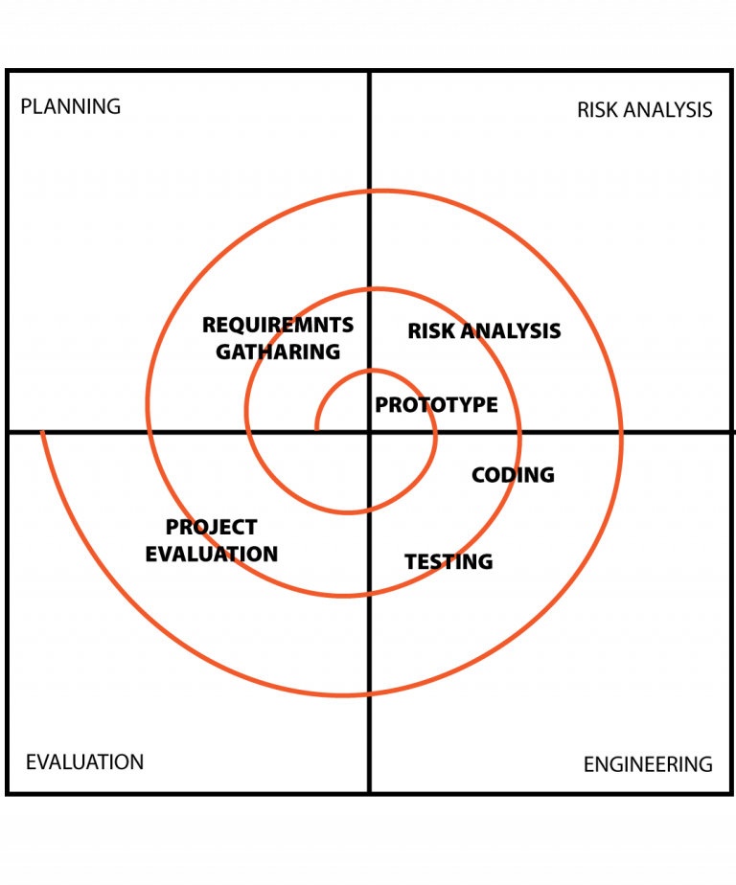

Slide 8
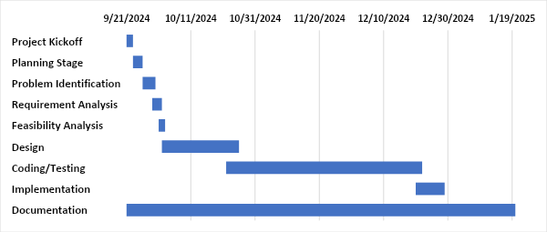
GANTT CHART

Slide 9
DELIVERABLES
Offers a wide range of products (cakes, bread, cookies, pastries, etc.) online.
Provide a seamless and better shopping experience.
Ensure secure user authentication.
Simplify the ordering process for customers.
Customer can view, browse, add product for purchase.

Slide 10

thank you

