Slide 1


Slide 2
CONTENTS
INTRODUCTION 3
PROBLAM STATEMENT 4
OBJECTIVE 5
METHODOLOGY 6
PROJECT GANTT CHART 7
DELIVERABLES 8
REFERENCES 9

Slide 3
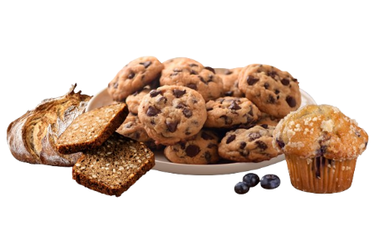
INTRODUCTION
This project involves creating an e-commerce platform for a bakery. The website will allow users to browse bakery products, add items to a cart, and place orders. The system will also handle user registration, payments, and order tracking.

Slide 4
PROBLAM STATEMENT
Inventory Management Issues:
Customer Service Challenges:
Limited Data Insight:
Inefficient Manual Operations:

Slide 5
OBJECTIVE
Build a user-friendly bakery e-commerce website.
Allow customers to view and purchase bakery items online.

Slide 6
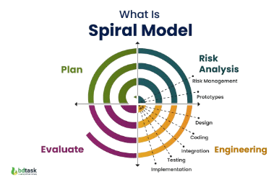

Slide 7
METHODOLOGY
The spiral model emphasizes iterative development, which means the project is built in phases with continuous feedback and refinement.
Planning: Define requirements, such as product categories, payment gateways, and user types.
Risk Analysis: Identify risks like payment security, user data privacy, etc.
Engineering: Develop the website in phases, starting with product listing, then cart, and finally, order management.
Evaluation: Test each feature after it's developed to ensure it meets user requirements before moving to the next phase.

Slide 8
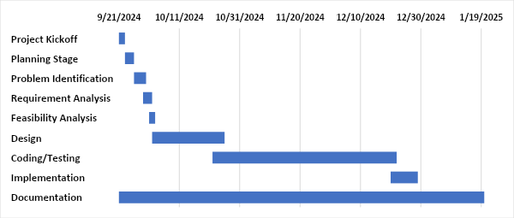
GANTT CHART

Slide 9
DELIVERABLES
Offers a wide range of products (cakes, bread, cookies, pastries, etc.) online.
Provide a seamless and intuitive shopping experience.
Ensure secure user authentication.
Simplify the ordering process for customers.
Customer can view, browse, add product for purchase.

Slide 10

thank you

