Slide 1
Week 5 Presentation
python-pptx was here!

Slide 2
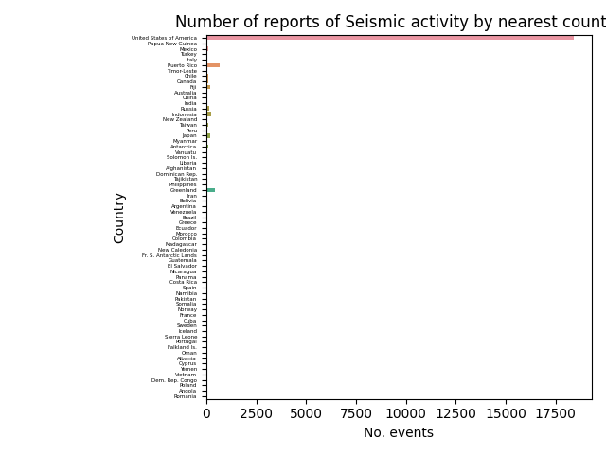
Here is an example of a bar chart
It shows that most earthquakes are in the US

Slide 3
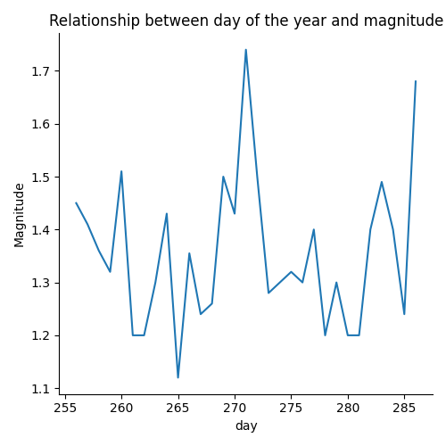
Here is an example of a Line chart
It shows that there is little relation between day and magnitude

Slide 4
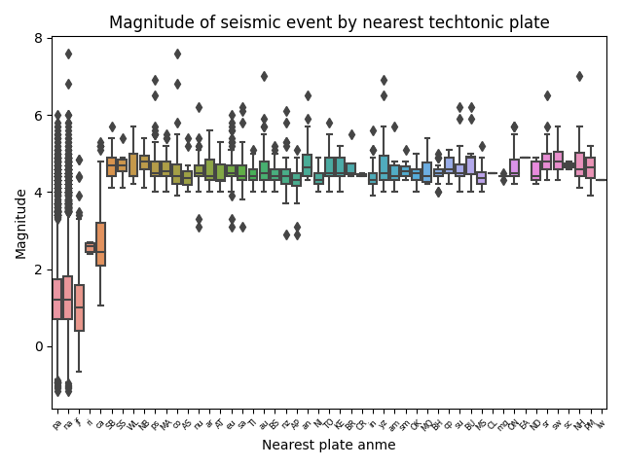
Here is an example of a boxplot
It shows that earthquakes near a few plates tend to be smaller

Slide 5
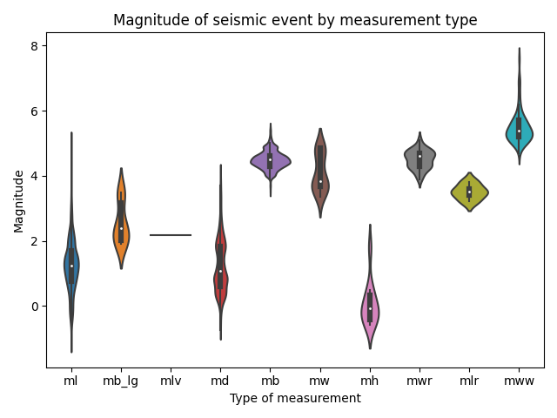
Here is an example of a violin plot
Its pretty similar to a box plot, and shows that measurement type varies by magnitude

Slide 6
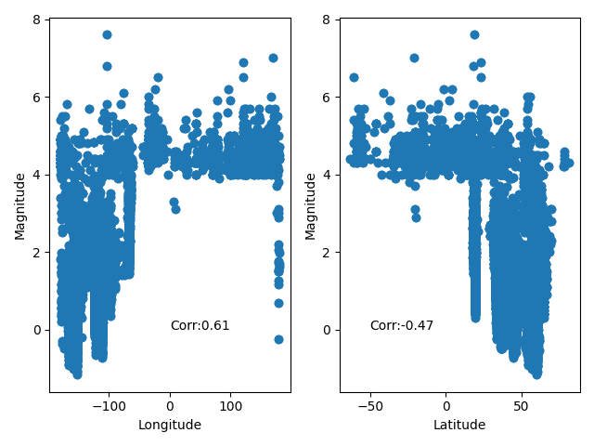
Here is a scatter plot of latitude and longitude vs magnitude
It shows a relationship with latitude, longitude and magnitude

Slide 7
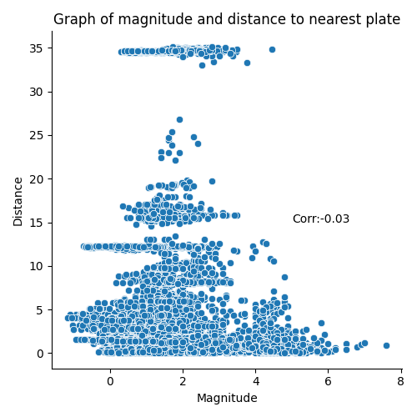
Here we see a scatter graph
It shows there is no relationship between earthquake magnitude and distance to a techtonic plate

Slide 8
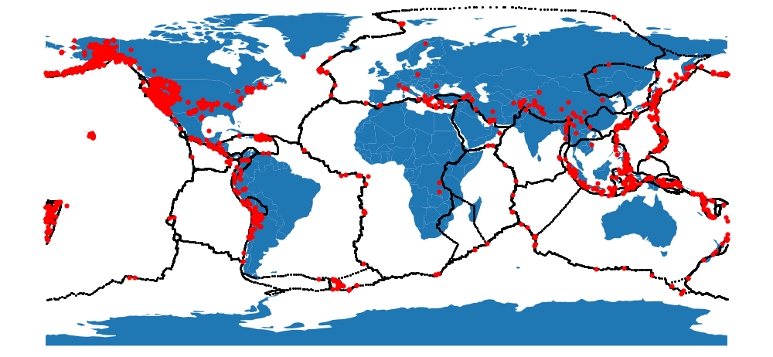
Here is a map of techtonic plates
It shows that activity is clustered around techtonic plates

Slide 9
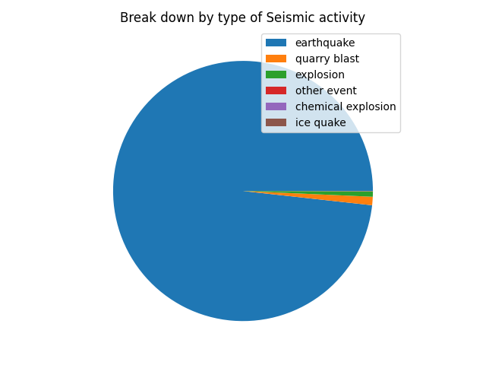
Here is an example of a pie chart
It shows that most seismic activity is caused by earthquakes

