Slide 1
Unsupervised learning
Which countries are eligible for aid?

Slide 2
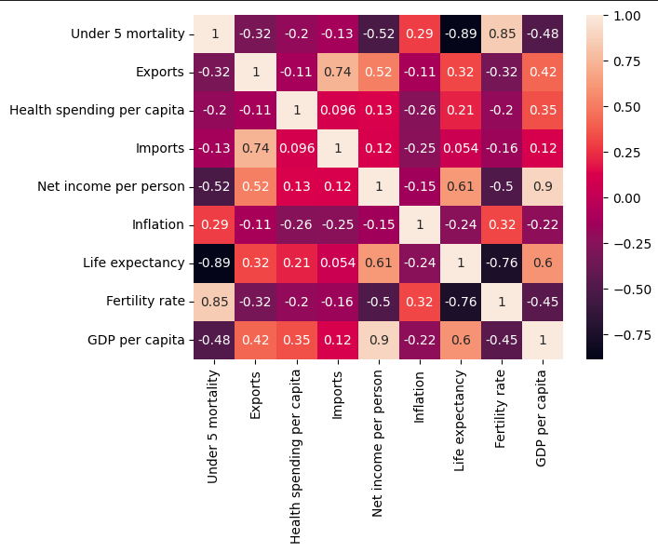
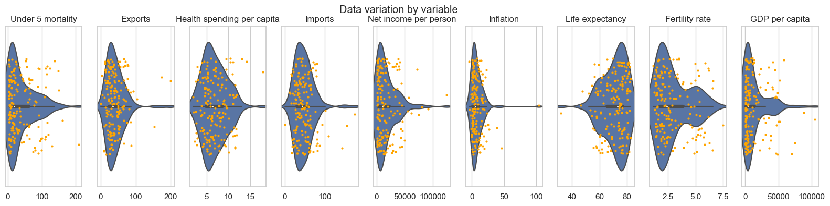
Data exploration
Imports and Exports are highly correlated
As are fertility, life expectancy and child mortality

Slide 3
Possible approaches?
K means clustering
Hierarchical clustering
What’s the difference?
K means less good if clusters are not spherical
Hierarchical good if there is a need to find a natural hierarchy
K means less computationally expensive
K means results can randomly vary with different starting numbers
In this case either probably ok?

Slide 4
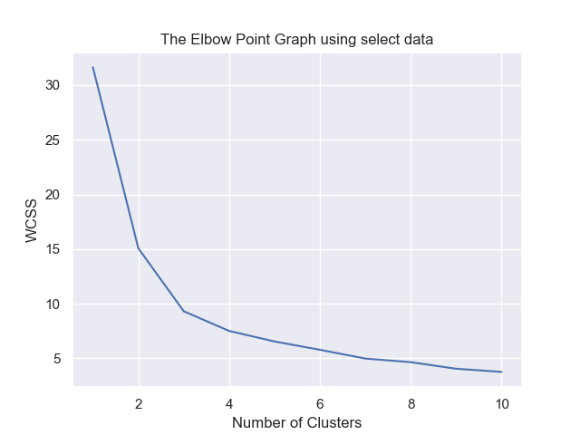
Elbow chart to indicate ideal number of clusters for K means
Indication that 2, 3 or even 4 clusters are idea

Slide 5
Inspecting the output of the 3 cluster k means clustering
Scatter charts show that 3 clusters looks sensible

Slide 6
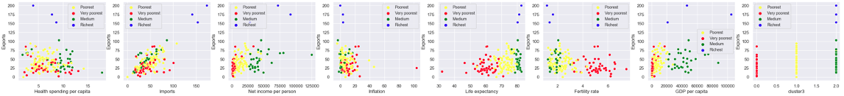
k means 4 clusters
4th cluster doesn't add much useful information - just indicates the high export/importers

Slide 7
k means 2 clusters
2 clusters looks quite useful to specifically answer the question of which countries are eligible for aid

Slide 8
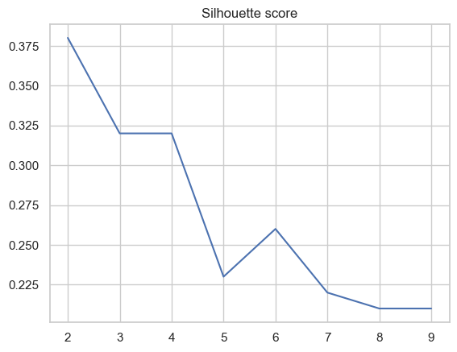
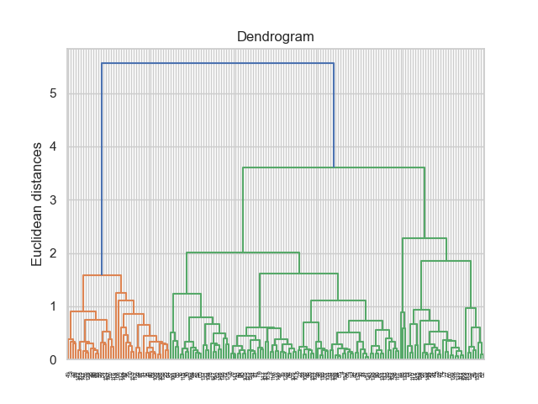
How many clusters are ideal with hierarchical clustering?
Silhoutte suggests 2 is the optimal number of clusters

Slide 9
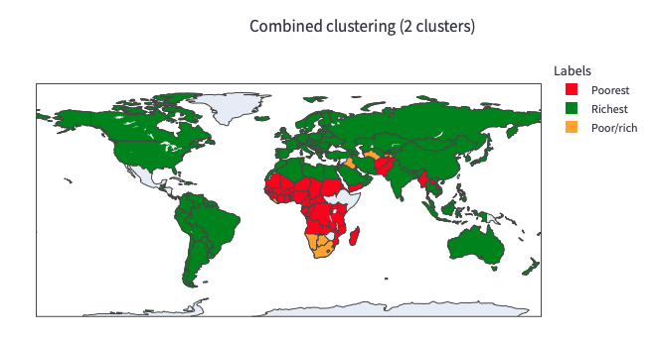
But what do 2 hierarchical clusters give us?
Quite similar results - just a few countries are classed differently

Slide 10
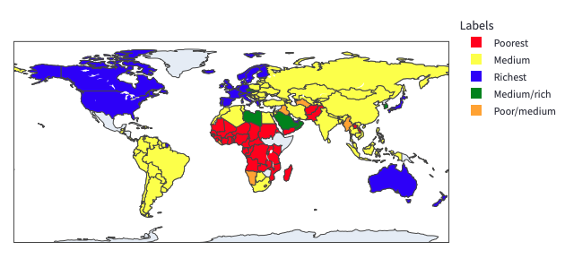
But what do 3 hierarchical clusters give us?
Quite similar results - just a few countries are classed differently
Might in some cases be useful to have this extra middle category

