Slide 1
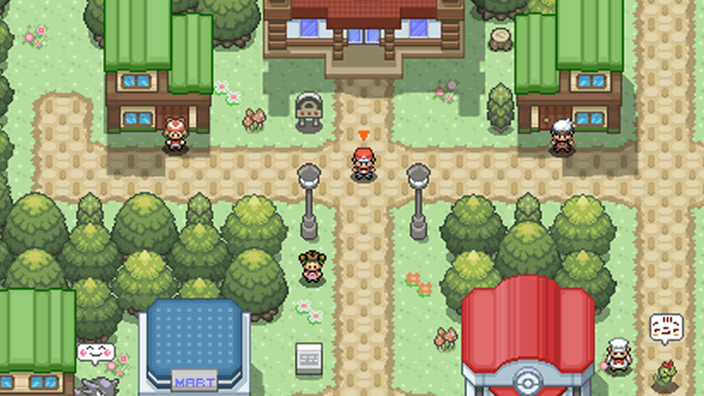
Project Apricorn - CDR
Group 15
Rebecca Casimir - CPE
Kalindi Desai - CPE
Darren Yong - EE
Trey Sandefur - EE

Slide 2
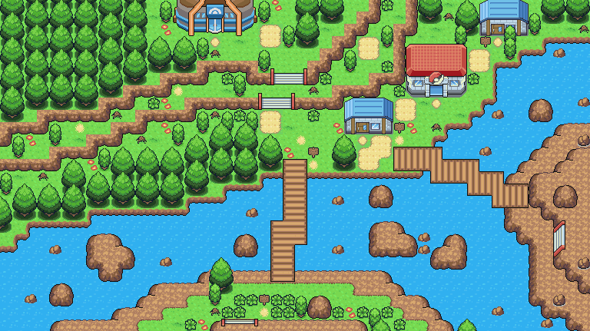

Outline:
Introduction
Introduction
Design
Testing
Administrative
Design
Testing
Administrative
T.S.

Slide 3
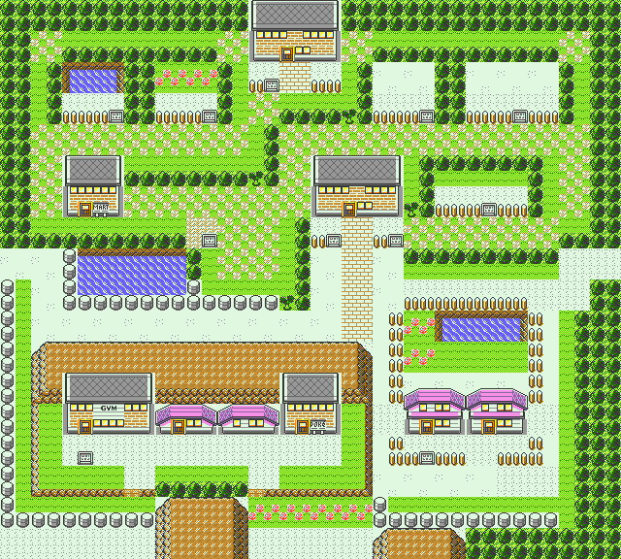
Introduction
T.S.

Slide 4
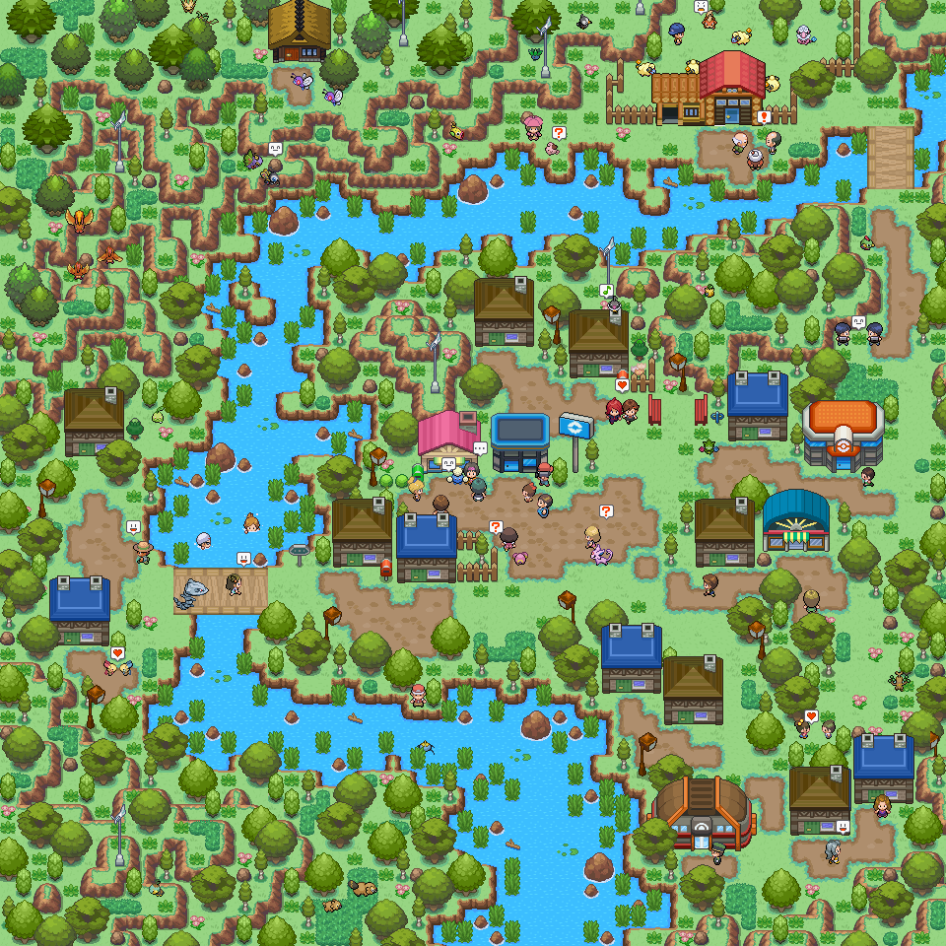
Motivation
Lack of interactive elements in queue lines, attractions, shows, and public areas within themed environments
Bite sized immersion that generally leads to the guests being bystanders
T.S.

Slide 5
Objective
Showcase how handheld RFID assemblies can be utilized in themed entertainment environments to drive more interaction from guests of all ages, and provide a more immersive story.
T.S.

Slide 6
Goals
Lightweight, durable shell
Reliable RF transmission
Simplistic PCB design with scalability in mind
Low power consumption
Secure and efficient backend
Stay true to the source material
T.S.

Slide 7
Design
T.S.

Slide 8
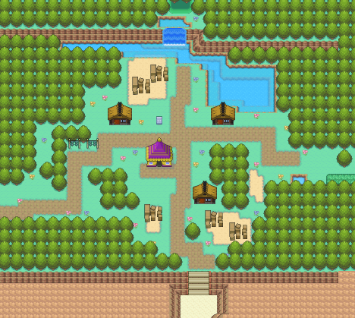
Design Constraints
Overall assembly must be light and portable, yet structurally sound enough to withstand drop testing
RF PCB must be secured and fully enclosed within the Pokéball shell
Retain goal of accurate Pokéball functionality in the final deliverable
Pokémon “entering”, “leaving”, and “evolving” within the Pokéball
Final assembly color, shape, and ornament design features
R.C.
Notes:
As we move on to our design, there are a few constraints that we want to keep in mind as we develop our project. Firstly, we want to make sure that our actual pokeball is able a reasonable size while also remaining light and portable. Our PCB must fit into a spherical shell with no loose parts otherwise it will lose the Pokéball image. All this must be done while staying true the Pokéball behavior.

Slide 9
Time Constraints
16 Weeks to assemble, debug, validate, and present the fully functional Pokéball system
Must prioritize our MVP
The class has set specified deadlines for each aspect of the project and the group has set its own specified deadlines for the Pokéball to ensure it will be complete on time.
R.C.
Notes:
Minus the past few weeks, time will ultimately be one of our largest constraints. While we would love to create a Pokéball that has extra bells and whistles, we must prioritize producing a minimal viable product works and includes the signature features that a “regular” Pokéball would have.

Slide 10
Budget Constraints
Unsponsored project - OOP Cost
Overall Pokéball assembly is relatively low cost and does not require many parts to design or development
Intentionally done to promote smaller financial footprint
Promotes a more scalable deployment at a smaller $/unit figure
Budget dictated final deliverable functionality
R.C.
Notes:
Being that we do not have financial backing we are limited with how many features we can implement in our final design. While we don’t have too many costly parts, we may have to compromise with more cost friendly options.

Slide 11
Requirements and Specifications
Active Time
12 Hours
Durability
5 feet drop test
Dimension
<5 inches in diameter
Weight
<3 pounds
Unique Identifiers
3 unique identifiers
Database Accuracy
98%
Wirelessly Transmit Data
10 Feet
Activation Time
1 minute
Max Pokemon Connection
1 Pokemon
Progression
3 minutes
K.D.
Notes:
Active Time: hours at park
Durability: common wear and tear and security of electronics
Dimension: portability and usage at “park”
Weight: portability and usage at “park”
Unique Identifiers: user id, pokemon id, and pokeball id to distinguish
Wirelessly Transmit Data: distance in battlefield requirements
Database Accuracy: transmitting data
Activation Time, MPC, Progress-> next slide

Slide 12
Demonstrable Requirements
Activation Time: 1 minute
Max Pokemon Connection: 1 Pokemon
Battle Progression: 3 minutes
K.D.
Notes:
describe process of activation ie steps
describe “land” layout and reason for 1 pokemon
describe process of battle and calculation

Slide 13

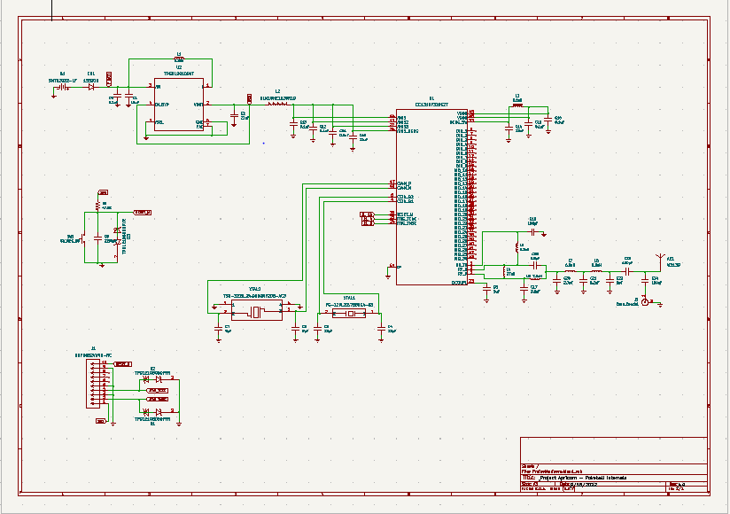
Apricorn Overall Schematic
1.
2.
5.
3.
4.
6.
T.S.

Slide 14
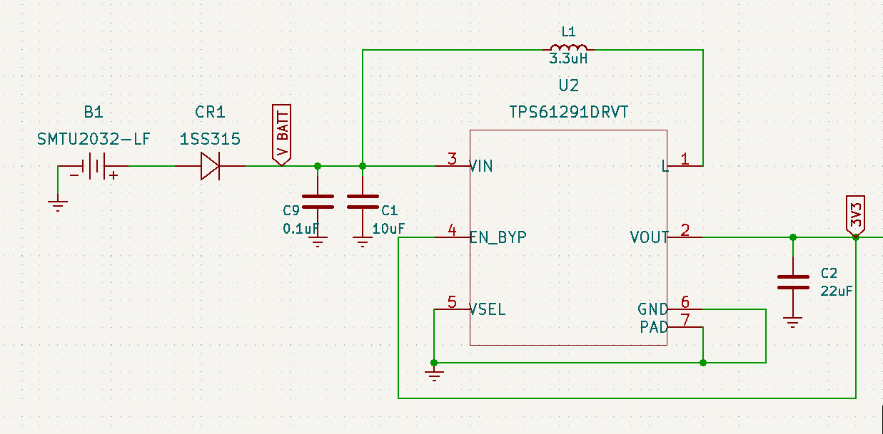
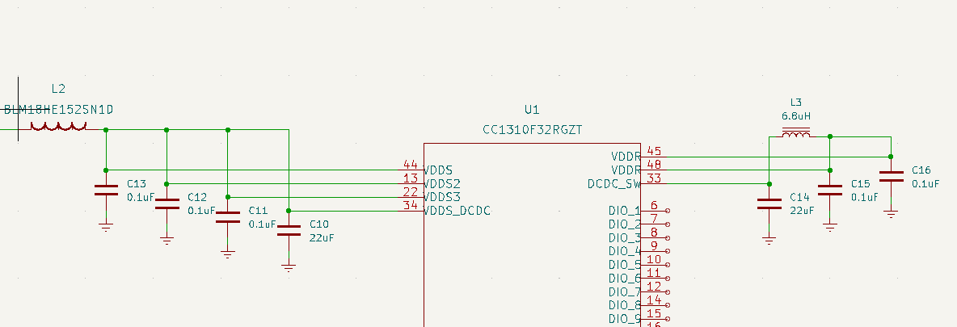
Apricorn Partial Schematic
Battery & Voltage Regulation
2. Bypass C’s
T.S.

Slide 15
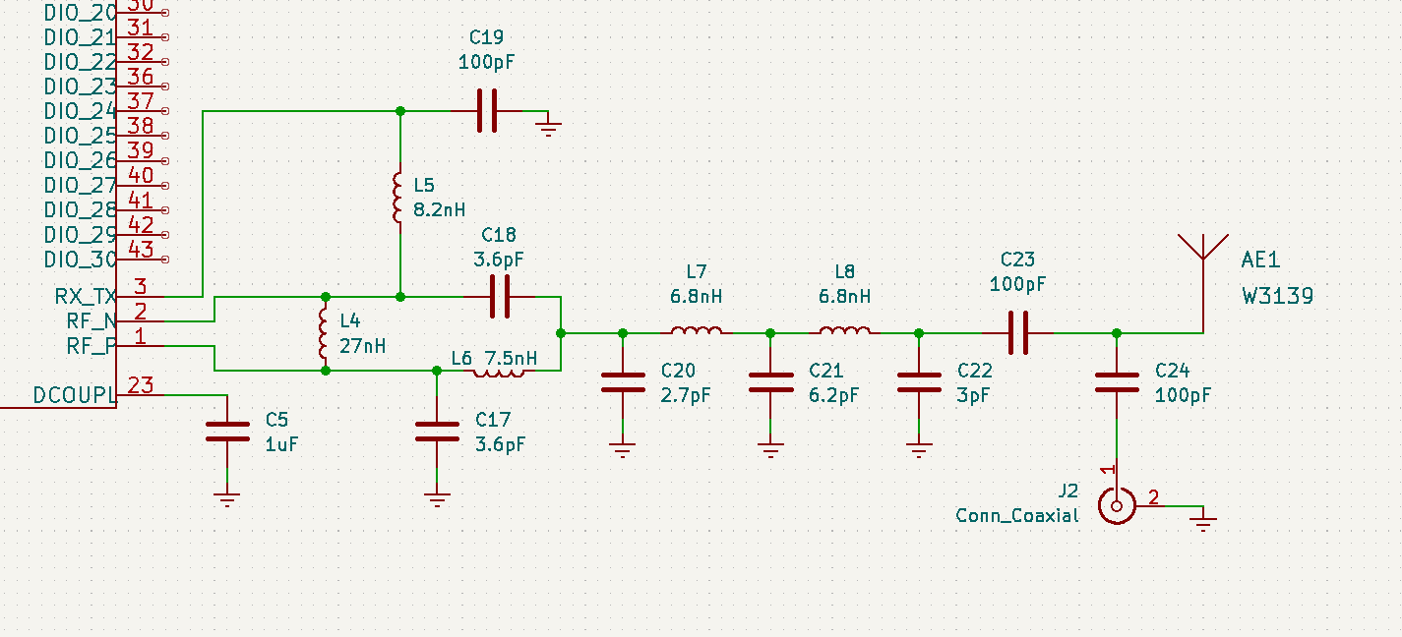
Apricorn Partial Schematic
3. RF Antenna Matching Circuit
T.S.

Slide 16
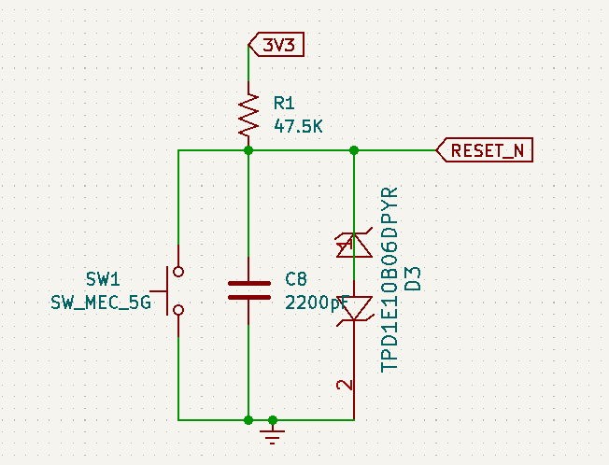
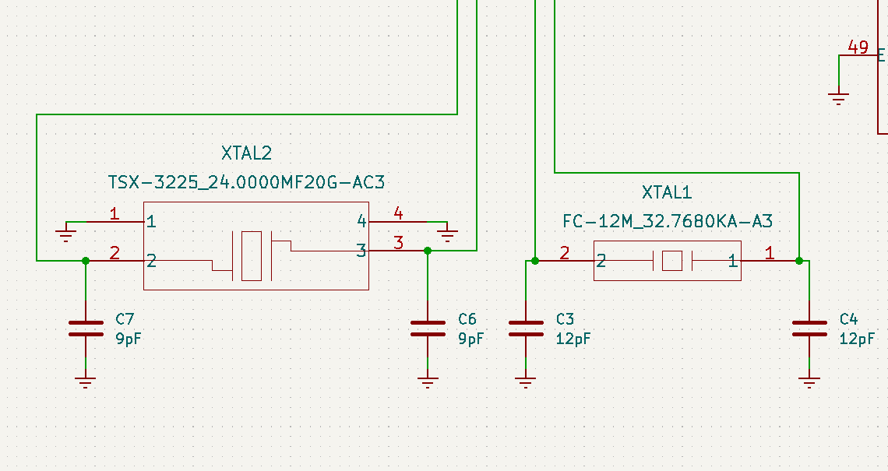
Apricorn Partial Schematic
4. Quartz Crystal Osc. Circuitry
5. Reset Switch Circuitry
T.S.

Slide 17
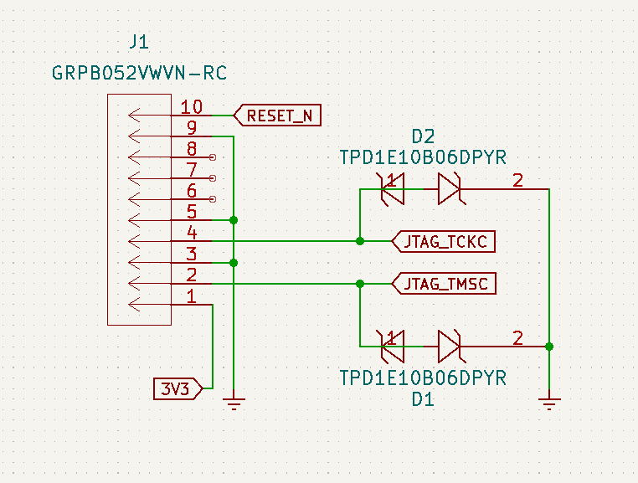
Apricorn Partial Schematic
6. JTAG Debugging Circuitry
T.S.

Slide 18
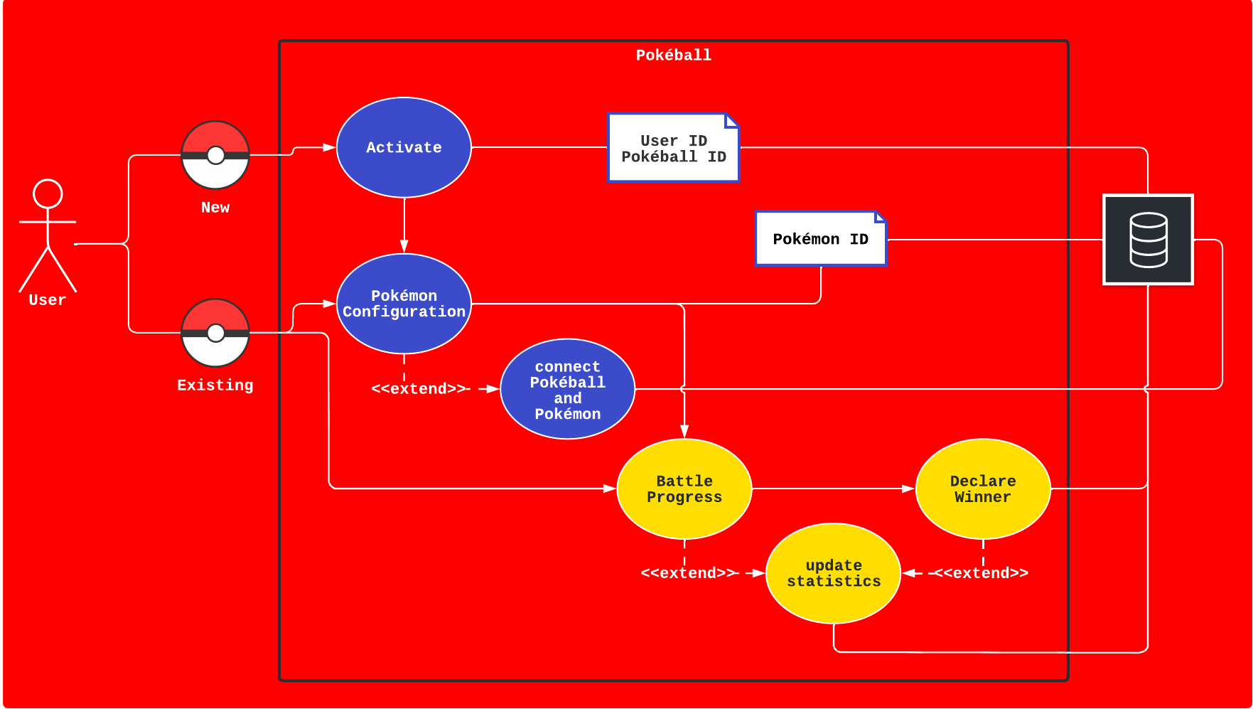
Software Flow
K.D.

Slide 19
Wireless Communication Types
 | Radio Frequency | Wi-Fi | Bluetooth
Communication | 1-way | 2-way | 2-way
Frequency | 30 KHz - 30 MHz | 2.4 GHz | 2.4 GHz
Data Transfer Rate | Very low | 720 Mbps (802.11ac) | 5 Mbps (Version 5.0)
Power Consumption | 1-3 microwatts | 80 milliwatt at 75 bytes per second | 2 milliwatts at 75 bytes per second
Range | 0 - 30 feet | 60 feet | 30 feet
D.Y.

Slide 20
What is Radio Frequency Identification?
Wireless communication technology
Encodes unique digital identification into tag or label
Can be active or passive
Requires device that captures the signal and can decode the signal
D.Y.

Slide 21
Active or Passive Tags
Passive RFID requires an external power source, usually a reader, to decode the data from the tag.
Passive tags are only energized when a reader is present.
Very small in size and can last a lifetime.
Active RFID utilizes an internal battery that will allow signal transmission over an extended range around 100 meters.
Active RFID tags are always energized.
Larger in size and has a shelf life equivalent to life of the battery.
D.Y.

Slide 22
RF Band Ranges
 | Low Frequency | High Frequency | Ultra-High Frequency
Frequency | 30 - 300 KHz | 3 - 30 MHz | 300 MHz - 3 GHz
Typical Operating Frequency | 125 KHz or 134 KHz | 13.56 MHz | 860 to 960 MHz
Range | 10 cm | 10 cm - 1 m | 12 m
Speed | Slow | Moderate | Fast
D.Y.

Slide 23
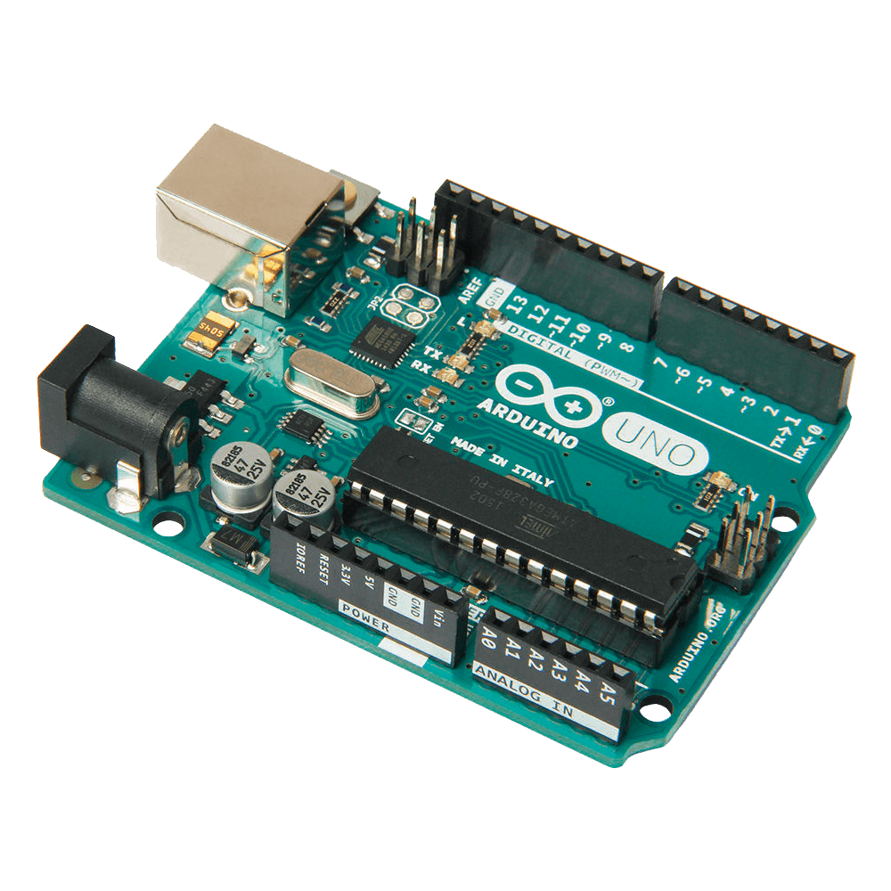
Microcontroller
Arduino Uno
Connect a RF receiver module
Will be used as a “base station”
Store Pokeball identification
Connects to display to view necessary information
D.Y.

Slide 24
Testing

Slide 25
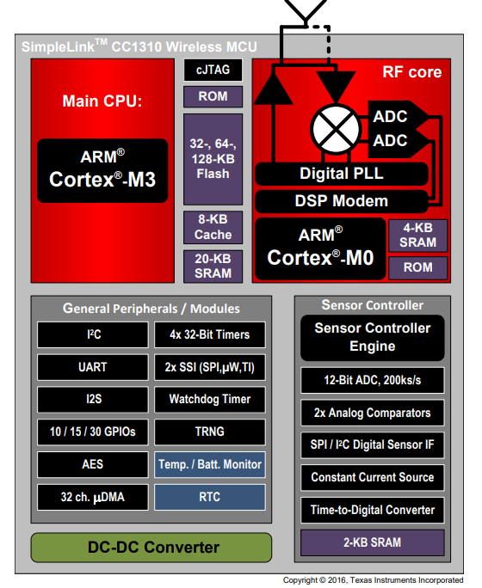
Product Selection
Texas Instruments SimpleLink™ Wireless Microcontroller Platform
32-bit ARM Cortex-M3 CPU
Powerful, low-cost, ultra-low-power
RF Core
Radio system that can support a wide range of frequency bands including RF, Bluetooth, and Wi-Fi
Multiple Connection Protocols
I2C
UART
SPI
Device Software
Code Composer Studio Integrated Development Environment (IDE)
SmartRF Studio
D.Y.

Slide 26
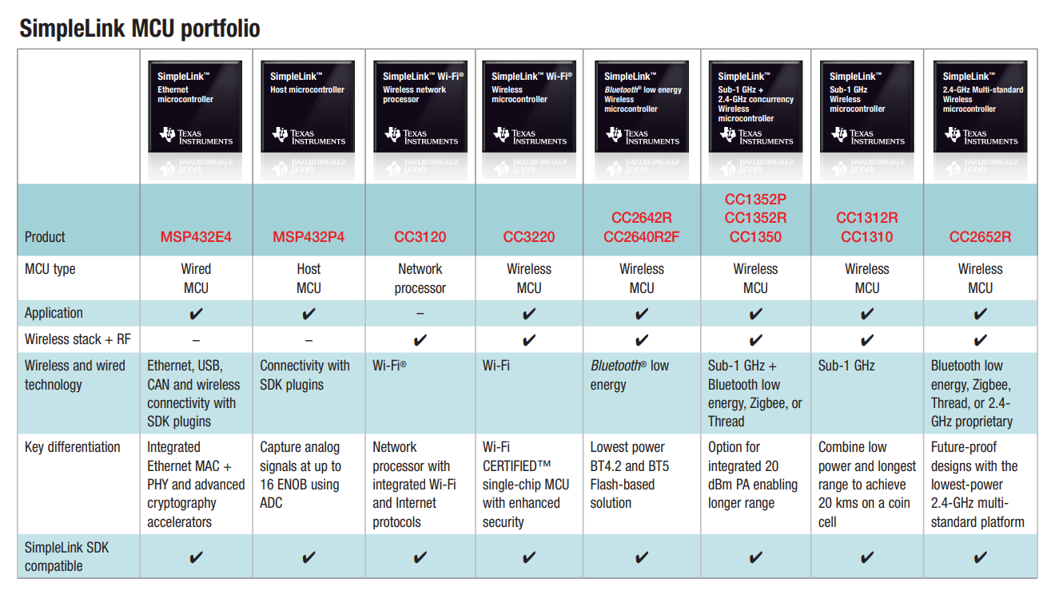
Product Selection
D.Y.

Slide 27
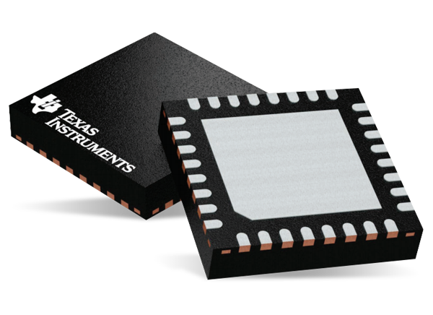
Product Selection
Pokeball Transceiver
Texas Instruments CC1310F128RGZR
Ability to transmit and receive radio frequencies in a single package
Has a clock speed of 48 MHz and onboard flash memory of 128 KB
Transmit operating frequency of 433.92 MHz or 868 MHz
Requires use of an antenna
Powered by 3V coin cell battery
The purpose of the Pokeball transceiver is to transmit it’s unique ID for the base station to identify an individual’s Pokeball.
D.Y.

Slide 28
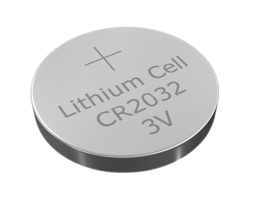
Product Selection
Battery
Uses a coin cell battery: 2032
Nominal voltage is 3V
Surface mount to PCB
Capacity is 235 mAh
Small size allows to fit with PCB into Pokeball
D.Y.

Slide 29
Software Selection
MySQL | MongoDB
Best for structured data with traditional relationships | Best for unstructured data
Great for limited budget | More Flexible
Very Secure | Cloud Based
Low Maintenance | Unstable Schema
MySQL | MongoDB
Best for structured data with traditional relationships | Best for unstructured data
Great for limited budget | More Flexible
Very Secure | Cloud Based
Low Maintenance | Unstable Schema
R.C.
Notes:
For our database we have decided to go with MySQL over MongoDB. This is really due to having more familiarity with MySQL. Mongodb is great when you need heaps of space readily available, but for our type of data we really won’t need anything of that sorts

Slide 30
Language Selection
C | Java | PHP | Javascript
Procedural Programming Language | Object-Oriented Programming Language | Easier interaction with database | Easier interaction with front end
Useful for programming microcontrollers | Does not support programming microcontrollers | Most compatible with LAMP stack | Most compatible with MEAN stack
C | Java | PHP | Javascript
Procedural Programming Language | Object-Oriented Programming Language | Easier interaction with database | Easier interaction with front end
Useful for programming microcontrollers | Does not support programming microcontrollers | Most compatible with LAMP stack | Most compatible with MEAN stack
C | Java | PHP | Javascript
Procedural Programming Language | Object-Oriented Programming Language | Easier interaction with database | Easier interaction with front end
Useful for programming microcontrollers | Does not support programming microcontrollers | Most compatible with LAMP stack | Most compatible with MEAN stack
K.D.

Slide 31
Stack Selection
LAMP | MEAN
(Linux OS, Apache Web Server, MySQL database, PHP language) | (MongoDB database, ExpressJS server-sider framework, Angular.js front end framework, Node.js framework)
Reliable, fast, and secure | Cloud compatibility
Highly scalable | Fast runtime and easy maintenance
Low maintenance | High maintenance
Multiple Languages | Single Language
Limited OS Support | Cross Platform Support
LAMP | MEAN
(Linux OS, Apache Web Server, MySQL database, PHP language) | (MongoDB database, ExpressJS server-sider framework, Angular.js front end framework, Node.js framework)
Reliable, fast, and secure | Cloud compatibility
Highly scalable | Fast runtime and easy maintenance
Low maintenance | High maintenance
Multiple Languages | Single Language
Limited OS Support | Cross Platform Support
K.D.

Slide 32
Administrative

Slide 33
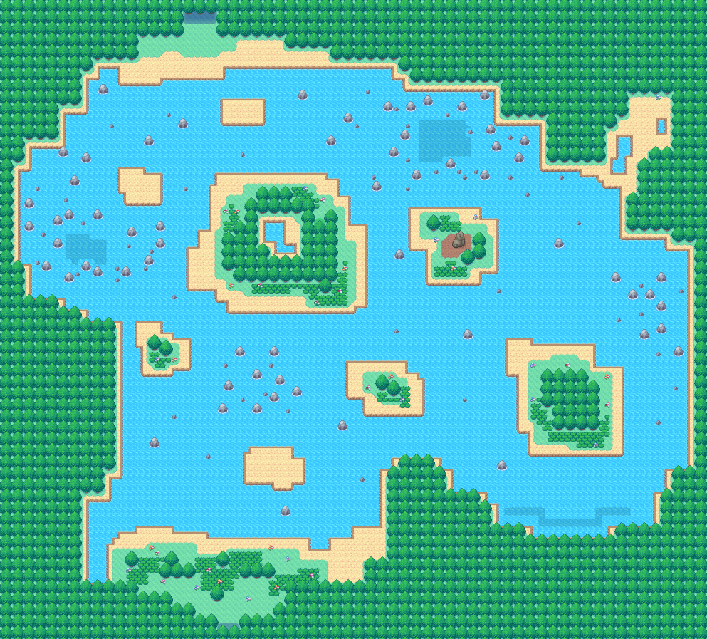
Project Milestones
9/25 Skeleton Web App
9/26 Receive PCB
9/28 PCB Debug (if needed)
10/10 Printed Pokeball Shell
10/25 Complete Application
10/27 Complete Assembly
11/2 Testing & DeBugging
11/10 Final Testing
11/21 Final Documentation
11/23 Video Demo
R.C.
Notes:
Ideally we would like to have the pokeball with all it’s parts placed together by halloween, Leaving as much room possible to debugging and adding extra features to Pokéball and application.

Slide 34
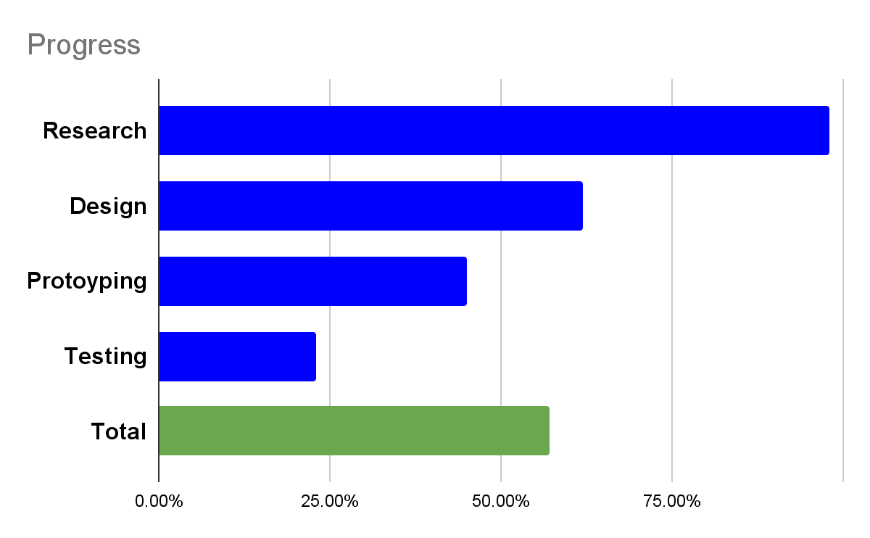
Progress
R.C.
Notes:
We have pretty completed all of our research for this project but of course we don’t know what we don’t know what we don’t know From the parts that we do have, we have managed to do some soft testing some parts that we want to use later in the project

Slide 35
Budget
Item | Quantity | Cost
Custom RFID tags | 4 | $18
3D Printed Shell | 2 | $0
Additional Programming Software |  | $0
Microcontroller | 2 | $0
Battery | 2 | $15
Bread Board | 1 | $0
Custom PCB | 2 | $68
5.0” LCD Display | 2 | $26
Buttons | 1-3 | $10
Total Estimate |  | $137
R.C.
Notes:
As mentioned earlier, we have managed to find very budget friendly components while also taking advantage of the free perks that UCF has to offer. However if necessary, we are more than willing to adjust the budget as needed.

Slide 36
Work Distribution
Hardware | Hardware Support | Software | Software Support
Trey Darren | Rebecca Kalindi | Kalindi Rebecca | Trey Darren
R.C.
Notes:
Here is our work distribution. The electrical engineers (Trey and Darren) on our team will be leading Hardware and the electrical development of our design and will have the computer engineers (Kalindi and Rebecca) as their support and backup and this will versa for the software development portion as well.

Slide 37
Issues
Use of Fusion360 collaboration Software
All computer & electrical engineers, staying in the “know” of what each group member is working on
Establishing an end point to the application
Controlling “multipathing” in our RF design during the final assembly construction
Ensuring PCB design accommodates for the usage of RF through proper trace lengths, widths, and correct impedance matching
T.S.

Slide 38
Thanks for Listening!

