Slide 1
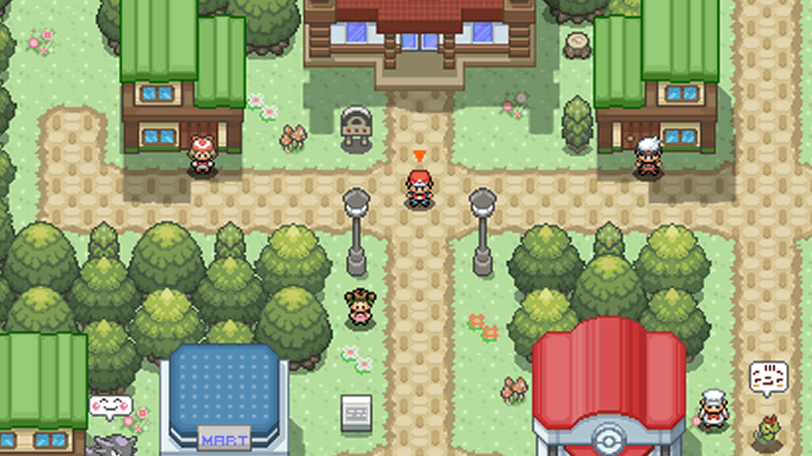
Project Apricorn
Middle Term Demo
Group 15
Rebecca Casimir - CPE
Kalindi Desai - CPE
Darren Yong - EE
Trey Sandefur - EE
Notes:
Welcome to our Project Apricorn Middle term Demo

Slide 2
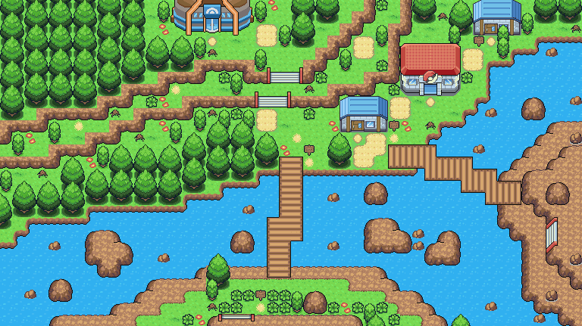

Outline:
Progress
PCB
Challenges
Software
Specifications
Notes:
Welcome to our Project Apricorn Middle term Demo,

Slide 3
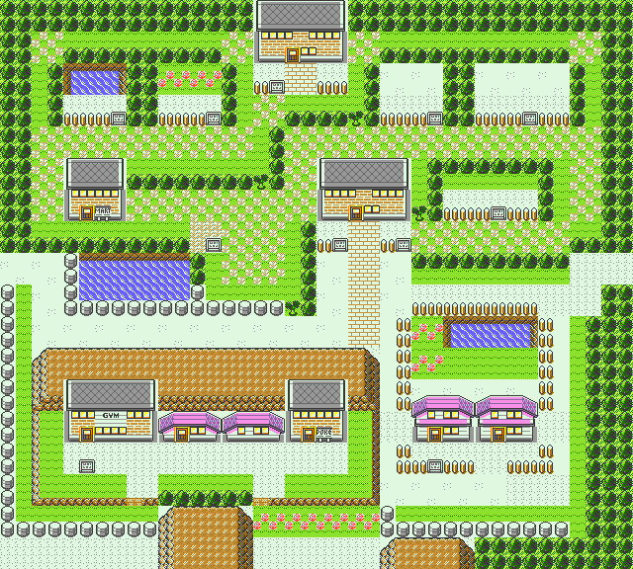
Progress

Slide 4
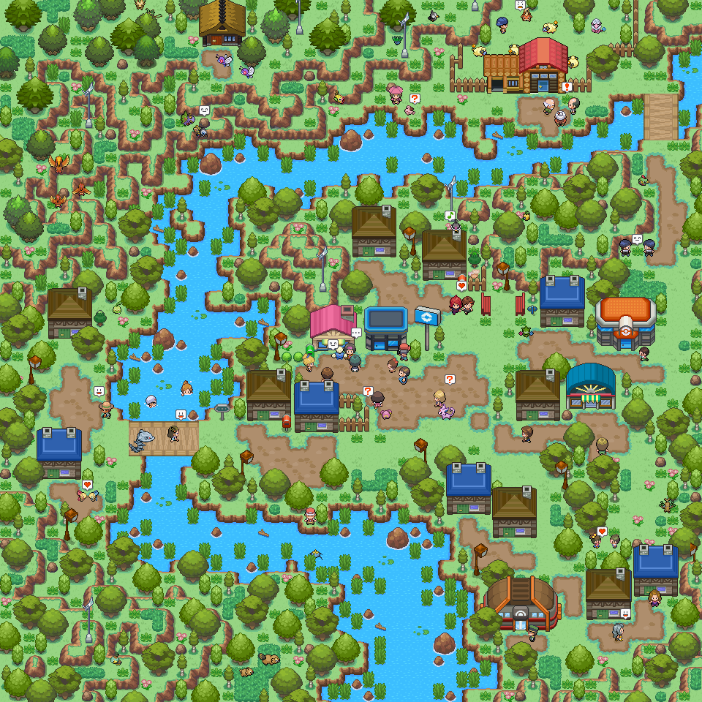
What is Project Apricorn?
High Frequency emitting Pokéball
Base station receiving signal
Database set up to add/update new Pokéball
New user registration page
Notes:
Project Apricorn is meant to emulate what it would be like to play with a Pokemon in a theme park scenario. The idea is that players are given a high frequency emitting Pokéball in which a base station receives that Pokéball signal to assign the player a pokemon. The player would then be able to interact with Pokéland system that would be based inside of that “theme park”.

Slide 5
Progression
PCB being developed
Pokéball shell designed but not printed
Database created
New user login page created
Interactive battle between Pokémon
Notes:
The outline of what we have currently accomplished are: pcb is built but requires slight troubleshooting, pokeball outer shell is designed and will be printed soon, the database has been created along with the registration page and interactive battle.

Slide 6
PCB Updates
T.S.

Slide 7
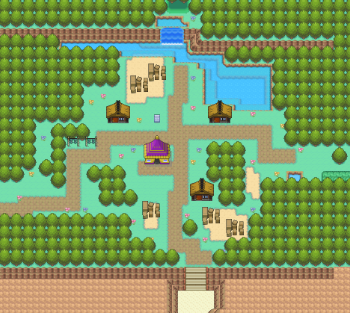
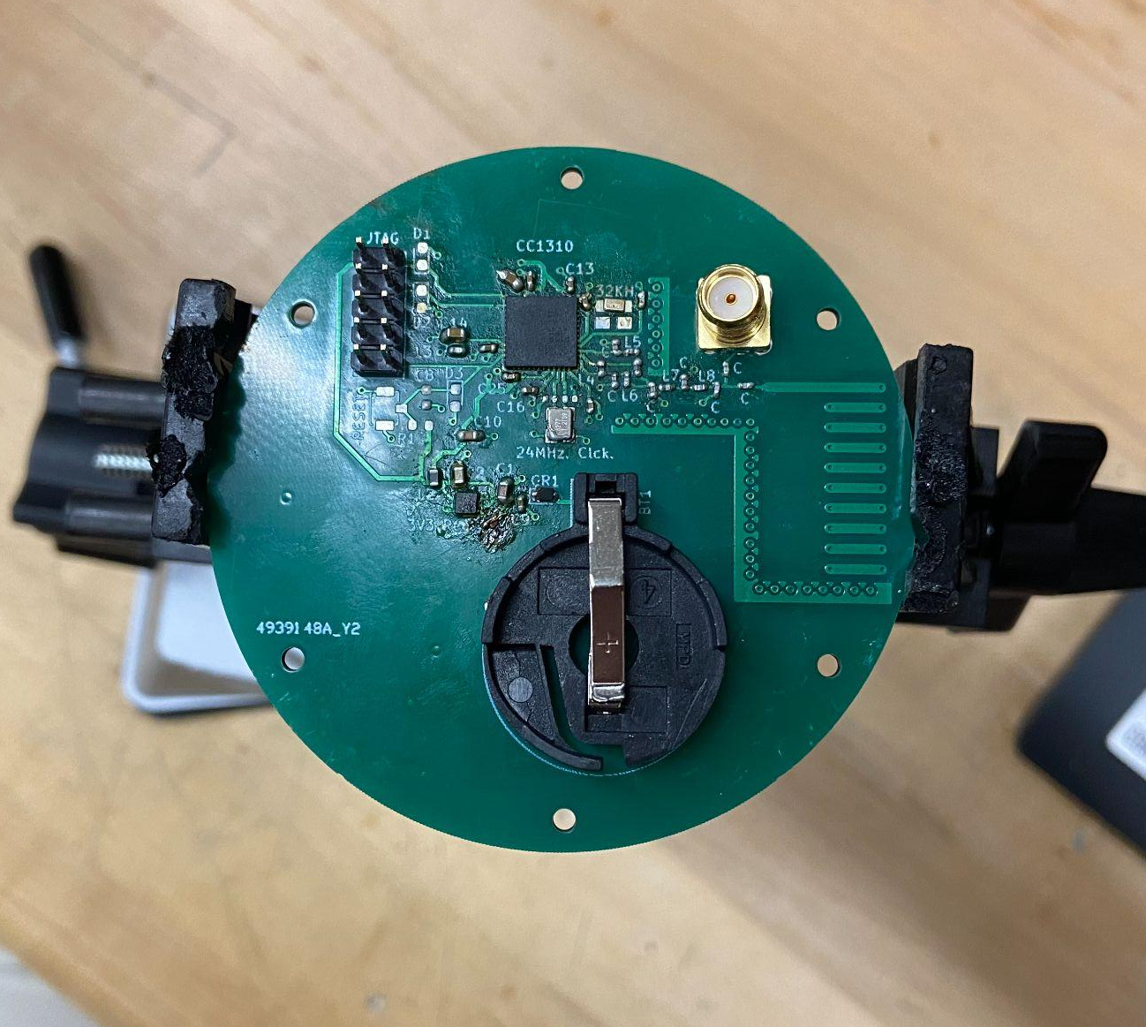
PCB Progress
f
power circuit & voltage regulation
5. 32KHz Crystal Osc. Circuit
3.
5.
2. Reset Button
6.
6. MCU Transceiver & Bypass Caps.
8.
4.
7.
2.
3. JTAG Circuit
1.
7. RF Impedance Matching Circuit
4. 24MHz Crystal Osc. Circuit
8. 915MHz Antenna & Aux. Antenna SMA Connector

Slide 8
PCB Progress - Current Status
1. Soldering Error Causing Board Blemish
3.
2. Reset Button Not Active
2.
1.
3. ESD protection diodes not connected to JTAG pin headers

Slide 9
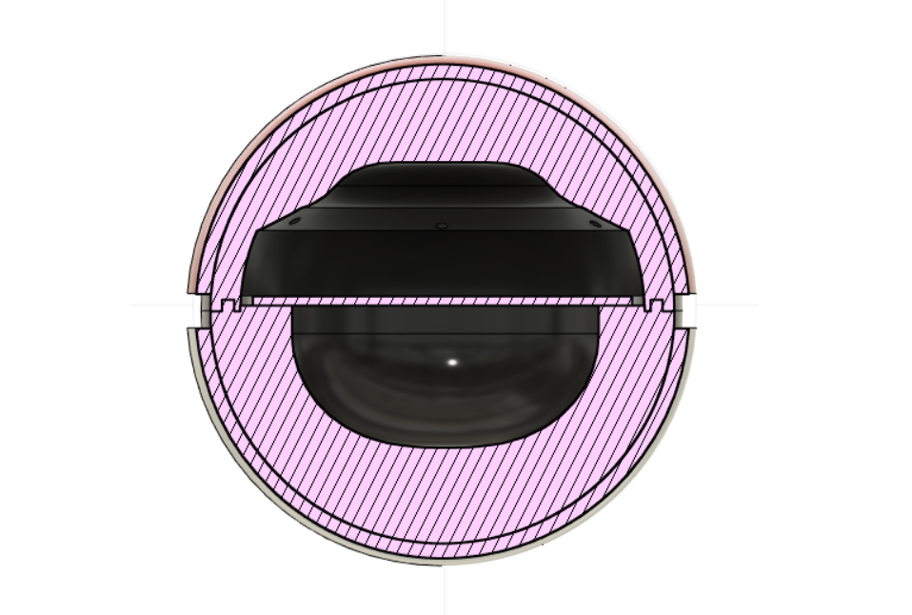
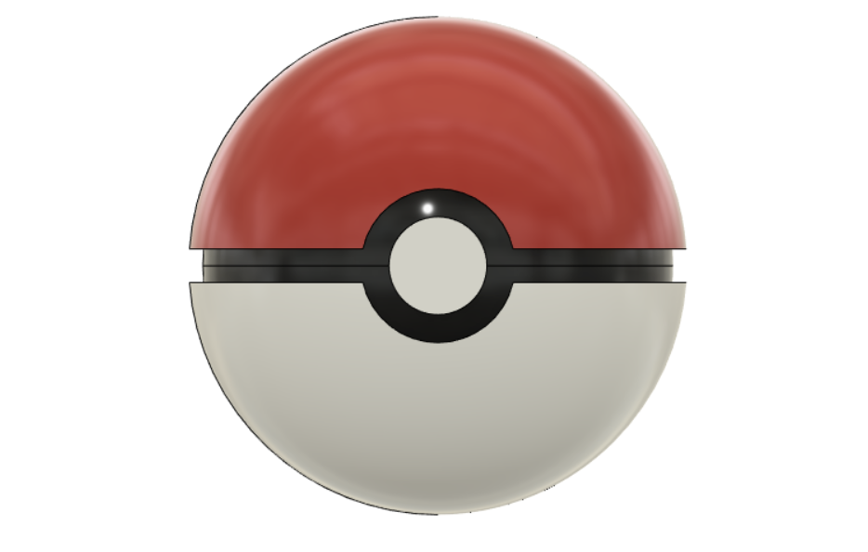
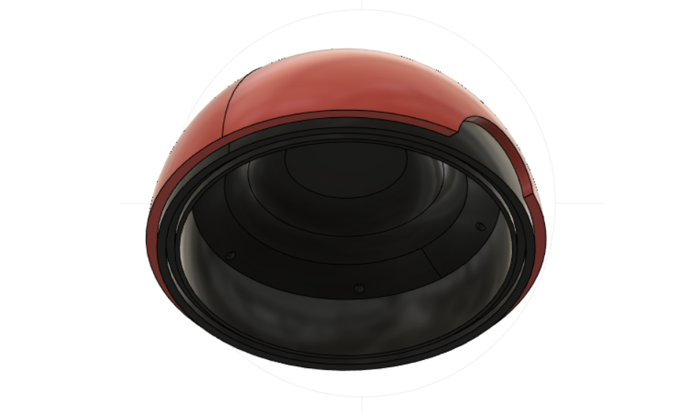
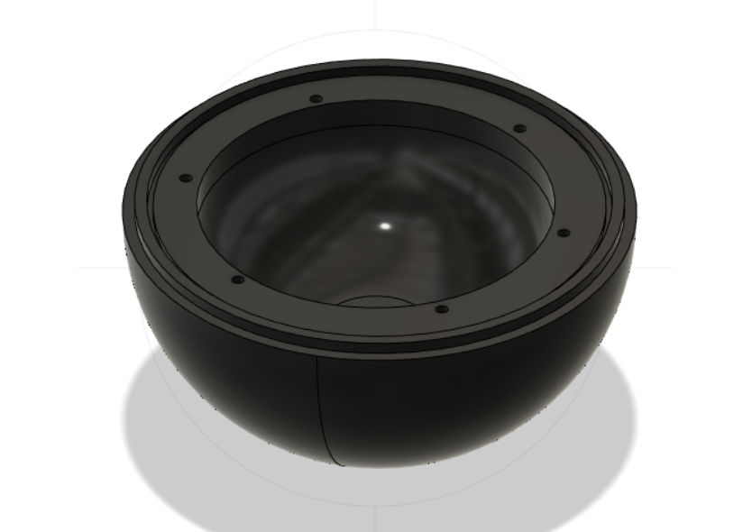
PCB Progress - 3D Housing

Slide 10
Software Demo
Notes:
Demo steps
Show our Database
Show our login/register page and login
Show Database after
Here you will see our Database which is hosted on MySQL, we have chosen to go with a Lamp Stack for our UI as it is the stack that we believe will be the most buidable, right now you can see a few users already registered in our database, the goal is that any player has the ability to register for our account, but they actually will not be able to interact with a pokemon unless they are on the park.
So lets sign up!
Here is our login and registration page so let’s make a test account. (do your thing),
Now let's check the database to make sure it is there.
We are still in the process of developing these pages on our local instance, and kalindi dive more into that
but before we do that I do want to discuss the challenges or concerns on my end.

Slide 11
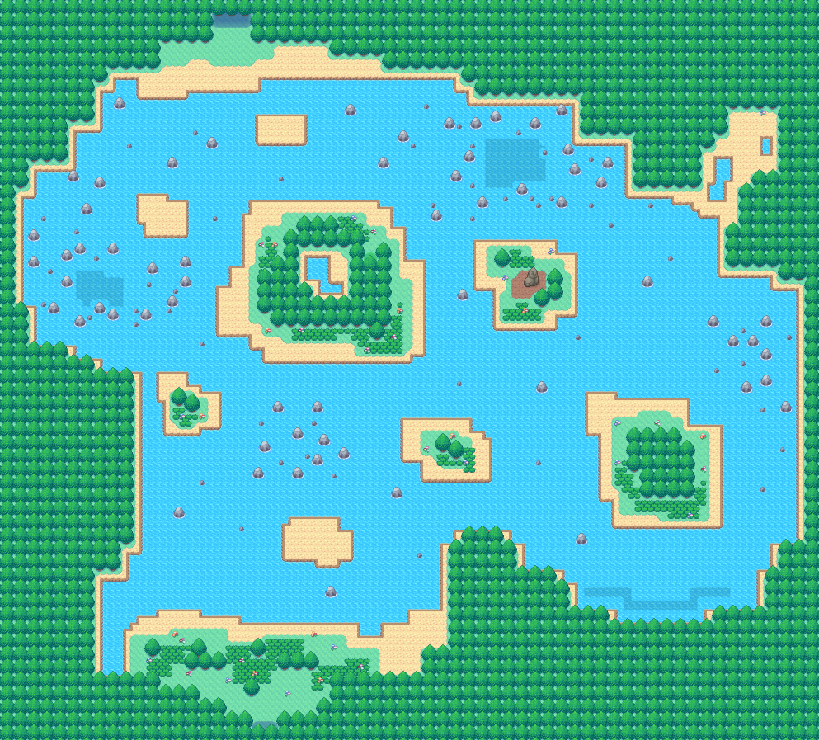
Challenges
Software to Hardware Connectivity
Software Pokemon Graphics limited
Finding a MVP, with the time remaining
Battle sequence being too static
Notes:
Sometimes the pages do have trouble interacting with each other and this raises a concern because I wonder how it will interact with the pcb when it is finished
While we’d to love to have more graphical effects for our Pokemons, we are limited with manpower and budget to execute those effects. We have to keep in mind this is designed for a theme park scenario and we just do not have direct access to theme park resources. This may lead to our pokemon’s looking more static.
We also need to find a stopping point with our software. There are so many routes that we can take with the software but we need to make sure that we are able to make it enough for a prototype while also not stretching ourselves too thin.

Slide 12
Specifications

Slide 13
Three Demonstrable Specifications
Activation Time
1 minute
Max Pokemon Connection
1 Pokemon
Progression
3 minutes
Notes:
These three requirements are our demonstrable requirements. We will show the steps of activating the pokeball and how it connects to the user in under one minute. We will also show the pokeball, once activated, connect to a pokemon and demonstrate that the pokeball will not be able to connect to another pokemon until the pokemon is “empty”. Once the pokeball is prepared for battle, we will show the process of the battle and demonstrate how the program will determine the winner within 3 minutes of beginning the battle sequence.

Slide 14
Future Progression

Slide 15
Progression Towards Final Demo
Development of final base station PCB
Test connection between Pokéball transmitting PCB to base station PCB
Link base station hardware to database
Notes:
Now that we have presented the current progress our project. Once the transmitting pokeball pcb is finished being put through troubleshooting and operating as designed. The next step is to develop the base station to receive the signal from the pokeball trasnceiver. Then the information gathered from the base station needs to be linked together to database so that the system will be able to add a new user or allow returning user to login.

