Slide 1
AP Computer Science Principles
Week 2 (at home): How Computers Work
Today’s Objectives:
• Students will be able to explain the fetch-decode-execute cycle and the role of the CPU in executing instructions.
• Students will understand the difference between system software and application software.
• Students will understand the role of computer languages in giving instructions to a computer.
• Students will be able to explain the difference between high-level and low-level computer languages and give examples of each.
• Students will understand the difference between text-based and visual-based programming languages.

Slide 2
Von Neumann Architecture
The structure and organization of virtually all modern computational devices are based on a single theoretical model called the Von Neumann architecture.

Slide 3
Von Neumann Architecture
The structure and organization of virtually all modern computational devices are based on a single theoretical model called the Von Neumann architecture.
This architecture is based on the idea that a central unit will coordinate a set of instructions for the computer to execute.

Slide 4
Von Neumann Architecture
The structure and organization of virtually all modern computational devices are based on a single theoretical model called the Von Neumann architecture.
This architecture is based on the idea that a central unit will coordinate a set of instructions for the computer to execute.
This architecture introduced memory as a place to store both instructions and data.

Slide 5
Von Neumann Architecture
The structure and organization of virtually all modern computational devices are based on a single theoretical model called the Von Neumann architecture.
This architecture is based on the idea that a central unit will coordinate a set of instructions for the computer to execute.
This architecture introduced memory as a place to store both instructions and data.
This architecture streamlined computer interaction into input and output devices.

Slide 6
Von Neumann Architecture
The structure and organization of virtually all modern computational devices are based on a single theoretical model called the Von Neumann architecture.
This architecture is based on the idea that a central unit will coordinate a set of instructions for the computer to execute.
This architecture introduced memory as a place to store both instructions and data.
This architecture streamlined computer interaction into input and output devices.
This architecture follows a sequential process known as the Fetch-Decode-Execute cycle.

Slide 7
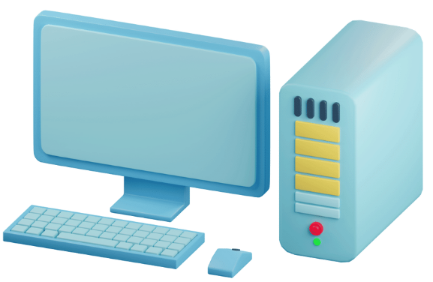
Computer Hardware
Central Processing Unit (CPU)

Slide 8
Computer Hardware
Central Processing Unit (CPU)
The CPU, often referred to as the "brain" of the computer, performs most of the calculations and instructions in a computer.

Slide 9
Computer Hardware
Central Processing Unit (CPU)
The CPU, often referred to as the "brain" of the computer, performs most of the calculations and instructions in a computer.
It carries out tasks such as arithmetic operations, logic operations, and controlling the flow of data.

Slide 10
Computer Hardware
Central Processing Unit (CPU)
The CPU, often referred to as the "brain" of the computer, performs most of the calculations and instructions in a computer.
It carries out tasks such as arithmetic operations, logic operations, and controlling the flow of data.
The CPU consists of the control unit, which manages the execution of instructions, and the arithmetic logic unit (ALU), which performs mathematical and logical operations.

Slide 11
Computer Hardware
Memory (RAM)

Slide 12
Computer Hardware
Memory (RAM)
Random Access Memory (RAM) is the temporary storage space where the computer stores data and instructions that are actively being used.

Slide 13
Computer Hardware
Memory (RAM)
Random Access Memory (RAM) is the temporary storage space where the computer stores data and instructions that are actively being used.
RAM is volatile, meaning its contents are lost when the computer is powered off.

Slide 14
Computer Hardware
Memory (RAM)
Random Access Memory (RAM) is the temporary storage space where the computer stores data and instructions that are actively being used.
RAM is volatile, meaning its contents are lost when the computer is powered off.
In the Von Neumann architecture, memory is used to store both data and instructions.

Slide 15
Computer Hardware
Memory (RAM)
Random Access Memory (RAM) is the temporary storage space where the computer stores data and instructions that are actively being used.
RAM is volatile, meaning its contents are lost when the computer is powered off.
In the Von Neumann architecture, memory is used to store both data and instructions.
The memory is divided into two primary components:

Slide 16
Computer Hardware
Memory (RAM)
Random Access Memory (RAM) is the temporary storage space where the computer stores data and instructions that are actively being used.
RAM is volatile, meaning its contents are lost when the computer is powered off.
In the Von Neumann architecture, memory is used to store both data and instructions.
The memory is divided into two primary components:
  Instruction Memory: It stores the program instructions that the CPU fetches and executes.

Slide 17
Computer Hardware
Memory (RAM)
Random Access Memory (RAM) is the temporary storage space where the computer stores data and instructions that are actively being used.
RAM is volatile, meaning its contents are lost when the computer is powered off.
In the Von Neumann architecture, memory is used to store both data and instructions.
The memory is divided into two primary components:
  Instruction Memory: It stores the program instructions that the CPU fetches and executes.
  Data Memory: This stores data used by the CPU during execution, such as variables, inputs, and intermediate results.

Slide 18
Computer Hardware
Storage Devices

Slide 19
Computer Hardware
Storage Devices
Hard Disk Drive (HDD): HDDs provide long-term storage for programs, data files, and the operating system. They use magnetic disks to store and retrieve data.

Slide 20
Computer Hardware
Storage Devices
Hard Disk Drive (HDD): HDDs provide long-term storage for programs, data files, and the operating system. They use magnetic disks to store and retrieve data.
Solid State Drive (SSD): SSDs are similar to HDDs but use flash memory technology for faster data access and improved reliability.

Slide 21
Computer Hardware
Storage Devices
Hard Disk Drive (HDD): HDDs provide long-term storage for programs, data files, and the operating system. They use magnetic disks to store and retrieve data.
Solid State Drive (SSD): SSDs are similar to HDDs but use flash memory technology for faster data access and improved reliability.
Optical Drives: Optical drives, such as CD/DVD drives, are used for reading and writing data on optical discs.

Slide 22
Computer Hardware
Motherboard

Slide 23
Computer Hardware
Motherboard
The motherboard is the main circuit board that connects and allows communication between various hardware components of the computer.

Slide 24
Computer Hardware
Motherboard
The motherboard is the main circuit board that connects and allows communication between various hardware components of the computer.
It houses the CPU, memory modules, storage devices, and other essential components.

Slide 25
Computer Hardware
Graphics Processing Unit (GPU)

Slide 26
Computer Hardware
Graphics Processing Unit (GPU)
The GPU, also known as the graphics card, is responsible for rendering and displaying images, videos, and 3D graphics on the computer screen.

Slide 27
Computer Hardware
Graphics Processing Unit (GPU)
The GPU, also known as the graphics card, is responsible for rendering and displaying images, videos, and 3D graphics on the computer screen.
It offloads the graphics-related computations from the CPU, allowing for smooth and efficient visual processing.

Slide 28
Computer Hardware
Input and Output Devices

Slide 29
Computer Hardware
Input and Output Devices
Input devices allow the user to input information to the computer: keyboard, mouse, microphone, etc.

Slide 30
Computer Hardware
Input and Output Devices
Input devices allow the user to input information to the computer: keyboard, mouse, microphone, etc.
Output devices allow the computer to output information: monitor, printer, speakers, etc.

Slide 31
Fetch-Decode-Execute Cycle
The Von Neumann architecture follows a sequential process known as the Fetch-Decode-Execute cycle:

Slide 32
Fetch-Decode-Execute Cycle
The Von Neumann architecture follows a sequential process known as the Fetch-Decode-Execute cycle:
  The CPU fetches an instruction from memory

Slide 33
Fetch-Decode-Execute Cycle
The Von Neumann architecture follows a sequential process known as the Fetch-Decode-Execute cycle:
  The CPU fetches an instruction from memory
  decodes it to understand the operation to be performed

Slide 34
Fetch-Decode-Execute Cycle
The Von Neumann architecture follows a sequential process known as the Fetch-Decode-Execute cycle:
  The CPU fetches an instruction from memory
  decodes it to understand the operation to be performed
  then executes the instruction

Slide 35
Fetch-Decode-Execute Cycle
The Von Neumann architecture follows a sequential process known as the Fetch-Decode-Execute cycle:
  The CPU fetches an instruction from memory
  decodes it to understand the operation to be performed
  then executes the instruction
This cycle repeats continuously, allowing the computer to process and execute a series of instructions

Slide 36
Computer Software

Slide 37
Computer Software
  System software is a collection of computer programs that manage the resources of a computer and facilitates access to those resources.

Slide 38
Computer Software
  System software is a collection of computer programs that manage the resources of a computer and facilitates access to those resources.
    System software acts as an intermediary between the users and the hardware.

Slide 39
Computer Software
  System software is a collection of computer programs that manage the resources of a computer and facilitates access to those resources.
    System software acts as an intermediary between the users and the hardware.
    The set of services and resources created by the software and seen by the user is called a virtual machine.

Slide 40
Computer Software
  System software is a collection of computer programs that manage the resources of a computer and facilitates access to those resources.
    System software acts as an intermediary between the users and the hardware.
    The set of services and resources created by the software and seen by the user is called a virtual machine.
    Examples of system software include operating systems (Windows, macOS, Linux), device drivers, and compilers.

Slide 41
Computer Software
  Application software allows the user to address some specialized task of interest to that user.

Slide 42
Computer Software
  Application software allows the user to address some specialized task of interest to that user.
    They are typically created to meet the needs of individuals, businesses, or specific industries.

Slide 43
Computer Software
  Application software allows the user to address some specialized task of interest to that user.
    They are typically created to meet the needs of individuals, businesses, or specific industries.
    Examples of application software include word processors, spreadsheets, and web browsers.

Slide 44

Computer Languages

Slide 45
Computer Languages
Once a computer was created, there was a need to communicate with it; but how?

Slide 46
Computer Languages
Once a computer was created, there was a need to communicate with it; but how?
At its core, computers are a set of electronic instructions. These electronic instructions can be broken down to the very basic idea: electricity on and electricity off.

Slide 47
Computer Languages
Once a computer was created, there was a need to communicate with it; but how?
At its core, computers are a set of electronic instructions. These electronic instructions can be broken down to the very basic idea: electricity on and electricity off.
This is how the computer language of binary came to be (binary has two states: on and off)

Slide 48
Computer Languages
We will discuss more about binary code in Unit 2, but for now, know that the binary language is how a machine is able to execute instruction.

Slide 49
Computer Languages
We will discuss more about binary code in Unit 2, but for now, know that the binary language is how a machine is able to execute instruction.
Binary is a series of 1s and 0s that a computer executes (where 1 represents electricity on and 0 represents electricity off)

Slide 50
Computer Languages
We will discuss more about binary code in Unit 2, but for now, know that the binary language is how a machine is able to execute instruction.
Binary is a series of 1s and 0s that a computer executes (where 1 represents electricity on and 0 represents electricity off)
However, binary is complex and difficult for humans to write and understand. There was a need to develop higher-level languages that are more human-readable and easier to work with.

Slide 51
Pseudocode to High-Level Language

Slide 52
Pseudocode to High-Level Language
Unfortunately, there is no way to convert human language into binary directly.

Slide 53
Pseudocode to High-Level Language
Unfortunately, there is no way to convert human language into binary directly.
Human language is riddled with ambiguities and assumptions that computers cannot handle.

Slide 54
Pseudocode to High-Level Language
Unfortunately, there is no way to convert human language into binary directly.
Human language is riddled with ambiguities and assumptions that computers cannot handle.
After human language, the next step in the language spectrum is to create a pseudocode – an artificial and informal language that helps programmers develop algorithms.

Slide 55
Pseudocode to High-Level Language
Unfortunately, there is no way to convert human language into binary directly.
Human language is riddled with ambiguities and assumptions that computers cannot handle.
After human language, the next step in the language spectrum is to create a pseudocode – an artificial and informal language that helps programmers develop algorithms.
Pseudocode is a "text-based" design tool.

Slide 56
Human Language | Pseudocode

Slide 57
Human Language | Pseudocode
We will input 10 grades into the computer gradebook and print the average of the 10 grades.

Slide 58
Human Language | Pseudocode
We will input 10 grades into the computer gradebook and print the average of the 10 grades. | Set sum to zero Set grade counter to one While grade counter is less than or equal to ten Input the next grade Add the grade into the sum Increment counter by one Set the class average to the sum divided by ten Print the average

Slide 59
While this provides a great way to write and develop algorithms, the computer cannot understand pseudocode.

Slide 60
While this provides a great way to write and develop algorithms, the computer cannot understand pseudocode.
After pseudocode, the next step is a programming language.

Slide 61
While this provides a great way to write and develop algorithms, the computer cannot understand pseudocode.
After pseudocode, the next step is a programming language.
A programming language is a formal language with a defined set of rules and syntax that allows programmers to write instructions and algorithms for a computer to execute.

Slide 62
Human Language | Pseudocode | Programming Language
We will input 10 grades into the computer gradebook and print the average of the 10 grades. | Set sum to zero Set grade counter to one While grade counter is less than or equal to ten Input the next grade Add the grade into the sum Increment counter by one Set the class average to the sum divided by ten Print the average

Slide 63
Human Language | Pseudocode | Programming Language
We will input 10 grades into the computer gradebook and print the average of the 10 grades. | Set sum to zero Set grade counter to one While grade counter is less than or equal to ten Input the next grade Add the grade into the sum Increment counter by one Set the class average to the sum divided by ten Print the average | sum = 0 counter = 1 while counter <= 10: grade = int(input(“Grade:”)) sum += grade count += 1 average = sum / 10 print(average)

Slide 64
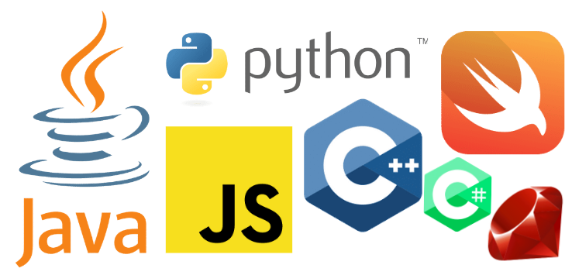
Programming Languages
Programming languages provide a structured way for programmers to express their logic, data manipulations, and computational tasks in a format that can be understood by computers. They offer a set of keywords, symbols, and rules that define how programs are written.

Slide 65
Syntax: Programming languages have specific rules and syntax that dictate how programs should be written.

Slide 66
Syntax: Programming languages have specific rules and syntax that dictate how programs should be written.
Data Types: Programming languages define different data types that determine how data is stored and manipulated in the program.

Slide 67
Syntax: Programming languages have specific rules and syntax that dictate how programs should be written.
Data Types: Programming languages define different data types that determine how data is stored and manipulated in the program.
Variables: Programmers can declare variables to store and manipulate data during program execution.

Slide 68
Syntax: Programming languages have specific rules and syntax that dictate how programs should be written.
Data Types: Programming languages define different data types that determine how data is stored and manipulated in the program.
Variables: Programmers can declare variables to store and manipulate data during program execution.
Control Structures: Programming languages provide control structures such as conditional statements (if-else, switch) and loops (for, while) to control the flow of execution within a program.

Slide 69
Functions and Procedures: Languages allow the definition and use of functions and procedures, which are reusable blocks of code that perform specific tasks.

Slide 70
Functions and Procedures: Languages allow the definition and use of functions and procedures, which are reusable blocks of code that perform specific tasks.
Libraries: Programming languages often provide libraries that offer pre-written code for common tasks, allowing developers to use existing coding solutions.

Slide 71
Functions and Procedures: Languages allow the definition and use of functions and procedures, which are reusable blocks of code that perform specific tasks.
Libraries: Programming languages often provide libraries that offer pre-written code for common tasks, allowing developers to use existing coding solutions.
Compilation: Programming languages are compiled, meaning they are translated into machine code before execution.

Slide 72
Examples of popular programming languages include:

Slide 73
Examples of popular programming languages include:
C/C++: Languages known for their efficiency and close interaction with hardware.

Slide 74
Examples of popular programming languages include:
C/C++: Languages known for their efficiency and close interaction with hardware.
Java: A widely used language known for its platform independence and object-oriented programming features.

Slide 75
Examples of popular programming languages include:
C/C++: Languages known for their efficiency and close interaction with hardware.
Java: A widely used language known for its platform independence and object-oriented programming features.
Python: A high-level language known for its simplicity, readability, and extensive libraries.

Slide 76
Examples of popular programming languages include:
C/C++: Languages known for their efficiency and close interaction with hardware.
Java: A widely used language known for its platform independence and object-oriented programming features.
Python: A high-level language known for its simplicity, readability, and extensive libraries.
JavaScript: A language primarily used for web development, enabling interactivity and dynamic content on web pages.

Slide 77
Examples of popular programming languages include:
C/C++: Languages known for their efficiency and close interaction with hardware.
Java: A widely used language known for its platform independence and object-oriented programming features.
Python: A high-level language known for its simplicity, readability, and extensive libraries.
JavaScript: A language primarily used for web development, enabling interactivity and dynamic content on web pages.
Ruby: A language known for its elegant syntax and focus on simplicity and productivity.

Slide 78
Examples of popular programming languages include:
C/C++: Languages known for their efficiency and close interaction with hardware.
Java: A widely used language known for its platform independence and object-oriented programming features.
Python: A high-level language known for its simplicity, readability, and extensive libraries.
JavaScript: A language primarily used for web development, enabling interactivity and dynamic content on web pages.
Ruby: A language known for its elegant syntax and focus on simplicity and productivity.
Swift: A language developed by Apple for iOS, macOS, and other Apple platforms.

Slide 79
Compilation Process
Machine Language:
Machine Language
0000 0000 0000 0000 0000 0000 0000 0010 0000 0000 0000 0011 0001 1101 0000 0001 0001 1110 0000 0010 0101 1110 1101 1110
Assembly Language
TOTAL .BLOCK 1 ABC .WORD 2 XYZ .WORD 3 LOAD REGD, ABC LOAD REGE, XYZ ADD REGF, REGD, REGE STORE REGF, TOTAL HALT

Slide 80
Compilation Process
Machine Language:
Machine language is a low-level programming language that consists of binary code that can be directly executed by a computer's CPU.
Machine Language
0000 0000 0000 0000 0000 0000 0000 0010 0000 0000 0000 0011 0001 1101 0000 0001 0001 1110 0000 0010 0101 1110 1101 1110
Assembly Language
TOTAL .BLOCK 1 ABC .WORD 2 XYZ .WORD 3 LOAD REGD, ABC LOAD REGE, XYZ ADD REGF, REGD, REGE STORE REGF, TOTAL HALT

Slide 81
Compilation Process
Machine Language:
Machine language is a low-level programming language that consists of binary code that can be directly executed by a computer's CPU.
The machine language is specific to the computer architecture.
Machine Language
0000 0000 0000 0000 0000 0000 0000 0010 0000 0000 0000 0011 0001 1101 0000 0001 0001 1110 0000 0010 0101 1110 1101 1110
Assembly Language
TOTAL .BLOCK 1 ABC .WORD 2 XYZ .WORD 3 LOAD REGD, ABC LOAD REGE, XYZ ADD REGF, REGD, REGE STORE REGF, TOTAL HALT

Slide 82
Compilation Process
Machine Language:
Machine language is a low-level programming language that consists of binary code that can be directly executed by a computer's CPU.
The machine language is specific to the computer architecture.
Machine language instructions directly correspond to the operations and data manipulation performed by the computer's hardware.
Machine Language
0000 0000 0000 0000 0000 0000 0000 0010 0000 0000 0000 0011 0001 1101 0000 0001 0001 1110 0000 0010 0101 1110 1101 1110
Assembly Language
TOTAL .BLOCK 1 ABC .WORD 2 XYZ .WORD 3 LOAD REGD, ABC LOAD REGE, XYZ ADD REGF, REGD, REGE STORE REGF, TOTAL HALT

Slide 83
Compilation Process
Machine Language:
Machine language is a low-level programming language that consists of binary code that can be directly executed by a computer's CPU.
The machine language is specific to the computer architecture.
Machine language instructions directly correspond to the operations and data manipulation performed by the computer's hardware.
Assembly Language:
Assembly language is a low-level programming language that provides a more human-readable representation of machine language instructions.
Machine Language
0000 0000 0000 0000 0000 0000 0000 0010 0000 0000 0000 0011 0001 1101 0000 0001 0001 1110 0000 0010 0101 1110 1101 1110
Assembly Language
TOTAL .BLOCK 1 ABC .WORD 2 XYZ .WORD 3 LOAD REGD, ABC LOAD REGE, XYZ ADD REGF, REGD, REGE STORE REGF, TOTAL HALT

Slide 84
Compilation Process
Machine Language:
Machine language is a low-level programming language that consists of binary code that can be directly executed by a computer's CPU.
The machine language is specific to the computer architecture.
Machine language instructions directly correspond to the operations and data manipulation performed by the computer's hardware.
Assembly Language:
Assembly language is a low-level programming language that provides a more human-readable representation of machine language instructions.
It uses mnemonic codes or symbols to represent individual machine instructions instead of binary code.
Machine Language
0000 0000 0000 0000 0000 0000 0000 0010 0000 0000 0000 0011 0001 1101 0000 0001 0001 1110 0000 0010 0101 1110 1101 1110
Assembly Language
TOTAL .BLOCK 1 ABC .WORD 2 XYZ .WORD 3 LOAD REGD, ABC LOAD REGE, XYZ ADD REGF, REGD, REGE STORE REGF, TOTAL HALT

Slide 85
Compilation Process
Machine Language:
Machine language is a low-level programming language that consists of binary code that can be directly executed by a computer's CPU.
The machine language is specific to the computer architecture.
Machine language instructions directly correspond to the operations and data manipulation performed by the computer's hardware.
Assembly Language:
Assembly language is a low-level programming language that provides a more human-readable representation of machine language instructions.
It uses mnemonic codes or symbols to represent individual machine instructions instead of binary code.
Each mnemonic corresponds to a specific machine instruction or operation.
Machine Language
0000 0000 0000 0000 0000 0000 0000 0010 0000 0000 0000 0011 0001 1101 0000 0001 0001 1110 0000 0010 0101 1110 1101 1110
Assembly Language
TOTAL .BLOCK 1 ABC .WORD 2 XYZ .WORD 3 LOAD REGD, ABC LOAD REGE, XYZ ADD REGF, REGD, REGE STORE REGF, TOTAL HALT

Slide 86
Both of these (machine and assembly language) are low-level programming languages – they work closely with the computer, and even though assembly language was a step close to human language, it was still not great to code in. Then, high level programming languages came around.

Slide 87
Both of these (machine and assembly language) are low-level programming languages – they work closely with the computer, and even though assembly language was a step close to human language, it was still not great to code in. Then, high level programming languages came around.
Source Code:
Source code is a high-level programming language, such as Python, Java, or C++.

Slide 88
Both of these (machine and assembly language) are low-level programming languages – they work closely with the computer, and even though assembly language was a step close to human language, it was still not great to code in. Then, high level programming languages came around.
Source Code:
Source code is a high-level programming language, such as Python, Java, or C++.
The code, written in human-readable form, with syntax rules governing how to give instructions to the computer.

Slide 89
Both of these (machine and assembly language) are low-level programming languages – they work closely with the computer, and even though assembly language was a step close to human language, it was still not great to code in. Then, high level programming languages came around.
Source Code:
Source code is a high-level programming language, such as Python, Java, or C++.
The code, written in human-readable form, with syntax rules governing how to give instructions to the computer.
Source code is translated into assembly language and eventually machine language by the compiler.

Slide 90
Compilation or Interpretation:
Depending on the programming language, the source code is either compiled or interpreted.

Slide 91
Compilation or Interpretation:
Depending on the programming language, the source code is either compiled or interpreted.
In compiled languages like C++ or Java, a compiler translates the entire source code into machine code, also known as object code, in a process called compilation.

Slide 92
Compilation or Interpretation:
Depending on the programming language, the source code is either compiled or interpreted.
In compiled languages like C++ or Java, a compiler translates the entire source code into machine code, also known as object code, in a process called compilation.
In interpreted languages like Python or JavaScript, an interpreter reads and executes the source code line by line, converting it into machine code on the fly.

Slide 93
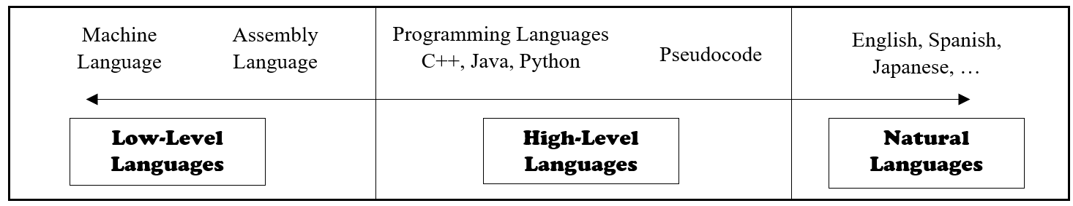
Low-level languages offer low-level control, direct hardware interaction, and proximity to machine code but lack portability and require detailed knowledge of the hardware.

Slide 94
Low-level languages offer low-level control, direct hardware interaction, and proximity to machine code but lack portability and require detailed knowledge of the hardware.
High-level languages provide higher-level abstractions, portability, and productivity at the cost of reduced control over hardware resources.

Slide 95
Text vs Visual Programming
Text-based programming involves writing code using programming languages.

Slide 96
Text vs Visual Programming
Text-based programming involves writing code using programming languages.
In this approach, programmers use a text editor or an integrated development environment (IDE) to write lines of code using specific syntax and rules.

Slide 97
Text vs Visual Programming
Text-based programming involves writing code using programming languages.
In this approach, programmers use a text editor or an integrated development environment (IDE) to write lines of code using specific syntax and rules.
Text-based programming allows programmers to have precise control over the logic and behavior of their programs.

Slide 98
Text vs Visual Programming
Text-based programming involves writing code using programming languages.
In this approach, programmers use a text editor or an integrated development environment (IDE) to write lines of code using specific syntax and rules.
Text-based programming allows programmers to have precise control over the logic and behavior of their programs.
Examples: C++, Java, Python

Slide 99
Visual-based programming, on the other hand, involves creating programs by manipulating graphical elements or blocks, rather than writing code directly.

Slide 100
Visual-based programming, on the other hand, involves creating programs by manipulating graphical elements or blocks, rather than writing code directly.
It uses visual programming languages or environments that allow users to build programs by arranging blocks and connecting them together to define the program's flow and behavior.

Slide 101
Visual-based programming, on the other hand, involves creating programs by manipulating graphical elements or blocks, rather than writing code directly.
It uses visual programming languages or environments that allow users to build programs by arranging blocks and connecting them together to define the program's flow and behavior.
Visual-based programming simplifies the coding process by abstracting complex syntax and allowing users to focus more on the program's logic and structure.

Slide 102
Visual-based programming, on the other hand, involves creating programs by manipulating graphical elements or blocks, rather than writing code directly.
It uses visual programming languages or environments that allow users to build programs by arranging blocks and connecting them together to define the program's flow and behavior.
Visual-based programming simplifies the coding process by abstracting complex syntax and allowing users to focus more on the program's logic and structure.
Examples: Scratch, Snap!, App Inventor

Slide 103
Text-Based Programming | Visual-Based Programming

Slide 104
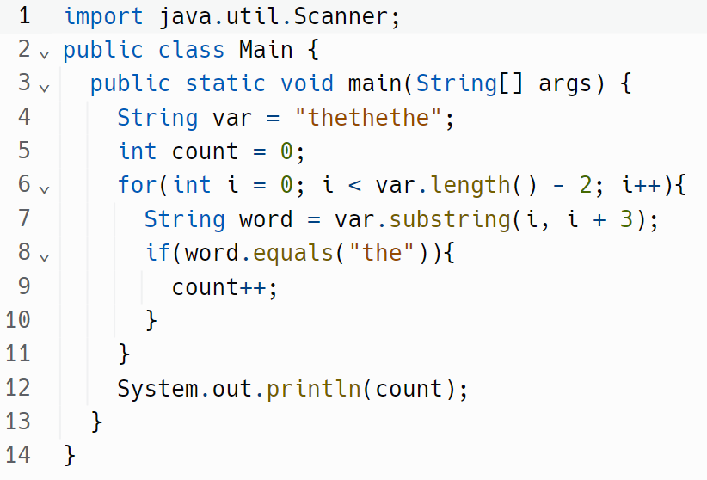
Text-Based Programming | Visual-Based Programming

Slide 105
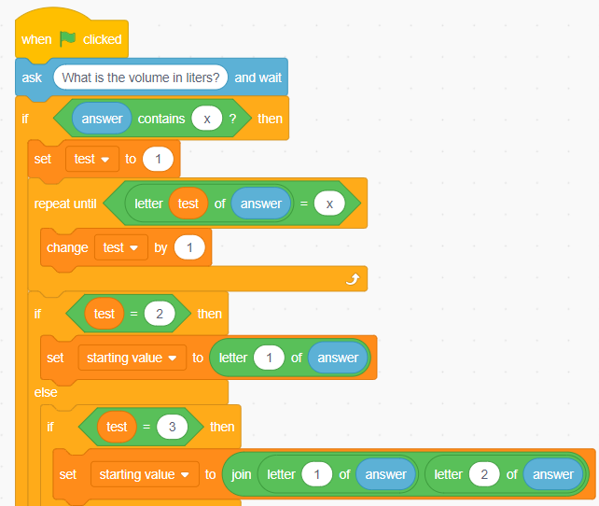
Text-Based Programming | Visual-Based Programming

