Slide 1
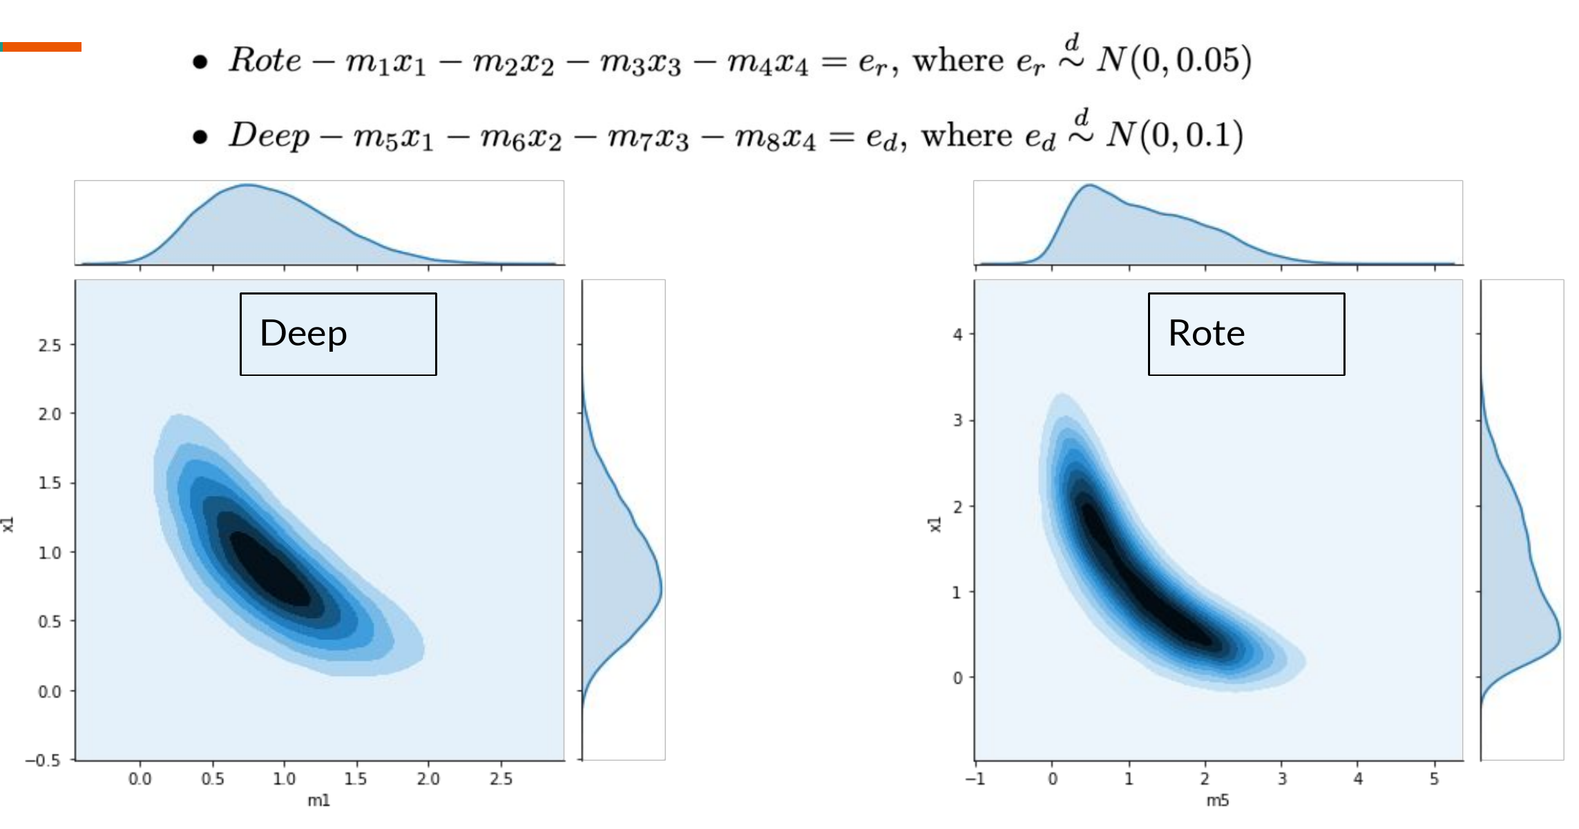
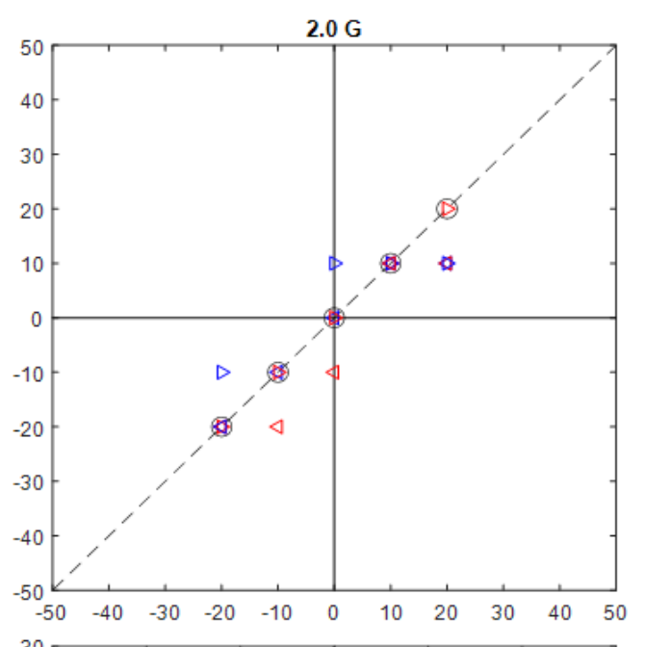
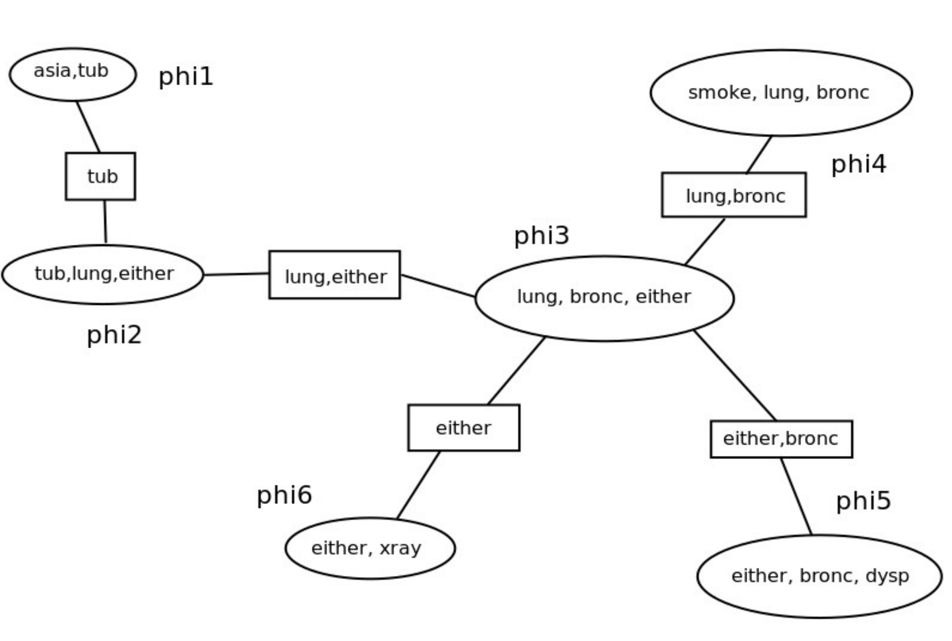
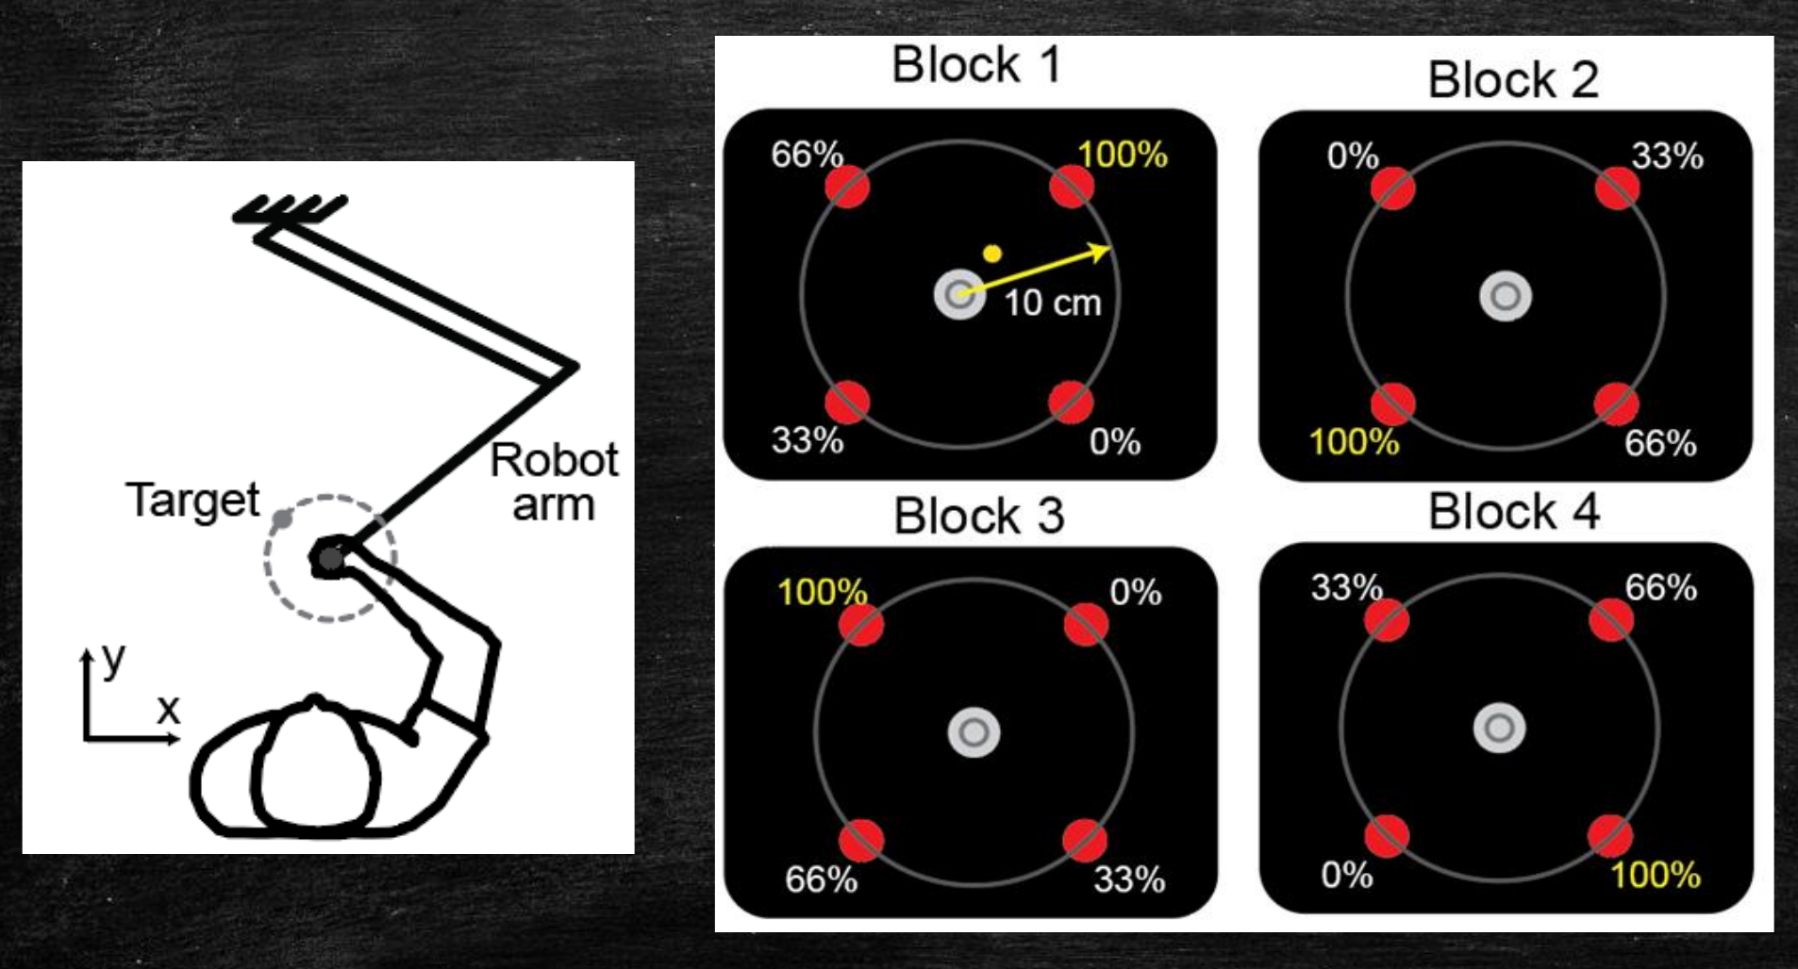
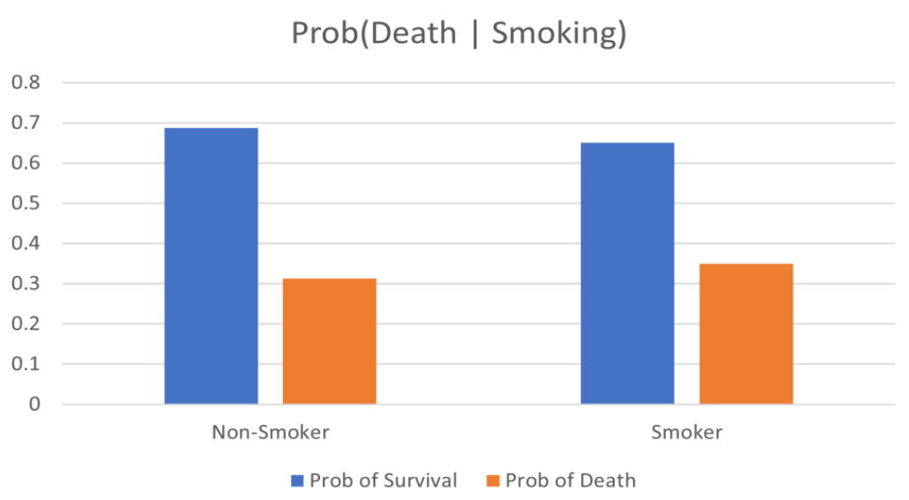
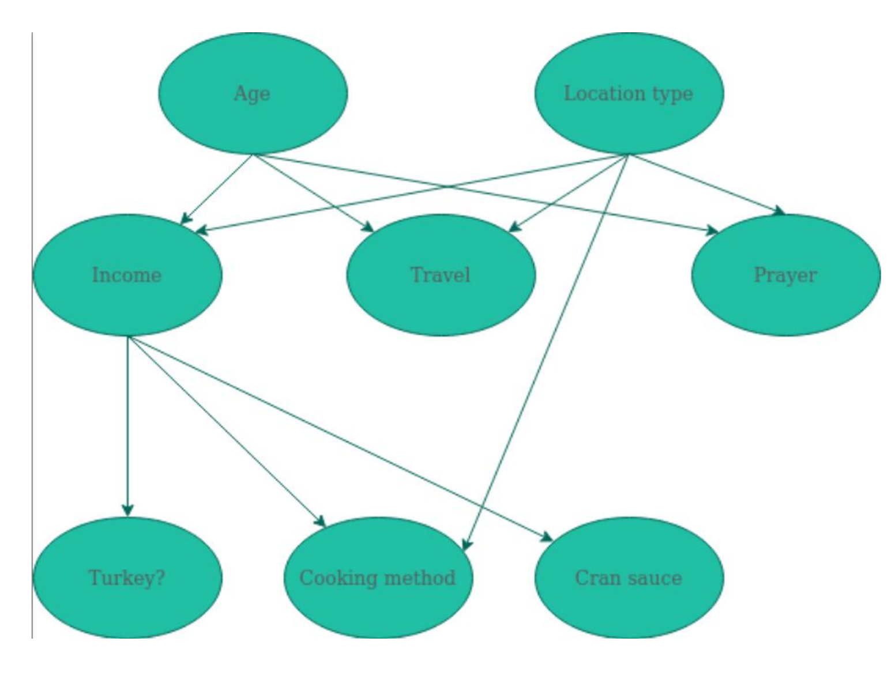
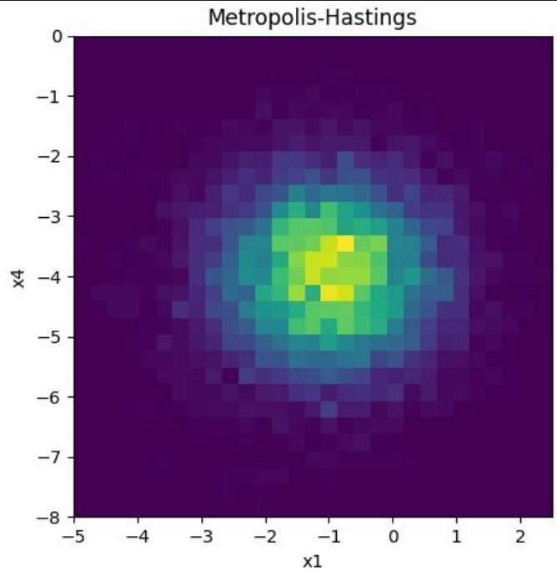
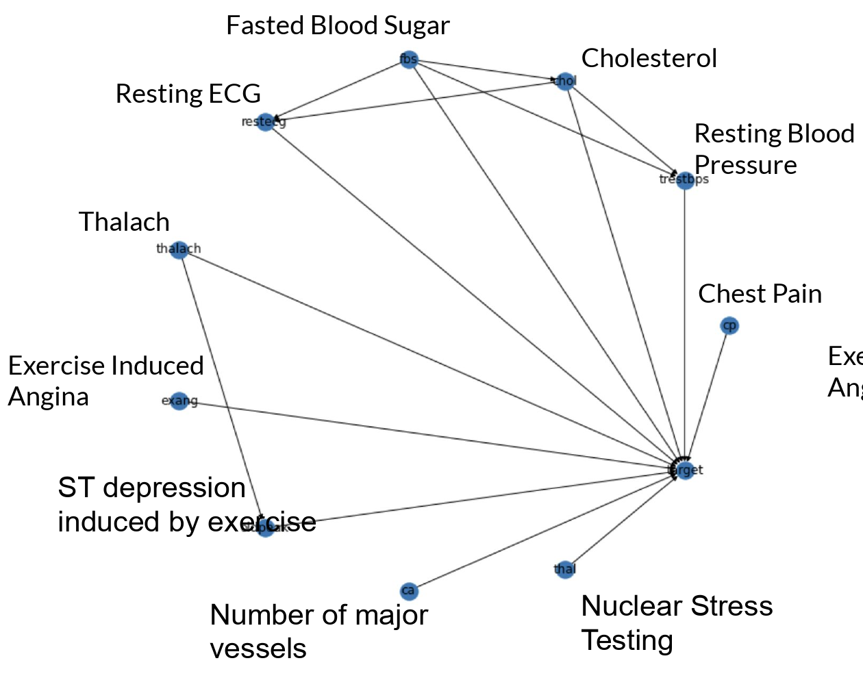
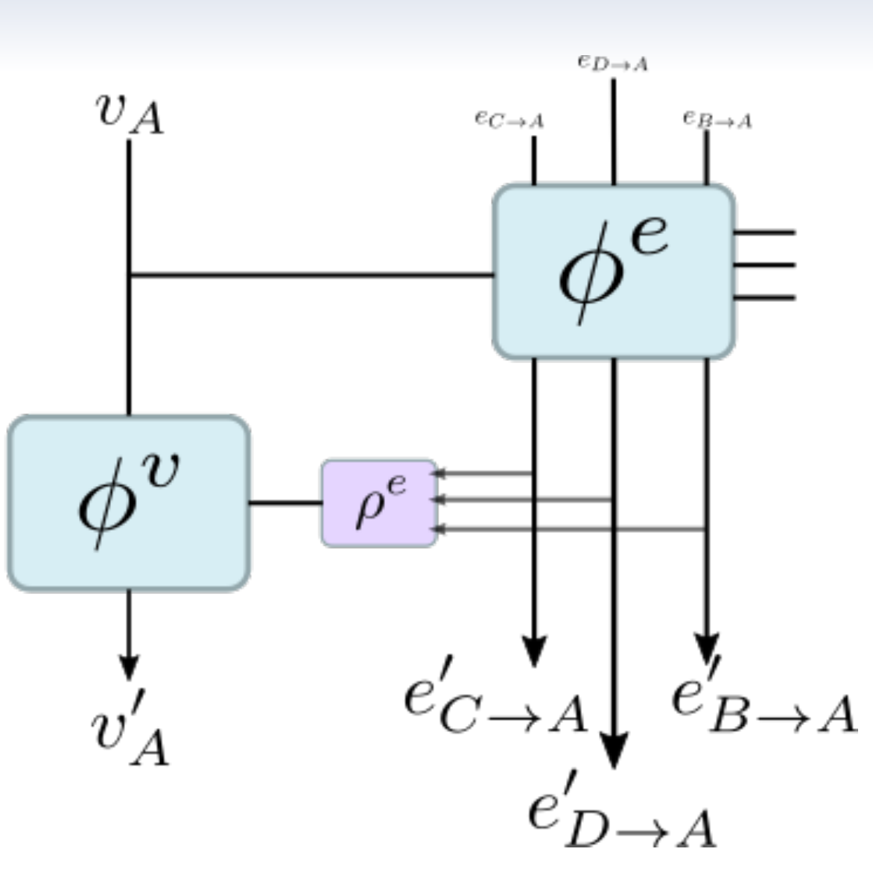
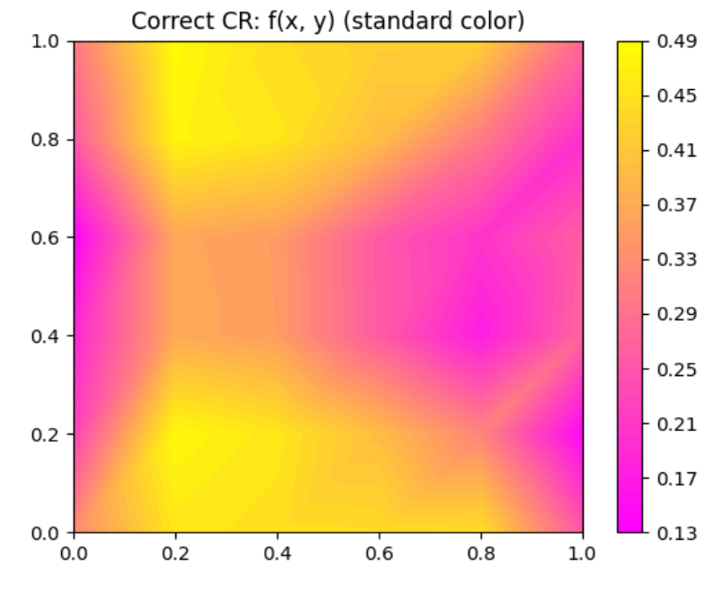
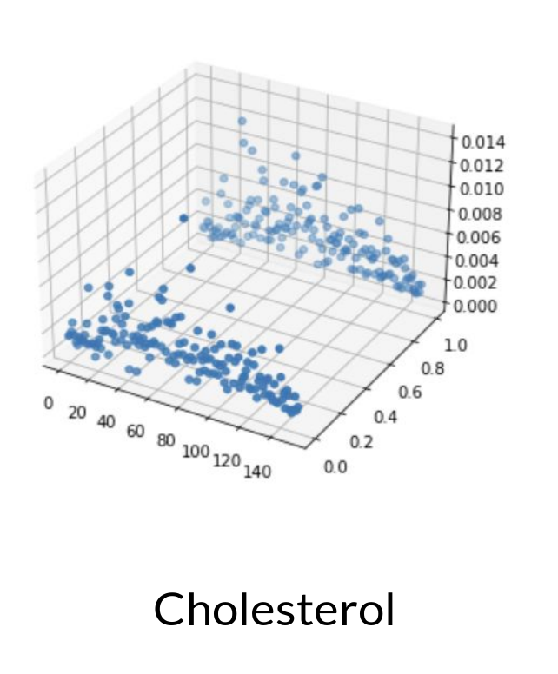
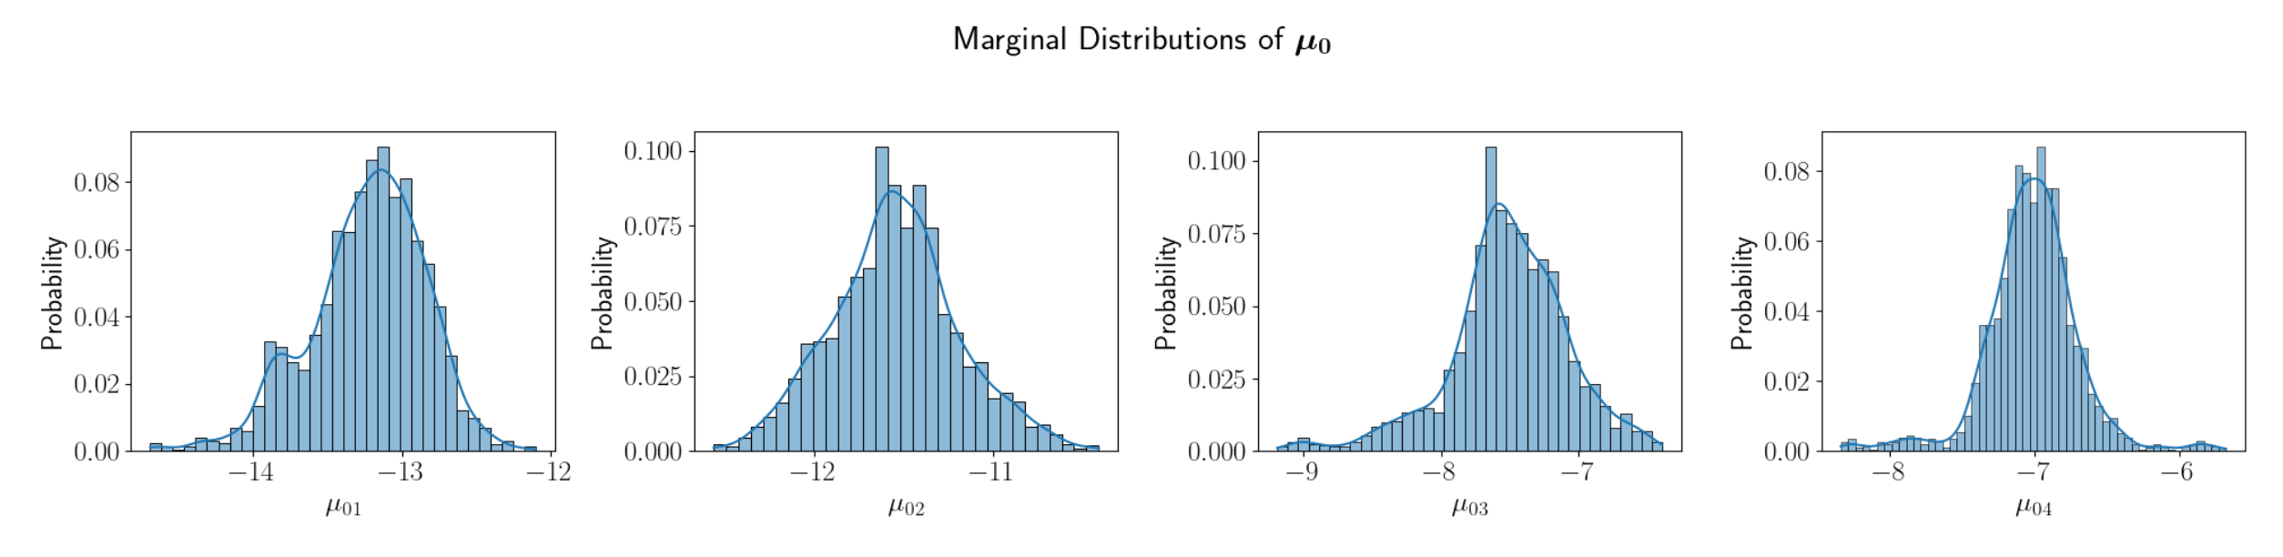
The Eye Mind Link: Eye Movements and Comprehension
(Megan Caruso, Ren Stengel, Nick Hunkins, Sam Pugh)
Modeling Orientation Perception
(Jamie Voros)
Modeling Lung Cancer
(Kaiyuan Xu)
Estimation of Expectation of Reward by MCMC
(Daniel Apuan, Rachel Marbaker)
Inferring health outcomes with the Junction Tree Algorithm
(Nate Omdalen)
Effectiveness of the Metropolis-Hastings algorithm on a mixed Gaussian data set with unknown variable interactions
(Vladimir Zhdanov)
How do Americans spend their Thanksgiving?
(Maria Stull, Kaleb Bishop)
CSCI 5822
“Probabilistic Models”
Prof. Rebecca Morrison, Spring 2021
Selected Student Projects
Junction Tree Algorithm: Heart Attack Dataset
(Nikhil Prabhu, David Kim, Abteen Ebrahimi)
GNNs For Constitutive Modeling With jraph And CRIKit
(Emily Jakobs, Mike McCabe, Steven Kordonowy)
Model Correction of Partial Lotka-Volterra Models
(Rileigh Bandy)

