Slide 1
Feasibility Studies of a Pattern Matching Based Track Finding Algorithm on a GPU
Rebecca Fair

Slide 2
Why?
After phase II upgrade higher luminosity, higher pileup, longer CPU time to process events
CPU HLT farm limited by size and cooling
GPUs are a possible solution:
GPUs have many more cores than CPUs (e.g. 3584 vs. 4) so are capable of massively parallel computations
But require bespoke programming e.g. in CUDA for NVIDIA GPUs
Write and evaluate GPU pattern matching algorithm in CUDA – events/s

Slide 3
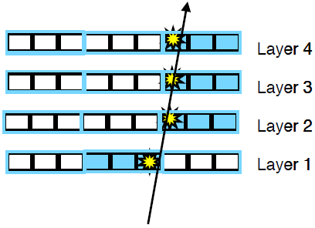
Pattern Matching
Hits are collected into coarse resolution hits (super strips)
All possible patterns of coarse hits determined by simulation
Pattern matching compares presimulated patterns to event hits
Trial set of 10⁶ patterns – representing sub-region of detector
Patterns split into 3 x 10⁴ groups containing 1 -2000 patterns
Each group contains patterns for 8 specific detector elements
If an event doesn’t contain hits on the correct detector elements – no need to match patterns for that group
Reduces number of patterns to be matched

Slide 4
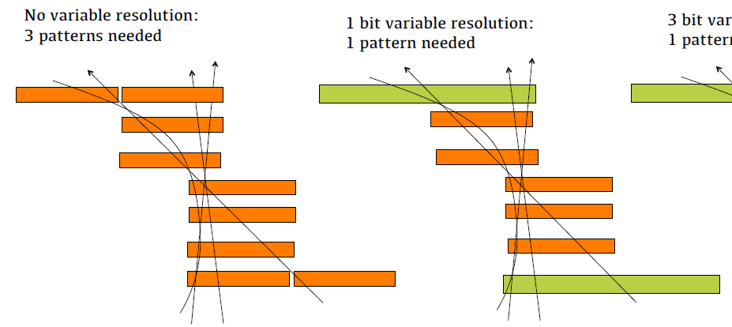
Pattern Matching
10100001
wildcard layer matches automatically
hit position
1 = pixel
0 = strip
“don’t care” bits
Wildcard layers and only require n of m layers to match
To account for < 100% detector efficiency
Don’t care bits
Reduce number of patterns required to describe tracks

Slide 5
GPUs
There are 3 main stages in GPU programming
Allocate and copy input arrays from host to GPU
Run kernel on GPU (the computation part)
Copy output arrays from GPU to host
On a GPU, moving and accessing data is usually the most time consuming!
Computations to be executed on the GPU are written as a kernel, and are executed as blocks of threads
Each parallel invocation of the kernel is a block
- blocks must run independently!
Each block can run up to 1024 threads

Slide 6
The Kernel
1 CUDA block per pattern group
The kernel has 2 main parts:
1. Each thread compares 1 pattern hash ID with 1 event hash ID to check for a match and increments a shared counter
If there are enough hash ID matches:
2. Each thread compares 1 pattern layer hit with all event hits for that detector element and increments that pattern’s counter
For low pileup events, fewer detector elements will receive a hit, so 2. will never be reached for most blocks

Slide 7
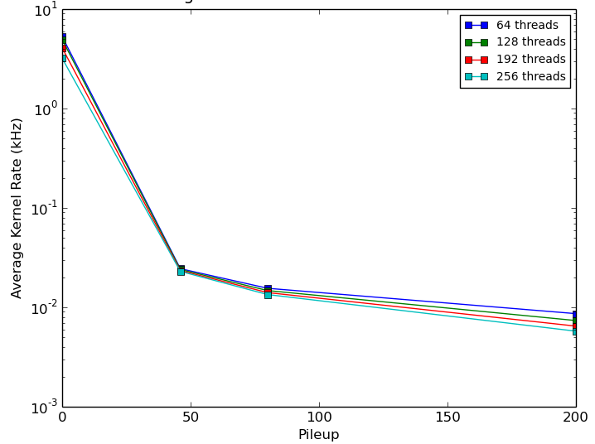
Initial Results for Different Pileups
Using Titan X (Pascal), 12GB global memory, 28 multiprocessors (128 cuda cores/MP), 1.53GHz GPU, 5 GHz memory clock
rate drops dramatically for high pileup
Pileup | N Events | Matches
1 | 1000 | 9851
46 | 100 | 1215
80 | 100 | 1743
200 | 100 | 8040

Slide 8
Bit Arrays
Instead of looping through detector elements and hits on GPU – create a bit array on the CPU describing hits for every element covered in the pattern set – then copy to GPU
Pattern set only covers 346 different elements
00000000 00000000 00000000 00000000
00000000 00000000 00000010 00000000
00000000 00000000 00001010 00000000
dc bits = 0:
00000000 00000100 00001010 00000000
dc bits = 1:
00000000 00001100 00001111 00000000
dc bits = 2:
00000000 00001111 00001111 00000000
Instead of looping over all elements and hits in an event – just check the corresponding bit in the bit array
Event hit data:
00100100
00101100
01001000
hit position = 9
hit position = 11
hit position = 18

Slide 9
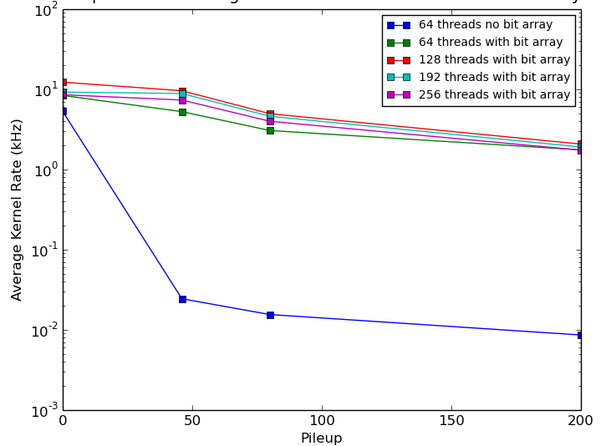
New Rate With Bit Arrays

Slide 10
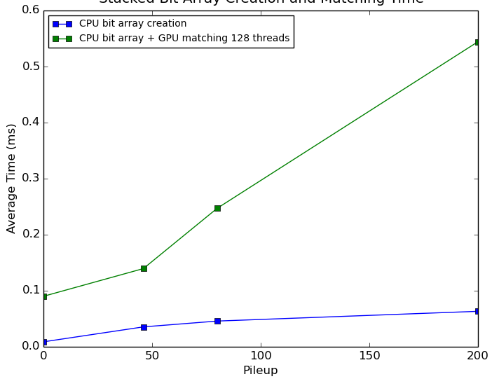
Stacked CPU bit array creation + GPU matching times
Could also implement this on GPU

Slide 11
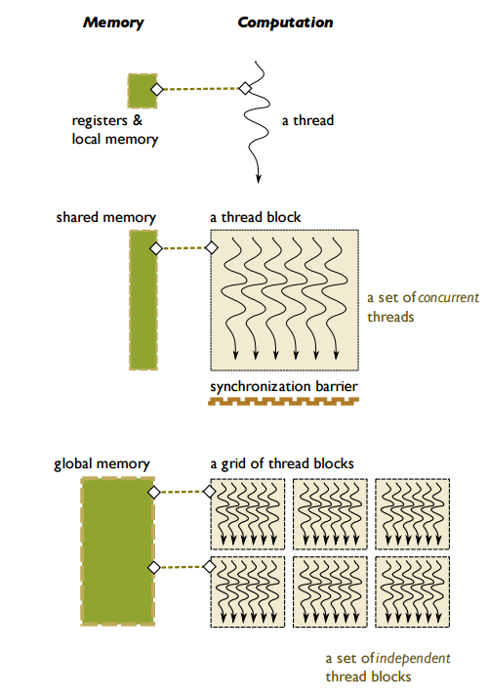
Reducing memory latency
Data that is transferred from the CPU is put into GPU global memory
Latency of global memory is 100s of cycles
Move data that will be accessed multiple times (bit arrays) to shared memory
Shared memory latency is 10s of cycles

Slide 12
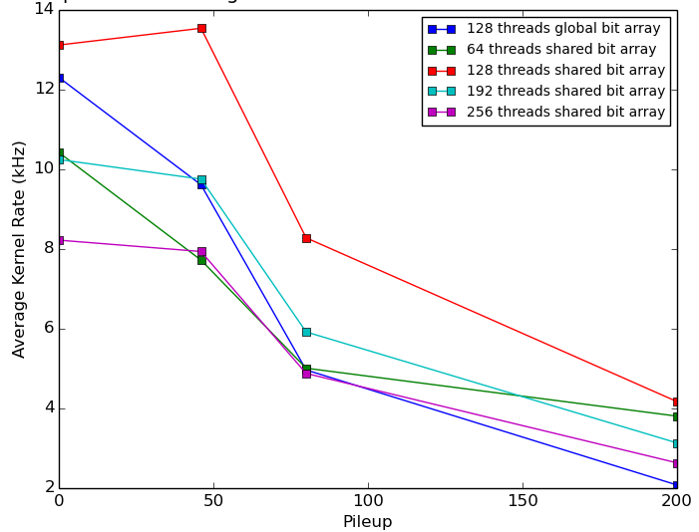
New Rate Using Shared Arrays

Slide 13
More improvements?
The second part of the kernel:
2. Each thread compares 1 pattern layer hit with all event hits for that detector element and increments that pattern’s shared counter
As multiple threads work on the same pattern, they must increment a shared counter – this involves synchronising threads so they don’t read/write at the same time – this costs cycles!
Instead get each thread to work on an entire pattern
Each thread will have to loop through all layers, but synchronisation is reduced!
Loop through layers can also be broken if a match is impossible i.e. when current matches + potential matches < required matches

Slide 14
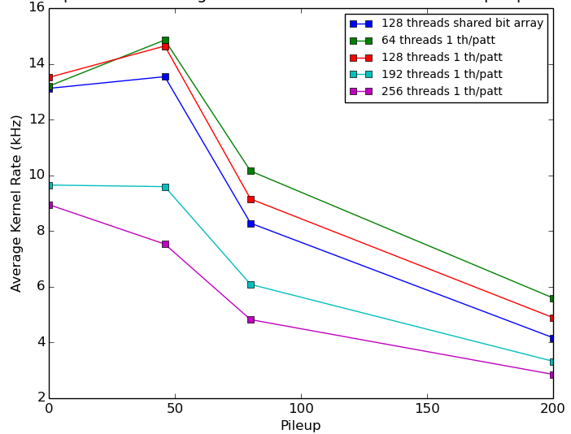
Single thread per pattern

Slide 15
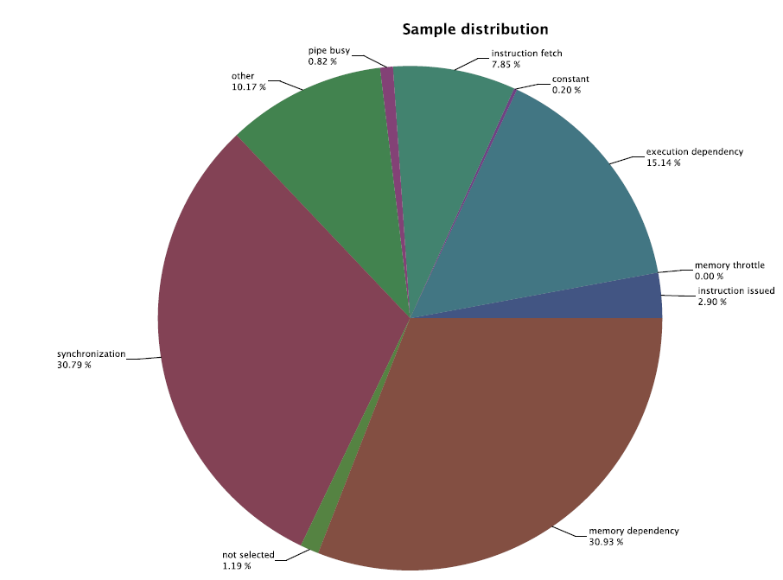
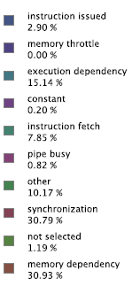
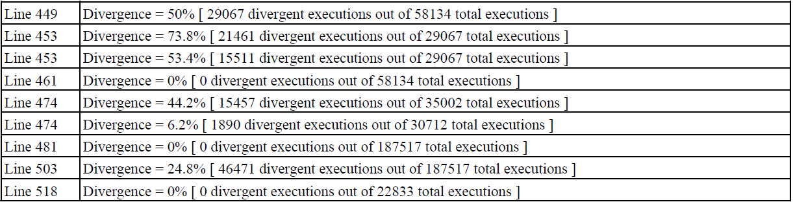
Bottlenecks
High divergence in first part of kernel – as only first nLayers threads can search for a hashID match
Solution: match multiple groups/block
Notes:
Memory dependency & synchronisation main cause of stall. Not fully utilising memory bandwidth, improve memory access alignment? Divergence particularly high in first part of kernel (checking for hash ID matches) as only first nLayers threads can match. Solution to this – use multiple groups/block but this causes other problems…
Another solution – split 2 kernel parts into 2 completely separate kernels. First kernel finds groups that match, second kernel matches patterns.

Slide 16
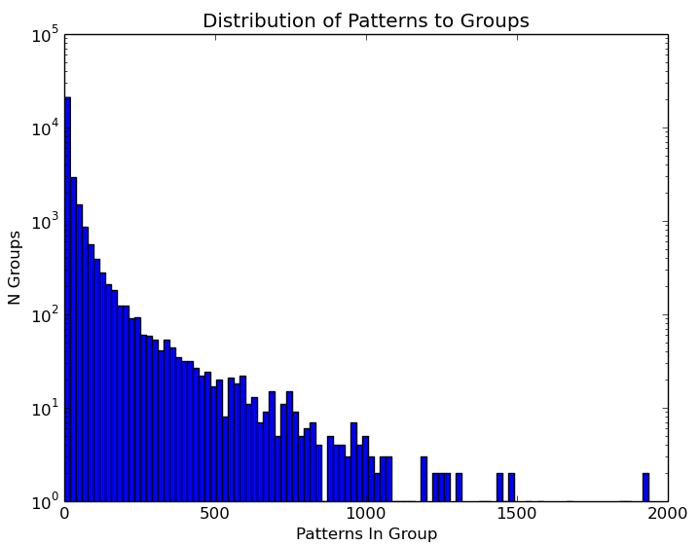
Unbalanced Groups
Groups don’t contain an equal number of patterns
Therefore CUDA blocks don’t get an equal amount of work
Many groups (~5500) contain only 1 pattern!

Slide 17
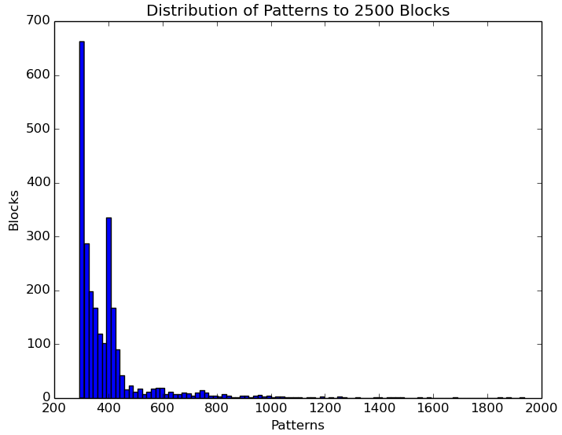
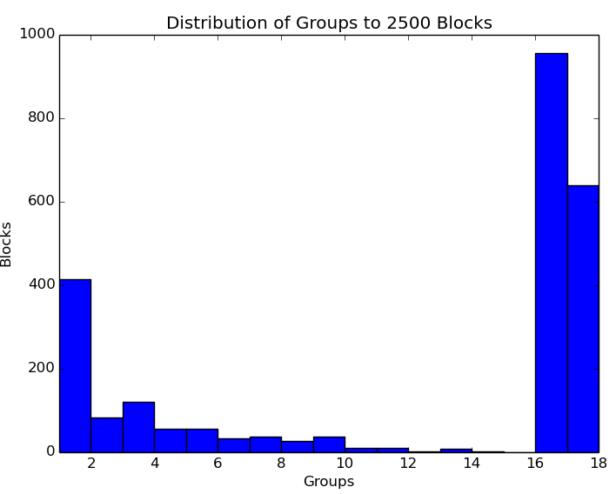
Multiple Pattern Groups Per Block
Instead of allocating 1 group/block, allocate multiple groups/block and try different numbers of blocks
Strategy - sweep backwards and forwards across blocks and if the number of patterns in a block is less than a threshold value (total nPatterns/nBlocks) add a group to that block
Results in more balanced distribution of patterns to blocks, but less balanced distribution of groups to blocks

Slide 18
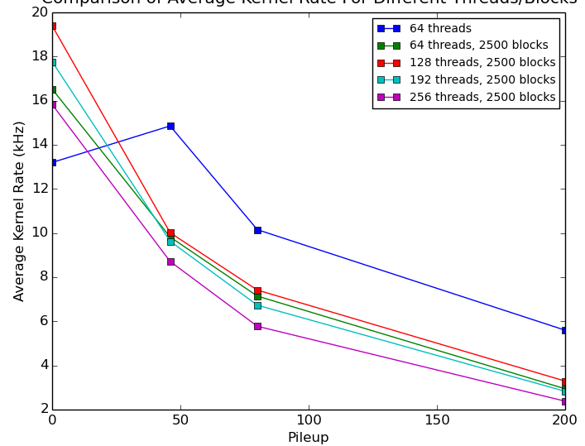
Multiple pattern groups per block
2500 blocks shows best performance, but only beats 1 group/block when matching single muon events!

Slide 19
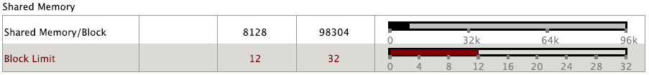
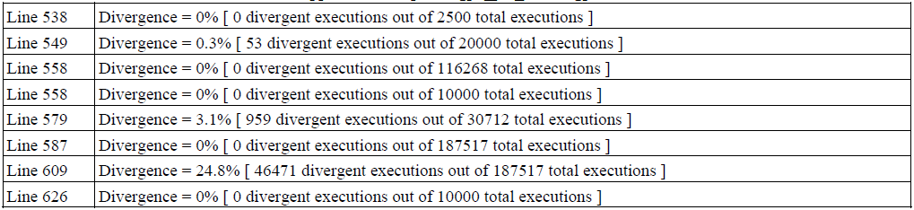
Bottlenecks in multiple groups/block
Notes:
Divergence now very low, but this required storing variables for each group in the block, increasing use of shared memory, reducing the number of blocks that can simultaneously execute on the same SM
- use more generic distributions of blocks to groups

Slide 20
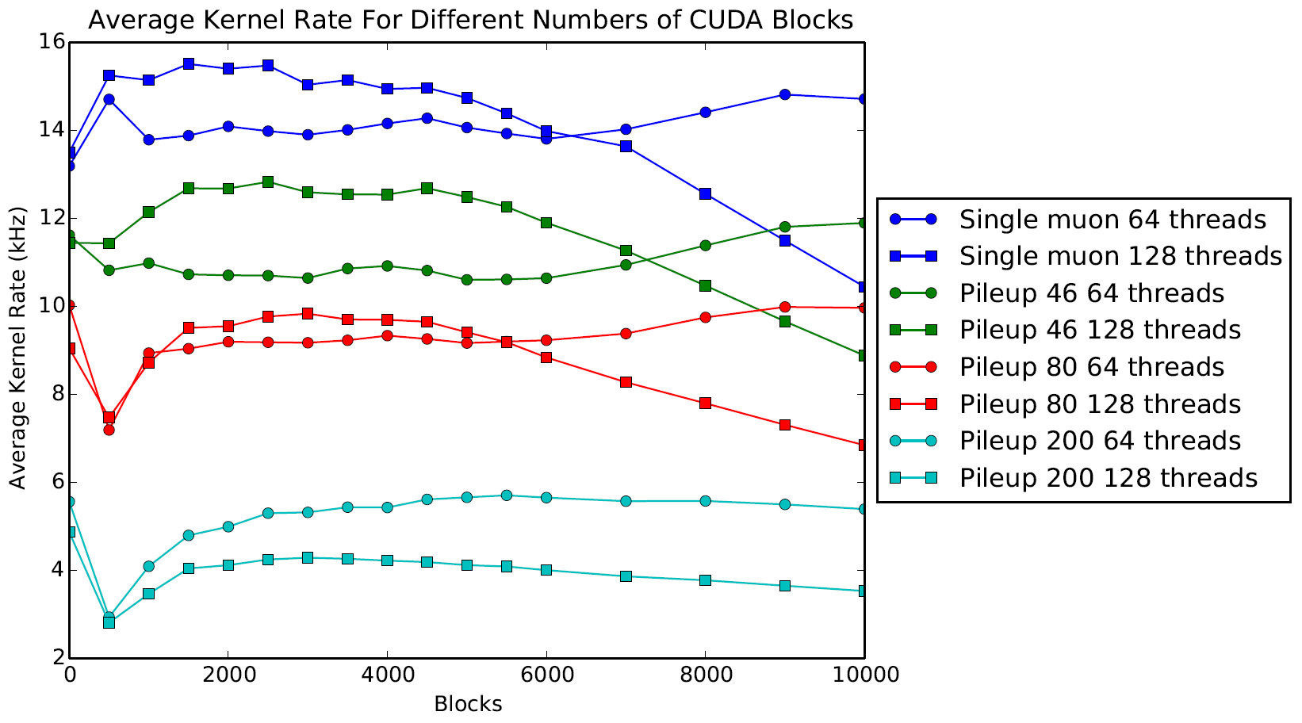
Reduced shared mem for multiple groups/block

Slide 21
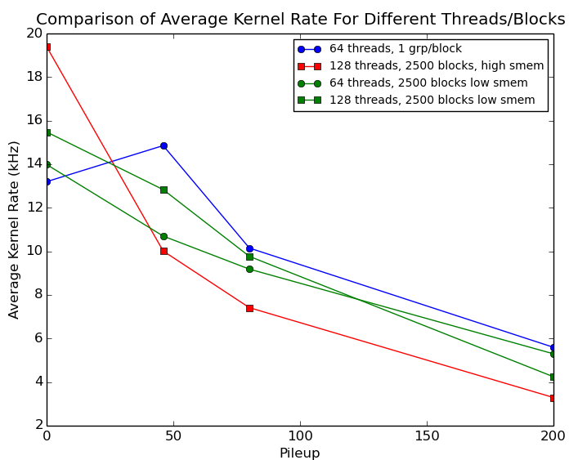
Reduced shared mem for multiple groups/block
Multiple groups/block approaches 1 group/block at high pileup – try different distributions of groups to blocks

Slide 22
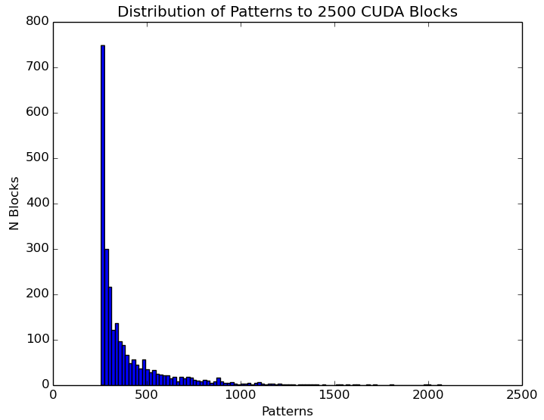
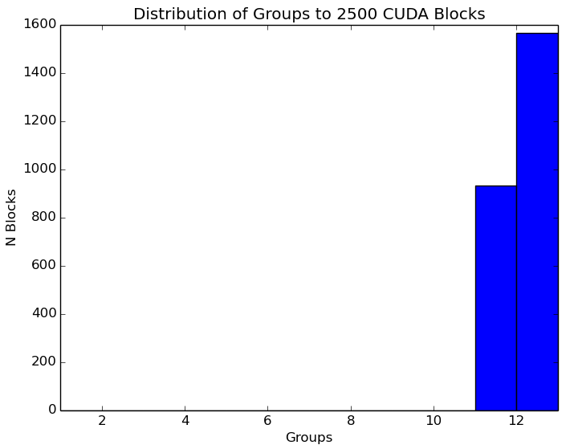
New work distribution strategy
Ignore number of patterns in each block, just sweep backwards and forwards and allocate an equal number of groups to each block
We now have an even distribution of groups

Slide 23
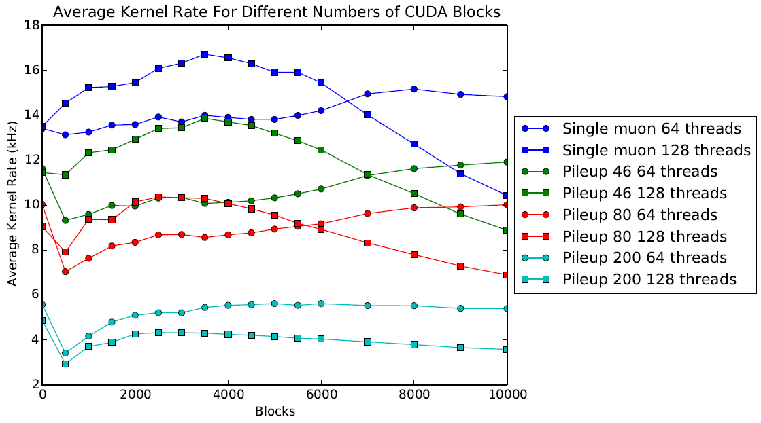

Slide 24
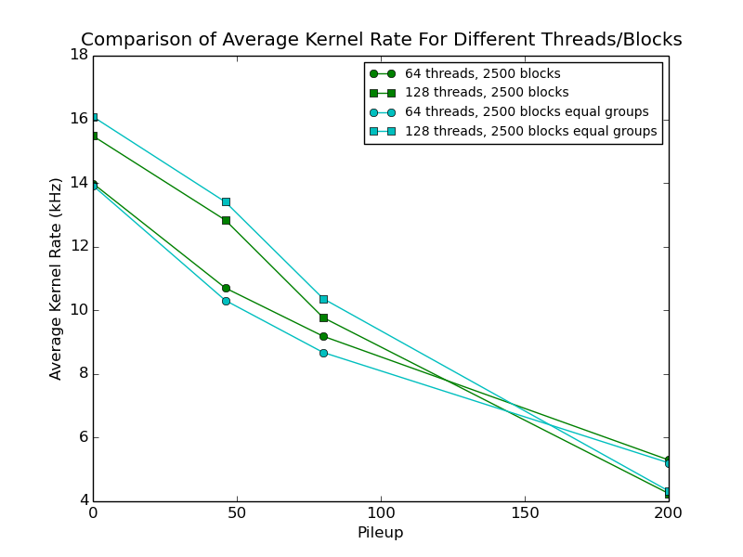

Slide 25
Summary
Due to their massively parallel computational nature, GPUs are well suited to pattern matching
Using bit arrays and making good use of shared memory can achieve event rates of ~kHz on a sub-region of detector
FTK++ will have 4 x 10⁶ patterns/sub-region and 1256 sub-regions: ~ 5 billion patterns and match at 100kHz!
1 GPU 10⁶ patterns at kHz → ? GPUs 5 x 10⁹ patterns at 100kHz?? – ambitious…
But rates are very competitive with ATLAS HLT farm
New NVIDIA Volta architecture in 2018 – more global memory, higher bandwidth, more SMs…

