Slide 1
miRNA pathway genes

Slide 2
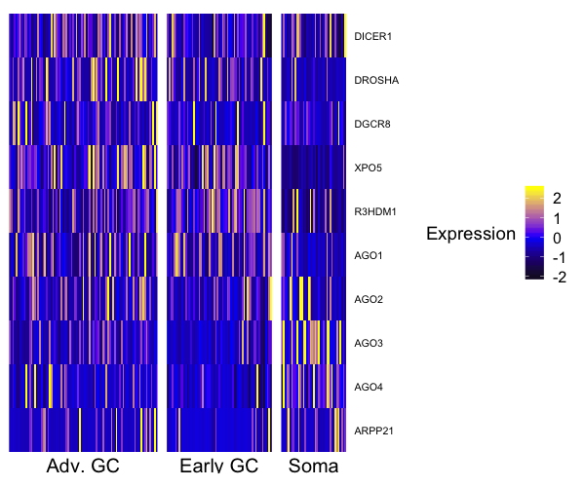

Slide 3
HIWI2 correlations

Slide 4
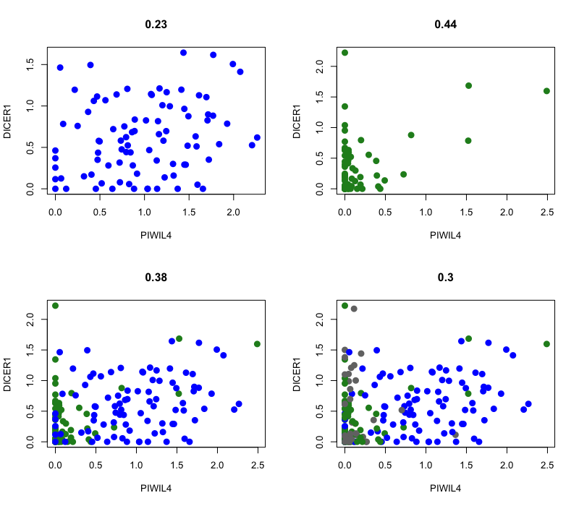
PIWIL4 (HIWI2) X DICER1
advanced
early
soma

Slide 5
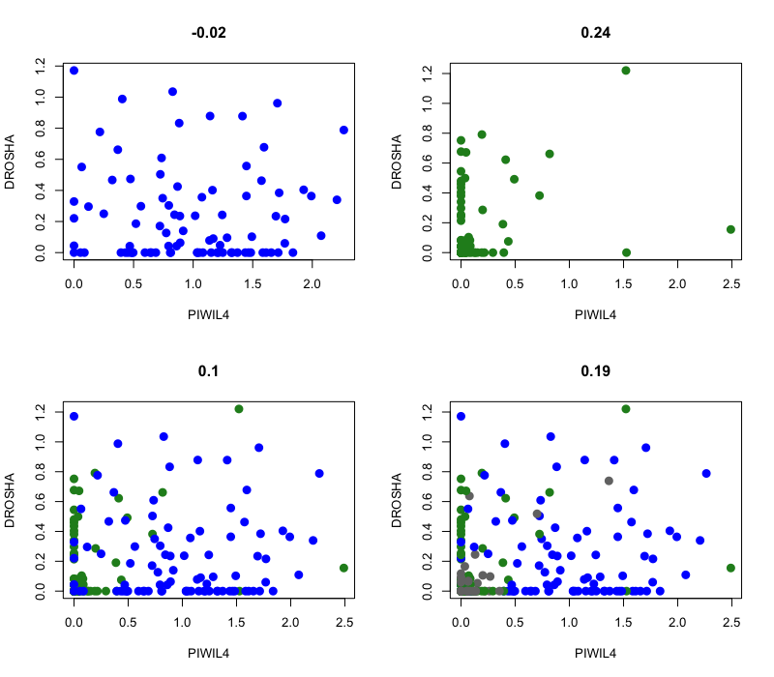
PIWIL4 (HIWI2) X DROSHA
advanced
early
soma

Slide 6
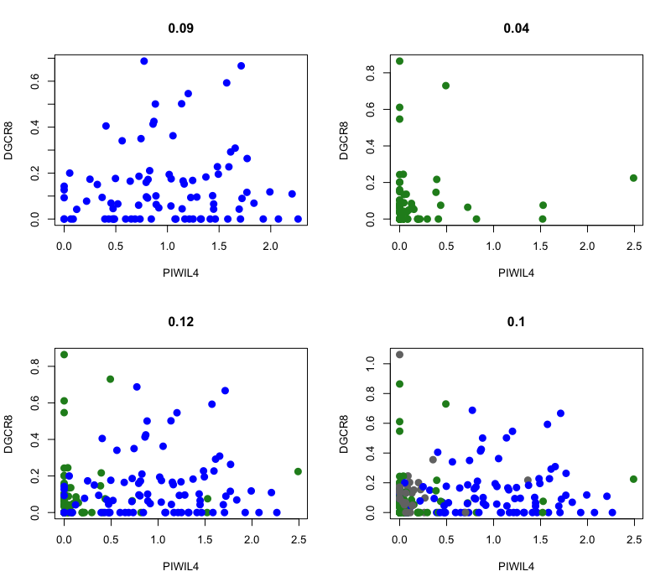
PIWIL4 (HIWI2) X DGCR8
advanced
early
soma

Slide 7
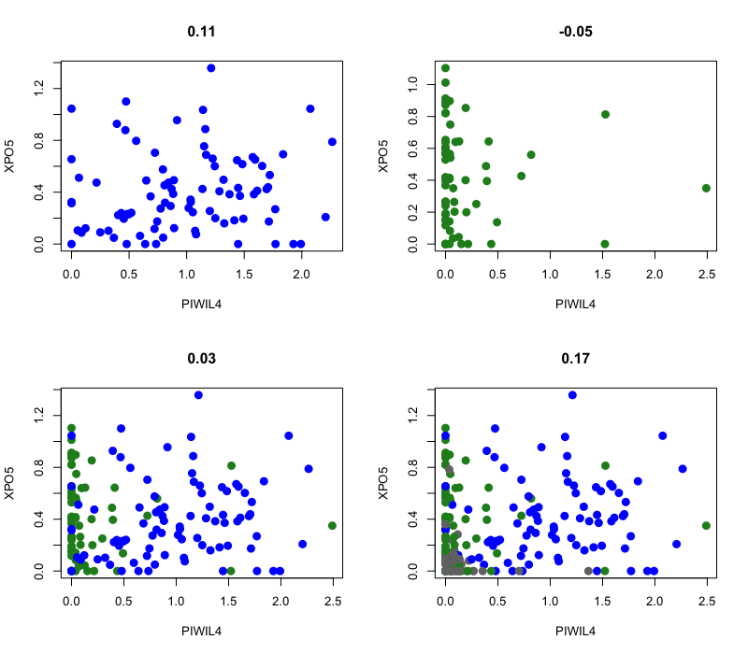
PIWIL4 (HIWI2) X XPO5
advanced
early
soma

Slide 8
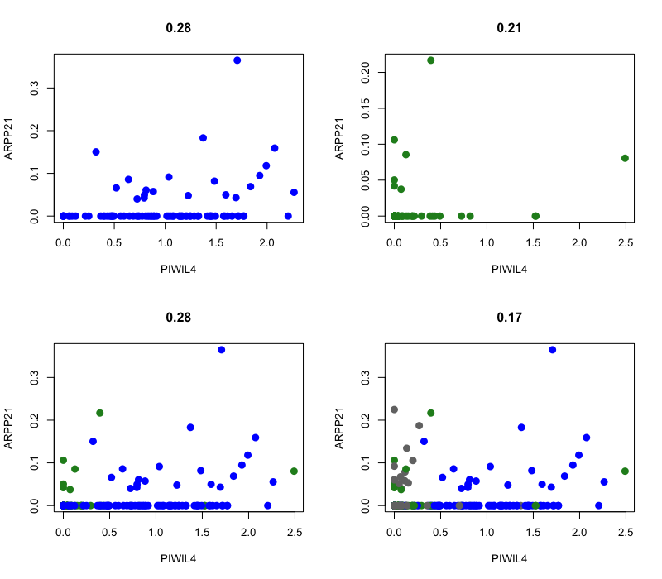
PIWIL4 (HIWI2) X ARPP21
advanced
early
soma

Slide 9

PIWIL4 (HIWI2) X AGO4
advanced
early
soma

Slide 10
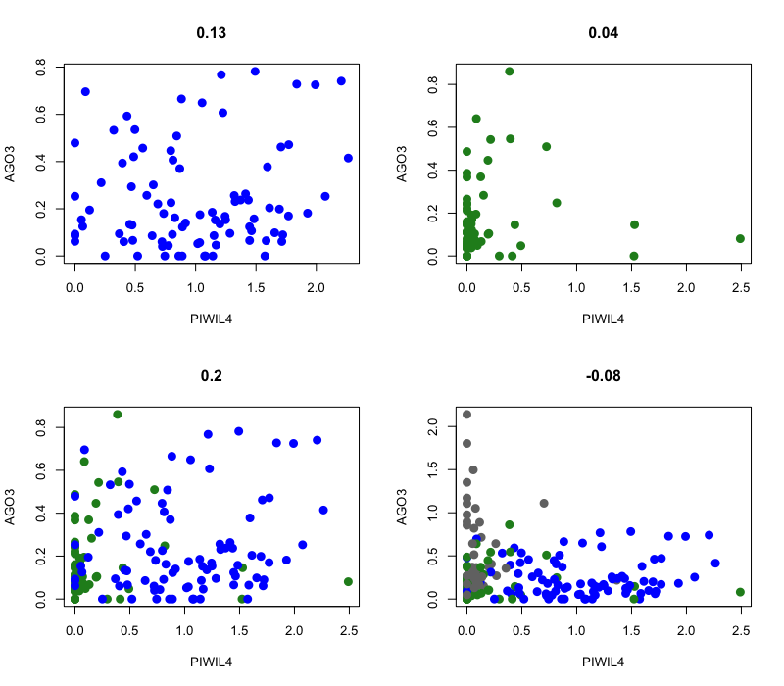
PIWIL4 (HIWI2) X AGO3
advanced
early
soma

Slide 11
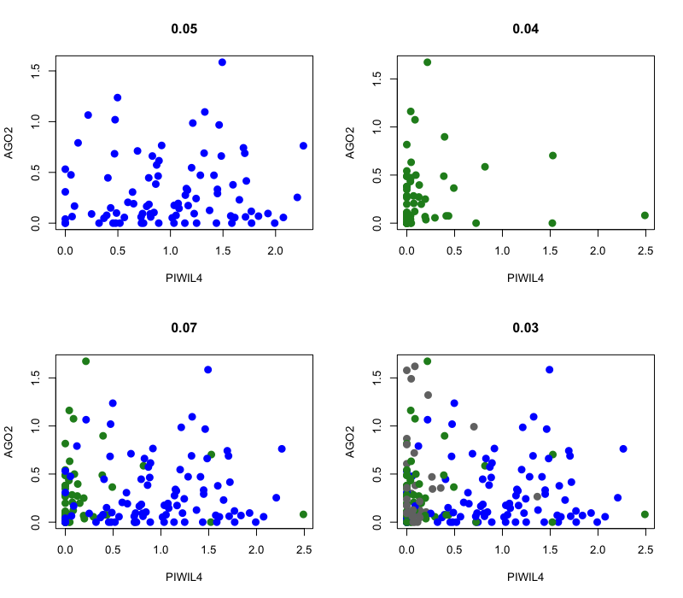
PIWIL4 (HIWI2) X AGO2
advanced
early
soma

Slide 12
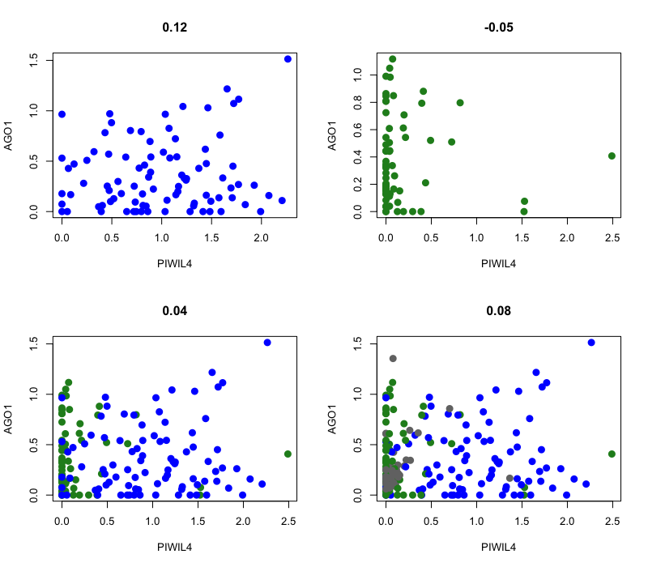
PIWIL4 (HIWI2) X AGO1
advanced
early
soma

Slide 13
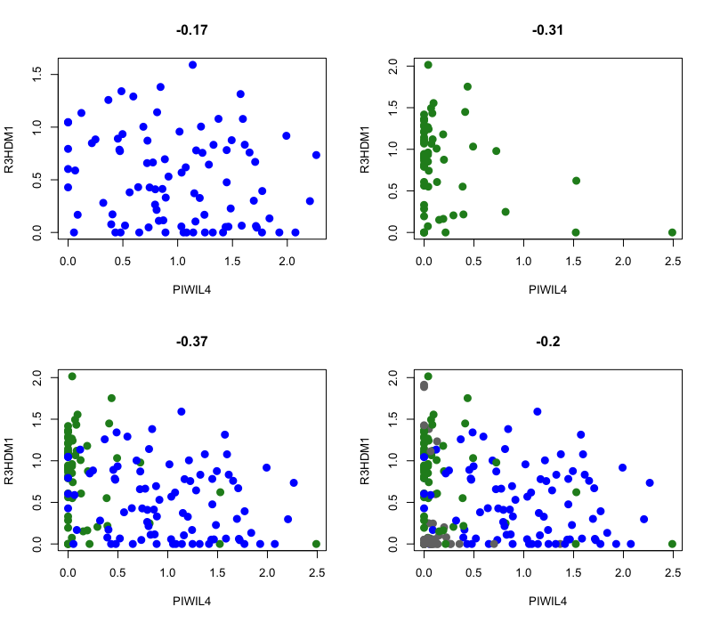
PIWIL4 (HIWI2) X R3HDM1
advanced
early
soma

Slide 14
L1HS correlations

Slide 15
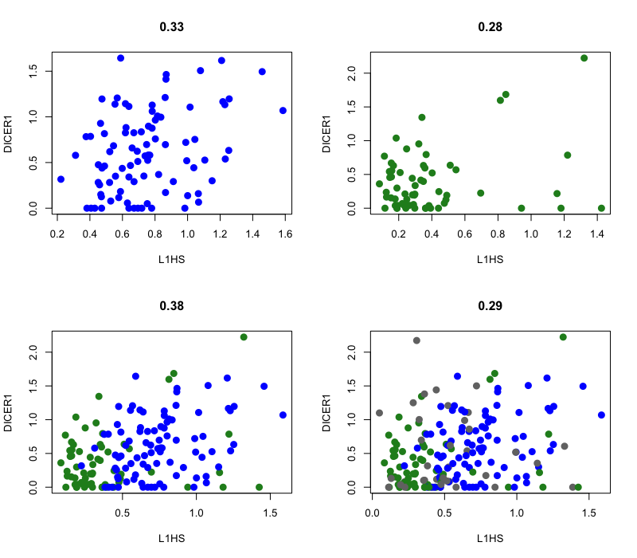
L1HS X DICER1
advanced
early
soma

Slide 16
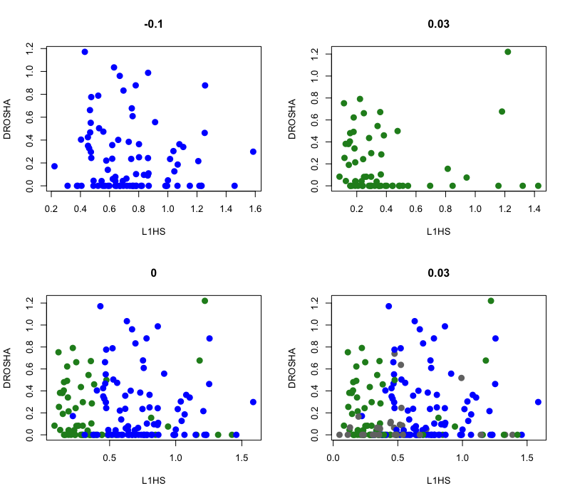
L1HS X DROSHA
advanced
early
soma

Slide 17
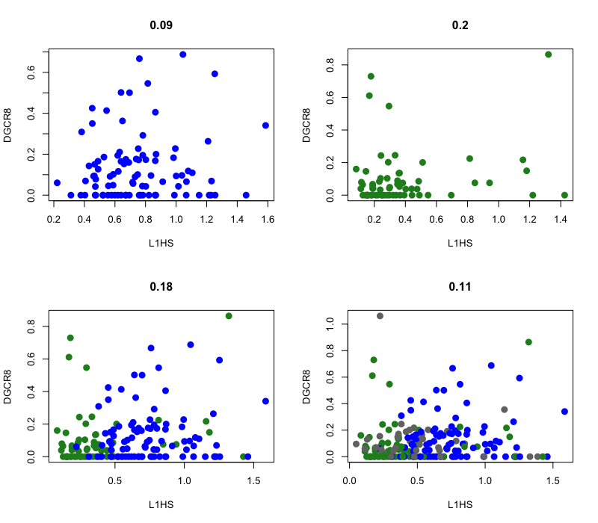
L1HS X DGCR8
advanced
early
soma

Slide 18
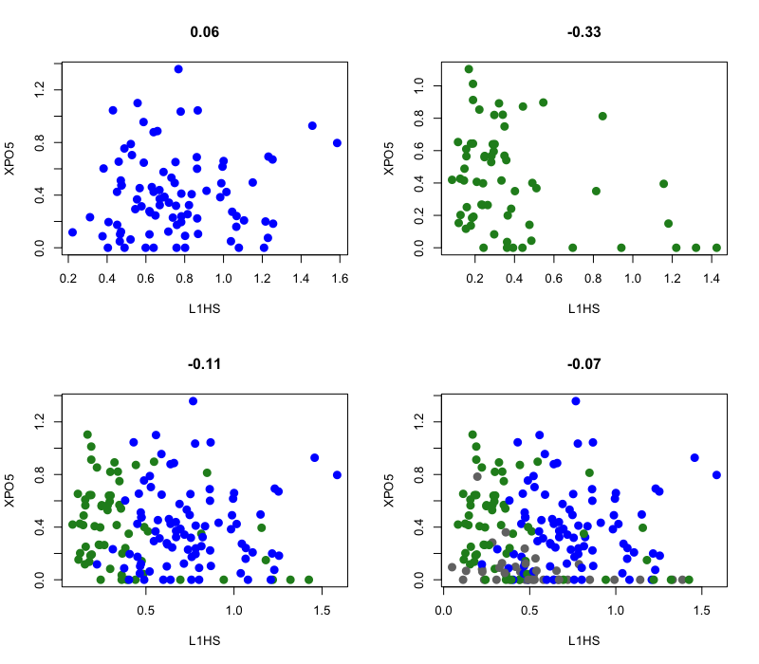
L1HS X XPO5
advanced
early
soma

Slide 19
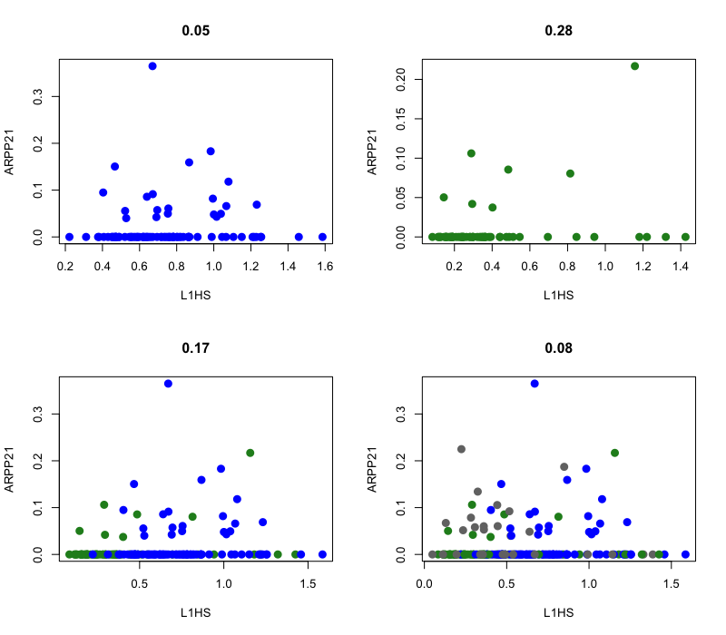
L1HS X ARPP21
advanced
early
soma

Slide 20
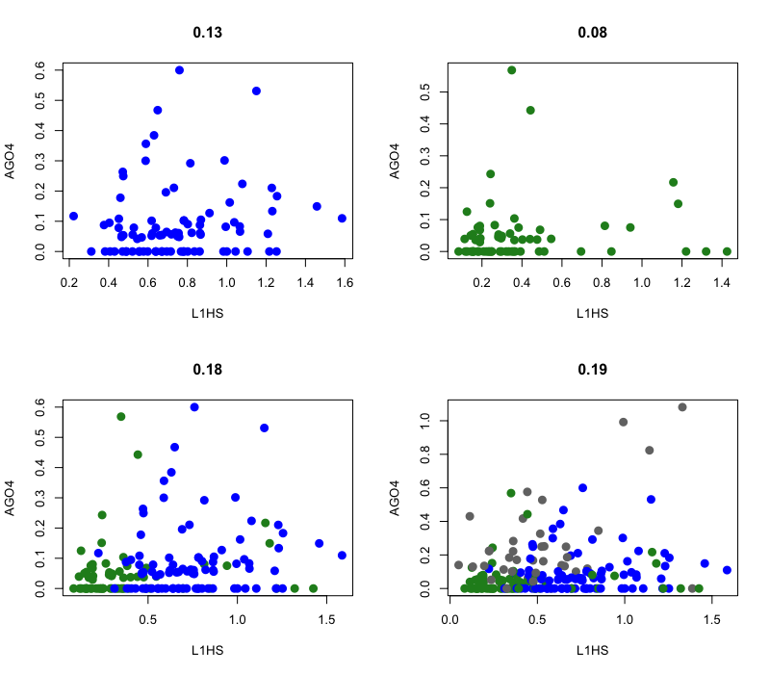
L1HS X AGO4
advanced
early
soma

Slide 21
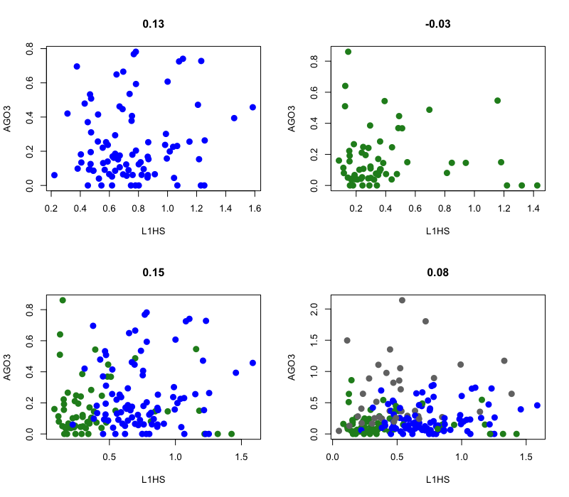
L1HS X AGO3
advanced
early
soma

Slide 22
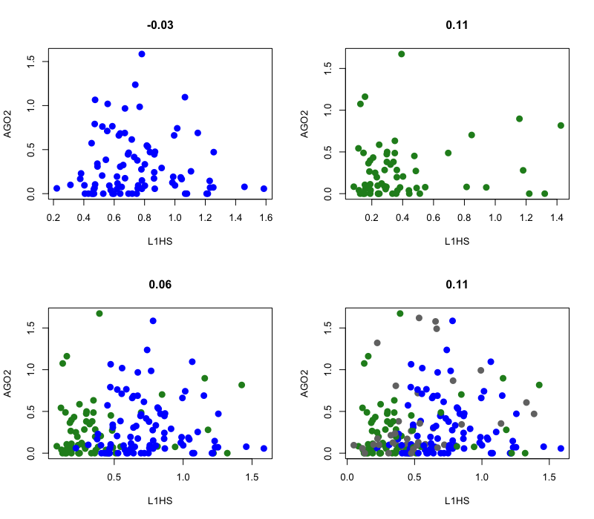
L1HS X AGO2
advanced
early
soma

Slide 23
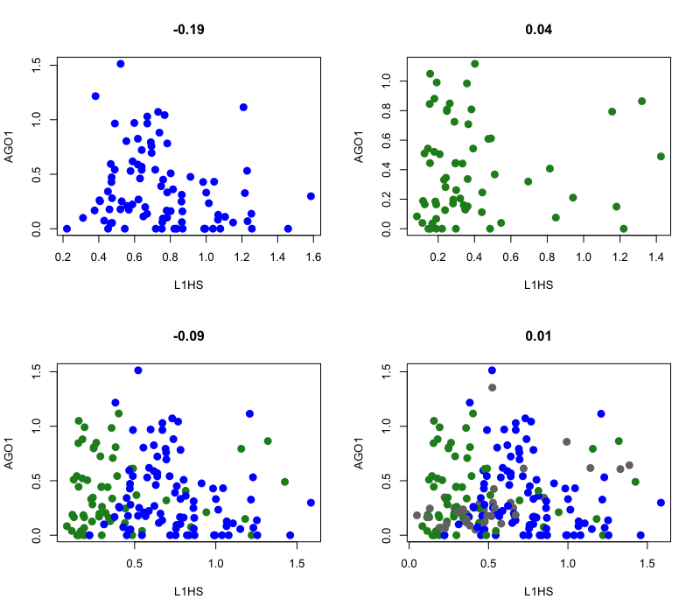
L1HS X AGO1
advanced
early
soma

Slide 24
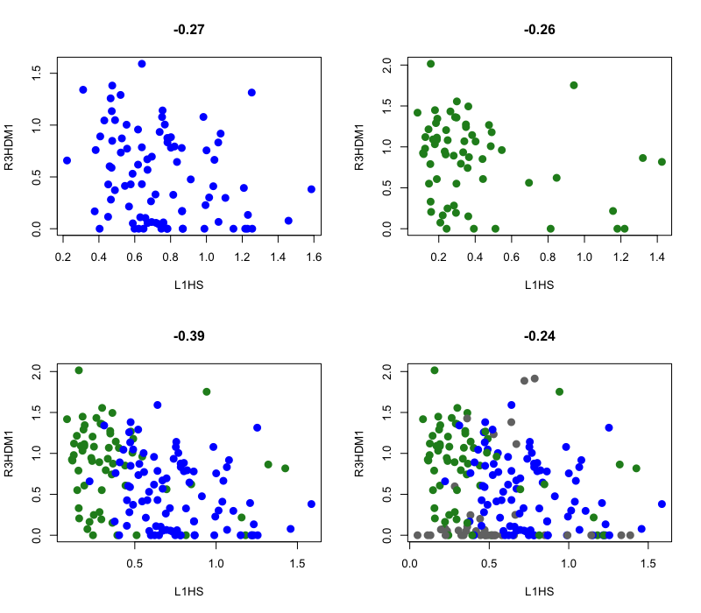
L1HS X R3HDM1
advanced
early
soma

