Slide 1
A
B
AGC
tSNE-2
PGC
Soma
C
tSNE-1
OCT4
VASA
MAEL
HSP90α
HILI
HIWI2
D
AGC
PGC
Soma
L1PA2
L1HS
L1PA3
AmnSINE2
AluYa5
HERV-Fc1_LTR1
MER91B
AluYb8
LTR81A
Transposons
L1PA2
L1HS
L1PA3
GC
OCT4
VASA
DAZL
NANOS2
AGC
PGC
AGC
PGC
AGC
PGC
Soma
Soma
Soma
HIWI
HILI
PIWIL3
HIWI2
MAEL
E
F
AGC
0.31
AGC
0.50
PGC
PGC
HSP90α
TDRD1
TDRD5
TDRD6
HILI
Soma
HIWI2
Soma
Transposon Repression Network
TDRD9
TDRD12
TDRKH
MORC1
L1HS
L1HS
PLD6
HENMT1
RNF17
G
-0.25
-0.09
Expression
-2
-1
1
0
2
Figure 3. Single cell sequencing reveals dramatic upregulation of L1 in advanced germ cells.
(A) Schematic of single cell RNA-seq analysis pipeline to interrogate week 19 male human germ cell sample for gene expression and repeat-ome expression. (B) tSNE clustering on transcriptome reference was used to generate three distinct cell populations. (C) Violin plots showing expression of germ cell markers and transposon repression genes in advanced germ cells (AGC) (blue), primordial germ cells (PGC) (green), and somatic cells (grey). (D) Heatmap displaying the most differentially expressed transposons sorted by myAUC score (top) and expression of germ cell markers and transposon repression pathway genes (below). Pairwise correlation analysis between L1HS and HILI (E), HIWI2 (F) and HSP90α (G) in the AGC, PGC, AGC + PGC, and total population. Pearson’s correlation coefficient scores are listed above each graph.
AGC
PGC
HSP90α
0.02
-0.08
AGC
AGC
PGC
PGC
Soma
L1HS
Notes:
Figure 3. Single cell human dataset reveals that L1 expression is dramatically upregulated in advanced germ cells.
Schematic of single cell RNA-seq analysis pipeline to interrogate week 19 male human germ cell sample for gene expression and repeatome expression.
tSNE clustering on transcriptome reference was used to generate three distinct cell populations.
Violin plots showing expression of germ cell markers and transposon repression genes in advanced germ cells (AGC) (yellow), primordial germ cells (PGC) (green), and somatic cells (magenta).
Heatmap displaying the most differentially expressed transposons sorted by myAUC score (top) and expression of germ cell markers and transposon repression pathway genes (below).
(Top) Pairwise correleation analysis between Hsp90a and L1HS in the AGC, PGC, AGC + PGC, and total population. Pearson’s (?) correlation coefficient score is listed above the graphs. (Bottom) ) Pairwise correleation analysis between PIWIL4 and L1HS in the AGC, PGC, AGC + PGC, and total population. Pearson’s (?) correlation coefficient score is listed above the graphs.
Figure outline
Show pipeline.
Show tsne
Show violin plots for oct4, vasa, MAEL, HIWI2, HILI, Hsp90a
Heatmap
Pairwise comparisions of L! vs Hsp90a, L1 vs HIwi2, and when we get it Line1 vs HILI

Slide 3
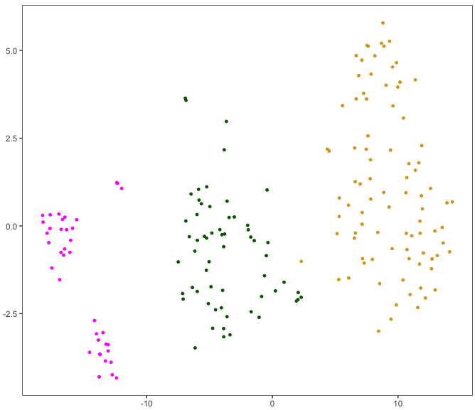
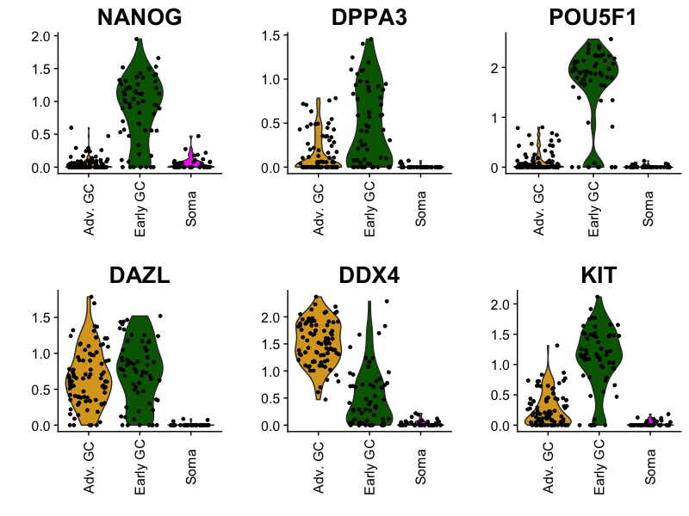
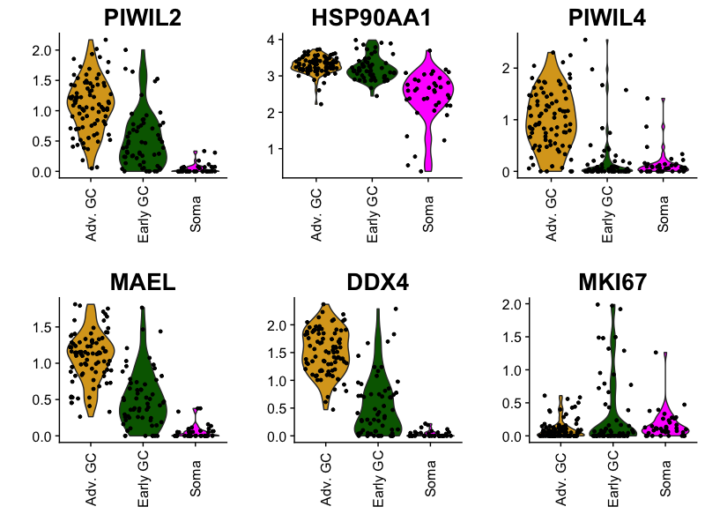
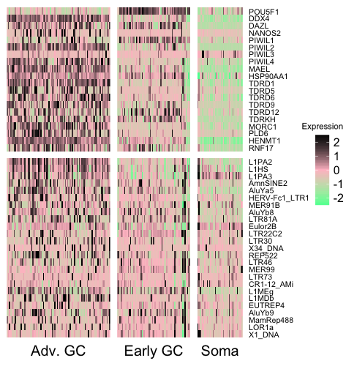
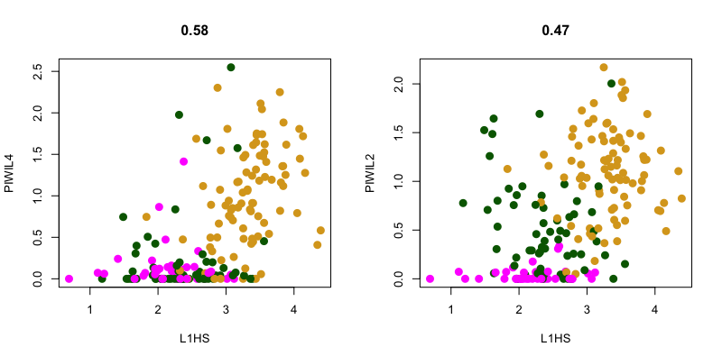
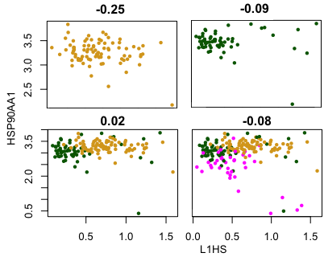
A
B
PGC
AGC
tSNE2
Soma
tSNE1
C
AGC
Soma
PGC
AGC
Soma
PGC
AGC
Soma
PGC
D
E
0.58
0.47
AGC
AGC
PGC
PGC
Transposons
HIWI2
Soma
HILI
Soma
F
AGC
PGC
AGC + PGC
All
AGC
PGC
Soma
Figure 3. Single cell human dataset reveals that L1 expression is dramatically upregulated in advanced germ cells.
(A) Schematic of single cell RNA-seq analysis pipeline to interrogate week 19 male human germ cell sample for gene expression and repeatome expression. (B) tSNE clustering on transcriptome reference was used to generate three distinct cell populations. (C) Violin plots showing expression of germ cell markers and transposon repression genes in advanced germ cells (AGC) (yellow), primordial germ cells (PGC) (green), and somatic cells (magenta). (D) Heatmap displaying the most differentially expressed transposons sorted by myAUC score (top) and expression of germ cell markers and transposon repression pathway genes (below). Pairwise correlation analysis between L1HS and HIWI2 (E) and HSP90AA (F) in the AGC, PGC, AGC + PGC, and total population. Pearson’s correlation coefficient score is listed above the graphs. Pairwise correlation analysis between PIWIL4 and L1HS in the AGC, PGC, AGC + PGC, and total population. Pearson’s (?) correlation coefficient score is listed above the graphs.
Notes:
Figure 3. Single cell human dataset reveals that L1 expression is dramatically upregulated in advanced germ cells.
Schematic of single cell RNA-seq analysis pipeline to interrogate week 19 male human germ cell sample for gene expression and repeatome expression.
tSNE clustering on transcriptome reference was used to generate three distinct cell populations.
Violin plots showing expression of germ cell markers and transposon repression genes in advanced germ cells (AGC) (yellow), primordial germ cells (PGC) (green), and somatic cells (magenta).
Heatmap displaying the most differentially expressed transposons sorted by myAUC score (top) and expression of germ cell markers and transposon repression pathway genes (below).
(Top) Pairwise correleation analysis between Hsp90a and L1HS in the AGC, PGC, AGC + PGC, and total population. Pearson’s (?) correlation coefficient score is listed above the graphs. (Bottom) ) Pairwise correleation analysis between PIWIL4 and L1HS in the AGC, PGC, AGC + PGC, and total population. Pearson’s (?) correlation coefficient score is listed above the graphs.
Figure outline
Show pipeline.
Show tsne
Show violin plots for oct4, vasa, MAEL, HIWI2, HILI, Hsp90a
Heatmap
Pairwise comparisions of L! vs Hsp90a, L1 vs HIwi2, and when we get it Line1 vs HILI

Slide 5
extras

Slide 6
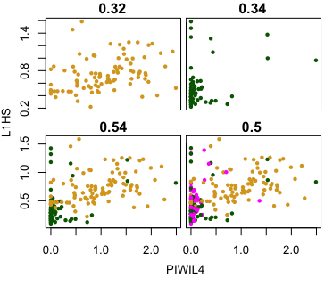
A
B
PGC
AGC
tSNE2
Soma
tSNE1
C
AGC
Soma
PGC
AGC
Soma
PGC
AGC
Soma
PGC
D
E
Transposons
AGC
PGC
AGC + PGC
All
AGC
PGC
AGC
PGC
Soma
AGC + PGC
All
Notes:
Figure 3. Single cell human dataset reveals that L1 expression is dramatically upregulated in advanced germ cells.
Schematic of single cell RNA-seq analysis pipeline to interrogate week 19 male human germ cell sample for gene expression and repeatome expression.
tSNE clustering on transcriptome reference was used to generate three distinct cell populations.
Violin plots showing expression of germ cell markers and transposon repression genes in advanced germ cells (AGC) (yellow), primordial germ cells (PGC) (green), and somatic cells (magenta).
Heatmap displaying the most differentially expressed transposons sorted by myAUC score (top) and expression of germ cell markers and transposon repression pathway genes (below).
(Top) Pairwise correleation analysis between Hsp90a and L1HS in the AGC, PGC, AGC + PGC, and total population. Pearson’s (?) correlation coefficient score is listed above the graphs. (Bottom) ) Pairwise correleation analysis between PIWIL4 and L1HS in the AGC, PGC, AGC + PGC, and total population. Pearson’s (?) correlation coefficient score is listed above the graphs.
Figure outline
Show pipeline.
Show tsne
Show violin plots for oct4, vasa, MAEL, HIWI2, HILI, Hsp90a
Heatmap
Pairwise comparisions of L! vs Hsp90a, L1 vs HIwi2, and when we get it Line1 vs HILI

Slide 9
piRNA Pathway Genes

Slide 10
Transposons
GCs
Transposon Repression Network

Slide 11
identify real cells
UMI-Tools
adapter-trimmed reads
assess overall read quality
FastQC v0.11.2
real cell whitelist
fastqc report
file
extract cell ID / UMI information and append to read name
UMI-Tools
action
program
reads with cell ID / UMI appended to name
result
quality trim reads to Q10
BBDuk
Multimappers
Maintained
quality trimmed reads with cell ID / UMI appended to read name
Multimappers
Discarded
align reads to repeatome reference
star/2.5.3a
align reads to transcriptome reference
star/2.5.3a
reads aligned to repeatome reference
reads aligned to transcriptome reference
assign aligned reads to specific repeat element
subread-1.6.0
assign aligned reads to specific gene
subread-1.6.0
assigned repeat elements
assigned genes
count unique reads per repeat element per cell
UMI-Tools
count unique reads per gene per cell
UMI-Tools
repeat element by cell matrix
gene by cell matrix
concatenate repeat element and gene cell matrices
repeat element & gene by cell matrix

Slide 12
identify real cells
UMI-Tools
adapter-trimmed reads
file
action
program
real cell whitelist
result
extract cell ID / UMI information and append to read name
UMI-Tools
quality trim reads to Q10
BBDuk
Multimappers
Maintained
Multimappers
Discarded
align reads to repeatome reference
star/2.5.3a
align reads to transcriptome reference
star/2.5.3a
assign aligned reads to specific repeat element
subread-1.6.0
assign aligned reads to specific gene
subread-1.6.0
count unique reads per repeat element per cell
UMI-Tools
count unique reads per gene per cell
UMI-Tools
repeat element by cell matrix
gene by cell matrix
concatenate repeat element
and gene cell matrices
repeat element & gene by cell matrix

