Slide 1
Week 19 hFGC Analysis
Transcriptome ONLY so far!
Am still working on realigning the Transposonome with the newly minted Transposonome RefGenome (sans simple repeats)

Slide 2
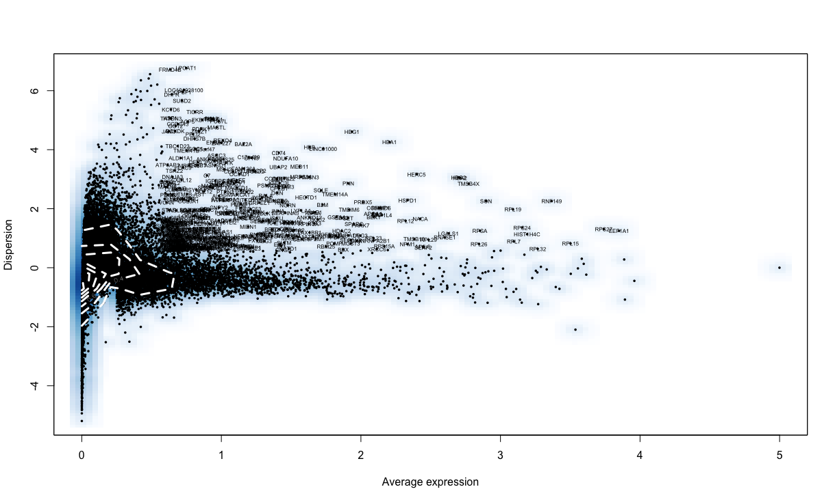
Differentially expressed genes across all w19 cells

Slide 3
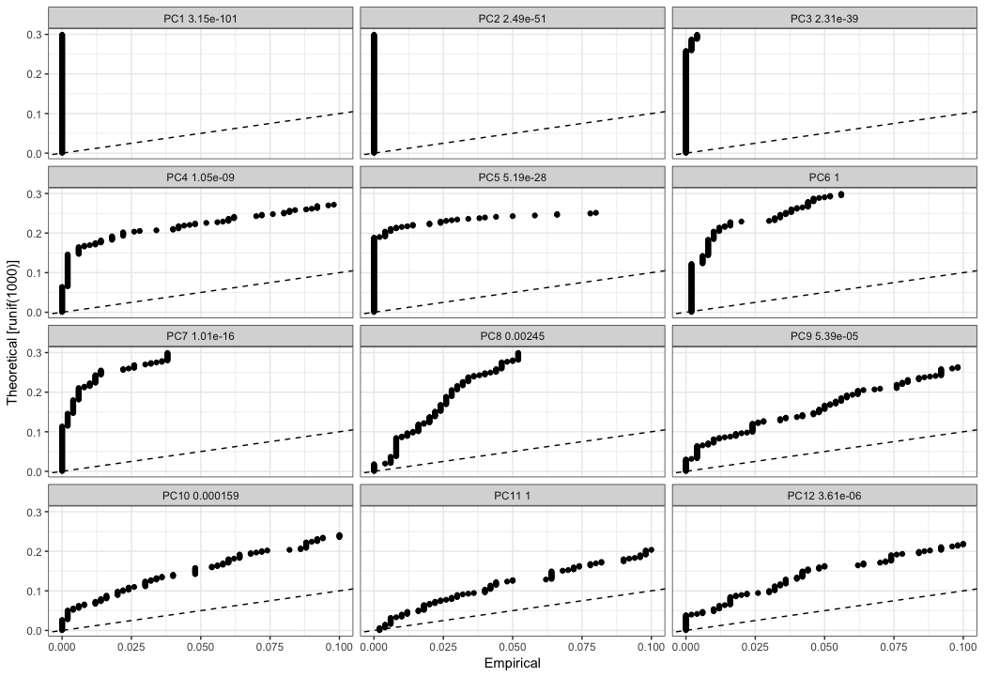
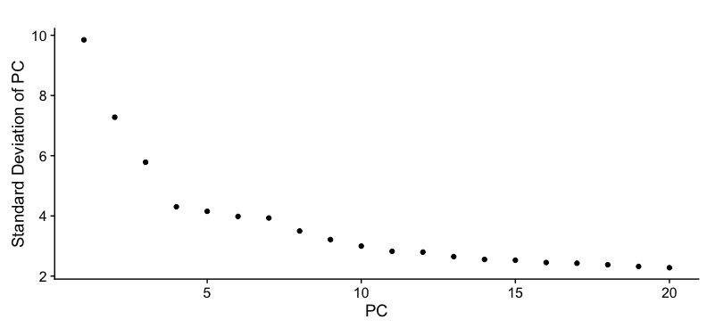
Jackstraw Analysis showing PC 1 through 10 are Significant
Elbow Plot showing decent “elbow” angle at PC 7-10

Slide 4
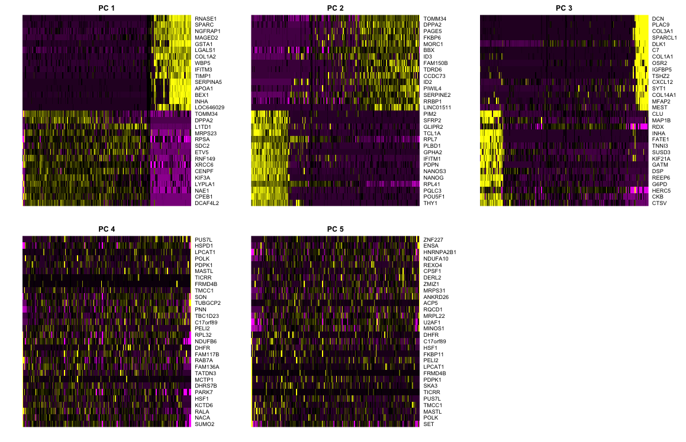
Top 10 Genes for PC 1-5

Slide 5
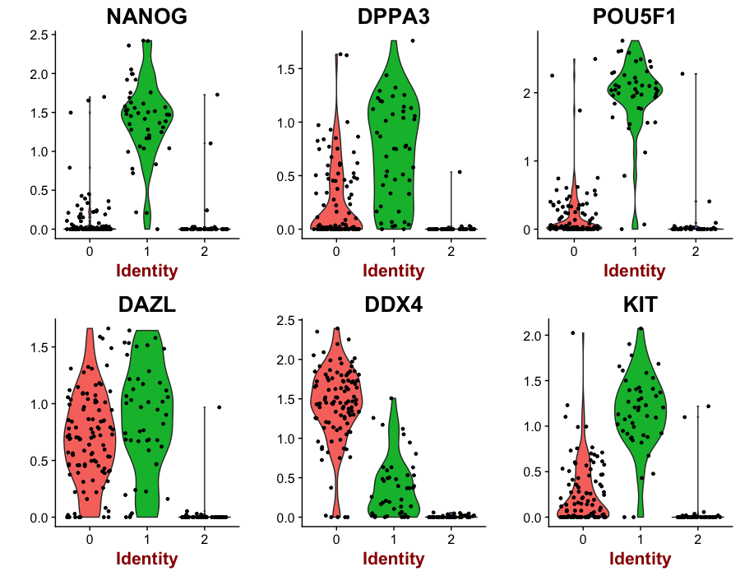
Expression of several GC makers
# cells:
Cluster 0 = 105
Cluster 1 = 46
Cluster 2 = 44

Slide 6
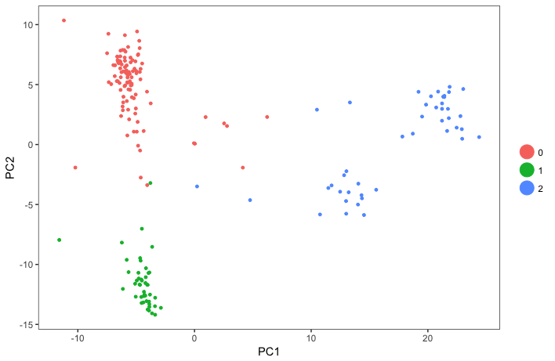
PC1 vs PC2 with Cluster ID 0 through 2
# cells:
Cluster 0 = 105
Cluster 1 = 46
Cluster 2 = 44

Slide 7
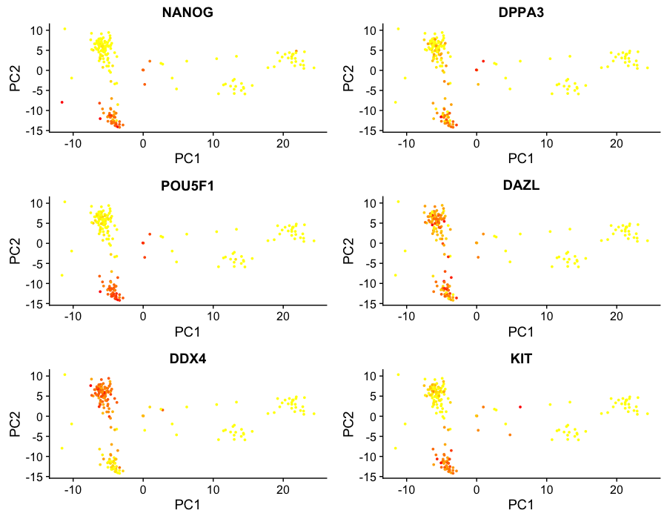
PC1 vs PC2 with Cluster ID 0 through 2, with expression of GC markers where yellow is low and orange is high
# cells:
Cluster 0 = 105
Cluster 1 = 46
Cluster 2 = 44

Slide 8
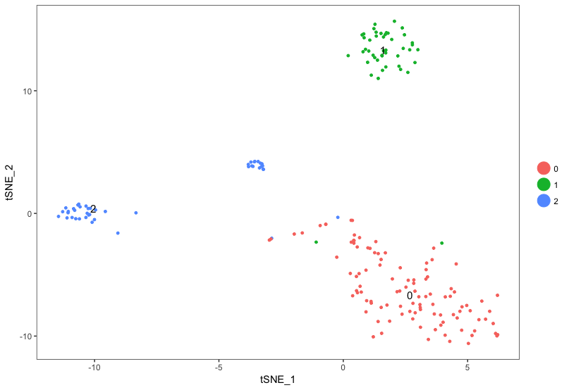
tSNE plot with Cluster ID 0 through 2
# cells:
Cluster 0 = 105
Cluster 1 = 46
Cluster 2 = 44

Slide 9
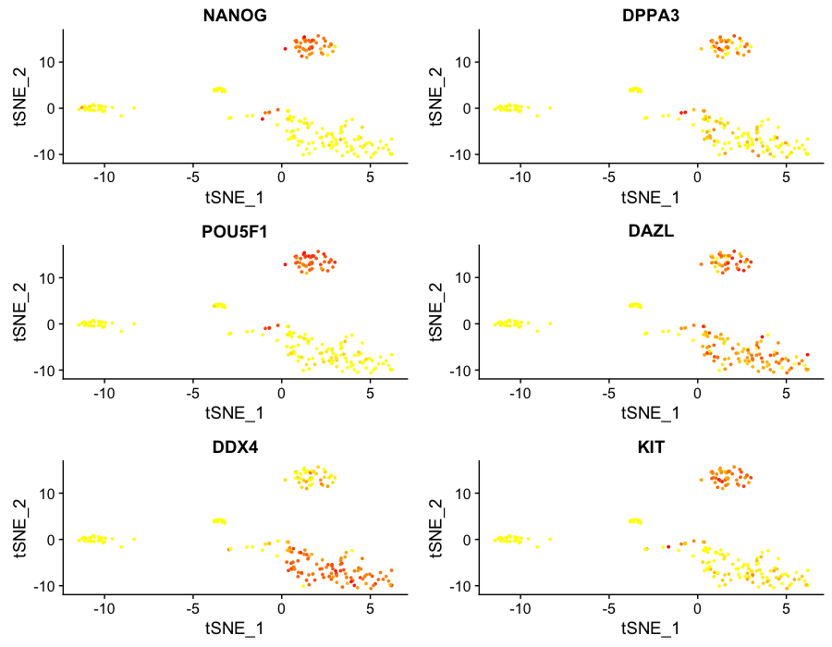
tSNE plot with Cluster ID 0 through 2, with expression of GC markers where yellow is low and orange is high
# cells:
Cluster 0 = 105
Cluster 1 = 46
Cluster 2 = 44

Slide 10
Conclusions: Clusters 0 and 1 are Germ Cells
: Cluster 1 is “less advanced” hFGC population
: Cluster 0 is “more advanced” hFGC population
: Cluster 2 is a somatic cell population (TBD)

Slide 11
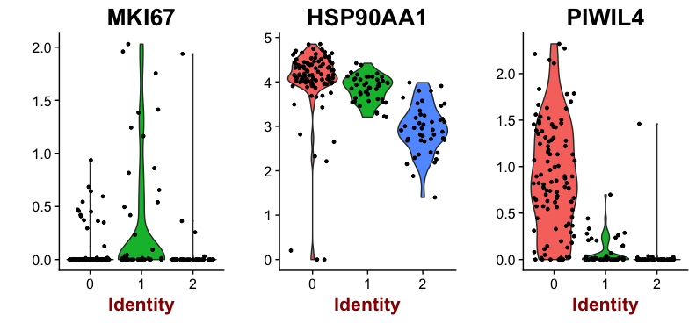
Violin plots of expression of several genes of interest
# cells:
Cluster 0 = GC, 105
Cluster 1 = GC, 46
Cluster 2 = Soma, 44

Slide 12
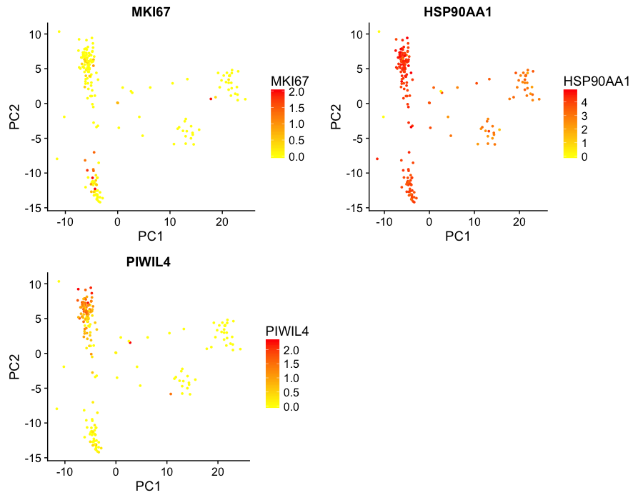
PC1 vs PC2 with Cluster ID 0 through 2, with expression of genes of interest where yellow is low and orange is high
# cells:
Cluster 0 = GC, 105
Cluster 1 = GC, 46
Cluster 2 = Soma, 44

Slide 13
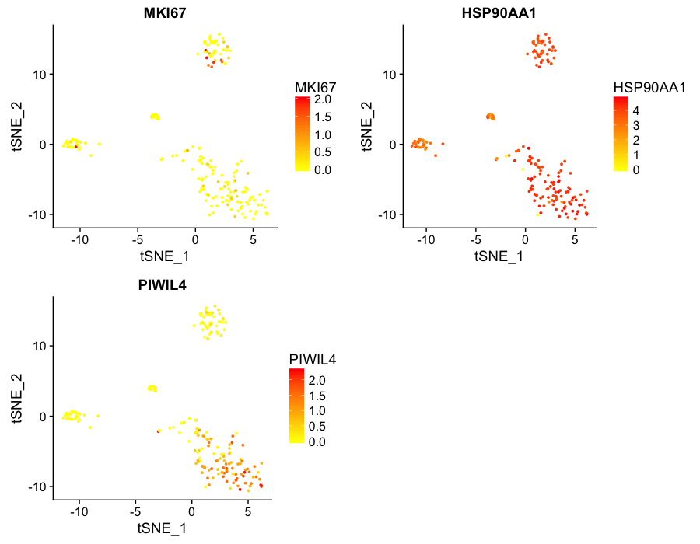
tSNE plot with Cluster ID 0 through 2, with expression of genes of interest where yellow is low and orange/red is high
# cells:
Cluster 0 = GC, 105
Cluster 1 = GC, 46
Cluster 2 = Soma, 44

