Slide 1
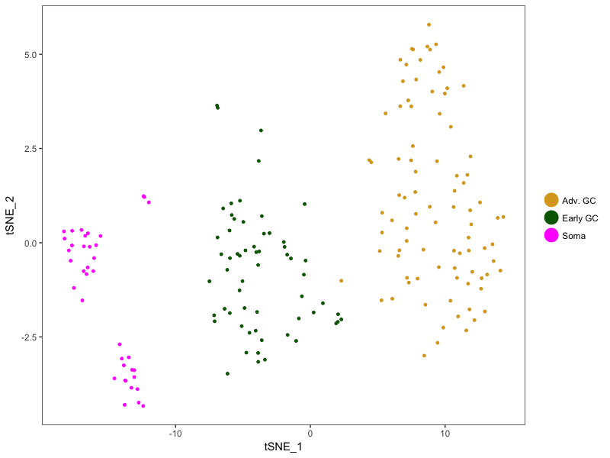
tSNE for Cluster ID 0 through 2 at W19
# cells:
Cluster Adv = 88
Cluster Early = 60
Cluster Soma = 39

Slide 2
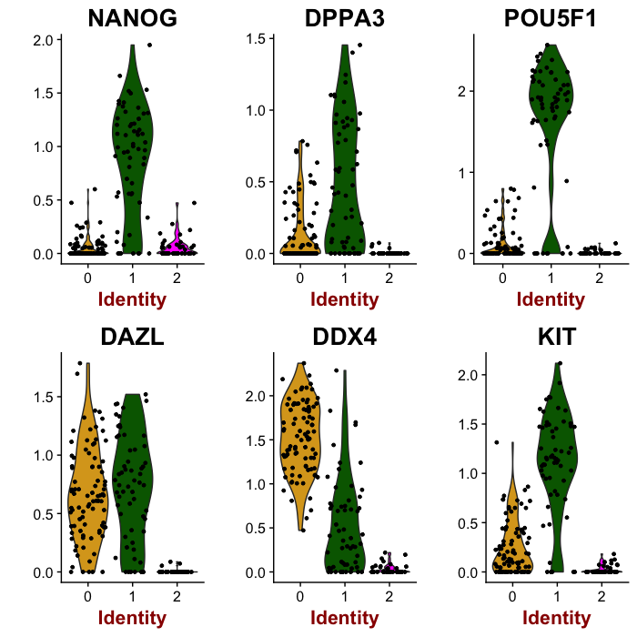
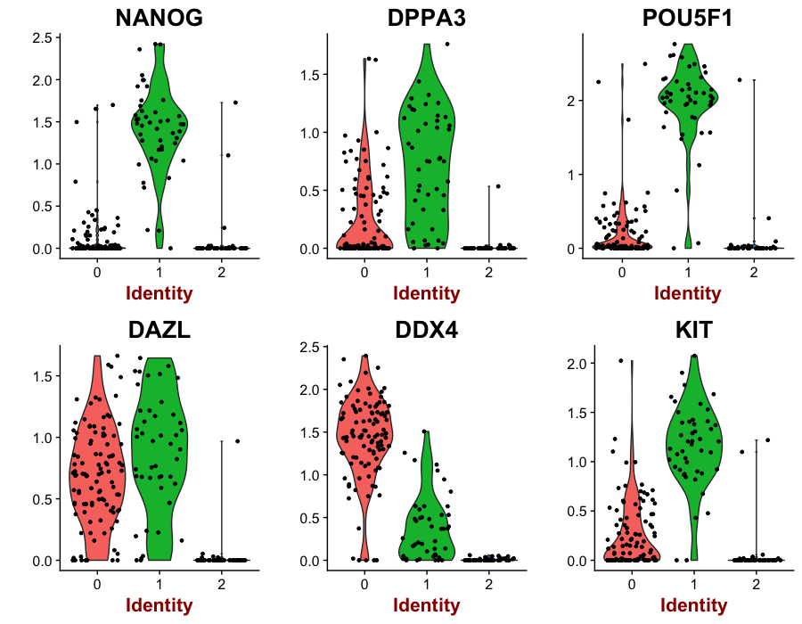
Expression of several GC makers
Laird Alignment
LiLi Alignment

Slide 3
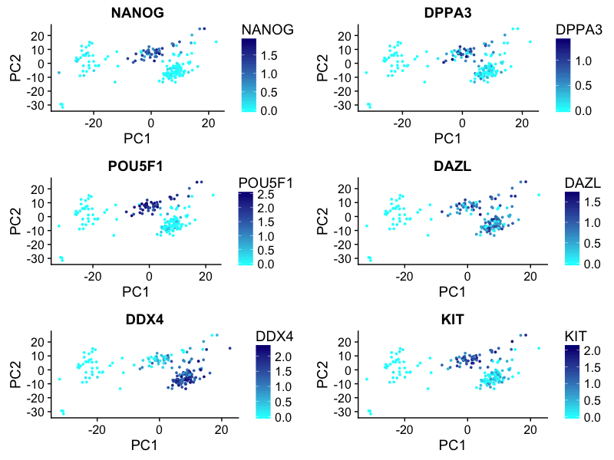
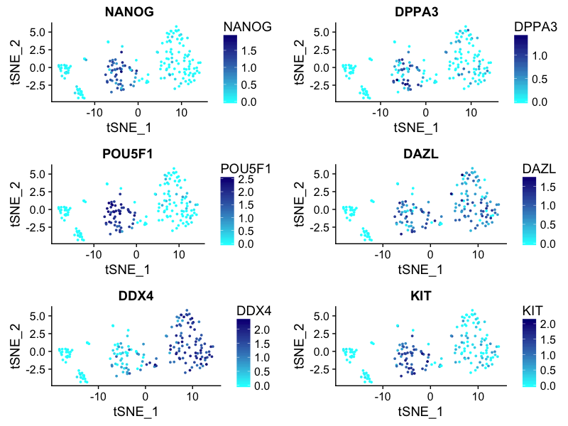
Expression of several GC makers
PCA space
tSNE space

Slide 4
Expression of several GC makers
PCA space
tSNE space
VASA^{neg} OCT4^{neg} germ cells?

Slide 5
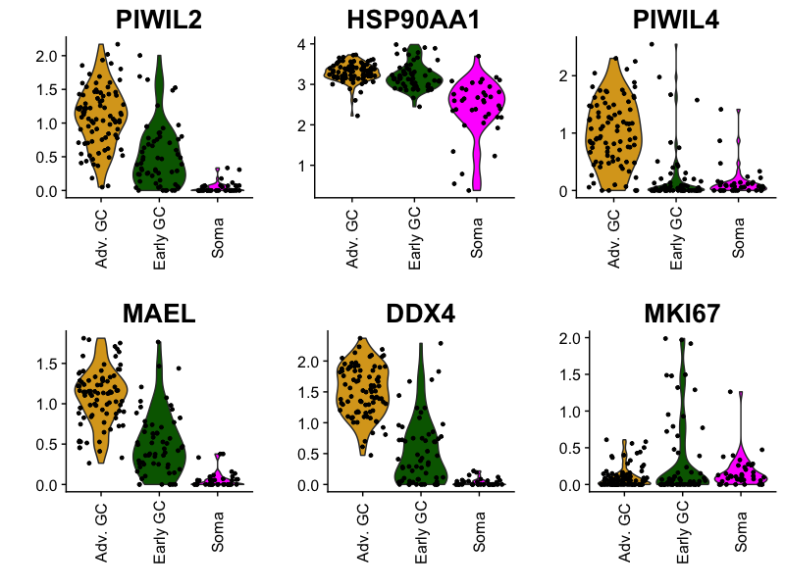
piRNA Pathway Genes

Slide 6
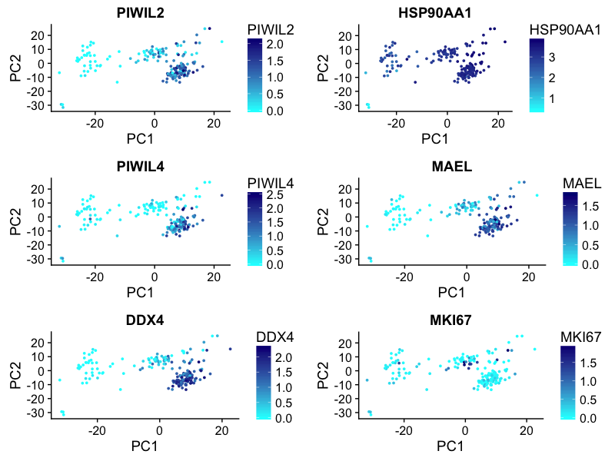
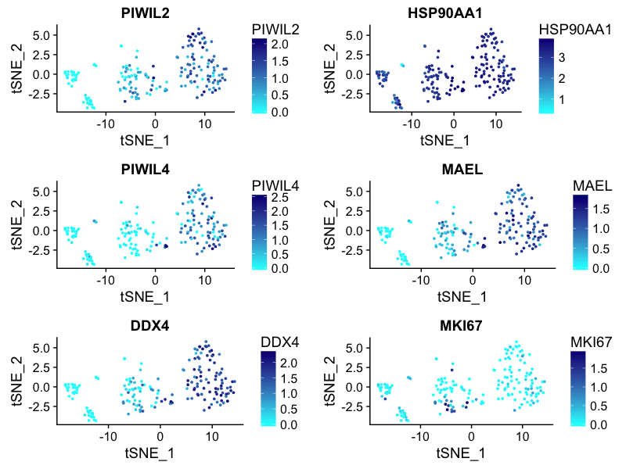
piRNA Pathway Genes
PCA space
tSNE space

Slide 7
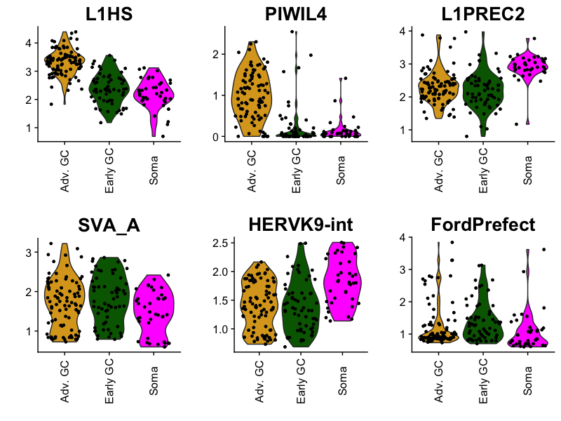
L1HS, PIWIL4, L1PREC2, SVA_A, HERVK9-int, FordPrefect

Slide 8
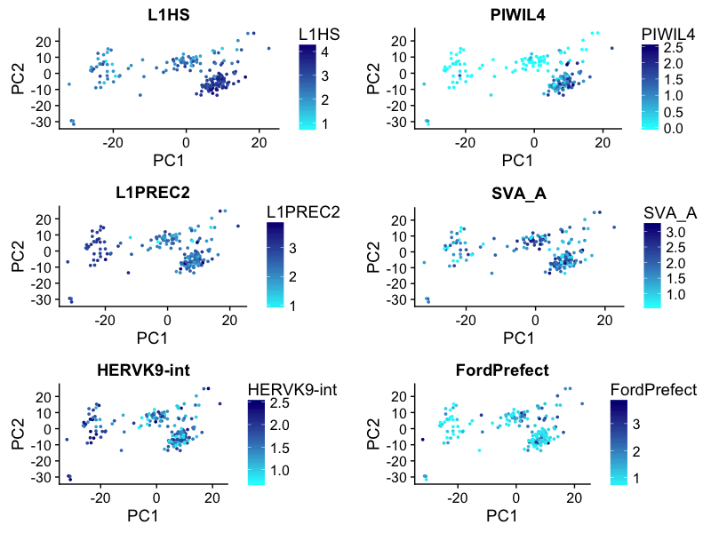
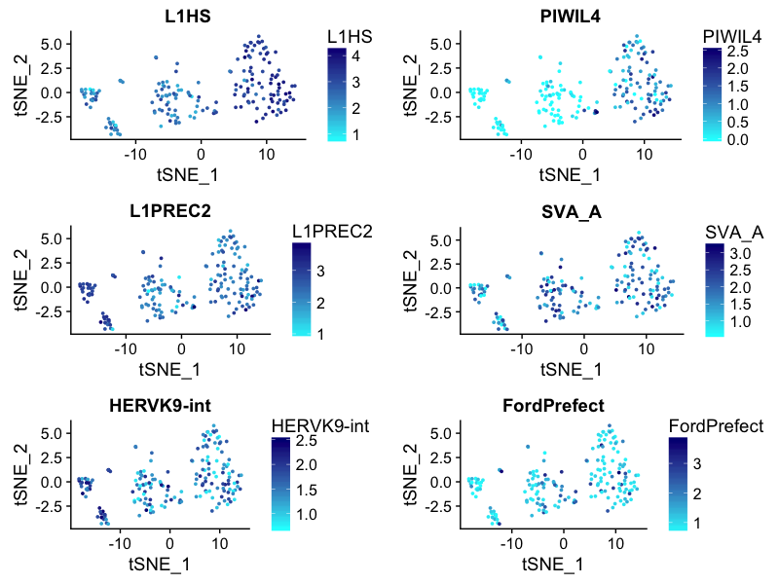
L1HS, PIWIL4, L1PREC2, SVA_A, HERVK9-int, FordPrefect
PCA space
tSNE space
VASA^{neg} OCT4^{neg} germ cells

Slide 9
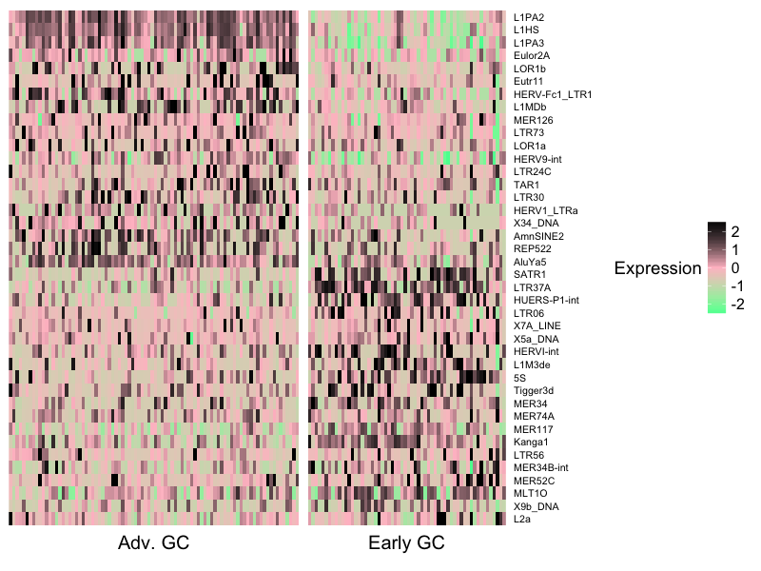
heatmap depicting the top 20 repeat element (after excluding all the tRNA because they were potentially boring) markers of the two GC clusters

