Slide 1
Math 530/630: CM 5.4 ANOVA: 2- and 3-way

Slide 2


Let’s add a second predictor!
Notes:
Talk about sticker data.

Slide 3



Slide 4
Being sticker rich
Children (ages 3–11) received a small (12, “sticker poor”) or large (30, “sticker rich”) number of stickers, and were then given the opportunity to share their windfall with either one or multiple anonymous recipients (Dictator Game).
Do the number of available resources and/or the number of potential recipients alter the likelihood of a child donating and/or the amount they donate?

Slide 5
Approach
“Givers” only analyzed
“A univariate [read: one response/outcome variable] ANOVA was conducted investigating the impact of the between-subjects factors [read: all levels of factors are measured from independent samples] of age (4: 3–4 years, 5–6 years, 7–8 years, 9–11 years), number of resources (2: 12 or 30 stickers), number of recipients (2: 1 or 2 anonymous recipients), and gender (2: female, male) on the proportion of resources shared.”

Slide 6
Adding a covariate
Past: one-way ANOVA
Now: analysis of covariance (ANCOVA)
Variables as covariates are typically added (+), and their effects are assumed to be additive
No interaction term (meaning we are not allowing for estimated non-parallel lines)
If we include another variable in our model, say 1 vs. 2 recipients, then our estimate of the effect of age group is interpreted holding the value of the covariate fixed.
Just like in multiple regression.
Notes:
ANCOVA – accounting for the effect of…
Not necessarily of interest, but we expect it has an effect
Just say ANCOVA to mean we don’t really care about that variable
Functionally equivalent to an ANOVA – mathematically equivalent

Slide 7
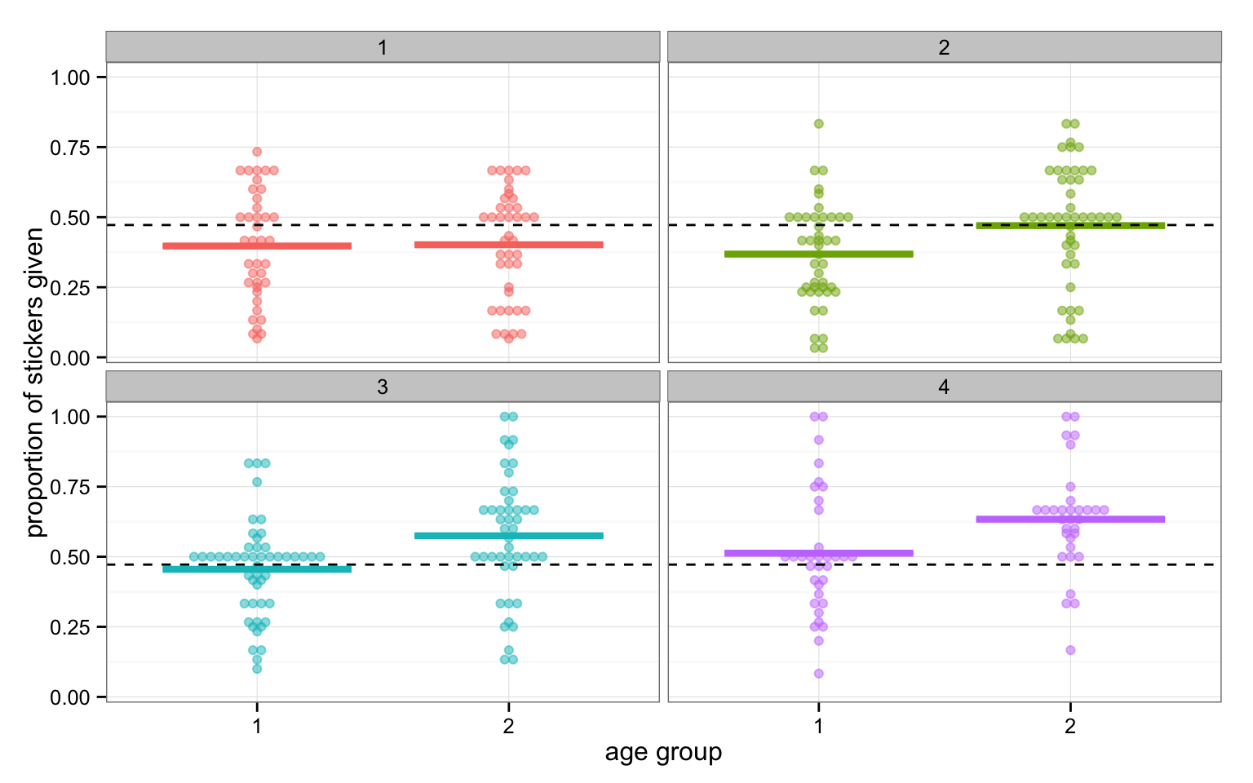
Notes:
Adding number of recipients (envelopes)
Appears different – maybe increasing with age

Slide 8
ggplot code for previous plot
ggplot(givers, aes(x = factor(num_env), y = prop_given, fill = age_group, colour = age_group)) +
geom_dotplot(stackdir = "center", binaxis = "y",
binwidth = .01, binpositions = "all", stackratio = 1, dotsize = 3, alpha = .5) +
stat_summary(fun.y = mean, fun.ymin = mean,
fun.ymax = mean, geom = "crossbar", width = 0.75, lwd = .75) +
scale_x_discrete(name = "age group") +
scale_y_continuous(name = "proportion of stickers given") +
geom_hline(yintercept = mean(givers$prop_given), lty = "dashed") +
theme_bw() +
theme(legend.position = "none") +
facet_wrap(~ age_group)

Slide 9
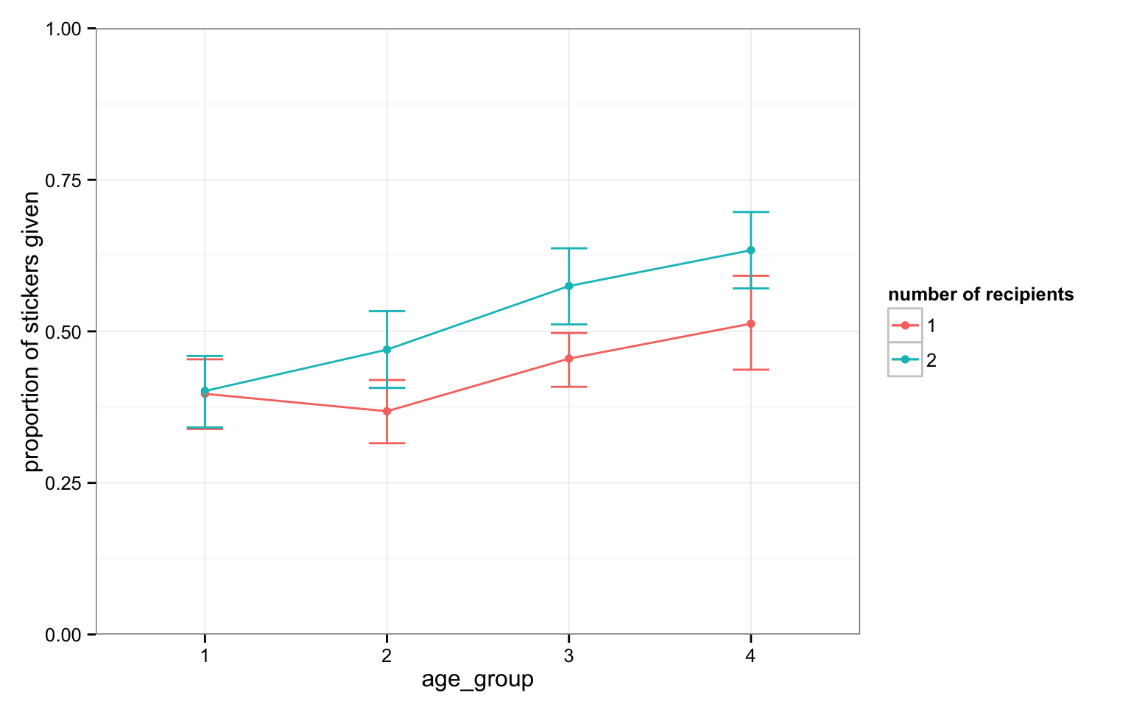
These are the “unadjusted” means plus 95% confidence intervals: in ANCOVA, you’ll also want to plot means adjusted for other factors in the model (aka, predicted marginal means or least squares means) and their standard errors (so error bars will be shorter!)
Notes:
Raw means!

Slide 10
ggplot code for previous plot
ggplot(givers, aes(x = age_group, y = prop_given, colour = num_env)) +
stat_summary(fun.y = mean, geom = "point") +
stat_summary(fun.y = mean, geom = "line", aes(group = num_env)) +
stat_summary(fun.data = mean_cl_boot, geom = "errorbar", width = 0.2) +
labs(x = "age_group",
y = "proportion of stickers given",
colour = "number of recipients") +
theme_bw() +
coord_cartesian(ylim = c(0, 1))

Slide 11
ANCOVA in R
anova(lm(prop_given ~ age_group + num_env, data = givers))
Analysis of Variance Table
Response: prop_given
Df Sum Sq Mean Sq F value Pr(>F)
age_group 3 1.5111 0.50370 12.575 0.00000008525 ***
num_env 1 0.5940 0.59399 14.829 0.000142 ***
Residuals 323 12.9383 0.04006
---
Signif. codes: 0 ‘***’ 0.001 ‘**’ 0.01 ‘*’ 0.05 ‘.’ 0.1 ‘ ’ 1
Don’t try this one at home…
Notes:
NO interaction! Naïve implementation.

Slide 12
ANCOVA in R
order
matters
anova(lm(prop_given ~ age_group + num_env, data = givers))
Analysis of Variance Table
Response: prop_given
Df Sum Sq Mean Sq F value Pr(>F)
age_group 3 1.5111 0.50370 12.575 0.00000008525 ***
num_env 1 0.5940 0.59399 14.829 0.000142 ***
Residuals 323 12.9383 0.04006
---
Signif. codes: 0 ‘***’ 0.001 ‘**’ 0.01 ‘*’ 0.05 ‘.’ 0.1 ‘ ’ 1
# eep order changes coefficient estimates!
anova(lm(prop_given ~ num_env + age_group, data = givers))
Analysis of Variance Table
Response: prop_given
Df Sum Sq Mean Sq F value Pr(>F)
num_env 1 0.5451 0.54510 13.608 0.0002642 ***
age_group 3 1.5600 0.52000 12.982 0.00000005007 ***
Residuals 323 12.9383 0.04006
---
Signif. codes: 0 ‘***’ 0.001 ‘**’ 0.01 ‘*’ 0.05 ‘.’ 0.1 ‘ ’ 1
!
Don’t try this one at home…
Notes:
Dang!! They don’t match. This isn’t what we want! Why is this happening?!

Slide 13
What is happening here?
Remember, the anova()command as we used it before was used to compare two nested models. The null hypothesis was that the more complicated model was not better than the less complicated model…
lm_age <- lm(prop_given ~ age_group, data = givers)
lm_age_env <- lm(prop_given ~ age_group + num_env, data = givers)
anova(lm_age, lm_age_env)
Analysis of Variance Table
Model 1: prop_given ~ age_group
Model 2: prop_given ~ age_group + num_env
Res.Df RSS Df Sum of Sq F Pr(>F)
1 324 13.532
2 323 12.938 1 0.59399 14.829 0.000142 ***
---
Signif. codes: 0 ‘***’ 0.001 ‘**’ 0.01 ‘*’ 0.05 ‘.’ 0.1 ‘ ’ 1
This is exactly what we got with num_env second!
Notes:
Comparing the two models!
Instead of specified model vs null (Intercept only) model, now it’s age_group +num_env vs age_group
That is, How much “better” is the model with envelopes added?

Slide 14
Wait, did lm() do this awful thing to us?
lm(prop_given ~ num_env + age_group, data = givers)
Call:
lm(formula = prop_given ~ num_env + age_group, data = givers)
Coefficients:
(Intercept) num_env2 age_group1 age_group2 age_group3
0.43472 0.08515 -0.07899 -0.05790 0.03841
Recall – the intercept represent the unspecified group
Call:
lm(formula = prop_given ~ age_group + num_env, data = givers)
Coefficients:
(Intercept) age_group1 age_group2 age_group3 num_env2
0.43472 -0.07899 -0.05790 0.03841 0.08515
Nope! Isn’t that special?
Notes:
NO – it was ANOVA.
Intercept represents the un-specified groups (num_env=1, age_group=4)

Slide 15
Types of sums of squares
Don’t bring this up on stack overflow ☺
Type 1: sequential (order matters) [this is the default in R!]
This is rarely what you will be interested in if you are not doing a nested models comparison intentionally
Type II:
This type tests for each main effect after the other main effect.
Note that no significant interaction is assumed (in other words, you should test for interaction first) and only if AB is not significant, continue with the analysis for main effects).
Type III:
This type tests for the presence of a main effect after the other main effect and interaction.
However, it is often not interesting to interpret a main effect if interactions are present (generally speaking, if a significant interaction is present, the main effects should not be further analysed).
If the interactions are not significant, type II gives a more powerful test.
Notes:
Computing the SS – where oh where do I put my variance?
SPSS and SAS default to Type III (which some dislike)
Doesn’t come up in one-way (orthogonal), because there’s only one way to “bin” the SS
SAS defined the Type terms, and they just stuck

Slide 16
ANCOVA in R the better way
order
does not
# library(car)
sticker_mod <- lm(prop_given ~ age_group + num_env, data = givers,
+ contrasts = list(age_group = contr.sum,
+ num_env = contr.sum))
Anova(sticker_mod, type = 2)
Anova Table (Type II tests)
Response: prop_given
Sum Sq Df F value Pr(>F)
age_group 1.560 3 12.982 0.00000005007 ***
num_env 0.594 1 14.829 0.000142 ***
Residuals 12.938 323
---
Signif. codes: 0 ‘***’ 0.001 ‘**’ 0.01 ‘*’ 0.05 ‘.’ 0.1 ‘ ’ 1
matter
!
This is the one!! You can also try type = 3 (but…)
Notes:
Package “car”=companion to applied regression
Contrasts = contrast coding for unordered factors ( using a “sum to 0” )
for ordered factors, use contr.poly
Capital A! Anova

Slide 17
ANCOVA in R the better way
sticker_ancova <- lm(prop_given ~ age_group + num_env, data = givers, contrasts = list(age_group = contr.sum, num_env = contr.sum))
summary(sticker_ancova)
Call:
lm(formula = prop_given ~ age_group + num_env, data = givers,
contrasts = list(age_group = contr.sum, num_env = contr.sum))
Residuals:
Min 1Q Median 3Q Max
-0.45169 -0.12351 0.02687 0.12317 0.46679
Coefficients:
Estimate Std. Error t value Pr(>|t|)
(Intercept) 0.47730 0.01116 42.768 < 0.0000000000000002 ***
age_group1 -0.07899 0.01936 -4.079 0.0000569 ***
age_group2 -0.05790 0.01864 -3.107 0.002058 **
age_group3 0.03841 0.01844 2.083 0.038061 *
num_env1 -0.04258 0.01106 -3.851 0.000142 ***
---
Signif. codes: 0 ‘***’ 0.001 ‘**’ 0.01 ‘*’ 0.05 ‘.’ 0.1 ‘ ’ 1
Residual standard error: 0.2001 on 323 degrees of freedom
Multiple R-squared: 0.1399, Adjusted R-squared: 0.1293
F-statistic: 13.14 on 4 and 323 DF, p-value: 0.0000000006306
Notes:
Contrast Coding! Versus the grand mean!
Coefficient calculation on right: Mean(age_group4) = B0- (B1 + B2 + B3)

Slide 18
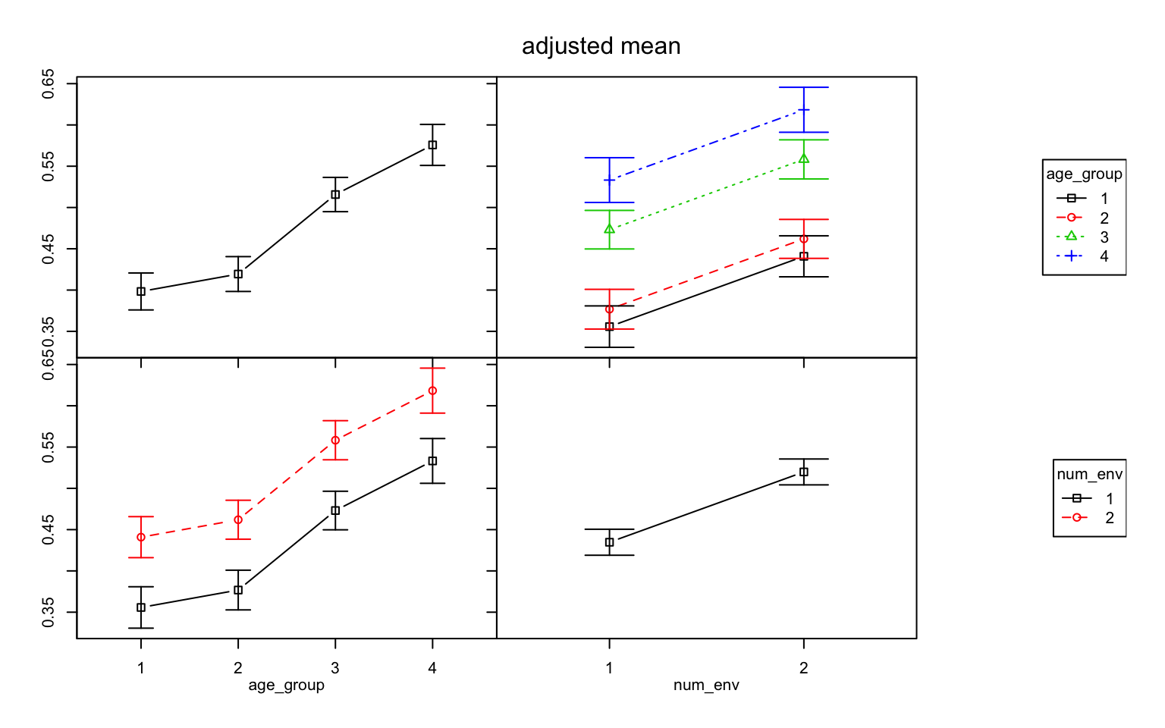
Means by age group
after adjusting for number of envelopes: seems to increase as age goes up? (bars show S.E.M.)
Notes:
Going up with age

Slide 19
Means by age group
after adjusting for number of envelopes: same increasing pattern (bars show S.E.M.)
Notes:
Num envelopes seems to matter

Slide 20
Means by number of envelopes
after adjusting for age group:
increases from 1 to 2 envelopes (bars show S.E.M.)

Slide 21
Means by number of envelopes
after adjusting for age group:
same increasing pattern for each age group (bars show S.E.M.)

Slide 22
Note: lines in the lower left and upper right panels must be parallel-
we made the model that way!
Notes:
By using the “+”, we’ve forced this. Model does ot allow interactions

Slide 23
ANCOVA
assumption:
Homogeneity of regression slopes
Notes:
Critical assumption – if we’re going to call it an ANCOVA, and ignore any potential interactions, we need to assure that there are no interactions.

Slide 24
Safe assumption? Let’s include interaction term…
# library(car)
sticker_int <- lm(prop_given ~ age_group*num_env, data = givers,
+ contrasts = list(age_group = contr.sum,
+ num_env = contr.sum))
Anova(sticker_int, type = 2)
Anova Table (Type II tests)
Response: prop_given
Sum Sq Df F value Pr(>F)
age_group 1.5600 3 13.0371 0.000000047 ***
num_env 0.5940 1 14.8920 0.0001377 ***
age_group:num_env 0.1747 3 1.4599 0.2254215
Residuals 12.7636 320
---
Signif. codes: 0 ‘***’ 0.001 ‘**’ 0.01 ‘*’ 0.05 ‘.’ 0.1 ‘ ’ 1
age_group*num_env is equivalent to:
age_group + num_env + age_group:num_env

Slide 25
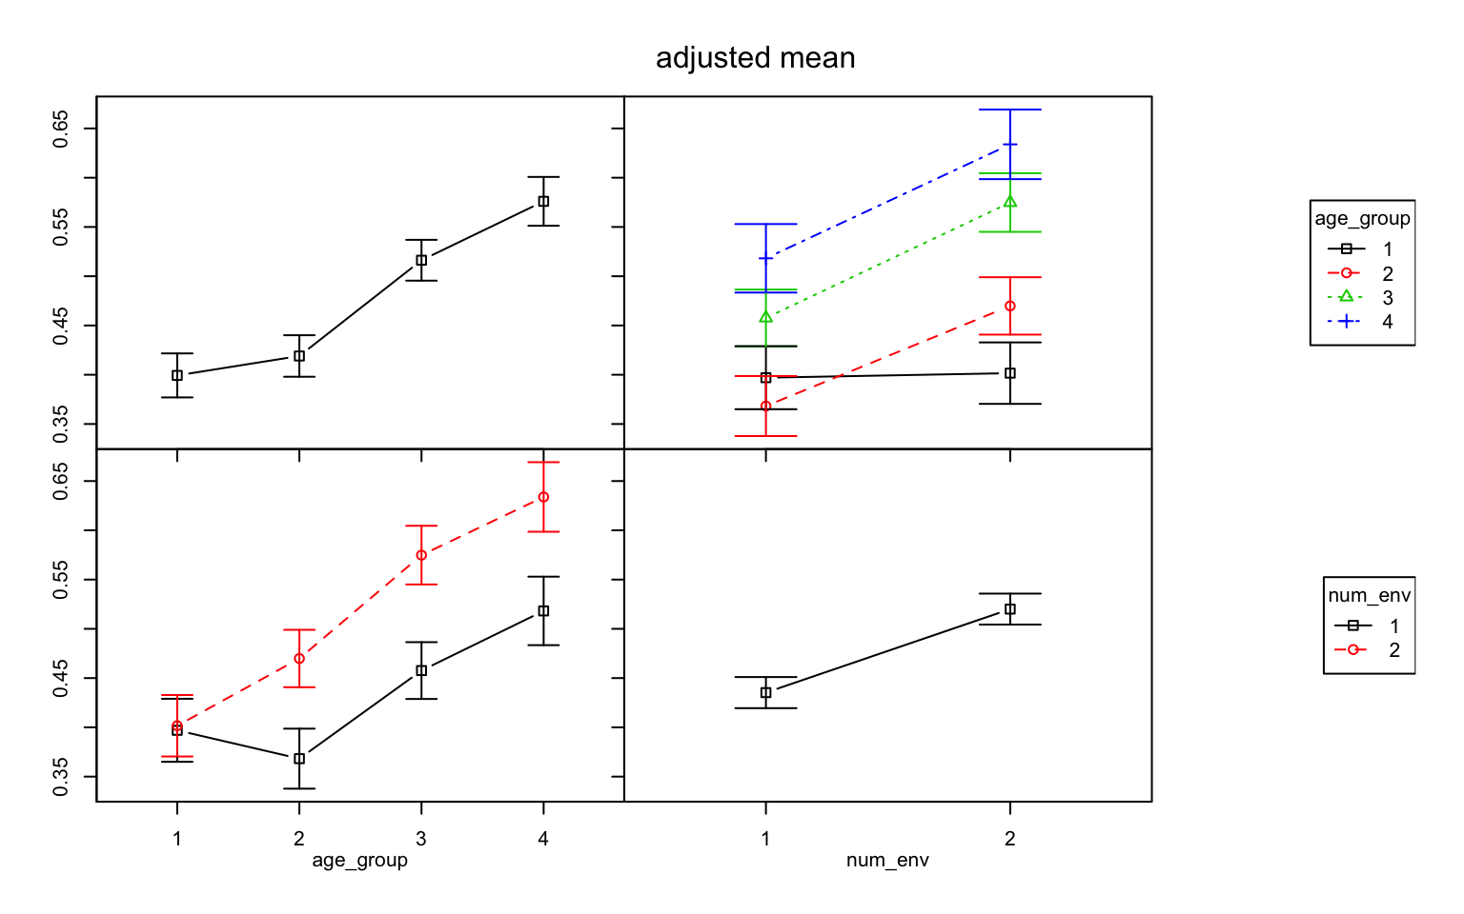
Lines in the lower left and upper right panels now can have non-parallel slopes- again, we made the model that way!
Notes:
By allowing an interaction. Not significant, but good to see what it looks like.
What do we see?

Slide 26
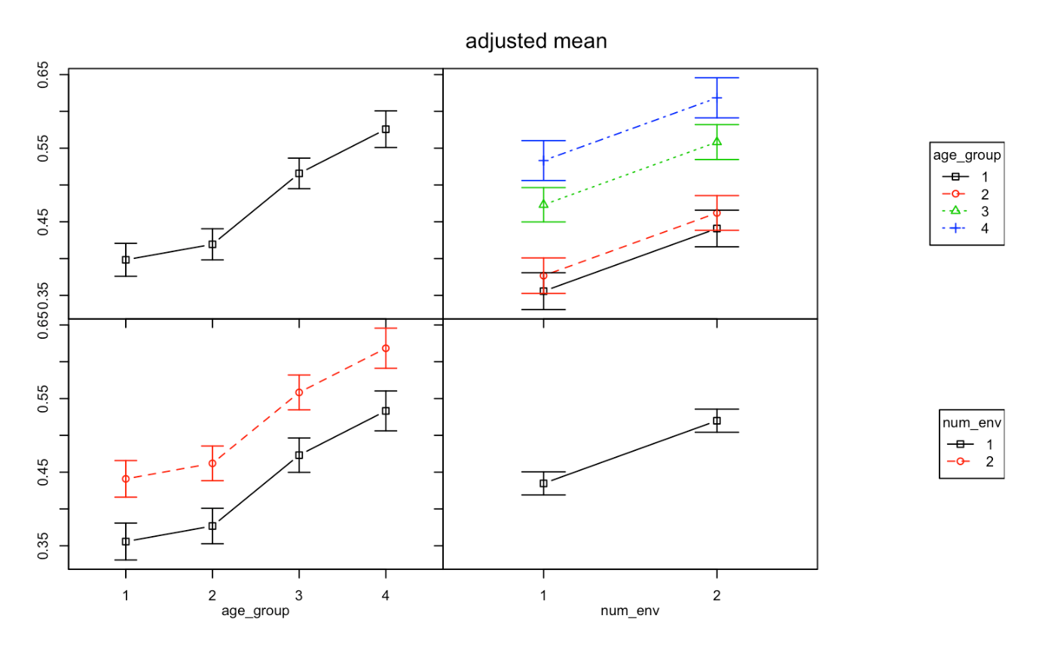

v
prop_given ~ age_group + num_env
prop_given ~ age_group * num_env
v
Notes:
ANCOVA – disallows interaction, but must be checked. Sometimes misused term.
ANOVA – allows interaction,

Slide 27
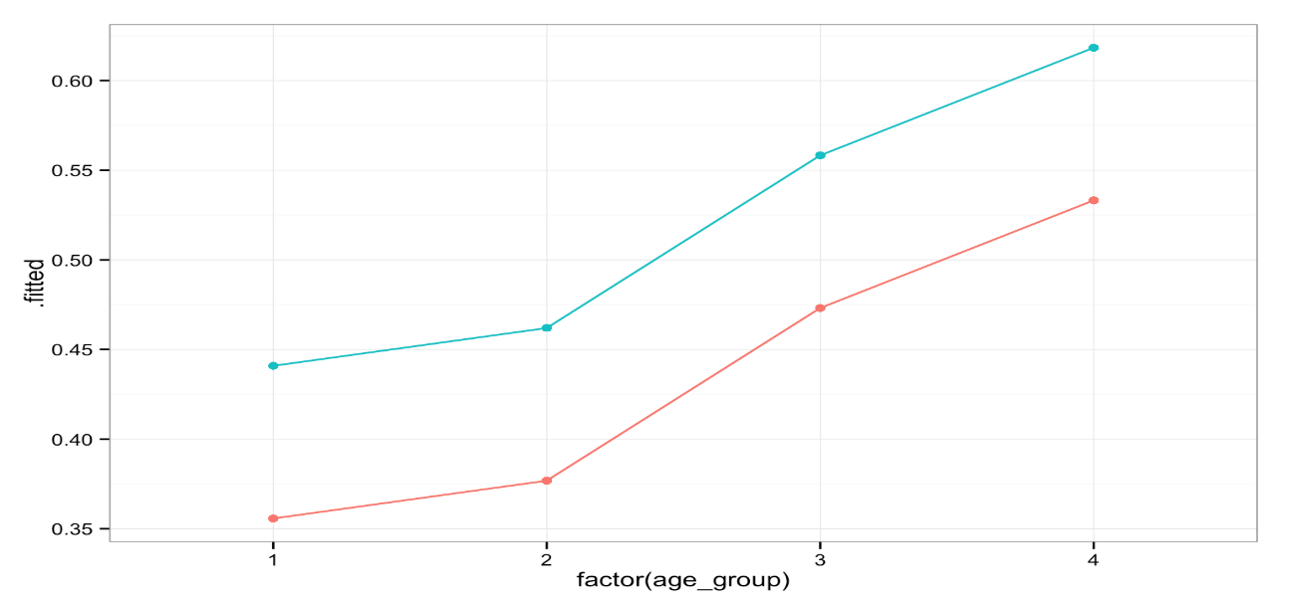
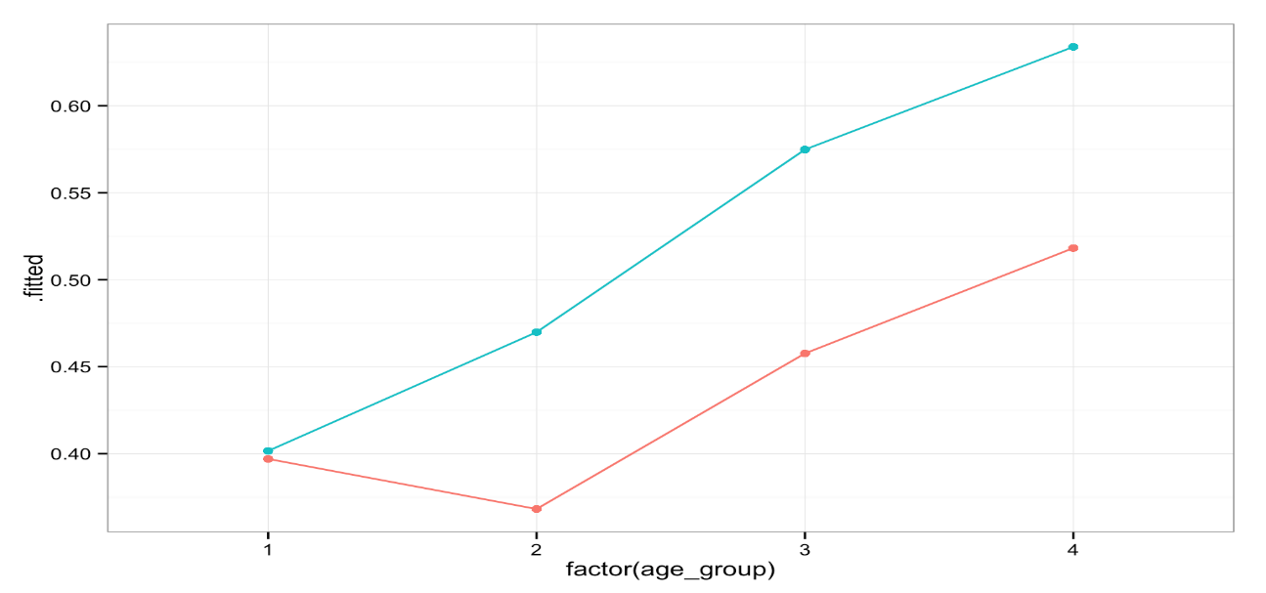
Covariate versus interacting terms
Covariates allow only for different intercepts, not slopes
Interactions allow for both different intercepts & slopes
prop_given ~ age_group + num_env
prop_given ~ age_group * num_env

Slide 28
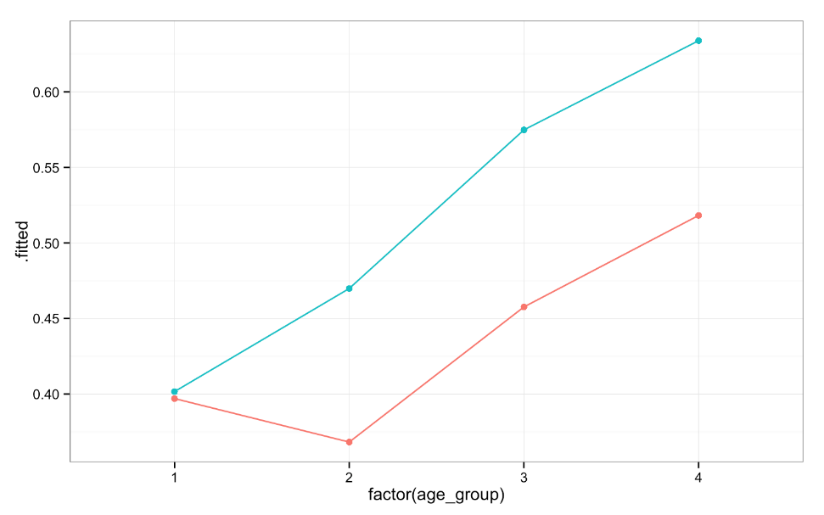
Covariate versus interacting terms
Models says: the effect of num_env is the same at every age
Model says: the effect of num_env could differ depending on age
prop_given ~ age_group + num_env
prop_given ~ age_group * num_env
age_group num_env fit_means fit_diff
(fctr) (fctr) (dbl) (dbl)
1 1 1 0.3557333 NA
2 1 2 0.4408878 0.08515454
3 2 1 0.3768267 NA
4 2 2 0.4619812 0.08515454
5 3 1 0.4731331 NA
6 3 2 0.5582876 0.08515454
7 4 1 0.5332060 NA
8 4 2 0.6183605 0.08515454
age_group num_env fit_means diff_fit
(fctr) (fctr) (dbl) (dbl)
1 1 1 0.3970085 NA
2 1 2 0.4016260 0.004617469
3 2 1 0.3682171 NA
4 2 2 0.4698582 0.101641102
5 3 1 0.4576389 NA
6 3 2 0.5748148 0.117175926
7 4 1 0.5181818 NA
8 4 2 0.6338542 0.115672348
Notes:
Adjusted means! Plot both.

Slide 29
Including interaction term changes interpretation
including an interaction changes the interpretation of coefficients for main effects
the coefficient on the constitutive term X cannot be interpreted as an unconditional marginal effect since it indicates only the effect of a one-unit change in X on Y when the conditioning variable is zero.
If the modifying variable is dichotomous, this simply requires the analyst to present four numbers—the marginal effect of X when Z is 0 and when Z is 1, along with the two corresponding standard errors.
Notes:
Isn’t really a “main effect” because it varies based on some other variable.
Have to say , “but”, or “depends on”

Slide 30
Bottom line
Using a variable as a covariate (+) rather than letting it interact with other variables (*) is an assumption called “homogeneity of regression slopes”, which is what we just observed- they are assumed to be parallel
If the variable you want to be covariate interacts with your other predictor, you cannot do an ANCOVA
Since the interaction effect here was not significant, we can proceed with interpreting the main effects of each of our predictors separately (sticking with sticker_int model):
age group
number of recipients

Slide 31
Back to our results…
# library(car)
sticker_int <- lm(prop_given ~ age_group*num_env, data = givers,
+ contrasts = list(age_group = contr.sum,
+ num_env = contr.sum))
Anova(sticker_int, type = 2)
Anova Table (Type II tests)
Response: prop_given
Sum Sq Df F value Pr(>F)
age_group 1.5600 3 13.0371 0.000000047 ***
num_env 0.5940 1 14.8920 0.0001377 ***
age_group:num_env 0.1747 3 1.4599 0.2254215
Residuals 12.7636 320
---
Signif. codes: 0 ‘***’ 0.001 ‘**’ 0.01 ‘*’ 0.05 ‘.’ 0.1 ‘ ’ 1
The significant main effect of age group tells us that the mean proportion given differed by age group

Slide 32
Back to our results…
# library(car)
sticker_int <- lm(prop_given ~ age_group*num_env, data = givers,
+ contrasts = list(age_group = contr.sum,
+ num_env = contr.sum))
Anova(sticker_int, type = 2)
Anova Table (Type II tests)
Response: prop_given
Sum Sq Df F value Pr(>F)
age_group 1.5600 3 13.0371 0.000000047 ***
num_env 0.5940 1 14.8920 0.0001377 ***
age_group:num_env 0.1747 3 1.4599 0.2254215
Residuals 12.7636 320
---
Signif. codes: 0 ‘***’ 0.001 ‘**’ 0.01 ‘*’ 0.05 ‘.’ 0.1 ‘ ’ 1
The significant main effect of number of recipients tells us that the mean proportion given differed based on number

Slide 33
Back to our results…
# library(car)
sticker_int <- lm(prop_given ~ age_group*num_env, data = givers,
+ contrasts = list(age_group = contr.sum,
+ num_env = contr.sum))
Anova(sticker_int, type = 2)
Anova Table (Type II tests)
Response: prop_given
Sum Sq Df F value Pr(>F)
age_group 1.5600 3 13.0371 0.000000047 ***
num_env 0.5940 1 14.8920 0.0001377 ***
age_group:num_env 0.1747 3 1.4599 0.2254215
Residuals 12.7636 320
---
Signif. codes: 0 ‘***’ 0.001 ‘**’ 0.01 ‘*’ 0.05 ‘.’ 0.1 ‘ ’ 1
No interaction- the effect of each variable did not depend on the level of the other

Slide 34
Interpreting effect of number of recipients
No need!
Only two levels, so F = 14.89 tells us that that proportion of stickers given was different when there was 1 vs. 2 recipients
Plots/adjusted means tell us: 2 recipients > 1 (p = 0.0001)
Note: if you did do a t-test, t = √F = 3.86
You are here

Slide 35
Interpreting effect of age group
F = 13 tells us that proportion of stickers given differed depending on age group, but which age groups were different from each other?
Need post hoc comparisons to examine main effect of group
You are here

Slide 36
Follow-up contrasts: multcomp?
# library(multcomp)
The mcp function must be used with care when defining parameters of interest in two-way ANOVA or ANCOVA models. Here, the definition of treatment differences (such as Tukey’s all-pair comparisons or Dunnett’s comparison with a control) might be problem specific. Because it is impossible to determine the parameters of interest automatically in this case, mcp in multcomp version 1.0-0 and higher generates comparisons for the main effects only, ignoring covariates and interactions (older versions automatically averaged over interaction terms).
A warning is given.
Notes:
Goodbye old friend!

Slide 37
Follow-up contrasts: phia?
# library(phia)
interactionMeans(sticker_2int, factors = "age_group")
age_group adjusted mean std. error
1 1 0.3993173 0.02233588
2 2 0.4190376 0.02107271
3 3 0.5162269 0.02072034
4 4 0.5760180 0.02477462
Notes:
Post-hoc inference for ANOVA
Oooh - easy adjusted means and sd. Adjusted for variable we’re not seeing (env).

Slide 38
Follow-up contrasts: phia?
# library(phia)
testInteractions(sticker_2int, pairwise = "age_group")
F Test:
P-value adjustment method: holm
Value Df Sum of Sq F Pr(>F)
1-2 -0.019720 1 0.0164 0.4124 0.5212039
1-3 -0.116910 1 0.5873 14.7247 0.0005996 ***
1-4 -0.176701 1 1.1193 28.0614 0.000001315 ***
2-3 -0.097189 1 0.4314 10.8150 0.0033566 **
2-4 -0.156980 1 0.9292 23.2954 0.000010775 ***
3-4 -0.059791 1 0.1367 3.4272 0.1301025
Residuals 320 12.7636
---
Signif. codes: 0 ‘***’ 0.001 ‘**’ 0.01 ‘*’ 0.05 ‘.’ 0.1 ‘ ’ 1
Notes:
There’s the p-values for differences between groups.

Slide 39

Let’s include 3 predictors!

Slide 40
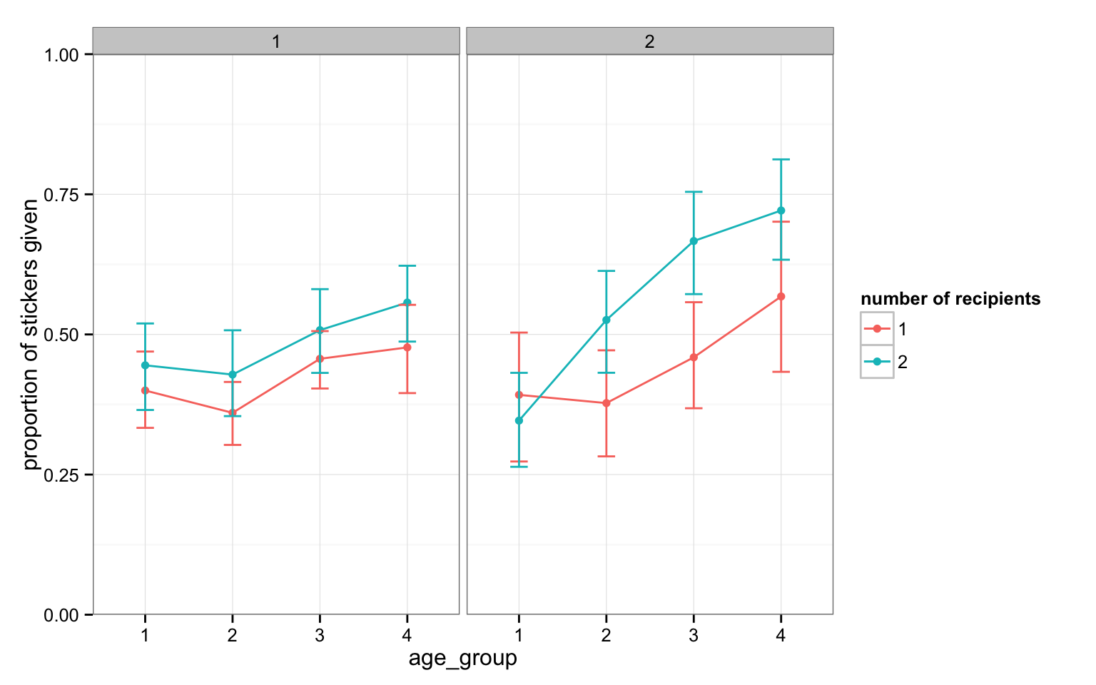
Girls = 1, Boys = 2
(again, unadjusted means)
Nevermind ☹
I might be thinking ANCOVA…
Notes:
Look at the trends.

Slide 41
# library(car)
sticker_3 <- lm(prop_given ~ age_group*num_env*gender, data = givers,
+ contrasts = list(age_group = contr.sum, num_env = contr.sum, gender = contr.sum))
Anova(sticker_3)
Anova Table (Type II tests)
Response: prop_given
Sum Sq Df F value Pr(>F)
age_group 1.5400 3 13.3548 0.00000003188 ***
num_env 0.6064 1 15.7770 0.00008854555 ***
gender 0.2059 1 5.3556 0.02131 *
age_group:num_env 0.1591 3 1.3795 0.24902
age_group:gender 0.3371 3 2.9234 0.03413 *
num_env:gender 0.0701 1 1.8242 0.17779
age_group:num_env:gender 0.1652 3 1.4325 0.23325
Residuals 11.9924 312
---
Signif. codes: 0 ‘***’ 0.001 ‘**’ 0.01 ‘*’ 0.05 ‘.’ 0.1 ‘ ’ 1
Notes:
There’s an interaction! End still easy – no interactions.
Thanks for no 3-way interaction. Think about what this might mean before you start the analyses.

Slide 42

We have a significant interaction effect!
Sum Sq Df F value Pr(>F)
age_group 1.5400 3 13.3548 0.00000003188 ***
num_env 0.6064 1 15.7770 0.00008854555 ***
gender 0.2059 1 5.3556 0.02131 *
age_group:num_env 0.1591 3 1.3795 0.24902
age_group:gender 0.3371 3 2.9234 0.03413 *
num_env:gender 0.0701 1 1.8242 0.17779
age_group:num_env:gender 0.1652 3 1.4325 0.23325
Residuals 11.9924 312
---
Signif. codes: 0 ‘***’ 0.001 ‘**’ 0.01 ‘*’ 0.05 ‘.’ 0.1 ‘ ’ 1
The interaction between age group and gender means we cannot fully interpret those main effects without using words like “but” or “depends on”

Slide 43
Principle of marginality
The separate partial effects, or main effects, of age group and gender are marginal to the age group-by-gender interaction.
In general, we neither test nor interpret main effects of explanatory variables that interact.
If we can rule out interaction either on theoretical or empirical grounds, then we can proceed to test, estimate, and interpret main effects.
It does not generally make sense to specify and fit models that include interaction regressors but that delete main effects that are marginal to them.
Such models — which violate the principle of marginality — are interpretable, but they are not broadly applicable.
?Anova: “Type-II tests are calculated according to the principle of marginality, testing each term after all others, except ignoring the term's higher-order relatives; so-called type-III tests violate marginality, testing each term in the model after all of the others.”
Notes:
“Higher order effects” = interactions
But, kinda stuck with III, aren’t we?

Slide 44
But for boys age seems to matter a lot!
Age group doesn’t seem to matter much for girls…
Notes:
?? Does it appear that the effect of gender on sticker generosity changes with age?

Slide 45
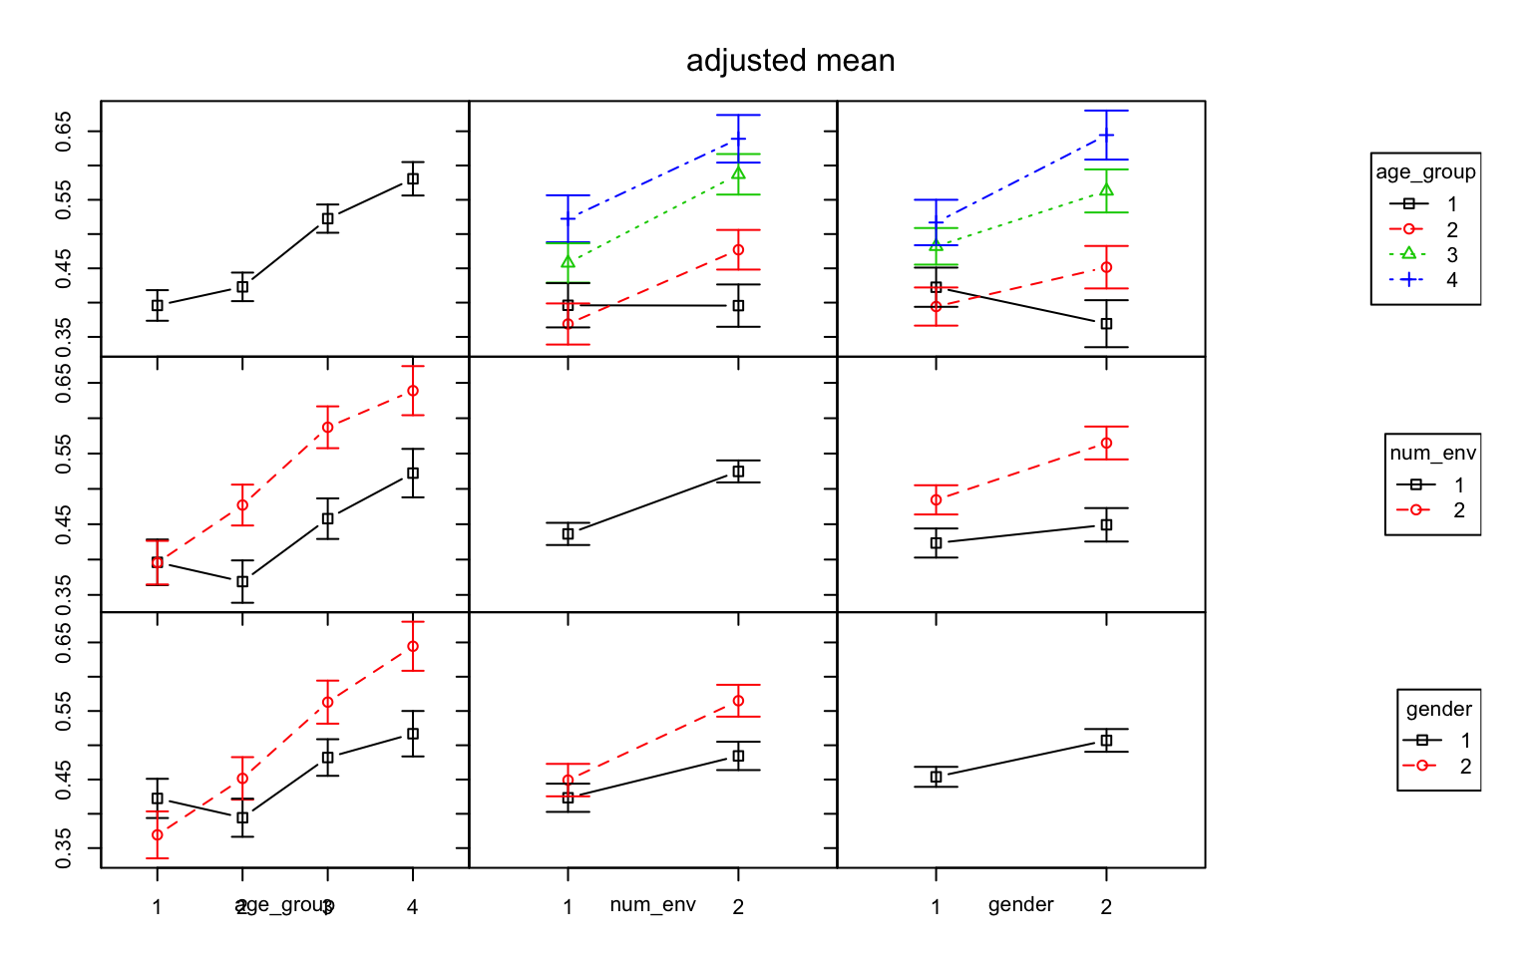
The effect of gender depends on age
&
the effect of age depends on gender
Notes:
Boys = red
Girls=black, age group seems to matter less for girls.
Is there a differential effect of gender for different age groups?

Slide 46
Adjusted interaction means
sticker_3int <- lm(prop_given ~ age_group*num_env*gender, data = givers,
contrasts = list(age_group = contr.sum, num_env = contr.sum, gender = contr.sum))
# library(phia)
interactionMeans(sticker_3int)
age_group num_env gender adjusted mean std. error
1 1 1 1 0.4000000 0.04001938
2 2 1 1 0.3601449 0.04088011
3 3 1 1 0.4565476 0.03705074
4 4 1 1 0.4768519 0.04621039
5 1 2 1 0.4449275 0.04088011
6 2 2 1 0.4283951 0.03773063
7 3 2 1 0.5076923 0.03844937
8 4 2 1 0.5568627 0.04755010
9 1 1 2 0.3922222 0.05062095
10 2 1 2 0.3775000 0.04383903
11 3 1 2 0.4591667 0.04383903
12 4 1 2 0.5677778 0.05062095
13 1 2 2 0.3462963 0.04621039
14 2 2 2 0.5258333 0.04383903
15 3 2 2 0.6666667 0.04497790
16 4 2 2 0.7211111 0.05062095
Notes:
Using phia again, we get new means
Numbers on plots

Slide 47
Simple effects analysis
A simple effects analysis looks at the main effect of one factor at a given level of a second factor (“pick a point” analysis)
This is our way of breaking down a significant interaction
It *can* be frowned upon to do this analysis post-hoc when you do not have a significant interaction effect in your omnibus ANOVA, or did not have a darn good reason to hypothesize one a priori

Slide 48
The effect of gender depends on age
&
the effect of age depends on gender
# library(phia)
testInteractions(sticker_3, fixed = "age_group", across = "gender", adjustment = "bonferroni")
F Test:
P-value adjustment method: bonferroni
Value Df Sum of Sq F Pr(>F)
1 0.053205 1 0.0546 1.4206 0.93686
2 -0.057397 1 0.0730 1.8992 0.67663
3 -0.080797 1 0.1477 3.8423 0.20345
4 -0.127587 1 0.2629 6.8387 0.03741 *
Residuals 312 11.9924
---
Signif. codes: 0 ‘***’ 0.001 ‘**’ 0.01 ‘*’ 0.05 ‘.’ 0.1 ‘ ’ 1
Boys shared 12.7% more stickers than girls on average at ages 9 – 11…
where does this number come from?
Notes:
Hold age fixed, look at gender effect

Slide 49
interactionMeans(sticker_3int)
age_group num_env gender adjusted mean std. error
1 1 1 1 0.4000000 0.04001938
2 2 1 1 0.3601449 0.04088011
3 3 1 1 0.4565476 0.03705074
4 4 1 1 0.4768519 0.04621039
5 1 2 1 0.4449275 0.04088011
6 2 2 1 0.4283951 0.03773063
7 3 2 1 0.5076923 0.03844937
8 4 2 1 0.5568627 0.04755010
9 1 1 2 0.3922222 0.05062095
10 2 1 2 0.3775000 0.04383903
11 3 1 2 0.4591667 0.04383903
12 4 1 2 0.5677778 0.05062095
13 1 2 2 0.3462963 0.04621039
14 2 2 2 0.5258333 0.04383903
15 3 2 2 0.6666667 0.04497790
16 4 2 2 0.7211111 0.05062095
Girls
Boys
(0.4768519 + 0.5568627)/2 - (0.5677778 + 0.7211111)/2
[1] -0.1275871
Boys shared 12.7% more stickers than girls on average at ages 9 – 11…
where does this number come from? See above!

Slide 50
The effect of gender depends on age
&
the effect of age depends on gender
# library(phia)
testInteractions(sticker_3, fixed = "gender", across = "age_group", adjustment = "bonferroni")
F Test:
P-value adjustment method: bonferroni
age_group1 age_group2 age_group3 Df Sum of Sq F Pr(>F)
1 -0.094394 -0.12259 -0.034737 3 0.4019 3.4851 0.03236 *
2 -0.275185 -0.19278 -0.081528 3 1.4307 12.4076 0.0000002189 ***
Residuals 312 11.9924
---
Signif. codes: 0 ‘***’ 0.001 ‘**’ 0.01 ‘*’ 0.05 ‘.’ 0.1 ‘ ’ 1
This is not so helpful- but does show significant effect of age is there for both boys and girls;
more breakdown is needed…

Slide 51
The effect of gender depends on age
&
the effect of age depends on gender
# library(phia)
testInteractions(sticker_3, pairwise = "age_group", fixed = "gender", adjustment = "bonferroni")
F Test:
P-value adjustment method: bonferroni
Value Df Sum of Sq F Pr(>F)
1-2 : 1 0.028194 1 0.0192 0.4993 1.0000000
1-3 : 1 -0.059656 1 0.0894 2.3246 1.0000000
1-4 : 1 -0.094394 1 0.1786 4.6473 0.3824087
2-3 : 1 -0.087850 1 0.1996 5.1919 0.2804164
2-4 : 1 -0.122587 1 0.3084 8.0242 0.0589929 .
3-4 : 1 -0.034737 1 0.0256 0.6660 1.0000000
1-2 : 2 -0.082407 1 0.1222 3.1802 0.9060965
1-3 : 2 -0.193657 1 0.6672 17.3571 0.0004817 ***
1-4 : 2 -0.275185 1 1.1853 30.8371 0.0000007213 ***
2-3 : 2 -0.111250 1 0.2443 6.3563 0.1463387
2-4 : 2 -0.192778 1 0.6371 16.5747 0.0007121 ***
3-4 : 2 -0.081528 1 0.1127 2.9314 1.0000000
Residuals 312 11.9924
---
Signif. codes: 0 ‘***’ 0.001 ‘**’ 0.01 ‘*’ 0.05 ‘.’ 0.1 ‘ ’ 1
Significant differences in proportion of stickers given differs between certain age groups, but only observed among boys not girls

Slide 52
Effect size
Omnibus: 𝛚²
omega.squared(sticker_3int) # seriously ugly
[1] 0.1119718
But also needed for all contrasts! Need either mean difference, t, or F statistic to calculate Cohen’s d for standard ANOVA/ANCOVA
library(compute.es)

Slide 53
What do we conclude?
Overall, model accounted for 11.2% of variance in proportion of stickers donated
Main effect: proportion of stickers donated depended on number of envelopes
Kids tended to share more proportionally when they thought there were 2 recipients rather than just 1
Interaction effect: suggested that…
Boys shared proportionally more than girls, but only in the oldest age group (age_group = 4)
For boys only, increased sharing at older ages, but only between certain age groups:
1 vs 3
1 vs 4
2 vs 4

Slide 54

Interactions with continuous variables…
Let’s take age as a continuous variable (in months) rather than as a factor with 4 levels
sticker_spot <- lm(prop_given ~ age*gender*num_env, data = givers, contrasts = list(gender = contr.sum, num_env = contr.sum))
Anova(sticker_spot, type = 2)
Sum Sq Df F value Pr(>F)
age 1.7416 1 46.5137 0.0000000000455 ***
gender 0.1804 1 4.8175 0.0288896 *
num_env 0.5689 1 15.1934 0.0001182 ***
age:gender 0.2815 1 7.5184 0.0064506 **
age:num_env 0.1256 1 3.3538 0.0679813 .
gender:num_env 0.0734 1 1.9615 0.1623209
age:gender:num_env 0.0713 1 1.9044 0.1685502
Residuals 11.9814 320
For spotlight analysis, you’ll want to dummy code (not deviation/effect code) your contrasts, and use summary()or tidy()

Slide 55
Spotlight analysis for ANOVA
We’ll use a spotlight analysis to better understand the interaction between gender (girls/boys) and age (in months)
sticker_spot <- lm(prop_given ~ age*gender*num_env, data = givers, contrasts = list(gender = contr.sum, num_env = contr.sum))
Anova(sticker_spot, type = 2)
Anova Table (Type II tests)
Response: prop_given
Sum Sq Df F value Pr(>F)
age 1.7416 1 46.5137 0.0000000000455 ***
gender 0.1804 1 4.8175 0.0288896 *
num_env 0.5689 1 15.1934 0.0001182 ***
age:gender 0.2815 1 7.5184 0.0064506 **
age:num_env 0.1256 1 3.3538 0.0679813 .
gender:num_env 0.0734 1 1.9615 0.1623209
age:gender:num_env 0.0713 1 1.9044 0.1685502
Residuals 11.9814 320

Slide 56
Spotlight analysis to understand interactions
“scaling changes do not affect significance tests, slopes, etc. of that variable or of any other variable in the model.”
Yes, this heuristic is accurate for simple models without interactions, but not for models with interactions.
Spotlight analysis exploits this fact by re-scaling your continuous covariate (here, age in months)
We want to evaluate main effect of gender when age takes on different values- the interaction tells us that the main effect of gender depends on the age we are looking at
We can pick any value to re-scale by
First, I’ll center age around the mean age
Can also use ±1 SD around the mean (usually of interest)

Slide 57
# center age at mean
givers <- givers %>%
mutate(age_mean = age - mean(age))
sticker_ctr <- lm(prop_given ~ age_mean*gender*num_env, data = givers, contrasts = list(gender = contr.treatment, num_env = contr.treatment))
tidy(sticker_ctr)
term estimate std.error statistic p.value
1 (Intercept) 0.4233064576 0.0200749628 21.0862885 1.727537e-62
2 age_mean 0.0014530306 0.0007301193 1.9901278 4.742745e-02
3 gender2 0.0170252154 0.0306598615 0.5552933 5.790820e-01
4 num_env2 0.0563245651 0.0283894013 1.9839998 4.810997e-02
5 age_mean:gender2 0.0010712428 0.0011078819 0.9669287 3.343099e-01
6 age_mean:num_env2 0.0004548377 0.0010525807 0.4321167 6.659476e-01
7 gender2:num_env2 0.0599339324 0.0431639747 1.3885175 1.659453e-01
8 age_mean:gender2:num_env2 0.0021650305 0.0015688634 1.3799994 1.685502e-01
Shine your spotlight on the gender effect:
It is not significant when age = mean age. So sharing in boys is 0.017 > girls(ns) @ 81 months (6.7 years) when num_env = 1

Slide 58
# center at 1 sd below mean
givers <- givers %>%
+ mutate(age_lowsd = age - (mean(age) - sd(age)))
sticker_lowsd <- lm(prop_given ~ age_lowsd*gender*num_env, data = givers, contrasts = list(gender = contr.treatment, num_env = contr.treatment))
tidy(sticker_lowsd)
term estimate std.error statistic p.value
1 (Intercept) 0.3834153744 0.0279165665 13.734331329 4.587631e-34
2 age_lowsd 0.0014530306 0.0007301193 1.990127755 4.742745e-02
3 gender2 -0.0123843751 0.0436644743 -0.283625883 7.768805e-01
4 num_env2 0.0438375824 0.0398851848 1.099094378 2.725531e-01
5 age_lowsd:gender2 0.0010712428 0.0011078819 0.966928707 3.343099e-01
6 age_lowsd:num_env2 0.0004548377 0.0010525807 0.432116699 6.659476e-01
7 gender2:num_env2 0.0004958102 0.0612413124 0.008096009 9.935454e-01
8 age_lowsd:gender2:num_env2 0.0021650305 0.0015688634 1.379999352 1.685502e-01
Shine your spotlight on the gender effect:
It is not significant when age is 1 SD below mean age. So sharing is
0.012 < (ns) in boys than girls @ 53 months (4.4 years)
when num_env = 1

Slide 59
# center at 1 sd above mean
givers <- givers %>%
+ mutate(age_hisd = age - (mean(age) + sd(age)))
sticker_hisd <- lm(prop_given ~ age_hisd*gender*num_env, data = givers, contrasts = list(gender = contr.treatment, num_env = contr.treatment))
tidy(sticker_hisd)
term estimate std.error statistic p.value
1 (Intercept) 0.4631975409 0.0288138200 16.0755339 4.864763e-43
2 age_hisd 0.0014530306 0.0007301193 1.9901278 4.742745e-02
3 gender2 0.0464348058 0.0427044430 1.0873530 2.776991e-01
4 num_env2 0.0688115479 0.0411240801 1.6732666 9.525206e-02
5 age_hisd:gender2 0.0010712428 0.0011078819 0.9669287 3.343099e-01
6 age_hisd:num_env2 0.0004548377 0.0010525807 0.4321167 6.659476e-01
7 gender2:num_env2 0.1193720545 0.0607124566 1.9661872 5.014113e-02
8 age_hisd:gender2:num_env2 0.0021650305 0.0015688634 1.3799994 1.685502e-01
Shine your spotlight on the gender effect:
It is significant when age is 1 SD above mean age. So sharing in boys is
0.046 > girls @ 108 months (9 years) when num_env = 1

Slide 60
Cautionary notes on spotlight analysis
Unless you are using them as a classification variable (i.e., they are not being used as actual numbers), dummy codes are only useful if you are planning to spotlight 1 group in an interaction
Otherwise, all of your purported “main effects” are actually the effects of a variable at one level of the other (i.e., when the other is 0).
Caution: if there are other variables in your model, recall that the main effect when dummy coded is just a marginal effect where the other variables are set to lowest level (here, num_env = 1)
They are called dummy codes for a reason ☺ That is, you may not be testing what you think you are testing.

Slide 61
What about when num_env = 2?
The spotlight method works best for a two-way analysis with two factors or one factor and one continuous variable.
What we really want to know is how the interaction between age and gender can be interpreted, averaging across number of envelopes (since that does not contribute to any interactions with other model predictors). There has to be a better way…

Slide 62
sticker_spot <- lm(prop_given ~ age*gender*num_env, data = givers, contrasts = list(gender = contr.sum, num_env = contr.sum))
interactionMeans(sticker_spot, factors = "gender", covariates = c(age = 80.9878))
gender adjusted mean std. error
1 1 0.4514687 0.01419470
2 2 0.4984609 0.01625708
interactionMeans(sticker_spot, factors = "gender", covariates = c(age = 53))
gender adjusted mean std. error
1 1 0.4044366 0.02014112
2 2 0.3911499 0.02345927
interactionMeans(sticker_spot, factors = "gender", covariates = c(age = 108))
gender adjusted mean std. error
1 1 0.4968614 0.02039448
2 2 0.6020313 0.02215622
@ mean age (81 mos):
diff = -.047
@ 1 sd below mean (53 mos): diff = .013
@ 1 sd above mean (108 mos): diff = -.105
Here, the default is to calculate adjusted mean values across all unspecified other factors in your model, so this is averaging across num_env 1 & 2

Slide 63
testInteractions(sticker_spot, pairwise = "gender", covariates = c(age = 80.9878), adjustment = "none") # at mean age
F Test:
P-value adjustment method: none
Value Df Sum of Sq F Pr(>F)
1-2 -0.046992 1 0.1775 4.741 0.03018 *
Residuals 320 11.9814
---
Signif. codes: 0 ‘***’ 0.001 ‘**’ 0.01 ‘*’ 0.05 ‘.’ 0.1 ‘ ’ 1
testInteractions(sticker_spot, pairwise = "gender", covariates = c(age = 53), adjustment = "none")
F Test:
P-value adjustment method: none
Value Df Sum of Sq F Pr(>F)
1-2 0.013287 1 0.0069 0.1847 0.6677
Residuals 320 11.9814
testInteractions(sticker_spot, pairwise = "gender", covariates = c(age = 108), adjustment = "none")
F Test:
P-value adjustment method: none
Value Df Sum of Sq F Pr(>F)
1-2 -0.10517 1 0.4567 12.197 0.000546 ***
Residuals 320 11.9814
---
Signif. codes: 0 ‘***’ 0.001 ‘**’ 0.01 ‘*’ 0.05 ‘.’ 0.1 ‘ ’ 1
@ mean age (81 mos): diff = -.047
@ 1 sd below mean (53 mos): diff = .013
@ 1 sd above mean (108 mos): diff = -.105

Slide 64
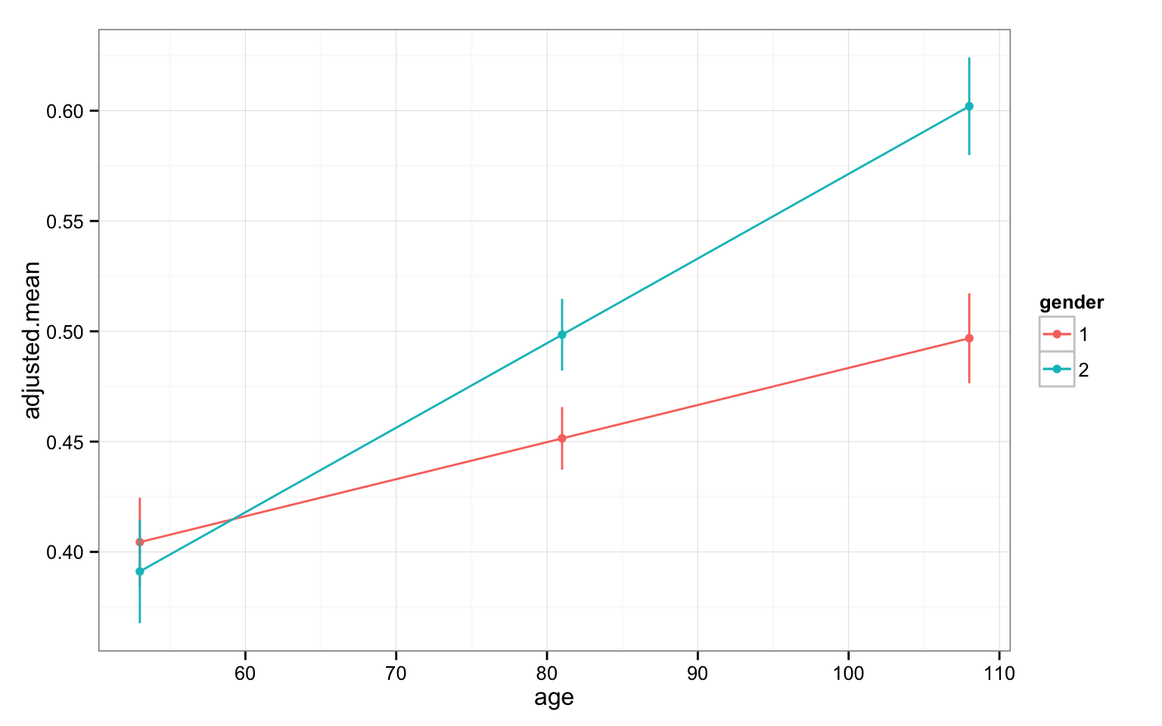
You can plot these adjusted conditional means! Use the estimated standard errors (realize these bars will always be shorter than standard deviations/95% confidence intervals).

Slide 65
Spotlight analysis summary
Great way to understand interactions with continuous covariates; also works for factors
Powerful way to see what is happening without subsetting your data
i.e., splitting by above/below mean/median/etc can be weak, unstable, potentially very misleading
This is not multiple testing- you do not need to worry about multiple comparisons here- it is used to interpret an already significant interaction
So don’t report them as if you ran different analyses with different results

