Slide 1
CM 3.3: Continuous Random Variables

Slide 2
Past: discrete rvs Present: continuous rvs
for discrete rvs, P(X = x) is technically called the probability mass function
for continuous rvs, the analogous concept is the density

Slide 3
Density
The density of X can be seen as a value proportional to the chance of drawing from the population a number that is lying in the close proximity of X.
Sadly, density does not give you probabilities directly
Probabilities can only be obtained from densities by taking an integral
Integrals are simply continuous sums

Slide 4
For continuous X, f(x) is a
Probability Density Function*
*Not a probability! (> 1)

Slide 5
Continuous rv pdf

Slide 6
What does P(X = a) = ?

Slide 7

One continuous distribution: Gaussian/normal
Let’s use the mean and sd from the coin flip example:
mean = 15
sd = 2.74 ( ≅ $\sqrt{7.5} )$

Slide 8
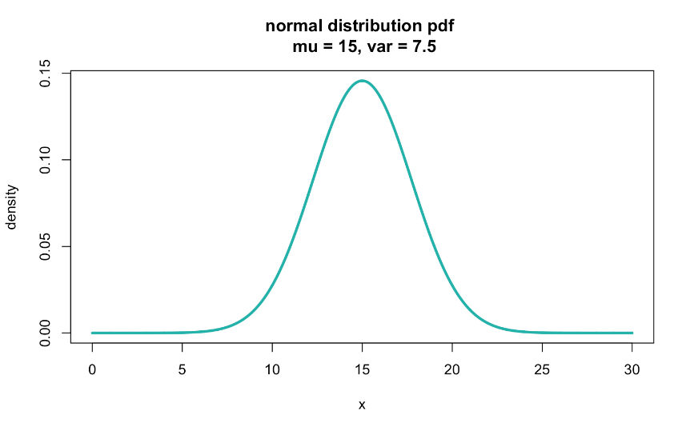
X ~ N(15, √7.5)

Slide 9

Questions we can ask the pdf
"What is the height of the density curve at x = 10?” 0.028
dnorm(10, 15, sqrt(7.5))

Slide 10
For all X, F(x) is a
cumulative distribution function

Slide 11
Cumulative distribution function

Slide 12
Discrete
Continuous
(since x is used as a variable in the
upper limit of integration, we use some other variable, say “t”, in the integrand)

Slide 13
cdf in practice
F(x) is the probability of values less than x
Thus, F(x) is the probability of an interval
If F(x) is the cdf for the age in months of fish in a lake, then F(10) is the probability a random fish is 10 months or younger.
Can F(10) be less than F(9)?

Slide 14
cdf for continuous rvs
By the Fundamental Theorem of Calculus:
The area under the curve from a to b of a function f is just the difference between the values of that function's antiderivative, F, at b and a.

Slide 15
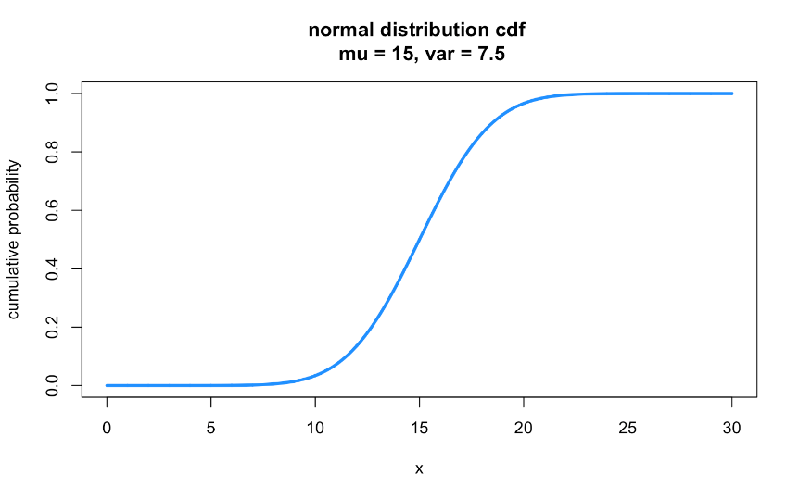
X ~ N(15, √7.5)

Slide 16
X ~ N(15, √7.5)
median (Q2) = 15
> qnorm(.5, 15, sqrt(7.5)) #Q2 (median)
[1] 15

Slide 17

X ~ N(15, √7.5)
Q3: ≈17
Q1: ≈13
> qnorm(.25, 15, sqrt(7.5)) #Q1
[1] 13.15283
> qnorm(.75, 15, sqrt(7.5)) #Q3
[1] 16.84717

Slide 18

Questions we can ask the cdf in R
"What is the probability that x is exactly 7?” 0
"What is the probability that x is between 18 to 24?” 0.136
"What is the probability that x ends in 7?” 0
"What is the probability that x is greater than 24?” 0.0005

Slide 19
Questions we can ask the cdf in R
"What is the probability that x is exactly 7?” 0
"What is the probability that x is between 18 to 24?” 0.136
pnorm(24, 15, sqrt(7.5)) - pnorm(18, 15, sqrt(7.5))
"What is the probability that x ends in 7?” 0
"What is the probability that x is greater than 24?” 0.0005
pnorm(24, 15, sqrt(7.5), lower.tail = FALSE)

Slide 20
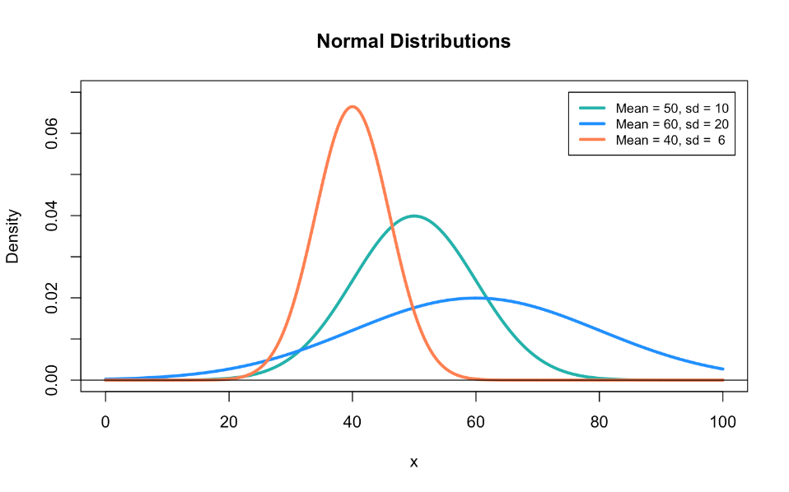

Slide 21
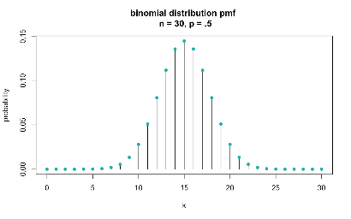
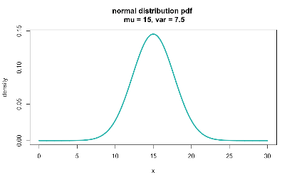
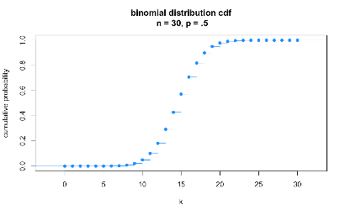
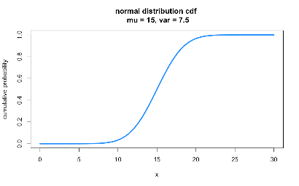

Slide 22
Transformations
If X ~ N(µ, σ²) and Y = X + b
Then Y ~ N(µ + b, σ²)
If X ~ N(µ, σ²) and Y = aX
Then Y ~ N(aµ, a²σ²)
If X ~ N(µ, σ²) and Y = aX + b
Then Y ~ N(aµ + b, a²σ²)

Slide 23
Random variables
Discrete
Continuous
Finite or countably infinite sample space.
Subset of integers.
Use sums.
Has pmf.
Uncountably infinite sample space.
Subset of the real number line.
Use integrals.
Has pdf.

Slide 24
continuous rvs
Outside support, f(x)=0
Integrate from -∞ to x
Differentiate
Outside support,
F(x)=0 or F(x)=1

Slide 25
X is a continuous rv
Integrate
from -∞ to x
Wolfram Alpha:
integrate 4x = 2x² + constant
integrate -4x + 4 = -2x² + 4x + constant

Slide 26
How to solve for A and C
x_{min}
Where A and C are constants of integration. Now we use the properties of F(x) to solve for those constants.
Specifically:
We know: F(x_{min}) = 0; so F(0) = 0
We also know: F(x_{max}) = 1; so F(1) = 1
x_{max}

Slide 27
Solve for A first
Notes:
F(x) = \left\{
\begin{array}{lr}
2x^2 & : 0\leq{x}\leq{1/2}\\
-2x^2-4x-1 & : {1/2}\leq{x}\leq{1}
\end{array}
\right.

Slide 28
Solve for C next
Notes:
F(x) = \left\{
\begin{array}{lr}
2x^2 & : 0\leq{x}\leq{1/2}\\
-2x^2-4x-1 & : {1/2}\leq{x}\leq{1}
\end{array}
\right.

Slide 29
Plug in: A = 0; C = -1
Notes:
F(x) = \left\{
\begin{array}{lr}
2x^2 & : 0\leq{x}\leq{1/2}\\
-2x^2-4x-1 & : {1/2}\leq{x}\leq{1}
\end{array}
\right.

Slide 30
Alternative way to solve for C
F(x) must be continuous, meaning that the graph of F(x) must touch when x = 1/2 (the two pieces of the piecewise graph must touch). So, to solve for C, we set x = 1/2 for each equation, plug in A = 0, and make them equal each other.

Slide 31
pdf
cdf

Slide 32
continuous rvs
Outside support, f(x)=0
Integrate from -∞ to x
Differentiate
Outside support,
F(x)=0 or F(x)=1

Slide 33
X is a continuous rv
Differentiate
Wolfram Alpha:
differentiate 0 = 0
differentiate (x+1)/2 = ½
differentiate 1 = 0

Slide 34

Expectation of a
Continuous random variable

Slide 36
Population median from pdf
Halfway point: half the population has a lower value, and half has a higher value
If f(x) is a pdf, then the median of the distribution is the point M such that:

Slide 37

Example: ladybug median life span
Suppose a ladybug’s life span (in months) has a pdf:
What is the median life span for the ladybug population?

Slide 38
Example: ladybug median life span

Slide 39
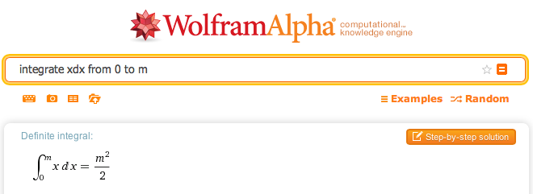
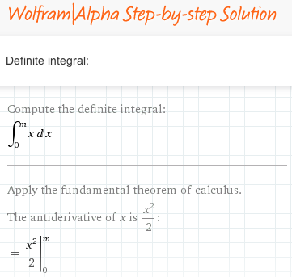
Aside: wolfram alpha

Slide 40
If we had the cdf, we could check this result:
How do we get there from the pdf? Integrate!
I know what you are thinking- I do so wish we could do more integration!

Slide 41
pdf → cdf:
Integrate!
constant = 0 (do this one on your own)
> (1/144)*(8.49^2)
[1] 0.5005563

Slide 42
Using the cdf
Now we can answer so many more questions without having to integrate each time…
Q1? 6
Q3? 10.4
IQR? 4.4

Slide 43
Example: ladybug mean life span
Suppose a ladybug’s life span has a pdf:
What is the mean life span for the ladybug population?

Slide 44
Example: ladybug mean life span

Slide 45
Example: ladybug life spans
What is the median life span? 8.49 months
What is the mean life span? 8 months
The mean is < median, so more than 50% of ladybugs live longer than 8 months
What is the variance of ladybug life spans?

Slide 46
Variance of ladybug life spans
I’ll leave this for you to solve…
12
8
0

Slide 47
Mini-review: probability functions
Discrete rvs:
probability mass function (pmf)
Continuous rvs:
probability density function (pdf)
f(x) is defined by the distribution!
Famous ones:
Bernoulli
Binomial
Negative binomial
Geometric
Hypogeometric
Poisson
f(x) is defined by the distribution!
Famous ones:
Normal/Gaussian
Chi-squared
F
Student’s t
Gamma
Beta

Slide 48
Mini-review: conditions for probability functions
Probability | Discrete rv: f(x) is a pmf if… | Continuous rv: f(x) is a pdf if…

Slide 49
Mini-review: cumulative density functions
Discrete rvs
Continuous rvs
where f(t) is just the pmf/pdf

Slide 50
Mini-review: Expectation of an rv
Discrete rvs
Continuous rvs

Slide 51
Mini-review: Variance of an rv
Discrete rvs
Continuous rvs

Slide 52
What you need to know about distributions
That lots of distributions exist (not just the normal!), and what types of rvs can typically be represented by them
What the pmf/pdf represents in terms of probability
What the cdf represents in terms of probability
How to calculate the expectation value and variance of the distribution, given the pmf/pdf
How to determine the pdf from the cdf for any function
Requires differentiation
How to determine the cdf from the pdf for any function
Requires integration

