Slide 1
CM 3.3: Continuous Random Variables

Slide 2
Past: discrete rvs Present: continuous rvs
for discrete rvs, P(X = x) is technically called the probability mass function
for continuous rvs, the analogous concept is the density
Notes:
Review
--------
Discrete RV
Probability Mass (Distribution) Function for a Random Variable =>
Cumulative Distribution Function
Asking questions of the PMF and CDF

Slide 3
Density
The density of X can be seen as a value proportional to the chance of drawing from the population a number that is lying in the close proximity of X.
Sadly, density does not give you probabilities directly
Probabilities can only be obtained from densities by taking an integral
Integrals are simply continuous sums
Notes:
Think ranges – more later

Slide 4
For continuous X, f(x) is a
Probability Density Function*
*Not a probability! (> 1)
Notes:
Still lower case

Slide 5
Continuous rv pdf

Slide 6
What does P(X = a) = ?
Notes:
0, because the below are equivalent, thus requiring the ends to be 0
Otherwise would sum to infinity, not 1

Slide 7

One continuous rv distribution: Gaussian/normal
Let’s use the mean and sd from a coin flip example:
Recall: X ~ Bin (30, 0.5)
E(X) = np = 30 * 0.5 =15
Var(X) = np(1-p) = 30 * 0.5 (1-0.5) = 7.5
Sd(X) = $\sqrt{7.5} \text{≅}$ 2.74
Notes:
To explore these concepts, let’s use the distribution for a normal random variable
Look at it..

Slide 8
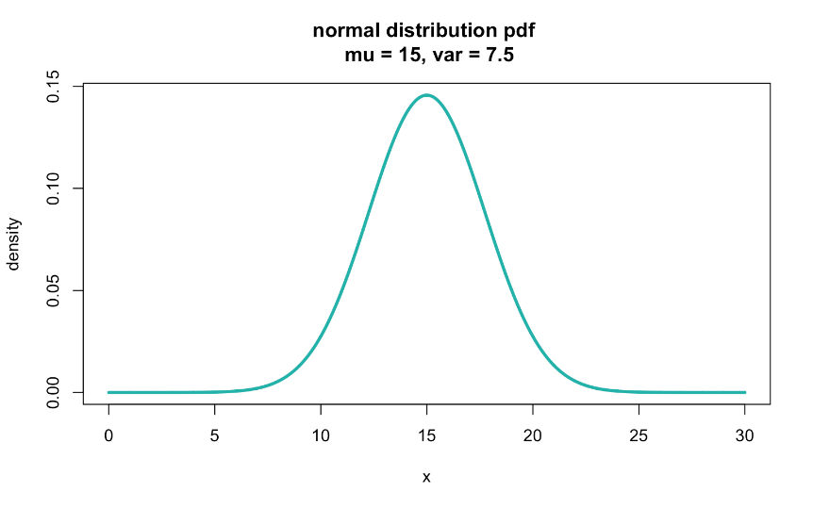
X ~ N(15, √7.5)
Notes:
X is distributed as a normal random variable with mean 15 and variance 7.5
What’s different from the pmf we saw last class?
X axis - same
Y axis – NOT probability
?sticks vs line – pdf is defined at all points in the range

Slide 9

Questions we can ask the pdf
"What is the height of the density curve at x = 10?” 0.028
dnorm(10, 15, sqrt(7.5))
Notes:
Not much, and not all that useful..
For continuous rv, we want….

Slide 10
For all X, F(x) is a
cumulative distribution function
Notes:
Cumulative!!
Big F – like pmf

Slide 11
Cumulative distribution function
Notes:
Analogous to discrete RV cdf
Remember cdf for pmf – what did it look like? Sideways S, “stair steps”, not connected lines
Here, must be connected and defined for the entire range

Slide 12
Discrete
Continuous
(since x is used as a variable in the
upper limit of integration, we use some other variable, say “t”, in the integrand)
Notes:
Comparing cdfs for discrete vs continuous rv,
Discrete is a summation, because we’re working with discrete x values (e.g. countable numbers)
Continuous is an integration (fancy sum) over the range

Slide 13
cdf in practice
F(x) is the probability of values less than x
Thus, F(x) is the probability of an interval
If F(x) is the cdf for the age in months of fish in a lake, then F(10) is the probability a random fish is 10 months or younger.
Can F(10) be less than F(9)?
Notes:
No – monotinic non-decreasing
Draw a pdf and the area of interest

Slide 14
cdf for continuous rvs
By the Fundamental Theorem of Calculus:
The area under the curve from a to b of a function f is just the difference between the values of that function's antiderivative, F, at b and a.
Notes:
Gives us the probability that t is between a range defined by a and b

Slide 15
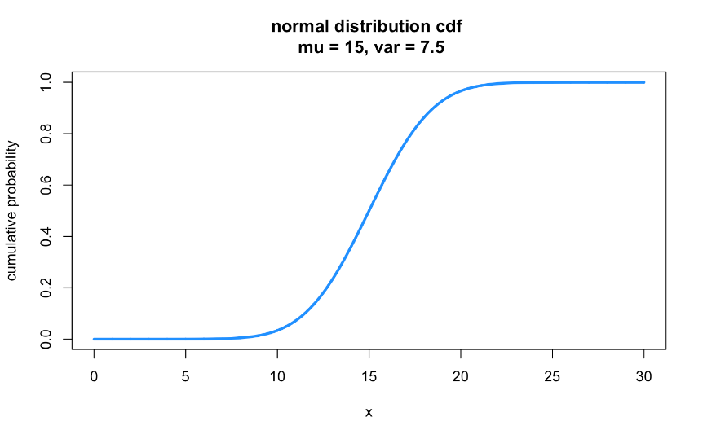
X ~ N(15, √7.5)
Notes:
Look at the cdf plot
A lot like the cdf for binomial rv
What’s different
X-axis – none
Y-axis – none
Line – continuous!

Slide 16
X ~ N(15, √7.5)
median (Q2) = 15
> qnorm(.5, 15, sqrt(7.5)) #Q2 (median)
[1] 15
Notes:
Now, we can get some answers!
At what point have we accumulated 50% of the probability?

Slide 17

X ~ N(15, √7.5)
Q3: ≈17
Q1: ≈13
> qnorm(.25, 15, sqrt(7.5)) #Q1
[1] 13.15283
> qnorm(.75, 15, sqrt(7.5)) #Q3
[1] 16.84717
Notes:
Fist and 3rd quartiles (25% and 75%)

Slide 18

Questions we can ask the cdf in R
"What is the probability that x is exactly 7?” 0
"What is the probability that x is between 18 to 24?” 0.136
"What is the probability that x ends in 7?” 0
"What is the probability that x is greater than 24?” 0.0005
Notes:
You try!

Slide 19
Questions we can ask the cdf in R
"What is the probability that x is exactly 7?” 0
"What is the probability that x is between 18 to 24?” 0.136
pnorm(24, 15, sqrt(7.5)) - pnorm(18, 15, sqrt(7.5))
"What is the probability that x ends in 7?” 0
"What is the probability that x is greater than 24?” 0.0005
pnorm(24, 15, sqrt(7.5), lower.tail = FALSE)
Notes:
Querying the cdf using R
1-pnorm(24,15,sqrt(7.5))

Slide 20
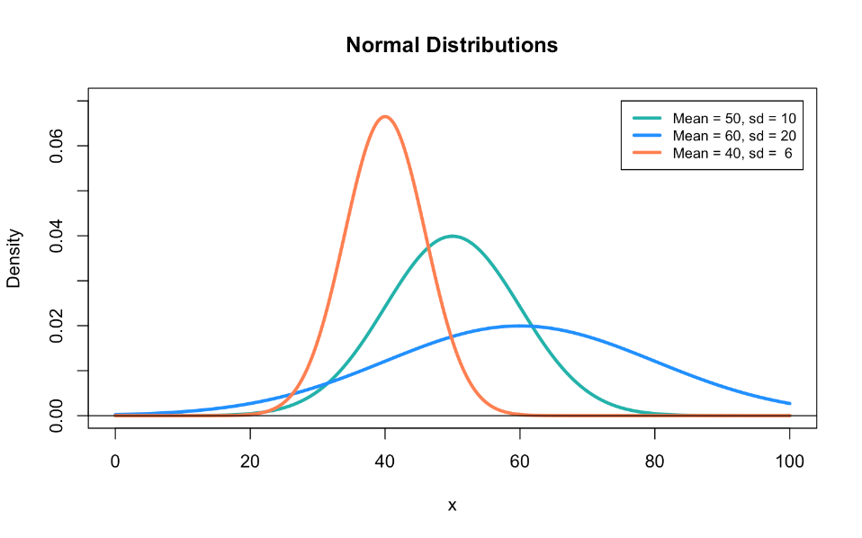
Notes:
Talked about normal a lot, but now we’re getting into it
What are the parameters that define a normal Dist? Mean and sd
What do the define? (location and spread)
What can we assume?
Shape? Always symmetric, flat tails (Kurtosis)
!! Recall that Kurtosis in defined in terms of deviation from the noral dist

Slide 21
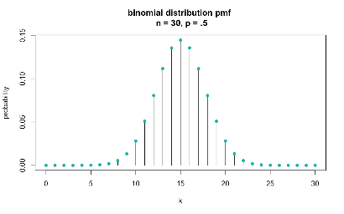
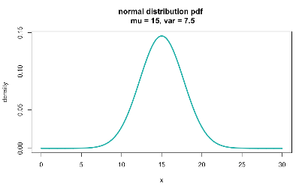
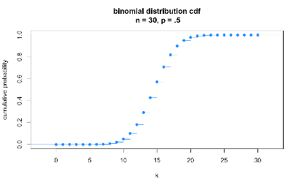
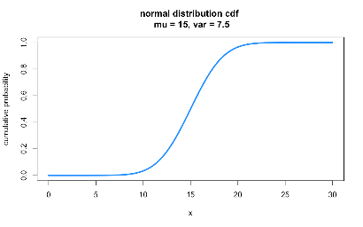

Slide 22
Transformations
If X ~ N(µ, σ²) and Y = X + b
Then Y ~ N(µ + b, σ²)
If X ~ N(µ, σ²) and Y = aX
Then Y ~ N(aµ, a²σ²)
If X ~ N(µ, σ²) and Y = aX + b
Then Y ~ N(aµ + b, a²σ²)
Notes:
We’ve talked about transformations a lot, especially linear transformations like scaling and centering
In some sense this is a review
What do each of these transformations change inre: to the parameters of a Normal dist?
What doesn’t change? Shape (skewness and kurtosis)

Slide 23
Random variables
Discrete
Continuous
Finite or countably infinite sample space.
Subset of integers-ish.
Use sums.
Has pmf.
Uncountably infinite sample space.
Subset of the real number line.
Use integrals.
Has pdf.
Notes:
To get probabilities use sum OR integration

Slide 24
continuous rvs
Outside support, f(x)=0
Integrate from -∞ to x
Differentiate
Outside support,
F(x)=0 or F(x)=1
Notes:
We can move between a cdf and pdf, with a little help from known characteristics / rules
f(x) for and given single x is 0
F(X) must approach 0 and x approaches – infinity and 1 as x approaches infinity

Slide 25
X is a continuous rv
Integrate
from -∞ to x
Wolfram Alpha:
integrate 4x = 2x² + constant
integrate -4x + 4 = -2x² + 4x + constant
Notes:
Let’s do one!!
Pull up wolfram alpha

Slide 26
How to solve for A and C
x_{min}
Where A and C are constants of integration. Now we use the properties of F(x) to solve for those constants.
Specifically:
We know: F(x_{min}) = 0; so F(0) = 0
We also know: F(x_{max}) = 1; so F(1) = 1
x_{max}

Slide 27
Solve for A first
Notes:
F(x) = \left\{
\begin{array}{lr}
2x^2 & : 0\leq{x}\leq{1/2}\\
-2x^2-4x-1 & : {1/2}\leq{x}\leq{1}
\end{array}
\right.

Slide 28
Solve for C next
Notes:
F(x) = \left\{
\begin{array}{lr}
2x^2 & : 0\leq{x}\leq{1/2}\\
-2x^2-4x-1 & : {1/2}\leq{x}\leq{1}
\end{array}
\right.

Slide 29
Plug in: A = 0; C = -1
Notes:
F(x) = \left\{
\begin{array}{lr}
2x^2 & : 0\leq{x}\leq{1/2}\\
-2x^2-4x-1 & : {1/2}\leq{x}\leq{1}
\end{array}
\right.

Slide 30
Alternative way to solve for C
F(x) must be continuous, meaning that the graph of F(x) must touch when x = 1/2 (the two pieces of the piecewise graph must touch). So, to solve for C, we set x = 1/2 for each equation, plug in A = 0, and make them equal each other.

Slide 31
pdf
cdf
Notes:
Pdf is not probability – well above 1

Slide 32
continuous rvs
Outside support, f(x)=0
Integrate from -∞ to x
Differentiate
Outside support,
F(x)=0 or F(x)=1
Notes:
Use outside support to solve for constants

Slide 33
X is a continuous rv
Differentiate
Wolfram Alpha:
differentiate 0 = 0
differentiate (x+1)/2 = ½
differentiate 1 = 0

Slide 34
Population median from pdf
Halfway point: half the population has a lower value, and half has a higher value
If f(x) is a pdf, then the median of the distribution is the point M such that:
Notes:
Corollary to the definition of the cdf – we can solve for M!

Slide 35
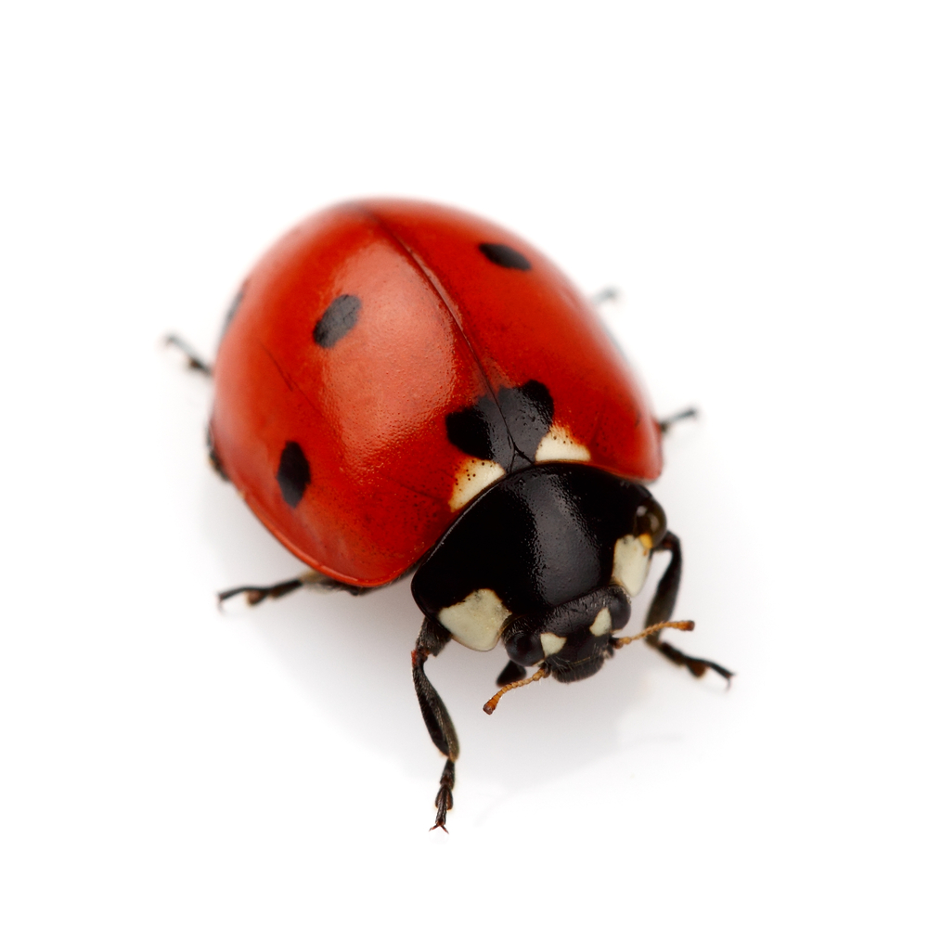
Example: ladybug median life span
Suppose a ladybug’s life span (in months) has a pdf:
What is the median life span for the ladybug population?
Notes:
Try it!!

Slide 36
Example: ladybug median life span

Slide 37
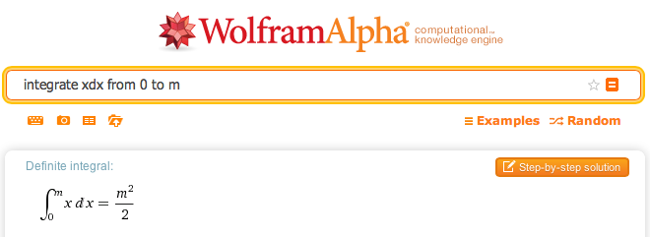
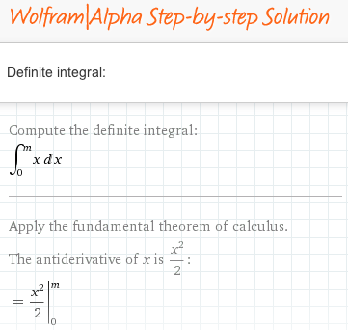
Aside: wolfram alpha

Slide 38
If we had the cdf, we could check this result:
How do we get there from the pdf? Integrate!
I know what you are thinking- I do so wish we could do more integration!

Slide 39
pdf → cdf:
Integrate!
constant = 0 (do this one on your own)
> (1/144)*(8.49^2)
[1] 0.5005563
Notes:
Now, over the whole range…
And plug in 8.49 – tada!!

Slide 40
Using the cdf
Now we can answer so many more questions without having to integrate each time…
Q1? 6
Q3? 10.4
IQR? 4.4
Notes:
1/4 = 1/144 *Q1^2
3/4 = 1/144 *Q3^2

Slide 41
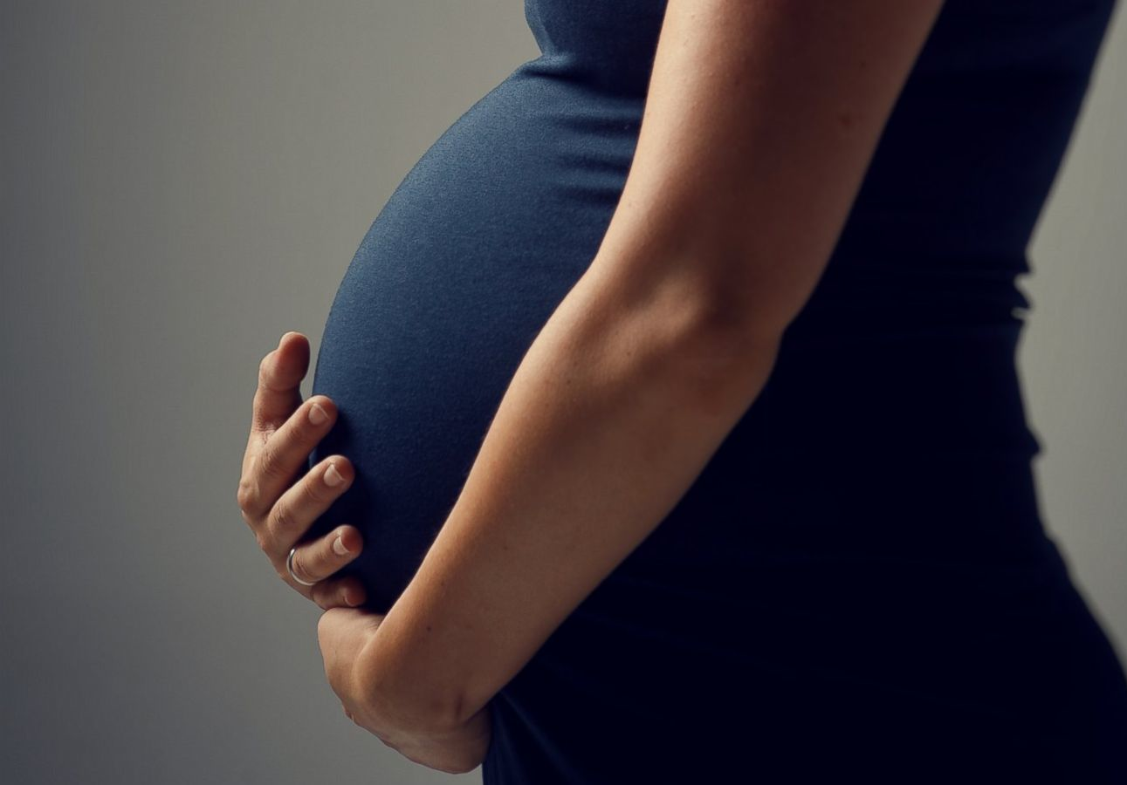
Expectation of a
Continuous random variable
Notes:
Same as discrete rv
Mean and Variance

Slide 43
Example: ladybug mean life span
Suppose a ladybug’s life span has a pdf:
What is the mean life span for the ladybug population?

Slide 44
Example: ladybug mean life span

Slide 45
Example: ladybug life spans
What is the median life span? 8.49 months
What is the mean life span? 8 months
The mean is < median, so more than 50% of ladybugs live longer than 8 months
What is the variance of ladybug life spans?

Slide 46
Variance of ladybug life spans
I’ll leave this for you to solve…
12
8
0

Slide 47
Mini-review: probability functions
Discrete rvs:
probability mass function (pmf)
Continuous rvs:
probability density function (pdf)
f(x) is defined by the distribution!
Famous ones:
Bernoulli
Binomial
Negative binomial
Geometric
Hypogeometric
Poisson
f(x) is defined by the distribution!
Famous ones:
Normal/Gaussian
Chi-squared
F
Student’s t
Gamma
Beta

Slide 48
Mini-review: conditions for probability functions
Probability | Discrete rv: f(x) is a pmf if… | Continuous rv: f(x) is a pdf if…

Slide 49
Mini-review: cumulative density functions
Discrete rvs
Continuous rvs
where f(t) is just the pmf/pdf

Slide 50
Mini-review: Expectation of an rv
Discrete rvs
Continuous rvs

Slide 51
Mini-review: Variance of an rv
Discrete rvs
Continuous rvs

Slide 52
What you need to know about distributions
That lots of distributions exist (not just the normal!), and what types of rvs can typically be represented by them
What the pmf/pdf represents in terms of probability
What the cdf represents in terms of probability
How to calculate the expectation value and variance of the distribution, given the pmf/pdf
How to determine the pdf from the cdf for any function
Requires differentiation
How to determine the cdf from the pdf for any function
Requires integration

