Slide 1
Class 9: Regression diagnostics & adding predictors
Alison Presmanes Hill

Slide 2
3 new distributions…
If you see squares of normal random variables (or of their differences!), think chi-squared.
If you see the ratio of an independent normal random variable (numerator) to the square-root of a chi-squared variable (denominator; any time you have an SE on the bottom!), think Student’s t.
If you see the ratio of two chi-squared random variables (i.e., sample variances from a normal distribution), think F distribution.

Slide 3
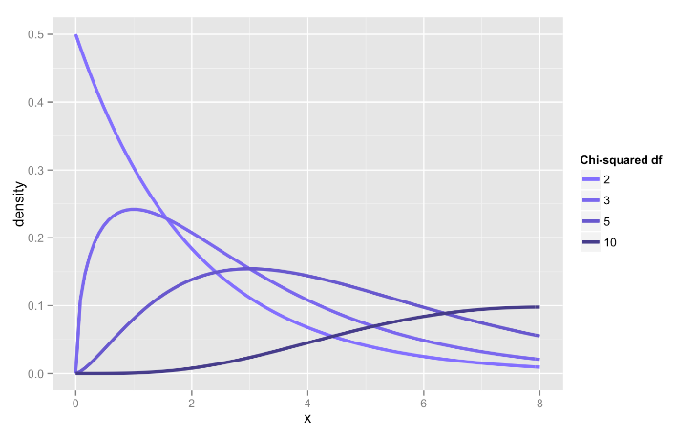
If you see squares of normal random variables, think chi-squared

Slide 4
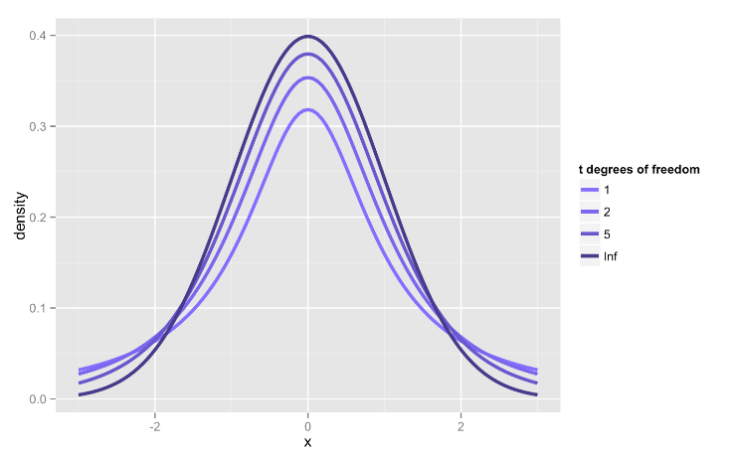
If you see the ratio of an independent normal random variable to the square-root of a chi-squared, think Student’s t

Slide 5
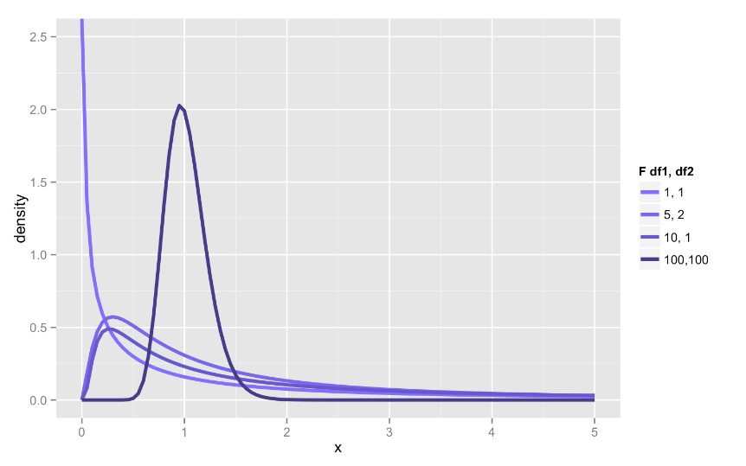
If you see the ratio of two chi-squared random variables (i.e., sample variances from a normal distribution), think F distribution

Slide 6

Swiss Fertility and Socioeconomic Indicators (1888)
Details (paraphrasing Mosteller and Tukey):
Switzerland, in 1888, was entering a period known as the demographic transition; i.e., its fertility was beginning to fall from the high level typical of underdeveloped countries.
The data collected are for 47 French-speaking “provinces” at about 1888.
Here, all variables are scaled to [0, 100].

Slide 7
6 swiss variables
Fertility: (common standardized measure)
Agriculture: % of males involved in agriculture as an occupation
Examination: % draftees received highest mark on army exam
Education: % draftees educated beyond primary school
Catholic: % Catholic (as opposed to Protestant)
InfantMortality: Percent of live births who live less than one year

Slide 8
> summary(swiss)
fertility agriculture examination
Min. :35.00 Min. : 1.20 Min. : 3.00
1st Qu.:64.70 1st Qu.:35.90 1st Qu.:12.00
Median :70.40 Median :54.10 Median :16.00
Mean :70.14 Mean :50.66 Mean :16.49
3rd Qu.:78.45 3rd Qu.:67.65 3rd Qu.:22.00
Max. :92.50 Max. :89.70 Max. :37.00
education catholic infant.mortality
Min. : 1.00 Min. : 2.150 Min. :10.80
1st Qu.: 6.00 1st Qu.: 5.195 1st Qu.:18.15
Median : 8.00 Median : 15.140 Median :20.00
Mean :10.98 Mean : 41.144 Mean :19.94
3rd Qu.:12.00 3rd Qu.: 93.125 3rd Qu.:21.70
Max. :53.00 Max. :100.000 Max. :26.60

Slide 9
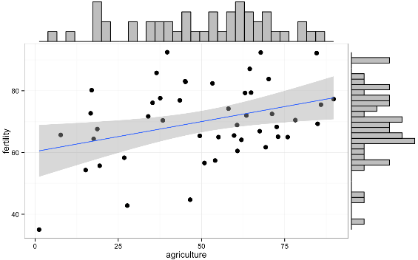
> with(swiss, cor.test(fertility, agriculture))
Pearson's product-moment correlation
data: fertility and agriculture
t = 2.5316, df = 45, p-value = 0.01492
alternative hypothesis: true correlation is not equal to 0
95 percent confidence interval:
0.07334947 0.58130587
sample estimates:
cor
0.3530792

Slide 10
> agr_mod <- lm(fertility ~ agriculture, data = swiss) # simple linear regression
> summary(agr_mod)
Call:
lm(formula = fertility ~ agriculture, data = swiss)
Residuals:
Min 1Q Median 3Q Max
-25.5374 -7.8685 -0.6362 9.0464 24.4858
Coefficients:
Estimate Std. Error t value Pr(>|t|)
(Intercept) 60.30438 4.25126 14.185 <2e-16 ***
agriculture 0.19420 0.07671 2.532 0.0149 *
---
Signif. codes: 0 ‘***’ 0.001 ‘**’ 0.01 ‘*’ 0.05 ‘.’ 0.1 ‘ ’ 1
Residual standard error: 11.82 on 45 degrees of freedom
Multiple R-squared: 0.1247, Adjusted R-squared: 0.1052
F-statistic: 6.409 on 1 and 45 DF, p-value: 0.01492

Slide 11
> agr_mod <- lm(fertility ~ agriculture, data = swiss)
> summary(agr_mod)
Coefficients:
Estimate Std. Error t value Pr(>|t|)
(Intercept) 60.30438 4.25126 14.185 <2e-16 ***
agriculture 0.19420 0.07671 2.532 0.0149 *
---
Signif. codes: 0 ‘***’ 0.001 ‘**’ 0.01 ‘*’ 0.05 ‘.’ 0.1 ‘ ’ 1
Residual standard error: 11.82 on 45 degrees of freedom
Multiple R-squared: 0.1247, Adjusted R-squared: 0.1052
F-statistic: 6.409 on 1 and 45 DF, p-value: 0.01492
> int_mod <- lm(fertility ~ 1, data = swiss) # intercept ONLY
> anova(int_mod, agr_mod)
Analysis of Variance Table
Model 1: fertility ~ 1
Model 2: fertility ~ agriculture
Res.Df RSS Df Sum of Sq F Pr(>F)
1 46 7178.0
2 45 6283.1 1 894.84 6.4089 0.01492 *
---
Signif. codes: 0 ‘***’ 0.001 ‘**’ 0.01 ‘*’ 0.05 ‘.’ 0.1 ‘ ’ 1

Slide 12

Sequences of nested models (revisited)
Full(er) model:
(Default) reduced model:
lm(y ~ 1 + x)
lm(y ~ 1)

Slide 13


Slide 14
Types of influence
Extremity on the x’s (leverage)
Extremity on y (discrepancy)
Influence on the regression estimates
Global
Specific coefficients
agr_mod <- lm(fertility ~ agriculture, data = swiss) # original model
slr_vars <- augment(agr_mod) # broom

Slide 15
Contaminated observation or special snowflake?
A contaminated observation is one that has been damaged in some way. Some examples:
Error of execution of the research procedure.
Inaccurate measurement of the dependent measure.
Data entry error.
Error in calculating a measure.
Nonattentive or distracted participants.
The outlier may simply be an extremely rare case. For example, a college freshman might be 12 years old and have an 800 SAT in math. Such an individual is extremely rare, but data is valid.

Slide 16


Slide 17

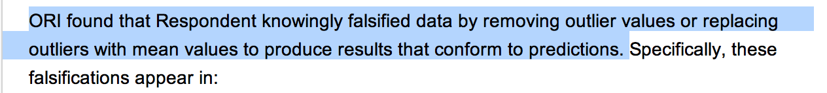
Outliers

Slide 18
Extremity on the x’s: leverage
Standardized measure of how far the observed value for each observation is from the mean value on the set of x’s
Observations with high leverage have the potential to be influential, especially if also extreme on Y

Slide 19
Leverage
Measure of how unusual the X value of a point is, relative to the X observations as a whole. Absolute minimum of 1/n. Leverage describes how unusual an observation is in predictor(s) data.
If h_{ii} is large then the ith observation has considerable impact on the fitted value
broom::.hat

Slide 20
Leverage
slr_vars %>%
filter(.hat > (2*mean(.hat))) %>%
select(.rownames, fertility, agriculture, .hat)
.rownames fertility agriculture .hat
1 Herens 77.3 89.7 0.08551436
2 La Chauxdfnd 65.7 7.7 0.09905898
3 V. De Geneve 35.0 1.2 0.12437740
## small samples
slr_vars %>%
filter(.hat > (3*mean(.hat))) %>%
select(.rownames, fertility, agriculture, .hat)
[1] .rownames fertility agriculture .hat
<0 rows> (or 0-length row.names)

Slide 21
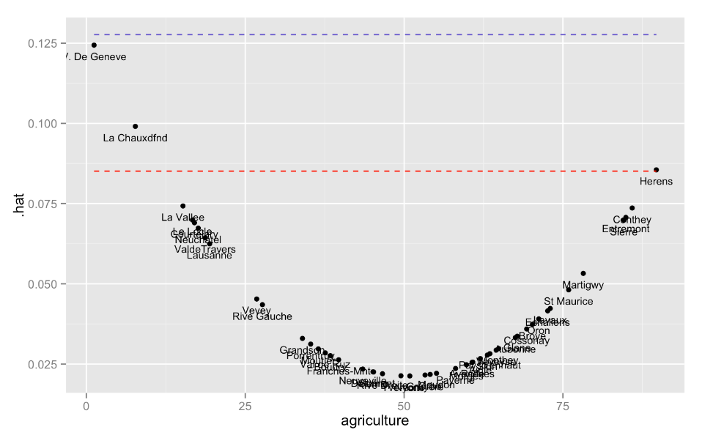
## plot leverage versus xs
ggplot(slr_vars, aes(x = agriculture, y = .hat)) +
geom_point() +
geom_line(aes(y = 2*mean(.hat)), colour = "red", lty = "dashed") +
geom_line(aes(y = 3*mean(.hat)), colour = "slateblue", lty = "dashed") +
geom_text(aes(label = .rownames), size = 3, vjust = 2)

Slide 22
Just the x’s
slr_vars %>%
select(.rownames, fertility, agriculture, .hat) %>%
mutate(mean_dev = agriculture - mean(agriculture)) %>%
arrange(mean_dev)
.rownames fertility agriculture .hat mean_dev
1 V. De Geneve 35.0 1.2 0.12437740 -49.4595745
2 La Chauxdfnd 65.7 7.7 0.09905898 -42.9595745
3 La Vallee 54.3 15.2 0.07427080 -35.4595745
…
45 Entremont 69.3 84.9 0.07068941 34.2404255
46 Conthey 75.5 85.9 0.07361779 35.2404255
47 Herens 77.3 89.7 0.08551436 39.0404255

Slide 23
Extremity on the y’s: discrepancy
The discrepancy (or distance²) between each predicted and observed value of y_{i}
A studentized residual is an observed residual divided by its standard error; two types:
Internally studentized (rstandard): re-normalize the residuals to have unit variance, using a measure of the error variance.
Also broom::.std.resid
Externally studentized (rstudent): re-normalize the residuals to have unit variance, using a leave-one-out measure of the error variance. This is a measure of the size of the residual, standardized by the estimated standard deviation of residuals based on all the data but that observation. Sometimes called jackknifed residuals.

Slide 24
Internally studentized residuals
rstandard
Also broom::augment(.std.resid)

Slide 25
Externally studentized residuals
rstudent
Sadly, not available in broom::augment

Slide 26
Save externally studentized residuals (ESR)
m_agr <- lm(fertility ~ agriculture, data = swiss) # original model
slr_vars <- augment(m1) # broom
slr_vars <- slr_vars %>%
mutate(.extsr = rstudent(m1)) # add ESR
> slr_vars %>%
select(.std.resid, .extsr) %>%
head()
.std.resid .extsr
1 1.4554806 1.4743391
2 1.2015896 1.2076959
3 2.1000488 2.1864890
4 1.5814696 1.6091557
5 0.6977688 0.6937354
6 0.7687025 0.7651537

Slide 27
Expect 5% with abs(.extsr) ≥ 2
> slr_vars %>%
filter(abs(.extsr) >= 2) %>%
select(.rownames, fertility, agriculture, .resid, .std.resid, .extsr)
.rownames fertility agriculture .resid .std.resid .extsr
1 Franches-Mnt 92.5 39.7 24.48582 2.100049 2.186489
2 V. De Geneve 35.0 1.2 -25.53742 -2.309602 -2.432516
3 Rive Droite 44.7 46.6 -24.65418 -2.109762 -2.197709
4 Rive Gauche 42.8 27.7 -22.88376 -1.980169 -2.049364
4 out of 47:
8.5% of observations with ESR considered to be relatively large
(expected ≈ 2 or 3 observations)

Slide 28
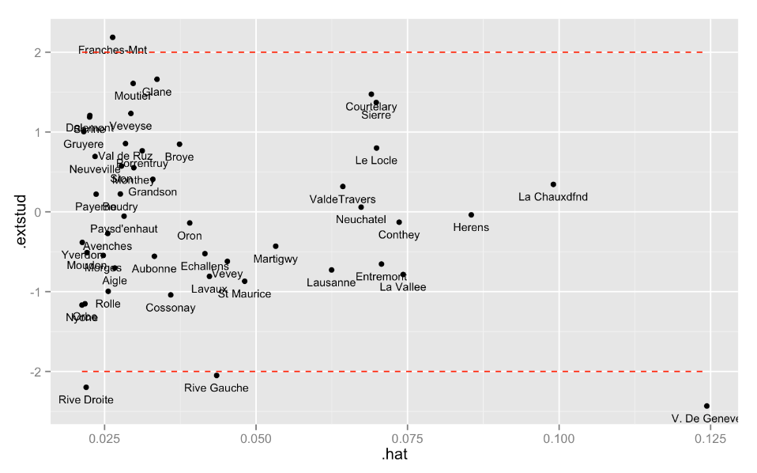
## plot leverage versus ESR ggplot(slr_vars, aes(x = .hat, y = .extsr)) + geom_point() + geom_text(aes(label = .rownames), size = 3, vjust = 2) + geom_line(aes(y = -2), colour = "red", lty = "dashed") + geom_line(aes(y = 2), colour = "red", lty = "dashed")

Slide 29
car::outlierTest()
> outlierTest(m1) # library(car)
No Studentized residuals with Bonferonni p < 0.05
Largest |rstudent|:
rstudent unadjusted p-value Bonferonni p
V. De Geneve -2.432516 0.01913 0.89909
ESR follows t_{n – k – 2} distribution (k = number of predictors, n = number of observations), t₄₄
Alpha = .025/n (two-tailed)
> qt(1-.025/47, 44) # 1 - (alpha/2)/n, df = n-k-2
_{[1] 3.504708}
_{> pt(-2.432516, 44)*2}
_{[1] 0.01912966}

Slide 30
Bonferroni adjustment
Problem: if n is large, and we “threshold” at t_{n – k – 2} we will get many outliers by chance alone, even if our model is correct
Solution: adjust the “threshold” to reflect reality- we are screening all observed ESR values and looking for the max, so we should account for multiple testing somehow
Recall: ESRs are t-distributed variables
For nominal 𝝰 = .05, the nominal critical t-value value is t_{n – k – 2} where k = number of regression coefficients (including intercept), n = number of observations
Instead, we would set 𝝰 = .05/n to find ESRs that are in fact outliers

Slide 31
Bonferroni adjustment
If I only wanted to know whether one datapoint was more extreme at 𝝰 = .05 (two-tailed), we compare to critical t₄₄ =
> lowert <- qt(.025, 44)
> uppert <- qt(1 - .025, 44)
> c(lowert, uppert)
[1] -2.015368 2.015368

Slide 32
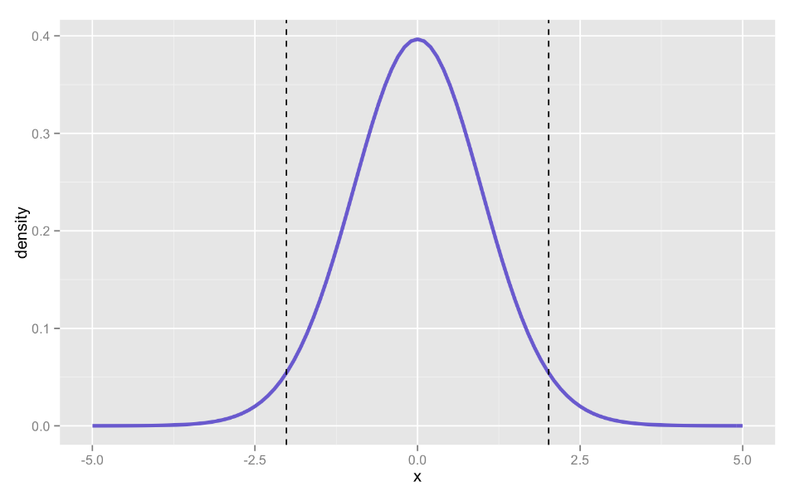
> lowert <- qt(.025, 44)
> uppert <- qt(1 - .025, 44)
> c(lowert, uppert)
[1] -2.015368 2.015368
p = .025 ←
→ p = .025
-2.015
2.015

Slide 33
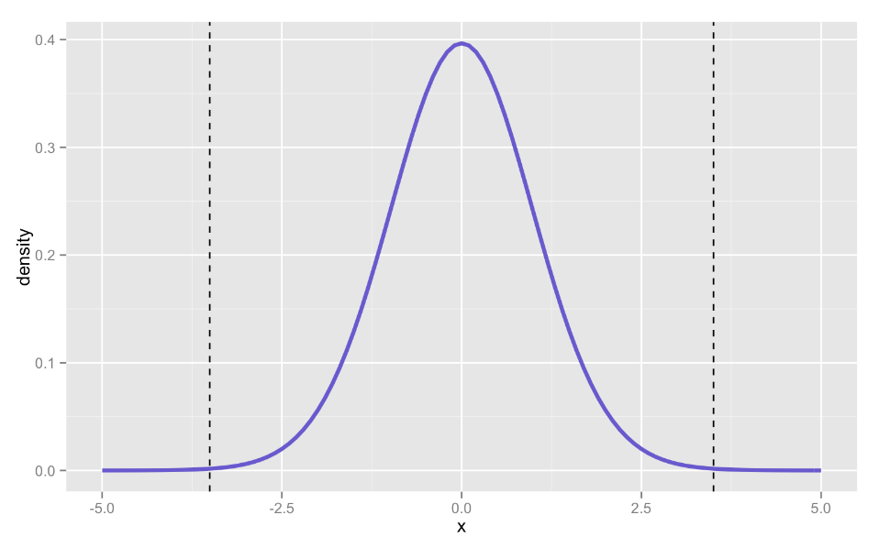
> lowertstar <- qt(.025/47, 44)
> uppertstar <- qt(1-.025/47, 44)
> c(lowertstar, uppertstar)
[1] -3.504708 3.504708
> pstar <- 1 - pt(3.504708, 44)
> pstar_fam <- pstar*47*2
> c(pstar, pstar_fam)
[1] 0.0005319156 0.0500000646
p = .0005 ←
If I do this 47x,
my family-
wise
p = .025
p = .0005
If I do this 47x,
my family-
wise
p = .025
-3.504708
3.504708

Slide 34


Slide 35
Influence on regression estimates
Global: DFFITS and Cook’s D provide information about how each case affects overall regression equation
Both are deletion statistics (like the externally studentized residuals)
Answer similar questions, but scale differently
Specific: DFBETAS provide information about how each case affects each individual coefficient estimate (i.e., each beta)
Will return to this in multiple regression

Slide 36
DFFITS
Compares predicted values of Y_{i} when (1) observation is included and (2) when observation is excluded
Number of standard deviations by which yhat would change for each case if it were deleted
Thus: “difference in fit, standardized”
Higher absolute values mean greater influence; 0 means no influence
But: extreme outliers could also change the regression equation, and hence the predicted values, for other observations too…

Slide 37
Cook’s distance (Cook’s D)
Influence on regression line, measured by how much the regression line would change if the point were not included in the analysis.
Cook's distance measures the influence of case i on all n fitted values y_{i} (not just the fitted value for case i as DFFITS)
Cook's distance refers to how far, on average, predicted y-values will move if the observation in question is dropped from the data set
With > 1 predictor, Cook's distance is presumably more important to you if you are doing predictive modeling, whereas dfbeta is more important in explanatory modeling.

Slide 38
Cook’s distance
n <- nrow(slr_vars)
k <- 1 # predictors (not including intercept), number regressors
d <- 4/(n - k - 1)
d
[1] 0.08888889
slr_vars %>%
filter(.cooksd > d)
.rownames fertility agriculture .fitted .se.fit .resid .hat .sigma .cooksd .std.resid
1 V. De Geneve 35.0 1.2 60.53742 4.167274 -25.53742 0.12437740 11.21922 0.37885147 -2.309602
2 Rive Gauche 42.8 27.7 65.68376 2.464307 -22.88376 0.04349378 11.41733 0.08914847 -1.980169
## plot leverage versus cooks d
ggplot(slr_vars, aes(x = .hat, y = .cooksd)) +
geom_point() +
geom_text(aes(label = .rownames), size = 3, vjust = 2) +
geom_line(aes(y = d), colour = "red", lty = "dashed")

Slide 39
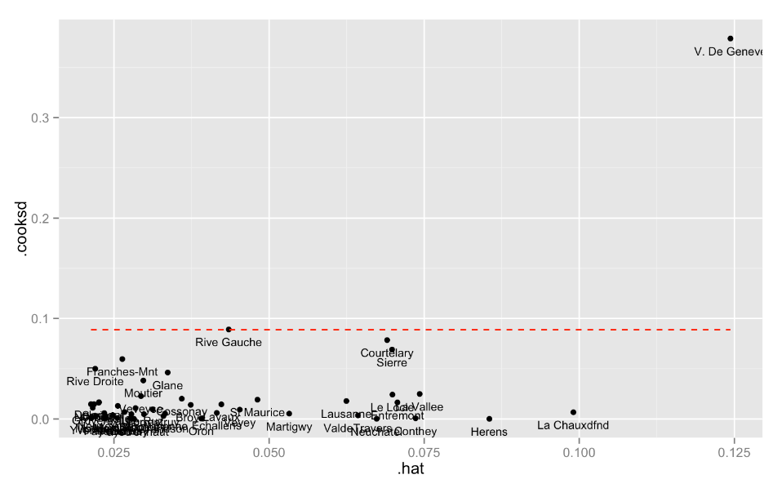
Cook’s D

Slide 40
Specific measures of influence
How each individual regression coefficient is changed by deleting each case from the dataset
Number of DFBETAS is the number of predictors in your model
Also for the intercept- generally not interesting one bit!
Recommendation: I would look at DFBETAS after Cook’s to isolate which x(’s) might be unduly influencing your overall regression equation
How to: when we do multiple regression…

Slide 41
Summing up diagnostics
Influence | Recommended index | R | broom::augment?
Leverage (extreme on x) | Hat values | hatvalues(model) | .hat
Discrepancy (extreme on y) | Externally studentized residual | rstudent(model) | Sadly no
Global influence | Cook’s d | cooks.distance(model) | .cooksd
Specific influence | DFBETAS | dfbetas(model) | Sadly no

