Slide 1
Class 15: Analysis of Variance II
Alison Presmanes Hill

Slide 2
all models are
Wrong
but some are
Useful
George E. P. Box (1979). Robustness in the strategy of scientific model building. In Robustness in Statistics, pages 201-236. Academic Press.
http://www.dtic.mil/cgi-bin/GetTRDoc?Location=U2&doc=GetTRDoc.pdf&AD=ADA070213

Slide 3
there is no need to ask the question
Is the model true?
If the “truth” is to be the “whole truth” then the answer must be
No.
The only question of interest is :
Is the model
illuminating and useful?

Slide 4
ANOVA: when and why
When:
We want to compare means we can use a t-test. This test has limitations:
You can compare only 2 means: often we would like to compare means from 3 or more groups.
It can be used only with one Predictor/Independent Variable.
ANOVA
Compares several means.
Can be used when you have manipulated more than one Independent Variables.
It is an extension of regression (the General Linear Model)

Slide 5



Slide 6
Being sticker rich
Children (ages 3–11) received a small (12, “sticker poor”) or large (30, “sticker rich”) number of stickers, and were then given the opportunity to share their windfall with either one or multiple anonymous recipients (Dictator Game).
Do the number of available resources and/or the number of potential recipients alter the likelihood of a child donating and/or the amount they donate?

Slide 7
Approach
“Givers” only analyzed
“A univariate [read: one response/outcome variable] ANOVA was conducted investigating the impact of the between-subjects factors [read: all levels of factors are measured from independent samples] of age (4: 3–4 years, 5–6 years, 7–8 years, 9–11 years), number of resources (2: 12 or 30 stickers), number of recipients (2: 1 or 2 anonymous recipients), and gender (2: female, male) on the proportion of resources shared.”

Slide 8
Focus on one factor first…
One-way ANOVA
Really only needed if > 2 levels for our one factor (what if = 2 levels?)
Age group (4 levels)
3–4 years,
5–6 years,
7–8 years,
9–11 years

Slide 9
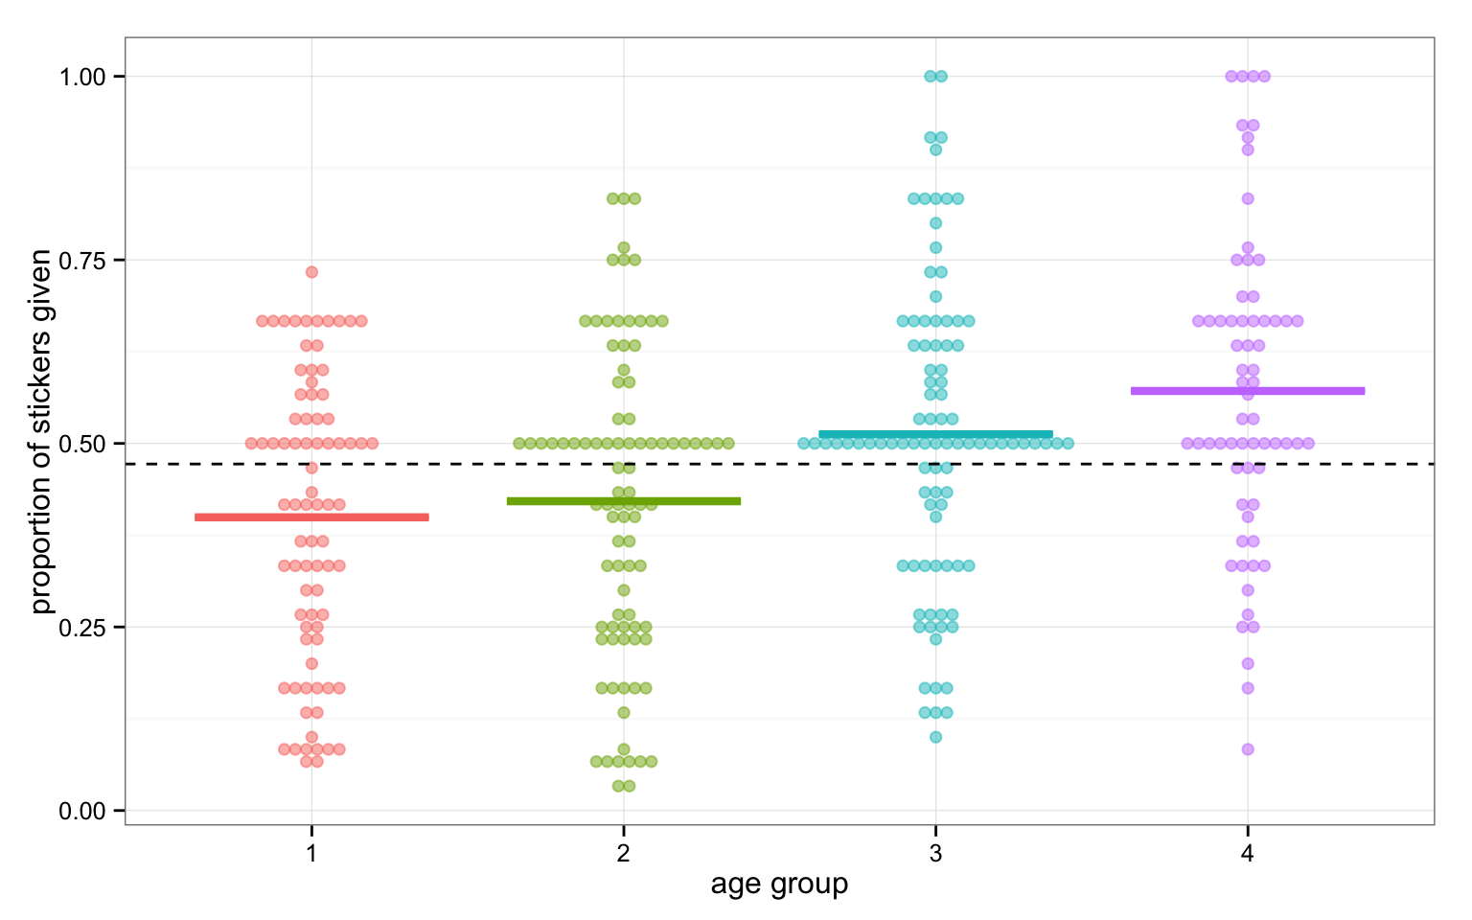

Slide 10
Let’s start with garden variety linear regression
sticker_lm <- lm(prop_given ~ age_group, data = givers)
summary(sticker_lm)
Call:
lm(formula = prop_given ~ age_group, data = givers)
Residuals:
Min 1Q Median 3Q Max
-0.49179 -0.15559 -0.00463 0.12047 0.48566
Coefficients:
Estimate Std. Error t value Pr(>|t|)
(Intercept) 0.39938 0.02285 17.479 < 2e-16 ***
age_group2 0.02192 0.03140 0.698 0.485639
age_group3 0.11496 0.03116 3.689 0.000264 ***
age_group4 0.17575 0.03413 5.150 4.53e-07 ***
---
Signif. codes: 0 ‘***’ 0.001 ‘**’ 0.01 ‘*’ 0.05 ‘.’ 0.1 ‘ ’ 1
Residual standard error: 0.2044 on 324 degrees of freedom
Multiple R-squared: 0.1004, Adjusted R-squared: 0.09212
F-statistic: 12.06 on 3 and 324 DF, p-value: 1.67e-07

Slide 11
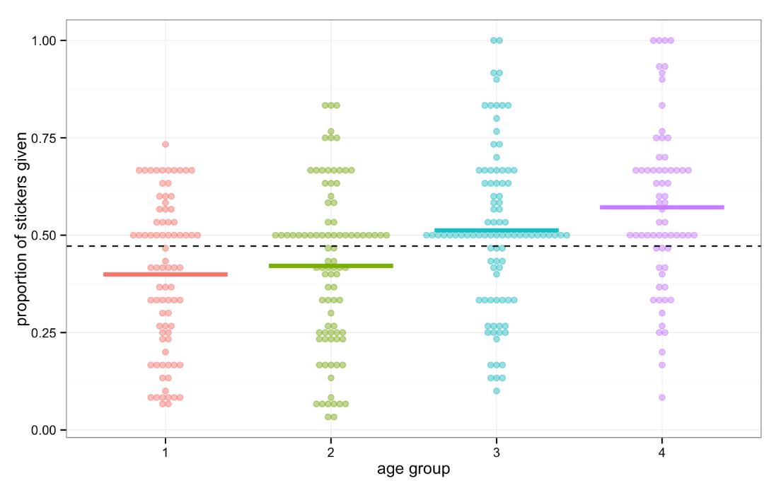
means <- givers %>%
+ group_by(age_group) %>%
+ summarise(cell_means = mean(prop_given)) %>%
+ mutate(tx_effects = cell_means - cell_means[1])
means
Source: local data frame [4 x 3]
age_group cell_means tx_effects
(fctr) (dbl) (dbl)
1 1 0.3993750 0.0000000
2 2 0.4212963 0.0219213
3 3 0.5143369 0.1149619
4 4 0.5751282 0.1757532
Notes:
\begin{bmatrix}
Y_{11} \\
Y_{21} \\
\vdots \\
Y_{n_33} \\
\end{bmatrix} = \begin{bmatrix}
1 & 0 & 0 \\
1 & 1 & 0 \\
\vdots & \vdots & \vdots \\
1 & 0 & 1 \\
\end{bmatrix} \begin{bmatrix}
\theta \\
\tau_2 \\
\tau_3 \\
\end{bmatrix} + \begin{bmatrix}
\varepsilon_{11} \\
\varepsilon_{22} \\
\vdots \\
\varepsilon_{n_33} \\
\end{bmatrix}

Slide 12
means
Source: local data frame [4 x 3]
age_group cell_means tx_effects
(fctr) (dbl) (dbl)
1 1 0.3993750 0.0000000
2 2 0.4212963 0.0219213
3 3 0.5143369 0.1149619
4 4 0.5751282 0.1757532
tidy(sticker_lm)
term estimate std.error statistic p.value
1 (Intercept) 0.3993750 0.02284908 17.4788218 1.179975e-48
2 age_group2 0.0219213 0.03140306 0.6980625 4.856388e-01
3 age_group3 0.1149619 0.03116379 3.6889579 2.640087e-04
4 age_group4 0.1757532 0.03412684 5.1499998 4.531246e-07

Slide 13
Omnibus ANOVA in R
sticker_lm <- lm(prop_given ~ age_group, data = givers)
anova(sticker_lm)
Analysis of Variance Table
Response: prop_given
Df Sum Sq Mean Sq F value Pr(>F)
age_group 3 1.5111 0.50370 12.06 0.000000167 ***
Residuals 324 13.5323 0.04177
---
Signif. codes: 0 ‘***’ 0.001 ‘**’ 0.01 ‘*’ 0.05 ‘.’ 0.1 ‘ ’ 1
Notes:
\begin{bmatrix}
Y_{11} \\
Y_{21} \\
\vdots \\
Y_{n_33} \\
\end{bmatrix} = \begin{bmatrix}
1 & 0 & 0 \\
0 & 1 & 0 \\
\vdots & \vdots & \vdots \\
0 & 0 & 1 \\
\end{bmatrix} \begin{bmatrix}
\mu_1 \\
\mu_2 \\
\mu_3 \\
\end{bmatrix} + \begin{bmatrix}
\varepsilon_{11} \\
\varepsilon_{22} \\
\vdots \\
\varepsilon_{n_33} \\
\end{bmatrix}

Slide 14
aov versus anova in R
?aov: “aov is designed for balanced designs, and the results can be hard to interpret without balance: beware that missing values in the response(s) will likely lose the balance.”
Use anova(lm())if you don’t have a balanced design
But really, only use anova(lm())if you:
Have an unbalanced design (but not horribly so- generally bad idea)
Are certain you wish to assume equal variances across groups
Foreshadowing: Behrens-Fisher problem revisited
Only have one predictor (i.e., one-way ANOVA)
Foreshadowing: types of sums of squares

Slide 15
What are the ANOVA assumptions?
The k samples are randomly selected from the k populations of interest
Each of the k populations have a normal distribution
All k populations have the same variance
Why does this matter?
Our observed F-statistic is based on the assumption that when H₀ is true, our F-statistic will have an F-distribution

Slide 16
ANOVA assumptions
Parallel those for linear regression, except for the assumption of linearity
We assume:
Which group an observation falls into is fixed, not random
Residuals are all independent
Residuals are normally distributed
Residuals have constant variance
Notes:
Anova forces us to assume variances equal
Inherently a two-sided test, so non-normal distributions generally have little effect if sample sizes are reasonably large

Slide 17
Checking ANOVA assumptions
A priori assumptions check
A posteriori assumptions check
Normality
Look at Q-Q plot by group
Look at skewness/kurtosis ratios by group
Homogeneity of variance
Look at boxplots by group
Look at actual standard deviations by group
Run levene test
Normality of residuals
Look at scatterplot of residuals by group (what will be the mean?)
Look at Q-Q plot of residuals by group
Look at skewness/kurtosis ratios by group
Homogeneity of residuals variance
Look at boxplots of residuals by group
Look at actual standard deviations by group
Run levene test

Slide 18
The plot of each sample's values against its mean (or its sample ID) will consist of vertical "stacks" of data points, one stack for each unique sample mean value. If the assumptions for the samples' population distributions are correct, the stacks should be about the same length. Outliers may appear as anomalous points in the graph.
A fan pattern like the profile of a megaphone, with a noticeable flare either to the right or to the left (one or more of the "stacks" of data points is much longer than the others), suggests that the variance in the values increases in the direction the fan pattern widens (usually as the sample mean increases), and this in turn suggests that a transformation may be needed.

Slide 19
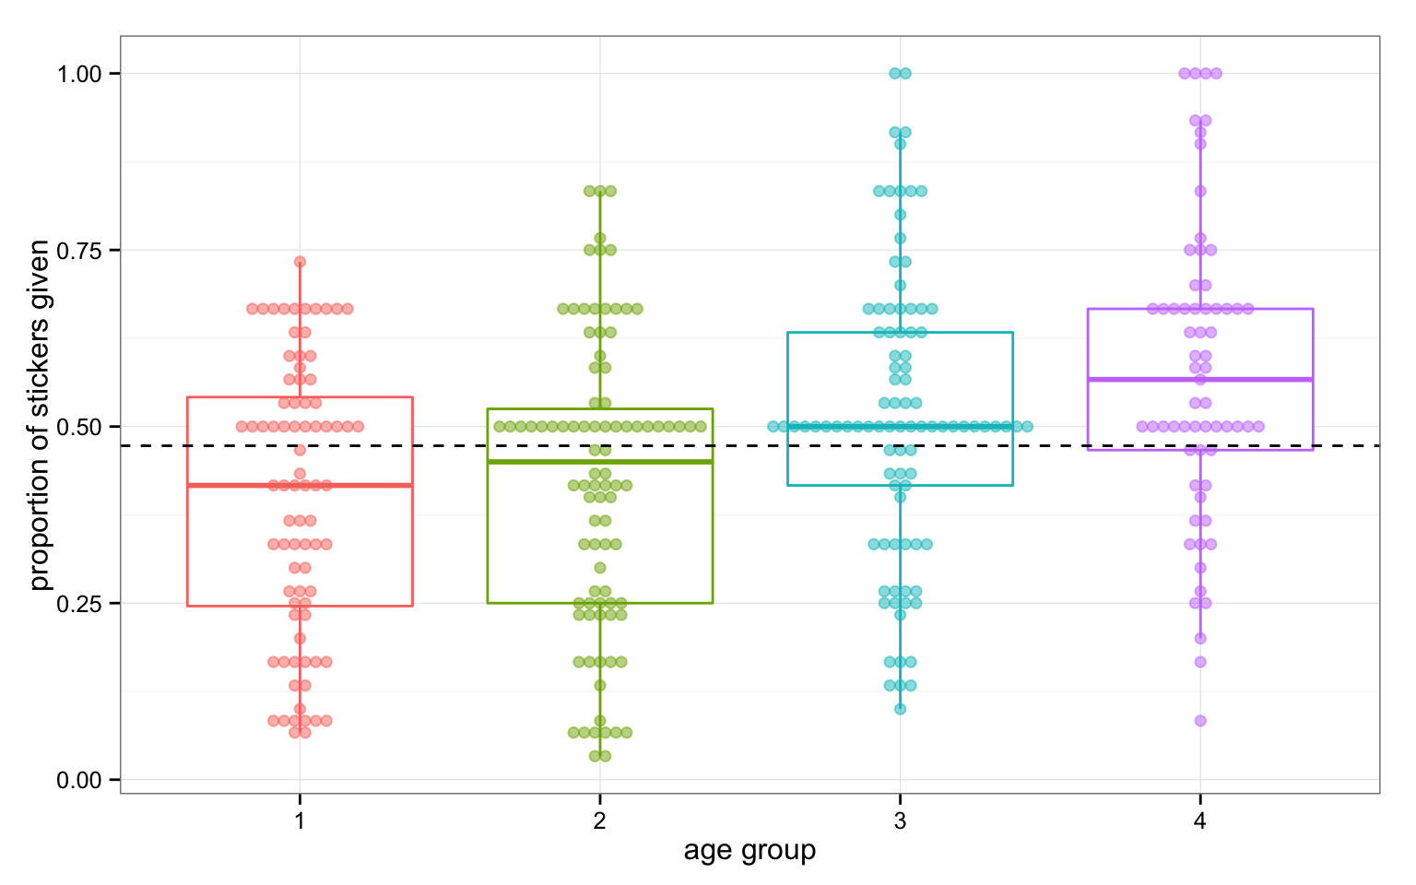
Side-by-side boxplots of the samples can also reveal lack of homogeneity of variances if some boxplots are much longer than others, and reveal suspected outliers.

Slide 20
Unequal variances, one-way
oneway.test(prop_given ~ age_group, data = givers)
One-way analysis of means (not assuming equal variances)
data: prop_given and age_group
F = 11.413, num df = 3.00, denom df = 174.57, p-value = 7.167e-07
B. L. Welch (1951), On the comparison of several mean values: an alternative approach. Biometrika, 38, 330–336.

Slide 21
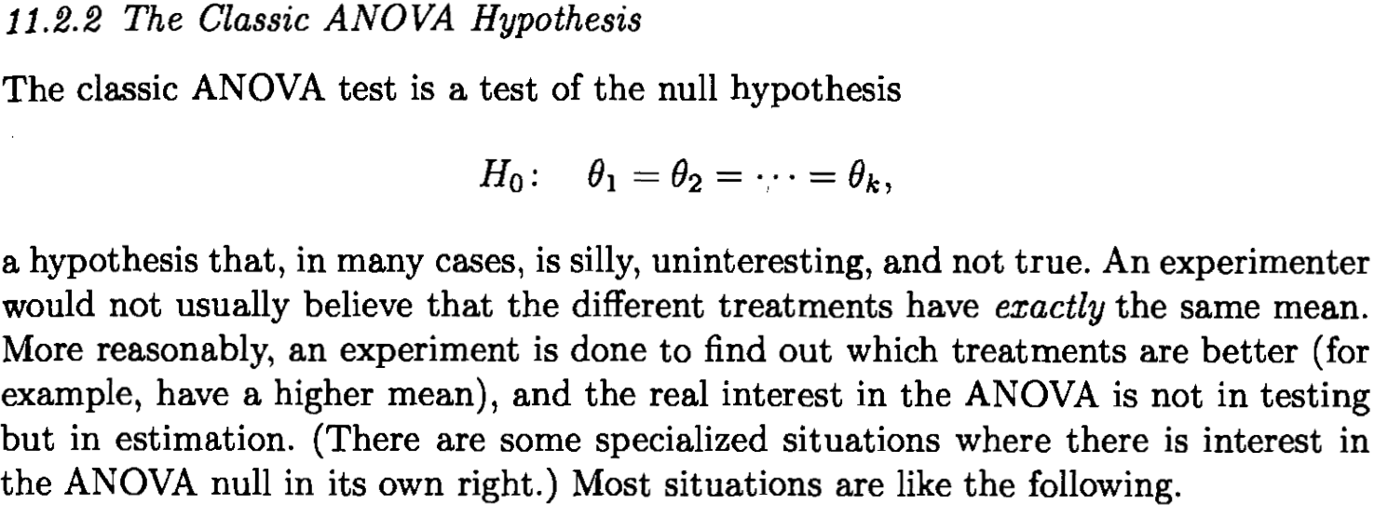
Casella & Berger (2001)

Slide 22
Why do contrasts?
The F-ratio tells us only that the experiment was successful
i.e. group means were different
It does not tell us specifically which group means differ from which.
We need additional contrasts to find out where the group differences lie.

Slide 23
How?
Multiple t-tests
We saw earlier that this is a bad idea
Orthogonal Contrasts/Comparisons
Hypothesis driven
Planned a priori
Post Hoc Tests
Not Planned (no hypothesis)
Compare all pairs of means
Trend Analysis

Slide 24
Planned Contrasts
Basic Idea:
The variability explained by the Model (Model sums of squares) is due to participants being assigned to different groups.
This variability can be broken down further to test specific hypotheses about which groups might differ.
We break down the variance according to hypotheses made a priori (before the experiment).

Slide 25
Contrasts
Let t = (t₁, …, t_{k}) be a set of variables, either parameters or statistics, and let a = (a₁, …, a_{k}) be known as constants. The function:
If a linear combination of t_{i}s; if
Then it is called a contrast.

Slide 26
For example:
Let’s say we have means θ₁,…, θ_{k} and constants a = (1, -1, 0, …, 0), then:
Is a contrast that compares θ₁ to θ₂

Slide 27
The ANOVA null is really just a statement about contrasts, and allows us to think and operate in a univariate space…

Slide 28

What is a contrast matrix?
In R, we parameterize our contrasts (just linear combinations of the cells means) in a matrix
The rows of this matrix correspond to the levels of the factor, and there is one column for each predictor included in the model
The coding scheme defined by the contrasts attribute in R is the inverse of the matrix of contrast weights.
dummy <- contrasts(givers$age_group)
dummy
2 3 4
1 0 0 0
2 1 0 0
3 0 1 0
4 0 0 1
Group means
solve(cbind(1, dummy))
1 2 3 4
1 0 0 0
2 -1 1 0 0
3 -1 0 1 0
4 -1 0 0 1
Coefs

Slide 29
Contrast matrices in R
contrasts(givers$age_group)
2 3 4
1 0 0 0
2 1 0 0
3 0 1 0
4 0 0 1
contr.treatment(4)
2 3 4
1 0 0 0
2 1 0 0
3 0 1 0
4 0 0 1
The default contrast setting in R here is called “dummy coding” in that each level is compared to the “reference level”, so the intercept is the cell mean of the reference group (here, age group = 1)
Group means
solve(cbind(1, dummy))
1 2 3 4
1 0 0 0
2 -1 1 0 0
3 -1 0 1 0
4 -1 0 0 1
Coefs

Slide 30
Linear regression with dummy coding
contrasts(givers$age_group) <- contr.treatment(4)
sticker_dummy <- lm(prop_given ~ age_group, data = givers)
summary(sticker_dummy)
<snip, snip>
Coefficients:
Estimate Std. Error t value Pr(>|t|)
(Intercept) 0.39938 0.02285 17.479 < 0.0000000000000002 ***
age_group2 0.02192 0.03140 0.698 0.485639
age_group3 0.11496 0.03116 3.689 0.000264 ***
age_group4 0.17575 0.03413 5.150 0.000000453 ***
---
Signif. codes: 0 ‘***’ 0.001 ‘**’ 0.01 ‘*’ 0.05 ‘.’ 0.1 ‘ ’ 1
Residual standard error: 0.2044 on 324 degrees of freedom
Multiple R-squared: 0.1004, Adjusted R-squared: 0.09212
F-statistic: 12.06 on 3 and 324 DF, p-value: 0.000000167
solve(cbind(1, dummy))
1 2 3 4
1 0 0 0
2 -1 1 0 0
3 -1 0 1 0
4 -1 0 0 1
The default contrast setting for “lm”

Slide 31
Contrast matrices in R
solve(cbind(1, simple_c))
1 2 3 4
0.25 0.25 0.25 0.25
2 -1.00 1.00 0.00 0.00
3 -1.00 0.00 1.00 0.00
4 -1.00 0.00 0.00 1.00
c <- contr.treatment(4)
simple_mat <- matrix(rep(1/4, 12), ncol = 3)
simple_mat
[,1] [,2] [,3]
[1,] 0.25 0.25 0.25
[2,] 0.25 0.25 0.25
[3,] 0.25 0.25 0.25
[4,] 0.25 0.25 0.25
simple_c <- c - simple_mat
simple_c
2 3 4
1 -0.25 -0.25 -0.25
2 0.75 -0.25 -0.25
3 -0.25 0.75 -0.25
4 -0.25 -0.25 0.75
contrasts(givers$age_group) <- simple_c
Let’s do “simple coding” instead, which still compares each level to the reference level, intercept being the grand mean across all 4 groups

Slide 32
Linear regression with simple coding
contrasts(givers$age_group) <- simple_c
sticker_simple <- lm(prop_given ~ age_group, data = givers)
summary(sticker_simple)
<snip, snip>
Coefficients:
Estimate Std. Error t value Pr(>|t|)
(Intercept) 0.47753 0.01140 41.905 < 2e-16 ***
age_group2 0.02192 0.03140 0.698 0.485639
age_group3 0.11496 0.03116 3.689 0.000264 ***
age_group4 0.17575 0.03413 5.150 4.53e-07 ***
---
Signif. codes: 0 ‘***’ 0.001 ‘**’ 0.01 ‘*’ 0.05 ‘.’ 0.1 ‘ ’ 1
Residual standard error: 0.2044 on 324 degrees of freedom
Multiple R-squared: 0.1004, Adjusted R-squared: 0.09212
F-statistic: 12.06 on 3 and 324 DF, p-value: 1.67e-07
solve(cbind(1, simple_c))
1 2 3 4
0.25 0.25 0.25 0.25
2 -1.00 1.00 0.00 0.00
3 -1.00 0.00 1.00 0.00
4 -1.00 0.00 0.00 1.00

Slide 33
Linear regression with deviation coding
solve(cbind(1, contr.sum(4)))
1 2 3 4
[1,] 0.25 0.25 0.25 0.25
[2,] 0.75 -0.25 -0.25 -0.25
[3,] -0.25 0.75 -0.25 -0.25
[4,] -0.25 -0.25 0.75 -0.25
contr.sum(4)
[,1] [,2] [,3]
1 1 0 0
2 0 1 0
3 0 0 1
4 -1 -1 -1
contrasts(givers$age_group) <- contr.sum(4)
sticker_dev <- lm(prop_given ~ age_group, data = givers)
summary(sticker_dev)
<snip, snip>
Coefficients:
Estimate Std. Error t value Pr(>|t|)
(Intercept) 0.47753 0.01140 41.905 < 2e-16 ***
age_group1 -0.07816 0.01977 -3.953 9.47e-05 ***
age_group2 -0.05624 0.01902 -2.956 0.00334 **
age_group3 0.03680 0.01883 1.955 0.05145 .
---
Signif. codes: 0 ‘***’ 0.001 ‘**’ 0.01 ‘*’ 0.05 ‘.’ 0.1 ‘ ’ 1
Residual standard error: 0.2044 on 324 degrees of freedom
Multiple R-squared: 0.1004, Adjusted R-squared: 0.09212
F-statistic: 12.06 on 3 and 324 DF, p-value: 1.67e-07
Let’s do “deviation coding” instead, which compares each level to the grand mean
Notes:
\beta_0 = (\mu_1 + \mu_2 + \mu_3 + \mu_4)/4 \\
\beta_1 = \mu_1 - (\mu_1 + \mu_2 + \mu_3 + \mu_4)/4 \\
\beta_2 = \mu_2 - (\mu_1 + \mu_2 + \mu_3 + \mu_4)/4 \\
\beta_3 = \mu_3 - (\mu_1 + \mu_2 + \mu_3 + \mu_4)/4

Slide 34
contr.sum(4)
[,1] [,2] [,3]
1 1 0 0
2 0 1 0
3 0 0 1
4 -1 -1 -1
solve(cbind(1, contr.sum(4)))
1 2 3 4
[1,] 0.25 0.25 0.25 0.25
[2,] 0.75 -0.25 -0.25 -0.25
[3,] -0.25 0.75 -0.25 -0.25
[4,] -0.25 -0.25 0.75 -0.25
Where the final effect is omitted to avoid singularity

Slide 35
solve(cbind(1, contr.sum(4)))
1 2 3 4
[1,] 0.25 0.25 0.25 0.25
[2,] 0.75 -0.25 -0.25 -0.25
[3,] -0.25 0.75 -0.25 -0.25
[4,] -0.25 -0.25 0.75 -0.25
These all say the same thing. This is typically the set of contrasts you wish to test with ANOVA

Slide 36

Why am I boring all of you with this?
Once you get beyond two group comparisons, you need to know a bit about how factors are utilized in linear models and what the resulting parameter estimates mean. One day you may even want to exert control on this.
A popular R package for performing linear modelling for thousands of, e.g., genes at once, while borrowing strength across the genes, is called limma. And, unlike lm(), limma does NOT make the design matrix for you. limma does not use the same formula interface as lm().

Slide 37
Multiple comparisons
At this point, you may be thinking, why do an ANOVA at all? Why not just do a whole heap of t-tests?
Proliferation of Type I error → family-wise error rates
Post-hoc inference

Slide 38
Multiple comparison procedures
Family type | Simultaneous methods |  | Sequential methods
 | Equal variances | Unequal variances | Equal variances | Unequal variances
Planned | Dunn-Bonferroni | Dunn-Bonferroni using Welch’s t’ | Hochberg | Hochberg using Welch’s t’
All pairwise | Tukey HSD (equal n) or Tukey-Kramer (unequal n) | Games-Howell or Dunnett T3 | Fisher-Hayter
Experimental vs control | Dunn-Bonferroni (unequal n) | Dunn-Bonferroni using Welch’s t’
Post-hoc | Sheffé | Sheffé using Welch’s t’

Slide 39
The “Big 3” MCPs
Planned contrasts
Bonferroni (orthogonal contrasts)
Holm (non-orthogonal, overlapping contrasts)
Hochberg (non-orthogonal, overlapping contrasts)
Sheffé
Tukey HSD

Slide 40
Planned contrasts
Sometimes we are less interested in the overall F test than in testing highly specific linear combination hypotheses
Planned orthogonal pair-wise contrasts
In some cases, these hypotheses “break down” the information to a set of means into non-overlapping components that are statistically uncorrelated
For example, contrasting groups A & B is orthogonal to contrasting groups C & D (they are linearly independent)
When contrasts are all orthogonal, can use ordinary t-tests with Bonferroni adjusted p-values (k-1 possible orthogonal contrasts)
Planned pair-wise contrasts (overlapping- not orthogonal)
Contrasting groups A & B is NOT orthogonal to comparing B & C
When this happens, we gain power by accounting for that overlap (Bonferroni will be overly conservative, increased Type II errors)

Slide 41
Bonferroni
If all k tests are done at α level, then the FWE must be less than or equal to kα
Thus, we use a new critical p-value for each contrast equal to α/k to keep FEW less than or equal to α
Pros: easy/straightforward
Cons: raises possibility of Type II errors, may be overly conservative
Several procedures developed early on to improve on Bonferroni for non-orthogonal contrasts

Slide 42
Holm: Method of Closure
Assume that the k tests are independent; that is, the falsity of one hypothesis is not precluded by the falsity of another
Rank order the p-values for your k tests from lowest to highest
Look at the lowest p-value first; if it is < α/k, reject null for that test and move on to the next. If not, stop.

Slide 43
Holm: Method of Closure
For each successive test, reduce divisor by 1 when previous was significant
For example, for second test, compare the second smallest p-value to α/k-1
Continue until you fail to reject (p > adjusted α)
This method has been shown to have more statistical power than Bonferroni

Slide 44
Hochberg: False Discovery Rate
Rank order the p-values for your k tests from lowest to highest
Look at the lowest p-value first; if it is < 1*α/k, reject null for that test and move on to the next. If not, stop.
For each successive test, add 1 to the numerator multiplier when previous was significant (leave denominator at k)
For example, for second test, compare the second smallest p-value to (2*α)/k

Slide 45
Scheffé
Allows you to perform any contrast hypothesis test after having viewed the data
Provides FEW protection AND protection against post-hoc cherry-picking of data
High protection → high cost
The larger the family of tests, the more protection needed, lower statistical power

Slide 46
Scheffé
Compute the generalized t-statistic exactly the way we have computed it in class
Then compare to a *new* t-critical value, t’
k = total number of independent groups before contrast hypothesis
What does the above formula assume?
Note: I use t’ here instead of F’ because you use the t’ to calculate confidence intervals in place of t

Slide 47
Tukey HSD
You are interested in performing all possible pairwise contrasts between pairs of groups of means
By stating this family of contrasts a priori, we get full protection at a lower cost

Slide 48
Tukey HSD
Works from two-sample t-test assuming equal variances
Standard t-test: compute a t-statistic and compare to a critical value from the t-distribution (standard t-test)
Tukey suggested a new statistic, q, to compare to a new critical value from the studentized range distribution

Slide 49
Tukey HSD
The HSD is the minimum difference between each possible pair of sample means that would be larger than one would expect by chance
q is the same for all pair-wise contrasts: it is your new critical value to beat
What does this imply about the 95% confidence interval for q?

Slide 50
Tukey HSD procedure
Find q, the critical value for the studentized range statistic (qtukey()), for α where q_{k} _{,N-k}
Note that these degrees of freedom are *not* the same as the overall F df in the ANOVA
Where MSE = mean square error or mean square within-groups for between-groups ANOVA
What does the above formula assume?

Slide 51
Planned contrasts
Similar to t-tests with one important distinction
For σhat², you use the data from all the groups (e.g., MS_{wg} or MSE) , regardless of whether a group is involved (i.e., has a nonzero weight) in the linear combination contrast
For standard t-test, what is our σhat² assuming equal variances?

Slide 52
False positive rate
 | Call based on observed data
True state of the world | Fail to reject H₀ | Reject H₀
H₀ | True negative 1 – 𝝰 | False positive Type I error 𝝰 | # true H₀’s
H₁ | False negative Type II error 𝛃 | True positive 1 – 𝛃 | # true H₁’s
 |  | # rejected H₀’s | # total tests

Slide 53
Family-wise error rate: P(≥ 1 false positive )
 | Call based on observed data
True state of the world | Fail to reject H₀ | Reject H₀
H₀ | True negative 1 – 𝝰 | False positive Type I error 𝝰 | # true H₀’s
H₁ | False negative Type II error 𝛃 | True positive 1 – 𝛃 | # true H₁’s
 |  | # rejected H₀’s | # total tests

Slide 54
Power: probability of true positive
 | Call based on observed data
True state of the world | Fail to reject H₀ | Reject H₀
H₀ | True negative 1 – 𝝰 | False positive Type I error 𝝰 | # true H₀’s
H₁ | False negative Type II error 𝛃 | True positive 1 – 𝛃 | # true H₁’s
 |  | # rejected H₀’s | # total tests

Slide 55
False discovery rate: E(# false pos / # discoveries)
 | Your decision based on observed data
True state of the world | Fail to reject H₀ | Reject H₀
H₀ | True negative 1 – 𝝰 | False positive Type I error 𝝰 | # true H₀’s
H₁ | False negative Type II error 𝛃 | True positive 1 – 𝛃 | # true H₁’s
 |  | # rejected H₀’s | # total tests

Slide 56
Contrasts when variances are equal
# library(multcomp)
sticker_mcp <- glht(sticker_lm, mcp(age_group = "Tukey"))
confint(sticker_mcp)
summary(sticker_mcp, test = univariate()) #unadjusted p values
summary(sticker_mcp, test = adjusted("bonferroni")) #p value adjustment
Simultaneous Tests for General Linear Hypotheses
Multiple Comparisons of Means: Tukey Contrasts
Linear Hypotheses:
Estimate Std. Error t value Pr(>|t|)
2 - 1 == 0 0.02192 0.03140 0.698 1.00000
3 - 1 == 0 0.11496 0.03116 3.689 0.00158 **
4 - 1 == 0 0.17575 0.03413 5.150 0.00000272 ***
3 - 2 == 0 0.09304 0.03022 3.079 0.01353 *
4 - 2 == 0 0.15383 0.03327 4.624 0.00003263 ***
4 - 3 == 0 0.06079 0.03304 1.840 0.40017
---
Signif. codes: 0 ‘***’ 0.001 ‘**’ 0.01 ‘*’ 0.05 ‘.’ 0.1 ‘ ’ 1
(Adjusted p values reported -- bonferroni method)
Use Tukey when you want all pairwise

Slide 57
Contrasts when variances are unequal
with(givers, pairwise.t.test(prop_given, age_group, pool.sd = FALSE, paired = FALSE, p.adjust = "bonferroni"))
Pairwise comparisons using t tests with non-pooled SD
data: prop_given and age_group
1 2 3
2 1.0000 - -
3 0.0013 0.0152 -
4 0.000006 0.000090 0.4482
P value adjustment method: bonferroni
# library(DTK) for Dunnett T3 (aka Dunnett-Tukey-Kramer)
sticker_dtk <- DTK.test(x = givers$prop_given, f = givers$age_group, a = 0.05)
sticker_dtk
[[1]]
[1] 0.05
[[2]]
Diff Lower CI Upper CI
2-1 0.02192130 -0.05883434 0.1026769
3-1 0.11496192 0.03541347 0.1945104
4-1 0.17575321 0.08602450 0.2654819
3-2 0.09304062 0.01343253 0.1726487
4-2 0.15383191 0.06405540 0.2436084
4-3 0.06079129 -0.02829979 0.1498824
DTK.plot(sticker_dtk)Cannot use TukeyHSD
TukeyHSD assumes variances equal, so can’t use when variances are unequal

