Slide 1
Class 5: Sampling distributions
Alison Presmanes Hill
2017-10-10

Slide 2
Presentation Days!
5 teams, 3 days
sample(1:5)
[1] 1 3 4 2 5
Day 1:
Team 1 = Grace / Annie / Narges
Day 2:
Team 3 = Carter / Nichole
Team 4 = Jie / Xiang
Day 3:
Team 2 = Carolina / Kendra
Team 5 = Jay / Salar

Slide 3
Samples
A sample includes the results of n random experiments. A sequence of random variables.
A random sample is the result of a random experiment repeated n times. Because experiment can be repeated, and observations are “exchangeable”, iid.

Slide 4

iid sequences of random variables
 |  | Number of random variables
 |  | 1 rv | > 1 rv
iid? | no | Body weight of Angela {X = 150} | Weight and height of Angela Data is a sequence of rvs: {X = 150; Y = 65}
 | yes | Body weight of n = 4 randomly selected people Data is a sequence of iid rvs: {X₁ = 150, X₂ = 125, X₃ = 208, X₄ = 180} | Weight and height of n = 4 randomly selected people Data is a sequence of iid rvs: {X₁ = 150, X₂ = 125, X₃ = 208, X₄ = 180} {Y₁ = 65, Y₂ = 60, Y₃ = 72, Y₄ = 70}
Both of these are sequences of iid random variables

Slide 5
Sequences of rvs
iid

Slide 6


Random variable, X = # of tweets per day
probability
@X₁
@X₂
@X₃
@X₄
@X₅
@X₆
@X_{n}
Random sample of size n, n > 1
Each X_{i} is one observation on the same rv
Population

Slide 7

Random variable, X = # of tweets per day
Random sample of size n, n > 1
@X₁
@X₂
@X₃
Population
@X₄
@X₅
@X₆
@X_{n}
X₁, X₂, …X_{n}
is a sequence of observations of the same rv

Slide 8
Random variable, X = # of tweets per day
Random sample of size n, n > 1
“X₂, …, X_{n}
don’t affect me!”
@X₁
“X₁, X₃,…, X_{n} don’t affect me!”
@X₂
@X₃
Population
@X₄
@X₅
“X₁, X₂, X₄,…,X_{n} don’t affect me!”
@X₆
“X₁, …, X_{n-1} don’t affect me!”
@X_{n}
X₁, X₂, …X_{n}
are mutually independent

Slide 9
Random variable, X = # of tweets per day
Random sample of size n, n > 1
X₁ = x₁
@X₁
X₂ = x₂
@X₂
X₃ = x₃
@X₃
Population
@X₄
@X₅
@X₆
@X_{n}
X_{n} = x_{n}
The values (x_{i}) of X₁, X₂, …X_{n} are each observed

Slide 10

Random variable, X = # of tweets per day
Random sample of size n, n > 1
X₁ = x₁
@X₁
X₂ = x₂
@X₂
X₃ = x₃
@X₃
Population
@X₄
X₄ = x₄
X₅ = x₄
@X₅
@X₆
@X_{n}
X_{n} = x_{n}
If two values of x_{i} are the same…

Slide 11
Random variable, X = # of tweets per day
Random sample of size n, n > 1
pdf is f(x₁)
@X₁
@X₂
pdf is f(x₂)
@X₃
Population
@X₄
@X₅
pdf is f(x₃)
@X₆
@X_{n}
pdf is f(x_{n})
Each X_{i} has a marginal distribution, f(x_{i})

Slide 12
Random variable, X = # of tweets per day
Random sample of size n, n > 1
pdf is f(x₁)
@X₁
@X₂
pdf is f(x₂)
@X₃
Population
@X₄
@X₅
pdf is f(x₃)
@X₆
@X_{n}
pdf is f(x_{n})
Hooray! Because each observation X_{i} is independent, we can just multiply each f(x_{i}) get joint pdf!

Slide 13
Random variable, X = # of tweets per day
Random sample of size n, n > 1
pdf is f(x_{i})
@X₁
@X₂
pdf is f(x_{i})
@X₃
Population
@X₄
@X₅
pdf is f(x_{i})
@X₆
@X_{n}
pdf is f(x_{i})
And because each observation X_{i} is identically distributed,
f(x₁) = f(x₂) = … = f(x_{n}) = f(x_{i})

Slide 14
Random variable, X = # of tweets per day
f(x₁, …, x_{n}) = f(x₁) × f(x₂) × … × f(x_{n}) =
Since X₁, X₂, …X_{n} are mutually independent, the probabilities P(X₁), P(X₂), …P(X_{n}) can simply be multiplied to get the joint pdf of the sequence of observations of the rv of interest
Since X₁, X₂, …X_{n} are identically distributed, all marginal densities f(x_{i}) are the exact same function

Slide 15
Summarizing observed values of an rv
Random sample of size n, n > 1
X₁ = x₁
@X₁
X₂ = x₂
@X₂
@X₃
X₃ = x₃
Population
@X₄
@X₅
@X₆
@X_{n}
X_{n} = x_{n}
After the sample X₁, X₂, …X_{n} is drawn, we usually want to create some summary of the x_{i} values

Slide 16
Formally, let X₁, X₂, …X_{n} be a random sample of size n from a population, and let T(x₁, x₂,…, x_{n}) be a real-valued or vector-valued function whose domain includes the sample space of (X₁, X₂, …X_{n}).
Then the random variable or random vector Y = T(x₁, x₂,…, x_{n}) is called a statistic.
The probability distribution of a statistic Y is called the sampling distribution of Y.

Slide 17

Statistics
The definition of a statistic is fairly broad
The main restriction is that it cannot be a function of a population parameter
Think of sample as collection/sequence of rvs: any function of an rv is an rv itself
2 main reasons we love them:
Sometimes they are estimators for population parameters we care about
Sometimes they are test statistics, i.e. the basis for a hypothesis test

Slide 18
Example statistic: the sample mean
Formally, Y = T(x₁, x₂,…, x_{n}) (this just says let’s make a new variable, call it Y, and make it equal some function, call it T(), of the observed values of X₁, X₂, …X_{n})
Let’s make Y the arithmetic average of the values in our random sample. This is a common statistic, so we all tend to call it the same thing (instead of Y)…
It’s a random variable too

Slide 19
Sample mean of X = average # of tweets per day
X versus x: It is pretty standard at this point to use uppercase letters to denote that we are talking about a statistic, and to use lowercase letters when we are talking about observed value of a statistic.
Let’s say we observed 6 twitter users whose tweets totaled: {X₁ = 5; X₂ = 3; X₃ = 0; X₄ = 10; X₅ = 3; X₆ = 2}
Each numerical value above is an x_{i} that we have now observed
Still a random variable

Slide 20
Example statistic: the sample variance
Formally, Y = T(x₁, x₂,…, x_{n}) (this just says let’s make a new variable, call it Y, and make it equal some function, call it T(), of the observed values of X₁, X₂, …X_{n})
Let’s make Y the average squared deviations of each value from the mean in our random sample. This is another common statistic, so we all tend to call it the same thing (instead of Y)…
It’s a random variable too

Slide 21
Example statistic: the sample variance
Again, we observed 6 twitter users whose tweets totaled: {X₁ = 5; X₂ = 3; X₃ = 0; X₄ = 10; X₅ = 3; X₆ = 2}
Each numerical value above is an x_{i} that we have now observed
Still a random variable

Slide 22
Expectation of a statistic
Now we have an interesting problem- we have defined the formula for expectation (and the variance) for any rv (either discrete or continuous)
How do we determine the expectation of a statistic, which is both an rv and a function of other rvs?

Slide 23
A helpful proof
Let X₁, X₂, …X_{n} be a random sample from a population. Let g(x) be a function such that E[g(X_{i})] and Var[g(X_{i})] exist. Then:
Since the X_{i}s are identically distributed, the expectation of each individual g(X_{i}) is the same for all i. We can arbitrarily pick i = 1.
For any given X_{i}, E(X_{i}) = 𝜇

Slide 24
Expectation of a statistic: the mean
Let X₁, X₂, …X_{n} be a random sample from a population with mean 𝜇 and variance σ² < ∞.
We know that the formula for the sample mean is:
To get the expectation of the sample mean statistic, we just take the expectation on each side of this equation.

Slide 25
Expectation of a statistic: the sample mean
Let X₁, X₂, …X_{n} be a random sample from a population with mean 𝜇 and variance σ² < ∞. Then, taking the expectation of both sides of the equation:
For any given X_{i}, E(X_{i}) = 𝜇
n can take on any value > 0: it will never change this result!

Slide 26

“The expected value of the sample mean is the population mean”

Slide 27
Variance of a statistic: the sample mean
So, we know that the expectation of our sample mean is the population mean
What about the variance of the sample mean?
We need another helpful proof…
Again, since the X_{i}s are identically distributed, the variance of each individual g(X_{i}) is the same for all i. We can arbitrarily pick i = 1.

Slide 28
Variance of a statistic: the sample mean
So, we know that the expectation of our sample mean is the population mean
What about the variance of the sample mean?

Slide 29
“The variance of the sample mean is the population variance divided by the number of observations”

Slide 30
Different from sample variance!
The sample variance, S², is also a statistic, and also has an expectation. Recall this is the formula for the sample variance:
To get its expectation, we again take the expectation of both sides of the equation
???

Slide 31
Expectation of a statistic: the sample variance
If S² were defined with n rather than (n – 1) in the denominator, then E(S²) would be biased and would not equal the population variance. We use (n – 1) in the denominator to create an unbiased estimator.

Slide 32
“The expectation of the sample variance is the population variance”

Slide 33
Expectation and variance of the sample mean
Why are these statistics about other statistics helpful to know?
How likely is it that the true mean of our sample is close to our population mean?
This probability is determined by the sampling distribution

Slide 34
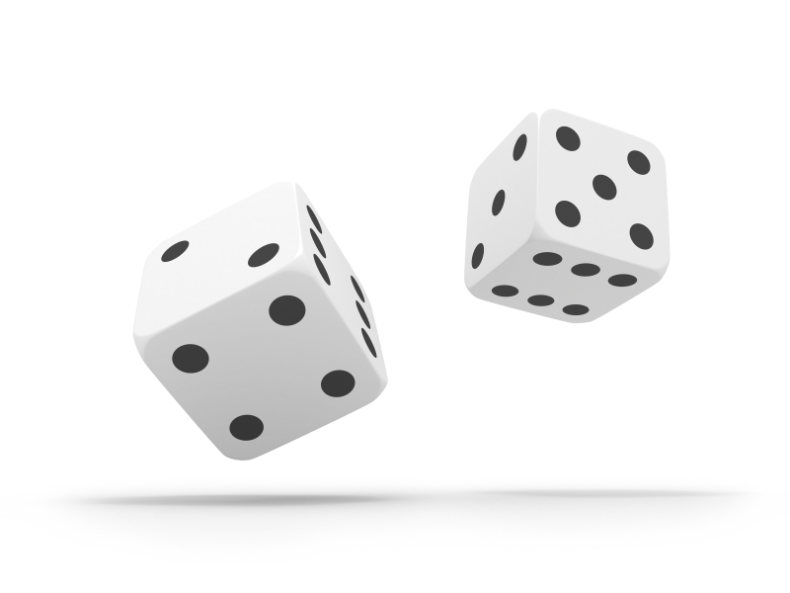
The sampling distribution of sample means
Let’s perform the following random experiment:
Toss n fair dice;
Observe the number of dots (“pips”) showing for each die as x_{i};
Calculate the mean number of dots across observed n values (note: here, n = 1)
Let’s start with n = 1 die

Slide 35
Three distributions to keep in mind simultaneously
The distribution of X in the population
The distribution of x in the particular sample
The sampling distribution of sample means across all possible samples

Slide 36
The population distribution
Here the population is infinite (n → ∞) and X has this probability distribution
x_{i} | p_{i}
1 | 1/6
2 | 1/6
3 | 1/6
4 | 1/6
5 | 1/6
6 | 1/6
sum | 1

Slide 37
Mean of the population distribution
What is the mean of this distribution?
x_{i} | p_{i}
1 | 1/6
2 | 1/6
3 | 1/6
4 | 1/6
5 | 1/6
6 | 1/6
sum | 1

Slide 38
Mean of the population distribution
What is the mean of this distribution?
x_{i} | p_{i} | E(x_{i})
1 | 1/6 | 1/6
2 | 1/6 | 2/6
3 | 1/6 | 3/6
4 | 1/6 | 4/6
5 | 1/6 | 5/6
6 | 1/6 | 6/6
sum | 1 | 3.5

Slide 39
Variance of population distribution
What is the variance/standard deviation of this distribution?
x_{i} | p_{i} | E(x_{i}) | [x_{i} –E(X)]² | × p_{i}
1 | 1/6 | 1/6 | 6.25 | 1.042
2 | 1/6 | 2/6 | 2.25 | 0.375
3 | 1/6 | 3/6 | 0.25 | 0.042
4 | 1/6 | 4/6 | 0.25 | 0.042
5 | 1/6 | 5/6 | 2.25 | 0.375
6 | 1/6 | 6/6 | 6.25 | 1.042
sum | 1 | 3.5 | not yet! | 2.917

Slide 40
n = 1
We can also consider this as the sampling distribution of means from samples of size n = 1
(where the samples are independent draws from an infinite population)
x_{i} | p_{i}
1 | 1/6
2 | 1/6
3 | 1/6
4 | 1/6
5 | 1/6
6 | 1/6
sum | 1

Slide 41
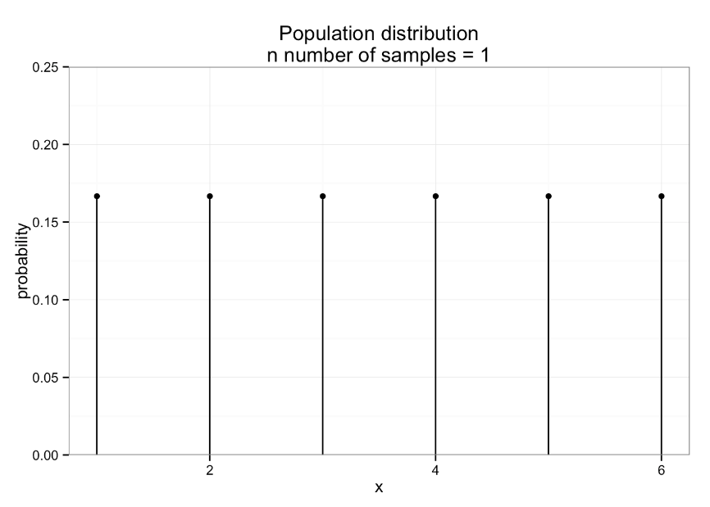

Slide 42
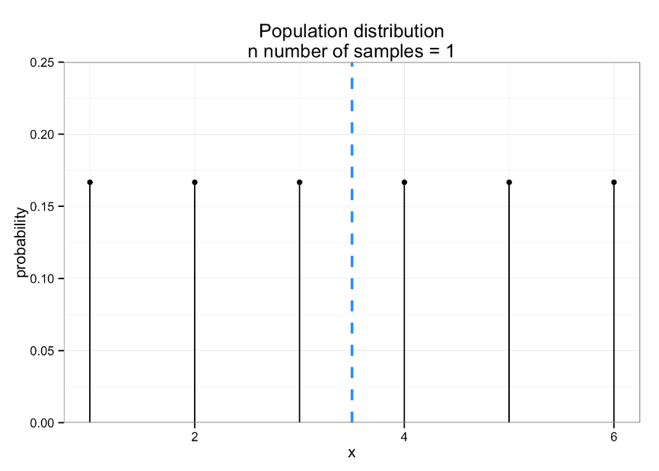

Slide 43
Now let’s add a second die to our random experiment. Our random variable, X, is the mean number of pips across both die. What is the population mean for this sample? (a) 2 (b) 3.5 (c) 2.5 (d) I have no idea!
Notes:
b) 3.5 (same as expected value for number of pips with 1 die!)

Slide 44
Step 1: what is the sample space? How can we count the number of elements in it?
n = 2
6 ⨉ 6 = 36 possible combinations

Slide 45
omega <- expand.grid(rep(list(1:6), 2)) omega <- omega %>% data.frame() names(omega) <- c("die1", "die2") #just renaming my 2 variables
> omega
die1 die2
1 1 1
2 2 1
3 3 1
4 4 1
5 5 1
6 6 1
7 1 2
8 2 2
9 3 2
10 4 2
11 5 2
12 6 2
13 1 3
14 2 3
15 3 3
16 4 3
17 5 3
18 6 3
19 1 4
20 2 4
21 3 4
22 4 4
23 5 4
24 6 4
25 1 5
26 2 5
27 3 5
28 4 5
29 5 5
30 6 5
31 1 6
32 2 6
33 3 6
34 4 6
35 5 6
36 6 6

Slide 46
Step 2: what are the sample means of all possible samples in sample space?

Slide 47
omega <- omega %>% mutate(xbar_i = (die1 + die2)/2)
> omega
die1 die2 xbar_i
1 1 1 1.0
2 2 1 1.5
3 3 1 2.0
4 4 1 2.5
5 5 1 3.0
6 6 1 3.5
7 1 2 1.5
8 2 2 2.0
9 3 2 2.5
10 4 2 3.0
11 5 2 3.5
12 6 2 4.0
13 1 3 2.0
14 2 3 2.5
15 3 3 3.0
16 4 3 3.5
17 5 3 4.0
18 6 3 4.5
19 1 4 2.5
20 2 4 3.0
21 3 4 3.5
22 4 4 4.0
23 5 4 4.5
24 6 4 5.0
25 1 5 3.0
26 2 5 3.5
27 3 5 4.0
28 4 5 4.5
29 5 5 5.0
30 6 5 5.5
31 1 6 3.5
32 2 6 4.0
33 3 6 4.5
34 4 6 5.0
35 5 6 5.5
36 6 6 6.0

Slide 48
Step 3a: how many unique values of xbar?
> omega %>%
select(xbar_i) %>%
distinct()
xbar_i
1 1.0
2 1.5
3 2.0
4 2.5
5 3.0
6 3.5
7 4.0
8 4.5
9 5.0
10 5.5
11 6.0

Slide 49
Step 3b: what is the probability of each?
> xbar_prob <- omega %>%
group_by(xbar_i) %>%
summarise(count = n(), p_i = count/36) %>%
arrange(xbar_i)
> xbar_prob
Source: local data frame [11 x 3]
xbar_i count p_i
1 1.0 1 0.02777778
2 1.5 2 0.05555556
3 2.0 3 0.08333333
4 2.5 4 0.11111111
5 3.0 5 0.13888889
6 3.5 6 0.16666667
7 4.0 5 0.13888889
8 4.5 4 0.11111111
9 5.0 3 0.08333333
10 5.5 2 0.05555556
11 6.0 1 0.02777778
> xbar_prob %>%
summarise(sum_of_ps = sum(p_i))
Source: local data frame [1 x 1]
sum_of_ps
1
What is the sum here?

Slide 50
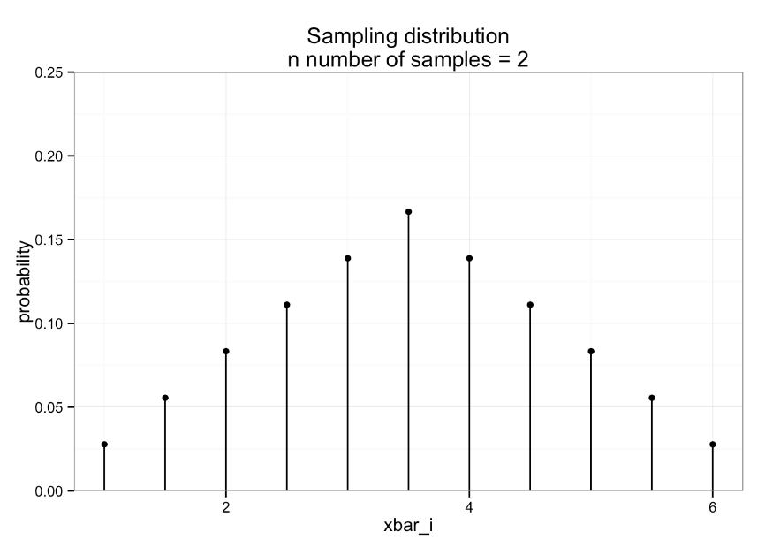

Slide 51
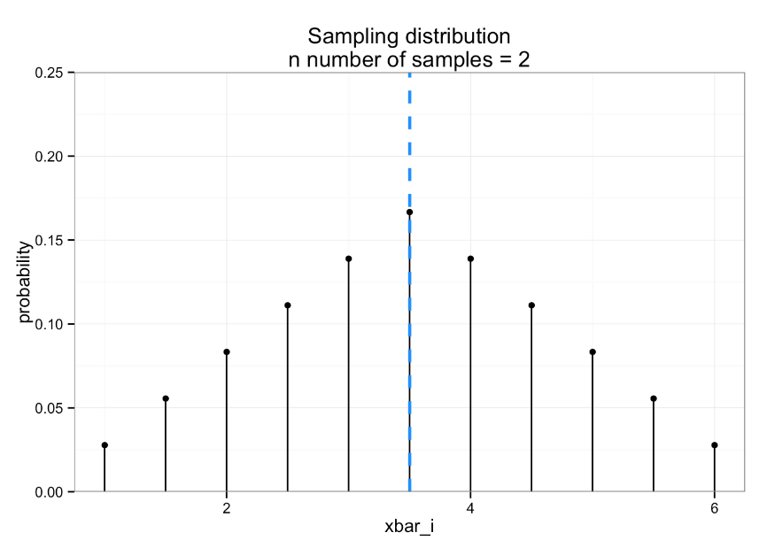

Slide 52
Step 4: what is the expectation?
> xbar_samp %>%
+ summarise(e_xbar = sum(e_x_i))
Source: local data frame [1 x 1]
e_xbar
1 3.5
> xbar_samp <- xbar_prob %>%
mutate(e_x_i = xbar_i * p_i)
> xbar_samp
Source: local data frame [11 x 4]
xbar_i count p_i e_x_i
1 1.0 1 0.02777778 0.02777778
2 1.5 2 0.05555556 0.08333333
3 2.0 3 0.08333333 0.16666667
4 2.5 4 0.11111111 0.27777778
5 3.0 5 0.13888889 0.41666667
6 3.5 6 0.16666667 0.58333333
7 4.0 5 0.13888889 0.55555556
8 4.5 4 0.11111111 0.50000000
9 5.0 3 0.08333333 0.41666667
10 5.5 2 0.05555556 0.30555556
11 6.0 1 0.02777778 0.16666667

Slide 53

Step 4: what is the expectation?
> xbar_samp %>%
+ summarise(e_xbar = sum(e_x_i))
Source: local data frame [1 x 1]
e_xbar
1 3.5
> xbar_samp <- xbar_prob %>%
mutate(e_x_i = xbar_i * p_i)
> xbar_samp
Source: local data frame [11 x 4]
xbar_i count p_i e_x_i
1 1.0 1 0.02777778 0.02777778
2 1.5 2 0.05555556 0.08333333
3 2.0 3 0.08333333 0.16666667
4 2.5 4 0.11111111 0.27777778
5 3.0 5 0.13888889 0.41666667
6 3.5 6 0.16666667 0.58333333
7 4.0 5 0.13888889 0.55555556
8 4.5 4 0.11111111 0.50000000
9 5.0 3 0.08333333 0.41666667
10 5.5 2 0.05555556 0.30555556
11 6.0 1 0.02777778 0.16666667

Slide 54
What did we just show?
Distribution: population
Statistic: mean
Distribution: sampling distribution of the mean
Statistic: mean

Slide 55

What if we now roll 3 dice (n = 3)?

Slide 56
To the in class exercise!

Slide 57
Did you get…
Source: local data frame [16 x 4]
xbar_i count p_i e_x_i
1 1.000000 1 0.00462963 0.00462963
2 1.333333 3 0.01388889 0.01851852
3 1.666667 6 0.02777778 0.04629630
4 2.000000 10 0.04629630 0.09259259
5 2.333333 15 0.06944444 0.16203704
6 2.666667 21 0.09722222 0.25925926
7 3.000000 25 0.11574074 0.34722222
8 3.333333 27 0.12500000 0.41666667
9 3.666667 27 0.12500000 0.45833333
10 4.000000 25 0.11574074 0.46296296
11 4.333333 21 0.09722222 0.42129630
12 4.666667 15 0.06944444 0.32407407
13 5.000000 10 0.04629630 0.23148148
14 5.333333 6 0.02777778 0.14814815
15 5.666667 3 0.01388889 0.07870370
16 6.000000 1 0.00462963 0.02777778
e_xbar
1 3.5
With 3 dice, this count column should sum to the total number of elementary events in this sample space: 6 ⨉ 6 ⨉ 6 = 216

Slide 58

What if we now increase the sample size to n = 4?

Slide 59
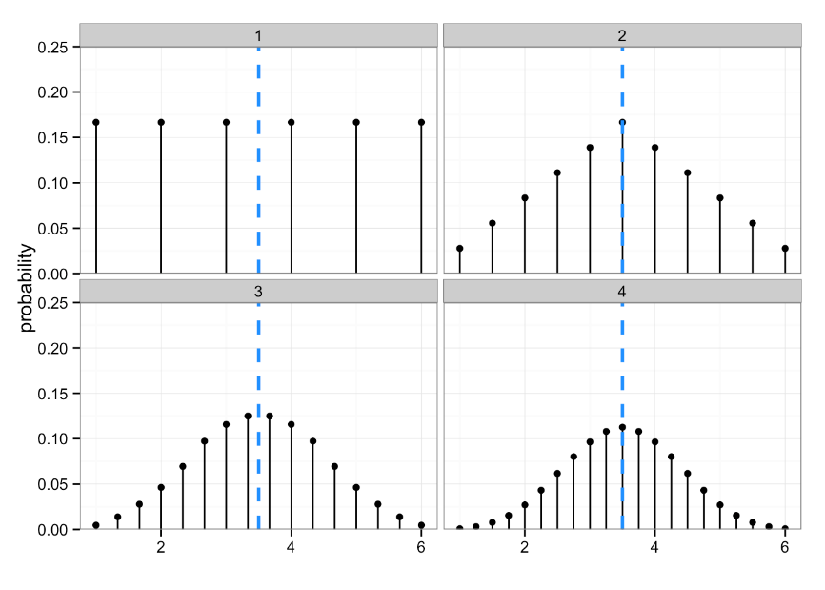

Slide 60
All of the below are a sequence of iid rvs
The previous result applies whether:
I roll n dice all at once
n = number of dice
I roll a single die n times (if I have a specific “style” or “method” for rolling, could argue this is not iid…)
n = number of rolls
n people each roll a single die once
n = number of people
n fair dice are rolled; each by a different person
n = number of each person/die combination

Slide 61
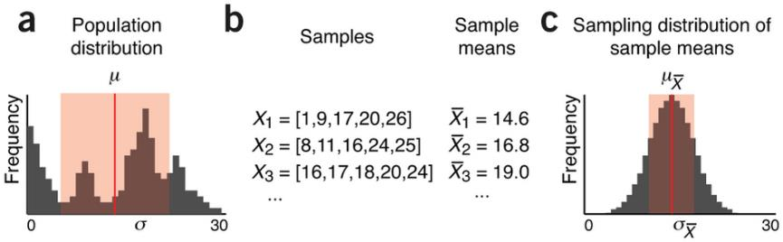
Population parameters are estimated by sampling
http://www.nature.com/nmeth/journal/v10/n9/full/nmeth.2613.html

Slide 62
Looks pretty close to normal, no?

Slide 63
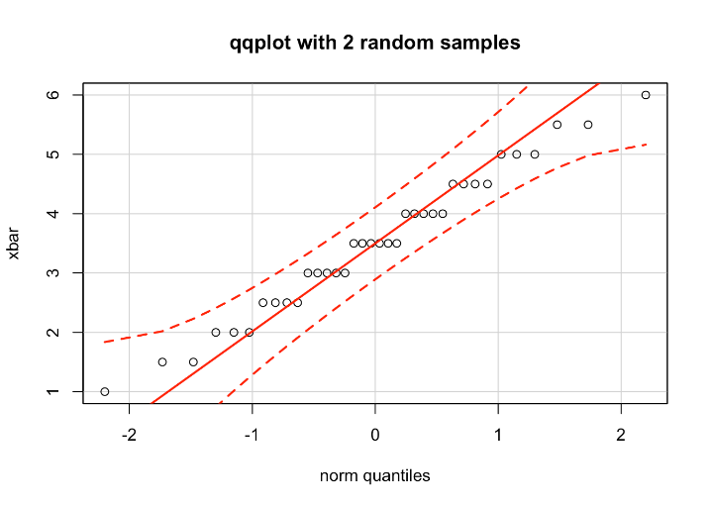
“Close to normal?”

Slide 64
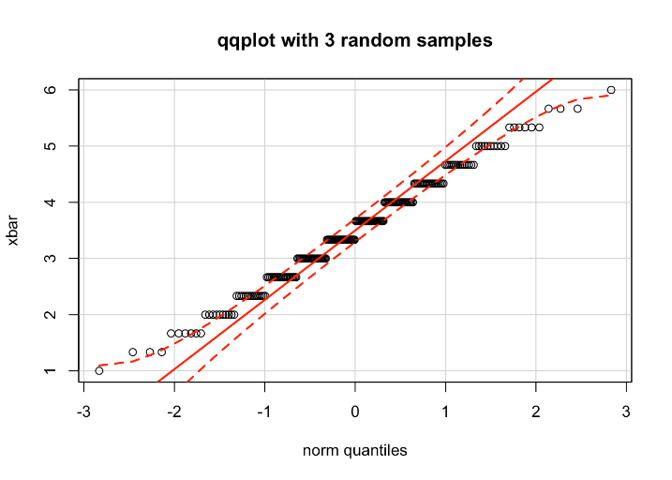
“Close to normal?”

Slide 65
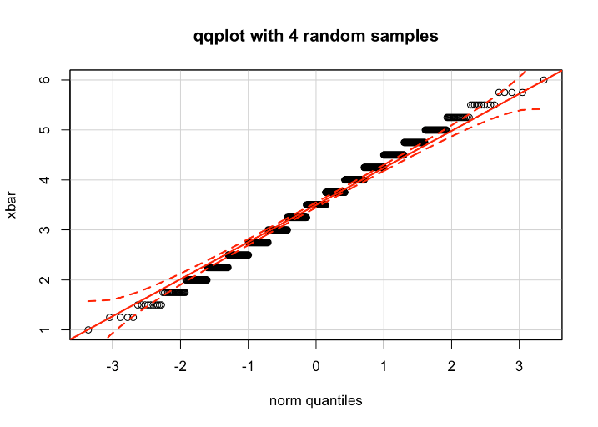
“Close to normal?”

Slide 66
QQplots in R
qqnorm(dataframe$variable)
qqline(dataframe$variable)
library(car)
qqPlot(dataframe$variable)
Do this!:
https://xiongge.shinyapps.io/QQplots/
Read this!:
http://stats.stackexchange.com/questions/101274/how-to-interpret-a-qq-plot

Slide 67
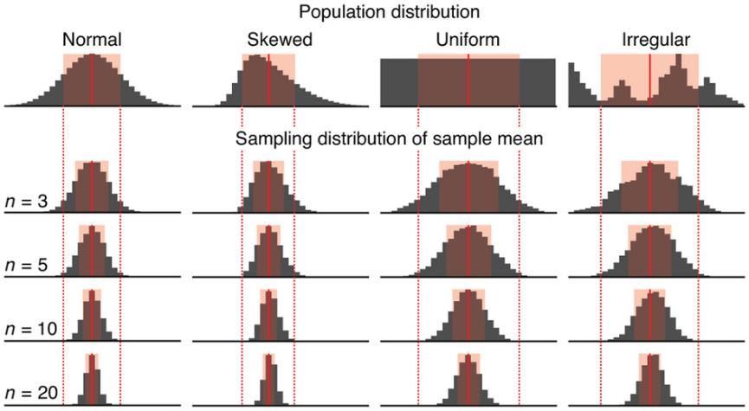
Sample means for 10,000 samples
http://www.nature.com/nmeth/journal/v10/n9/full/nmeth.2613.html

Slide 68
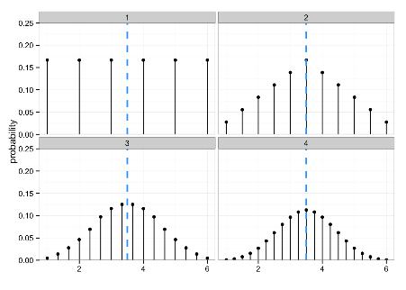

What did change?
Hopefully I’ve convinced you that no matter how many random samples we take, the expectation of our sample mean is the population mean.
But clearly something else changed every time we added another random sample/observation. What was it?

Slide 69
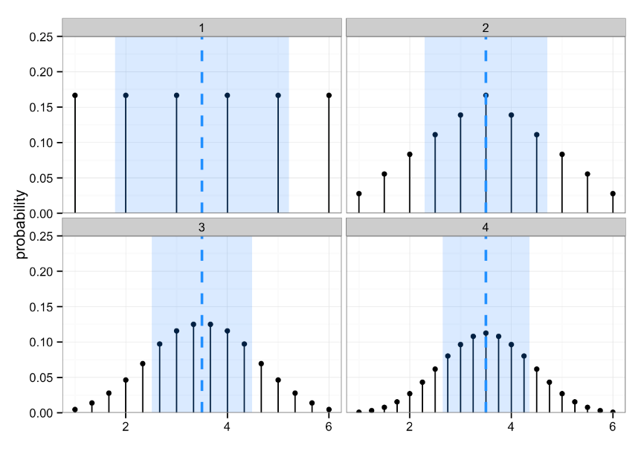

Slide 70
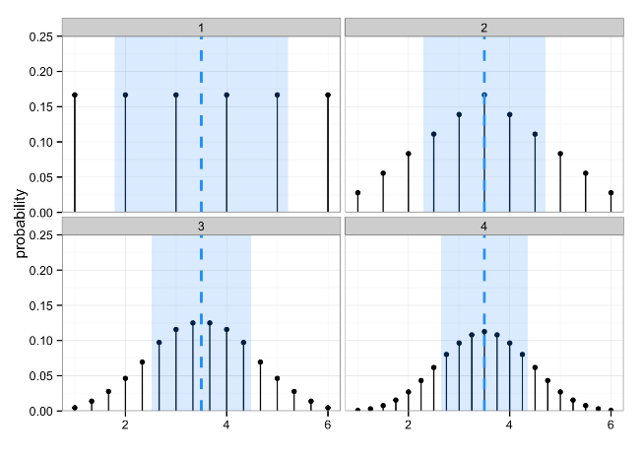
In other words…
The sample mean is obviously a good guess at E(X) = 𝜇, but how good is it?

Slide 71
Spread of the sampling distribution of means
# of dice
1 | 3.5 | 2.917 | 1.708
2 | 3.5 | 1.458 | 1.207
3 | 3.5 | 0.972 | 0.986
4 | 3.5 | 0.729 | 0.854
If we know the spread for the population distribution, can we calculate the spread of the sampling distributions of the mean?

Slide 72
Standard error
The standard error (SE) is the standard deviation of the sampling distribution of a statistic
Here, the statistic is the mean, so the standard deviation of the sampling distribution of the mean is the standard error of the mean (often called SEM)
But realize that this is just a specific standard error -- it’s a more general concept and they won’t always have this exact form

Slide 73
Law of large numbers

Slide 74
Weak LLN
The average of a large, iid sample will be close to the true mean

Slide 75
Strong LLN
Let X₁, X₂,… be iid rvs with E[X_{i}]=µ < ∞. Then:
Works by swamping, not compensation.
If you flip a fair coin and get 80 heads in the first 100 flips, then over the next 100 flips, the expected number of heads is 50—not 20*
*see gambler’s fallacy; but caveat- Bayesian inference

Slide 76
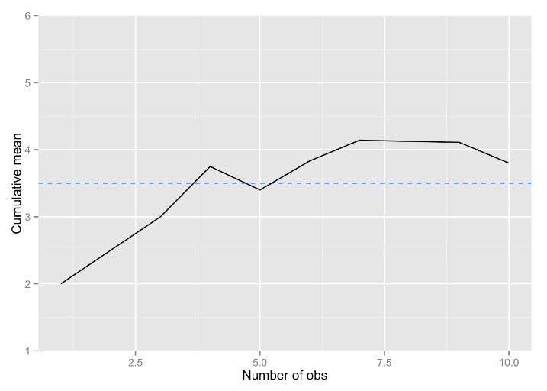
LLN in action: 10 dice to estimate the known population mean

Slide 77
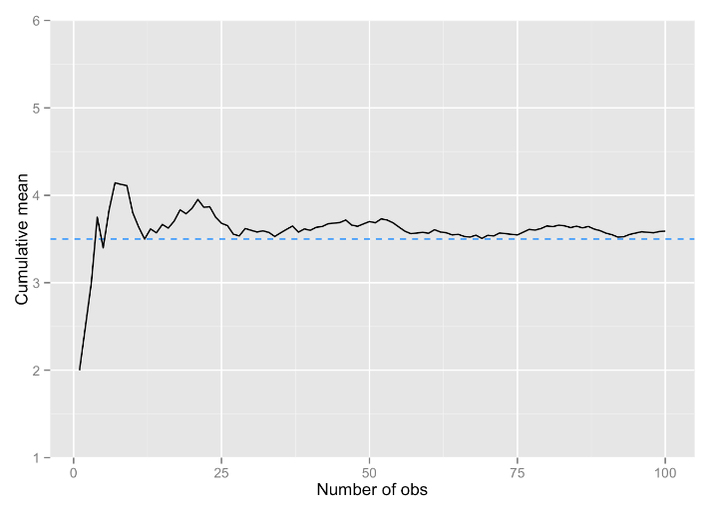
LLN in action: 100 dice to estimate the known population mean

Slide 78
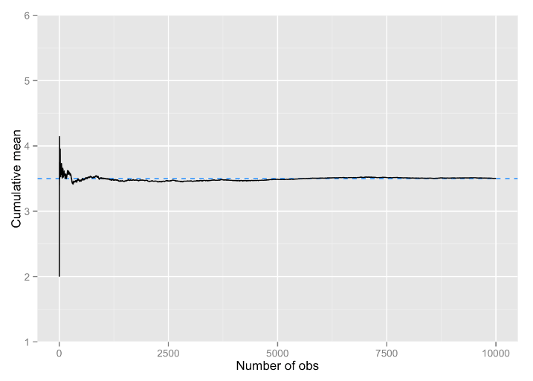
LLN in action: 10,000 dice to estimate the known population mean

Slide 79
What LLN does not say
“If I can just make my sample big enough, I won’t have to worry about error.”
There is no sample that is “big enough” in an unqualified sense
Data still must be iid
In stats, there are precious few fundamental constants, like there are in math (think: e) or physics (think: speed of light)
Context and goals always matter

Slide 80
Central Limit Theorem

Slide 81
CLT
The sampling distribution for the mean of a large, iid sample will be approximately a normal distribution, regardless of the shape of the population distribution of X:
How large n needs to be for the approximation to be good enough depends upon how far from normal the population distribution is, but n ≥ 100 almost always suffices.
If the population distribution of X is itself normal, then, regardless of n, the sampling distribution of x is exactly normal.

Slide 82
CLT
“If we average more and more independent random quantities with a common distribution, and that common distribution isn’t too pathological, then the average becomes closer and closer to a Gaussian” – Cosma Shalizi

Slide 83
Applying the CLT
“I can average any large-ish bunch of numbers and divide by the sd and call it a z-score. Then I can compare it to a N(0,1) to determine statistical significance. I’ve got a hit if the number’s greater than 1.96!”
the CLT assumes you’re averaging observations that are iid
CLT applies in the case of:
Averaging gene expression for 1 gene across exchangeable subjects
Averaging disfluency use for 1 conversation task across exchangeable subjects
CLT does not apply if:
Averaging gene expression for 1 subject across genes
Averaging disfluency use for 1 subject across conversation tasks

