Slide 1
Math 530/630: CM 4.1
Sampling distributions

Slide 2
So far… what do we know?
Random Variables
Discrete and Continuous
Have pmf or pdf – with specific parameters
And a really useful cdf
Answer questions about the probability of an observation
P( X = x) = ? %
E(X) and Var(X)
Samples
Descriptive statistics
E.g. mean, median, variance, standard deviation, skew kurtosis
Notes:
Population ~ sample space (or multiples thereof)
e.g. a single flip, or multiple flips

Slide 3
What do we want to know?
How to use our sample to understand a population
Currently a disconnect
I can tell you all about my sample
And all about a known population
But I can’t tell you about how my sample is related to its’ unknown population
Notes:
Currently a disconnect -
I can tell you all about my sample
or all about a know population (and possible samples)
The magic is “Sampling Distributions”

Slide 4
Today
Sampling Distributions
“Toy” examples to build concepts
Starts with a known population
LLN (Law of Large Numbers)
CLT (Central Limit Theorem)
Notes:
Draw on the board: Population, sample, sampling distribution – with arrows

Slide 5
Samples
A sample includes the results of n random experiments. A sequence of random variables.
A random sample is the result of a random experiment repeated n times. Because experiment can be repeated, and observations are “exchangeable”, iid.
Notes:
(Maybe) more about iid later
Exchangeable – each observations supplies the same type of information

Slide 6



X = # tweets per day
Random sample of size n, n >1 1
X₁ = x₁
@X₁
X₂ = x₂
@X₂
@X₃
X₃ = x₃
Population
@X₄
@X₅
@X₆
@X_{n}
X_{n} = x_{n}
After the sample X₁, X₂, …X_{n} is drawn, we usually want to create some summary of the x_{i} values
Notes:
Don’t care about individuals – want summaries!!
NOT stalking Xi

Slide 7

Statistics
The definition of a statistic is fairly broad
The main restriction is that it cannot be a function of a population parameter
Think of a sample as a collection/sequence of rvs: any function of an rv is an rv itself
2 main reasons we love them:
Sometimes they are estimators for population parameters we care about
Sometimes they are test statistics, i.e. the basis for a hypothesis test
Notes:
Not a function of a parameter, must be random!
Summarizes data into a value that makes a point or conclusion about the population
Just because they’re not a function of a parameter, doesn’t mean they can’t tell us something about a population
Estimator – like in linear regression
Test statistics – like a z or t-test statistic

Slide 8
Formally, let X₁, X₂, …X_{n} be a random sample of size n from a population, and let T(x₁, x₂,…, x_{n}) be a real-valued or vector-valued function whose domain includes the sample space of (X₁, X₂, …X_{n}).
Then the random variable or random vector Y= T(x₁, x₂,…, x_{n}) is called a statistic.
The probability distribution of a statistic Y is called the sampling distribution of Y.
Notes:
T is a place holder for any function (mean, var, etc)
linear on non-linear combination of the observed values
Y is an rv, because X is an rv
has it’s own distribution – different from X
Before: probability distribution (one value, or an interval)
Now: summaries (multiple values)
today - known dists (unrealistic)
next class – potentially unknown dist
??Draw some pictures of probability dists vs sampling distribution of the mean

Slide 9
Example statistic: the sample mean
Formally, Y = T(x₁, x₂,…, x_{n}) (this just says let’s make a new variable, call it Y, and make it equal some function, call it T(), of the observed values of X₁, X₂, …X_{n})
Let’s make Y the arithmetic average of the values in our random sample. This is a common statistic, so we all tend to call it the same thing (instead of Y)…
It’s a random variable too
Notes:
Why is it random?
Because it’s from a random sample. Lots of possible samples!!

Slide 10
Sample mean of X = average # of tweets per day
X versus x: It is pretty standard at this point to use uppercase letters to denote that we are talking about a statistic, and to use lowercase letters when we are talking about observed value of a statistic.
Let’s say we observed 6 twitter users whose tweets totaled: {X₁ = 5; X₂ = 3; X₃ = 0; X₄ = 10; X₅ = 3; X₆ = 2}
Each numerical value above is an x_{i} that we have now observed
Still a random variable
Notes:
Small x => sample data
Notation nightmares!!

Slide 11
Example statistic: the sample variance
Formally, Y = T(x₁, x₂,…, x_{n}) (this just says let’s make a new variable, call it Y, and make it equal some function, call it T(), of the observed values of X₁, X₂, …X_{n})
Let’s make Y the average squared deviations of each value from the mean in our random sample. This is another common statistic, so we all tend to call it the same thing (instead of Y)…
It’s a random variable too
Notes:
Big S – definition of the statistic

Slide 12
Example statistic: the sample variance
Again, we observed 6 twitter users whose tweets totaled: {X₁ = 5; X₂ = 3; X₃ = 0; X₄ = 10; X₅ = 3; X₆ = 2}
Each numerical value above is an x_{i} that we have now observed
Still a random variable
Notes:
small s – sample variance
Come back to n-1!

Slide 13
Expectation of a statistic
Now we have an interesting problem- we have defined the formula for expectation (and the variance) for any rv (either discrete or continuous)
How do we determine the expectation of a statistic, which is both an rv and a function of other rvs?
Notes:
General Form

Slide 14
A helpful proof
Let X₁, X₂, …X_{n} be a random sample from a population. Let g(x) be a function such that E[g(X_{i})] and Var[g(X_{i})] exist. Then:
Since the X_{i}s are identically distributed, the expectation of each individual g(X_{i}) is the same for all i. We can arbitrarily pick i = 1.
For any given X_{i}, E(X_{i}) = 𝜇
Notes:
General form
So, this represents the mean of whatever statistic G represents

Slide 15
Expectation of a statistic: the mean
Let X₁, X₂, …X_{n} be a random sample from a population with mean 𝜇 and variance σ² < ∞.
We know that the formula for the sample mean is:
To get the expectation of the sample mean statistic, we just take the expectation on each side of this equation.
Notes:
What is the mean of the means?
Or
The expectation of the expectations?

Slide 16
Expectation of a statistic: the sample mean
Let X₁, X₂, …X_{n} be a random sample from a population with mean 𝜇 and variance σ² < ∞. Then, taking the expectation of both sides of the equation:
For any given X_{i}, E(X_{i}) = 𝜇
n can take on any value > 0: it will never change this result!

Slide 17

“The expected value of the sample mean is the population mean”
Notes:
Important!!
NOT saying the sample mean is the population mean
AM saying that the mean of all possible sample means is the population mean

Slide 18
Variance of a statistic: the sample mean
So, we know that the expectation of our sample mean is the population mean
What about the variance of the sample mean?
We need another helpful proof…
Again, since the X_{i}s are identically distributed, the variance of each individual g(X_{i}) is the same for all i. We can arbitrarily pick i = 1.

Slide 19
Variance of a statistic: the sample mean
So, we know that the expectation of our sample mean is the population mean
What about the variance of the sample mean?

Slide 20
“The variance of the sample mean is the population variance divided by the number of observations”
Notes:
Standard deviation??

Slide 21
Expectation and variance of the sample mean
Why are these statistics about other statistics helpful to know?
How likely is it that the mean of our sample is close to our population mean?
This probability is determined by the sampling distribution
Notes:
Sampling distributions = Distribution of ALL the possible sample means (with a given n)
Now - enumerate and calculate
Code-along –
enumerate and calculate,
random sample with replacement
Next class –
sample only
and classical…

Slide 22
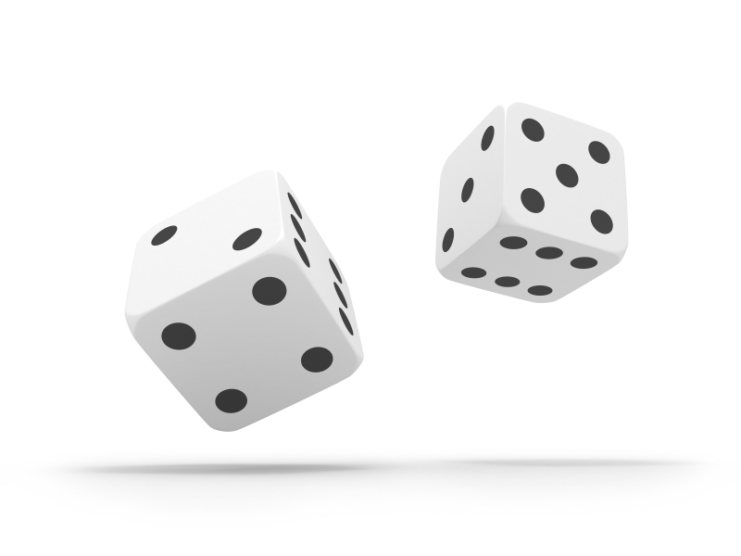
Three distributions to keep in mind simultaneously
The distribution of X in the population
The distribution of x in the particular sample
The sampling distribution of sample means across all possible samples
Notes:
In the real world …
Which one can you create? Sample dist
use it to make assumptions about the other two
it’s an estimate
Population is real (to frequentists), but unseeable
Too large
changing?
Sampling distribution
exact is theoretical
can be estimated from a sample (next class)
let’s you make inferences about your statistic!

Slide 23
The sampling distribution of sample means
Let’s perform the following random experiment:
Toss n fair dice;
Observe the number of dots (“pips”) showing for each die as x_{i};
Calculate the mean number of dots across observed n values (note: here, n = 1)
Let’s start with n = 1 die
Notes:
Build some intuition using a toy problem where we know the population

Slide 24
The population distribution
Here the population is infinite (n → ∞) and X has this probability distribution
x_{i} | p_{i}
1 | 1/6
2 | 1/6
3 | 1/6
4 | 1/6
5 | 1/6
6 | 1/6
sum | 1
Notes:
N – number of throws
Entire probability space – equally probably

Slide 25
Mean of the population distribution
What is the mean of this distribution?
x_{i} | p_{i}
1 | 1/6
2 | 1/6
3 | 1/6
4 | 1/6
5 | 1/6
6 | 1/6
sum | 1

Slide 26
Mean of the population distribution
What is the mean of this distribution?
x_{i} | p_{i} | E(x_{i})
1 | 1/6 | 1/6
2 | 1/6 | 2/6
3 | 1/6 | 3/6
4 | 1/6 | 4/6
5 | 1/6 | 5/6
6 | 1/6 | 6/6
sum | 1 | 3.5
Notes:
Mean = E
3.5 is not observable – outside the probability space

Slide 27
Variance of population distribution
What is the variance/standard deviation of this distribution?
x_{i} | p_{i} | E(x_{i}) | [x_{i} –E(X)]² | × p_{i}
1 | 1/6 | 1/6 | 6.25 | 1.042
2 | 1/6 | 2/6 | 2.25 | 0.375
3 | 1/6 | 3/6 | 0.25 | 0.042
4 | 1/6 | 4/6 | 0.25 | 0.042
5 | 1/6 | 5/6 | 2.25 | 0.375
6 | 1/6 | 6/6 | 6.25 | 1.042
sum | 1 | 3.5 | not yet! | 2.917

Slide 28
n = 1
We can also consider this as the sampling distribution of means from samples of size
n = 1
(where the samples are independent draws from an infinite population)
x_{i} | p_{i}
1 | 1/6
2 | 1/6
3 | 1/6
4 | 1/6
5 | 1/6
6 | 1/6
sum | 1
Notes:
Mean of a single number is that number…
Doesn’t really meet our rule that n>1, but good for illlustration

Slide 29
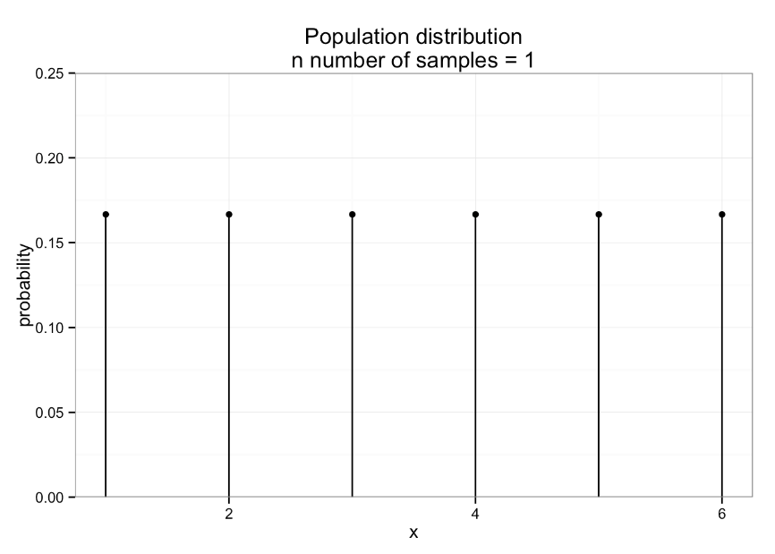
Notes:
Not very interesting – equiprobable

Slide 30
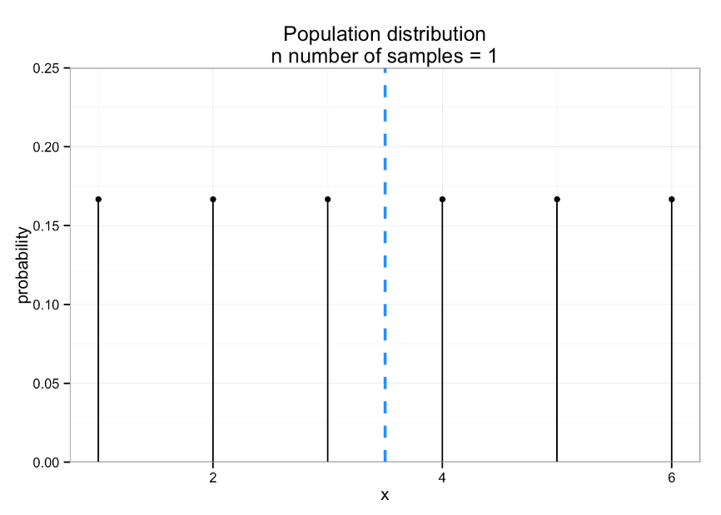
Notes:
Mean – can’t get 3.5

Slide 31
Now let’s add a second die to our random experiment. Our random variable, X, is the mean number of pips across both die. What is the population mean for this sample? (a) 2 (b) 3.5 (c) 2.5 (d) I have no idea!
Notes:
Same X as the last …

Slide 32
Step 1: what is the sample space? How can we count the number of elements in it?
n = 2
6 ⨉ 6 = 36 possible combinations

Slide 33
omega <- expand.grid(rep(list(1:6), 2)) omega <- omega %>% data.frame() names(omega) <- c("die1", "die2") #just renaming my 2 variables
> omega
die1 die2
1 1 1
2 2 1
3 3 1
4 4 1
5 5 1
6 6 1
7 1 2
8 2 2
9 3 2
10 4 2
11 5 2
12 6 2
13 1 3
14 2 3
15 3 3
16 4 3
17 5 3
18 6 3
19 1 4
20 2 4
21 3 4
22 4 4
23 5 4
24 6 4
25 1 5
26 2 5
27 3 5
28 4 5
29 5 5
30 6 5
31 1 6
32 2 6
33 3 6
34 4 6
35 5 6
36 6 6
Notes:
Expand.grid = fully cross factored
All possible combinations

Slide 34
Step 2: what are the sample means of all possible samples in sample space?

Slide 35
omega <- omega %>% mutate(xbar_i = (die1 + die2)/2)
> omega
die1 die2 xbar_i
1 1 1 1.0
2 2 1 1.5
3 3 1 2.0
4 4 1 2.5
5 5 1 3.0
6 6 1 3.5
7 1 2 1.5
8 2 2 2.0
9 3 2 2.5
10 4 2 3.0
11 5 2 3.5
12 6 2 4.0
13 1 3 2.0
14 2 3 2.5
15 3 3 3.0
16 4 3 3.5
17 5 3 4.0
18 6 3 4.5
19 1 4 2.5
20 2 4 3.0
21 3 4 3.5
22 4 4 4.0
23 5 4 4.5
24 6 4 5.0
25 1 5 3.0
26 2 5 3.5
27 3 5 4.0
28 4 5 4.5
29 5 5 5.0
30 6 5 5.5
31 1 6 3.5
32 2 6 4.0
33 3 6 4.5
34 4 6 5.0
35 5 6 5.5
36 6 6 6.0
Notes:
Repeats??

Slide 36
Step 3a: how many unique values of xbar?
> omega %>%
select(xbar_i) %>%
distinct()
xbar_i
1 1.0
2 1.5
3 2.0
4 2.5
5 3.0
6 3.5
7 4.0
8 4.5
9 5.0
10 5.5
11 6.0
Notes:
Look at that mean (E)

Slide 37
Step 3b: what is the probability of each?
> xbar_prob <- omega %>%
group_by(xbar_i) %>%
summarise(count = n(), p_i = count/36) %>%
arrange(xbar_i)
> xbar_prob
Source: local data frame [11 x 3]
xbar_i count p_i
1 1.0 1 0.02777778
2 1.5 2 0.05555556
3 2.0 3 0.08333333
4 2.5 4 0.11111111
5 3.0 5 0.13888889
6 3.5 6 0.16666667
7 4.0 5 0.13888889
8 4.5 4 0.11111111
9 5.0 3 0.08333333
10 5.5 2 0.05555556
11 6.0 1 0.02777778
> xbar_prob %>%
summarise(sum_of_ps = sum(p_i))
Source: local data frame [1 x 1]
sum_of_ps
1
What is the sum here?
Notes:
Point out symmetry

Slide 38
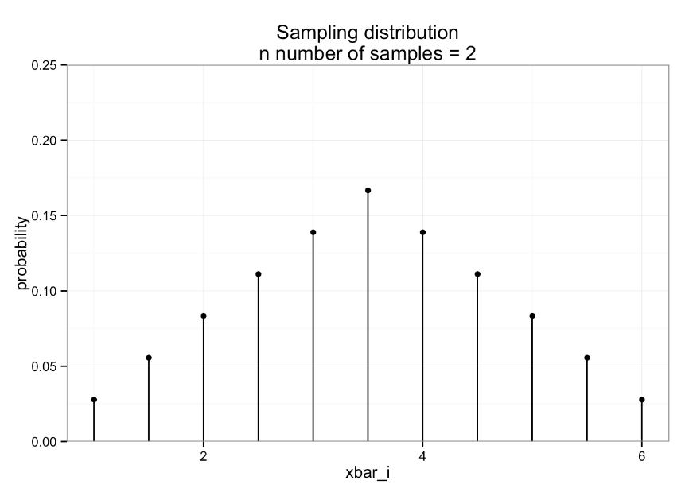
Notes:
Possible sample means – NOT outcomes
Still talking about a known random variable and it’s distribution – fully enumerated

Slide 39
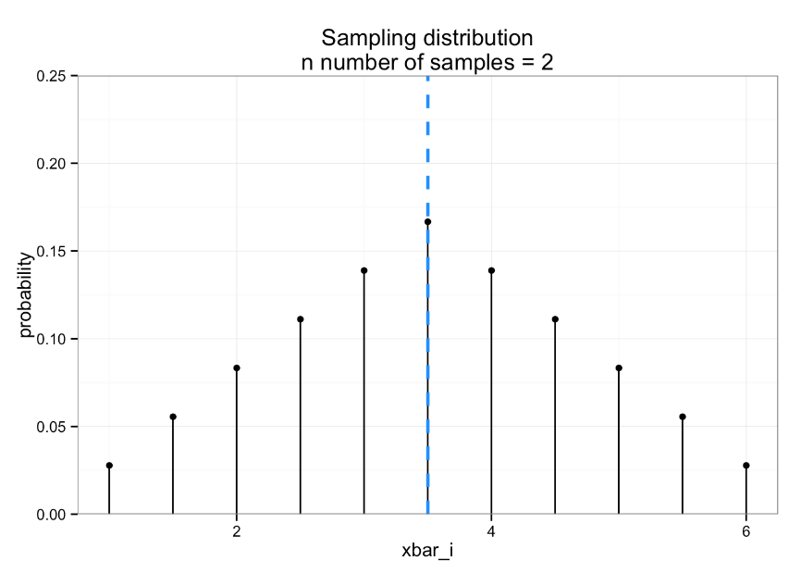
Notes:
Same mean!!

Slide 40
Step 4: what is the expectation?
> xbar_samp %>%
+ summarise(e_xbar = sum(e_x_i))
Source: local data frame [1 x 1]
e_xbar
1 3.5
> xbar_samp <- xbar_prob %>%
mutate(e_x_i = xbar_i * p_i)
> xbar_samp
Source: local data frame [11 x 4]
xbar_i count p_i e_x_i
1 1.0 1 0.02777778 0.02777778
2 1.5 2 0.05555556 0.08333333
3 2.0 3 0.08333333 0.16666667
4 2.5 4 0.11111111 0.27777778
5 3.0 5 0.13888889 0.41666667
6 3.5 6 0.16666667 0.58333333
7 4.0 5 0.13888889 0.55555556
8 4.5 4 0.11111111 0.50000000
9 5.0 3 0.08333333 0.41666667
10 5.5 2 0.05555556 0.30555556
11 6.0 1 0.02777778 0.16666667
Notes:
Expectation of the sampling distribution of the sample means

Slide 41

Step 4: what is the expectation?
> xbar_samp %>%
+ summarise(e_xbar = sum(e_x_i))
Source: local data frame [1 x 1]
e_xbar
1 3.5
> xbar_samp <- xbar_prob %>%
mutate(e_x_i = xbar_i * p_i)
> xbar_samp
Source: local data frame [11 x 4]
xbar_i count p_i e_x_i
1 1.0 1 0.02777778 0.02777778
2 1.5 2 0.05555556 0.08333333
3 2.0 3 0.08333333 0.16666667
4 2.5 4 0.11111111 0.27777778
5 3.0 5 0.13888889 0.41666667
6 3.5 6 0.16666667 0.58333333
7 4.0 5 0.13888889 0.55555556
8 4.5 4 0.11111111 0.50000000
9 5.0 3 0.08333333 0.41666667
10 5.5 2 0.05555556 0.30555556
11 6.0 1 0.02777778 0.16666667

Slide 42
What did we just show?
Distribution: population
Statistic: mean
Distribution: sampling distribution of the sample mean
Statistic: mean
Notes:
Left: RV X probability
Right:
add another die,
mean sample means x probability

Slide 43

What if we now roll 3 dice (n = 3)?

Slide 44
To the in class exercise!

Slide 45
Did you get…
Source: local data frame [16 x 4]
xbar_i count p_i e_x_i
1 1.000000 1 0.00462963 0.00462963
2 1.333333 3 0.01388889 0.01851852
3 1.666667 6 0.02777778 0.04629630
4 2.000000 10 0.04629630 0.09259259
5 2.333333 15 0.06944444 0.16203704
6 2.666667 21 0.09722222 0.25925926
7 3.000000 25 0.11574074 0.34722222
8 3.333333 27 0.12500000 0.41666667
9 3.666667 27 0.12500000 0.45833333
10 4.000000 25 0.11574074 0.46296296
11 4.333333 21 0.09722222 0.42129630
12 4.666667 15 0.06944444 0.32407407
13 5.000000 10 0.04629630 0.23148148
14 5.333333 6 0.02777778 0.14814815
15 5.666667 3 0.01388889 0.07870370
16 6.000000 1 0.00462963 0.02777778
e_xbar
1 3.5
With 3 dice, this count column should sum to the total number of elementary events in this sample space: 6 ⨉ 6 ⨉ 6 = 216

Slide 46

What if we now increase the sample size to n = 4?
Notes:
Here we did die, but it could be any observation – just added observations

Slide 47
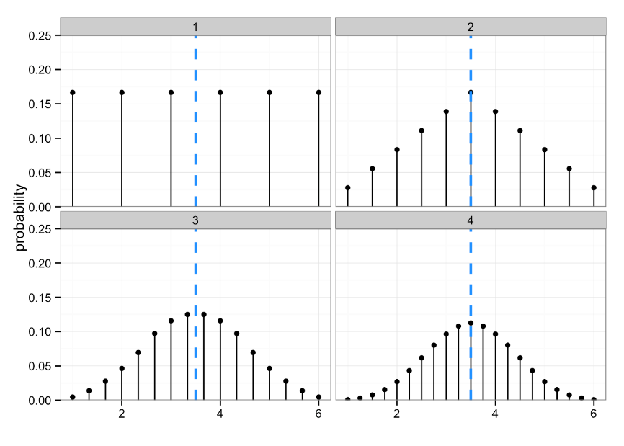
Notes:
Why??
We can make conclusions about a populations from our sample – about a theoretical distribution
We can go from a population to a sampling distributions of sample means
No matter how many I add, same mean

Slide 48
Looks pretty close to normal, no?

Slide 49
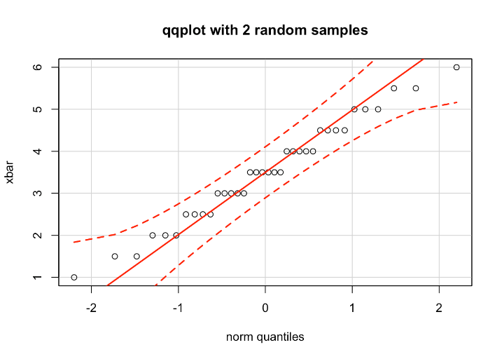
“Close to normal?”

Slide 50
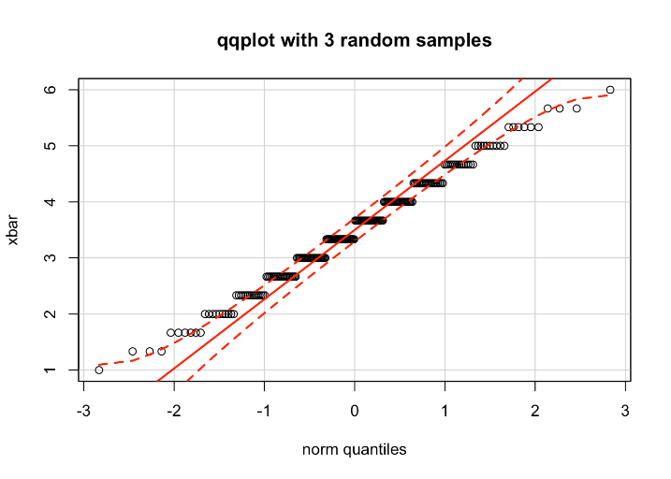
“Close to normal?”

Slide 51
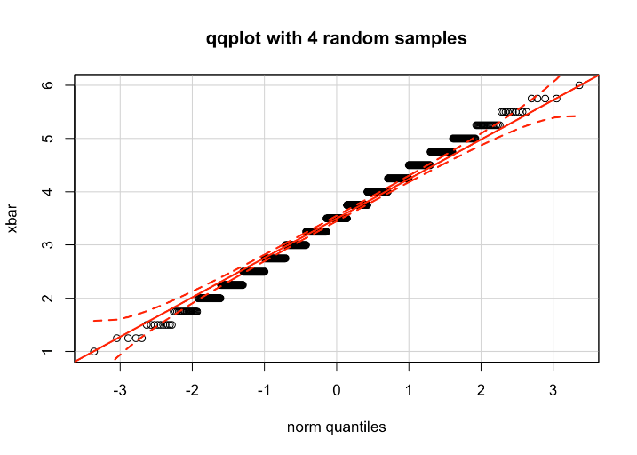
“Close to normal?”

Slide 52
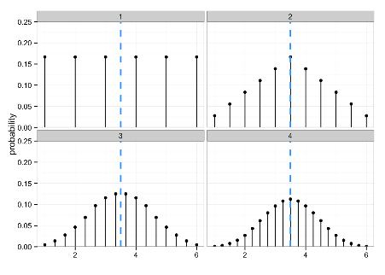

What did change?
Hopefully I’ve convinced you that no matter how many random samples we take, the expectation of our sample mean is the population mean.
But clearly something else changed every time we added another random sample/observation. What was it?
Notes:
Spread! Probability weight moving towards mean

Slide 53
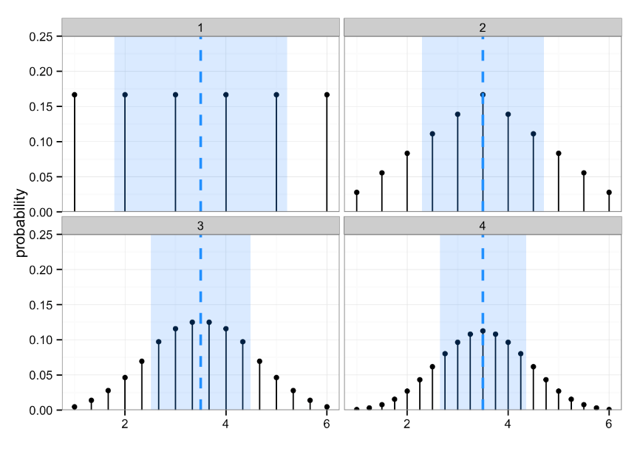
Notes:
Blue show SE

Slide 54
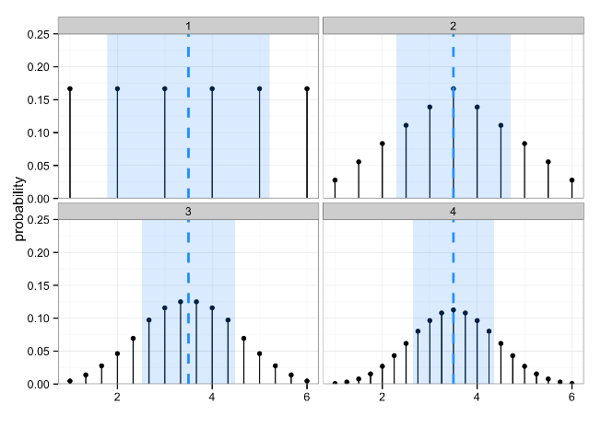
In other words…
The sample mean is obviously a good guess at E(X) = 𝜇, but how good is it?

Slide 55
Spread of the sampling distribution of means
# of dice
1 | 3.5 | 2.917 | 1.708
2 | 3.5 | 1.458 | 1.207
3 | 3.5 | 0.972 | 0.986
4 | 3.5 | 0.729 | 0.854
If we know the spread for the population distribution, can we calculate the spread of the sampling distributions of the mean?
Notes:
This one changes based on 1/ sqrt of n
What does this mean?
As the sample size grows, the var get smaller. Sample means get closer to the true population mean.
Known to be true.

Slide 56
Standard error
The standard error (SE) is the standard deviation of the sampling distribution of a statistic
Here, the statistic is the mean, so the standard deviation of the sampling distribution of the mean is the standard error of the mean (often called SEM)
But realize that this is just a specific standard error -- it’s a more general concept and they won’t always have this exact form
Notes:
IMPORTANT CONCEPT!!
What happens at n=1? It IS the population.
Standard error formulas for other statistics are online – also ugly. Use R.
Not all that interested in calculating the SE – more interested in how much of the populations probability density falls within a SE of the mean
Draw a dist – or use one of those above

Slide 57
Law of large numbers

Slide 58
Weak LLN
The average of a large, iid sample will be close to the true mean

Slide 59
Strong LLN
Let X₁, X₂,… be iid rvs with E[X_{i}]=µ < ∞. Then:
Works by swamping, not compensation.
If you flip a fair coin and get 80 heads in the first 100 flips, then over the next 100 flips, the expected number of heads is 50—not 20*
*see gambler’s fallacy; but caveat- Bayesian inference
Notes:
What is n is the population size? Well of course the above is true.
What if it’s one less? And so on?

Slide 60
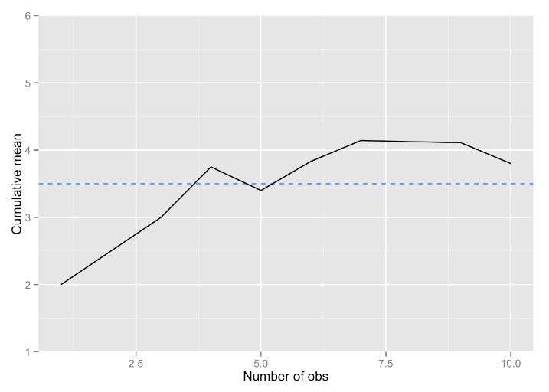
LLN in action: 10 dice to estimate the known population mean

Slide 61
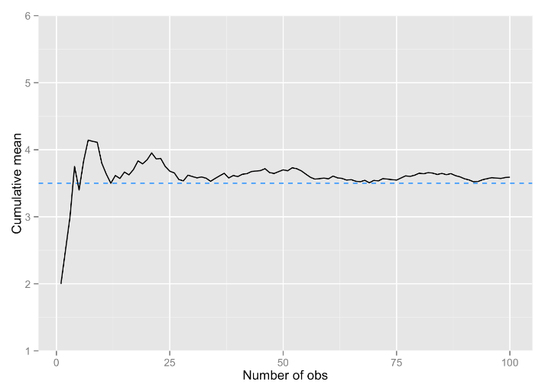
LLN in action: 100 dice to estimate the known population mean

Slide 62
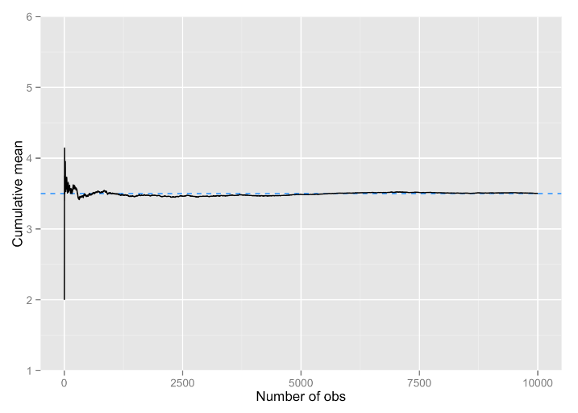
LLN in action: 10,000 dice to estimate the known population mean

Slide 63
What LLN does not say
“If I can just make my sample big enough, I won’t have to worry about error.”
There is no sample that is “big enough” in an unqualified sense
Data still must be iid
In stats, there are precious few fundamental constants, like there are in math (think: e) or physics (think: speed of light)
Context and goals always matter

Slide 64
Central Limit Theorem

Slide 65
CLT
The sampling distribution for the mean (or sum) of a large, iid sample will be approximately a normal distribution, regardless of the shape of the population distribution of X:
How large n needs to be for the approximation to be good enough depends upon how far from normal the population distribution is, but n ≥ 100 almost always suffices.
If the population distribution of X is itself normal, then, regardless of n, the sampling distribution of x is exactly normal.
Notes:
Variance needs to be non-infinite
N>30 tends to be the stated assumption

Slide 66
CLT
“If we average more and more independent random quantities with a common distribution, and that common distribution isn’t too pathological, then the average becomes closer and closer to a Gaussian” – Cosma Shalizi

Slide 67
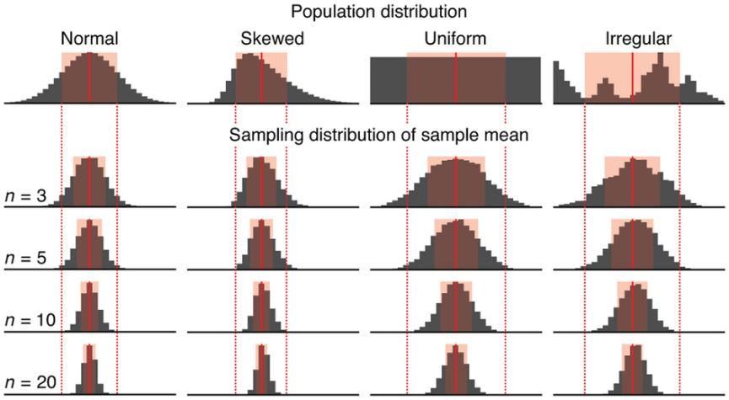
Sample means for 10,000 samples
http://www.nature.com/nmeth/journal/v10/n9/full/nmeth.2613.html
Notes:
Population – unknown/unseen
Sampling – theoretical (sorta)
What happens to the expectation of other statistics as n increases? Not always so pretty!!

Slide 68
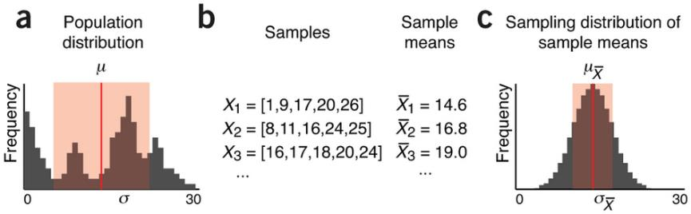
Population parameters are estimated by sampling
http://www.nature.com/nmeth/journal/v10/n9/full/nmeth.2613.html
Notes:
What does this MEAN??
We don’t have to know the underlying population – we can estimate it using the sampling dist.
But, how do we get the sampling dist?
Maybe we can build a sampling dist from OUR data!!
Are we there yet? No. So far still working with “known” populations, but we’ll get there.

Slide 69
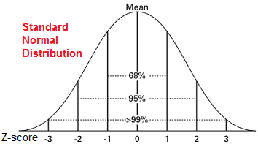
Why does it matter?
Notes:
Foreshadowing – shouldn’t be completely clear right now
-----------------
Reason we statisticians LOVE the normal distribution – really we LOVE the CLT!!
No matter how screwy my data is, if my sample is big enough, and I’m interested in the mean, and I can get the sampling dist, I can use the NORMAL DIST!!
Normal dist with mean 0 and sd 1
What is the Z-score? Distance from the mean (0) in standard deviations
We know how much of the probability is within some sd
Can use it to determine how confident we are that our mean is “close” to the population mean
Can use it to compare means

Slide 70
Applying the CLT
the CLT assumes you’re averaging observations that are iid
CLT applies in the case of:
Averaging gene expression for 1 gene across exchangeable subjects
Averaging disfluency use for 1 conversation task across exchangeable subjects
CLT does not apply if:
Averaging gene expression for 1 subject across genes
Averaging disfluency use for 1 subject across conversation tasks
Notes:
Why iid?
Simplifies the math….
Independent – means we can just multiply the probabilities => Joint probability rather than conditional probability
Identically distributed – the probability is the same for every sample!!
NO!! “I can average any large-ish bunch of numbers and divide by the sd and call it a z-score. Then I can compare it to a N(0,1) to determine statistical significance. I’ve got a hit if the number’s greater than 1.96!”

Slide 71
QQplots in R
qqnorm(dataframe$variable)
qqline(dataframe$variable)
library(car)
qqPlot(dataframe$variable)
Do this!:
https://xiongge.shinyapps.io/QQplots/
Read this!:
http://stats.stackexchange.com/questions/101274/how-to-interpret-a-qq-plot

Slide 72
Independent and Identically distributed

Slide 73
iid sequences of random variables
 |  | Number of random variables
 |  | 1 rv | > 1 rv
iid? | no | Body weight of Angela {X = 150} | Weight and height of Angela Data is a sequence of rvs: {X = 150; Y = 65}
 | yes | Body weight of n = 4 randomly selected people Data is a sequence of iid rvs: {X₁ = 150, X₂ = 125, X₃ = 208, X₄ = 180} | Weight and height of n = 4 randomly selected people Data is a sequence of iid rvs: {X₁ = 150, X₂ = 125, X₃ = 208, X₄ = 180} {Y₁ = 65, Y₂ = 60, Y₃ = 72, Y₄ = 70}
Both of these are sequences of iid random variables
Notes:
Normally would see these as rows and columns.

Slide 74
Sequences of rvs
iid
Notes:
Each observed value:
… is drawn from it’s own peculiar distribution
… is drawn from a dist with a common mean, but’s it’s own sd.
… is drawn fron a dist with it’s own mean, but a common sd.
… is drawn from the same dist – iid!!
Think of it as each observed value is pulled from the same underlying distribution.
doesn’t have to be normal.
doesn’t have to be known.
Ex Problems: Linguistic data or siblings/SAT scores

Slide 75

Random variable, X = # of tweets per day
probability
@X₁
@X₂
@X₃
@X₄
@X₅
@X₆
@X_{n}
Random sample of size n, n > 1
Each X_{i} is one observation on the same rv
Population
Notes:
Probability –
If we had a known population, we could use probability to describe an individual observation
Statistics -
Samples are assumed to represent populations, and we want to use our sample to infer “things” about the larger population

Slide 76
Random variable, X = # of tweets per day
Random sample of size n, n > 1
@X₁
@X₂
@X₃
Population
@X₄
@X₅
@X₆
@X_{n}
X₁, X₂, …X_{n}
is a sequence of observations of the same rv
Notes:
Individual Observations
Every time I pull an observations, it’s coming from the same population
What is the RV? # tweets per day

Slide 77
Random variable, X = # of tweets per day
Random sample of size n, n > 1
“X₂, …, X_{n}
don’t affect me!”
@X₁
“X₁, X₃,…, X_{n} don’t affect me!”
@X₂
@X₃
Population
@X₄
@X₅
“X₁, X₂, X₄,…,X_{n} don’t affect me!”
@X₆
“X₁, …, X_{n-1} don’t affect me!”
@X_{n}
X₁, X₂, …X_{n}
are mutually independent
Notes:
Independence assumption

Slide 78
Random variable, X = # of tweets per day
Random sample of size n, n > 1
X₁ = x₁
@X₁
X₂ = x₂
@X₂
X₃ = x₃
@X₃
Population
@X₄
@X₅
@X₆
@X_{n}
X_{n} = x_{n}
The values (x_{i}) of X₁, X₂, …X_{n} are each observed
Notes:
Large X is an rv
Small x is the observed values (essentially a placeholder for the values)

Slide 79

Random variable, X = # of tweets per day
Random sample of size n, n > 1
X₁ = x₁
@X₁
X₂ = x₂
@X₂
X₃ = x₃
@X₃
Population
@X₄
X₄ = x₄
X₅ = x₄
@X₅
@X₆
@X_{n}
X_{n} = x_{n}
If two values of x_{i} are the same…
Notes:
no problem!!

Slide 80
Random variable, X = # of tweets per day
Random sample of size n, n > 1
pdf is f(x₁)
@X₁
@X₂
pdf is f(x₂)
@X₃
Population
@X₄
@X₅
pdf is f(x₃)
@X₆
@X_{n}
pdf is f(x_{n})
Each X_{i} has a marginal distribution, f(x_{i})
Notes:
Each Xi might have it’s own pdf=f(xi)
pdf is a placeholder, not defined

Slide 81
Random variable, X = # of tweets per day
Random sample of size n, n > 1
pdf is f(x₁)
@X₁
@X₂
pdf is f(x₂)
@X₃
Population
@X₄
@X₅
pdf is f(x₃)
@X₆
@X_{n}
pdf is f(x_{n})
Hooray! Because each observation X_{i} is independent, we can just multiply each f(x_{i}) get joint pdf!
Notes:
Recall from Probability…

Slide 82
Random variable, X = # of tweets per day
Random sample of size n, n > 1
pdf is f(x_{i})
@X₁
@X₂
pdf is f(x_{i})
@X₃
Population
@X₄
@X₅
pdf is f(x_{i})
@X₆
@X_{n}
pdf is f(x_{i})
And because each observation X_{i} is identically distributed,
f(x₁) = f(x₂) = … = f(x_{n}) = f(x_{i})
Notes:
Probability density function’s
Makes the math make sense, not dealing with individual pdfs

Slide 83
Random variable, X = # of tweets per day
f(x₁, …, x_{n}) = f(x₁) × f(x₂) × … × f(x_{n}) =
Since X₁, X₂, …X_{n} are mutually independent, the probabilities P(X₁), P(X₂), …P(X_{n}) can simply be multiplied to get the joint pdf of the sequence of observations of the rv of interest
Since X₁, X₂, …X_{n} are identically distributed, all f(x_{i}) are the exact same function
Notes:
Because they are iid …
We don’t have to treat them as individuals, can create one big pdf. Makes the math easier…
Focusing on notation – don’t necessarily need to get the math
Warning!! Need to meet the iid assumptions – otherwise the math doesn’t work!!

