Slide 1
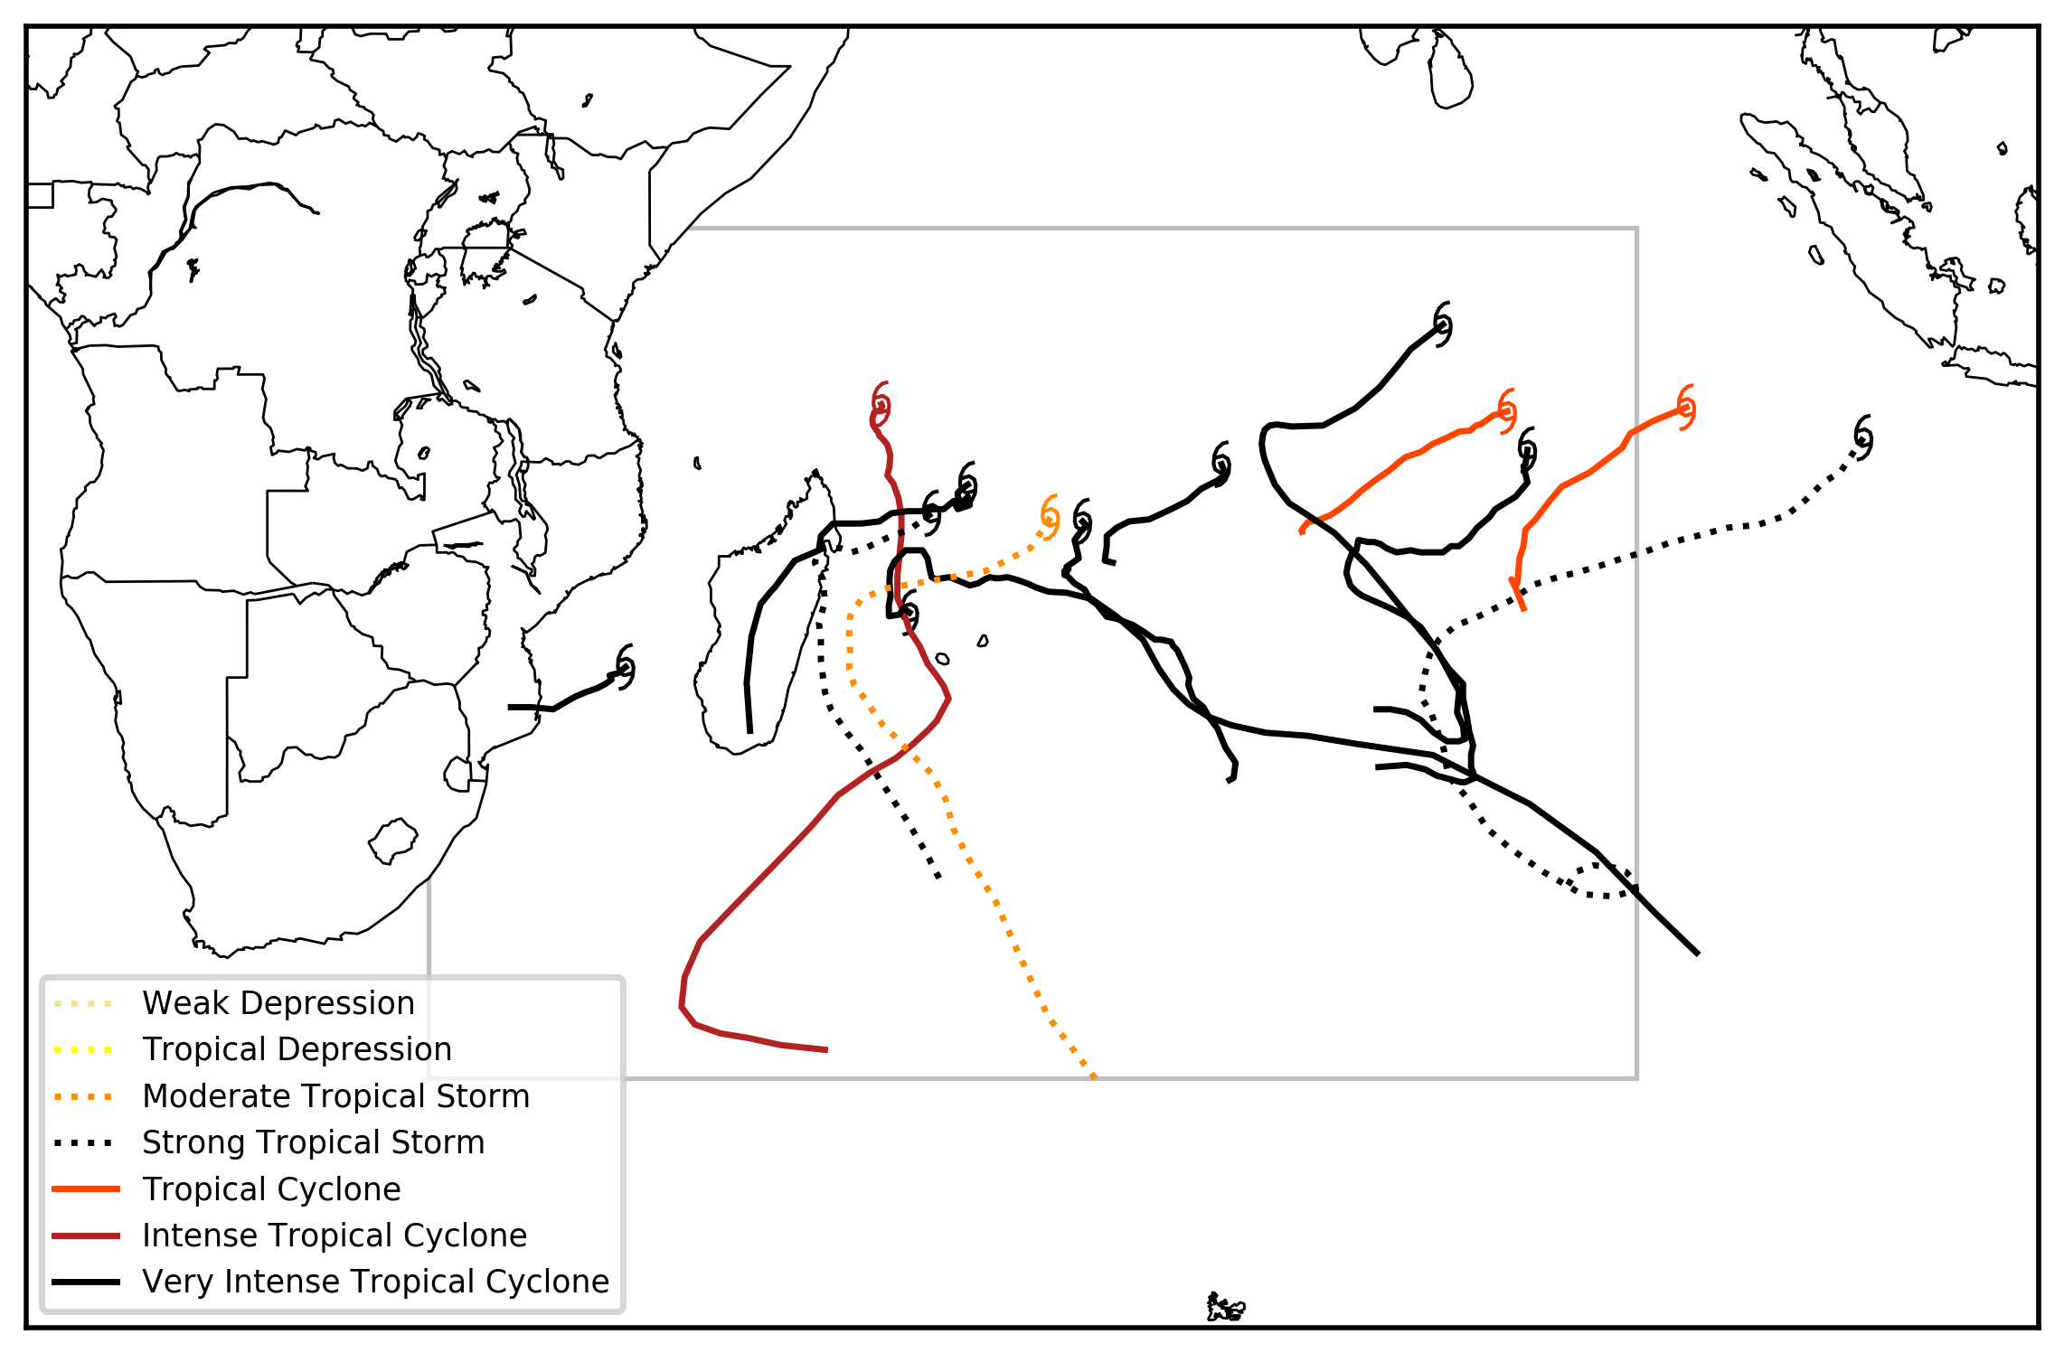
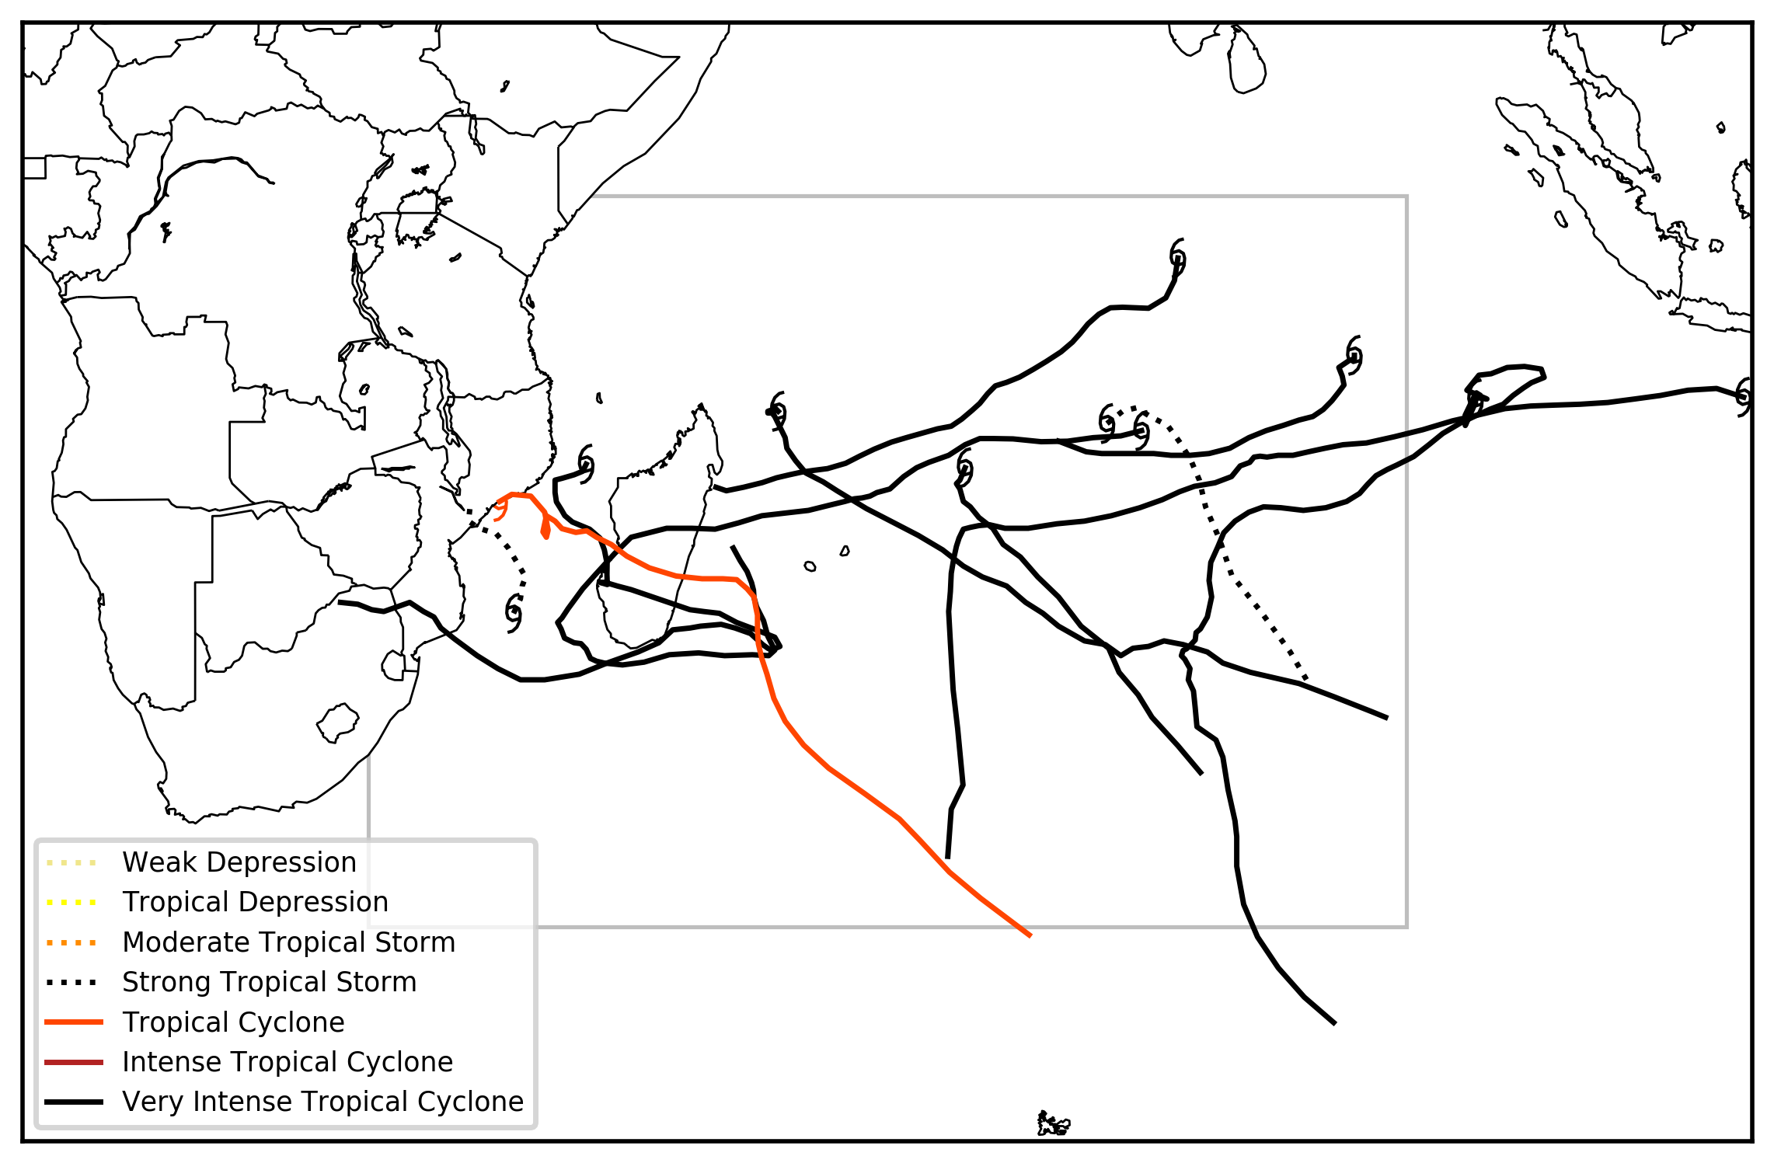
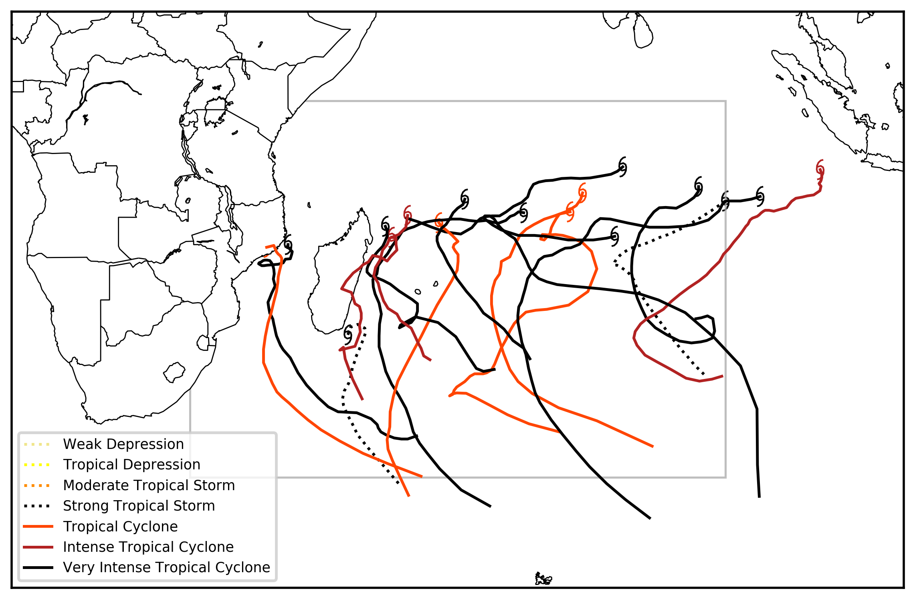
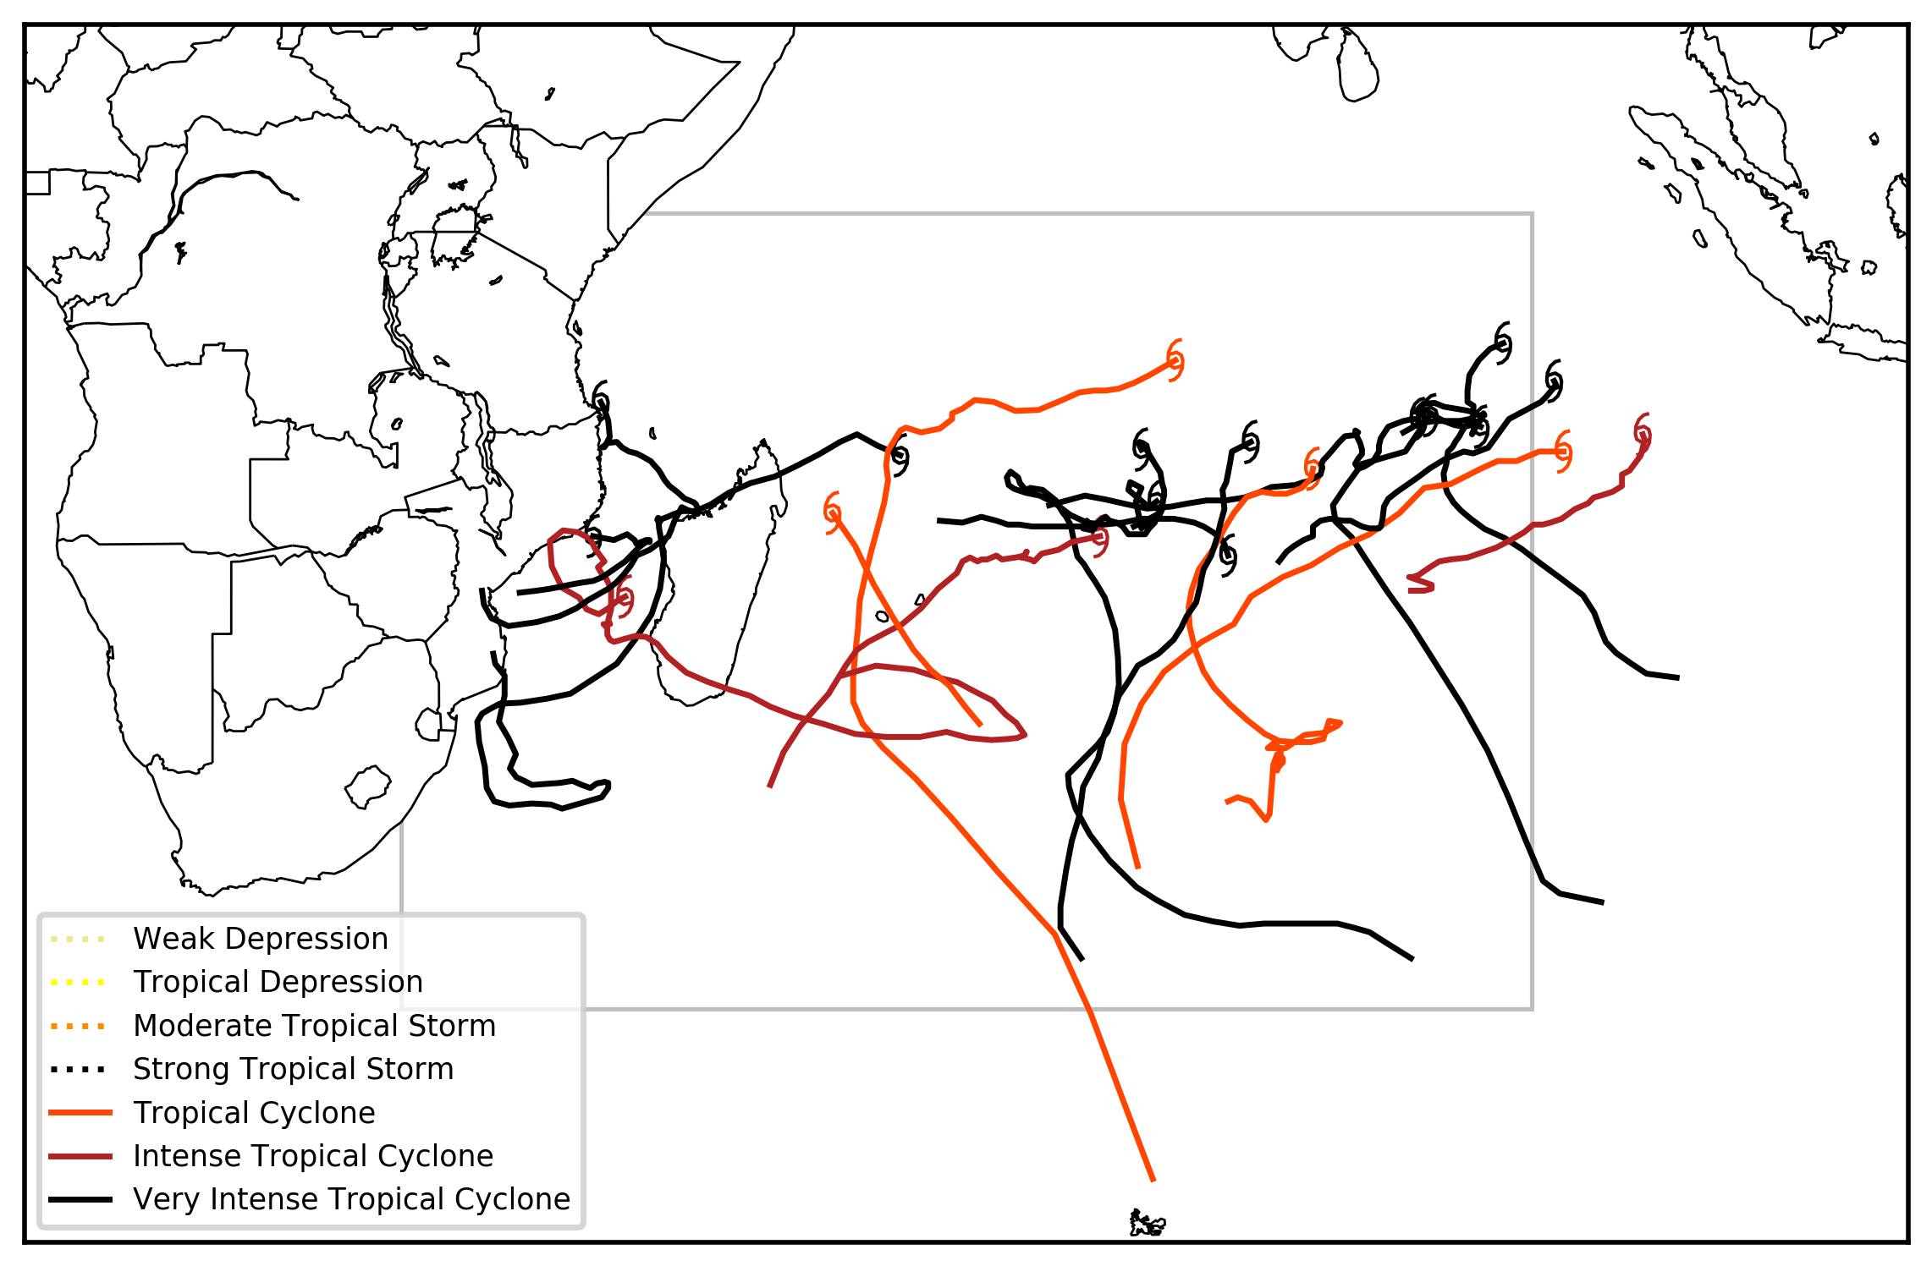
MJO 2-3
13 TCs [62% intense]
MJO 4-5
11 TCs [73% intense]
MJO 6-7
17 TCs [65% intense]
MJO 8-1
18 TCs [78% intense]

Slide 2
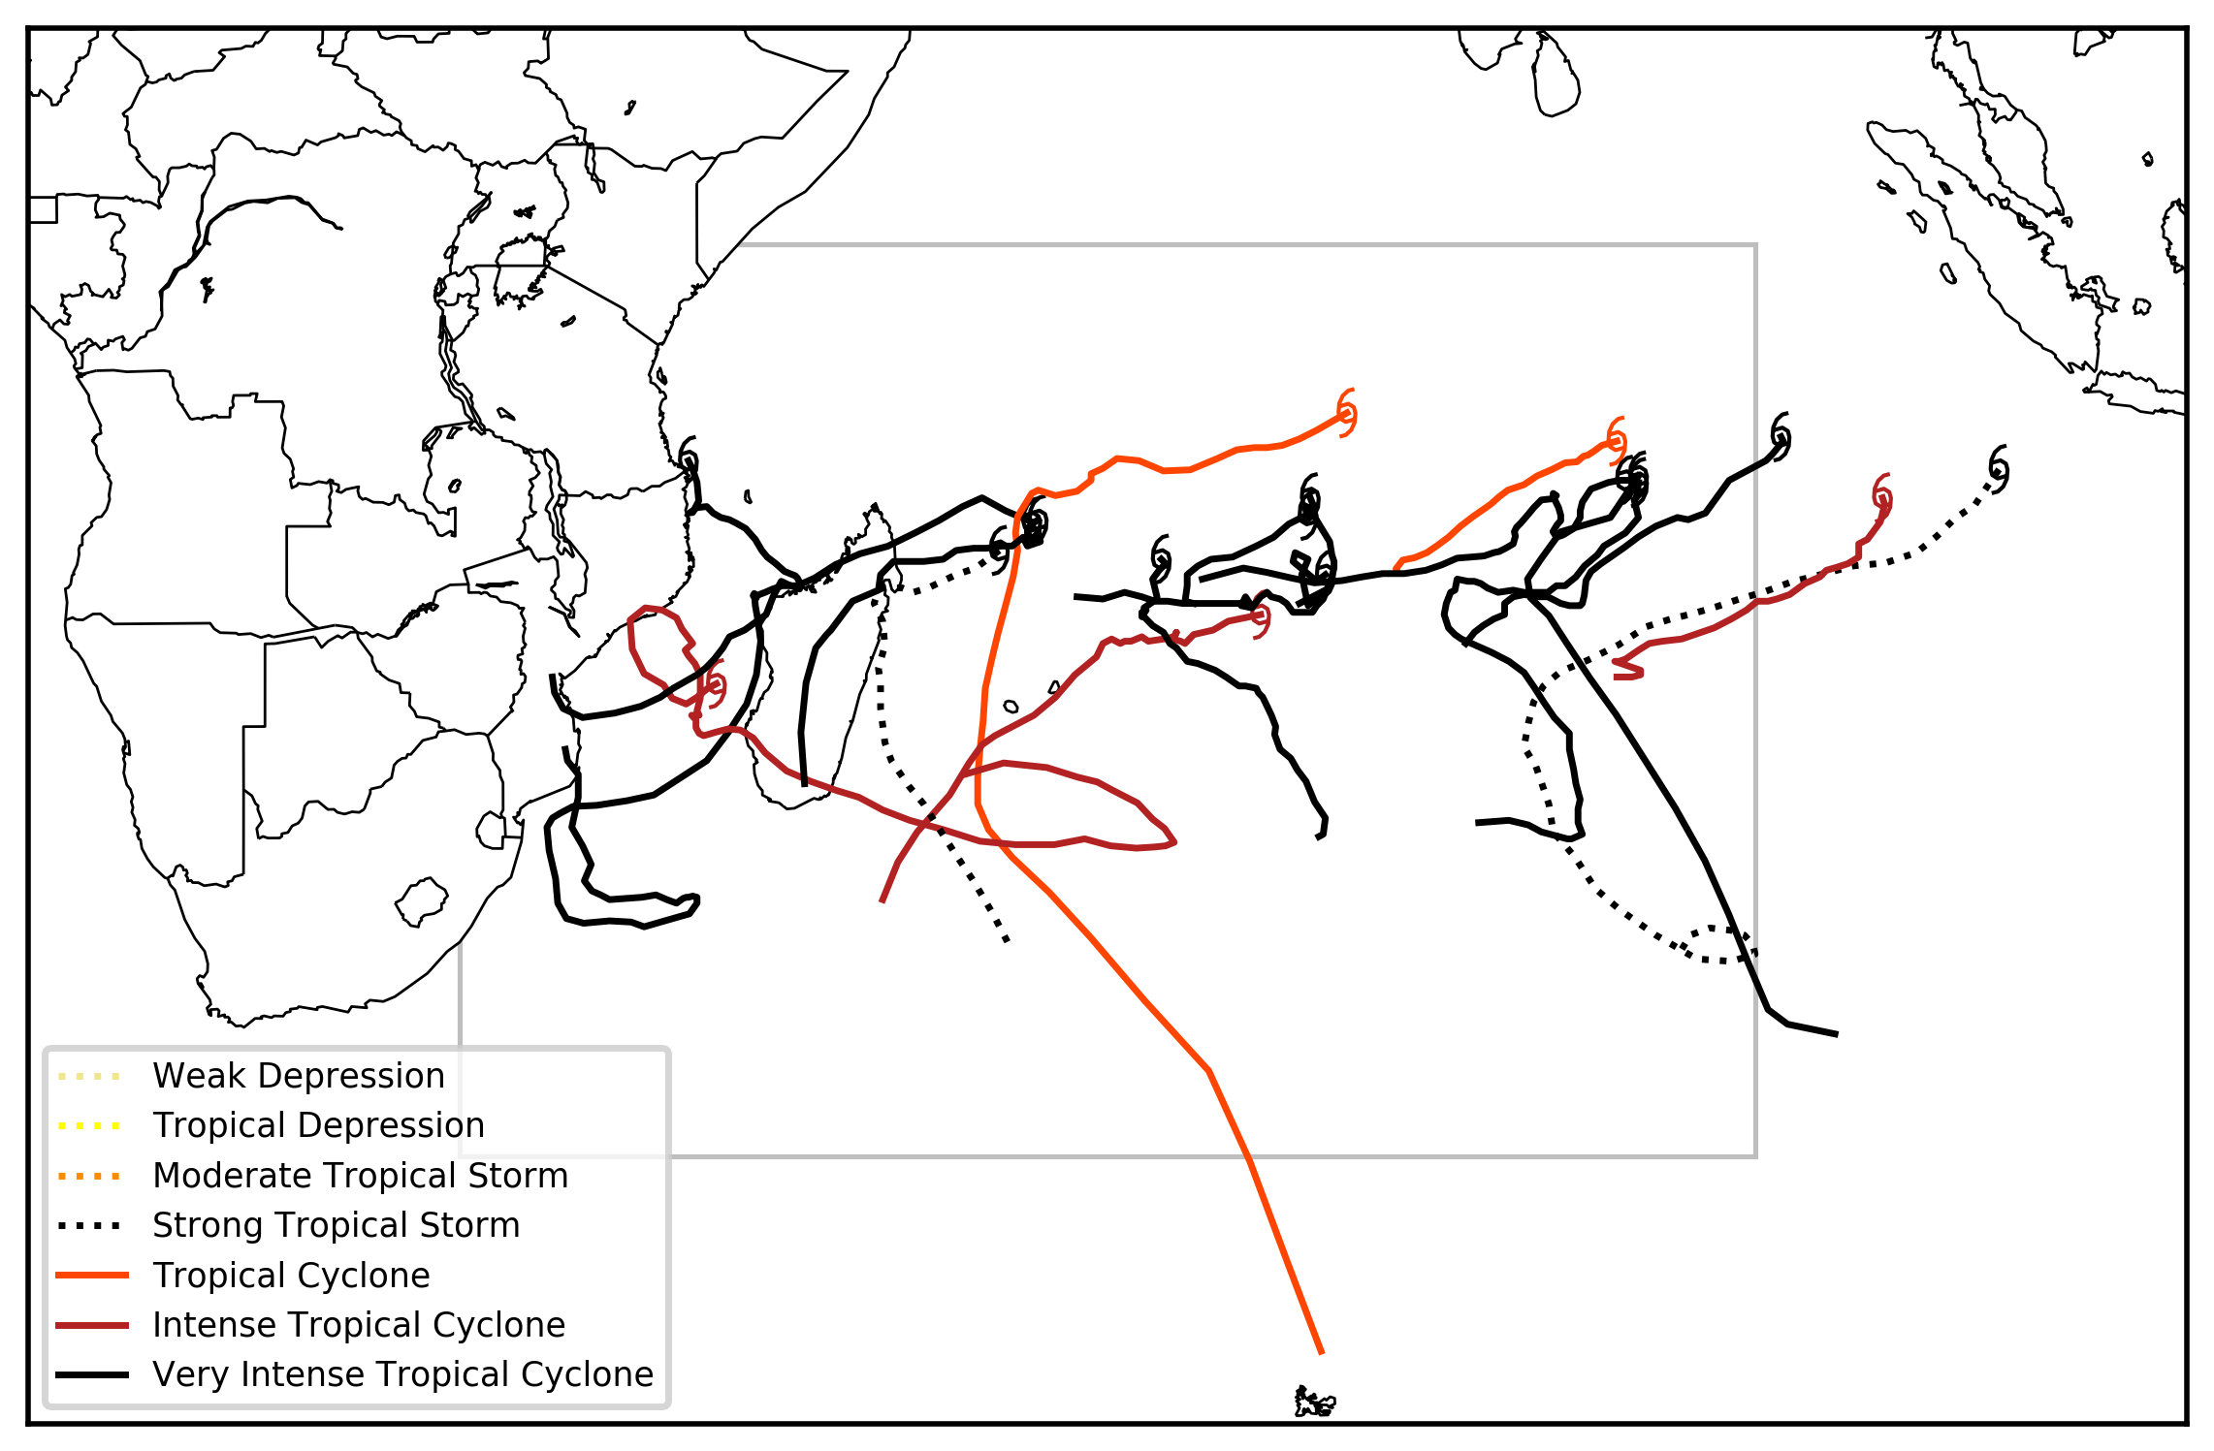
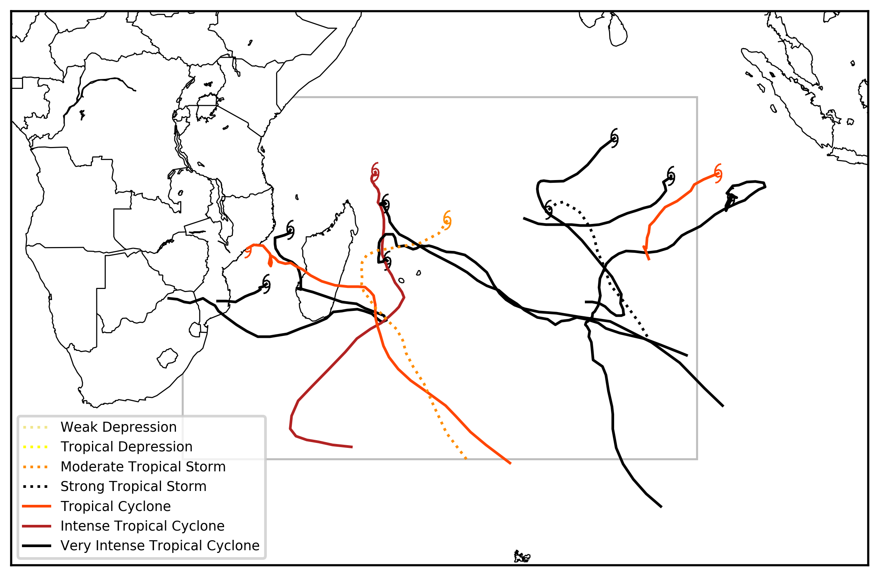
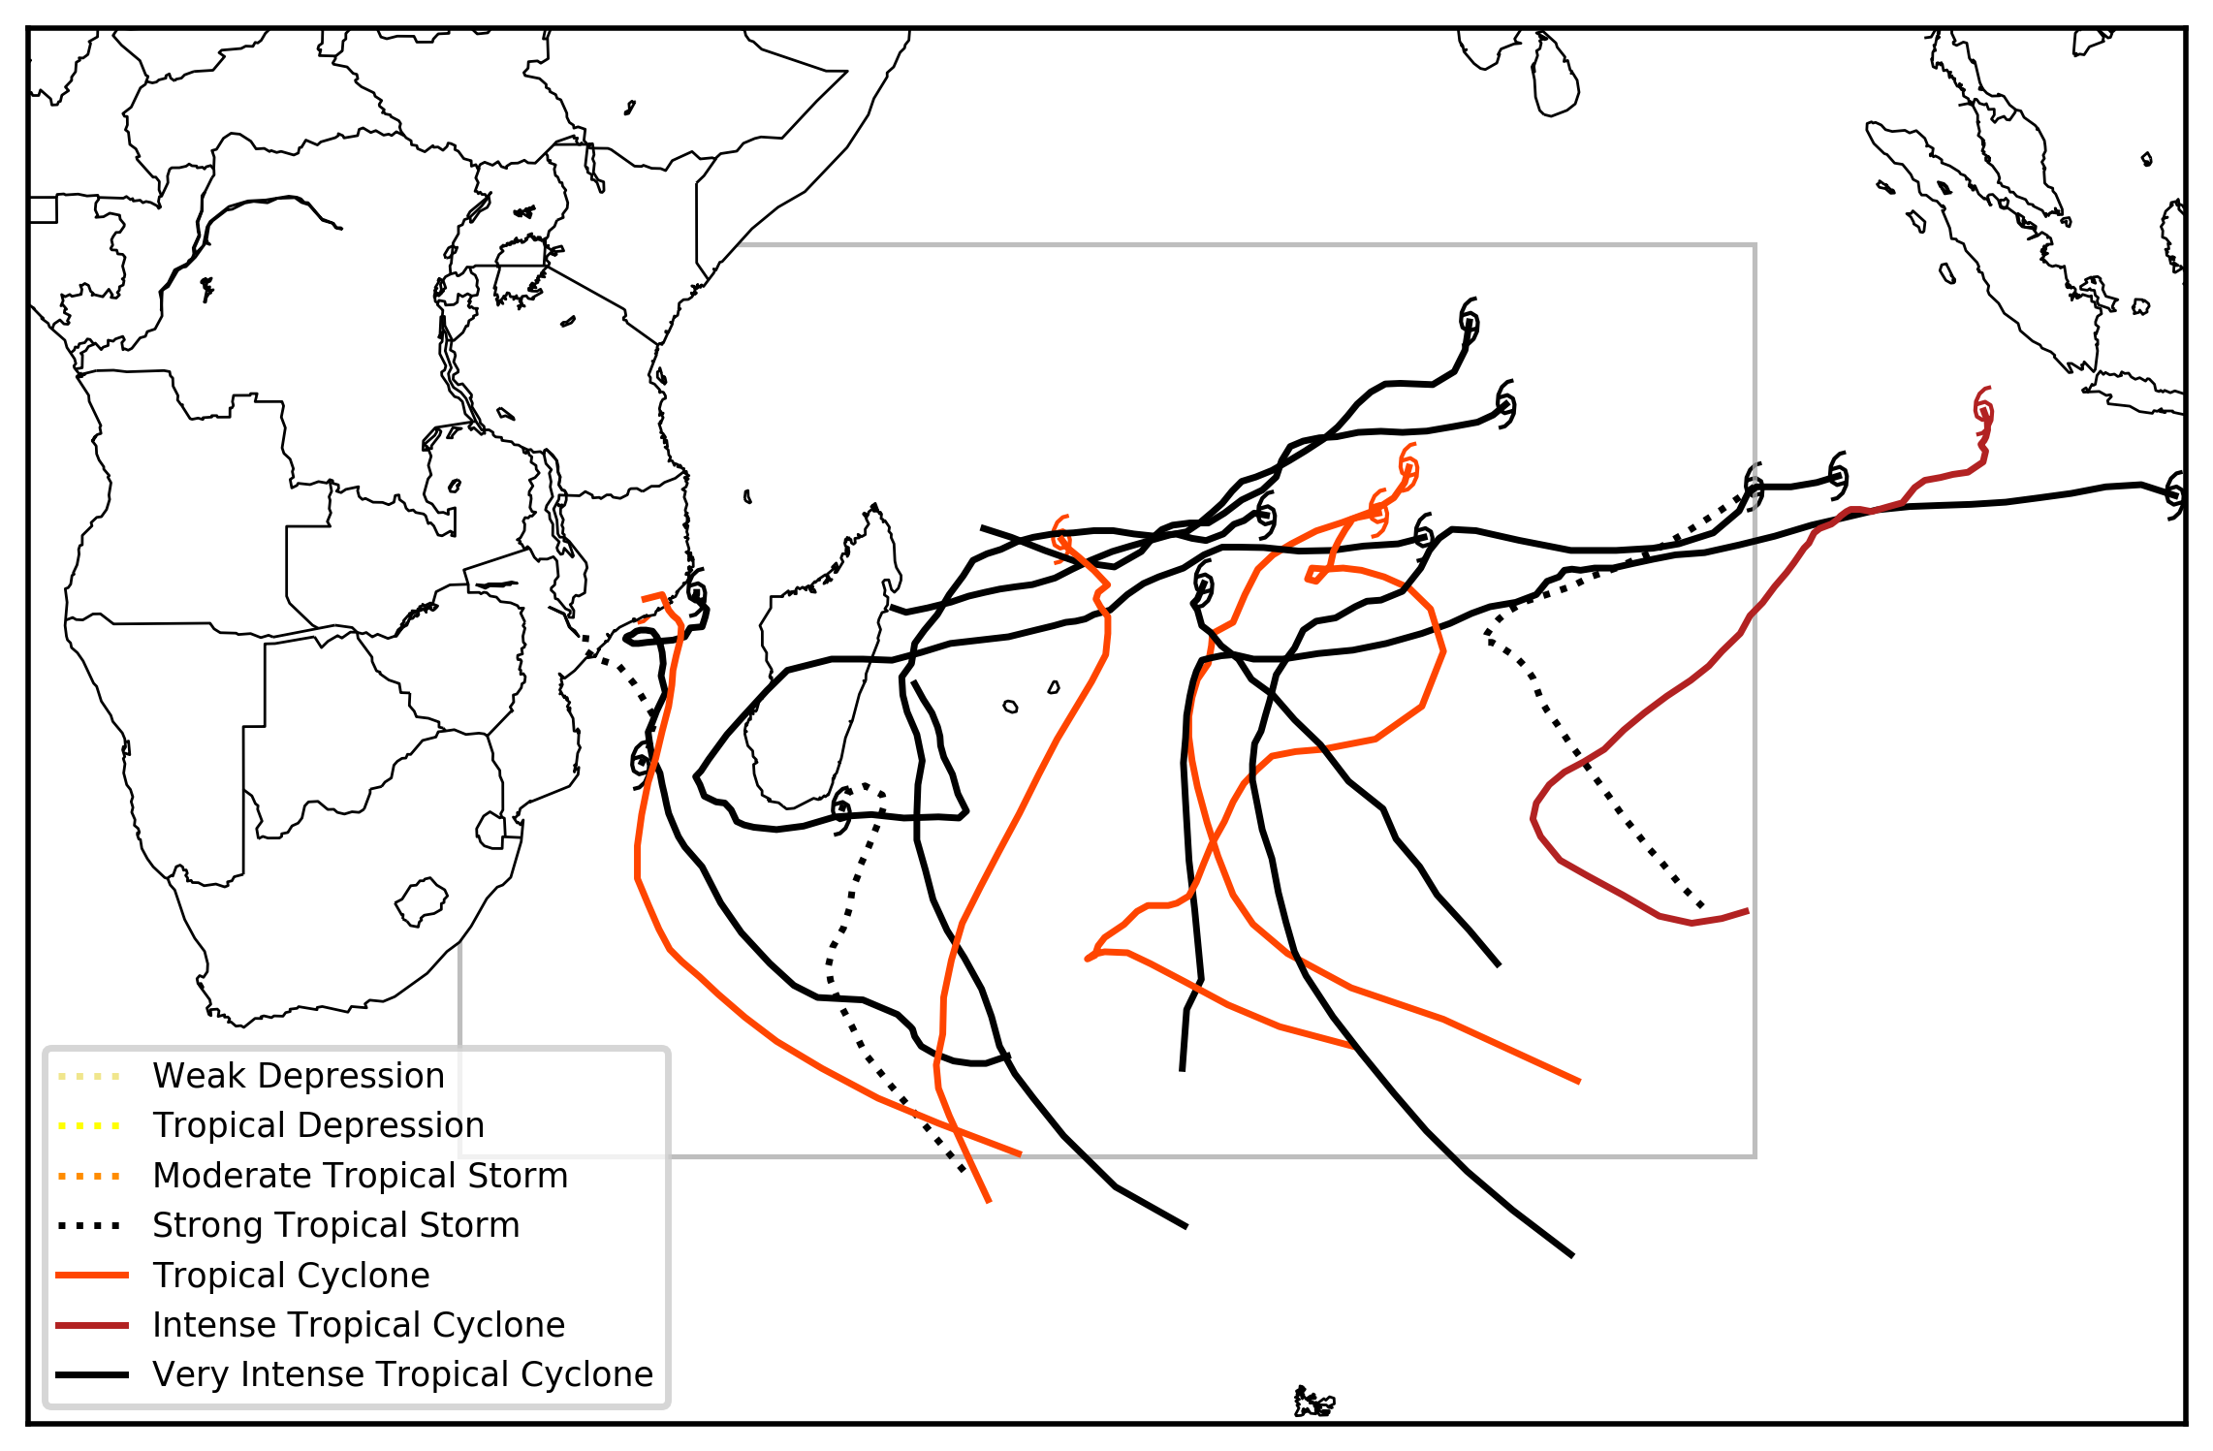
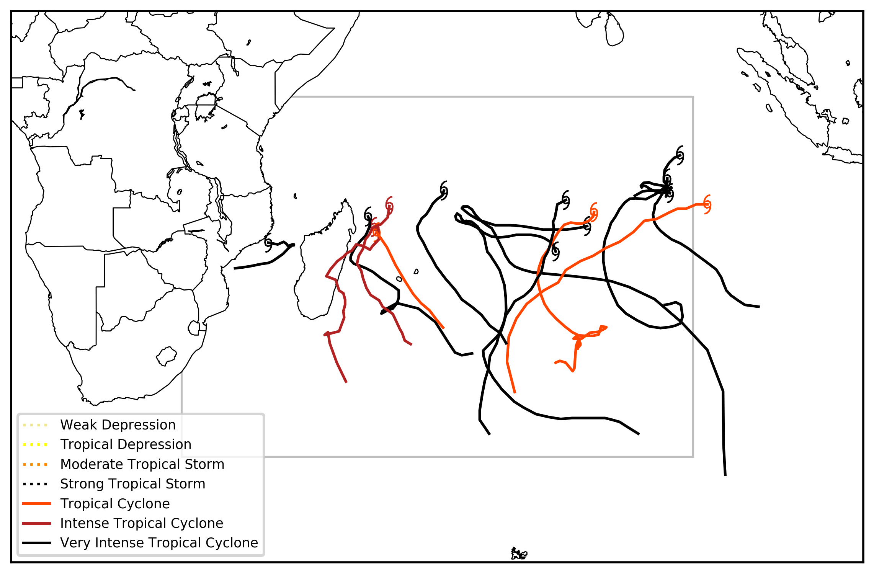
MJO 1-2
18 TCs [78% intense]
MJO 3-4
12 TCs [67% intense]
MJO 5-6
16 TCs [56% intense]
MJO 7-8
14 TCs [79% intense]

