Slide 1
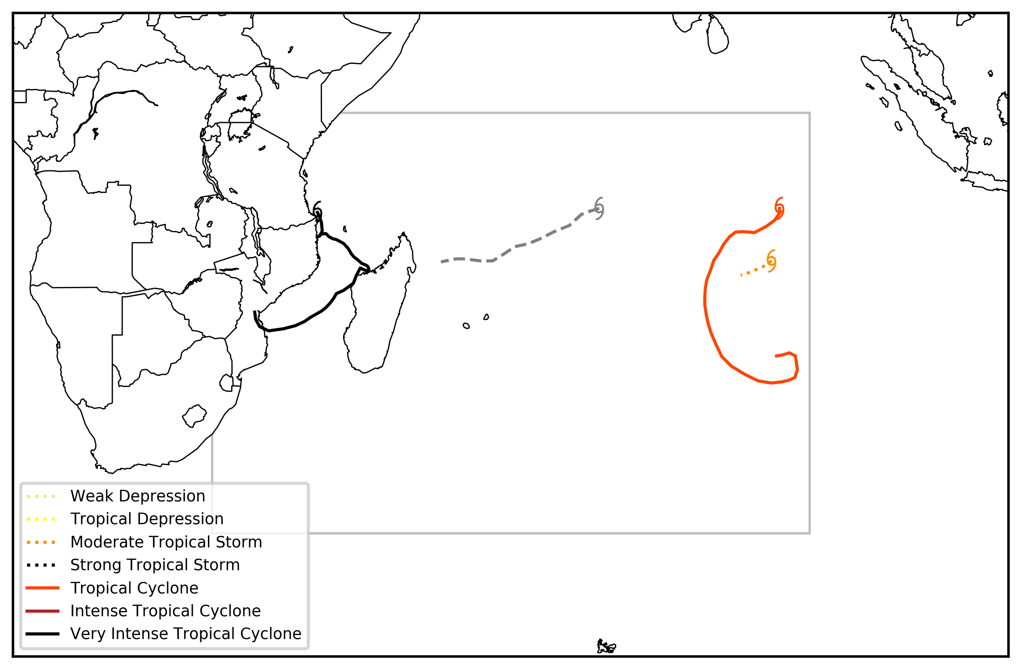
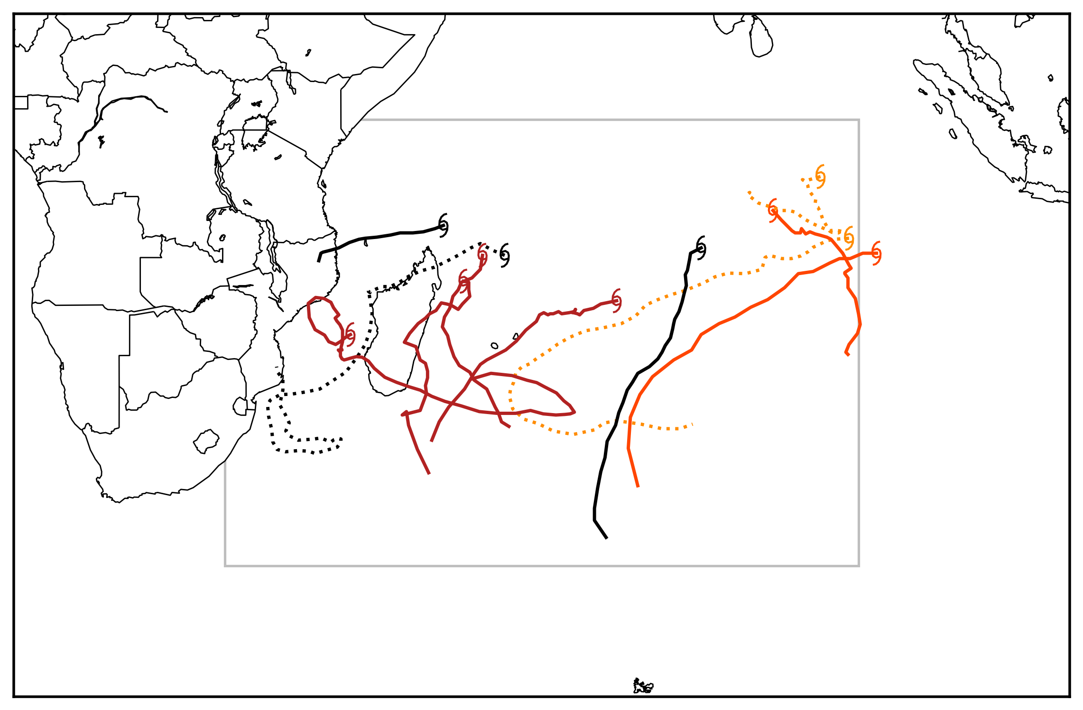
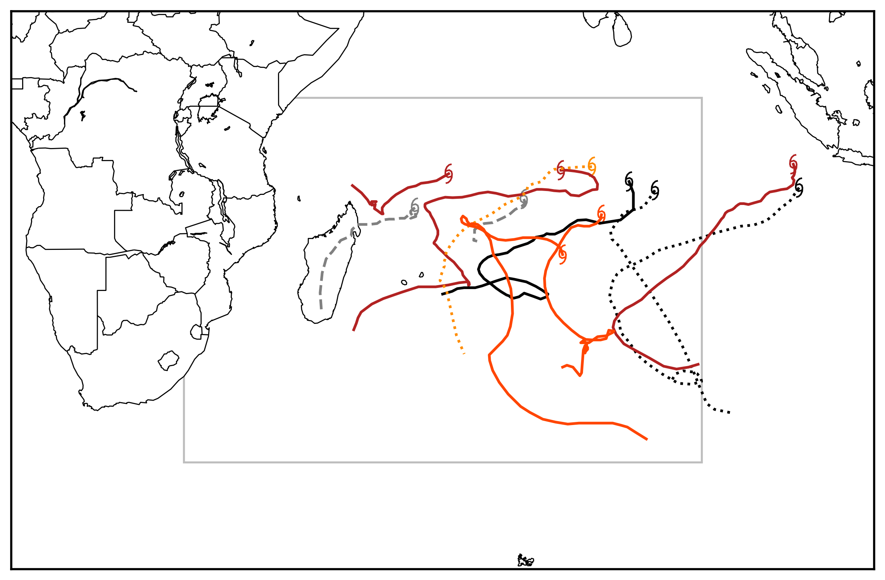
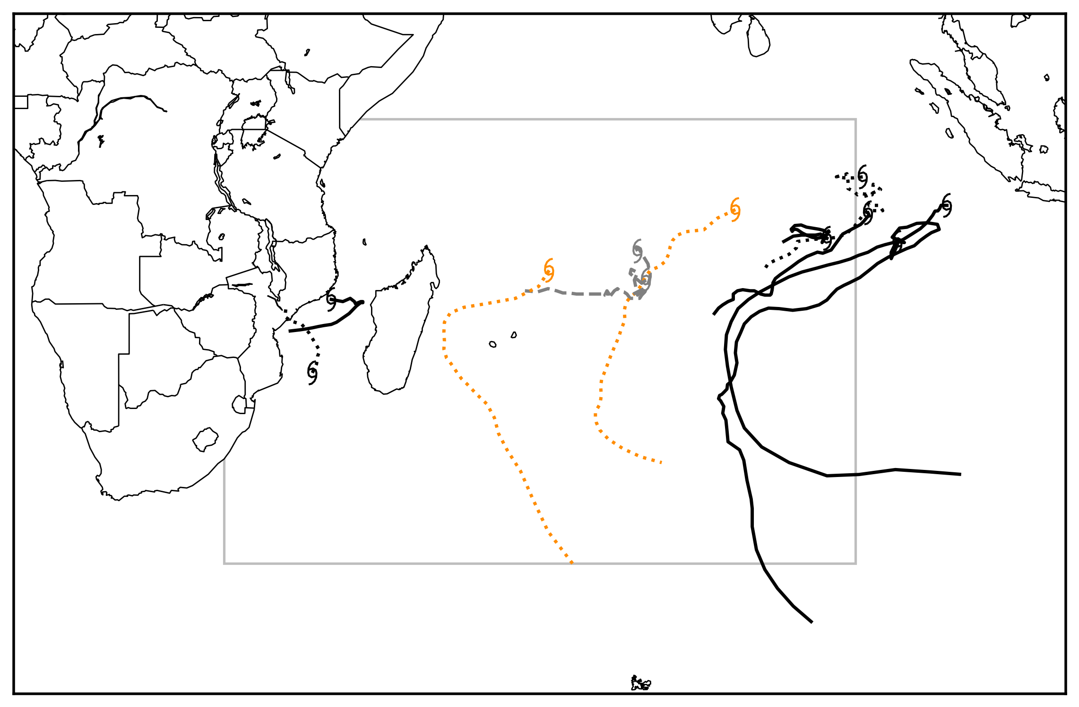
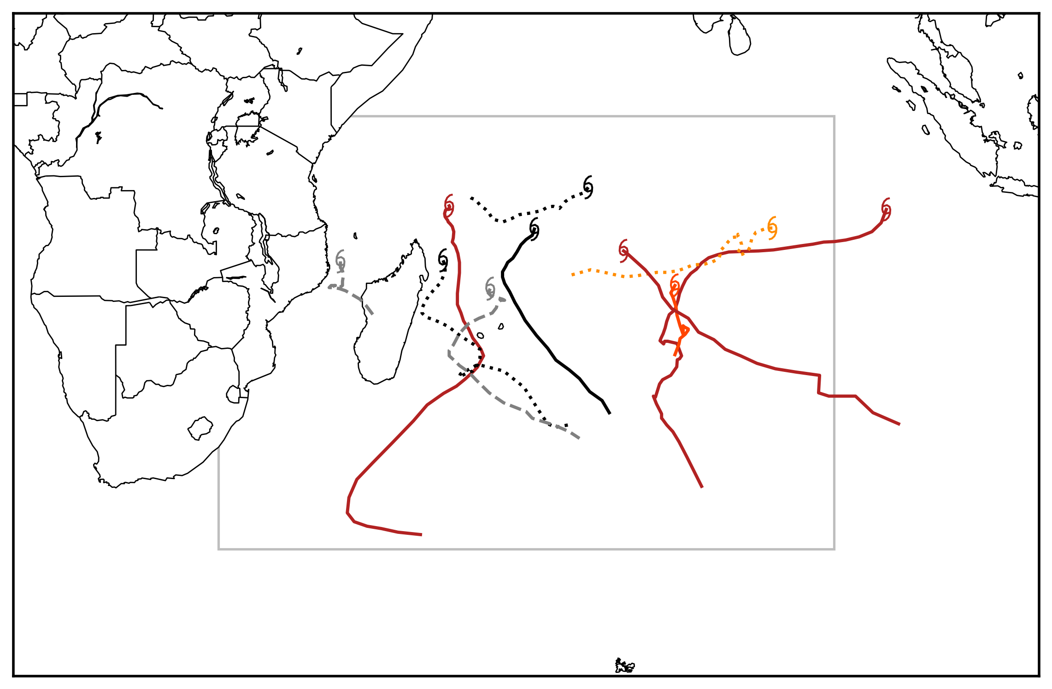
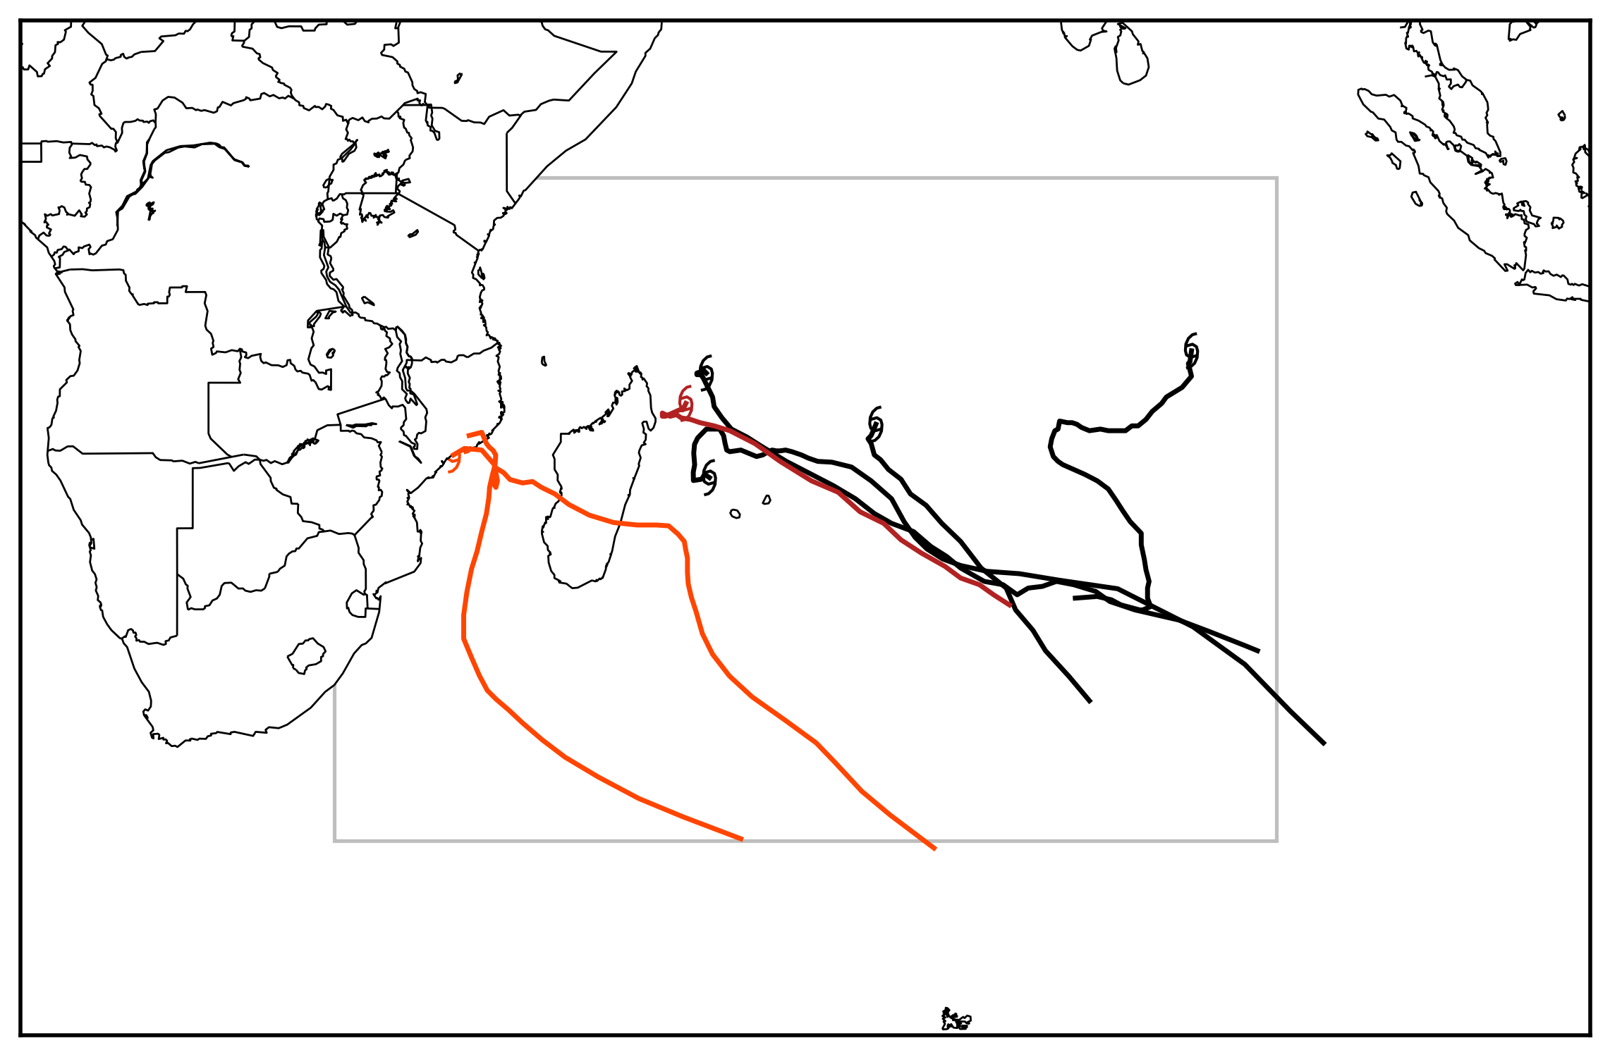
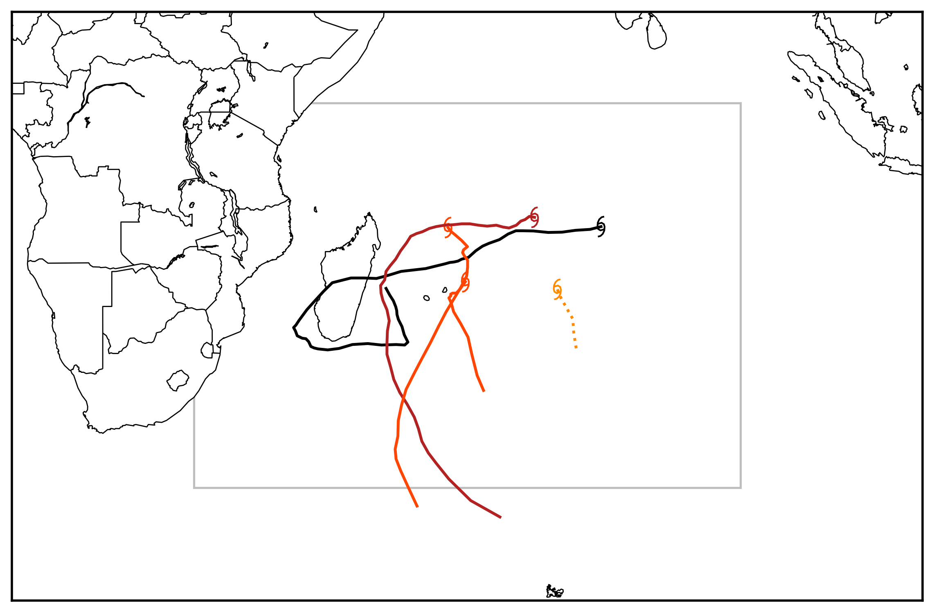
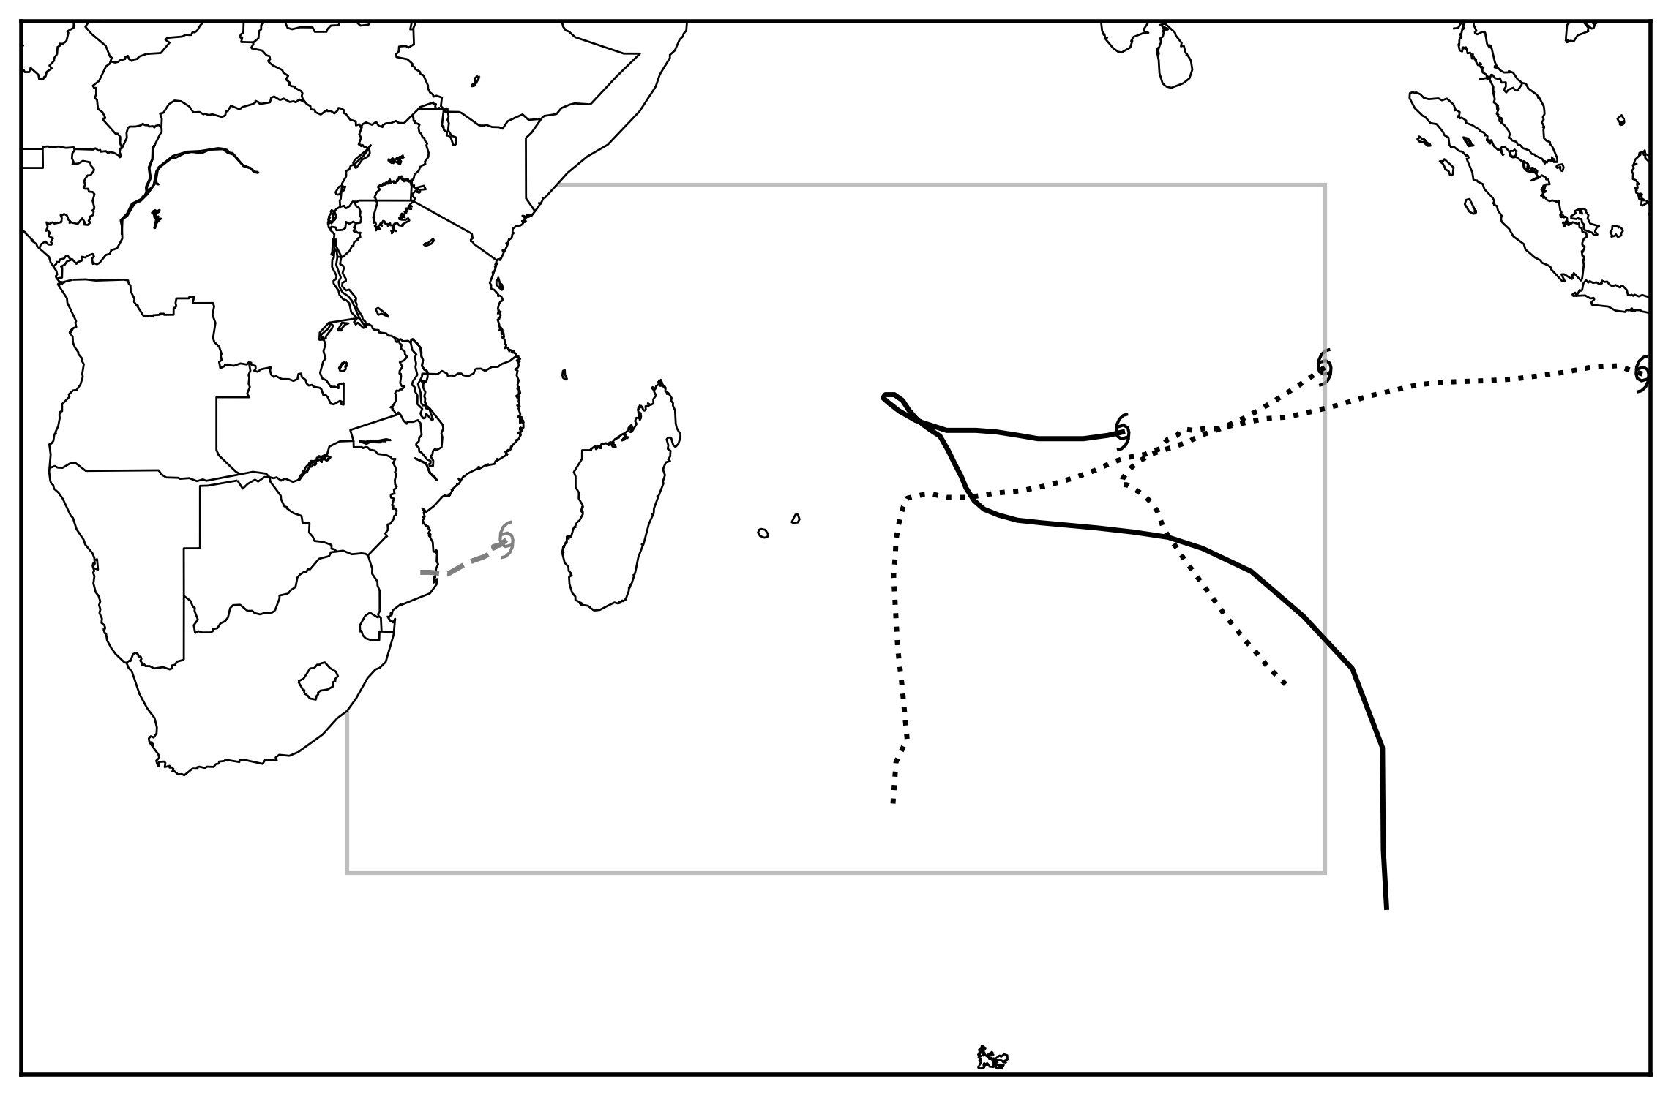
MJO Phase 1
4 TCs (25% intense)
MJO Phase 2
11 TCs (55% intense)
MJO Phase 3
11 TCs (36% intense)
MJO Phase 4
10 TCs (50% intense)
MJO Phase 5
10 TCs (40% intense)
MJO Phase 6
7 TCs (71% intense)
MJO Phase 7
5 TCs (40% intense)
MJO Phase 8
4 TCs (25% intense)

