Slide 1
Intro to JavaScript
Rebecca Wieberdink
03/22/2019

Slide 2
What is JavaScript?
A programming language that provides functionality and interactivity to a webpage
Widely used, has lots of frameworks and libraries that make programming easier
Can make dynamic changes to the webpage, provide animation, understand user input

Slide 3

JavaScript Variable
Variables can be…
Strings: Test within quotation marks
var name = “Jessica”;
Numbers: Number values
var age = 27;
Booleans: True or False outside of quotation marks
var isHealthy = true;

Slide 4
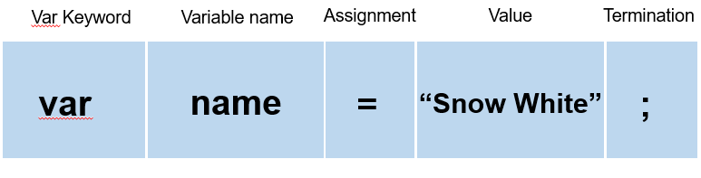
Variable syntax

Slide 5
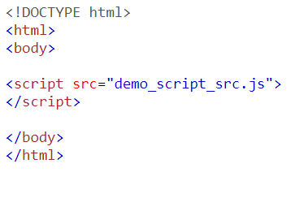
Including JavaScript
Written in an external .js file and linked to the HTML page | Written in the HTML file within script tags

Slide 6
JavaScript Alert()
The alert() method displays an alert box with a specified message and an OK button.
An alert box is often used if you want to make sure information comes through to the user.

Slide 7
JavaScript Prompt()
The prompt function is used to get textual or numerical (or both) data from the user. It will just put up a dialogue box on screen with any message you’d like to display along with a text box allowing them to input anything they like.
var response = prompt("Hey there, what's your name?");
alert("You typed: " + response);

Slide 8
JavaScript Confirm()
The confirm function is used in a very similar fashion as the alert function, but with one big difference. The confirm function will show an alert box with two options “OK” and “Cancel”.
Example:
var response = confirm("Hey there, do you want to learn more about JavaScript?");
alert("Your response was: " + response);
When the user clicks “OK” the response variable will be true, if the user clicks “Cancel” the response variable will be false.

Slide 9
JavaScript Array
An array is a special variable, which can hold more than one value at a time.
An array can hold many values under a single name, and you can access the values by referring to an index number.
Examples:
var cars = ["Saab", "Volvo", "BMW"];
The value of cars[2] would be “BMW”

Slide 10
JavaScript Console.log
The console.log() method writes a message to the console.
The console is useful for testing purposes.
Example:
console.log(“this code here”);
That would show up in the console along with the line number.
Using console.log() helps to debug.

Slide 11
JavaScript Object
Objects are variables too. But objects can contain many values.
This code assigns many values (Fiat, 500, white) to a variable named car:
var car = {type:”BMW", model:”328i", color:”silver"};
The values are written as name:value pairs.

Slide 12
JavaScript Function
A JavaScript function is a block of code designed to perform a particular task.
A JavaScript function is executed when "something" invokes it (calls it).
A JavaScript function is defined with the function keyword, followed by a name, followed by parentheses ().
Function names can contain letters, digits, underscores, and dollar signs (same rules as variables).

Slide 13
JavaScript Function (continued)
The parentheses may include parameter names separated by commas: (parameter1, parameter2, ...)
The code to be executed, by the function, is placed inside curly brackets: {}
function name(parameter1, parameter2, parameter3) { // code to be executed }

Slide 14
JavaScript Conditionals
Conditionals control behavior in JavaScript and determine whether or not pieces of code can run.
if The most common type of conditional is the if statement, which only runs if the condition enclosed in parentheses () is true.
Example:
if (10 > 5) { var outcome = "if block"; }

Slide 15
JavaScript Conditionals (continued)
else is used along side an if statement referred to as an “if/else” statement.
You can extend an if statement with an else statement, which adds another block to run when the if conditional doesn’t pass.
Example:
if ("cat" === "dog") { var outcome = "if block"; } else { var outcome = "else block"; }
The result would be the outcome from the else statement.

