Slide 1
Spanish I
Rebekah Simpson
Notes:
Becky

Slide 2
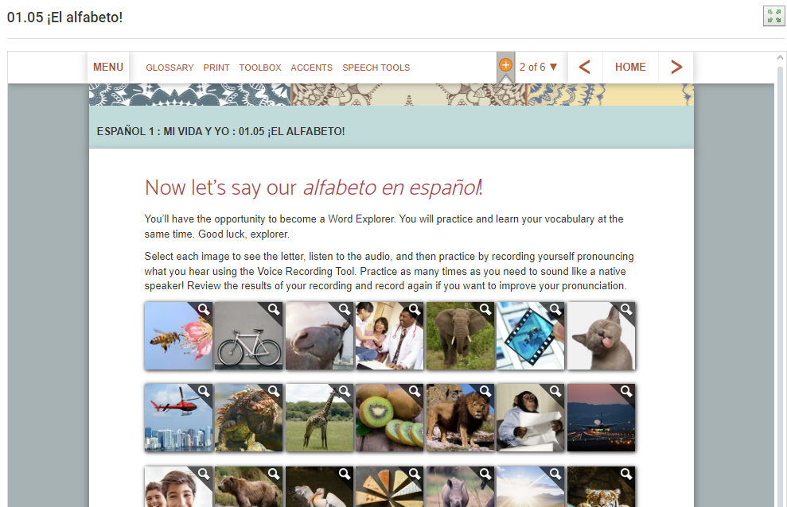
Before
Didn’t like the course
Low student success rate
Dense, text-heavy lessons
Teacher complaints
F
Notes:
Becky
1st section: things we knew about this course
Low student success rate specifically identified by ALSDE as an area to target
2nd section: problems we identified
Second issue here probably stems from the density of the lessons – poor chunking
ADD Sample lesson: FLVS Spanish I 1.05 El Alfabeto
: unclear what vocabulary was being emphasized; students could not easily identify key points or action items

Slide 3
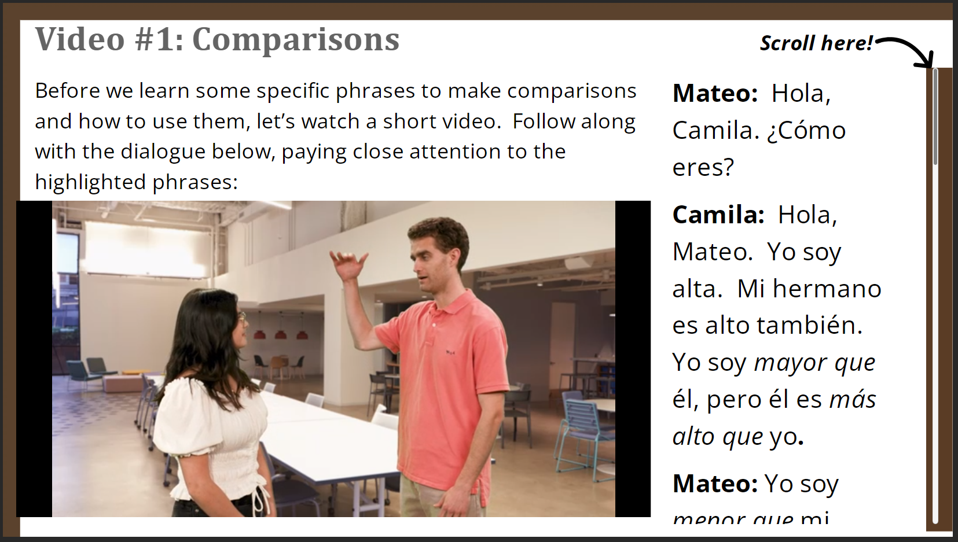
Our Plan
Improve scaffolding
Segment content and align with ACTFL guidelines
Create authentic multimedia models
Notes:
Becky
Notes guides are not submitted or graded, but test questions are drawn from them, so those who complete them are better prepared for assessments.
ACTFL = professional group for language educators
Multimedia principle = people learn better from words AND graphics together than they do from either alone. We know this is particularly effective for novice-level learners. But we also know that it’s ONLY effective when the media is directly related to the instructional goal. Decorative images don’t improve learning. So we wanted to be strategic and use multimedia where it would have the most impact, such as applying grammatical concepts to everyday situations.
Example: 5.07 Comparisons video

Slide 4
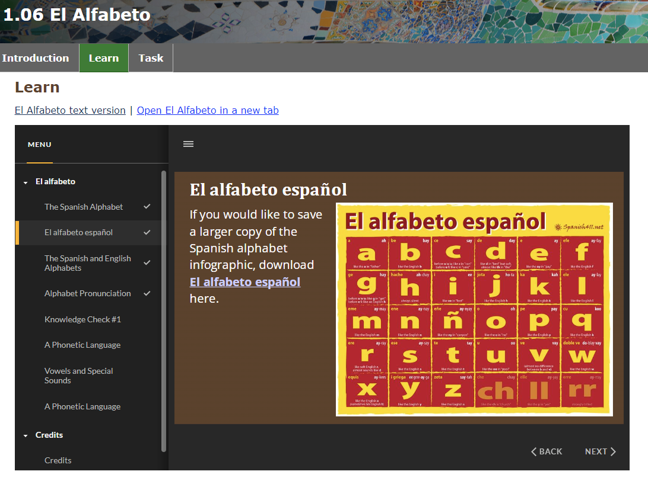
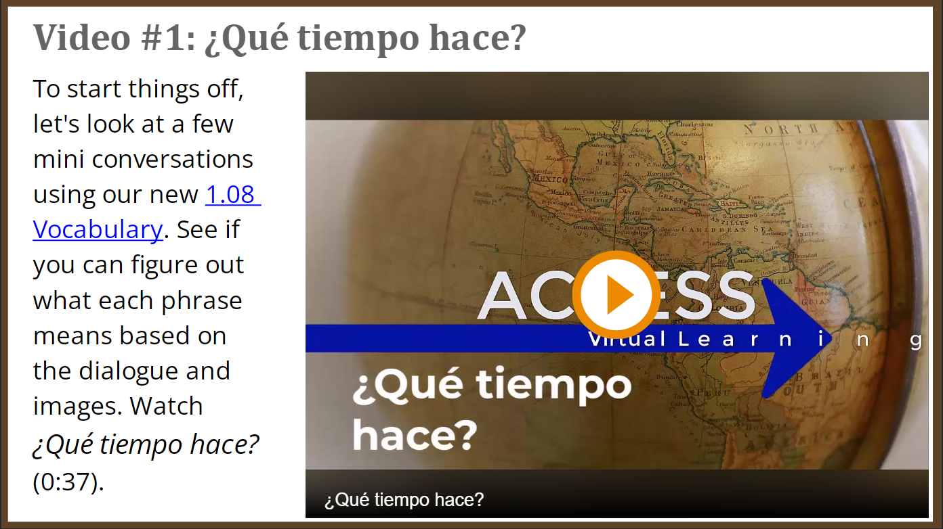
After
Clear objectives
Easy navigation
Different chunking
Less scrolling
Less text-heavy
Notes Guides and Vocabulary list downloads by lesson
Notes:
Clear objectives
Easy navigation
Different chunking
Less scrolling
Less text-heavy
Notes Guides and Vocabulary list downloads by lesson
Becky
Link on OBJECTIVES:
Quick tour of 1.06 El Alfabeto: this lesson has the same content as the vendor lesson I showed you earlier. That lesson had 6 full HTML pages and no player menu to help signpost where you are in the lesson. The new version has 3 HTML pages, no scrolling, and uses slides with a player menu to chunk the information and help students stay oriented. In the previous version, you only experienced the alphabet through the interactive. In this version, you still get the audio pronunciation guide through the videos, but you also get a graphic showing the entire alphabet and downloadable documents for reference.
Link on DOWNLOADS:
Quick tour of 1.08 ¿Qué tiempo hace?: Vocabulary downloadable on Video 1 slide; Notes Guide on Hace slide. These are not submitted or graded, but they give students a way to engage with the content in addition to the on-screen interactives, and notes to return to for reference.

Slide 5


Slide 6
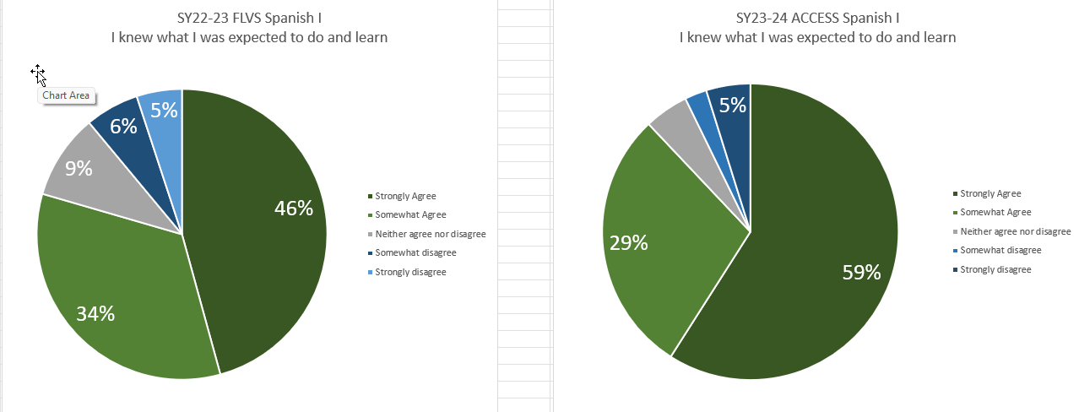
Results - Expectations
Notes:
Becky
Our student surveys from fall block schedule have been very encouraging. I’d like to show you a few charts comparing the student survey responses to the old course on the left with responses to the new course on the right.
We ask students to rate how strongly they agree or disagree with a series of statements. In these charts, green is good and blue is bad. The statement here is “I knew what I was expected to do and learn.” We have a big jump here in the number of students who strongly agree with this statement.

Slide 7
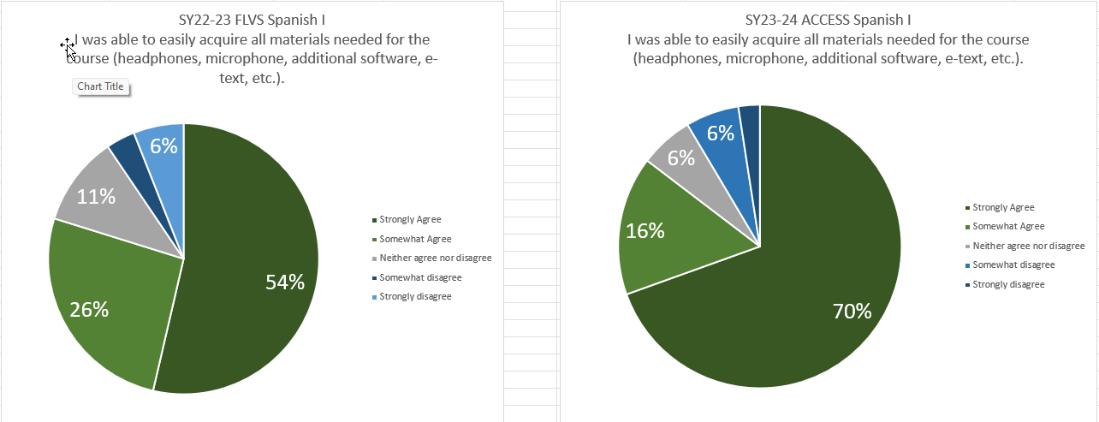
Results - Materials
Notes:
Becky
Materials – SA grew by 16 points

Slide 8
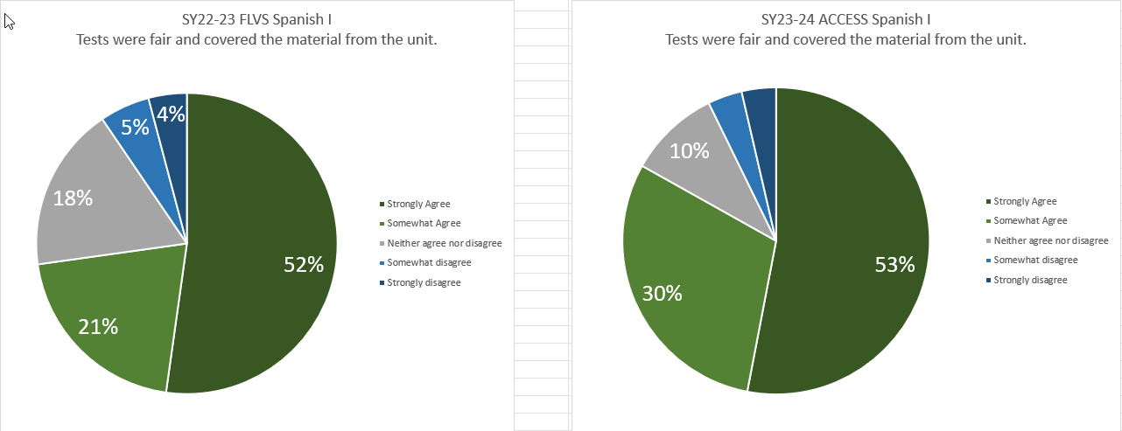
Results – Test fairness
Notes:
Becky
Fair tests – more “agree” responses

Slide 9
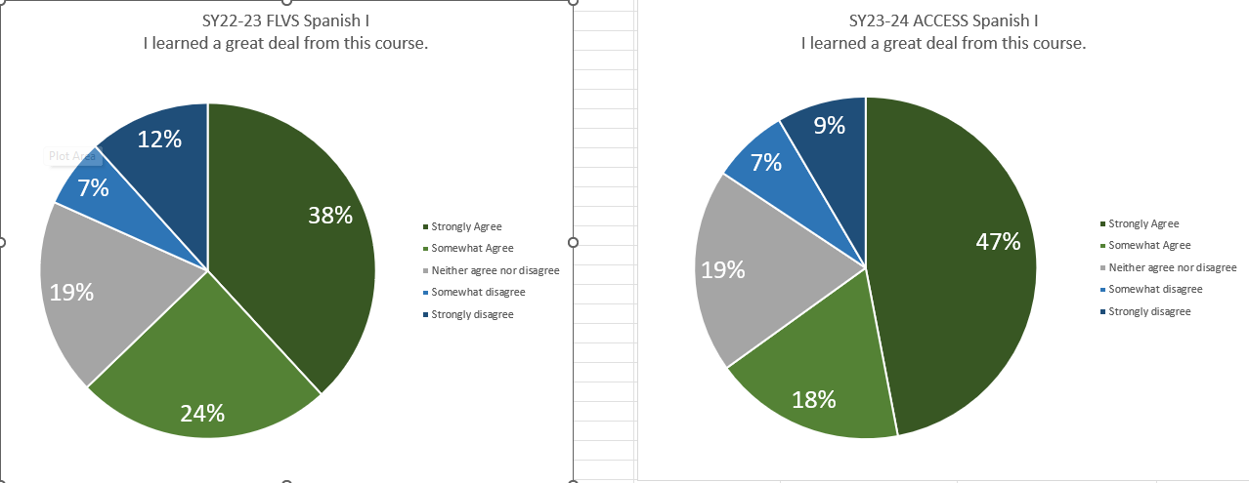
Results - Learning
Notes:
Becky
Learned a great deal – strongly agree up by 11 points, disagree/strongly disagree down by 3

Slide 10
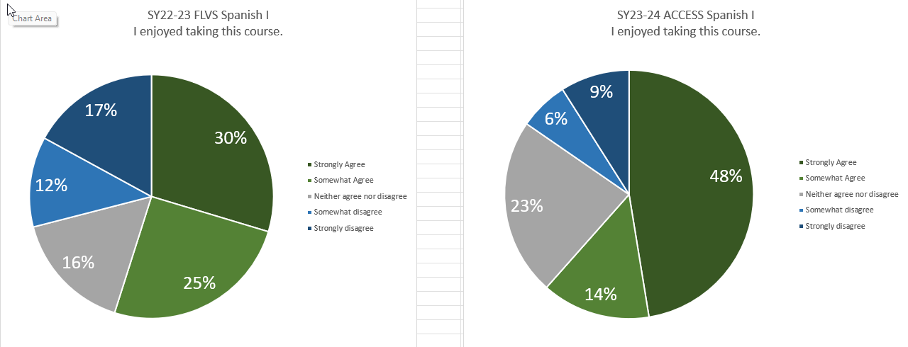
Results - Enjoyment
Notes:
Becky
Finally – the statement here is “I enjoyed taking this course” – the blue section (disagree, strongly disagree) section has shrunk by 14 points. The green section (agree, strongly agree) has grown by 7 points, with almost half of respondents now strongly agreeing that they enjoyed the course. We don’t typically see big jumps like these.

Slide 11
Success Rate and Enrollment

