Slide 1
A Real-Time COVID-19 Vaccine Rollout Score
Rebekah Callari-Kaczmarczyk

Slide 2
Overall Process
Review documentation/dataset
Review previous research
Determine features
Standardize features
Weight features and create score

Slide 3
Dataset Overview
Different vaccine types
Different levels of reporting (i.e. missing values)
Fairly easy to determine who is the “best” – not as easy to rank the middle

Slide 4
Previous Research
Limited
Most research is retroactive (Palache et al., 2017)
John Hopkins COVID-19 Vaccine Metrics
Total Vaccines Distributed
People Fully Vaccinated
% of Population Fully Vaccinated

Slide 5
What makes a vaccine rollout effective?
Percent of population fully vaccinated
Number of vaccines distributed
Rate of distribution
Fairness and equity in distribution

Slide 6
Percent of Population Fully Vaccinated
Total number of people fully vaccinated per hundred (percent of population)
Only pulled latest record for each country

Slide 7
Number of Vaccinations
Total vaccinations per hundred (percent of population)
Only pulled latest record for each country

Slide 8
Rate of vaccination
Two values:
Percent of people fully vaccinated per hundred
Percent of total vaccinations per hundred
Linear regression with time series
If fewer than 2 samples, rate was determined to be 0
Dates were converted to days from start date of dataset

Slide 9
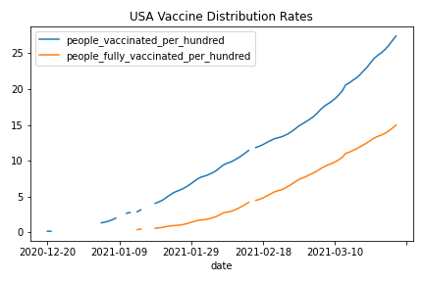
Linear Regression Checks
Plotted a couple of countries
Checked r2 scores

Slide 10
Features
Needed to standardize
Shapiro-Wilks test suggested that samples were not normal
Used the MinMax Scaler in scikitlearn

Slide 11
Standardized Features
Country | % Total Vacc | % Fully Vacc | Rate Fully Vacc | Rate Total Vacc
Afghanistan | 0.000818 | 0 | 0 | 0.00196
Albania | 0.013033 | 0 | 0.000785 | 0.000769
Algeria | 0.000994 | 0 | 0 | 0
Andorra | 0.070251 | 0 | 0.012048 | 0.036741
Angola | 0.00152 | 0 | 0 | 0.004069

Slide 12
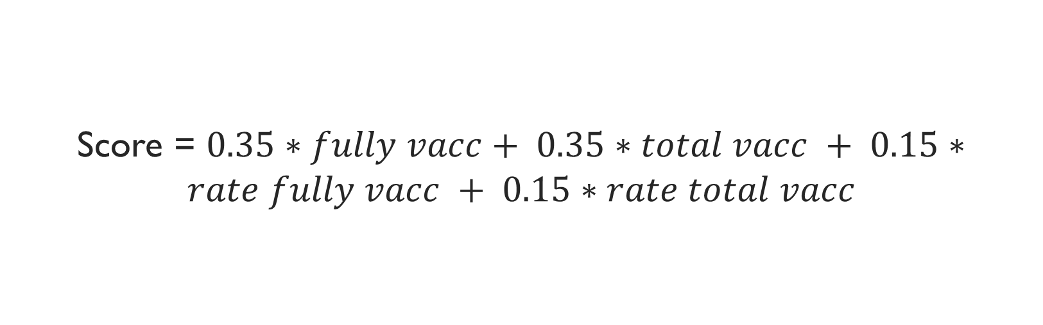
Final Score
Score = $0.35∗fully vacc+ 0.35∗total vacc + 0.15∗rate fully vacc + 0.15∗rate total vacc$

Slide 13
Results
Country | Rollout Score
Gibraltar | 90.23327
Israel | 59.97416
Seychelles | 46.67904
Cayman Islands | 30.88817
Bermuda | 28.61527

Slide 14
References
John Hopkins Coronavirus Resource Center: https://coronavirus.jhu.edu/vaccines/international
Palache, A., Abelin, A., Hollingsworth, R., Cracknell, W., Jacobs, C., Tsai, T., & Barbosa, P. (2017). Survey of distribution of seasonal influenza vaccine doses in 201 countries (2004–2015): the 2003 World Health Assembly resolution on seasonal influenza vaccination coverage and the 2009 influenza pandemic have had very little impact on improving influenza control and pandemic preparedness. Vaccine, 35(36), 4681-4686.

