Slide 1
A Real-Time COVID-19 Vaccine Rollout Score
Rebekah Callari-Kaczmarczyk

Slide 2
Overall Process
Review documentation/dataset
Review previous research
Determine features
Standardize features
Weight features and create score

Slide 3
Dataset Overview
Different vaccine types
Different levels of reporting (i.e. missing values)
Fairly easy to determine who is the “best” – not as easy to rank the middle

Slide 4
Previous Research
Limited
Most research is retroactive (Palache et al., 2017)
John Hopkins COVID-19 Vaccine Metrics
Total Vaccines Distributed
People Fully Vaccinated
% of Population Fully Vaccinated

Slide 5
What makes a vaccine rollout effective?
Percent of population fully vaccinated
Number of vaccines distributed
Rate of distribution
Fairness and equity in distribution

Slide 6
Percent of Population Fully Vaccinated
Total number of people fully vaccinated per hundred (percent of population)
Only pulled latest record for each country

Slide 7
Number of Vaccinations
Total vaccinations per hundred (percent of population)
Only pulled latest record for each country

Slide 8
Rate of vaccination
Two values:
Percent of people fully vaccinated per hundred
Percent of total vaccinations per hundred
Linear regression with time series
If fewer than 2 samples, rate was determined to be 0
Dates were converted to days from start date of dataset

Slide 9
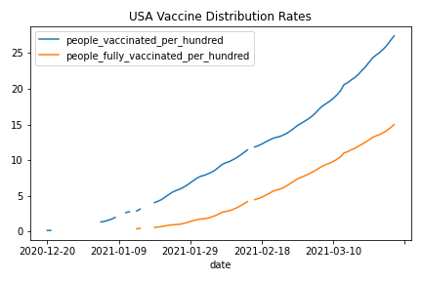
Linear Regression Checks
Plotted a couple of countries
Checked r2 scores

Slide 10
Features
Needed to standardize
Shapiro-Wilks test suggested that samples were not normal
Used the MinMax Scaler in scikitlearn

Slide 11
Standardized Features
Country | % Total Vacc | % Fully Vacc | Rate Fully Vacc | Rate Total Vacc
Afghanistan | 0.000818 | 0 | 0 | 0.00196
Albania | 0.013033 | 0 | 0.000785 | 0.000769
Algeria | 0.000994 | 0 | 0 | 0
Andorra | 0.070251 | 0 | 0.012048 | 0.036741
Angola | 0.00152 | 0 | 0 | 0.004069

Slide 12
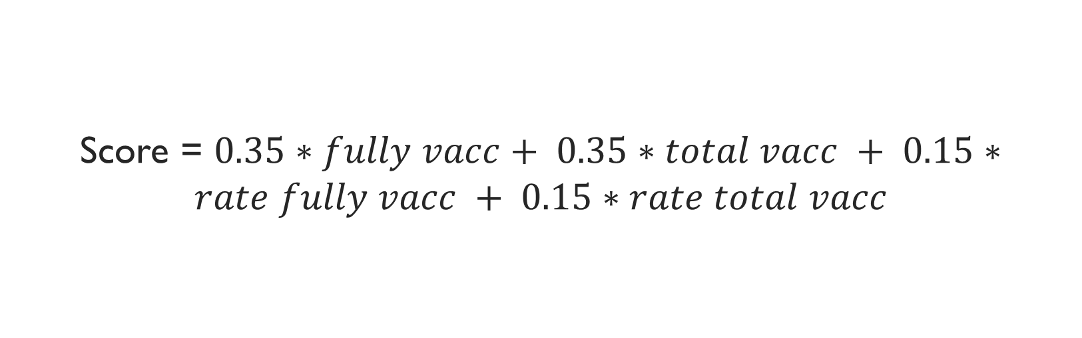
Final Score
Score = $0.35∗fully vacc+ 0.35∗total vacc + 0.15∗rate fully vacc + 0.15∗rate total vacc$

Slide 13
Results
Country | Rollout Score
Gibraltar | 90.23327
Israel | 59.97416
Seychelles | 46.67904
Cayman Islands | 30.88817
Bermuda | 28.61527

