Slide 1

Understanding Atypical Parasitoid Wasp Diversity Trends Across Latitudes Through Host Diversity
BINF*6210 Assignment 1
By: Rebekah Hest

Slide 2
Understanding spatial-ecological-interactions
Latitudinal diversity gradient (LDG): ecological pattern where species richness and diversity peak at or near the equator (latitude = 0°) and decreases towards the poles (Mannion, 2020).
Anomalous latitudinal diversity patterns observed in parasitoid wasps (Castellanos-Labarcena, 2024).
Need to investigate other mechanisms of parasitoid diversity.
Host richness at the at subfamily level previously studied (Timms et al., 2016).

Slide 3
Gap:
Knowledge of relationship between host diversity and spatial distribution on parasitoid wasp diversity.
Question:
Does host diversity predict parasitoid wasp diversity and explain the anomalous trend across latitudes?

Slide 4
H₁ Resource Diversity Relationship:
More diverse resources (hosts) provides more ecological niches
If host diversity increases, then parasitoid diversity increases
H₂ Host Dilution:
Lower relative abundance of hosts reduces specialist success, homogenizing towards generalists
If host diversity increases, then parasitoid diversity decreases
H₀ Null Hypothesis:
Parasitoid diversity not influenced by host diversity

Slide 5
remove NA: BIN, lat, lon
Generalized Additive Model & Plot:
Calculate:
Shannon Diversity Index (H')
latitude midpoint
Merge datasets:
Generalized Additive Model & Partial Effect Plots:
Parasitoid: Ichneumoninae
latitude vs parasitoid diversity
latitude vs host diversity
latitude midpoints
parasitoid diversity (H')
host diversity (H')
3. latitude + host diversity vs parasitoid diversity
Retrieve Data via BOLD API:
Host: Heliconiinae|Danainae
Parasitoid (n = 16586)
Organize data into 10° latitude bins:
Overall range [-50°, 90°]
Host (n = 10458)
Retrieval
Filtering
Manipulation
Calculations
Modelling

Slide 6
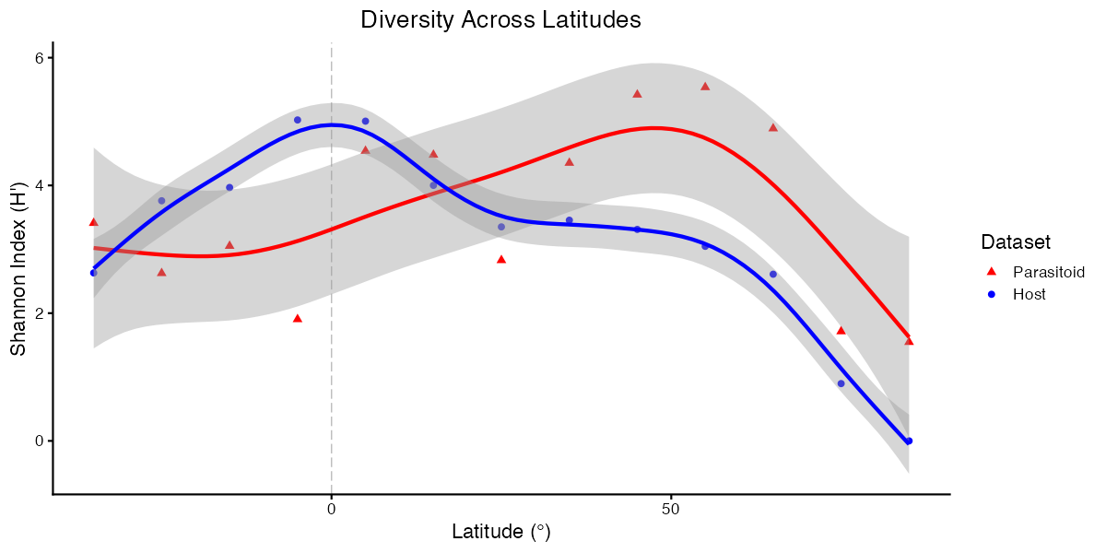
Host closely follows typical trend with latitude, unlike Parasitoid that displays anomalous trend

Slide 7
Effect of latitude on diversity differs between taxonomic groups
Response group | P-value | R-squared
Parasitoid wasp | 0.0651 | 0.535
Host butterfly | 0.00153* | 0.986
Parasitoid diversity is not predicted by latitude.
Host diversity is significantly predicted by latitude.
Different pattern between parasitoid and host.
Can host diversity be a predictor of parasitoid diversity?

Slide 8
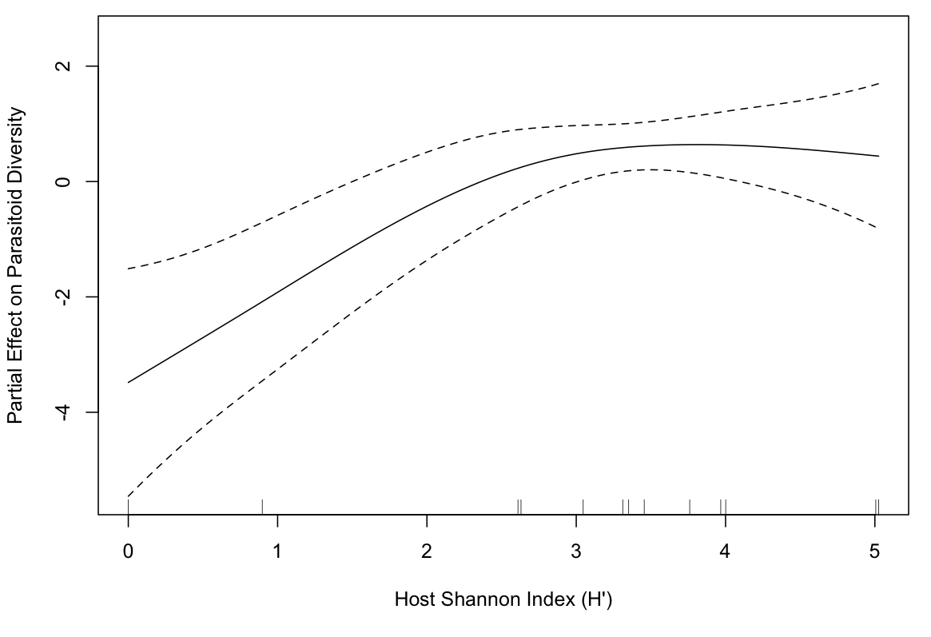
Host Diversity is a significant predictor of Parasitoid Diversity when modelled with Latitude

Slide 9
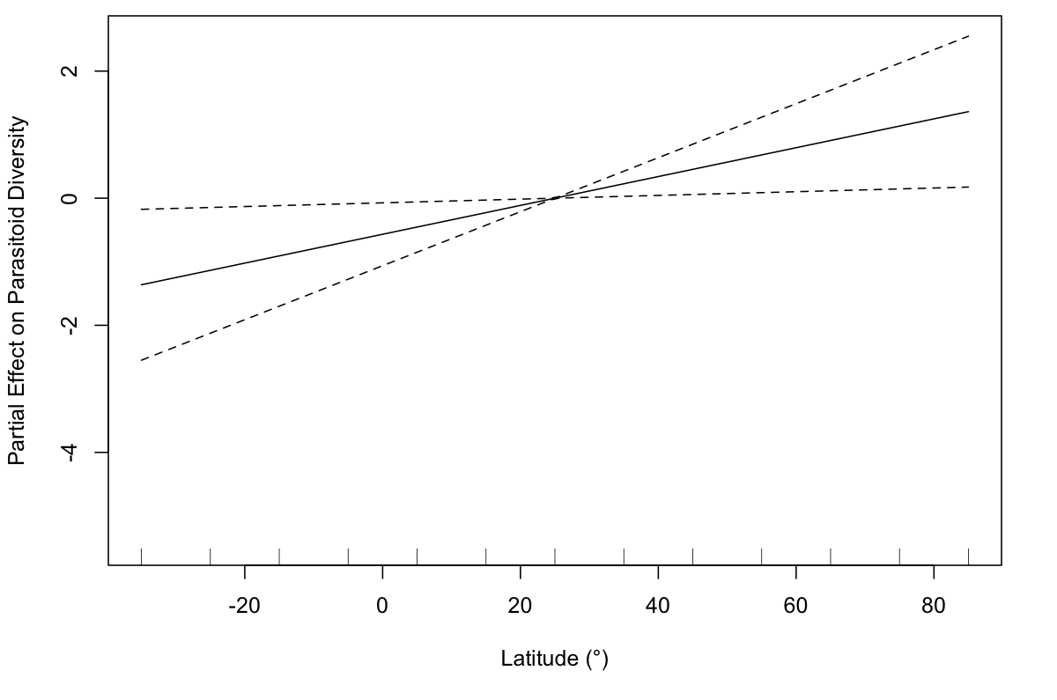
Latitude is a significant predictor of Parasitoid Diversity when modelled with Host Diversity

Slide 10
Combining spatial and ecological interactions improves predictability of parasitoid diversity
Predictor variable | P-value | R-squared
Host Diversity | 0.0231* | 0.519
Latitude | 0.0474*
Parasitoid diversity is significantly predicted by covariates.
Host diversity effective degree of freedom (2.132) suggests non-linear effect.
Latitude narrow Confidence Interval (30°) suggests dense sampling.

Slide 11
Proportion of variance (~52%) indicates additional covariates could improve model accuracy
Environmental: temperature, precipitation, seasonality, habitat (Castellanos-Labarcena, 2024).
Biotic: competition, predation, parasitoid life-history strategies (endoparasitoidism vs ectoparasitoidism, Idiobiont vs Koinobiont) (Quicke, 2015).
Additional hosts: caterpillars, beetles, aphids, spiders, ticks, mites, nematodes (Wahl & Sharkey, 1993).

Slide 12
Acknowledgements
I would like to express gratitude to Dirk Steinke for their advice and guidance on my regression analysis and plot decisions.
I would also like to thank my colleagues Eva Innocenta, Farah Sadoon, Liona Vu, Sharon Tsukernik and Sabrina Saiphoo for reviewing my R code and providing me with meaningful feedback regarding my visualizations.
Finally, I’d like to thank Jesscia Castellanos-Labarcena for inspiring this project and for providing me with insight into the limitations of studying parasitoid-host interactions at the community level.

Slide 13
References
Castellanos-Labarcena, J., Steinke, D., & Adamowicz, S. J. (2024). Anomalous latitudinal gradients in parasitoid wasp diversity—Hotspots in regions with larger temperature range. Journal of Animal Ecology, 94(3), 410-422. https://doi.org/10.1111/1365-2656.14196
Mannion, P. D. (2020). A deep-time perspective on the latitudinal diversity gradient. Proceedings of the National Academy of Science, 117(30), 17479-17481. https://doi.org/10.1073/pnas.2011997117
Quicke, D. L. J. Idiobionts, Koinobionts and Other Life History Traits. John Wiley & Sons, 2014, pp. 87-105.
Timms, L. J., Schwarzfeld, M., & Sääksjärvi, I. E. (2016). Extending understanding of latitudinal patterns inparasitoid wasp diversity. Insect Conservation and Diversity, 9(1), 74-86. https://doi.org/10.1111/icad.12144
Wahl, D. B., & Sharkey, M. J. Hymenoptera of the World: An Identification Guide to Families. Agriculture Canada, 1993, pp. 358-449.

