Slide 1
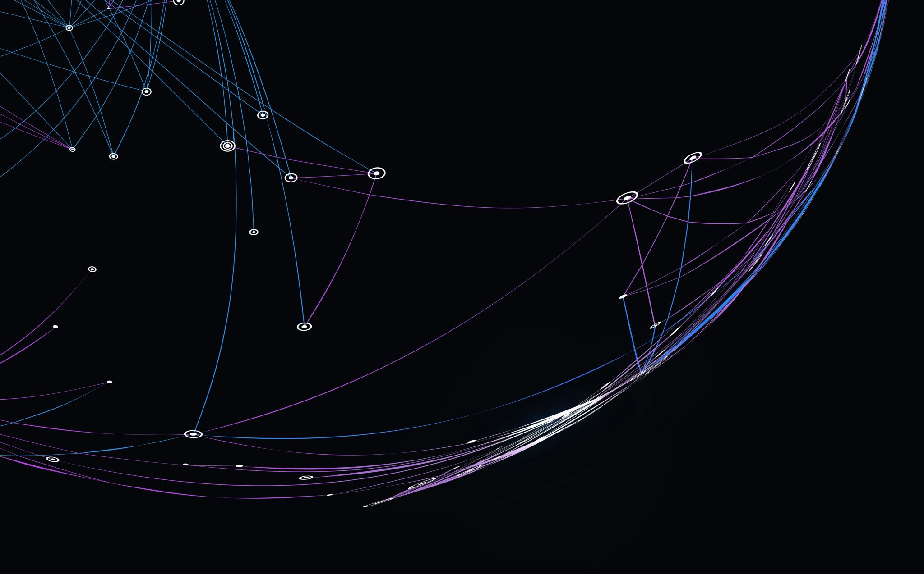
Creating FPS AI with Deep Learning in Unreal Engine
Team C
Kyle Hinton (kah31@hood.edu)
Somayyeh Kamyab (sk43@hood.edu)
Kyle McQuillen (kjm28@hood.edu)
Yohannes Terefe (yt13@hood.edu)
Paul Wells (pfw3@hood.edu)
Spring 2021

Slide 2
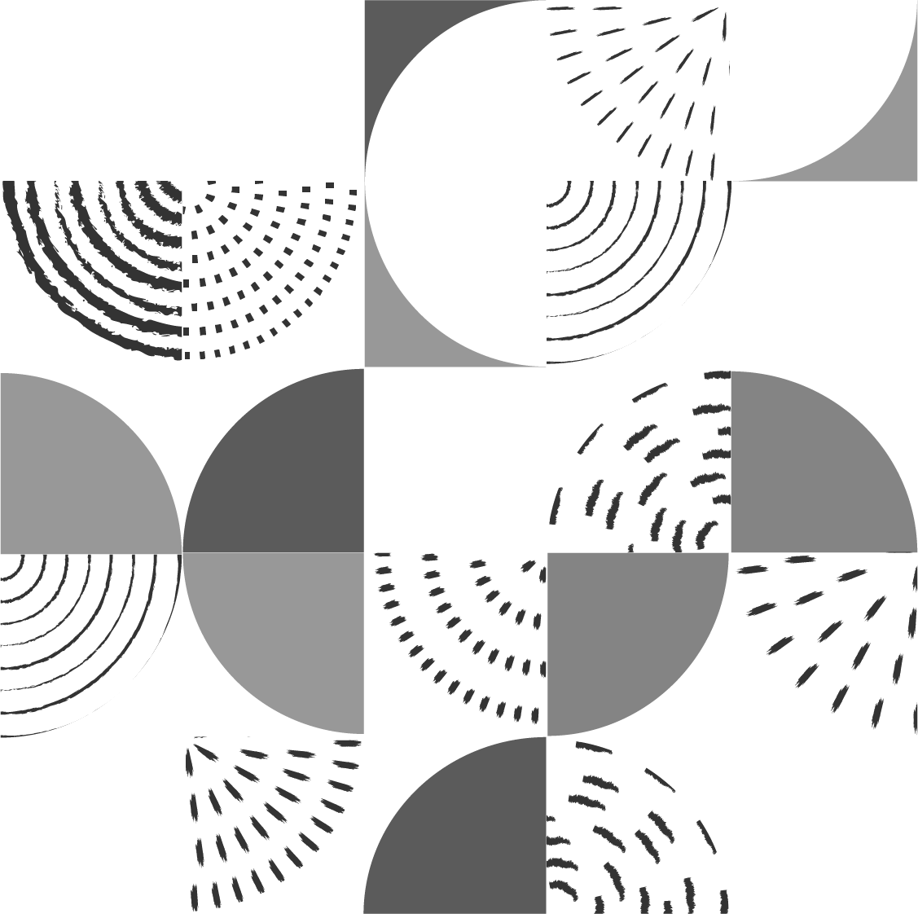
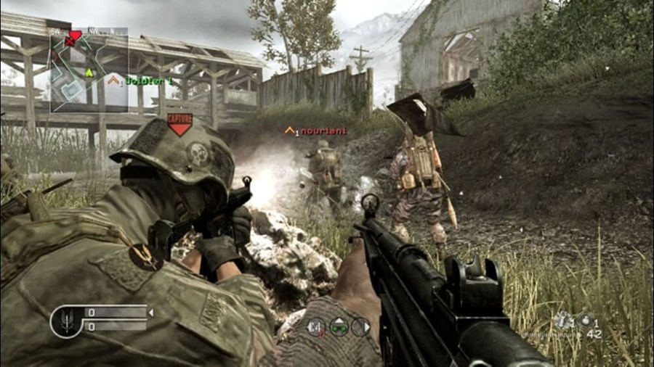
The Project
Training of an AI capable of operating in a 3D game space
Use of “sensory” data to train the Neural Network
Determine optimal reward strategies to produce effective agents
Call of Duty 4: Modern Warfare
Notes:
Our primary goal is to create a reinforcement agent capable of playing a FPS in a 3D environment. We also wanted to use sensory data opposed to images. We define sensory as…
The last objective is to determine which strategies work best for rewarding the agent

Slide 3
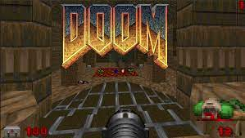
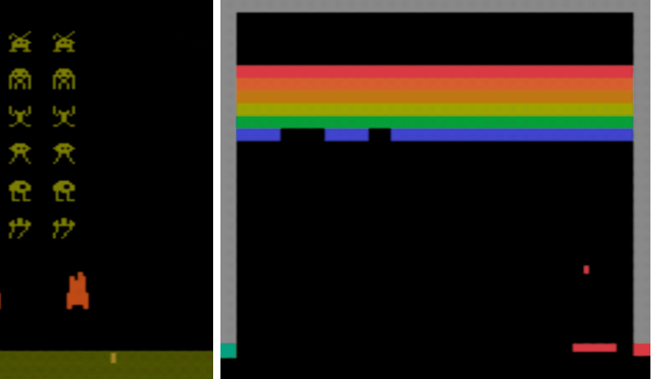
Prior Work
TensorFlow agents and Atari
Visual Doom AI Competition
Notes:
how this project is different than those mentioned, and,
how is it different using image vs numerical-based data and why?

Slide 4
Project Objectives
1. Implementation of Reinforcement Learning Agent into UE4
2. Collect training data
3. Study the training process
Notes:
Describe what a functioning agent is and lead into next slide which is how it will be judged

Slide 5
Expected Outputs
Video of agent playing
Score
Agent stats
World stats

Slide 6
Technical Details
Experiment Workflow
Run training
View attempted run
Determine if changes need to be made
Tools used
TensorFlow Agents
Unreal Engine
Flask

Slide 7
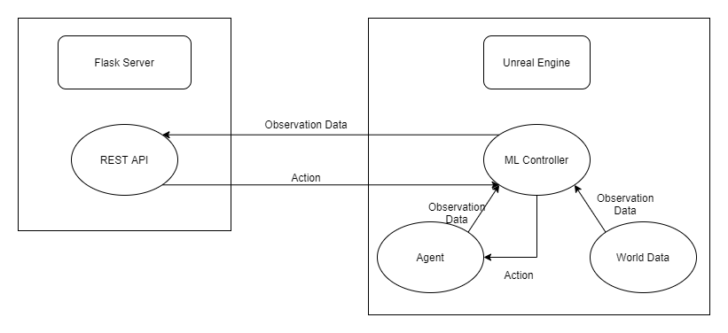
Components
Notes:
What is being sent in between componenets

Slide 8
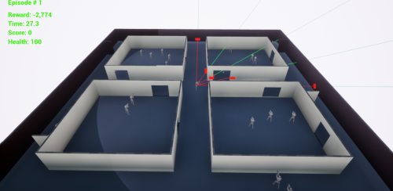
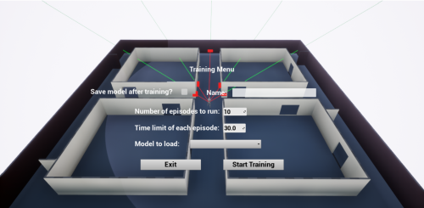
Agent in Action
Working Sensors
Reward System
Game Systems
Developer Interface

Slide 9
The Models
BaseNet
Small
Provides a baseline
DeeperNet
Larger
Architecture is tuned

Slide 10
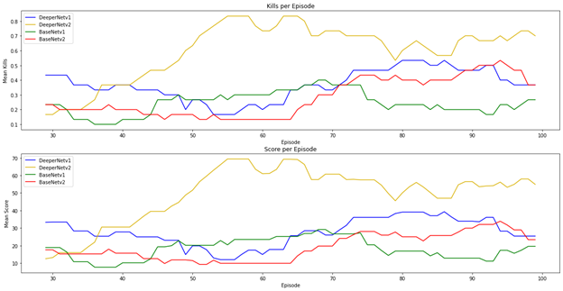
Analysis
DeeperNetv2 performed best
Reward system hurt DeeperNetv1
Reward system is important

Slide 11
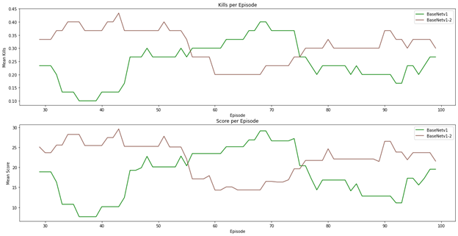
Analysis
One model, two different computers
Training path is not consistent
Performance at peaks was about the same

Slide 12
Conclusion
Influencing the model is detrimental
Training behavior will not be consistent
Environment design is vital

Slide 13
Lessons Learned
Better planning for systems integration
Better unit testing
Better data collection

Slide 14
Future Work
Adversarial Learning
A Truly Random Level
Further Optimization of the Agent
Optimization of the Game

