Slide 1
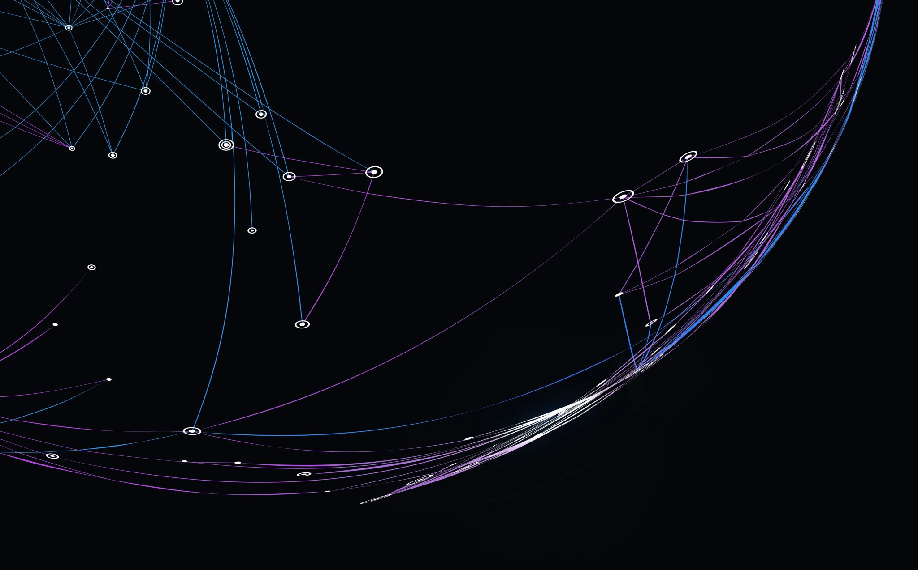
Creating FPS AI with Deep Learning Midterm Report
Team C
Kyle Hinton (kah31@hood.edu)
Somayyeh Kamyab (sk43@hood.edu)
Kyle McQuillen (kjm28@hood.edu)
Yohannes Terefe (yt13@hood.edu)
Paul Wells (pfw3@hood.edu)

Slide 2
Kyle Hinton
Roles: Software Engineer
Time Spent: 50.5 Hours
Implementation and base configuration of RL Agent
Deconstructing RL Agent training flow

Slide 3
Somayyeh Kamyab
Roles: Team member, do task outside/in Unreal Engine like research on project; how reward function work
Time Spent: Total 22 hours

Slide 4
Kyle McQuillen
Roles: Target tracing and work on AI target specifically in the Unreal Engine
Time: 23 hours

Slide 5
Yohannes Terefe
Role: Create the First Level Shoothouse map design on the Unreal Engine
Time spent: 20 hours

Slide 6
Paul Wells
Roles: Team Coordinator, Software Engineer
Time Spent: 49 hours

Slide 7
The Project
Training of an AI capable of operating in a 3D game space
Use of “sensory” data to train the Neural Network
Determine optimal reward strategies to produce effective agents
Notes:
Our primary goal is to create a reinforcement agent capable of playing a FPS in a 3D environment. We also wanted to use sensory data opposed to images. We define sensory as…
The last objective is to determine which strategies work best for rewarding the agent

Slide 8
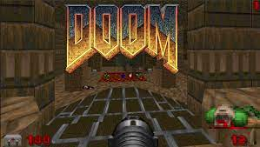
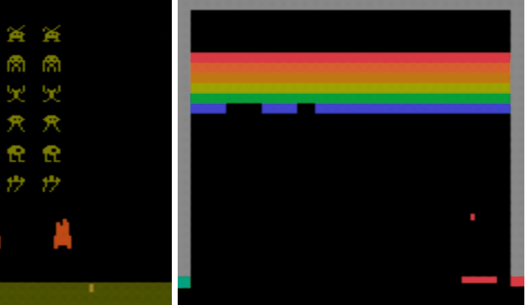
Prior Work
TensorFlow agents and Atari
Visual Doom AI Competition

Slide 9
Project Plan
Implementation of Reinforcement Learning Agent
Optimize said agent using a Genetic Algorithm
Experiment
Compare and Contrast

Slide 10
Technical Details
Experiment Workflow
Run training
View attempted run
Determine if changes need to be made
Tools used
TensorFlow Agents
Unreal Engine
Flask

Slide 11
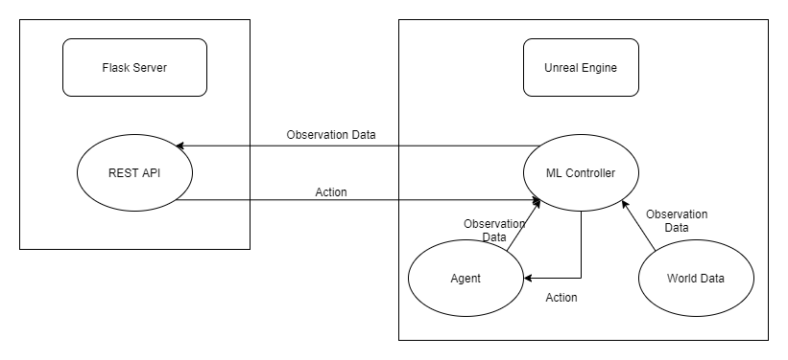
Components

Slide 12
Expected Outputs
Video of agent playing
Score
Agent stats
World stats

Slide 13
Current State
Our current AI can choose the best option to optimize it’s learning.
Can leverage its actions based off the reward return.

Slide 14
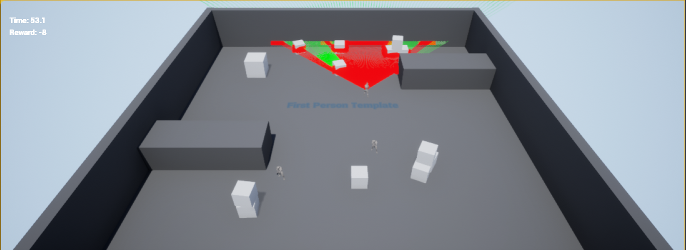
Agent in Action
Working Sensors
Reward System
Game Systems

Slide 15
Problems
Adapting Unreal Engine to be an environment for a TF Agent
Figuring out initial implementation tools
Team coordination and task assignments

Slide 16
To Do
Task | How | When
Implement data recording and analysis pipeline | Using Unreal Engine to send saved data to server for analysis | 4/16/21
Finish implementation of agent | Using TF Agents on the flask server | 4/9/21
Randomize level aspects | Using functions in Unreal Engine | 4/16/21
Implement genetic algorithm optimizer | Using TensorFlow functions on the flask server | 4/23/21
Implement adversarial learning | Revaluating current approach to learning to allow multiple agents to train on a server | 4/30/21

