Slide 1
MERIDIAN
Q1 revenue missed target by 18%; Q2 plan targets 2.8Cr
Q1 FY2026 revenue review | Ravi Sharma, Sales Manager | 28 March
Clarity. Momentum. Results.
Meridian - Confidential

Slide 2
Q1 closed 43L short of target; three fixes are underway
Q1 FY2026 sales review, held 28 March: results, causes, actions, Q2 plan.
Q1 revenue 1.97Cr vs 2.4Cr target: 18% miss
Three causes: ~43L stuck in enterprise deals, SMB conversion at 22.0%, South at 70%
Q2 target 2.8Cr (stretch 3Cr) needs your sign-off
Meridian - Confidential
2

Slide 3
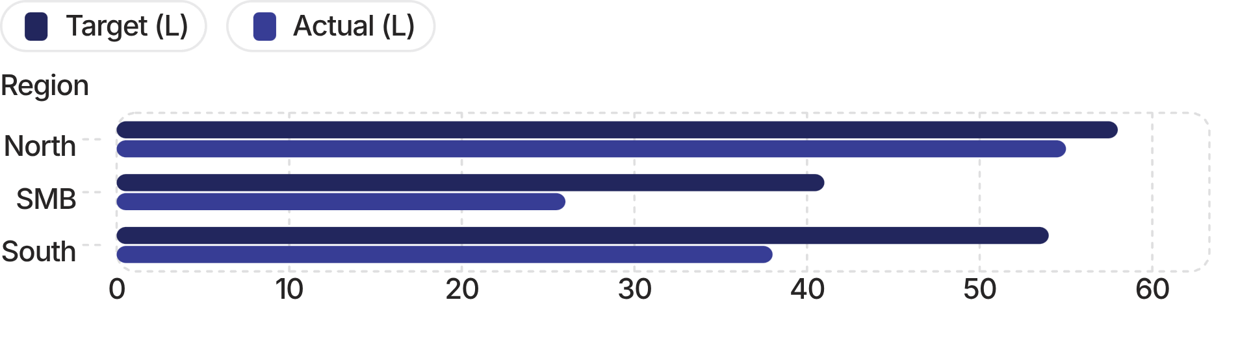
Q1 revenue was 1.97Cr against a 2.4Cr target; only North came close
North: 95% of target (55L vs 58L), the only region near plan
SMB: 63% of target (26L vs 41L); conversion fell 34.8% to 22.0%
South: 70% of target (38L vs 54L); 6 closures vs 8-9 expected
Enterprise: 3 stuck deals hold ~43L in pipeline since January
1.97Cr
1.97Cr vs 2.4Cr target (-43L, -18%)
Regional figures are rough, from the team sheet.
Meridian - Confidential
3

Slide 4
Stalled enterprise deals and a campaign priced 20% high drove the miss
01
TechNova: 83 days in negotiation after a February procurement freeze
02
GlobalEdge: proposal out since 19 Jan; buyer comparing 2 vendors
03
Horizon Fintech: verbal commitment idle for 55 days
04
SMB
SMB: Feb campaign priced 20% above standard; 304 leads, poor quality
05
South
South: 24 open deals at quarter start, only 6 closed
Meridian - Confidential
4

Slide 5
Three stuck enterprise deals worth ~43L have owners and dates by 10 April
01
02
TechNova: Priya takes over; revised proposal 4 Apr, buyer call 5 Apr
GlobalEdge: Ankit follows up 3 Apr; close by 10 Apr, no extensions
03
04
GlobalEdge: if a competitor wins, fight-or-walk decision immediately
Horizon Fintech: Ravi calls Suresh this week to convert the 55-day verbal
Meridian - Confidential
5

Slide 6
SMB recovery plan targets the slide from 34.8% to 22.0% conversion
Deepa reports on the Feb campaign (304 leads) by 4 Apr
Outbound script reverts to the January version this week
Facebook campaign paused if still running
Deepa calls 5-6 dropped leads; lost-deal log starts now
Weekly report to Ravi every Monday 9 a.m., starting next week
Meridian - Confidential
6

Slide 7
South closed 6 deals against 8-9 expected; stale deals now get a decision
01
South ended at 70% of target: 38L vs 54L
02
24 open deals at quarter start; 6 closed, 4 new logos
03
Sneha sends all 60+ day-old deals by 4 Apr
04
Ravi and Sneha decide each: push, nurture or drop
05
Monthly South + SMB review starts 25 Apr
Meridian - Confidential
7

Slide 8
Five process fixes start 1 April, led by a 6 p.m. Friday CRM rule
01
02
03
Every deal updated in CRM by 6 p.m. Friday; Ravi checks Monday
Monday 9 a.m. team check-in starts 1 Apr
Enterprise deal reviews every 2 weeks: Ravi plus the AE
04
05
South + SMB pipeline review monthly; first on 25 Apr
Objection-handling workshop before 15 Apr; pricing deck updated by 7 Apr
Meridian - Confidential
8

Slide 9
Q2 target is 2.8Cr, 40L above Q1's target; we need your sign-off before 4 April
2.8Cr
Q2 target 2.8Cr vs Q1 target 2.4Cr: +40L (+17%)
Stretch goal: 3Cr if all enterprise deals close
~43L of stuck enterprise deals stay live; Karan adds Nagpur and Indore
Ask: confirm the 2.8Cr target and acknowledge the 3Cr stretch
Ravi shares the rep-level split by 4 Apr, after your sign-off
Q2 target
Meridian - Confidential
9

Slide 10
Six owners hold 18 actions; the last dated one falls on 25 April
Owner | Actions and deadlines
Ravi | Horizon Fintech call: this week · Check-in invite: 1 Apr · Q2 rep split: 4 Apr
Ravi | Q2 sign-off email: before 4 Apr · Workshop: before 15 Apr · South + SMB review: 25 Apr · CRM check: every Monday
Priya | TechNova proposal: 4 Apr · Buyer call: 5 Apr · Trainer shortlist: 8 Apr
Ankit | GlobalEdge follow-up: 3 Apr · Pricing deck: 7 Apr · GlobalEdge close: 10 Apr
Sneha | 60+ day deal list: 4 Apr
Karan | Nagpur + Indore market entry plan: 5 Apr
Deepa | Script revert: this week · Feb campaign report: 4 Apr · Weekly report: Mondays 9 a.m.
Meridian - Confidential
10

