Slide 1


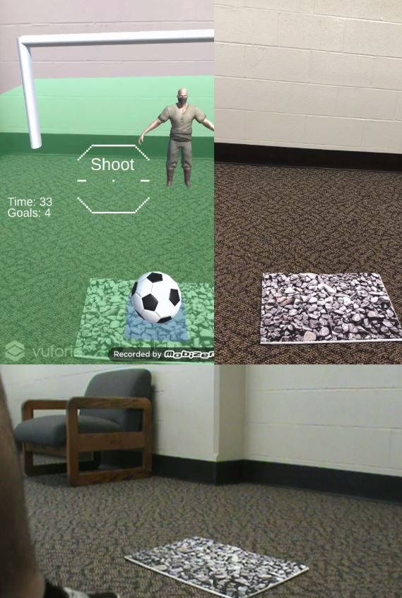
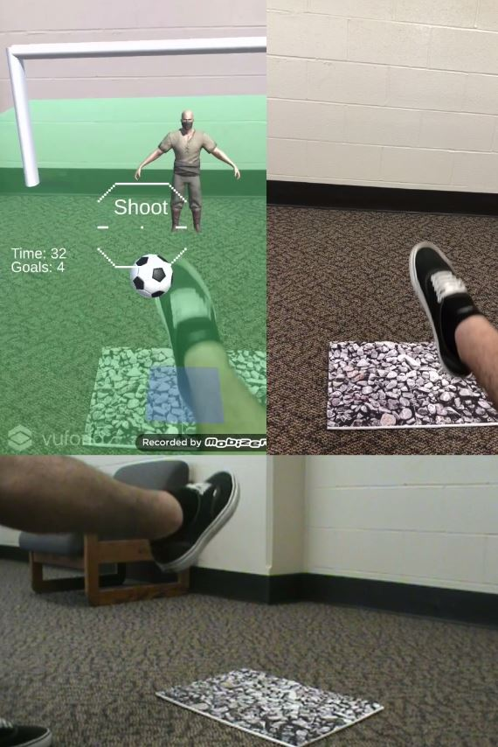

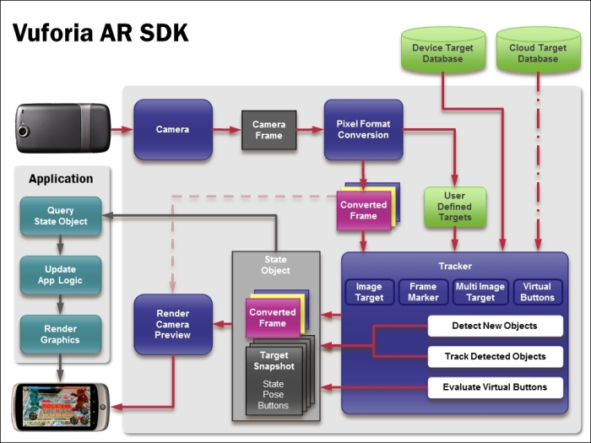

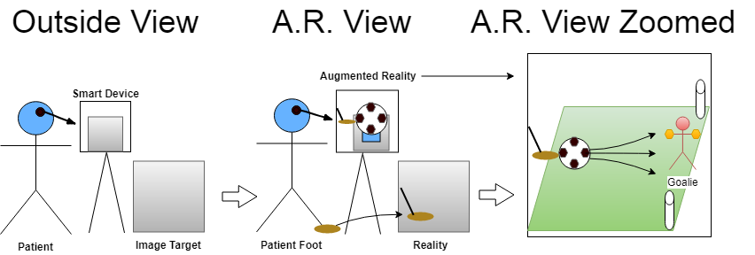

Smartphone Gamification
Augmented Reality For Lower Extremity Rehabilitation Chris Baker, AA
Dr. Wenyao Xu, MS & PhD
climb up for summer research
Significance
Conclusion
The Technical Novelty
Unique: Augmenting reality through smart device cameras for the patient to perform rehab exercises anywhere.
Fun: Turning exercise into video games.
Data Analysis: Recording meaningful information about the exercise to help the medical team adapt to patient needs.
Cameras & Tracking: Continue to improve every year which will eventually allow smaller paper targets and smoother virtual button triggering with movements.
Portability: With a smart device and a paper anyone can take this game anywhere and play it whenever they desire. More control over the road to recovery.
Accessibility: Most families have an android device. Several devices can be bought for $50 on amazon. Therefore, for the cost of one therapy session someone can have access to infinite sessions.
Efficiency: Computer Scientists and Medical Teams can set up and collect meaningful data to adapt to the patients needs and respond quickly with modifications.
“The Atlantic” news article site
Background Data
Methods
Knee and Hip Rating: Western Ontario and McMaster Universities Osteoarthritis Index is rated on pain, stiffness, and the functional ability of joints [See Figure A].
Household Funds: The Average American household funds split into 3 categories [See Figure B].
Cost of Current Therapy Programs: On site Physical Therapy sessions are approximately $50 to $350 depending on the injury and time needed for the patient. These sessions occur multiple times a week for at least a month. This is unaffordable for most Low and Middle Income Families.
Game Development Diagram: [See Figure A].
Gameplay Diagram: [See Figures in B].
References
Gail D Deyle, Stephen C Allison, Robert L Matekel, Michael G Ryder, John M Stang, David D Gohdes, Jeremy P Hutton, Nancy E Henderson, Matthew B Garber; Physical Therapy Treatment Effectiveness for Osteoarthritis of the Knee: A Randomized Comparison of Supervised Clinical Exercise and Manual Therapy Procedures Versus a Home Exercise Program, Physical Therapy, Volume 85, Issue 12, 1 December 2005, Pages 1301–1317, https://doi.org/10.1093/ptj/85.12.1301
“Physical Therapy.” MedStar Visiting Nurse Association, www.medstarvna.org/home-health-care/rehabilitation-at-home/physical-therapy/.
Thompson, Derek. “Very Sad Graph: How Much Americans Have Left to Spend After Essentials, Today.” The Atlantic, Atlantic Media Company, 1 Aug. 2012, www.theatlantic.com/business/archive/2012/08/very-sad-graph-how-much-americans-have-left-to-spend-after-essentials-today/260606/.
Tabrisky, Cindi. Personal interview with Physical Therapist. 31 May 2018.
S. (2012, March 13). Video games replace physical therapy for Parkinson's patients. Retrieved from https://www.youtube.com/watch?v=-OwzfBUTSKw
Gameplay with Multiple Camera Views within and outside game.
Evaluation
Virtual Buttons: Responsive and smooth with big images and small button area (20% or less).
Device Gameplay: Great, but top-down angle
Using Raycast: High shots are difficult. Programming or orientation can fix this.
Implementation Benefits
Increased stability: Through Calisthenics standing on one leg and kicking with the other or holding leg in air.
Improved Range of Motion: Testing and pushing reach capabilities.
Accurate data collection: Can be analyzed by experts for therapy adaptation.
Enjoyable: May lead to higher patient adherence and improve efficiency in recovery.
Acknowledgments
1. I would like to thank Dr. Wenyao Xu and his lab including grad students Jerry and Zhengxiong for their mentorship.
2. Mustapha Farraj, Mihir Patel, and Joshua Segel for collaborating on AR programming challenges.
3. Glauco Pires for help with game creating in Unity.
4. Dr. Joanna Barthelemy, Dr Anyango Kamina, Dr. Margarita Dubocovich, Dr. David Shubert, Dr. Debbie Timineri, Grant Glatfelter, LaKeisha Lewter, Chris Root, and iSEED.
5. My family and friends for their support, including Cindi Tabrisky for her professional experience in Physical Therapy.
Figure A: Inpatients have twice as much recovery compared to Outpatient and other methods.
Physical Therapy Treatment Study on Osteoarthritis of the Knee
www.buffalo.edu

