Slide 1
Leopard Core introduction

Slide 2
Leopard – e200z4d core
E200z4d processor¹
dual issue hardware architecture
5 stage of pipeline
4 Kbyte of instruction cache
Nexus class 3+ for real time debugging
supports
Book E code
32 bit instruction
VLE code
16 bit instruction
MMU
16 entries
Signal processor engine (SPE)
SIMD instruction
2 x 32-bit operation simultaneously
2 x 16-bit operation simultaneously
DPS instruction
Floating point unit (FPU)
1) additional details can be found in the training session related to the e200zX

Slide 3
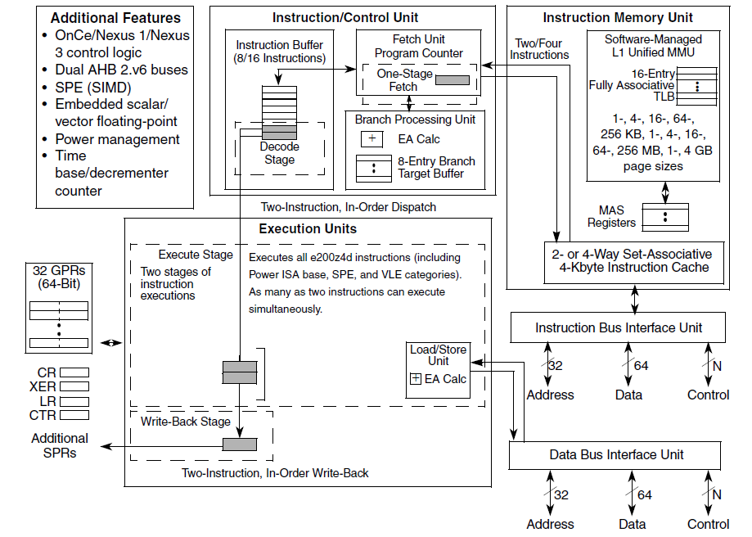
Block sheme

Slide 4
Programming Model: e200z4d Register Overview
Supervisor Mode Base Register Set
User Programmer’s Model
e200zX Book E Registers
Hardware Implementation
Dependent Registers
Cache Flush
& Invalidate
SPR General
Registers
Machine State Register
GPR0
GPR1
GPR31
L1FINV0
SPRG0
SPRG1
l
l
SPRG9
MSR
l
l
l
L1FINV1
Processor Version
HID0
Cache Control
PVR
LR
XER
CR
CTR
HID1
L1CSR0
Processor ID
System Version
L1CSR1
PIR
SPEFSCR
USPRG0
SVR
Cache Config
Interrupt Vector Offset Registers
L1CFG0
Debug Facilities Register Set
Interrupt Register Set
L1CFG1
Debug
Control
Instruction
Addr. Compare
Save & Restore
Registers
Critical S/R
Registers
Interrupt Vector
Offset Registers
IVOR32
l
l
IVOR35
BTB Control
BUSCR
DBCR0-2
IAC1-8
SRR0
SRR1
CSRR0
CSRR1
IVOR1
l
l
IVOR15
MMU Control
and Status
Debug Status
DBSR
Data Exception
Address
MMU Assist
MMUCRS0
Data Address Compare
Machine Check S/R Registers
MAS0
l
l
MAS4
MMU Config
DAC1
DAC2
DEAR
Interrupt
Vector Prefix
MMUCFG
Data Value Compare
MCSRR0
Syndrome
TLBCFG0
TLBCFG1
DVC1
DVC2
MCSRR1
ESR
IVPR
MAS6
e200zX Specific Registers
Storage Control Register Set
Timer Facilities Register Set
Debug Counter
Debug Control
Process Identification Register
Control
& Status
Decrementer
Auto Reload
Time Base
Upper/Lower
DBCNT
DBCR3-6
PID0
Debug Save & Restore
TCR
TSR
DEC
DECAR
TBL
TBU
Debug Save & Restore
DSRR0
DSRR1
Notes:
Process ID Register (PID, also referred to as PID0). This register is provided to
indicate the current process or task identifier. It is used by the MMU as an extension
to the effective address, and by external Nexus 2/3/4 modules for Ownership Trace
Message generation.
The processor ID register (PIR) contains a value that can be used to distinguish the processor from other processors in the system. The PIR value is read into a GPR using mfspr.
The processor version register (PVR) contains a value identifying the version and revision level of the processor. The PVR distinguishes between processors that differ in attributes that may affect software.
On the e200, the PVR is implemented as defined in Book E. The PVR contents are read into a GPR using mfspr. The PVR is read-only.
Process ID Register (PID, also referred to as PID0). This register is provided to
indicate the current process or task identifier. It is used by the MMU as an extension
to the effective address, and by external Nexus 2/3/4 modules for Ownership Trace

Slide 5
Instruction timing
Most of instruction executed in a single cycle
all integer instruction
except multiply and divide
Branch instruction
throughput and latency of 2 cycles
branch prediction can reduce it to 1 cycle
each core embeds 2 execution unit
dual issue of most instruction

Slide 6
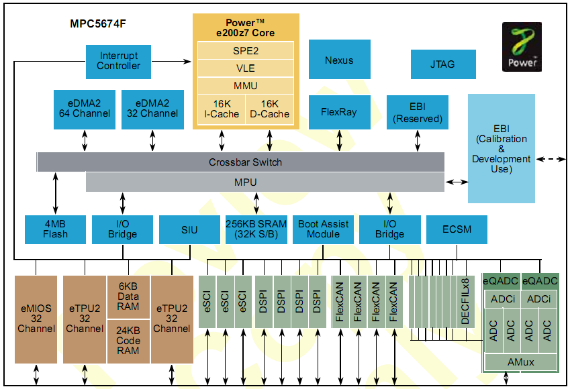
Cache : Block Diagram
Cache enables faster memory access
Cache is only accessible to the core.
Cache is not accessible to other masters such as:
eDMA
FlexRay
Nexus tools can read cache
when the processor stops
Leopard device includes only Instruction Cache

Slide 7
MMU: Introduction
All core accesses go through the MMU.
Memory must be defined in the MMU to be visible to the core
Otherwise an exception occurs
MMU does not control memory accesses from:
eDMA
Flexray
16 entries available
pages from 1K to 4G
Nexus tools can read MMU settings when the processor stops.
Notes:
This presentation will explain these features and how to use them.
The MMU does address translation but you can map logical addresses to physical addresses.
Address translation may be used for the purpose of calibration.
Assembly software must be used to execute the TBL instructions to initialize the MMU. Compiler can not generate the TLB initialization code.
Also MMU provides for memory access timing to allow for external memory emulation during development.

Slide 8
SPE - Overview
Designed to accelerate DSP operation
64 bit registers
Single Instruction Multiple Data (SIMD) operation
2 x 32-bit operation simultaneously
4 x 16-bit operation simultaneously
Accumulator register
0
31
32
63
RA
RB
+
+
RD

Slide 9
FPU - Overview
Floating Point unit
Single precision floating point
Fully IEEE compliant

Slide 10
Additional details
for additional details refer to the e200zX core training

