Slide 1
Peripheral Bridges
Version 1.1

Slide 2
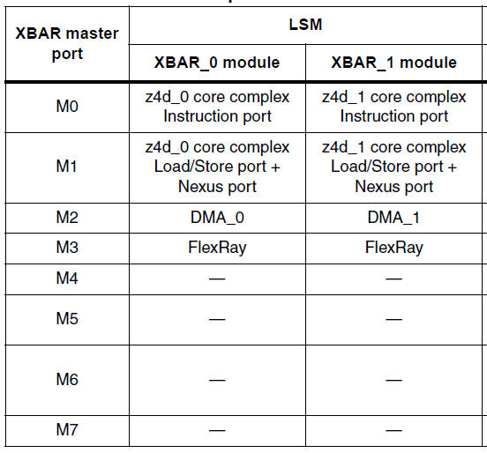
Masters and slaves (a)
Notes:
PRIDGE is one of the 4 walls used to reach “freedom of interference” from unwanted access to peripherals from masters.
1

Slide 3
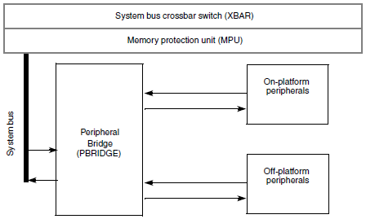
Peripheral Bridge
The peripheral bridge (PBRIDGE) is the interface between the system bus and on-chip peripherals (slave)
Accesses that fall within the address space of the PBRIDGE are decoded to provide individual module selects for peripheral devices on the slave bus interface
This device includes two instantiations of the AIPS
In LSM only a single AIPS is visible to the user
Notes:
PRIDGE is one of the 4 walls used to reach “freedom of interference” from unwanted access to peripherals from masters.
ON platform peripherals are strictly connected to the core functionality (e.g. INTC, PIT, SWT) and usually goes with the same clock as the core
OFF platform peripherals are the “normal” peripherals as SIUL, eTimer,…

Slide 4
Peripheral Bridges: System integration modes
LS Mode
DP Mode
The only difference between the two modes affecting the operation of the AIPS bridges is the fact that the RC Checker AIPS is switched off in DPM mode.
The gray part becomes non operational in DP Mode

Slide 5
Peripheral Bridges: Peripheral Bridge Summary
Bridges connect “Masters” to “Peripherals”
Slave peripherals are modules that contain readable/writable control and status registers.
“Masters” (connected to crossbar port):
0: e200z4 core – CPU
1: e200z4 core – nexus
2: eDMA
3: Flexray
“Peripherals”:
Bridge itself
Crossbar
eDMA
INTC
...
Bridge registers have controls for each master & “peripheral”

Slide 6
Peripheral Bridges: Master Privilege Registers (MPROTn)
MTR: Master Trusted for Reads. This bit determines whether the master is trusted for read accesses:
0 This master is not trusted for read accesses.
1 This master is trusted for read accesses.
MTW: Master Trusted for Writes. This bit determines whether the master is trusted for write accesses.
0 This master is not trusted for write accesses.
1 This master is trusted for write accesses.
MPL: Master Privilege Level. This bit determines how the privilege level of the master is determined.
0 Accesses from this master are forced to user-mode.
1 Accesses from this master are not forced to user-mode.
Notes:
One MPROT for each master

Slide 7

Peripheral Bridges: Peripheral Access Control Registers (PACRn)
SP: Supervisor Protect. This bit determines whether the peripheral requires supervisor privilege level for access.
0 This peripheral does not require supervisor privilege level for accesses.
1 This peripheral requires supervisor privilege level for accesses.
The MPROTx[MPL] control bit for the master must be set. If not, the access is terminated with an error response and no peripheral access is initiated on the IPS bus.
WP: Write Protect. This bit determines whether the peripheral allows write accesses.
0 This peripheral allows write accesses.
1 This peripheral is write protected.
If a write access is attempted, the access is terminated with an error response and no peripheral access is initiated on the IPS bus
TP: Trusted Protect. This bit determines whether the peripheral allows accesses from an untrusted master.
0 Accesses from an untrusted master are allowed.
1 Accesses from an untrusted master are not allowed. If an access is attempted by an untrusted master, the access is terminated with an error response and no peripheral access is initiated on the IPS bus.
Notes:
One per each peripherals

Slide 8
Peripheral Bridges: Peripheral Access Control Registers (PACRn)

Slide 9
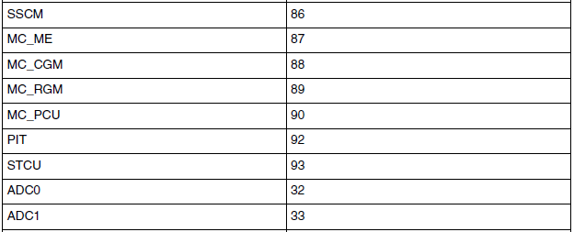
Peripheral Bridges: Off-platform Peripheral Access Control Registers (OPACRn)
Defaults for each off-platform peripheral’s access:
same as PACRs
………………..

Slide 10
Peripheral Bridges: ACCESS SUPPORT
Aligned 32-bit word accesses, halfword accesses, and byte accesses are supported for the peripherals.
Read cycles: Two-clock read accesses with the PBRIDGE when the requested access size is 32-bits or smaller
Write cycles: Three clock write accesses with the PBRIDGE when the requested access size is 32-bits or smaller

Slide 11
AIPS – key points
Notes:
PRIDGE is one of the 4 walls used to reach “freedom of interference” from unwanted access to peripherals from masters.
Protection is defined per peripherals on Masters’ trustiness (e.g. LinFlex can be accessed only by trusted masters)
10

