Slide 1
Leopard DPM mode

Slide 2
Leopard SPC56EL60 1M Flash - Block Diagram
Not just cores are replicated
DMA module redundancies is available only LSM mode
JTAG/Nexus are shared between Core0 and Core1
PMU
PowerPC™
e200z4
JTAG
Nexus3+
PowerPC™
e200z4
PMU
SWT
SWT
MCM
FPU
FPU
MCM
STM
STM
INTC
VLE
VLE
INTC
MMU
FlexRay
MMU
CACHE
CACHE
eDMA
CACHE
RC
CACHE
eDMA
Cross Bar Switch
Cross Bar Switch
Memory Protection Unit
Memory Protection Unit
AIPS
Bridge
RC
RC
AIPS
Bridge
FLASH
SRAM
RC
FLPLL
BAM
SSCM
FMPLL
IRCOSC
CMU
CMU
TSENS
TSENS
CRC
PIT
ADC I/F
12 bit
12 bit
CTU
eTIMER
eTIMER
FlexCAN
FlexCAN
LINFLEX
DSPI
DSPI
eTIMER
LINFLEX
DSPI
PWM
FCCU
MC
SIU
PWM
XOSC
WAKE
S&H
S&H
Mux
Mux
Notes:
HP presentation template tutorial - Rev. 1
leopard overview
not only the core is replicated but also some modules
2 DMA in DPM mode

Slide 3
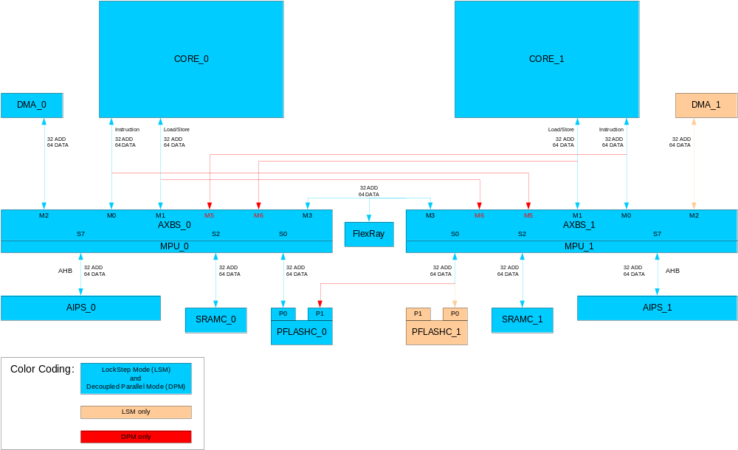
LSM/DPM address space

Slide 4
Addressing Space - Flash
LSM
  FLASH at base address 0x0
DPM
  CORE_0 and CORE_1 address the whole FLASH at base address 0x0

Slide 5
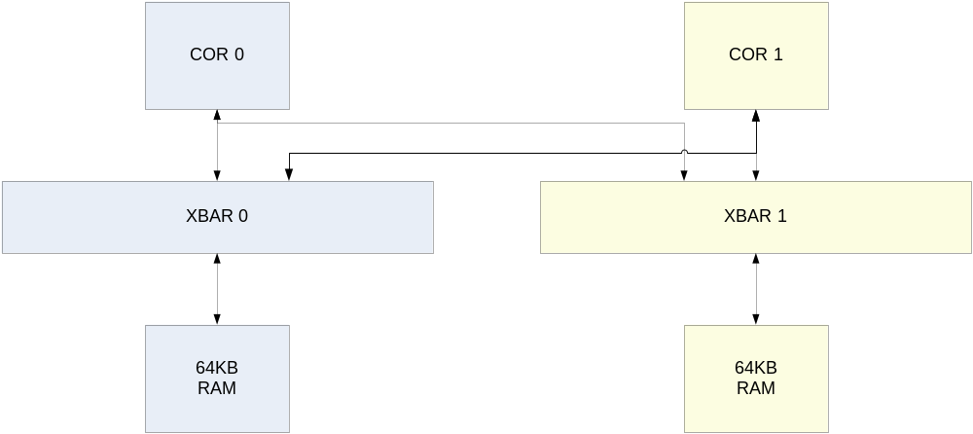
Addressing Space – SRAM (a)
LSM
  128KB RAM at base address 0x4000_0000
DPM
  each core has its own 64KB RAM
  both cores access RAM_0 at 0x4000_0000
  both cores access RAM_1 at 0x5000_0000
0x4000_0000
0x5000_0000
0x5000_0000
RAM 0
RAM 1

Slide 6
Addressing Space – SRAM (b)
Linker file is slightly different in LSM and DPM
LSM
  SRAM_SIZE = 128K // 64KB SRAM
  SRAM_BASE_ADDR = 0x4000_0000
DPM
  SRAM_0_SIZE = 64K // 64KB SRAM
  SRAM_1_SIZE = 64K // 64KB SRAM
  SRAM_0_BASE_ADDR = 0x4000_0000
  SRAM_1_BASE_ADDR = 0x5000_0000

Slide 7
Addressing Space - Peripherals
Each core can access all peripherals
All off-platform peripherals are connected to the AIPS_0
  Core_0 and Core_1 access these peripherals through XBAR_0
  to access these peripherals (i.e. FlexCAN, LinFlex), Core_0 and Core_1 use the same base address
On-Platform peripherals (i.e. INTC, STM, ...) are connected to respective AIPS
  i.e. INTC_0 is connected to AIPS_0 (INTC_1 to AIPS_1)
  to access these peripherals, Core_0 and Core_1 use the same base address

Slide 8
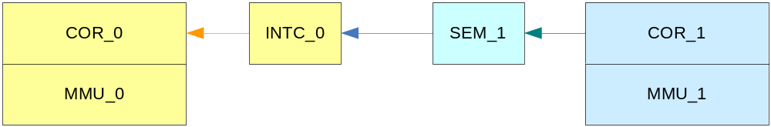
Semaphore module
The semaphore unit (SEMA4) provides the hardware support needed in multi-core systems for implementing
  semaphores
  simple mechanism to achieve lock/unlock operations via a single write access
Each core can trigger an interrupt to the other core through the Semaphore modules
Notes:
HP presentation template tutorial - Rev. 1
schema a blocchi

Slide 9
Selection of LSM/DPM
Selction between the 2 modes (LSM and DPM) is done by an option bit, LSM_DPMB
  option bits are stored in the Shadow Flash (0x00FF_FE10)
FCCU monitors the lsm_dpmb signal
  when DPM mode is selected an NMI is triggered after the first mode transition out of DRUN
  both DPM applications need to handle at least one NMI after the first mode change out of DRUN
In DPM only the Core_0 starts using the reset vector (RCHW)
  Core_0 explicitly “wakes up” Core_1
  Core_0 explicitly sets the address of the first instruction fetched by Core_1

Slide 10
DPM Boot steps
An example of steps needed to manage the boot of both cores in DPM
  configure the LSM_DPMB=0b and the reset vector used by Core_0 (RCHW)
  reset
  Core_0 boots normally
  Core_0 “installs” its NMI handler
  Core_0 sets the reset vector used by Core_1 and starts Core_1
  Core_0 starts to execute its application or just wait for its NMI (device is still in DRUN mode)
  Core_1 boots normally
  Core_1 “installs” its NMI handler
  Core_1 change the device mode from DRUN to RUN0
  FCCU triggers an NMI to both cores
  Core_0 and Core_1 manage their own NMI
  Core_0 and Core_1 start working independently

Slide 11
DPM Boot steps – single core
An example of steps needed to manage the boot of single core in DPM (only Core_0)
  configure the LSM_DPMB=0b and the reset vector used by Core_0 (RCHW)
  reset
  Core_0 boots normally
  Core_0 “installs” its NMI handler
  Core_0 starts to execute its application
  Core_0 change the device mode from DRUN to RUN0
  FCCU triggers an NMI
  Core_0 manage its own NMI
  Core_0 starts working

Slide 12
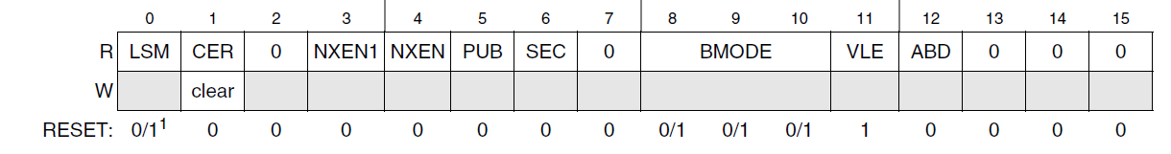
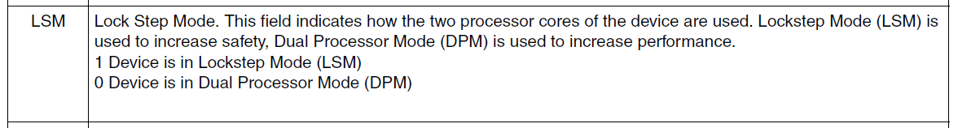
Verify DPM or LSM mode
By reading the SSCM status register
By reading the Shadow Flash configuration
  user option bits (0x00FF_FE10)

Slide 13
Memory protection mechanisms for channel isolation
3 protection levels exist to prevent undesired/non-authorized accesses:
  MMU
    Virtual page can be protected based (R/W/E) on
      Execution mode (user/supervisor)
      Process ID (PID):
        different user processes running on the same core can be assigned different privileges
        PID can be changed/assigned in supervisor mode only
    Min page size = 1KB
  MPU
    Access rights to defined memory map regions are assigned on a per-master and PID basis
    Min region size = 32Bytes
  AIPS
    Slave modules can be protected from master access
Note: same memory protection mechanisms help against systematic SW faults
Slide <number>
Notes:
HP presentation template tutorial - Rev. 1

Slide 14
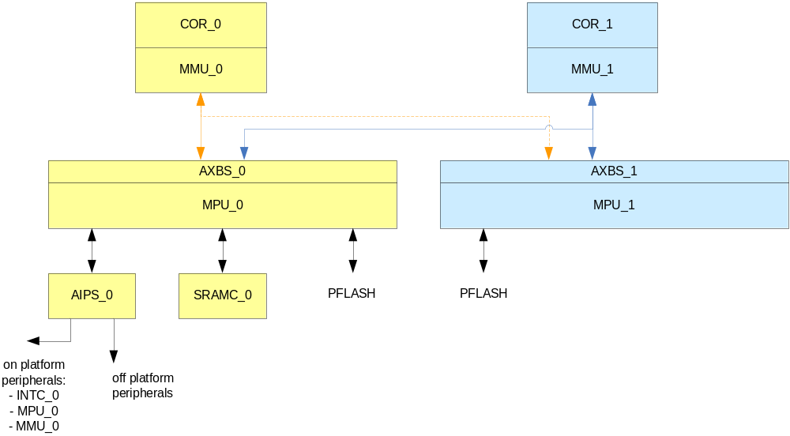
CORE_1 against CORE_0
3 protection levels
MMU
MPU
AIPS
Slide <number>
Notes:
HP presentation template tutorial - Rev. 1

Slide 15
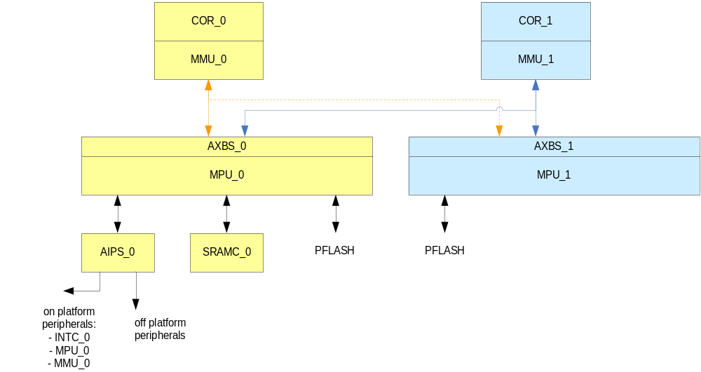
CORE_1 against CORE_0: on-platform peripherals
Faulty CORE_1 can modify MMU_1 configuration
only CORE_0 can modify MPU_0 and AIPS_0 configuration
Assumption: CORE_1 can not access off platform peripherals
Slide <number>
Notes:
HP presentation template tutorial - Rev. 1

Slide 16

CORE_1 against CORE_0: SRAM
Faulty CORE_1 can modify MMU_1 configuration
only CORE_0 can modify MPU_0 and AIPS_0 configuration
Assumption: CORE_1 can not access off platform peripherals
Slide <number>
Notes:
HP presentation template tutorial - Rev. 1

Slide 17
BACKUP
BACKUP

Slide 18
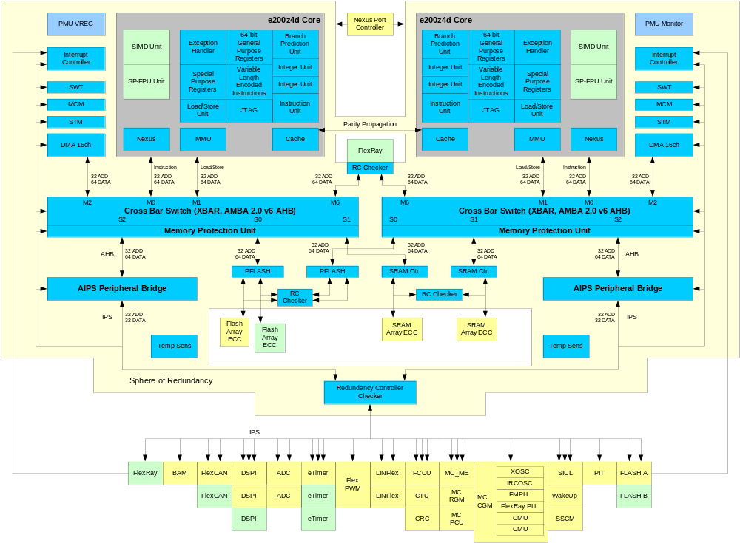
Leopard SPC56EL60 1M Flash – Detailed block diagram
Notes:
HP presentation template tutorial - Rev. 1
leopard overview
not only the core is replicated but also some modules
2 DMA in DPM mode

Slide 19
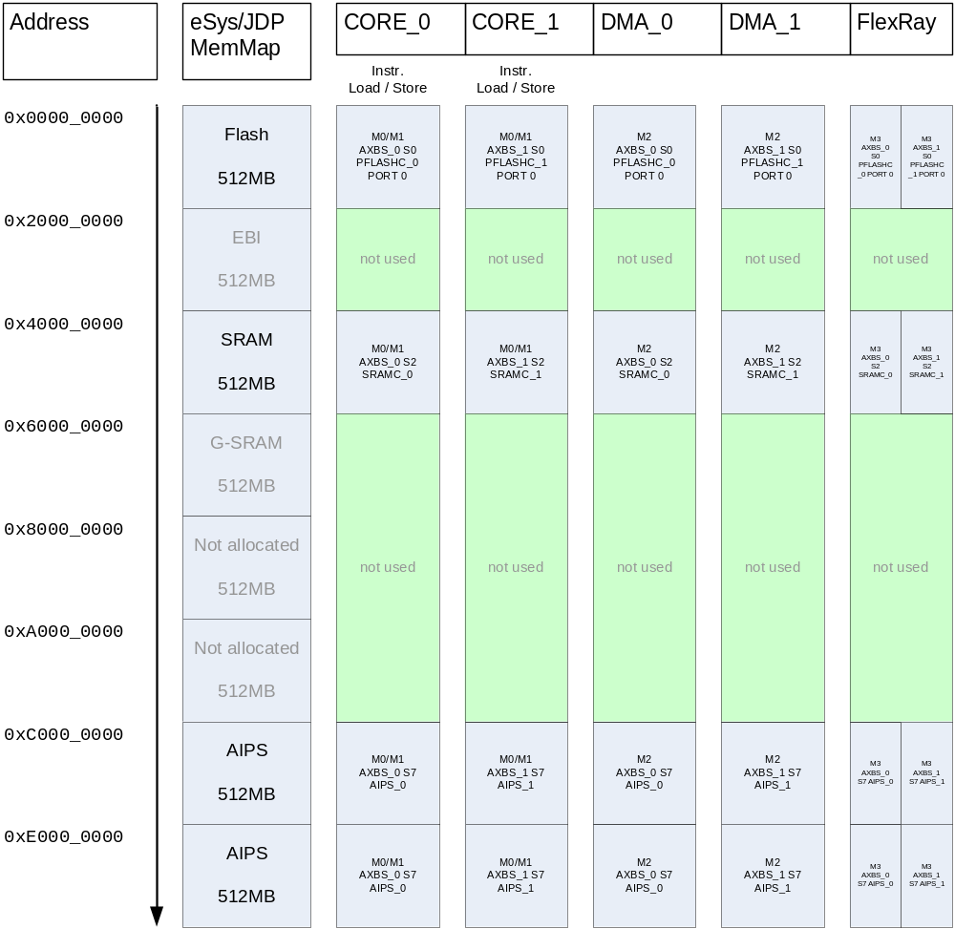
Address space – LSM
Notes:
HP presentation template tutorial - Rev. 1
address decoding in DPM

Slide 20
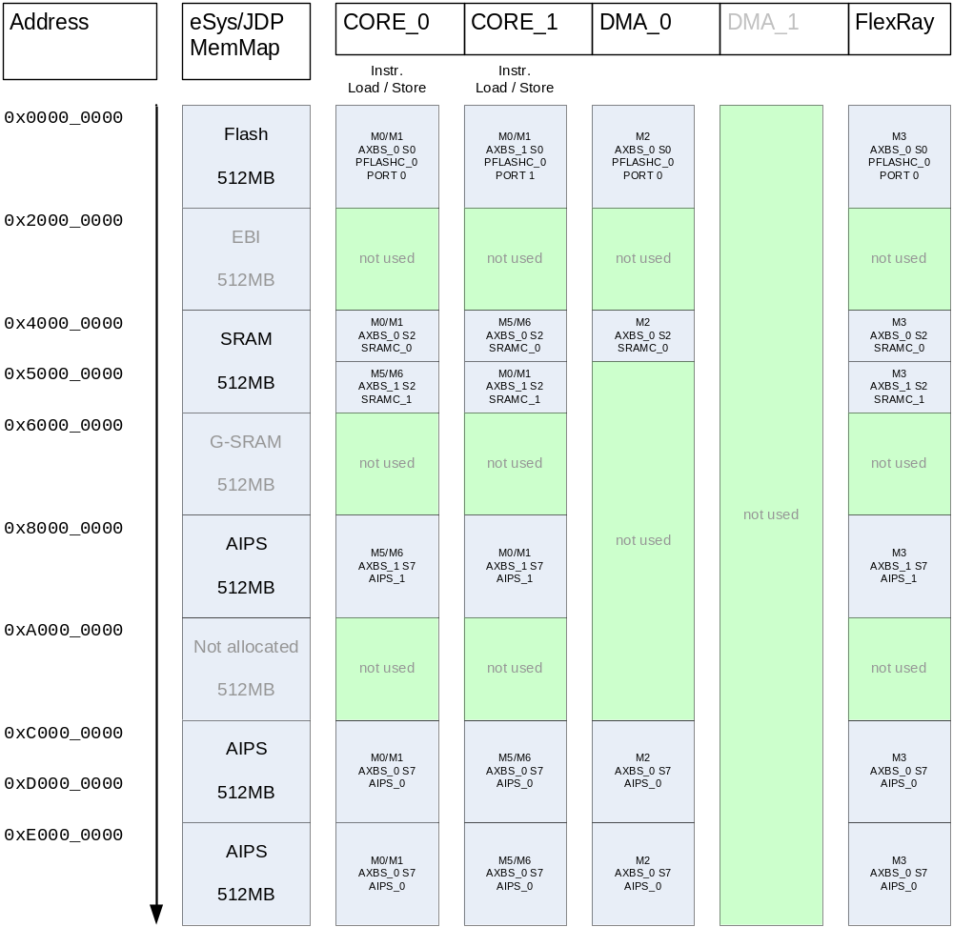
Address Space - DPM
Notes:
HP presentation template tutorial - Rev. 1
AIPS bridge in LSM

Slide 21
Crossbar in LSM/DPM
Notes:
HP presentation template tutorial - Rev. 1
Crossbar in LSM & DPM
immagine

Slide 22
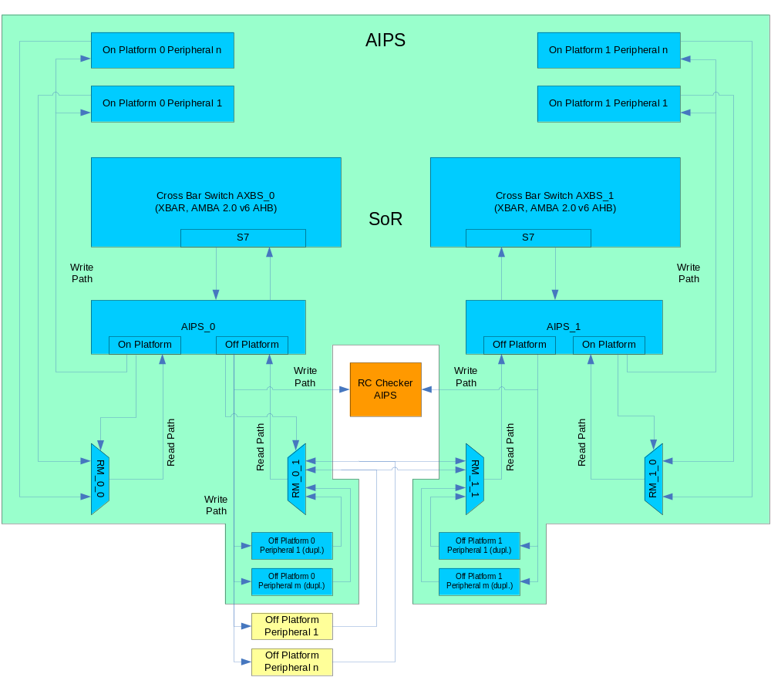
AIPS in LSM
Notes:
HP presentation template tutorial - Rev. 1
AIPS bridge in DPM

Slide 23
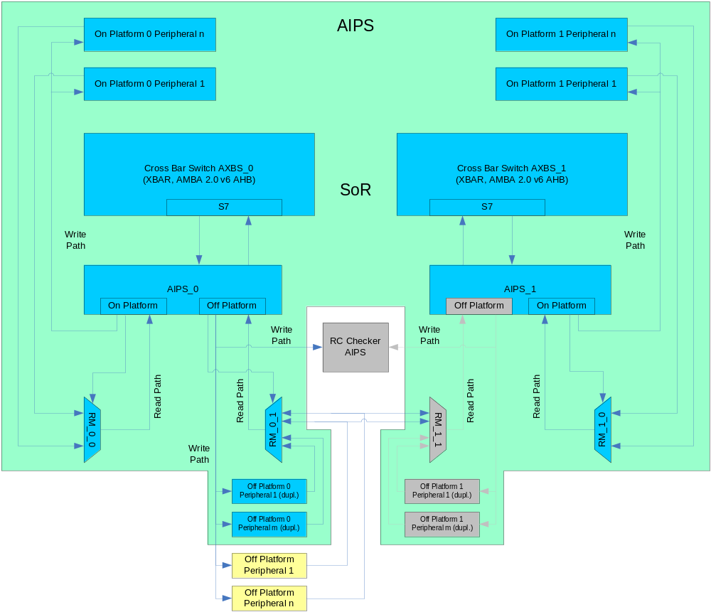
AIPS in DPM
Notes:
HP presentation template tutorial - Rev. 1
AIPS bridge in DPM

Slide 24
Channel isolation: application SW requirements
The effectiveness of integrity measures MMU, MPU, AIPS depends on their configuration
  Application software is responsible for configuring MMU, MPU, AIPS so that access to system resources used redundantly (e.g. SRAM area for stack, on-platform peripherals) is prevented to the other channel or at least limited to RO
MMU_0 cfg can be changed by CORE_0 only (the same for CORE_1)
  Each core is responsible for its MMU configuration
    Configuration can be changed in supervisor mode only
    Supervisor mode is entered only after IRQ/exception
MPU and AIPS configuration registers accessible via AIPS_x →
  MPU and AIPS configurations suffer from the same potential problem i.e. they can be accessed and modified by both cores
  Each core is responsible for configuring the MPU/AIPS of its channel
  Each core is responsible for preventing the other channel to gain access to its own MPU and AIPS, e.g.
    AIPS_0 on-platform port not accessible by CORE_1 master (same for AIPS_1 and CORE_0)
    MPU_0 prevents access to memory mapped config registers to CORE_1 master (same for MPU_1 and CORE_0)
Slide <number>
Notes:
HP presentation template tutorial - Rev. 1

