Slide 1
SPC564ELx Leopard FCCU
Notes:
5/23/2012
1

Slide 2
Introduction
FCCU is a hardware IP providing a central capability of controlling and collecting faults reported by individual modules of the SoC
faults are reported to the outside world via output pin(s)
Internal actions (e.g. IRQ, NMI, Reset) can be taken.
The operation of the Fault Collection Unit is independent from the CPU
FCCU is clocked by the safer clock (RC osc)
FCCU provides a fault reporting mechanism even in case the CPU is misbehaving
FCCU is purposely developed to increase the level of Safety of the system/ECU level

Slide 3
Functional Safety
Main features:
independent module
if other control modules is misbehaving user still can trigger some actions to prevent critical situation.
reporting externally faults occurring on the SoC
Different output protocols are available
collection of faults is centralized
faults can be treated in a different way depending on the application needs
fser can inject fake faults during the initialization phase to test fault collection & reporting

Slide 4
Fault Collection and Control Unit (FCCU) Architecture
Leopard
Power, Clock,
Run Modes
Control Module
Mode
Entry
Reset Generation Module
Interrupt
Controller
hard
reaction
request
soft
reaction
request
alarm
External Device
Module
error
status
FCCU
Module
error
Module
error
NMI
CPU
Module
HW
checker
test result (treated as error signal)

Slide 5
Role of FCCU During Reset/Boot
FCCU reset and test is executed during start-up
functional reset does NOT reset the FCCU
During the device reset/boot phase, FCCU monitors of off-line (power on self test) tests execution
Record test execution
Record test result (i.e. pass/fail)
5
Notes:
5/23/2012
5
5

Slide 6
Role of FCCU During Reset/Boot
Set of start-up tests to be executed is defined through the test flash time
In case of error (i.e. test fail or test non-executed) the FCCU moves to ALARM/FAULT state according to its configuration
After boot the “logged” reset status is fully available to SW
6
Notes:
5/23/2012
6
6

Slide 7
Run-time Error Collection
7
Run-time errors
Store error indications coming from monitoring elements and react accordingly
Store (and react to) erroneous activation of off-line tests
Notes:
5/23/2012
7
7

Slide 8

FCCU faults sources
Fault | FCCU |  | RGM
LVD 1.2 V self test | NCF
HVD 1.2 V self test | NCF
LVD VREG self test | NCF
LVD IO self test | NCF
LVD Flash self test | NCF
MC_ME | NCF | LR, SR
Core_0 watchdog | NCF | LR, SR, SM, IRQ
Core_1 watchdog | NCF | LR, SR, SM, IRQ
FMPLL_0 | NCF | LR, SR, SM, IRQ
FMPLL_1 | NCF | LR, SR, SM, IRQ
CMU_0 | NCF | LR, SR, SM, IRQ
CMU_1 | NCF | LR, SR, SM, IRQ
CMU_2 | NCF | LR, SR, SM, IRQ
FlexRay | NCF
Fault | FCCU | RGM
CFLASH | CF | LR
DFLASH | CF | LR
MCM_0 | CF | LR
MCM_1 | CF | LR
RCCU0_[6:0] | CF | LR
RCCU1_[6:0] | CF | LR
STCU CF | CF
STCU NCF | NCF
MCM_0 | NCF
MCM_1 | NCF
ADC_0 | NCF
ADC_1 | NCF
SWT_0 | CF | LR
SWT_1 | CF | LR
Legend:
CF = Critical Fault
NCF = Not Critical Fault
LR = Long Functional Reset
SR = Short Functional Reset
SM = Safe Mode
IRQ = Interrupt Request
Some fault are connected only to the RGM and generates a destructive reset (i.e. low/high voltage detected, ...)
8

Slide 9
Path Redundancy on Critical Error Reaction
Detected critical errors are forwarded independently by each channel to two different modules:
Reset Generation Module
Fault Collection and Control Unit
Additionally:
The state of the RGM is forwarded to the FCCU
The FCCU forward an additional reset request to the RGM
This strategy is used to drastically decrease the common mode failure on the Reset path
Safety concept
The RGM should be set to trap the same critical faults as the FCCU
CPUA
CPUB
Checker
RGM
FCCU
External
Device
9
Notes:
9

Slide 10
Magic Carpet summary
Mode Entry (MC_ME)
Reset Generation Module (MC_RGM)

Slide 11
MC_ME Mode Diagram
SYSTEM MODES
USER MODES
RECOVERABLE
HW FAILURE
LOW POWER
SW REQUEST
MODES
SAFE
RUN 0
HALT
RUN 1
RESET
DRUN
STOP
NON
RUN 3
RECOVERABLE
TEST
HW FAILURE
HW triggered transition
HW triggered transition
SW triggered transition
SW triggered transition

Slide 12
MC_ME System Modes Description
RESET
Virtual mode completely managed by HW
The flash initialization is executed while device in RESET
DRUN (Default RUN)
Mode automatically entered out of RESET
This mode is used by the application to configure the device out of RESET
SAFE
Mode automatically entered on “recoverable HW failure detection” like oscillator, PLL or voltage failure
Device in a SAFE configuration with IRC, output high impedance (if configured so)
 | PDO | MVREG | FLASH | PLL1 | PLL0 | XOSC | IRCOSC
RESET | OFF | ON | NORMAL | OFF | OFF | OFF | ON
SAFE | √ | ON | NORMAL | OFF | OFF | OFF | ON
 | ON
DRUN | OFF | ON | √ | √ | √ | √ | ON
 |  |  | NORMAL | OFF | OFF | OFF
√ CONFIGURABLE
NOT CONFIGURABLE

Slide 13
MC_RGM System Modes Description
The reset generation module (MC_RGM) centralizes the different reset sources and manages the reset sequence of the device.
Destructive: is associated with an event related to a critical - usually hardware - error or dysfunction:
power-on reset
1.2 V low-voltage detected
1.2 V high-voltage detected
2.7 V low-voltage det. (VREG)
2.7 V low-voltage det. (flash)
2.7 V low-voltage det. (I/O)
comparator error
Functional: is associated with an event related to a less-critical – usually non-hardware - error or dysfunction:
– external reset
– JTAG initiated reset
– core reset
– software reset
– core watchdog reset
– PLL0 fail
– oscillator freq. too low
– system clock freq. too high/low
– FCCU SAFE mode
– software watchdog timer
– PLL1 fail
– flash, ECC, or lock-step error
– CMU1/2 clock freq. too high/low
– self-test completed
– FCCU soft reaction request
– FCCU hard reaction request
13

Slide 14
MC_RGM:RGM_FES (Functional Event Status Register)
The reset generation module (MC_RGM) centralizes the different reset sources and manages the reset sequence of the device.
Field | Description
F_EXR | Flag for External Reset
F_FCCU_HARD | Flag for FCCU hard reaction request
F_FCCU_SOFT | Flag for FCCU soft reaction request
F_ST_DONE | Flag for self-test completed
F_CMU12_FHL | Flag for CMU1/2 clock frequency higher/lower than reference
F_PLL1 | Flag for PLL1 fail
F_SWT | Flag for software watchdog timer
F_FCCU_SAFE | Flag for FCCU SAFE mode request
F_CMU0_FHL | Flag for CMU0 clock frequency higher/lower than reference
F_CMU0_OLR | Flag for oscillator frequency lower than reference
F_PLL0 | Flag for PLL0 fail
F_CWD | Flag for core watchdog reset
F_SOFT | Flag for software reset
F_CORE | Flag for core reset
F_JTAG | Flag for JTAG initiated reset
14

Slide 15
RGM/FCCU example – no dual path
MCM
fault (NCF)
FCCU
RGM
The fault is triggered to the FCCU
FCCU reacts independently than the RGM
Fault reaction depends on the FCCU settings

Slide 16
RGM/FCCU example – dual path (CF)
RCCU
fault (CF)
FCCU
RGM
RGM and FCCU reacts independently to the fault
RGM resets the device (LR)
Note : FCCU is not reset by RGM reset
FCCU takes some action depending on the configuration:
signal the fault externally
after the reset the device goes into SAFE mode
NMI

Slide 17
RGM/FCCU example – dual path (NCF)
CMU
fault (NCF)
FCCU
RGM
RGM and FCCU reacts independently to the fault
RGM reaction is configurable, ie:
IRQ
FCCU takes some action depending on the configuration, ie:
wait for the NCF timeout
signal the fault externally
device in SAFE mode
NMI

Slide 18
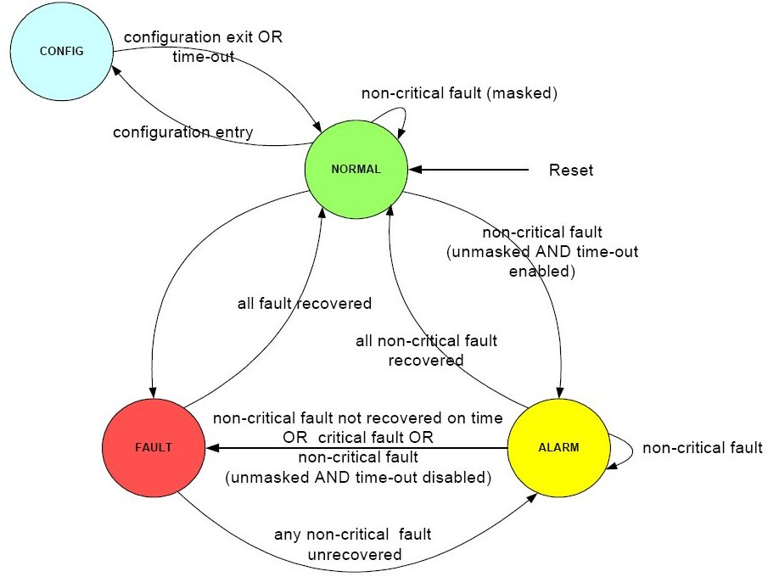
FSM and Graded Reaction to Error Conditions
The FCCU shall be in NORMAL state when the device is working fine.
If a configuration command occurs, FCCU moves to the CONFIG state.
If the configuration is not completed within the time-out, the FCCU moves to the NORMAL state
If a critical fault occurs, FCCU moves to the FAULT state.
If a non-critical fault occurs, FCCU moves to the ALARM state.
18
Notes:
5/23/2012
18
18

Slide 19
FSM and Graded Reaction to Error Conditions
The ALARM state is kept for a programmable timeout period. If the error is not recovered in time, FCCU moves to FAULT state
An interrupt can be issued in the ALARM state
The FAULT state is kept when a failure is present in the device.
Proper reactions (IRQ, reset, external pin, safe state after a configurable timeout period) can be configured when FAULT state is entered.
19
Notes:
5/23/2012
19
19

Slide 20
NCF machine configuration
Non-Critical Fault configuration
0
0
FAULT STATE
1
FCCU_NCFE[0..3]
1
ALARM STATE
FCCU_NCF_TOE[0..3]
NCF can be enabled/disabled by application software
FCCU_NCFE[0..3] register
In case of NCF, FCCU can move to either ALARM or FAULT state
FCCU_NCF_TOE[0..3] register
NCF reaction must be configured

Slide 21
FCCU state machine configuration
FCCU can NOT be disabled
in case of CF, FSM moves always to FAULT state
CF reaction must be configured
CF can’t be disabled
NCF reaction must be configured

Slide 22
FCCU reaction to fault
Hereafter the potential FCCU reactions to faults:
RESET
SAFE mode
Error OUT
IRQ
NMI
The reaction to each CF and NCF can be configured independently of the other ones

Slide 23
FCCU reaction to fault – RESET
Reset reaction is taken in FAULT state
no reset reaction in ALARM state
For each fault (NCF and CF) possible reset configurations are:
no reset reaction
Short functional reset
Long functional reset
Registers involved are:
FCCU_CFS_CFG[0..7] for CF
FCCU_NCFS_CFG[0..7] for NCF

Slide 24
FCCU reaction to fault – SAFE
FCCU moves the device in SAFE state (MC_ME)
SAFE reaction is taken in FAULT state
no SAFE reaction in ALARM state
depending on both RGM and FCCU reset reaction, SAFE state can be reached after the reset of the device
SAFE reaction is not configurable and can’t be disabled

Slide 25
FCCU reaction to fault – Error OUT
FAULT is signaled externally by 2 pins EOUT[0..1]
different protocol can be implemented
Error Out reaction can’t be disabled
protocol parameters must be configured according to the used external error our monitor device

Slide 26
FCCU reaction to fault – NMI
FCCU triggers an NMI in FAULT state
this reaction can not be disabled
If the RGM resets the device the NMI line is masked until the first MODE TRANSITION REQUEST (MC_ME module)
if the RGM doesn’t reset the device the NMI is trigged as soon as the FCCU state machine reaches the FAULT state
Notes:
NMI is set for all the faults in the same way.
5/23/2012
26

Slide 27
FCCU reaction to fault – IRQ
FCCU triggers an IRQ in ALARM state
IRQ must be managed by the
Interrupt controller (enabled)
Interrupt vector table (handler)

Slide 28
FCCU MCS Register
The FCCU_MCS register contains a queue of the last 4 states of the MC.MCS0 is the latest one, while MCS3 is the oldest one.
A qualifier indicates if the FCCU is in the FAULT state when the MC state has been captured.
The MC state is synchronous to the system clock and provided by a different module while the FCCU state is synchronous to the safe clock, therefore some uncertainty must be considered regarding the FAULT state indication.
Version 1.0
28

Slide 29
FCCU Timeout Register
The FCCU_CFG_TO register defines the preset value of the watchdog timer for the recovery from the CONFIG state
If the configuration is not completed within the time-out, the FCCU moves automatically from the CONFIG state to the NORMAL state and the default values for the configuration register is restored
The watchdog time-out is clocked with the RC oscillator clock (16 Mhz)
The default time-out value is 4,096 ms
Version 1.0
29

Slide 30
FCCU NCF Timeout Register
The FCCU_NCF_TO register defines the preset value of the timer for the recovery of the non-critical faults (if enabled).
Once FCCU enters in ALARM state, following the assertion of a non-critical fault enabled (NCFEx and NCFTOEx are set), the timer starts the count down.
If the fault is not recovered within the time-out the FCCU moves from the ALARM state to the FAULT state.
Version 1.0
30

Slide 31
EOUT feature overview
Version 1.0
31
Three EOUT (ErrorOUT) protocols supported
Dual-rail
Time switching
Bi-stable
Output frequency
Output signals derived from RC oscillator (16MHz ±15%)
Prescaler range from 2*1024*(1÷63)
Switching modes for Dual-rail and Time switching protocols
Slow switching mode
Fast switching mode
Output signal polarity is configurable
Single control bit for both EOUT signals
IO Pads configuration
Slow speed of 6-50ns fall/rise time on 50pF
Medium speed of 4-25ns fall/rise time on 50pF load
Notes:
31

Slide 32
FCCU I/O control: EOUT pins
The FCCU_EINOUT register allows I/O read/write operations, typically in NORMAL state:
The Mode is set by FCCU_CFG.FOM bits
It’s not possible configure both EOUT pins as input
Test mode are not used in normal mode
Mode = FCCU_CFG.FOM | FCCU_EOUT[0] | FCCU_EOUT[1]
Test0 | input | output
Test1 | output | output
Test2 | output | input
Version 1.0
32

Slide 33
Dual-rail protocol
Logical state | Dual rail encoding F[1:0] | Pattern
Non-faulty (NORMAL, ALARM) | 10, 01 | Toggling
Faulty (ERROR) | 00, 11 | Toggling
Configuration (CONFIG) | High-Z | No toggling (FCCU_CFG.CM=0)
 | Non-faulty behavior | Toggling (FCCU_CFG.CM=1)
Reset | High-Z | No toggling
Version 1.0
33

Slide 34
Time switching protocol
Logical state | Time switching encoding F[1:0] | Pattern
Non-faulty (NORMAL, ALARM) | 10, 01 | Toggling
Faulty (ERROR) | 10 | No toggling
Configuration (CONFIG) | 01 | No toggling (FCCU_CFG.CM=0)
 | Non-faulty behavior | Toggling (FCCU_CFG.CM=1)
Reset | High-Z | No toggling
Version 1.0
34
Notes:
34

Slide 35
Bi-stable protocol
Logical state | Bi-stable encoding F[1:0] | Pattern
Non-faulty (NORMAL, ALARM) | 01 | No toggling
Faulty (ERROR) | 10 | No toggling
Configuration (CONFIG) | 10 | No toggling (FCCU_CFG.CM=0)
 | Non-faulty behavior | No toggling (FCCU_CFG.CM=1)
Reset | High-Z | No toggling
Version 1.0
35
Notes:
35
QUESTIONS to CLARIFY
FCCU_CFG.CM=0 setup
Config phase has the same signaling as Error phase.
Is it the same for Pictus?

Slide 36
EOUT frequency
EOUT frequency is derived from RC Safe clock 16MHz
Worst case RC clock tolerance is ±15%
EOUT frequency setup uses two prescalers
10bit fixed prescaler
6bit user configurable prescaler
EOUT protocol frequency setting
EOUT_{freq} = RC_{16MHz} / ((FOP+1)*2*1024)
Version 1.0
36
Notes:
36

Slide 37
Phase transition behavior
Two modes of transition behavior available in Dual-rail and Time switching protocol
Slow switching mode
Fast switching mode
Slow switching mode
The EOUT protocol transition occurs on EOUT time period boundary
No EOUT frequency violation
Delay of mode change signaling possible (max one EOUT time period)
Fast switching mode
The EOUT protocol transition occurs immediately
A pulse with the minimum duration corresponding to 16MHz/1024 period can occur
EOUT frequency can be violated
Version 1.0
37

Slide 38
FCCU commands
To use FCCU some fixed procedures must be performed:
Config state
Normal state
Lock FCCU
NVM Load
Read CFSx
Clear CFSx
Read NCFSx
Clear NCFSx
...
These action are explained in the next slides ...

Slide 39
FCCU: Control Command
CONFIG State (OP1)
NORMAL State (OP2)
FCCU_CFK = 0x913756AF
FCCU_CFK = 0x825A132B
FCCU_CTRL.OPR = OP1
FCCU_CTRL.OPR = OP2
FCCU_CTRL.OPS = SUCCESSFUL
FCCU_CTRL.OPS = SUCCESSFUL
N
N
Y
Y
Start the WDG timer for the recovery from the CONFIG state
code
FCCU enter in CONFIG State
FCCU enter in NORMAL State
Version 1.0
39

Slide 40
FCCU: Control Command
LOCK FCCU(OP16)
NVM Load (OP31)
FCCU_CFK = 0x7ACB32F0
FCCU_CFK = 0x29AF8752
FCCU_CTRL.OPR = OP16
FCCU_CTRL.OPR = OP31
FCCU_CTRL.OPS = SUCCESSFUL
FCCU_CTRL.OPS = SUCCESSFUL
N
N
Y
Y
code
code
LOCK FCCU
The content of the configuration registers can be locked by the OP16 operation.
The configuration lock can be disabled only by a global reset of the FCCU.)
NVM Load
The initial values, after the reset phase, of the FCCU_CFG.CM, FCCU_CFG.SM, FCCU_CFG.PS, FCCU_CFG.FOP, FCCU_CFG.FOM registers are set by the NVM (Non Volatile Memory) interface
Version 1.0
40

Slide 41
Critical Fault STATUS Reg.
Read CFSx Reg.
Clear CFSx Reg.
FCCU_CTRL.OPR = OP9
FCCU_CFK = 0x618B7A50
Clear FCCU CFSx Reg.
N
FCCU_CTRL.OPS = SUCCESSFUL
N
FCCU_CTRL.OPS = SUCCESSFUL
Y
Y
X = FCCU_CFS[x].R
Read FCCU CFSx Reg.
Read CFSx Register
The FCCU_CFSx register contains the latched fault indication collected from the critical fault sources.
No reactions are executed until the FCCU moves in the NORMAL state.
Clear CFSx Register
The status bits of the FCCU_CFSx register (configured as SW recoverable faults) can be cleared by the above locked sequence.
41

Slide 42
Non-Critical Fault STATUS Reg.
Read NCFSx Reg.
Clear NCFSx Reg.
FCCU_CTRL.OPR = OP10
FCCU_NCFK = 0xAB3498FE
Clear FCCU NCFSx Reg.
N
FCCU_CTRL.OPS = SUCCESSFUL
N
FCCU_CTRL.OPS = SUCCESSFUL
Y
Y
X = FCCU_NCFS[x].R
Read FCCU NCFSx Reg.
Read NCFSx Register
The FCCU_NCFSx register contains the latched fault indication collected from the non-critical fault sources.
No reactions are executed until the FCCU moves in the NORMAL state.
Clear NCFSx Register
The status bits of the FCCU_NCFSx register (configured as SW recoverable faults) can be cleared by the above locked sequence.
Version 1.0

Slide 43
FCCU example of configuration and usage
Some example of how to configure and use the CPU are showed:
Reaction CF ->with RESET
Fault management
Reaction CF ->without RESET
Fault management
Reaction NCF -> ALARM -> ALARM_ISR (not RESET generation by NCF 8-24)
Reaction NCF -> ALARM -> ALARM_ISR(time-out) + NMI_ISR
EOUT Pins
...

Slide 44
CF reaction: with RESET by RGM
FCCU Init:
FCCU_CONFIG_STATE(); /* CONFIG state */
FCCU.CFG.B.SM = 1; /* EOUT protocol fast switching mode*/
FCCU.CFG.B.PS = 1; /* fcc_eout[1] active low, fcc_eout[0] active low */
FCCU_CFG_FOM_Config(CFG_FOM0); /* CFG_FOM0 = Dual-Rail [fccu_eout[1:0]= outputs] */
FCCU_CFG_FOP_Config(0); /* Fault Output Prescaler */
FCCU_NORMAL_STATE(); /* NORMAL state */
…
Reset
main
SAFE
SAFE Mode
…
Fault Management
…
Y
CF Fault
SAFE
RUN
N
…
GENERAL SETTING
RGM:
SAFE State
RESET
FCCU:
Lacth Fault
EOUT signaling
FCCU Init
Reset
…
code
…
Back
44

Slide 45
FAULT management
FAULT Management
SAFE
1
Y
MODE TRANSITION REQUEST (MC_ME module)
N
SAFE
NMI
Unmask NMI
recovering code
recovering code
…
RUN
…
Clear FCCU Status flag
…
…
Clear FCCU Status flag
…
Back
45
Notes:
To unmask the NMI a mode transition request must be executed
5/23/2012
45

Slide 46
CF reaction: without RESET
FCCU Init:
FCCU_CONFIG_STATE(); /* CONFIG state */
FCCU.NCFE[0].R = 0xFFFFFFFF; /* Enable FCCU to move to ALARM or FAULT State */
FCCU.NCF_TOE[0].R = 0; /* FCCU moves into the FAULT state if the respective fault is enabled (NCFEx is set) */
FCCU.CFG.B.SM = 1; /* EOUT protocol fast switching mode*/
FCCU.CFG.B.PS = 1; /* fcc_eout[1] active low, fcc_eout[0] active low */
FCCU_CFG_FOM_Config(CFG_FOM0); /* CFG_FOM0 = Dual-Rail [fccu_eout[1:0]= outputs] */
FCCU_CFG_FOP_Config(0); /* Fault Output Prescaler */
FCCU.IRQ_EN.B.CFG_TO_IEN = 1; /* FCCU IRQ Enable Register */
FCCU.CFS_CFG[0].R = 0; /* No reset reaction */
FCCU_NORMAL_STATE(); /* NORMAL state */
…
Reset
main
…
GENERAL SETTING
…
FCCU Init
FCCU:
NMI assert
Lacth Fault
EOUT signaling
…
code
…
NMI ISR
Clear FCCU Status flag
…
RUN
Fault CF
SAFE
Only for the fault connected to FCCU and not to the RGM.
…
code
…
Back
Version 1.0
46

Slide 47
ALARM_ISR (not RESET generation by NCF 8-24)
FCCU Init:
FCCU_CONFIG_STATE(); /* CONFIG state */
FCCU.NCFS_CFG[0].R = 0xFFFFFFFF; /* NCF No reset reaction */
FCCU.NCFE[0].R = 0xFFFFFFFF; /* Enable FCCU to move to ALARM or FAULT State */
FCCU.NCF_TOE[0].R = 0xFFFFFFFF; /* FCCU moves into the ALARM state if the respective fault is enabled (NCFEx is set) */
FCCU.NCF_TO.R = 0x00F42400 ; /* Non-critical fault timeout (1.0 sec)*/
FCCU.CFG.B.SM = 1; /* EOUT protocol fast switching mode*/
FCCU.CFG.B.PS = 1; /* fcc_eout[1] active low, fcc_eout[0] active low */
FCCU_CFG_FOM_Config(CFG_FOM0); /* CFG_FOM0 = Dual-Rail [fccu_eout[1:0]= outputs] */
FCCU_CFG_FOP_Config(0); /* Fault Output Prescaler */
FCCU.IRQ_EN.B.CFG_TO_IEN = 1; /* FCCU IRQ Enable Register */
FCCU.CFS_CFG[0].R = 0; /* No reset reaction */
FCCU_NORMAL_STATE(); /* NORMAL state */
…
Reset
main
…
code
…
FCCU:
ALARM ISR assert
Lacth Fault
EOUT signaling
…
GENERAL SETTING
…
Fault NCF N.12
FCCU Init
not RESET generation by NCF 8-24
ALARM ISR (ISR 250)
Clear FCCU Status flag
…
RUN
…
code
…
Back
Version 1.0
47

Slide 48
ALARM_ISR(time-out) + NMI_ISR
FCCU Init:
FCCU_CONFIG_STATE(); /* CONFIG state */
FCCU.NCFS_CFG[0].R = 0xFFFFFFFF; /* NCF No reset reaction */
FCCU.NCFE[0].R = 0xFFFFFFFF; /* Enable FCCU to move to ALARM or FAULT State */
FCCU.NCF_TOE[0].R = 0xFFFFFFFF; /* FCCU moves into the ALARM state if the respective fault is enabled (NCFEx is set) */
FCCU.NCF_TO.R = 0x00F42400; /* Non-critical fault timeout (1.0 sec)*/
FCCU.CFG.B.SM = 1; /* EOUT protocol fast switching mode*/
FCCU.CFG.B.PS = 1; /* fcc_eout[1] active low, fcc_eout[0] active low */
FCCU_CFG_FOM_Config(CFG_FOM0); /* CFG_FOM0 = Dual-Rail [fccu_eout[1:0]= outputs] */
FCCU_CFG_FOP_Config(0); /* Fault Output Prescaler */
FCCU.IRQ_EN.B.CFG_TO_IEN = 1; /* FCCU IRQ Enable Register */
FCCU.CFS_CFG[0].R = 0; /* No reset reaction */
FCCU_NORMAL_STATE(); /* NORMAL state */
…
Reset
main
…
code
…
Fault NCF
not RESET generation by NCF 8-24
N
Wait ALARM – Timeout
…
GENERAL SETTING
…
SAFE
FCCU:
ALARM ISR assert
Lacth Fault
EOUT signaling
NMI ISR
Clear FCCU Status flag
…
NCF not solved before the time out expires
RUN
FCCU Init
…
ALARM ISR (ISR 250)
…
…
code
…
Back
Version 1.0
48

Slide 49
Example N. 1: NOT Critical Fault
NOT Critical Fault:
KEY1: to inject asynchronous EXTERNAL IRQ
Blinking LED1
EXTERNAL IRQ: Fake NCF (ALARM IRQ)
ALARM IRQ: wait timeout (5 sec) or check External pushbutton (KEY2)
If TIMEOUT: NMI IRQ (without RESET)
NMI IRQ:
LED1 off
Clear FCCU FAULT and return to main
If KEY2 pressed:
LED1 off
Clear FCCU FAULT and return to main

Slide 50

Example N. 1: NOT Critical Fault (flow)
Reset
Mother Board Connection (connect the two buttons ):
J8 pin 1B to PJ9 pin 1
J8 pin 2B to PJ9 pin 2
EXTERNAL IRQ (ISR 41)
FAKE NOT CRITICAL FAULT
main
ALARM IRQ
RUN
…
ALARM ISR (ISR 250)
…
NCF ➔not RESET reaction
…
GENERAL SETTING
…
FCCU Init
ALARM Time Out
N
KEY2
Y
SAFE
…
code
…
KEY2 Pressed
NMI ISR
Clear FCCU Status flag
…
N
RUN
Y
KEY1
Clear FCCU Status flag
RUN
External IRQ
…
code
…
50

Slide 51
Example N. 2: Critical Fault
Critical Fault:
Blinking LED1
KEY1: to inject asynchronous EXTERNAL IRQ
EXTERNAL IRQ:
Fake CF:
LED1 off
SAFE STATE
RESET
After RESET: unmask NMI
NMI IRQ:
Clear FCCU FAULT and return to main

Slide 52
Example N. 2: Critical Fault (flow)
Reset
Mother Board Connection (connect the ones buttons ):
J8 pin 1B to PJ9 pin 1
main
EXTERNAL IRQ (ISR 41)
FAKE CRITICAL FAULT
RUN
SAFE
Reset
…
GENERAL SETTING
…
main
FCCU Init
…
GENERAL SETTING
UNMASK NMI
…
UNMASK NMI
…
code
…
NMI IRQ
KEY1
NMI ISR
Clear FCCU Status flag
…
External IRQ
RUN
Version 1.0
52
Notes:
To unmask NMI a MODE transition to DRUN is needed (a transition to SAFE to SAFE doesn’t unmask NMI)

Slide 53
BACKUP
53

Slide 54
FCCU registers
Register Name | Address Offset (ips_addr[8:0]) | Reset Value | Access (WR) state
FCCU Control Register (FCCU_CTRL) | 000h | 00000000h | ALL
FCCU CTRL Key Register (FCCU_CTRLK) | 004h | 00000000h | ALL
FCCU Configuration Register (FCCU_CFG) | 008h | 00000008h | CONFIG
FCCU CF Configuration Register (FCCU_CF_CFG0..3) | 00Ch ... 018h | CF_CFG[] static parameter | CONFIG
FCCU NCF Configuration Register (FCCU_NCF_CFG0..3) | 01Ch ... 028h | NCF_CFG[] static parameter | CONFIG
FCCU CFS Configuration Register (FCCU_CFS_CFG0..7) | 02Ch ... 048h | CFS_CFG[] static parameter | CONFIG
FCCU NCFS Configuration Register (FCCU_NCFS_CFG0..7) | 04Ch ... 068h | NCFS_CFG[] static parameter | CONFIG
FCCU CF Status Register (FCCU_CFS0..3) | 06Ch ... 078h | 00000000h | ALL
FCCU CF Key Register (FCCU_CFK) | 07Ch | 00000000h | ALL
FCCU NCF Status Register (FCCU_NCFS0..3) | 080h ... 08Ch | 00000000h | ALL
Register Name | Address Offset (ips_addr[8:0]) | Reset Value | Access (WR) state
FCCU NCF Key Register (FCCU_NCFK) | 090h | 00000000h | ALL
FCCU NCF Enable Register (FCCU_NCFE0..3) | 094h ... 0A0h | NCF_EN[] static parameter | CONFIG
FCCU NCF Time-out Enable Register (FCCU_NCF_TOE0..3) | 0A4h ... 0B0h | NCF_TOEN[] static parameter | CONFIG
FCCU NCF Time-out Register (FCCU_NCF_TO) | 0B4h | 0000FFFFh | CONFIG
FCCU CFG Timeout Register (FCCU_CFG_TO) | 0B8h | 00000006h | !CONFIG
FCCU IO Control Register (FCCU_EINOUT) | 0BCh | 000000X0h | ALL
FCCU Status Register (FCCU_STAT) | 0C0h | 00000000h | read-only
FCCU NA Freeze Status Register (FCCU_NAFS) | 0C4h | 00000000h | ALL
FCCU AF Freeze Status Register (FCCU_AFFS) | 0C8h | 00000000h | ALL
FCCU NF Freeze Status Register (FCCU_NFFS) | 0CCh | 00000000h | ALL
FCCU FA Freeze Status Register (FCCU_FAFS) | 0D0h | 00000000h | ALL
FCCU SC Freeze Status Register (FCCU_SCFS) | 0D4h | 00000000h | ALL
FCCU CF Fake Register (FCCU_CFF) | 0D8h | 00000000h | ALL
FCCU NCF Fake Register (FCCU_NCFF) | 0DCh | 00000000h | ALL
FCCU IRQ Status Register (FCCU_IRQ_STAT) | 0E0h | 00000000h | ALL
FCCU IRQ Enable Register (FCCU_IRQ_EN) | 0E4h | 00000000h | ALL
FCCU XTMR Register (FCCU_XTMR) | 0E8h | 00000000h | ALL
FCCU MCS Register (FCCU_MCS) | 0ECh | 00000000h | read-only
54

Slide 55
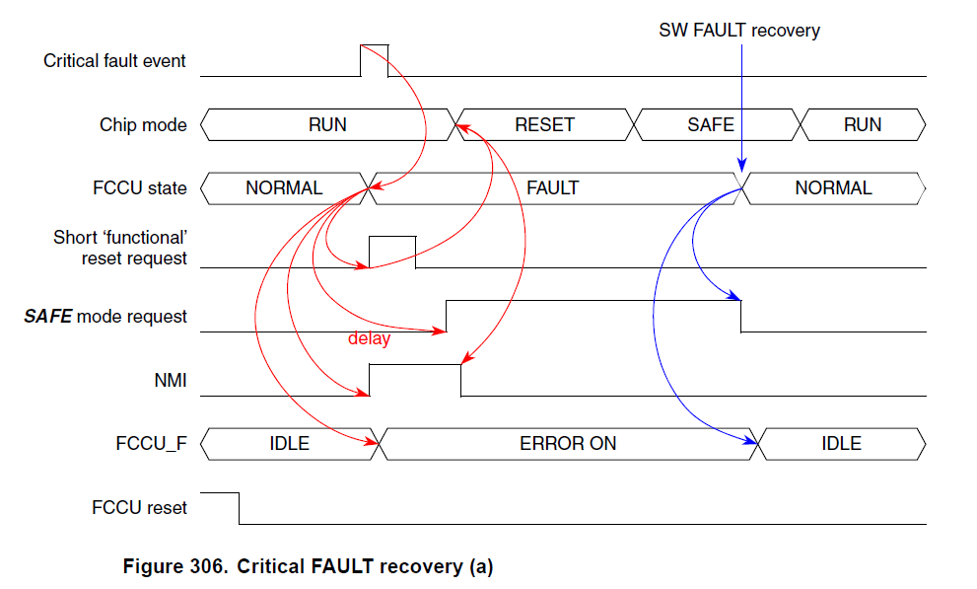
FCCU: Critical FAULT recovery (SW recovery)
Version 1.0
55

Slide 56
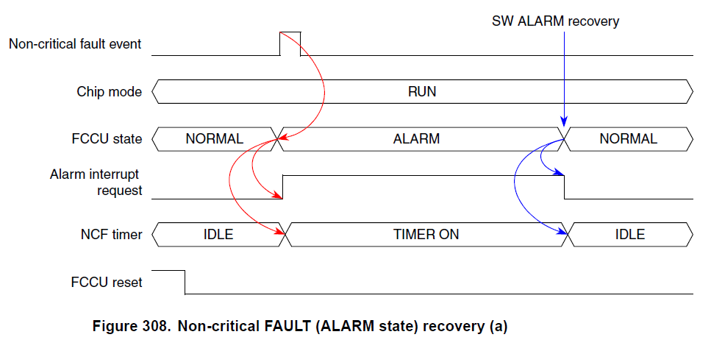
FCCU: Not-Critical FAULT recovery (SW recovery)
Version 1.0
56

Slide 57
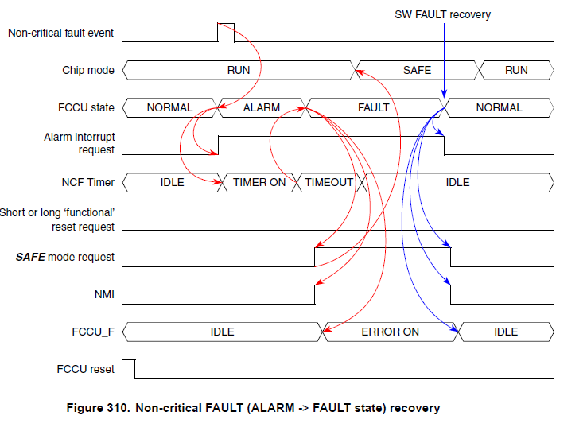
FCCU: Not-Critical FAULT (ALARM->FAULT) recovery
Version 1.0
57

Slide 58
NMI Mask
The NMI signal internally generated by FCCU is masked when:
FCCU asynchronous reset
MC’s current mode (mc_state[3:0]) = RESET
and un-masked when:
a SW change request of the MC state is triggered (sw_mode_change_req = 1)

Slide 59
Error out synchro
100us

