Slide 1
Leopard Semaphore unit SEMA4

Slide 2
SEMA4 Overview
The semaphore unit (SEMA4) provides the hardware support needed in multi-core systems for implementing
  semaphores
  simple mechanism to achieve lock/unlock operations via a single write access
Only used in DPM
semaphores are used to let each processor know who has control of common memory.
  Before a core can update or read memory coherently, it has to check the semaphore to see if the other core is not already updating the memory.
  If the semaphore is clear, it can write common memory, but if it is set, it has to wait for the other core to finish and clear the semaphore

Slide 3
SEMA4 Features 1/2
Support for 16 hardware-enforced gates in a dual-processor configuration
Each hardware gate appears as a three-state with all 16 gates mapped as an array of bytes
  Three-state implementation
    if gate = 0b00, then state = unlocked
    if gate = 0b01, then state = locked by e200z4d_0 (master ID = 0)
    if gate = 0b10, then state = locked by e200z4d_1 (master ID = 1)
  After it is locked, the gate must be unlocked by a write of zeroes from the locking processor

Slide 4
SEMA4 Features 2/2
Optionally enabled interrupt notification after a failed lock write provides a mechanism to indicate the gate is locked
the contents of individual semaphore gates or notification logic is cleared after reset

Slide 5
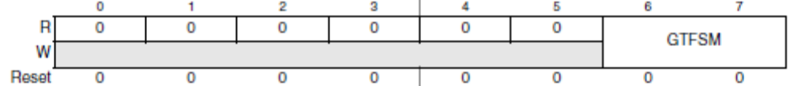
SEMA4: Semaphores gate n register (SEMA4_GATEn)
Bit | Name | Description
6-7 | GTFSM | Gate Finite State Machine. The hardware gate is maintained in a three-state implementation, defined as: 00 The gate is unlocked (free). 01 The gate has been locked by processor 0. 10 The gate has been locked by processor 1. 11 This state encoding is never used and therefore reserved. Attempted writes of 0x03 are treated as no operation and do not affect the gate state machine. Note: The state of the gate reflects the last processor that locked it, which can be useful during system debug.

Slide 6
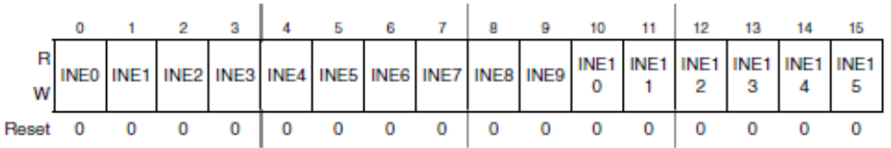
SEMA4: processor n IRQ notification enable (SEMA4_CP{0,1}INE)
The optional notification interrupt function consists of two registers for each processor: an interrupt notification enable register (SEMA4_CPnINE) and the interrupt request register (SEMA4_CPnNTF).
Bit | Name | Description
0-15 | INEn | Interrupt Request Notification Enable n. This field is a bitmap to enable the generation of an interrupt notification from a failed attempt to lock gate n. 0 The generation of the notification interrupt is disabled. 1 The generation of the notification interrupt is enabled.

Slide 7
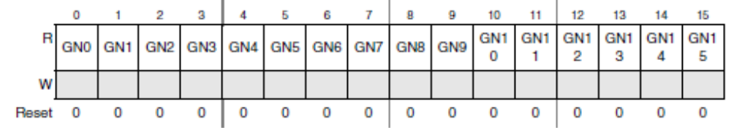
SEMA4: Semaphores processor n IRQ notification (SEMA4_CPxNTF)
The notification interrupt is generated via a unique finite state machine, one per hardware gate. This machine operates in the following manner:
  When an attempted lock fails, the FSM enters a first state where it waits until the gate is unlocked
  After it is unlocked, the FSM enters a second state where it generates an interrupt request to the failed lock processor
  When the failed lock processor succeeds in locking the gate, the IRQ is automatically negated and the FSM returns to the idle state. However, if the other processor locks the gate again, the FSM returns to the first state, negates the interrupt request, and waits for the gate to be unlocked again.
Bit | Name | Description
0-15 | GNn | Gate n Notification. This read-only field is a bitmap of the interrupt request notification from a failed attempt to lock gate n. 0 No notification interrupt generated. 1 Notification interrupt generated.

Slide 8
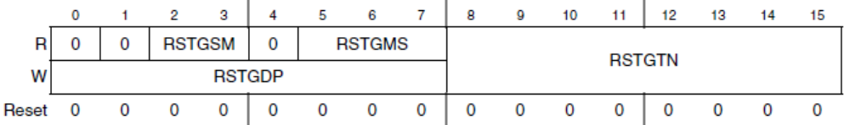
SEMA4: Semaphores (secure) reset gate n (SEMA4_RSTGT) 1/2
Allows a hardware gate (or all the gates) to be initialized by following a specific dual-write access pattern.
The secure gate reset requires two consecutive writes with predefined data patterns from the same processor to force the clearing of the specified gate(s).
Bit | Name | Description
2-3 | RSTGSM | Reset Gate Finite State Machine. The reset state machine is a three-state implementation, defined as: 00 Idle, waiting for the first data pattern write. 01 Waiting for the second data pattern write. 10 The 2-write sequence has completed. Generate the specified gate reset(s). After the reset is performed, this machine returns to the idle (waiting for first data pattern write) state. 11 This state encoding is never used and therefore reserved. Reads of the SEMA4_RSTGT register return the encoded state machine value.

Slide 9
SEMA4: Semaphores (secure) reset gate n (SEMA4_RSTGT) 2/2
Bit | Name | Description
5-7 | RSTGMS | Reset Gate Bus Master. This 3-bit read-only field records the logical number of the bus master performing the gate reset function. The reset function requires that the two consecutive writes to this register be initiated by the same bus master to succeed. This field is updated each time a write to this register occurs.
8-15 | RSTGTN | Reset Gate Number. This 8-bit field specifies the specific hardware gate to be reset. This field is updated by the second write. If RSTGTN < 64, then reset the single gate defined by RSTGTN, else reset all the gates. The corresponding secure IRQ notification state machine(s) are also reset.
0-7 | RSTGDP | Reset Gate Data Pattern. This write-only field is accessed with the specified data patterns on the two consecutive writes to enable the gate reset mechanism. For the first write, RSTGDP = 0xe2 while the second write requires RSTGDP = 0x1d.

Slide 10
Semaphores (secure) reset gate - Flow
Flow to reset one or all gates
  Select the Gate to be cleared through the RSTGTN
  1st write with RSTGDP = 0xe2
  2nd write with RSTGDP = 0x1d

Slide 11
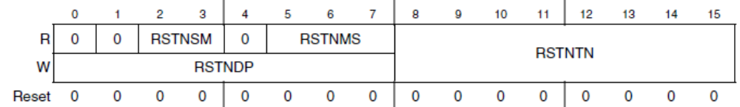
SEMA4: Semaphores (secure) Reset IRQ notification (SEMA4_RSTNTF) 1/2
Allows an IRQ notification (or all the notifications) to be initialized by following a specific dual-write access pattern.
The secure reset mechanism requires two consecutive writes with predefined data patterns from the same processor to force the clearing of the IRQ notification(s).
Bit | Name | Description
2-3 | RSTNSM | Reset Notification Finite State Machine. The reset state machine is maintained in a 2-bit, three-state implementation, defined as: 00 Idle, waiting for the first data pattern write. 01 Waiting for the second data pattern write. 10 The two-write sequence has completed. Generate the specified notification reset(s). After the reset is performed, this machine returns to the idle (waiting for first data pattern write) state. 11 This state encoding is never used and therefore reserved. Reads of the SEMA4_RSTNTF register return the encoded state machine value.

Slide 12
SEMA4: Semaphores (secure) Reset IRQ notification (SEMA4_RSTNTF) 2/2
Bit | Name | Description
5-7 | RSTNMS | Reset Notification Bus Master. This 3-bit read-only field records the logical number of the bus master performing the notification reset function. The reset function requires that the two consecutive writes to this register be initiated by the same bus master to succeed. This field is updated each time a write to this register occurs.
8-15 | RSTNTN | Reset Notification Number. This 8-bit field specifies the specific IRQ notification state machine to be reset. This field is updated by the second write. If RSTNTN < 64, then reset the single IRQ notification machine defined by RSTNTN, else reset all the notifications.
0-7 | RSTNDP | Reset Notification Data Pattern. This write-only field is accessed with the specified data patterns on the two consecutive writes to enable the notification reset mechanism. For the first write, RSTNDP = 0x47 while the second write requires RSTNDP = 0xb8.

Slide 13
Semaphores (secure) reset IRQ - Flow
Flow to reset one or all gates
  Select the Gate to be cleared through the RSTNTN
  1st write with RSTNDP= 0x47
  2nd write with RSTNDP= 0xb8

Slide 14
SEMA4: Functional description
important rules to correctly implement system solution
  All writes to shared data values or shared hardware resources must be protected by a gate variable
  After a processor locks a gate, accesses to the shared data or resources by other processes/processors must be blocked. This is enforced by software conventions
  The processor that locks a particular gate is the only processor that can unlock, or open, that gate

Slide 15
SEMA4: Example1
Coherent read done with semaphores:
The e200z4d_0 wants to coherently read a section of shared memory
The e200z4d_0 should check that the semaphore for the shared memory is not currently set
The e200z4d_0 should set the semaphore for the shared memory to prevent the e200z4d_1 from updating the shared memory
The e200z4d_0 reads the required data, then unlock the semaphore

