Slide 1
Sine wave generator (SWG)
Leopard training
v.1.0

Slide 2
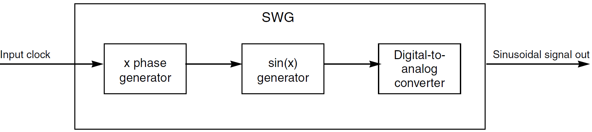
Sine wave generator (SWG)
Leopard includes a DAC (SWG) which generates a sinusoidal voltage signal
  this signal is used to generate the exciting signal for the resolver in a motor control application
The Sine Wave Generator (SWG) generates a high-quality sinusoidal voltage signal
  programmable oscillation frequency and amplitude voltage

Slide 3
Main features
Input clock frequency range: 12–20 MHz
  a dedicated clock prescaler is implemented
Output sinusoidal signal
  frequency range from 1 kHz to 50 kHz in 16 Hz steps for a 16 MHz input clock
  Sine wave amplitude from 0.47 V to 2.26 V
The linearity/noise performances are carefully optimized through digital processing

Slide 4
Input clock
Input clock must be between 12 and 20MHz
Input clock is configurable through the MC_CGM
Available input clock
  FMPLL0
  FMPLL1
  RC
A dedicated auxiliary clock divider is implemented
  Auxiliary clock 0 divider 1

Slide 5
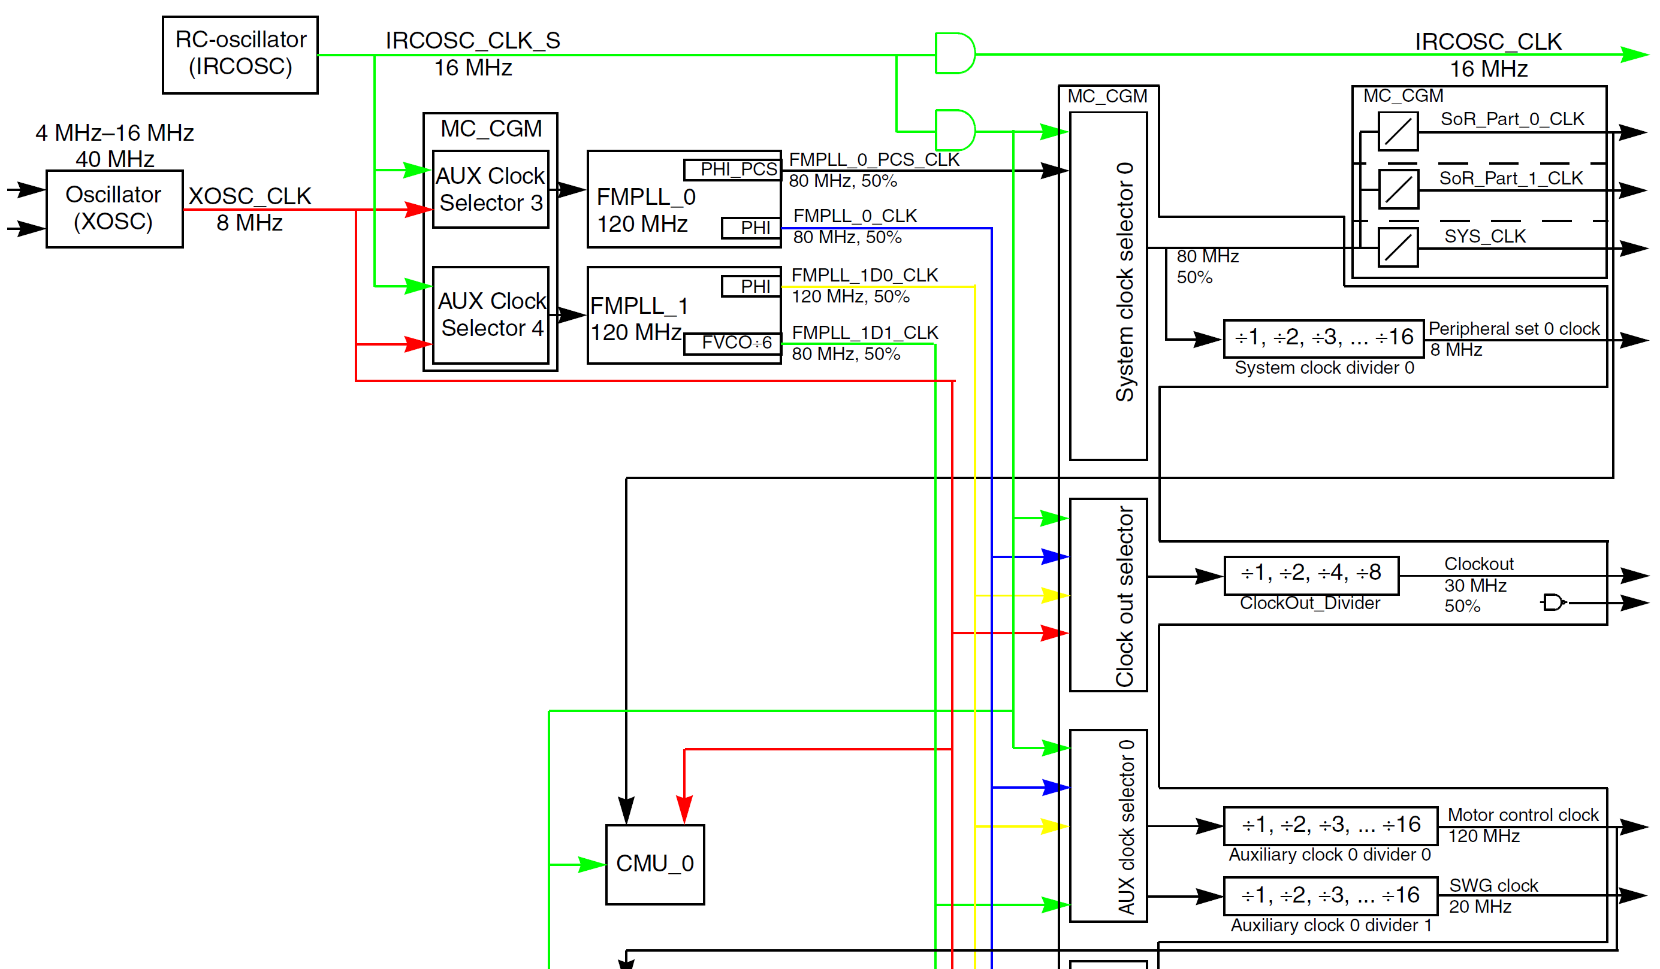
Leopard clock distribution

Slide 6

Output sine wave frequency
Frequency range from 1 kHz to 50 kHz in 16 Hz steps for a 16 MHz input clock
Configurable through SWG_CTRL[IOFREQ]
  value from 66 to 3277
both frequencies are in Hz

Slide 7
Changing output frequency
To change output frequency
  Determinate the required value of SWG_CTRL[IOFREQ]
  Ensure that SWG_CTRL[LDOS]=0
    new frequency is loaded y waiting until LDOS=0 and then LDOS=1
  Write the new value of SWG_CTRL[IOFREQ]
  Set SWG_CTRL[LDOS]
Sine wave with the new frequency is produced after two input clock after this procedure

Slide 8
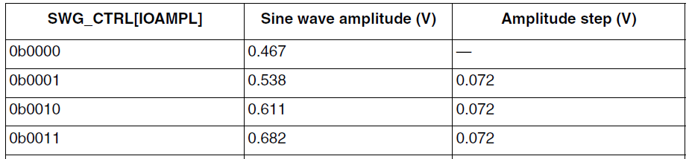
Output sine wave amplitude
The amplitude of the sine wave is controlled by SWG_CTRL[IOAMPL] field
A table shows the relationship between the sine wave amplitude and the IOAMPL field content
...

Slide 9
Recommendation
After make a change to the SWG_CTRL register, the SWG expects that this data is preserved for at least 50 clock cycles
  Failure to do so may cause unexpected output from the SWG

