Slide 1
Crossbar
Version 1.1

Slide 2
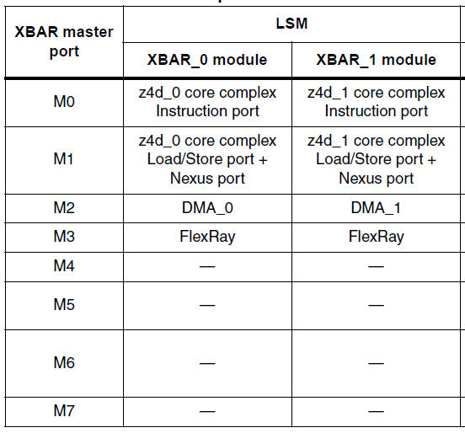
Masters and slaves (a)
Notes:
XBAR allows concurrent accesses from masters to slaves
Masters can access all slave.
Configurable in terms of priority and arbitration (best configuration is application dependent).
1

Slide 3
Crossbar Introduction: General Operation
When a master makes an access to the XBAR
If the targeted slave port is available then the access is immediately presented on the slave port, zero wait state
If the targeted slave port of the access is busy or parked on a different master port the requesting master simply see wait states inserted until the targeted slave port can service the master’s request
A master is given control of the targeted slave port only after a previous access to a different slave port has completed
Once the master has control of the slave port, the master remains in control of that slave port until it gives up the slave port

Slide 4
Crossbar Introduction: Controls – Parking and Priority
Higher performance - slave ports “parked” on a particular master
Parking is defined in Slave General Purpose Control Registers
Reset default: all slaves are parked on the core (Master port 0)
Higher performance - “priority” given to a desired master in resolving simultaneous access from different masters to a slave port
Slave ports define if masters use fixed or round- robin priority “arbitration”
Arbitration is defined in each slave port’s Slave General Purpose Control Register
Reset default: fixed priorities are used
When using fixed priority arbitration, relative priorities of masters are defined for each slave
Priorities are defined in each slave port’s Master Priority Register
Reset default: slaves give the core the highest priority
Parking and priority arbitration fields can be protected by making them read-only
Defined in Slave General Purpose Control Register (write-once bit field)
Reset default: All fields for that slave port can be written

Slide 5
Crossbar Parking: Parking Slave Ports
Parking a slave port on a master may save an initial clock normally used for arbitration
Parking Control Options (defined in XBAR_GPCRn[PCTL])
Park on specific master: Parks on master specified in XBAR_GPCRn[PARK] field; no extra clock if accessed next by the specified master
Park on last (POL): slaves parks on last master; no extra clock if accessed next by same master
Park on no master: this is a low power park which can result in an overall power savings
Best performance is generally achieved when slave ports are parked on the most frequently used master
Reset default: all slave ports are parked on the core

Slide 6
Crossbar Arbitration: Fixed and Round Robin
When multiple masters simultaneously attempt to access a slave, arbitration is determined by either
Fixed priority (default)
Round Robin
Fixed priority: each master is assigned a unique priority level in the MPR (Master Priority Register).
If two masters request access to a slave port, the master with the highest priority in the selected priority register will gain control over the slave port.
Round Robin: each master is assigned a relative priority based on the master number.
As an example of arbitration in round-robin mode, assume the XBAR is implemented with master ports 0, 1, 4 and 5. If the last master of the slave port was master 1, and master 0, 4 and 5 make simultaneous requests, they will be serviced in the order 4, 5 and then 0.

Slide 7
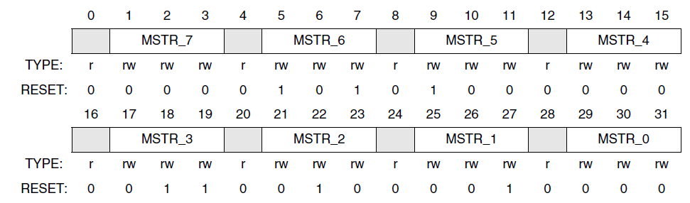
Registers – Master priority
Master priority register (MPRn)
One MPR per slave
MSTRx
Notes:
RM ST pag.326
MSTR0: arbitration priority for master port 0 on the associated slave port.
000 This master has the highest priority when accessing the slave port.
111This master has the lowest priority when accessing the slave port.

Slide 8
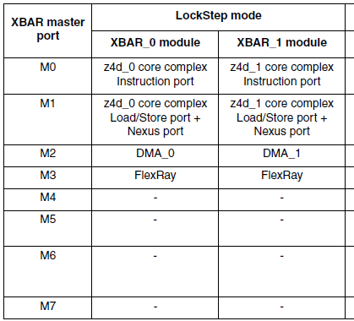
Crossbar Ref.: Master Priority Register (XBAR_MPRn)
The Master Priority Register (MPR) sets the priority of each master port on a per slave port basis and resides in each slave port.
MSTR0: arbitration priority for master port 0 on the associated slave port.
MSTR7: master port 7 on the associated slave port.
Notes:
000 This master has the highest priority when accessing the slave port.
111This master has the lowest priority when accessing the slave port.

Slide 9
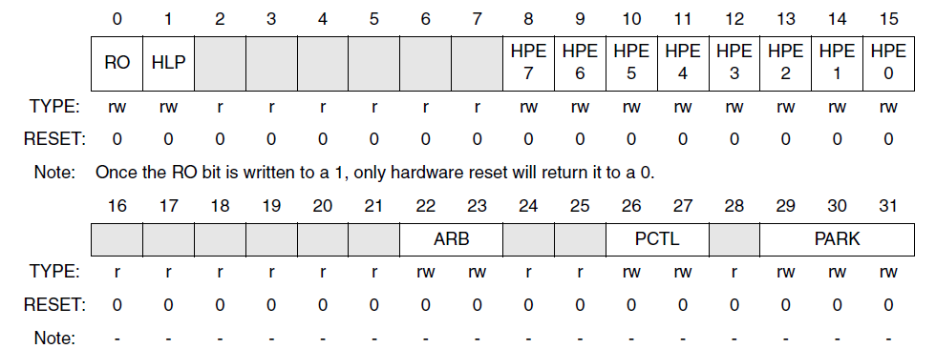
Registers – Slave
Slave General Purpose Control Register
One MPR per slave
SGPCRn
Notes:
RM ST pag.329
HALT request
The HLP bit in the GPCR controls the priority level of the max_halt_request in the arbitration algorithm.
If the HLP bit is cleared then the max_halt_request will have the highest priority of any master and will gain control of the slave port at the next arbitration point
(most likely the next bus cycle, unless the current master is running a locked or fixed length burst transfer).
If the HLP bit is set then the slave port will wait until no masters are actively making requests before moving to halt mode.
PCTL - Parking Control — These bits determine the parking control used by this slave port.
PARK — These bits are used to determine which master port this slave port parks on when no masters are actively making requests and the PCTL bits are set to 00.
HPE - The XBAR has a hardware input per master port (mX_high_priority) which is used to temporarily elevate the master’s priority level on all slave ports. When the master’s
mX_high_priority input is asserted the master port will automatically have higher priority than all other master ports.
This functionality is useful because it allows the user to automatically elevate a master port’s priority level throughout the XBAR in order to quickly perform temporary tasks such as
servicing interrupts.

Slide 10
Crossbar Ref.: Slave General Purpose Control Register (SGPCRn) 1/2
Read only. Used to force all of a slave port’s registers to be read only. Once written to 1 it can only be cleared by hardware reset. This bit is cleared by hardware reset and is write once after reset.
0 All this slave port’s registers can be written.
1 All this slave port’s registers are read only and cannot be written (attempted writes have no effect and result in an error response).
Halt low priority. Used to set the behaviout during a request to go into Halt mode
If the HLP bit is set then the slave port will wait until no masters are actively making requests before moving to halt .
Arbitration mode. Used to select the arbitration policy for the slave port. This field is initialized by hardware reset.
00 Fixed priority using MPR
01 Round-robin (rotating) priority
1x Reserved
Notes:
RM ST pag.329
HALT request
The HLP bit in the GPCR controls the priority level of the max_halt_request in the arbitration algorithm.
If the HLP bit is cleared then the max_halt_request will have the highest priority of any master and will gain control of the slave port at the next arbitration point
(most likely the next bus cycle, unless the current master is running a locked or fixed length burst transfer).
If the HLP bit is set then the slave port will wait until no masters are actively making requests before moving to halt mode.

Slide 11
Crossbar Ref.: Slave General Purpose Control Register (SGPCRn) 2/2
Parking control. Used to select the parking algorithm used by the slave port. This field is initialized by hardware reset.
00 When no master is making a request the arbiter will park the slave port on the master port defined by the PARK bit field.
01 When no master is making a request the arbiter will park the slave port on the last master to be in control of the slave port.
10 When no master is making a request the arbiter will park the slave port on no master and will drive all outputs to a constant safe state.
11 Reserved
Park. Used to determine which master port this slave port parks on when no masters are actively making requests . PCTL must be set to 00.
000 Park on master port 0
001 Park on master port 1…
HPE - The XBAR has a hardware input per master port which is used to temporarily elevate the master’s priority level on all slave ports. When the master’s
input is asserted the master port will automatically have higher priority than all other master ports.
This functionality is useful because it allows the user to automatically elevate a master port’s priority level throughout the XBAR in order to quickly perform temporary tasks such as servicing interrupts.

Slide 12
XBAR – key points
Notes:
XBAR allows concurrent accesses from masters to slaves
Masters can access all slave.
Configurable in terms of priority and arbitration (best configuration is application dependent).
11

