Slide 1
Cross Triggering Unit (CTU)
Version 1.0

Slide 2
CTU Motivation
In the PWM driven systems it is important to precisely schedule acquisition of the state variables with respect to PWM cycle.
The state variables are obtained through the following peripherals:
  ADC
  Position Counter (e.g. Quadrature Decoder, Resolver and Sine-Cos sensor)
  PWM duty cycle decoder
CTU is designed to make acquisition more precise and easier to implement while freeing main CPU for other tasks.

Slide 3
CTU Purpose
The Cross Triggering Unit (CTU) is intended to completely avoid CPU involvement for in-time acquisitions of the state variables during control cycle (PWM cycle, half PWM cycle or number of PWM cycles)
CPU
FlexPWMs
CTU
ADC
Timers

Slide 4
CTU Block Diagram
CTU Clock (as PWM)
Prescaler
PWM_REL
TRIGGER_0
ADC_CMD_0
Interface with ADC 0
PWM_ODD_x
NEXT_CMD_0
FIFO_0
Interface with PWM
PWM_EVEN_x
TRIGGER_1
Trigger Generator
Scheduler
ADC_CMD_1
Interface with ADC 1
RPWM_x
NEXT_CMD_1
FIFO_1
Interface with TIMERs
ETMR0_IN
ETIMER0_TRG
Interface with TIMERs
ETMR1_IN
ETIMER1_TRG
EXT_IN
MRS
EXT_TRG
Interface with EXTERNAL signal
Interface with EXTERNAL signal

Slide 5
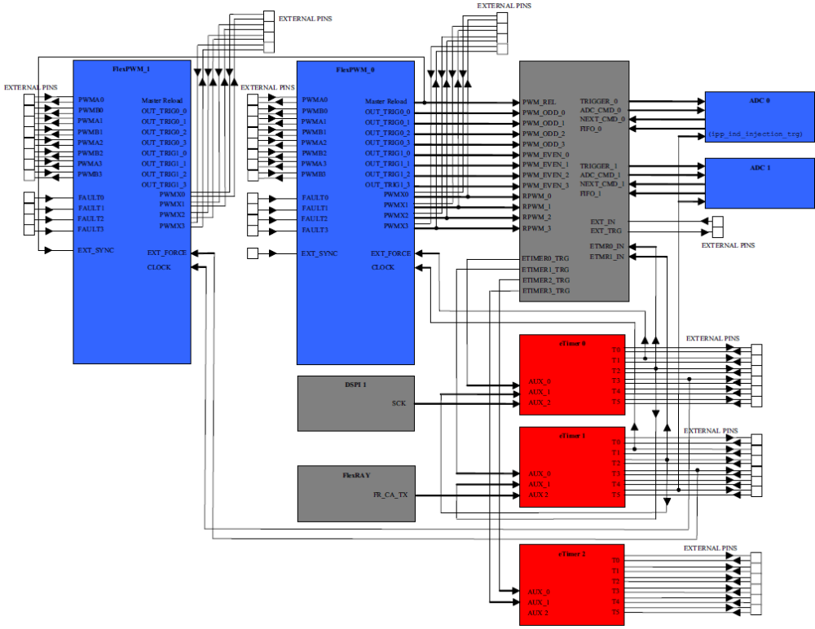
CTU Interaction with other peripheral
CTU interacts with the following peripherals:
ADC
eTIMER
FlexPWM

Slide 6
CTU Feature Overview
Up to 16 input events
4 FIFOs for ADC results storage
DMA support (to read acquired data from FIFOs and to configure the CTU)
Over-sampling support (stream of consecutive ADC commands for each Trigger Event)
Reload mechanism for safety
Selectable control period (defined by 2 consecutive MRS)
Configurable action/output for each trigger event (pulse, command(s) or both sent to one or more peripherals - ADC, timers etc.)

Slide 7
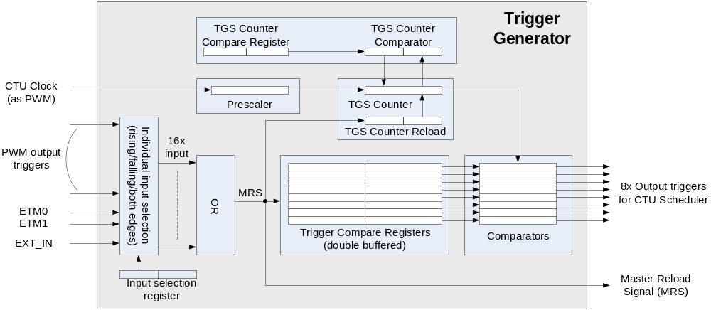
Trigger Generator
Time triggered mode - Block Scheme
Master reload signal (MRS) starts timing cycle
  Each cycle can generate up to 8 output trigger for Scheduler
  MRS signal is generated by any of selected input signals (PWMs, ETM, EXT_IN)
Counter counts up to Compare value then stops and waits for new MRS event

Slide 8
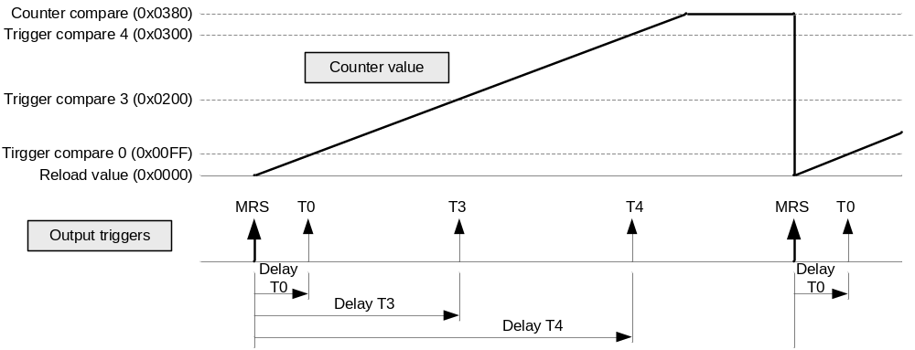
Trigger Generator
Time triggered mode – Timing diagram
Counter operation
  Counts with MC_CLK divided by CTU prescaler
  Reloads with each MSR event
  Counts up to Counter compare value then stops
Output triggers
  Each Trigger compare value determines trigger generation delay
  To avoid trigger generation, compare value has to be out of counter range

Slide 9
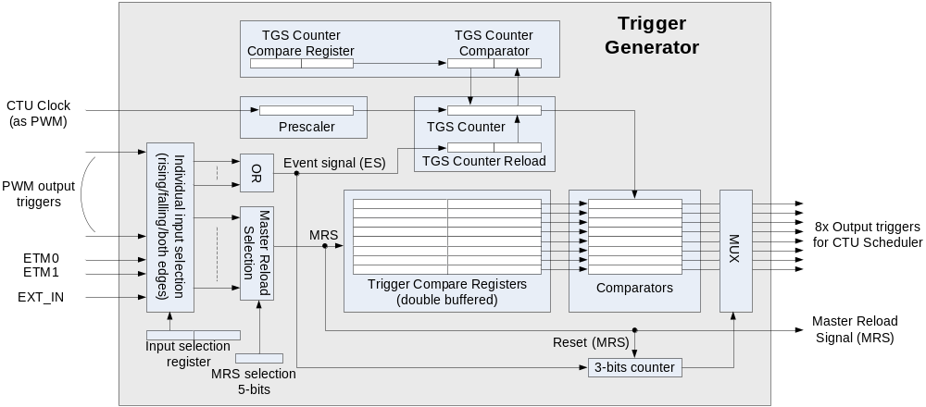
Trigger Generator
Sequential mode - Block Scheme
Event signal (ES)
  Up to 32 inputs events can be selected to generate ES
  Each ES event selects new output trigger delay after ES event
MSR events
  Only one of 32 two possible inputs events drives MSR signal
  It reloads compare register sets and clears 3-bits output counter

Slide 10
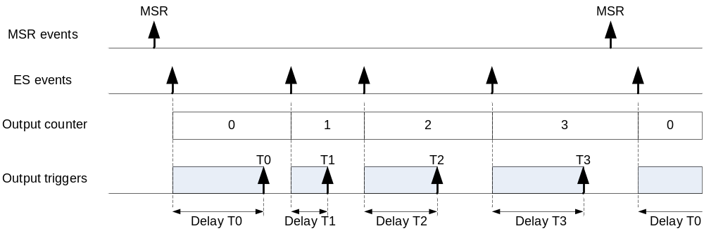
Trigger Generator
Sequential mode – Timing diagram
Each ES event
  Reloads TGS counter
  Control output selection counter
3-bits output counter selects which Comparator is used for output trigger generation
MSR event
  Restarts output selection counter
  Reloads compare registers

Slide 11
CTU Trigger Generator Example Timing
Delay T₀
Triggered Mode
Delay T₁
Trigger 0
Master Reload Signal
Trigger 1
Trigger 2
Trigger 3
Delay T₂
Master Reload Signal
Delay T₃
Sequential Mode
Delay T₀
Delay T₁
Event Signal 1
Event Signal 2
Event Signal 3
Master Reload Signal – Event Signal 0
Trigger 0
Master Reload Signal – Event Signal 0
Trigger 1
Trigger 2
Trigger 3
Delay T₂
Delay T₃

Slide 12
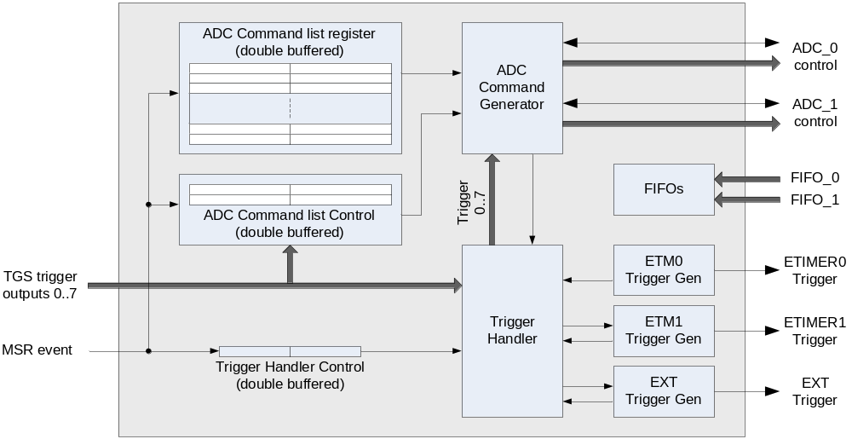
CTU Scheduler

Slide 13
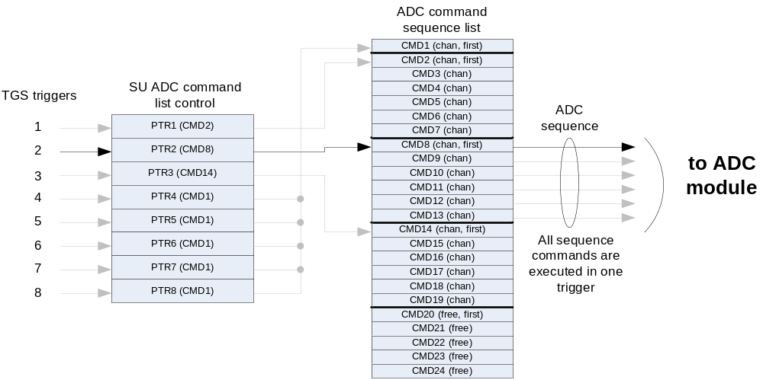
ADC Command Generation
Each time trigger from TGS is linked to one ADC command sequence trigger
ADC command sequence trigger points to the first command in the list
Number of commands is controlled by first command bit of the successive command sequence

Slide 14
CTU ADC Command Structure
Channel A number [4 bits]
  (ADC A channel number to sample)
Channel B number [4 bits]
  (ADC B channel number to sample)
FIFO selection bits for the ADC unit A/B [2 bits]
Conversion Mode selection [1 bit]
First command bit
  (for CTU internal use only)
Interrupt request [1 bit]
  (for CTU internal use only)

Slide 15
CTU Faults and Errors
Stored in Error Flag Register
Cleared by writing 1 (writing 0 has no effect)
Detected errors:
  MRS occurred while user update of double-buffered registers
  More than 8 event signals received before next MRS (in Sequential Mode)
  Invalid/unrecognized ADC command
  MRS occurred before some of the enabled trigger events occur and the MRS_O bit is set.
  New incoming event occurred before the trigger event from previous incoming event (in Sequential mode only)
  A trigger event occurred and actions of the previous trigger event are not completed (there are 4 overrun flags. One for each type of output)

Slide 16
CTU DMA Support
5 DMA channels reserved for CTU
Each FIFO is assigned one DMA channel for data reads
  (FIFO can perform a DMA request when the number of words stored in the FIFO reaches the FIFO threshold value)
MRS can be used as an optional DMA request signal

Slide 17
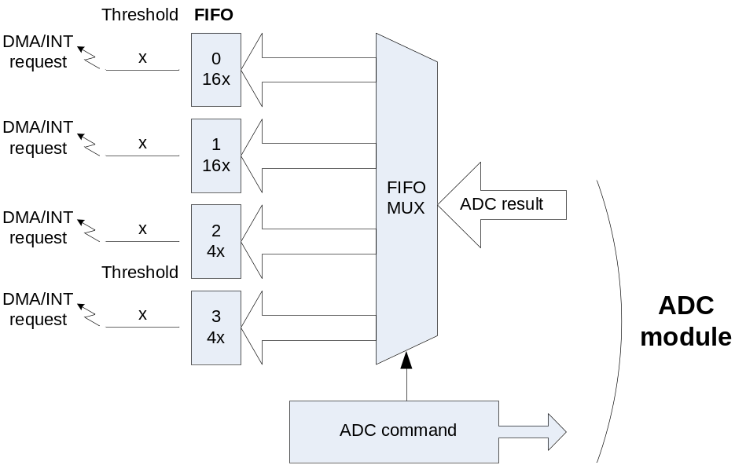
ADC FIFOs
CTU module contains 4x FIFO to store ADC results
  2 FIFOs with 16 entries, 2 FIFOs with 4 entries
Each ADC command contains selection of the FIFO where to store the result of ADC measurement
DMA transfer or INT request is generated when number of items inside FIFO is higher then threshold
FIFO entries can be read either in unsigned right-justified or signed left-justified format

Slide 18
CTU
CTU example

Slide 19
CTU Example System Diagram
Resolver
Sine
Cosine
PWM
DC/DC converter
(Optional)
PWM
3-phase Inverter
100μs
Torque sensor
Sine
Cosine
I₁
I₂
Torque sensor
Sine
Cosine
I₃
LPF
200μs
Motor
MCU

Slide 20
CTU Example
Main features
PWM period is 50μs (PWM frequency is 20KHz) and the CTU control period is 100μs.
Current acquisition every 100μs at Vector 0 state 0: 3 currents using high gain and 3 currents using low gain (with a delay to compensate the delay due to the LPFs).
Resolver acquisition every 100μs (synchronized with the beginning of the control period).
Torque sensors acquisition every 50μs (4 acquisitions in 200μs synchronized with the beginning of the control period).

Slide 21
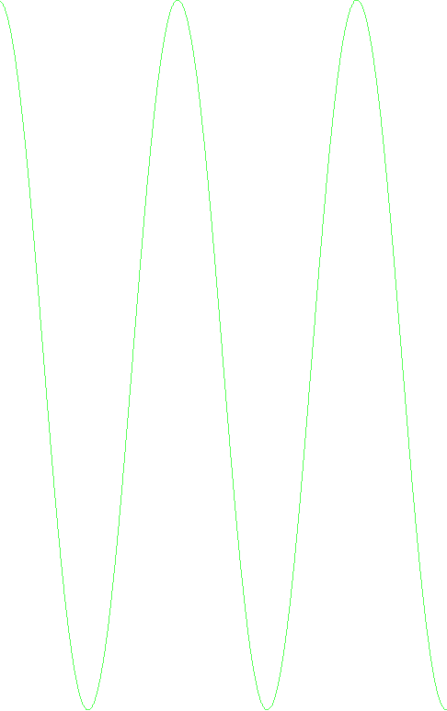
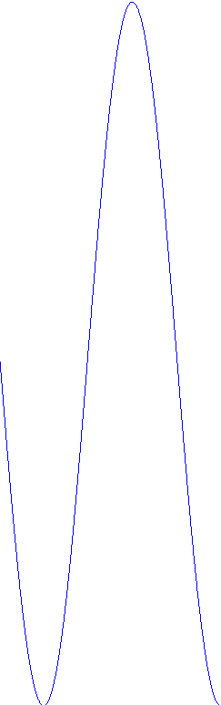
CTU Example
Sampling Times – Ideal Case
Control period (100μs)
PWM (50μs)
Resolver (100μs)
Torque (200μs)
LPF delay
LPF delay

Slide 22
CTU Example (2 ADCs – 1 CTUs)
Timing without LPF
FIFO1 (Currents)
Dual sampling on Torque sensor 1
Dual sampling on Torque sensor 2
Dual sampling on Torque sensor 2
Dual sampling on Resolver
Dual sampling on Torque sensor 2
Dual sampling on Torque sensor 1
Dual sampling on Torque sensor 2
Dual sampling on Torque sensor 1
Dual sampling on Torque sensor 2
Dual sampling on Torque sensor 1
Dual sampling on Torque sensor 2
Dual sampling on Resolver
Dual sampling current I3_{L} and I3_{H}
Dual sampling current I1_{L} and I2_{L}
Dual sampling current I3_{L} and I3_{H}
Dual sampling current I1_{H} and I2_{H}
Dual sampling current I1_{L} and I2_{L}
Trigger event 2 - Command 3
Trigger event 2 - Command 1
Trigger event 2 - Command 2
Trigger event 1 - Command 1
Trigger event 1 - Command 2
Trigger event 1 - Command 3
Trigger event 1 - Command 4
Trigger event 1 - Command 8
Trigger event 1 - Command 9
Trigger event 1 - Command 10
Trigger event 2 - Command 1
Trigger event 2 - Command 2
Trigger event 2 - Command 3
Trigger event 1 - Command 5
Trigger event 1 - Command 6
Trigger event 1 - Command 7
FIFO2 (Torque sensors)
Trigger event 1 - Command 11
FIFO3 (Resolver)
FIFO4
DMA transfer (read) for FIFO 1 (Currents) with threshold = 9.
DMA transfer (read) for FIFO 3 (Resolver) with threshold = 3.
DMA transfer (read) for FIFO 2 (Torque sensors) with threshold = 13.
PWM reload - CTU MRS
FIFO 2 empty interrupt: data ready to call to the control algorithm
And so on…
Trigger Event 1 delay = 50 μs – 5*T_{ADC}
11 Dual sampling commands. 2 Dual samplings on Torque sensor 1 and 2 Dual samplings on Torque sensor 2 (Torque sensor 1 and 2 values are calculated as average values). 2 Dual samplings for Resolver (Resolver values are calculated as average values). 1 Dual sampling for currents I1_{H} and I2_{H}, 2 Dual samplings for currents I1L and I2L (currents I1L and I2L are calculated as average value) and 2 Dual samplings for currents I3_{H} and I3_{L} (currents I3_{H} and I3_{L} are calculated as average value).
Trigger Event 2 delay = 100 μs – T_{ADC}
3 Dual sampling commands. 1 Dual sampling on Torque sensor 1 and 2 Dual samplings on Torque sensor 2 (Torque sensor 2 values are calculated as average values).
Trigger Event 2 delay = 100 μs – T_{ADC}
3 Dual sampling commands. 1 Dual sampling on Torque sensor 1 and 2 Dual samplings on Torque sensor 2 (Torque sensor 2 values are calculated as average values).
PWM reload - CTU MRS
PWM (50μs)
Resolver (100μs)
Torque (200μs)

Slide 23
BACKUP
BACKUP

Slide 24
CTU Example
Considerations
Microcontroller resources: 8 PWM channels and 4 ADCs / 2 CTUs.
CTUs are statically configured using 3 trigger events for each one.
1 interrupt (FIFO 3 CTU 1 empty interrupt) to call the control algorithm for each control period.
FIFO DMA read transfer hardware started in order to have the data ready in RAM without CPU load.
Some values are calculated as average values: note that the used sampled values are symmetric so the average value can be calculated as (A1+A2)>>2, i.e. a division is not necessary.
It is to make sure that all conversions end before PWM channels move again, so the maximum duty cycle is limited. According to this the required time is 1 * TADC_Conversion + TADC_Sampling= 1 * 0.8ms + 0.125ms = 0.925ms on a PWM semi-period, so the maximum duty cycle is 100% – (0.925ms/25ms * 100)% = 96.3% without considering the dead-time, the PWM rise/fall time and the settling time (ringing time). If the conversion time increases, the maximum duty cycle decreases.

Slide 25
CTU Example (4 ADCs – 2 CTUs)
Timing
FIFO1 (Currents)
FIFO1 (Currents)
FIFO2 (Torque sensors)
FIFO2 (Torque sensors)
FIFO3 (Resolver)
PWM reload - CTU MRS
FIFO 3 CTU 1 empty interrupt: data ready to call to the control algorithm
Dual sampling on Torque sensor 1
PWM reload - CTU MRS
Dual sampling on Torque sensor 1
Dual sampling on currents I₁ and I₂
Dual sampling on Resolver
Dual sampling on Resolver
Trigger event 1 (CTU 1) - Command 1
Trigger event 3 (CTU 1) - Command 1
Trigger event 3 (CTU 1) - Command 3
Trigger event 2 (CTU 1) - Command 1
Trigger event 3 (CTU 1) - Command 2
And so on…
Dual sampling on Torque sensor 2
Dual sampling on Torque sensor 2
Single sampling on current I₃
DMA transfer (read) for FIFO 1 CTU 1 with threshold = 1.
Trigger event 1 (CTU 2) - Command 1
DMA transfer (read) for FIFO 1 CTU 2 with threshold = 0.
Trigger event 2 (CTU 2) - Command 1
Trigger event 3 (CTU 2) - Command 1
Trigger Event 3 delay = 50μs – T_{ADC} for CTU 1 with 3 Dual sampling commands.
Trigger Event 3 delay = 50μs for CTU 2 with 1 Dual sampling command.
Trigger Event 1 delay = 0 μs for both CTU.
2 Dual sampling commands. 1 Dual sampling on Torque sensor 1 (ADC 1 and ADC 2) and 1 Dual sampling on Torque sensor 2 (ADC 3 and ADC 4).
Trigger Event 2 delay = LPF delay for both CTU.
1 Dual sampling command and 1 Single sampling command. 1 Dual sampling on currents I₁ and I₂ and 1 Single sampling on current I₃.
PWM (50μs)
Resolver (100μs)
Torque (200μs)

Slide 26
CTU Example (4 ADCs – 2 CTUs)
Timing without LPF
FIFO1 (Currents)
FIFO1 (Currents)
FIFO2 (Torque sensors)
FIFO2 (Torque sensors)
FIFO3 (Resolver)
DMA transfer for FIFO 2 CTU 1 (Torque sensors) with threshold = 5.
DMA transfer for FIFO 2 CTU 2 (Torque sensors) with threshold = 5.
DMA transfer for FIFO 1 CTU 1 (Currents) with threshold = 1.
DMA transfer for FIFO 1 CTU 2 (Currents) with threshold = 5.
DMA transfer for FIFO 3 CTU 1 (Resolver) with threshold = 3.
Dual sampling on Resolver
FIFO 2 CTU 2 empty interrupt: data ready to call to the control algorithm
Dual sampling on currents I1_{H} and I1_{L}
Dual sampling on Resolver
Dual sampling on Torque sensor 1
Dual sampling on Torque sensor 1
Dual sampling on Torque sensor 1
Dual sampling on Torque sensor 1
PWM reload - CTU MRS
PWM reload - CTU MRS
Trigger event 1 (CTU 1) - Command 1
Trigger event 2 (CTU 1) - Command 1
Trigger event 2 (CTU 1) - Command 2
Trigger event 2 (CTU 1) - Command 3
Trigger event 2 (CTU 1) - Command 4
Trigger event 2 (CTU 1) - Command 5
Trigger event 1 (CTU 1) - Command 1
Dual sampling on currents I3_{H} and I3_{L}
Dual sampling on currents I2_{H} and I2_{L}
Dual sampling on currents I3_{H} and I3_{L}
Dual sampling on Torque sensor 2
Dual sampling on Torque sensor 2
Dual sampling on Torque sensor 2
Dual sampling on Torque sensor 2
Trigger event 1 (CTU 2) - Command 1
Trigger event 2 (CTU 2) - Command 1
Trigger event 2 (CTU 2) - Command 2
Trigger event 2 (CTU 2) - Command 3
Trigger event 2 (CTU 2) - Command 4
Trigger event 2 (CTU 2) - Command 5
Trigger event 1 (CTU 2) - Command 1
And so on…
Trigger Event 2 delay = 50 μs – 2*T_{ADC}
10 Dual sampling commands. 2 Dual samplings on Torque sensor 1 (ADC 1 and ADC 2) and 2 Dual samplings on Torque sensor 2 (ADC 3 and ADC 4). 2 Dual samplings on Resolver (ADC 1 and ADC 2) and 2 Dual samplings on currents I3_{H} and I3_{L} (ADC 3 and ADC 4). 1 Dual samplings on currents I1_{H} and I1_{L} (ADC 1 and ADC 2) and 1 Dual samplings on currents I2_{H} and I2_{L} (ADC 3 and ADC 4).
Trigger Event 1 delay = 0 μs
2 Dual sampling commands. 1 Dual sampling on Torque sensor 1 (ADC 1 and ADC 2) and 1 Dual sampling on Torque sensor 2 (ADC 3 and ADC 4).
Trigger Event 1 delay = 0 μs
2 Dual sampling commands. 1 Dual sampling on Torque sensor 1 (ADC 1 and ADC 2) and 1 Dual sampling on Torque sensor 2 (ADC 3 and ADC 4).
PWM (50μs)
Resolver (100μs)
Torque (200μs)

Slide 27
CTU Example (4 ADCs – 2 CTUs)
Sampling Times
Control period (100μs)
PWM (50μs)
Resolver (100μs)
Torque (200μs)
LPF delay
LPF delay

