Slide 1
eTimer
Version 1.0

Slide 2
eTimer Block Diagram
ETC[5:0] external I/Os may be shared among eTimer channel inputs/outputs
Notes:
Watchdog timer is available just in Ch0; it can be used in quadrature counting mode to detect stall conditions
It is supposed that OFLAG0 matches ETC0 output (when enabled), OFLAG1 matches ETC1 etc. (to be verified!)

Slide 3
eTimer Main Features 1/2
SPC560Lxx contains two eTimer modules with six 16bit counter/timer channels each
Selectable up/down (programmable modulo) counting
Max count is Fsys for internal clocks and Fsys/2 for external
Count once or repeatedly
Counter and compare registers are preloadable
Each eTimer module control six external signals that can be shared among channels and programmed as input or output
Separate prescaler for each channel
Each channel has capture/compare ability
Continuous and single shot capture (duty/period measurement)

Slide 4
eTimer Main Features 2/2
Channels are cascadable
Counting start can be synchronised across channels
Programmable input filter
DMA support of capture/compare registers
OFLAG comparison for safety critical applications

Slide 5
eTimer Channel Structure
Notes:
Primary and secondary inputs may be shared ETC[5..0]
Other counters is an input used to connect OFLAG outputs from other counters
Output may be connected to the cerresponding ETC[…] or to any counter input (Other counters)

Slide 6
eTimer Features: Counting Sources (CTRL:PRISRC/SECSRC)
Primary Count Source input (counter clk)
Prescaled System Clock (/1, /2, /4 ... /128)
External input (ETC[5:0])
Other counter output (OFLAG)
Secondary Count Source input (counter commands)
External input (ETC[5:0])
Other counter output (OFLAG)
Maximum counter count rate
External sources: half of the eTimer base clock
Internal sources: eTimer base clock
Notes:
Primary Source Input is usually used as a clock source for inc or dec of the counter
Secondary Source Input is usually used for counter “commands”: capture, trigger, direction, enable or second signal in quadrature mode

Slide 7
eTimer Features: Counting Modes 1/2
A counter may be programmed to count up/down, depending on one of the following Counting Mode (CTRL:CNTMODE):
CNTMODE | Description
‘000’ | No operation
‘001’ | Count on rising edge of Primary Source.
‘010’ | Count on both rising and falling edges of Primary Source.
‘011’ | Count on rising edge of Primary Source while Secondary Source is high active.
‘100’ | Quadrature Count Mode, uses both Primary and Secondary Sources.
‘101’ | Count on rising edge of Primary Source, while Secondary Source specifies count direction (1 = minus).
‘110’ | Edge of Secondary Source triggers counting on rising edges of Primary Source until compare (secondary source edge acts as counting start/stop until compare).
‘111’ | Cascaded Counter Mode. Primary Source must be set to one of the other counter outputs (OFLAG).
Notes:
Counter simply counts…. What is it counted?
Mode 0: Interrupts caused by transitions on selected timer inputs are disabled as well
Mode 2: If source is internal clk then prescaler must be at least /2

Slide 8
eTimer Features: Counting Modes 2/2
Counting direction (CTRL:DIR)
Count up
Count down
Count once (CTRL:ONCE)
Count repeatedly (continuous mode)
Count one shot (until compare) then stop
Count length (CTRL:LENGTH)
Countinue counting to binary roll-over
Count until compare, then re-initialise
Primary and secondary source polarity (CTRL:PIPS, SIPS)
True polarity (by default as referred in the previous table)
Inverted polarity (not applicable when input source is system clock)

Slide 9
eTimer Features: Input Capture
CAPT1 and CAPT2 registers
are 2 word depth FIFOs with programmable “water-mark” (depth) when input capture interrupt flag is signalled (1 or 2)
can be independently disabled or set to capture on rising, falling on both edges
when both CAPT1 and CAPT2 are enabled then they work in a “ping-pong” style
Capture Modes
One shot (single capture on enabled CAPTx circuits, then disabled)
Free running (continuous capturing on enabled CAPTx circuits)
Notes:
Input capture is used to measure pulse width (by capturing the counter value on two successive input edges) or waveform period (by capturing the counter value on two consecutive rising edges or two consecutive falling edges).
The Capture Registers store a copy of the counter’s value when an input edge (positive, negative, or both) is detected.
Also, controlling the operation of the capture circuits is the arming logic which allows captures to be performed in a free running
(continuous) or one shot fashion.
In free running mode, the capture sequences will be performed indefinitely. If both capture circuits are enabled, they will work together in a ping-pong style where a capture event from one circuit leads to the arming of the other and vice versa. In one shot mode, only one capture sequence will be performed.
If both capture circuits are enabled, capture circuit 0 is first armed and when a capture event occurs, capture circuit 1 is armed.
Once the second capture occurs, further captures are disabled until another capture sequence is initiated. Both capture circuits are also capable of
generating an interrupt to the CPU.
The input source is the secondary count source.

Slide 10
eTimer Features: Output Compare
Two programmable counter compare circuits - COMP1 and COMP2.
Both COMP1 and COMP2 can be optionally cross-loaded from the corresponding CMPLD1 and CMPLD2 pre-load registry on compare event.
Both COMP1 and COMP2 can directly drive a timer output flag (OFLAG) when match with current counter value is found.
Notes:
cross-loaded means that both COMP1 and COMP2 may be optionally loaded from either CMPLD1 or CMPLD2 on either COMP1 or COMP2 compare event

Slide 11
eTimer Features: Output Flag Mode 1/2
On a compare event, a timer output (OFLAG) may be affected according to one of the following Ouput Flag Modes (CTRL2:OUTMODE):
OUTMODE | Description
‘0000’ | Software controlled (CTRL2:FORCE)
‘0001’ | OFLAG output cleared on successful compare (COMP1 or COMP2)
‘0010’ | OFLAG output set on successful compare (COMP1 or COMP2)
‘0011’ | OFLAG output toggled on successful compare (COMP1 or COMP2)
‘0100’ | OFLAG output toggled on compare event using alternating (COMP1 then COMP2 then COMP1…) compare registers
‘0101’ | OFLAG set on compare with COMP1, cleared on Secondary Source input edge
‘0110’ | OFLAG set on compare with COMP2, cleared on Secondary Source input edge
‘0111’ | OFLAG set on compare, cleared on counter roll-over

Slide 12
eTimer Features: Output Flag Mode 2/2
OUTMODE | Description
‘1000’ | OFLAG set on compare with COMP1, cleared on compare with COMP2
‘1001’ | OFLAG asserted while counter is active, released when counter is stopped
‘1010’ | OFLAG asserted when counting up, released when counting down
‘1111’ | Enable gated clock output while counter is active
Output Polarityt Select (CTRL2:OPS)
True polarity (by default as referred in the previous table)
Inverted polarity

Slide 13
eTimer Features: Load/Hold of Counter Register
Current counter value can be updated by means of:
direct write to Counter Register (CNTR) with immediate effect
load from Counter Pre-load register (LOAD) on selected compare event (COMPx) or selected capture event (CAPTx)
load from selected Compare Pre-load register (CMPLDx) on selected compare event (COMPx)
Counter value can be read by means of:
direct read from Counter Register (CNTR) – immediate value
read from Counter Hold Register (HOLD) – contains counter value latched whenever any counter within module is read
Notes:
All the module timer HOLD registers are updated on read from any timer CNTR register. This makes possible coherent reading from cascade counters.
LENGTH - Count Length
This bit determines whether the counter counts to the compare value and then reinitializes the counter continues counting past the compare value, to the binary roll over.
1 = Count until compare, then reinitialize. The value that the counter is reinitialized with depends on the settings of CLC1 and CLC2.
If neither of these indicates the counter is to be loaded from one of the CMPLD registers, then the LOAD register is used to reinitialize the counter upon matching either COMP register. If one of CLC1 or CLC2 indicates that the counter is to be loaded from one of the CMPLD registers, then the counter will reinitialize to the value in the appropriate CMPLD register upon a match with the appropriate COMP register.
If both of the CLC1 and CLC2 fields indicate that the counter is to be loaded from the CMPLD registers, then CMPLD1 will have priority if both compares happen at the same value.
When output mode $4 is used, alternating values of COMP1 and COMP2 are used to generate successful comparisons. For example, the counter counts until
COMP1 value is reached, re-initializes, then counts until COMP2 value is reached, re-initializes, then counts until COMP1 value is reached, etc. 0 = Continue counting to roll over.

Slide 14
eTimer Features: Interrupts and Control Flags
The following maskable interrupts and flags are available to control eTimer module within application (STS:…, INTDMA:…):
Flag | Description
WDT | Watchdog Timer (set on watchdog overflow)
RCF | Redundant Channel (set when miscompare between channel outputs is detected)
ICF1, ICF2 | Input Capture 1 and 2 (set on input capture CAPTx event)
IEHF, IELF | Input Edge High/Low (set on high/low transition on counter input)
TOF | Timer Overflow (set when timer rolls over 0xFFFF or 0x0000, depending on counting direction)
TCF1, TCF2 | Timer Compare 1 and 2 (set on compare COMP1/COMP2 event)
TCF | Timer Compare (set on any compare event)
Notes:
TCF ?
----→ missing IC overflow flag may be replaced by checking if in the fifo is just 1 entry and not 2
+ ICFxDE – Input Capture x DMA enable
+ CMPLDxDE – Comparator Load Register x enable

Slide 15
eTimer Additional Features 1/3: Redundant Channel
Safety feature that compares outputs (OFLAG) between two adjacent channels pairs (0 and 1, 2 and 3, etc.)
When a difference between channel outputs is detected then:
channel output that has got enabled redundancy (CTRL2:RDNT) goes to a programmable inactive level
interrupt (RCF) is generated when enabled and when redundancy (RDNT) is enabled at least in one channel of the channel pair
Notes:
To be verified!

Slide 16
eTimer Additional Features 2/3
Watchdog Timer (WDTOL, WDTOH)
A free-running down-counter, available only on Channel 0 in Quadrature Count Mode
Used to detect stalled count conditions
It is re-loaded to time-out value each time the Channel 0 counter value changes
When the Channel counter value toggles between two values (possibly stalled encoder) the watchdog counter is not re-loaded
When watchdog timer reaches 0, an interrupt (WDT) is asserted
Common channel enable (ENBL)
All the eTimer module channel enable bits are located in the same register, therefore multiple channels can be enabled at the same time, if needed

Slide 17
eTimer Additional Features 3/3: Master/Slave Mode
Any timer channel can be assigned as a master (MSTR)
A master compare (COMPx) signal can be broadcasted to the other timer channels within the module (slaves)
On a master compare event, a slave modules could:
force their OFLAG output signals to defined values (COFRC)
re-initialise their counter values from either LOAD or CMPLDx reg. (COINIT)
Notes:
To be verified!
Is it possible to have multiple masters?

Slide 18
eTimer working modes
COUNT Mode
EDGE-COUNT Mode
GATED-COUNT Mode
QUADRATURE-COUNT Mode
SIGNED-COUNT Mode
TRIGGERED-COUNT Mode
ONE-SHOT Mode
CASCADE-COUNT Mode
PULSE-OUTPUT Mode
FIXED-FREQUENCY PWM Mode
IABLE-FREQUENCY PWM Mode

Slide 19
COUNT Mode
the counter will count the rising edges of the selected clock source
Used for
counting external events such as “widgets” on a conveyor belt passing a sensor
Notes:
Ref. man. Pag.502

Slide 20
EDGE-COUNT Mode
the counter will count both edges of the selected external clock source
Used for:
counting the changes in the external environment such as a simple encoder wheel

Slide 21
GATED-COUNT Mode
the counter will count while the selected secondary input signal is high
Used for:
This mode is used to time the duration of external events

Slide 22
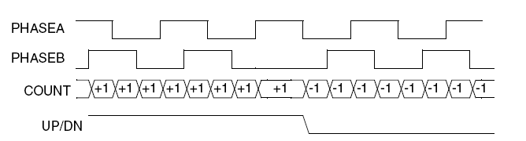
Quadrature mode
The counter will decode the primary and secondary external inputs as quadrature encoded signals.
The quadrature signals are square waves that are 90 degrees out of phase.
they are usually generated by rotary or linear sensors used to monitor movement of motor shafts or mechanical equipment
The decoding of quadrature signal provides both count and direction information.

Slide 23
SIGNED-COUNT Mode
the counter counts the primary clock source while the selected secondary source provides the selected count direction (up/down)

Slide 24
Triggered-Count Mode
The counter will begin counting the primary clock source after a positive transition of the secondary input occurs
The counting will continue until a compare event occurs or another positive input transition is detected
Subsequent secondary positive input transitions will continue to restart and stop the counting until a compare event occurs

Slide 25
eTimer: One-Shot Mode
An external events causes the counter to count, when terminal count is reached, the output is asserted
This “delayed” output can be used to provide timing delays

Slide 26
CASCADE-COUNT Mode
the counter’s input is connected to the output of another selected counter
This “Cascade” or “Daisy-Chained” mode enables multiple counters to be cascaded to yield longer counter lengths

Slide 27
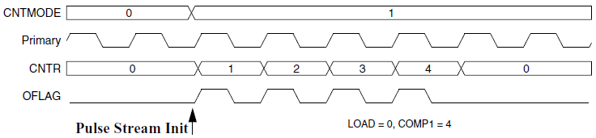
eTimer: Pulse-Out Mode
The counter will output a pulse stream of pulses that has the same frequency of the selected clock source, and the number of output pulses is equal to the compare value minus the init value
This mode is useful for driving step motor systems

Slide 28
FIXED-FREQUENCY PWM Mode
the counter output yields a Pulse Width Modulated (PWM) signal with
a frequency equal to the count clock frequency divided by 65,536
a pulse width duty cycle equal to the compare value divided by 65,536.
This mode of operation is often used to drive PWM amplifiers used to power motors and inverters.

Slide 29
Variable-Frequency PWM Mode
Pulse Width Modulated (PWM) signal whose frequency and pulse width is determined by the values programmed into the COMP1 and COMP2 registers, and the input clock frequency.
This method of PWM generation has the advantage of allowing almost any desired PWM frequency and/or constant on or off periods.
The CMPLD1 and CMPLD2 registers allows the programmer time to calculate values for the next PWM cycle while the PWM current cycle is underway.

Slide 30
BACKUP

Slide 31
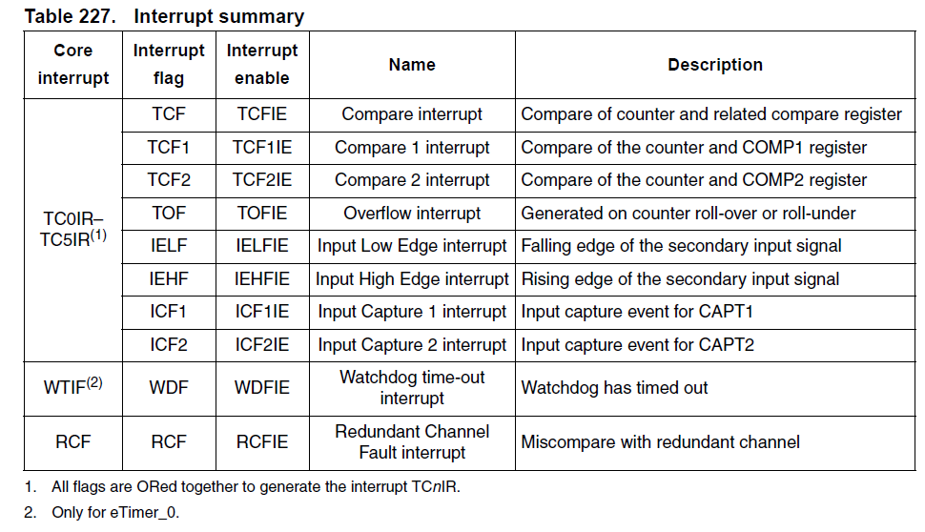
Interrupts

Slide 32
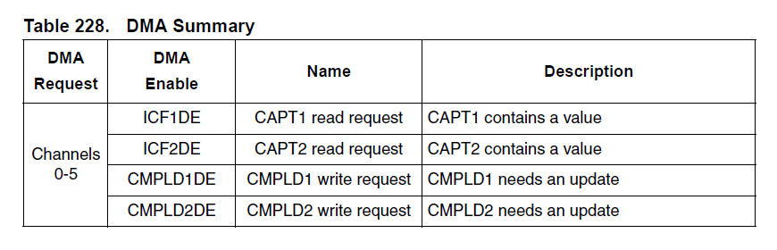
DMA
Notes:
Setting this bit enables DMA write requests to the CMPLD1 register whenever data is transferred out of the CMPLD1 reg into either the CNTR, COMP1, or COMP2 registers.

Slide 33
Watchdog
to monitor for a stalled count when channel 0 is in quadrature count mode.
When the watchdog is enabled, it loads the time-out value into a down counter.
The down counter counts as long as channel 0 is in quadrature decode count mode.
If this down counter reaches zero, an interrupt is asserted.
The down counter is reloaded to the time-out value each time the counter value from channel 0 changes
Notes:
Watchdog Timer
The watchdog timer is used to monitor for a stalled count when channel 0 is in quadrature count mode. When the watchdog is enabled, it loads the time-out value into a down counter.
The down counter counts as long as channel 0 is in quadrature decode count mode. If this down counter reaches zero, an interrupt is asserted. The down counter is reloaded to the
time-out value each time the counter value from channel 0 changes. If the channel 0 count value is toggling between two values (indicating a possibly stalled encoder), then the down
counter is not reloaded.

