Slide 1
Flexray

Slide 2
Agenda
FlexRay Overview
  Introduction
  FSL FlexRay Products
  FlexRay Protocol
  User Tasks to Build a FlexRay Cluster
  FSL FlexRay Hardware
FSL FlexRay Software
  Unified Driver & AutoSAR
General Information and Q&A
Notes:
The purpose of this training is to
-give an overview of FlexRay (inc protocol basics)
-highlight collateral available from FSL to help with FlexRay development (HW / SW)
-demonstrate this collateral (DEMO)
The FAE should be able to understand the basics and get a FlexRay network up-and-running in no time to support customers!

Slide 3

FlexRay Overview
Introduction
Notes:
-Consider the basics

Slide 4
FlexRay Focus
FlexRay is:
  a communication system comprising the specification of a communications protocol and a physical layer
  for high-speed automotive control applications
    FSL are driving non-automotive use
FlexRay is defined in the context of an industry consortium since 2000
“A common electronic architecture is the key enabler
for synergies and rapid migration of innovation.”
(Juergen E. Schrempp at the Annual Press Conference on Feb. 26, 2001)
Notes:
- Freescale is one of the founding core partners (along with BMW, DC & Phiips (now NXP))
- Consortium has >100 members in three membership shells (core, premium, development)

Slide 5
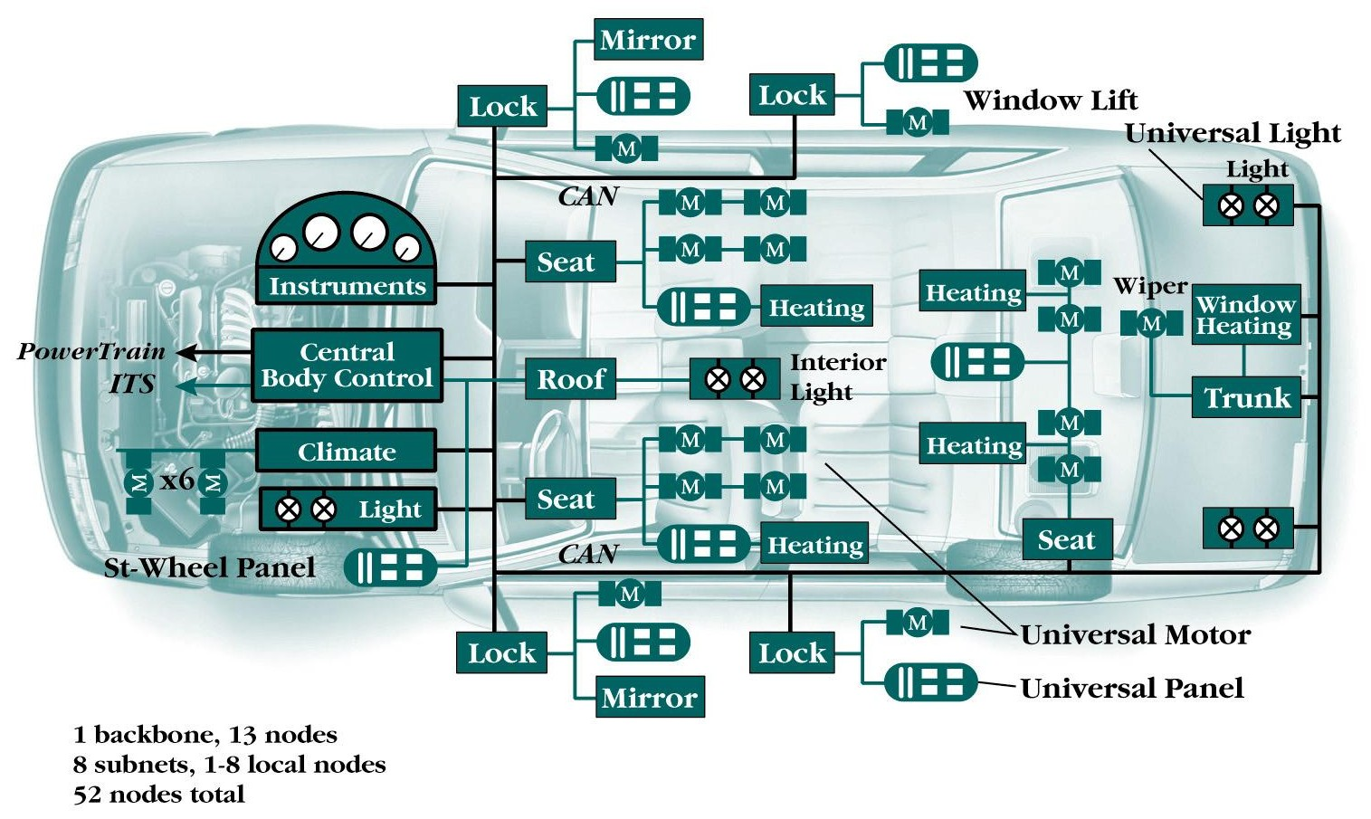
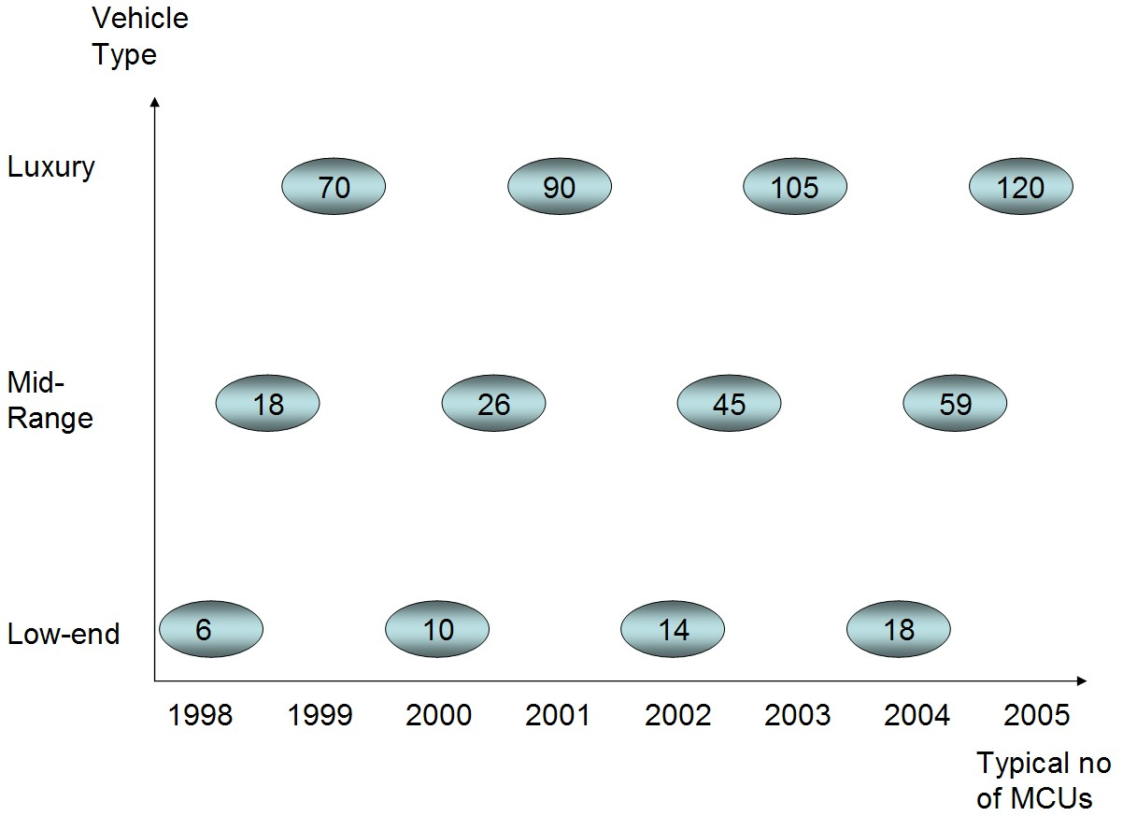
FlexRay Motivation
The typical number of microcontrollers in cars has rapidly increased
Vehicles have a lot more electronics which are related to:
  engine control (e.g. spark, fuel, knock, etc)
  comfort controls (e.g. seat and window controls)
  safety (e.g. electronic braking)
The electronic systems must safely and efficiently replace entire mechanical and hydraulic applications.
Notes:
Highlight chart

Slide 6
Vehicle Networking
 | LIN | CAN | FlexRay
Distributed timebase | No | No | Yes
Speed | 20Kbit/s | 1 Mbit/sec | 10 Mbits/sec
Channels | Single | Single | Dual
Time Triggered | No | No (additional function) | Yes
Arbitration | None (master/slave) | CSMA | TDMA
FlexRay Backbone
Gateway 1
(Powertrain)
Gateway 2
(Telematics)
Gateway 3
(Body/Comfort)
Gateway 4
(Chassis)
FlexRay / CAN
Engine
MOST
Video System
LIN / CAN
Door Locks
FlexRay
Steer-by-Wire
Transmission
Mobile Phone
Climate
Brake-by-Wire
Radio
Seatbelts
Safety
Transumer …
Sunroof
Notes:
TDMA –data is tx/rx at precise times.
FlexRay is fault tolerant, high speed and predictable.
FlexRay / CAN –not muxed. One or the other.
FlexRay application domains could be Powertrain, by-wire systems, driver assistance, high speed communication, backbone, chassis, etc

Slide 7
FlexRay Overview
FlexRay Protocol
Notes:
-Consider the basics of the FlexRay protocol

Slide 8
Node Architecture
with standalone CC
with integrated CC
Host
Host
Communication
Controller
Communication
Controller
Bus
Driver
Bus
Driver
Bus
Driver
Bus
Driver
Notes:
Communicates to host via EBI.

Slide 9
Functional Blocks
Controller Host Interface
Protocol
Overall Control
Media Access
Control
Clock Sync
Frame/Symbol
Processing
Coding
Decoding
channel
Notes:
These functional blocks will be discussed in the next slides.

Slide 10

Media Access Control
Communication Cycle
Flexible Time Division
Multiple Access
Time Division Multiple Access
NIT
1
2
3
4
5
6
7
8
9
11
Channel B
10
0
3a
1a
3c
4a
1c
5a
4b
3d
5b
t
1
2
3
4
5
6
7
9
14
8
10
Channel A
3b
1b
2a
3c
1c
5a
3e
1d
2b
t
Example FlexRay communication cycle
  Each node can send/receive messages only in a predefined slot
  Requires at least 2 static slots
  Dynamic slots are optional
* 3a = Node 3 message a, 3b = Node 3 message b
Notes:
-Static and dynamic segments (critical & less critical data)
-Everything is configurable (communication cycle size, no of slots, size of slots, etc)
-Critical data can be send on both channels (identical data) –eg 3c
-bandwidth is 10Mbps on both channels (20Mbps total if safety aspect not used)
-NIT = Network Idle Time

Slide 11
Media Access Control
t
communication
cycle level
static segment
dynamic segment*
symbol window*
network idle time
static slot
minislot
arbitration
grid level
1
2
3
...
n
...
slot number
action point
macrotick
level (MT)
..
..
..
..
..
..
..
..
microtick
level (uT)
...
* = optional
Static slot min length= 4MT
Microtick = Oscillator Frequency (1 / 40MHz = 25ns)
Notes:
-Number of static slots and minislots are configurable
-number of uTs in a MT is also configurable
-FlexRay protocol requires a 40MHz clock source

Slide 12
Media Access – Static Segment
Communication Cycle
Static Segment
Dynamic Segment
NIT
1
2
3
4
5
6
7
9
14
8
10
Channel A
3b
1b
2a
3c
1c
5a
3e
1d
2b
t
MT
actionpoint
idle
idle
transmission start sequence
frame
channel idle delimiter
Notes:
-Each slot has a number of MTs (configurable)
-Data is always sent/received at these precise slot times
-We’ll look at the FlexRay frame in the following slides

Slide 13
Media Access – Dynamic Segment
Communication Cycle
Static Segment
Dynamic Segment
NIT
1
2
3
4
5
6
7
9
14
8
10
Channel A
3b
1b
2a
3c
1c
5a
3e
1d
2b
t
minislots
dyn. slots
8
9
10
11
12
13
14
15
16
17
18
channel
ID 9
ID 10
ID 14
Notes:
-Dynamic segment is optional
-for less critical data
-priority scheme ID9 is higher than ID10.
-if ID9 has no data to transmit, ID10 can transmit earlier
-maximum size of frame can be set in configuration
-No of minislots are configurable
-each minislot is owned by exactly one node per channel and cycle (or none)
-if transmission does not start in a minislot all node increase their slot counter
-if many nodes transmit the slot counter reaches a smaller number at cycle end
-it may happen that not all node are able to transmit their frames

Slide 14
Frame Format
Payload preamble indicator
Startup frame indicator
Sync frame indicator
Null frame indicator
Reserved bit
Header CRC
Covered Area
Frame ID
Payload
length
Header
CRC
Cycle
count
Data 0
Data 1
Data 2
Data n
CRC
CRC
CRC
11 bits
7 bits
11 bits
6 bits
0 ... 254 Bytes
24 bits
11111
Header Segment
Payload Segment
Trailer Segment
FlexRay Frame 5 + (0 ... 254) + 3 Bytes
Notes:
-Frame ID used for filtering & you can specify which frames are used for clock synchronization.
-PPI is used for network management software
-Null frame indicates that the data is not valid (not updated in buffer for example)
-Sync frame indicator –used to synchronize the FR network
-Startup frame indicator –used to start up a FR network
-Cycle count –contains the number of the CC in which the frame stored in this message buffer was received (Rx only)
-Payload –up to 254bytes (compared to 16bytes in CAN)
-CRC covers whole frame. Does not correct errors, only flags errors.

Slide 15
Clock Synchronization
FlexRay is a time triggered system -Media Access is controlled by time
  No collision avoidance mechanism in case of collisions
  Prevention of collisions only
Clocks do not have exactly the same frequency (tolerances)
Clock frequencies change over time because of temperature, aging, vibrations, etc
The same understanding of time in all nodes is the base for the communication
Clock synchronization is essential with FlexRay!!
The Protocol uses Rate and Offset correction calculations

Slide 16
Protocol Operation Control State Machine
Default
Config
transition by
host command
transition depends
on conditions
transition depends
on conditions or
host command
defined in the
configuration
Config
Ready
Halt
transition depends
on internal
conditions
Wakeup
Startup
Normal
Active
Normal
Passive
Notes:
-Host configures the FlexRay Node
-each node knows the FlexRay network configuration
-the host configures the CHI, protocol configuration, message buffers, etc
-enters the ready state on completion
-Wake up –the CC transmits a series of Wakeup signals, called a Wakeup Symbol, to wake up FlexRay nodes
-Startup –the CC starts a network synchronization process or attempts to enter a running cluster
-Node can only transmit and receive in Normal Active mode
-Normal passive state –a problem has encountered and the node goes into a listen state (can re-synchronize back into the network)
-The node can move from any state into the halt state (must be reconfigured)
-Can a node put another to sleep?

Slide 17
Coding / Decoding
Frame Coding
Frame Start
Sequence
1 ... 18 bit
11 bit
1
0
Header Seg.
Payload Seg.
Trailer Seg.
0
1
Transmission
Start Sequence
Byte Start
Sequence
Frame End
Sequence
Idle
Delimiter
TSS is configured in the config state
1 bit = 25ns (40MHz PE clock)
Disadvantage:
  25% overhead + header/trailer = lower than 80% efficiency
  Required for effective communication

Slide 18
Coding / Decoding –Bit Resynchronization
byte resynchronization edge
Byte Coding
Byte Start
Sequence
Data
Byte Start
Sequence
Data
8 bit
8 bit
2 bit
2 bit
NRZ coding (8 data bits + start and stop bit)

Slide 19
Topology –Cascaded Stars & Bus
Node 4
Node 3
Star coupler A2
Node 1
Node 8
Node 5
Node 2
Node 9
Node 6
Star coupler A1
Node 7
Notes:
-The star coupler is like a booster for long distances
-NXP PL supports this
-Bus –maximum of 22 stubs
-Star –maximum of 16 branches
-Example –front/back of car

Slide 20
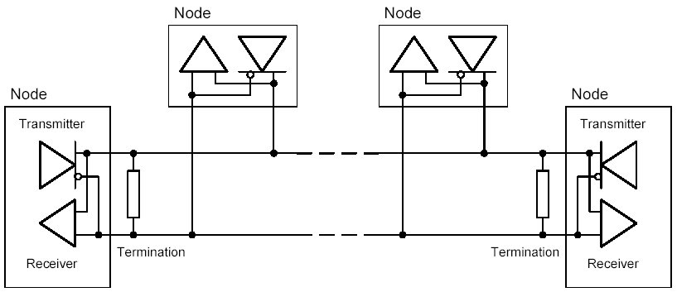
Bus Driver / Physical Layer
Physical Layer Characteristics
  shielded and unshielded cables can be used
  maximum distance between nodes 24m
  difference voltage data 1: 150 - 300 mV
  difference voltage data 0: -150 -300 mV
Bus Driver Characteristics
  wake-up detector
  supply voltage monitoring
  over temperature protection
Notes:
-Termination resistor –small value
-Differential voltage –common mode voltage –helps with GND bouncing

Slide 21
FlexRay Overview
User Tasks to Build a FlexRay Cluster
Notes:
-Consideration to what H/W to use

Slide 22
User Tasks to Build a FlexRay Cluster
Step 1: Application Data
The following information can be answered by the applications:
  number of nodes
  minimum cycle time
  information to transmit per node / communication matrix
  special requirements, for example degree of reliability and safety
With this information the following decisions can be made:
  network topology (star versus bus)
  cycle length
  number of static and dynamic slots

Slide 23
User Tasks to Build a FlexRay Cluster
Step 2: Define Frame Size
Based on the communication matrix:
  define which information should be transmitted in the static segment and which in the dynamic segment
Decision on static frame length, cycle time and number of static frames
  find the optimum
    longer cycle time → more static frames can be send
    longer frames → less overhead, higher bandwidth
Decision on dynamic frame length and its update rate
Define number of dynamic frames per node and cycle
Try to distribute the frames equally over the cycles

Slide 24
User Tasks to Build a FlexRay Cluster
Step 3: Configure FlexRay Node
Based on the decisions made before:
  define Flexray communication schedule
Define FlexRay Configuration
  cycle time, required precision
  macrotick length
  static slot length, action point offset
  set NIT length
Decision on dynamic frame length and its update rate
  minislot size, minislot actionpoint offset
  maximum dynamic frame length per node → pLatestTx
  dynamic slot idle phase

Slide 25
User Tasks to Build a FlexRay Cluster
Step 4: Configure FlexRay Node
Define clock synchronization
  set synchronization nodes
  set acceptance range
Define Startup
  set coldstart nodes
  configure startup timing
Define wakeup nodes
  set wakeup nodes
  configure wakeup timing
Define error behavior
  enable/disable state transitions in case of error

