Slide 1
Leopard Clock Generation Module

Slide 2
CGM Overview
The MC_CGM includes the following features:
generates system and peripheral clocks
selects and enables the system clock supply from system clock sources
contains a set of registers to control clock dividers
supports multiple clock sources and maps their address spaces to its memory map
guarantees glitch-less clock transitions when changing the system clock selection

Slide 3
CGM Clock sources
Clock Sources
4-40 MHz External Crystal/Oscillator
16 MHz Internal RC Oscillator (safe clock)
System Clock can be driven by
16 MHz Internal RC Oscillator
Default system clock at reset output
it can NOT be disabled (safe clock)
FMPLL0
The input/reference clock can be either the IRCOSC or the XOSC
The progressive clock switching
Frequency modulation

Slide 4
Init Environment: Leopard System Clock Generation
Notes:
13-Jul-10
3

Slide 5
Init Environment: Leopard System Clock Generation
PLL clock selection sources (IRCOSC, XOSC)
System clock selection sources (IRCOSC, PLL0)
Clock Out Selector sources (IRCOSC, XOSC,PLL0, PLL1)
Motor Contr. Perip. And Sine wave gen. clock selector sources: IRCOSC, PLL0(PHI), PLL1(PHI, VCO/6)
Flexray clock selector sources: PLL0, PLL1(PHI, VCO/6)
FlexCAN clock selector sources: PLL0, PLL1

Slide 6
Init Environment: Leopard System Clock Generation
PLL clock selection sources (IRCOSC, XOSC)
System clock selection sources: IRCOSC, PLL0
Clock Out Selector sources (IRCOSC, XOSC,PLL0, PLL1)
Motor Contr. Perip. And Sine wave gen. clock selector sources: IRCOSC, PLL0(PHI), PLL1(PHI, VCO/6)
Flexray clock selector sources: PLL0, PLL1
Can clock selector sources: PLL0, PLL1(PHI, VCO/6)
5
Notes:
13-Jul-10
5

Slide 7
Init Environment: Leopard System Clock Generation
PLL clock selection sources (IRCOSC, XOSC)
System clock selection sources (IRCOSC, PLL0)
Clock Out Selector sources: IRCOSC, XOSC,PLL0, PLL1
Motor Contr. Perip. And Sine wave gen. clock selector sources: IRCOSC, PLL0, PLL1
Flexray clock selector sources: PLL0, PLL1(PHI, VCO/6)
Can clock selector sources: PLL0, PLL1(PHI, VCO/6)
6
Notes:
13-Jul-10
6

Slide 8
CGM System Clock Generation
The MC_ME provides the system clock select
The MC_RGM provides the safe clock request
The safe clock request forces the selector to select the 16 MHz internal RC oscillator as the system

Slide 9
CGM Auxiliary Clock – Motor Control

Slide 10
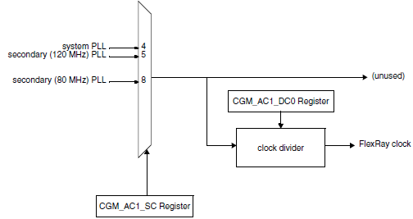
CGM Auxiliary Clock - FlexRay

Slide 11
CGM Auxiliary Clock - FlexCan

Slide 12
CGM Auxiliary Clock – PLL0 Input

Slide 13
CGM Auxiliary Clock – PLL1 Input

Slide 14
CGM
IRC 16MHz

Slide 15
CGM IRC 16MHz Digital Interface – Control Register
Trimming (+/- 1%)

Slide 16
CGM IRC 16MHz Application Control
Switching on/off controlled by Mode Entry
16MHz RC Digital Interface
Mode Entry
rc_sys_pd
Logic
RCON
ME_XXX_MC
31 5 0
S_RC
ME_GS
31 5 0
rc_sys_stat
rc_sys_pd | System RC power-down
rc_sys_stat | System RC status
XXX | Any mode like DRUN,HALT etc.

Slide 17
CGM
XOSC 4-40 MHz

Slide 18
CGM XOSC 4-40MHz Digital Interface – Control Register
Clock available interrupt flag
Configurable start-up time (EOCV<7:0> x 512)
Bit | Name | Description
0 | OSCBYP | Oscillator bypass
8-15 | EOCV | End of count value
16 | M_OSC | Oscillator available interrupt mask
24 | I_OSC | Oscillator available interrupt flag

Slide 19
CGM XOSC 4-40MHz Application Control
XOSC Switching on/off controlled by Mode Entry
XOSC Digital Interface
Mode Entry
osc_sys_pd
Logic
XOSCON
ME_XXX_MC
31 6 0
S_XOSC
ME_GS
31 6 0
osc_sys_stat
osc_sys_pd | System XTAL OSC power-down
osc_sys_stat | System XTAL OSC status
XXX | Any mode like DRUN,HALT etc.

Slide 20
CGM
Frequency modulated PLL

Slide 21
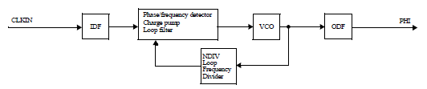
FMPLL
The purpose of the FMPLL0 is to generate a 120 MHz (max) system clock from a common 4–40 MHz input clock.
The purpose of the FMPLL1 is to generate a 120 MHz (max) clock for motor control peripherals from a common 4–40 MHz input clock.
The FMPLL support programmable frequency modulation of the system clock.
The FMPLL operating modes:
Power down
Progressive clock switching
Normal
Normal with Spread Spectrum Clock Generation
These modes are controlled by two registers:
Control Register (CR)
Modulation Register (MR)

Slide 22
CGM FMPLL Control Register (CR) 1/2
Bit | Bit name | Bit description
2-5 | IDF | The value of this field sets the PLL Input division factor.
6-7 | ODF | The value of this field sets the PLL Output division factor
9-15 | NDIV | The value of this field sets the PLL Loop division factor

Slide 23
CGM FMPLL Control Register (CR) 2/2
Bit | Bit name | Bit description
23 | en_pll_sw | This bit is used to enable progressive clock switching.
25 | unlock_once | This bit is a sticky indication of PLL loss of lock condition. Unlock_once is set when the PLL loses lock. Whenever the PLL reacquires lock, unlock_once remains set. unlock_once is cleared after a POR event.
27 | i_lock | This bit is set by hardware whenever there is a lock/unlock event. It is cleared by software, writing 1.
28 | s_lock | This bit is an indication of whether the PLL has acquired lock.
29 | pll_fail_mask | This bit is used to mask the pll_fail output.
30 | pll_fail_flag | This bit is asynchronously set by hardware whenever a loss of lock event occurs while PLL is switched on. It is cleared by software, writing 1.

Slide 24
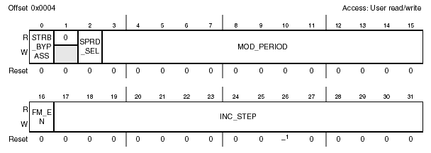
CGM FMPLL Modulation Register (MR)
Bit | Bit name | Bit description
0 | STRB_BYPASS | Bypass the STRB signal used inside PLL to latch the correct values for control bits (INC_STEP, MOD_PERIOD and SPRD_SEL).
2 | SPRD_SEL | The SPRD_SEL control the spread type in Frequency Modulation mode: centre spread or down spread.
3-15 | MOD_PERIOD | The MOD_PERIOD field is the binary equivalent of the modulation period.
16 | FM_EN | The FM_EN enables the frequency modulation
17-31 | INC_STEP | The INC_STEP field is the binary equivalent of the incremental step value

Slide 25

CGM FMPLL Normal mode
the PLL output clock (PHI) is derived by the reference clock (XOSC) through this relation:
where the value of idf, ldf and odf are set in CR

Slide 26
CGM FMPLL Progressive clock switching
PLL can be programmed to switch progressively system clock to PLL clock
This allows a gradual increase of current consumption for better voltage regulator response
PLL is configured with the new value of frequency (FPLL)
system clock is switched to PLL clock
system clock = fpll/8
system clock = fpll/4
system clock = fpll/2
system clock = fpll

Slide 27
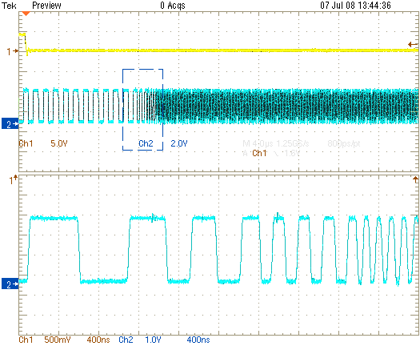
PLL - Progressive clock switching (PCS)
system clock is switched to the PLL clock
(phase 2)
phase 3
phase 4
phase 5
phase 6

Slide 28
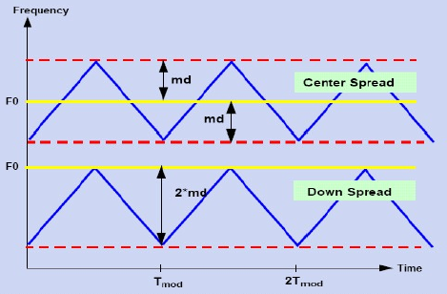
CGM FMPLL Normal mode with frequency modulation 1/2
The output clock frequency modulation can be enabled, following two steps
configure the FM modulation characteristics : MOD_PERIOD, INC_STEP.
Enable the FM modulation by programming the SSCG_EN bit of MR register to 1. FM modulated mode can be enabled only when PLL is in lock state.
Frequency modulation decreases the EMC emission

Slide 29
Recommendations
To avoid any unpredictable behavior of the PLL clock, it is recommended to respect the following guidelines:
The PLL VCO frequency should reside in the range 256–512 MHz.
Care is required when programming the multiplication and division factors to respect this requirement.
Use progressive clock switching.

Slide 30
CGM
Clock Monitor Unit (CMU)

Slide 31
CGM Clock Monitoring Unit (CMU)
The main task of the CMU is to permanently supervise the integrity of the various product’s clock sources
CMU_0 monitors the clock frequency of System Clock and XOSC
CMU_1 monitors the clock frequency of the Motor Control Clock
CMU_2 monitors the clock frequency of the Flex Ray Clock
The second task is frequency measurement.
It measures the deviation of a clock (IRCs) by measuring its frequency versus XOSC as reference clock
CMU forwards these kind of events to the following modules which can generate to a safe mode transition, a reset or an interrupt
MC_CGM
MC_ME
FCCU

Slide 32
Init Environment: Leopard System Clock Generation
Notes:
13-Jul-10
31

Slide 33
CGM CMU: Crystal clock monitor
If frequency OSC is smaller than frequency RC divided by 2^{RCDIV}
A failure event OLR is signaled to the MC_RGM and FCCU, which in turn can generate an interrupt
RCDIV is a configurable fields of the CMU_0_CSR
Only CMO_0 implements this function

Slide 34
CGM CMU: PLL clock monitor
Depending on the following conditions
If FPLL is lower than HLREF[11:0] bits in CMU_LFREFR
If FPLL is higher than HFREF[11:0] bits in CMU_HFREFR
If the PLL output is outside these threshold
a dedicated event pending bit in CMU_ISR is set.
a failure event is signaled to the MC_RGM and FCCU, which in turn can generate an interrupt and/or takes other safety action

Slide 35
CGM CMU: Frequency meter
The purpose of frequency meter is to correlate the RC oscillator output to the XOSC clock
This function can have multiple use, i.e.:
to calibrate the internal RC oscillators (CK_IRC) using the XOSC clock as reference clock
detect the crystal frequency

Slide 36
CGM CMU: Frequency meter - Detail
CK_RC frequency measure starts when SFM (Start Frequency Measure) bit in CMU_CSR is set to 1
The measurement duration is given by the CMU_MDR register in terms of IRC clock cycles with a width of 20 bits (MD)
The SFM bit is reset to 0 by the hardware once the frequency measurement is done and the count is loaded in the CMU_FDR
The frequency FRC can be derived from the value loaded in the CMU_FDR register as follows:
F_{IRC} = F_{XOSC} * MD / n
where n is the value in CMU_FDR register

Slide 37
BACKUP
BACKUP

Slide 38
CGM CMU: Control register
The CMU registers are mapped through the MC_CGM. The base address for each CMU is shown following:
Module | Base address
CMU_0 | 0xC3FE_0100
CMU_1 | 0xC3FE_0120
CMU_2 | 0xC3FE_0140
The memory map of each CMU is shown following:
Address offset | Register name and purpose
0x00 | Control Status Register (CMU_CSR)
0x04 | Frequency Display Register (CMU_FDISP)
0x08 | High Frequency Reference Register (CMU_HFREFR_A)
0x0C | Low Frequency Reference Register (CMU_LFREFR_A)
0x10 | Interrupt Status Register (CMU_ISR)
0x18 | Measurement Duration Register (CMU_MDR)

Slide 39
CGM CMU: Control status register (CMU_CSR)
Bit | Name | Description
8 | SFM | Start frequency measure The software can only set this bit to start a clock frequency measure. It is reset by hardware when the measure is ready in the CMU_FDR register. 0: Frequency measurement is completed or not yet started. 1: Frequency measurement is not completed.
22-23 | CKSEL1 | Clock selection CKSEL1 selects the clock to be measured by the frequency meter. 00: CK_IRCfast is selected. 01: CK_IRCslow is selected. 10: CK_32K crystal Oscillator clock is selected. 11: CK_IRCfast is selected
29-30 | RCDIV[1:0] | RC clock division factor These bits specify the RC clock division factor. The output clock is CK_IRCfast divided by the factor 2^{RCDIV}. This output clock is used to compare with CK_XOSC for crystal clock monitor feature. The clock division coding is as follows. 00: Clock divided by 1 (No division) 01: Clock divided by 2 10: Clock divided by 4 11: Clock divided by 8
31 | CME_A | Clock monitor enable 0: Monitor is disabled. 1: Monitor is enabled.

Slide 40
CGM CMU: Frequency display register (CMU_FDISP)
Bit | Name | Description
12-31 | FD | Measured frequency bits This register displays the measured frequency F_{RC} with respect to F_{OSC}. The measured value is given by the following formula F_{RC} = (F_{OSC} * MD) / n, Where n is the value in CMU_0_FDR register

Slide 41
CGM CMU: High frequency reference register A (CMU_HFREFR_A)
Bit | Name | Description
20-31 | HFREF_A | High Frequency reference value These bits determine the high reference value for the PLL clock. The reference value is given by (HFREF_A/16) * (F_{RC}/4).

Slide 42
CGM CMU: Low frequency reference register A (CMU_LFREFR_A)
Bit | Name | Description
20-31 | LFREF_A | Low Frequency reference value These bits determine the low reference value for the PLL clock. The reference value is given by (LFREF_A/16) * (F_{RC}/4).

Slide 43
CGM CMU: Interrupt status register (CMU_ISR) 1/2
Bit | Name | Description
28 | FLCI_A | PLL Clock frequency less than reference clock interrupt This bit is set by hardware when both of the following are true: PLL frequency becomes lower than reference clock frequency (FRC/4) value CK_FMPLL is ‘ON’ and the PLL locked as signaled by the MC_ME. It can be cleared by software by writing ‘1’. 0: No FLC event. 1: FLC event is pending.
29 | FHHI_A | FMPLL_0 Clock frequency higher than high reference interrupt This bit is set by hardware when both of the following are true: PLL frequency becomes higher than HFREF_A value CK_FMPLL is ‘ON’ and the PLL locked as signaled by the MC_ME. It can be cleared by software by writing ‘1’. 0: No FHH event. 1: FHH event is pending.

Slide 44
CGM CMU: Interrupt status register (CMU_ISR) 2/2
Bit | Name | Description
30 | FLLI_A | FMPLL_0 Clock frequency less than low reference event This bit is set by hardware when both of the following are true: PLL frequency becomes lower than LFREF_A value CK_FMPLL is ‘ON’ and the PLL locked as signaled by the MC_ME. It can be cleared by software by writing ‘1’. 0: No FLL event. 1: FLL event is pending.
31 | OLRI | Oscillator frequency less than RC frequency event This bit is set by hardware when both of the following are true: frequency of CK_XOSC is less than CK_IRCfast/2^{RCDIV} frequency CK_XOSC is ‘ON’ and stable as signaled by the MC_ME. It can be cleared by software by writing ‘1’. 0: No OLR event. 1: OLR event is pending.

