Slide 1
Reset Generation Module (RGM)
Version 1.0

Slide 2
Reset Generation Module
There are two classes of reset handled by the RGM
  Destructive resets completely restart the MCU after a critical event
  Functional resets restart digital modules but preserve analog, flash and debugging module settings
The RGM contains various registers that reflect the status of the MCU and allow users to configure the reset behaviour
Optional some sources can generate either a SAFE mode request or interrupt instead of a reset
RGM drives the reset pin on a reset event
  the reset pin is a bidirection pins

Slide 3
Four phases of reset
Enter Phase 0 when:
Power-on/destructive reset
Exit Phase 0 when:
Power-up has completed
16MHz IRC is running and stable
All enabled destructive resets processed
Min 3 IRC cycles
VREG voltage OK
Phase 0
Phase 1
Exit Phase 1 when:
All enabled phase 1 resets processed
Min 350 IRC cycles
Enter Phase 1 when:
External/non-shortened functional reset
Phase 2
Exit Phase 2 when:
Flash intialized
Min 8 IRC cycles
Phase 3
Enter Phase 3 when:
Shortened functional reset
Exit Phase 3 when:
Resets handled
Min 40 IRC cycles
trimming, self-test configuration, and FCCU initialization done

Slide 4
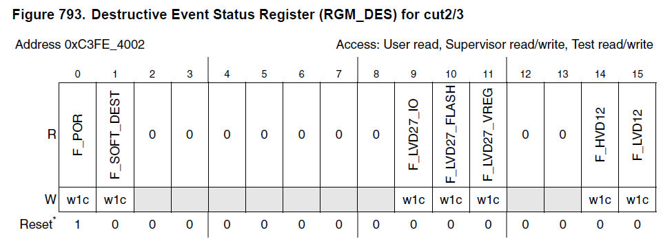
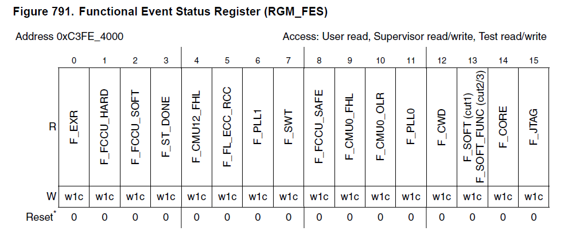
Type of reset
Destructive
  Device re-starts from phase 0
Functional
  Device re-starts from phase 1 or 3
    Depending on the RGM configuration

Slide 5
Reset functionality
Destructive resets
  Power-on reset
  1.2V low-voltage detected
  1.2V high-voltage detected
  2.7V low-voltage detected (VREG, FLASH, I/O)
  Comparator error
Functional resets
  External reset#
  JTAG initiated reset#
  Core reset#
  Software reset
  Core watchdog reset*#
  PLL0 fail*#
  Oscillator frequency too low*#
  system clock freq. too high/low*#
  FCCU SAFE mode*
  Software watchdog timer
  PLL1 fail*#
  Flash, ECC, lock-step error
  CMU1/2 clock frequency too high/low*#
  Self test completed
  FCCU soft reaction request#
  FCCU hard reaction request
* Can optionally create an interrupt request or a safe mode request
# Can optionally choose a short reset sequence

