Slide 1
System Integration Unit (SIU)
Version 1.0

Slide 2
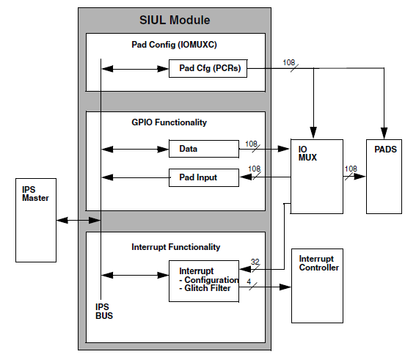
SIU features: Introduction
MCU configuration at reset
  Pad configuration
External Interrupts/DMA configuration
  4 system interrupt vectors for 32 interrupt sources
  32 programmable digital glitch filters
  Independent interrupt mask
  Edge detection
General Purpose I/O Management
  GPIO function on 108 I/O pins
  Dedicated input and output registers for each GPIO pin

Slide 3
Pad configuration
Pad Control is managed through PCR registers
IOMux configuration is managed through:
  PCR Registers (output functionalities)
  PSMI Registers (input functionalities)

Slide 4
SIUL Pad Control and IOMux config
Pad Control Register (PCR) – General
It allows configuration of the static electrical and functional characteristics associated with I/O pads
One PCR Register per PAD
Depending on the usage of each pad on the device, we may have:
  PAD with GPIO and digital alternate function;
  PAD with Slew Rate Control;
  PAD with GPIO and analog functionality;
  PAD dedicated to Precise ADC Channels.
This impact the availability of certains bits in the PCR registers, as described in the following

Slide 5
SIUL Pad Control and IOMux config
Pad Configuration Register (PCR) – Bitfields description
 | 0 | 1 | 2 | 3 | 4 | 5 | 6 | 7 | 8 | 9 | 10 | 11 | 12 | 13 | 14 | 15
R |  | SMC | APC |  | PA |  | OBE | IBE |  |  | ODE |  |  | SRC | WPE | WPS
W
Reset | 0 | 0 | 0 | 0 | 0 |  | 0 | 1 | 0 | 0 | 0 | 0 | 0 | 0 | 0 | 0
SMC (Safe Mode Control): Override automatic deactivation of the output buffer upon entering SAFE mode of the SoC.
APC (Analog Pad Control): Enables the usage of the pad as analog input.
PA (Pad Output Assignment): Select the function that is allowed to drive the output of a multiplexed pad.
OBE (Output Buffer Enable): Enables the output buffer of the pad when in GPIO mode.
IBE (Input Buffer Enable): Enables the input buffer of the pad.
ODE (Open Drain Output Enable): Selects either open drain or push/pull driver configurations for the pad. This feature applies to output pads only.
SRC (Slew Rate Control): Controls the slew rate of the output signals
WPE (Weak Pull Up/Down Enable): Enables/Disables the weak pull up/down on the pad.
WPS (Weak Pull Up/Down Select): Selects weak pull up/down if enabled.

Slide 6
SIUL Pad Control and IOMux config
PSMI Registers – Choosing the input pad
Different pads can be chosen as possible inputs for a certain peripheral function.
Each PADSEL selects the pad currently used for a certain input function.

Slide 7
SIUL GPIO Functionality
SIUL
PAD Control
PCR Regs
PSMI Regs
GPIO functionality
Data
IOMux &
PADs
Pad Inputs
Ext. Interrupt Mgmt
Interrupt Controller
Interrupt config
Glitch filter

Slide 8
SIUL GPIO Functionality
Features (1/2)
SIUL manages GPIO pads both:
  On individual base (R/W access to a single GPIO);
    Access is done on a byte basis
  On port base (parallel access).
Ports accesses can be:
  Data Read: 32-bit, 16-bit or 8-bit accesses
  Data Write: 32-bit,16-bit or 8-bit accesses
    This mechanism allows support for port accesses or for bit manipulation without the need to use read-modify-write operations

Slide 9
SIUL GPIO Functionality
Features (2/2)
All the pads have separate data inputs and data output registers:
  The data output registers support both read and write operations to be performed.
  The data input registers support read access only.
When the pad is configured to use one of its alternate functions:
  the data input value reflects the respective value of the pad (Input value to the associated IP from “outside world”).
  If a write operation is performed to the data output register, it will not be reflected by the pad value until reconfigured to GPIO.

Slide 10
SIUL GPIO Functionality
Register Description: Access to the single GPIO
Read/write access to a single GPIO can be done on a byte basis by using:
  GPDOn_n+3 register (write access)
    Each bit stores the data to be driven out on the external GPIO pad controlled by this register.
  GPDIn_n+3 register (read access)
    Each stores the value of the external GPIO pad associated with this register

Slide 11
SIUL GPIO Functionality
Register Description: Access to ports
Access to ports is done by using:
  Parallel GPIO Pad Data Out Registers PGPDOn
  Parallel GPIO Pad Data Input Registers PGPDIn
  Access to these register locations are coherent with accesses to the bit-wise GPIO Pad Data Input and Output Registers (GPDI/GPDO Regs)
The x and bit index define which PPDO register bit is equivalent to which PDO register bit according to the following equation:
  PPDO[x][y] = PDO[(x*16)+y], where x= the # of port and y = # GPIO inside the port x
  E.g.: x=3, y = 5 (-> pin 5 of port 3) => PPDO[3,5] = PDO(3*16+5) = PDO(53)
Notes:
HP presentation template tutorial - Rev. 1
Ports are numbered from 0!

Slide 12
SIUL GPIO Functionality
Register Description: Masked access to ports
This mechanism allow port accesses or for bit manipulation without the need to use read-modify-write operations
Mask Field.
  Each bit corresponds to one data bit in the MPPDO[x] register at the same bit location.
Masked Parallel Pad Data Out.
  The x and bit index define which MPPDO register bit is equivalent to which PDO register bit according to the follwing equation:
  MPPDO[x][y] = PDO[(x*16)+y]
The MPGPDO[x] register may only be accessed with 32 bit writes. 8-bit or 16-bit writes will not modify any bits in the register and cause a transfer error response by the module. Read accesses will return 0.
Notes:
HP presentation template tutorial - Rev. 1
Mask field = 1 -> The associated bit value in the MPPDO[x] field is written
Mask field = 0 -> The associated bit value in the MPPDO[x] field is ignored

Slide 13
SIUL External Interrupt Management
SIUL
PAD Control
PCR Regs
PSMI Regs
GPIO functionality
Data
IOMux &
PADs
Pad Inputs
Ext. Interrupt Mgmt
Interrupt Controller
Interrupt config
Glitch filter

Slide 14
SIUL External Interrupt Management
External IRQ Management: Feature set
SIUL supports 4 interrupt vectors to the interrupt controller.
The SIUL supports 32 external interrupts, EIRQ0-EIRQ31.
Up to 8 external interrupt sources can be grouped on a single interrupt line.
  All of the external interrupt pads within a single group have equal priority.
Each external interrupt line:
  Can be enabled or disabled independently.
  Independent interrupt mask
  Edge detection (rising, falling, both)
  Each external interrupt supports an individual flag (clear-by-write-1)
  Have a digital glitch filter applied to it.
    The glitch filters need a running internal oscillator clock to work. If such clock is not available, external interrupts will be effectively disabled when the glitch filter is enabled

Slide 15
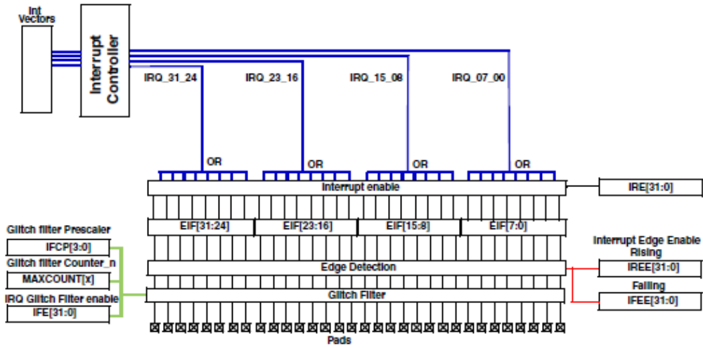
SIUL External Interrupt Management
External IRQ Management: Block Scheme
External Interrupt Pad diagram
Notes:
HP presentation template tutorial - Rev. 1
Each of the “Light Blue” registers have each single bit associated to a single external interrupt line.
Setting a bit to “1” the feature is enabled, “0” means feature disabled.

Slide 16
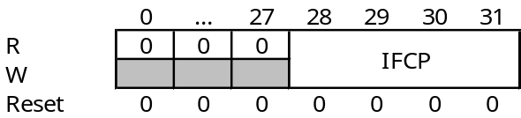
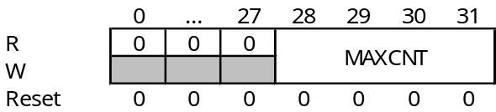
SIUL External Interrupt Management
SIUL Registers and Digital filters settings
Digital filters can be configured by setting the following registers:
  Interrupt filter clok prescaler register (IFCP reg).
    Prescaled Filter Clock Period = T_{IRC} x (IFCP + 1) = T_{CK}
  Interrupt filters maximum counter registers (IFMCn regs);
  MAXCNT = Maximum Interrupt Filter Counter setting

Slide 17
SIUL MCU Identification Registers (MIDR)
SIUL includes two registers that can be read by users and tools manufactures to determine what device is present (which part number, pkg, flash size etc.) and to take the corresponding actions. These registers are called:
  MIDR1
  MIDR2
Bit
0
1
2
3
4
5
6
7
8
9
10
11
12
13
14
15
16
17
18
19
20
21
22
23
24
25
26
27
28
29
30
31
R
S/F
Flash_Size_1
Flash_Size_2
0
0
0
0
0
0
0
Part_No
0
0
0
0
0
0
0
FR
W
Notes:
HP presentation template tutorial - Rev. 1

