Slide 1
Deserial Serial Peripheral Interface
Version 1.0

Slide 2
Features
Master and slave modes supported
Programmable master bit rates
Programmable clock polarity and phase
End-of-transmission interrupt flag
Programmable transfer baud rate
Programmable data frames from 4 to 16 bits
  using continuous chip select feature is possible to transmit more 16bits
As many as 8 chip select lines available, depending on package and pin multiplexing
Queueing operation possible through use of the I/O processor or eDMA
  5 depth RX and TX FIFOs

Slide 3
DSPI Configurations
Serial Peripheral Interface (SPI) Configuration
  Operation as basic SPI or Queued SPI using internal FIFOs
  Programmable transfer attributes on a per frame basis
    Serial clock: baud rate, polarity and phase
    Frame size: 4 to 16 bits
    Various programmable delays
    Chip Select: Up to 8, and continuous hold capability

Slide 4
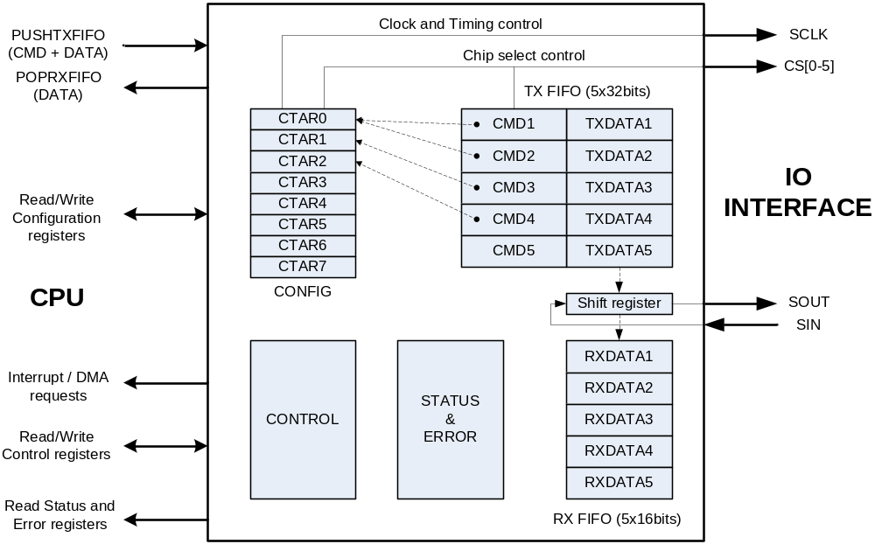
SPI
Block diagram

Slide 5
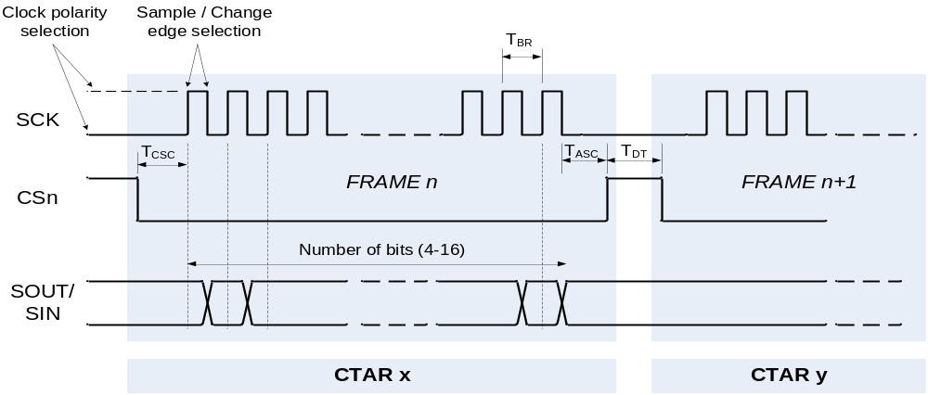
SPI
Transfer attribute configuration – CTAR[0-7]
8 configuration registers per SPI module and Master mode
Slave mode only uses CTAR0 as frame configuration
Each CTAR controls
  Frame size
  Baud rate and transfer delay values
  Clock phase
  Clock polarity
  MSB or LSB first bit selection

Slide 6
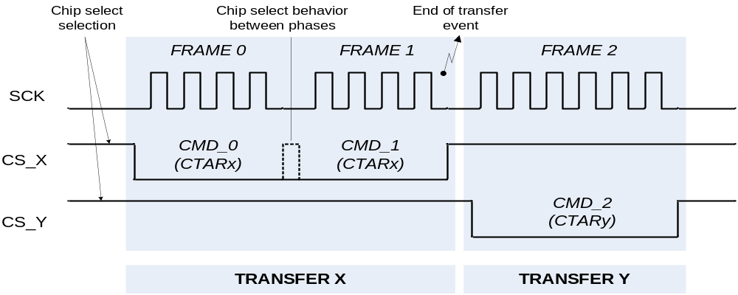
SPI
Data transfers – DSPIx_PUSHR, DSPIx_POPR
Each item written to PUSHR register contains data + command
Each item read from POPR only contain data part
Command controls
  Selection of frame attribute configuration word
  Chip select assignment for given frame
  Continuous mode of the chip select
  End of queue event generation
  Clearing of the transfer count

Slide 7
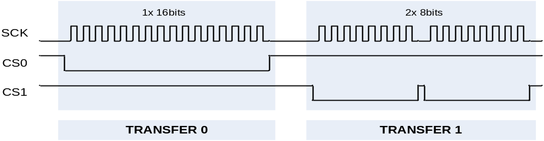
SPI
Transfer example
Requirement is to generate two SPI transfers using one SPI peripheral
  Both frames have the same speed and timings
  Different chip selects and number of bits
Transfer 0 (1x 16bits, CS0)
Transfer 1 (2x 8bits, CS1)
1
2
3
CTAR Configuration
2 CTAR registers needed
CTAR0 (bits=16,Timing=X)
CTAR1 (bits=8,Timing=X)
Command Configuration
3 commands needed
CMD0 (CS=0,CTAR=0)
CMD1 (CS=1,CTAR=1)
CMD2 (CS=1,CTAR=1)
TXFIFO PUSH
3 writes to fifo
TXPUSH0 (CMD=0,Data=f00)
TXPUSH1 (CMD=1,Data=f10)
TXPUSH2 (CMD=2,Data=f11)

Slide 8
Mode Selection
Selection of Master or Slave Mode is made in the DSPI_MCR[MSTR] bitfield
  0: Slave (default)
  1: Master
Note: PCSx to SS signal must be configured active low for slave mode operation.
DSPI Master
DSPI Slave
SIN
SOUT
Shift Register
SOUT
SIN
Shift Register
SCK
SCK
Baud Rate
Generator
PCSx
SS

Slide 9
DSPI
Modes of operation
Master mode
  The serial communication clock SCK is controlled by the peripheral
  Transfer mode attributes are controlled by the SPI command in the current TX FIFO entry using one of the preconfigured CTAR registers
  Transfer attributes control is on a frame by frame basis
Slave mode
  DSPI peripheral responds to transfers initiated by another master
  The slave is selected having CS0 asserted
  Clock polarity, clock phase and number of bits is configured by CTAR0
Module disable mode
  Clock to non-memory mapped logic is stopped
Debug mode
  DSPI stops all serial transfers and enters a stopped state
  Has to be enabled by FRZ bit in control register otherwise DSPI is unaffected by debug request

Slide 10
DSPI SPI: SPI Master Mode Operation
Use CPU or DMA to fill FIFO
Clock & Transfer Attribute Reg. Fields Baud Rate Frame size Clock polarity Clock phase LSB/MSB first Various timing delays (details later) | CTAR0
 | CTAR1
 | CTAR2
 | CTAR3
 | CTAR4
 | CTAR5
 | CTAR6
 | CTAR7
Push Reg. Transmit FIFO | Command | Data
 | Command | Data
 | Command | Data
 | Command | Data
TFFF
Tx FIFO
Fill Flag
Shift Reg. | Data
SOUT
SIN
DSPI
Rx FIFO
Drain Flag
Receive FIFO Pop Reg. | Data
 | Data
 | Data
 | Data
SPI Command Attributes for Frame
Specify a CTAR
PCS0 – PCS7
End of Queue
etc. (details later)
RFDF
DSPI Logic
SCK
PCS0:5
Use CPU or DMA to empty FIFO

Slide 11
SPI Slave Mode Operation
Slave Mode differences from Master Mode are circled.
Use CPU or DMA to fill FIFO
Clock & Transfer Attribute Reg. Fields Baud Rate Frame size Clock polarity Clock phase LSB/MSB first Various timing delays (details later) | CTAR0
 | CTAR1 | Not Used
 | CTAR2 | Not Used
 | CTAR3 | Not Used
 | CTAR4 | Not Used
 | CTAR5 | Not Used
 | CTAR6 | Not Used
 | CTAR7 | Not Used
Push Reg. Transmit FIFO | Not used | Data
 | Not used | Data
 | Not used | Data
 | Not used | Data
TFFF
Tx FIFO
Fill Flag
Shift Reg. | Data
SOUT
SIN
DSPI
SPI Command Attributes for Frame
Specify a CTAR
PCS0 – PCS5
End of Queue
etc. (details later)
Receive FIFO Pop Reg. | Data
 | Data
 | Data
 | Data
Rx FIFO
Drain Flag
RFDF
DSPI Logic
SCK
SS
Use CPU or DMA to empty FIFO

Slide 12
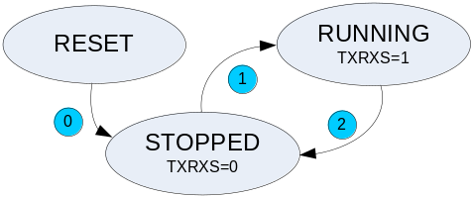
SPI
Operating States
STOPPED
  No serial transfers are initiated in master mode or responded in slave mode
  Safe state for writing various configuration registers of the DSPI without causing undetermined results
RUNNING
  Serial transfers take place
TXRXS bit in status register reflects current mode
Transition | Current state | Next state | Description
0 | RESET | STOPPED | Generic power-on-reset transition
1 | STOPPED | RUNNING | The DSPI starts when all of the following conditions are true EOQF bit is clear Debug mode is unselected or the FRZ bit is clear HALT bit is clear
2 | RUNNING | STOPPED | The DSPI stops after the current frame for any one of the following conditions EOQF bit is set Debug mode is selected and the FRZ bit is set HALT bit is set

Slide 13
SPI
Module Control – DPSIx_MCR
MSTR | master/slave selection
MDIS | disables/enables SPI module
PCSSE[0-6] | selects inactive state value of chip selects
DIS_TXF DIS_RXF | switch between simple double buffered mode and FIFO mode for TX and RX side respectively
FRZ | controls behavior of SPI module in debug mode
CONT_SCKE | turn on continuous SCK mode
CLR_TXF CLR_RXF | flushes TXFIFO, RXFIFO respectively
MTFE | turn on modified timing transfer format
SMPL_PT | selects delay of SIN sample in modified transfer mode
HALT | stops or starts SPI transfers

Slide 14
SPI
Status, event notification – DSPIx_SR, DSPIx_RSER
Flags of DSPIx_SR register reflect status of DSPI peripheral and can be optionally used as events for Interrupt or DMA services
Requested events are enabled in DSPIx_RSER register
Flag | Event | Description
TCF | INT | Transfer complete flag. Indicates that all bits in a frame have been shifted out.
TXRXS | - | Reflects the operating state of the DSPI, stopped or running
EOQF | INT | End of queue flag. Indicates that transmission in progress is the last entry in the queue.
TFUF | INT | Transmit FIFO underflow flag. The transmit underflow condition is detected only for slave mode.
TFFF | INT / DMA | Transmit FIFO fill flag. Provides a method for the DSPI to request more entries to be added because TX FIFO is not full.
RFOF | INT | Receive FIFO overflow flag. The bit is set when the RX FIFO and shift register are full and a transfer is initiated.
RFDF | INT / DMA | Receive FIFO drain flag. Provide a method for the DSPI to request entries be removed from RX FIFO.

Slide 15
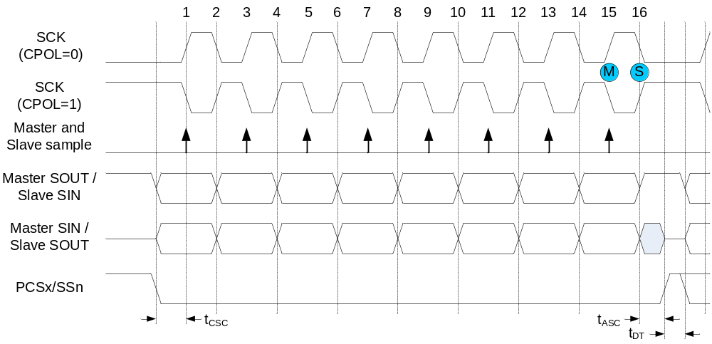
SPI
Classic SPI Transfer Format (CPHA=0)
First data bit is available on the first clock edge
Data change happens on the even-numbered clock edges
First clock edge is asserted after t_{CSC} delay
Chip select is deasserted after t_{ASC} delay
New frame transfer is inserted by the master after t_{DT} delay
Master updates TCF, EOQF flags and TXCTR next to last clock edge (M)
Slave updates TCF flag and RXCTR with the last clock edge (S)

Slide 16
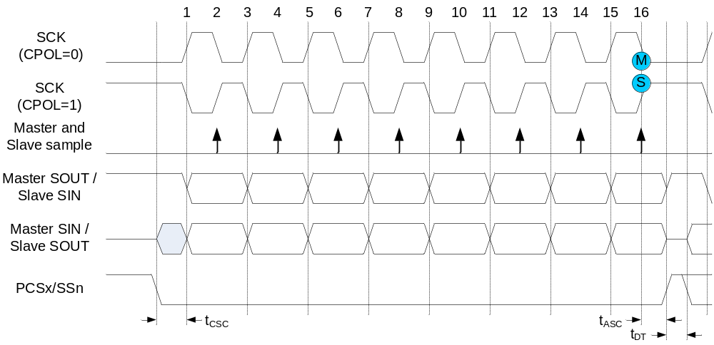
SPI
Classic SPI Transfer Format (CPHA=1)
First data bit is available after the first clock edge, valid with the second
Data change happens on the odd-numbered clock edges
First clock edge is asserted after t_{CSC} delay
Chip select is deasserted after t_{ASC} delay
New frame transfer is inserted by the master after t_{DT} delay
Master updates TCF, EOQF flags and TXCTR with the last clock edge (M)
Slave updates TCF flag and RXCTR with the last clock edge (S)

Slide 17
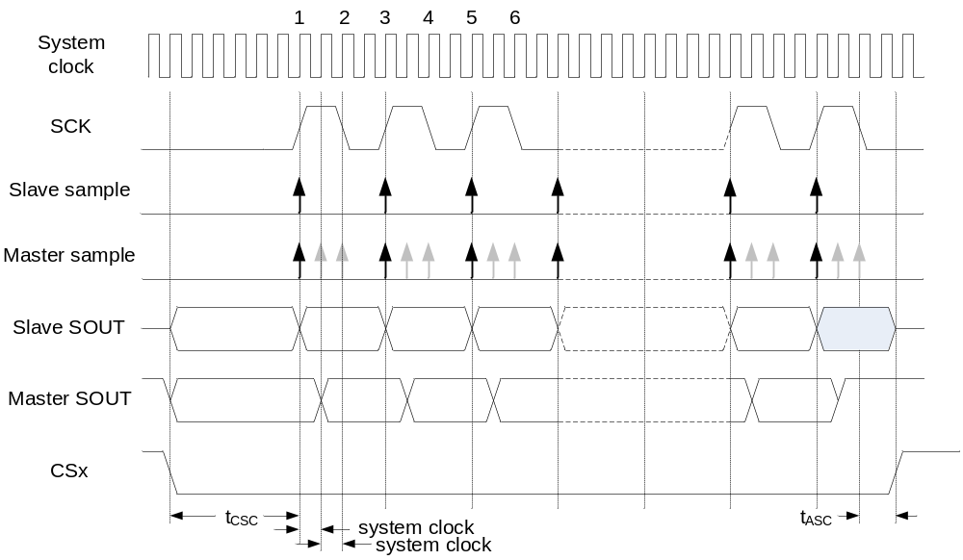
SPI
Modified SPI Transfer Format (MTFE=1, CPHA=0)
First data bit is available on the first clock edge
Slave samples and change data on the same odd-numbered clock edge
Master places new data one system clock cycle after odd numbered clock edge
Master samples data with odd numbered edges plus variable number of system clocks given by SMPL_PT bit field in MCR register
NOTE: Thorough analysis of timing budget is necessary for the modified transfer format to operate correctly

Slide 18
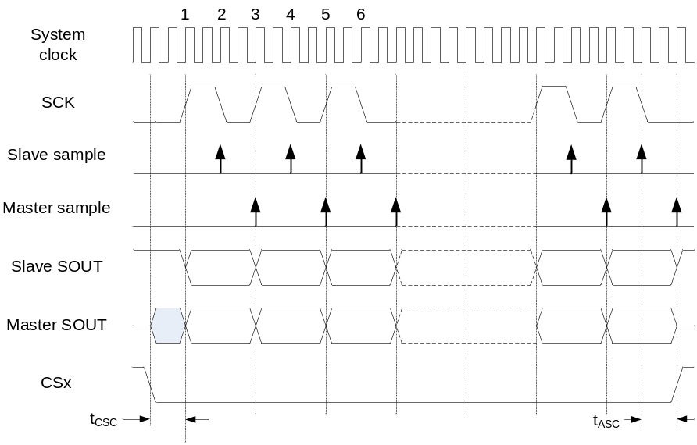
SPI
Modified SPI Transfer Format (MTFE=1, CPHA=1)
First data bit is available after the first clock edge
Slave samples master data on even-numbered clock edges
Master samples slave data on odd-numbered clock edges
Master and slave place new data on odd-numbered clock edges
NOTE: Thorough analysis of timing budget is necessary for the modified transfer format to operate correctly

Slide 19
SPI Transmit Commands and Data (PUSH_R)
0
1
2
3
4
5
6
7
8
9
10
11
12
13
14
15
R
CONT
CTAS
EOQ
CTCNT
PE
PP
PCS7
PCS6
PCS5
PCS4
PCS3
PCS2
PCS1
PCS0
W
reset
0
0
0
0
0
0
0
0
0
0
0
0
0
0
0
0
R
TX DATA
W
reset
0
0
0
0
0
0
0
0
0
0
0
0
0
0
0
0
TxData - Data to be transmitted
PCS0:7 - Peripheral Chip Select 0-7
  Selects external device(s) to get transmitted data. Multiple CS allow multiplexing beyond 8 CS.
PP - Parity Polarity. PP bit controls polarity of the parity bit transmitted and checked
PE - Parity Enable. PE bit enables parity bit transmission and parity reception check for the SPI frame
CTCNT - Clear SPI Transfer Counter
  Provides a means to clear the SPI transfer counter (used for queue mgmt.)
EOQ - End of Queue
CTAS - Clock and Transfer Attributes Select
  Select one of CTAR 0:7 registers to be used for timings needed in communicating to External device. external (Slave mode defaults to CTAR0)
CONT - Continuous Peripheral Chip Select Enable
  Specifies if PCS signals are inactive or remain asserted between transfers

Slide 20
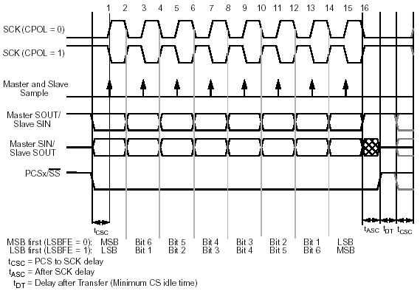
DSPI Timings: Frame Timing Attributes
Command options per transfer frame
(in command or CTAR)
  Clock Rate
  Clock Polarity (CPOL)
  Clock Phase (CPHA)
    Edge used to capture data
  PCS to SCK delay
  SCK to /PCS delay
  Delay between frames
  4 to 16 bit size
  8 Chip Selects
    Continuous CS
    Deglitched decode
  LSB or MSB first
One Frame

Slide 21
Frame Timing Attributes
DSPI_CTARx
DSPI_CTARx
PCSSCK
CSSCK[0:3]
PASC
ASC[0:3]
PCS to SCK DLY
SLK to PCS DLY
PCS
SCK
CPOL = 0
(CPHA=0)
IDLE LO
SCK
(CPHA=1)
SCK
(CPHA=0)
CPOL = 1
IDLE HI
SCK
(CPHA=1)
SOUT
SIN
MSB
6
5
4
3
2
1
LSB
MSB
6 5
INTERNAL STROBE
FOR DATA CAPTURE
Bits per transfer can be from 4 to 32 bits
Notes:
On MPC500 we could put delays between frames. Can be done here also on a per frame basis

Slide 22
DSPI Timings: Clock and Transfer Attribute Registers 0-7
0
1
2
3
4
5
6
7
8
9
10
11
12
13
14
15
R
DBR
FMSZ
CPOL
CPHA
LSBFE
PCSSCK
PASC
PDT
PBR
W
reset
0
1
1
1
1
0
0
0
0
0
0
0
0
0
0
0
16
17
18
19
20
21
22
23
24
25
26
27
28
29
30
31
R
CSSCK
ASC
DT
BR
W
reset
0
0
0
0
0
0
0
0
0
0
0
0
0
0
0
0
DBR - Double Baud Rate
FMSZ - Frame Size; 4 to 16 bits
CPOL - Clock Polarity: Inactive state of SCK is low (0) or high (1)
CPHA - Clock Phase:
  0: SCK Leading edge: data is captured; Following edge: data is changed
  1: SCK Leading edge: data is changed; Following edge: data is captured
LSBFE - LSB First Enable – selects if LSB or MSB is transferred first.
PCSSCK, CSSCK - PCS to SCK delay
PASC, ASC - SCK to PCS delay
PDT, DT - delay after transfer (PCS negation to next PCS assertion)
PBR, BR - baud rate

Slide 23
Status Register
TRANSMIT FLAGS
TCF Transmit Complete Flag
EOQF End of Queue Flag
TFUF Transmit FIFO Underflow Flag
(1 = DSPI Slave TxFIFO has no data
when transmission is initiated)
TFFF Transmit FIFO Fill Flag
RECEIVE FLAGS
RFOF Receive FIFO Overflow Flag
(1 = Receive FIFO is full when
transfer was initiated)
RDRF Receive FIFO Drain Flag
RUNNING STATUS
TXRXS Transmit Receive Status
(1 = DSPI is running)
ERROR FLAG
SPEF SPI Parity Error Flag.
(1 = Parity error has occurred)
DSPI_SR
0 1 2 3 4 5 6 7 8 9 10 11 12 13 14 15
TCF
TXRXS
0
EOQF
TFUF
0
TFFF
0
0
0
SPEF
0
RFOF
0
RDRF
0
RST: 0………………………………………………………………………………………………………………………0
16 17 18 19 20 21 22 23 24 25 26 27 28 29 30 31
TXCTR
TXNXTPTR
RXCTR
POPNXTPTR
RST: 0………………………………………………………………………………………………..………………………0
Transmit Counter
TxCNT← TxCNT + 1
When PUSHR is written
TxCNT← TxCNT - 1
Upon Tx Command execution
Transmit Next Pointer
Points to next entry
to be transmitted
from the Tx FIFO
Receive Counter
RxCNT← RxCNT + 1
Upon Data Transfer to FIFO
RxCNT← RxCNT - 1
When POPR is read
POP Next Pointer
Points to next entry
that will be returned
when POPR is read

Slide 24
IRQ/DMA Request Sources
Transmit | Receive | ERROR
TFFF: Tx FIFO not full – “Fill Flag” (IRQ or DMA) | RFDF: Rx FIFO not empty - “Drain Flag” (IRQ or DMA) | SPEF: SPI Parity Error Request Enable
TCF: Transfer of current frame complete (IRQ) | RFOF: Frame received while FIFO full (IRQ)
EOQF: End of queue reached (IRQ)
TFUF: Attempt to transmit with empty FIFO (IRQ)
INTC
Vector #
131
132
133
134
135
DSPI
Interrupt
TFUF,RFOF
EOQF
TFFF
TCF
RFDF
SPEF

Slide 25
DMA / IRQ Request Select & Enable Register
0 1 2 3 4 5 6 7 8 9 10 11 12 13 14 15
TCF
_RE
0
0
EOQF
_RE
TFUF
_RE
0
TFFF
_RE
TFFF
_DIRS
0
0
SPEF
_RE
0
RFOF
_RE
0
RDRF
_RE
RFDF
_DIRS
RST: 0………………………………………………………………………………………………………………………0
16…………………………………………………………………………………………………….31
0
0
0
0
0
0
0
0
0
0
0
0
0
0
0
0
RST: 0………………………………………………………………………………………………………………………0
DSPI DMA/Interrupt Request Select and Enable Register (DSPI_RSER)
  7 Request Enable bits for flags to allow interrupt requests or DMA requests
  2 Selection bits for selecting DMA request or interrupt request for flags:
    TFFF using TFFF_DIRS
    RFDF using RFDF_DIRS

Slide 26
BACKUP

Slide 27
eDMA + DSPI
Automatic SPI message management
eDMA
Transfer based on descriptors in RAM; capability to link transfers
Transfers can be initiated by timers and then handled based on SPI interrupts
Automatic data gathering and scattering
DSPI
Configurable SPI parameters per chip select
Message based communication (automatic chip select activation/desactivation)
eDMA + DSPI
SPI Message scattering and message gathering from/to different message areas (satellite, SQUIB, firing, safing)
Automatic SPI message management without CPU load

Slide 28
eDMA + DSPI operation
System RAM
Transmit Queues
eDMA
Command 0
Data 0
Command 0
Data 0
saddr
. . .
. . .
. . .
. . .
Command n
Data n
Command n
Data n
DMA Chan.
Logic
Timer
Clock & Transfer Attribute Reg. Fields
Baud Rate
Frame size
Clock polarity
Clock phase
LSB/MSB first
Various timing delays (details later)
Tx FIFO
Fill Flag
Push Reg.
Transmit
FIFO
Command
Data
daddr
Command
Data
TFFF
Command
Data
Command
Data
IRQ
Command
Data
Shift Reg.
Data
SOUT
DSPI
Receive
FIFO
Pop Reg.
Data
SIN
Data
Data
IRQ
Data
RFDF
DSPI Logic
Data
Rx FIFO
Drain Flag
saddr
System RAM
Receive Queues
DMA Chan.
Logic
SCK
PCS0:5
eDMA + DSPI =
Automatic message management
Without CPU load
Data
eDMA
Data
Data
. . .
. . .
daddr
. . .
Data
Data
Data

