Slide 1
FLEXPWM
Version 1.0

Slide 2
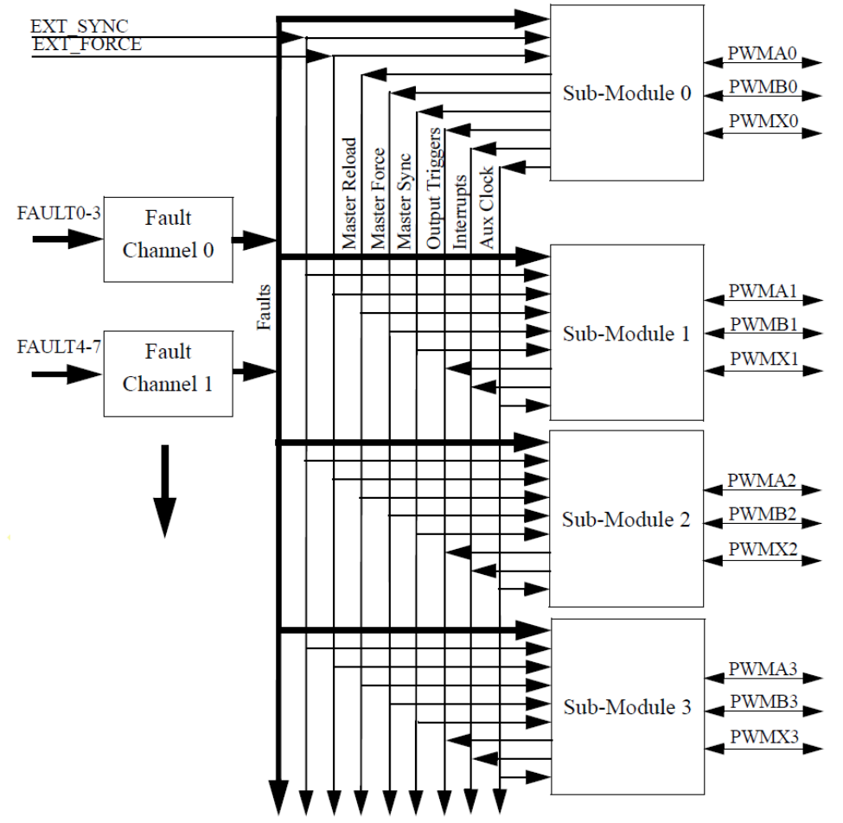
FLEXPWM: Introduction
2 modules
  each one contains 4 PWM sub-modules
  each sub-module can control an H-bridge power stage and 4 fault inputs
Capable of controlling most motor types:
  AC induction motors
  Permanent Magnet AC Motors
  Brushless & brushed DC Motors
  Switched & Variable Reluctant Motors
  Stepper Motors

Slide 3
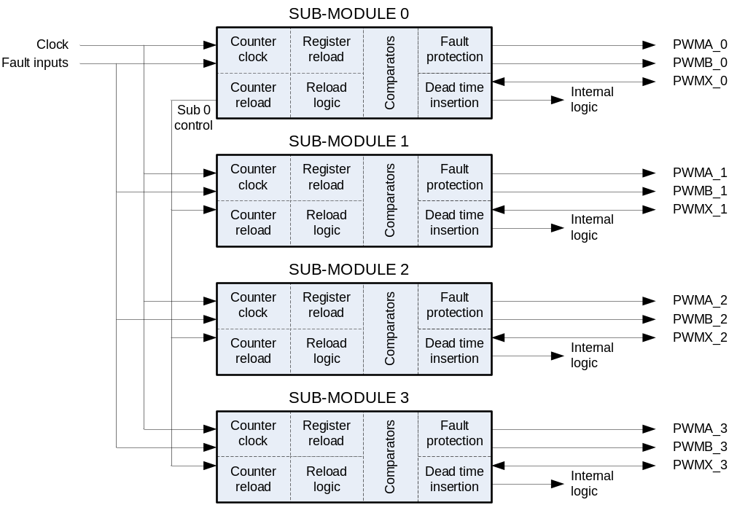
Block Scheme

Slide 4
Features (a)
Register Reload
Counter Synchronisation
Independent or Complementary Channels
Dead-time Insertion
Top/Bottom or Manual Correction
Fault Protection
Interrupts
DMA access

Slide 5
Features (b)
16 bit of resolution for center, edge aligned, and asymmetrical PWMs
PWM outputs can operate as complimentary or independent channels
Double buffered PWM registers
Multiple output trigger events can be generated per PWM cycle via hardware
Independent top and bottom dead-time insertion in complementary mode
Enhanced dual edge capture functionality
Fault inputs can be assigned to control multiple PWM outputs

Slide 6
FLEXPWM: External Signal Descriptions
PWMA[0-3] & PWMB[0-3] | The output pins of the PWM channels
PWMX[0-3] | The aux output pins of the PWM channels
Fault[0-3] | Input pins for disabling selected PWM channels
EXT_SYNC | Allows a source external to the PWM to initialise the PWM counter
EXT_FORCE | allows a source external to the PWM to force an update of PWM output
OUT_TRIG[0-3] | allows the PWM sub-module to control timing of the ADC conversions
EXT_CLK | allows an on-chip external source to control the PWM clocking, allowing the PWM to synchronised to the timer.

Slide 7
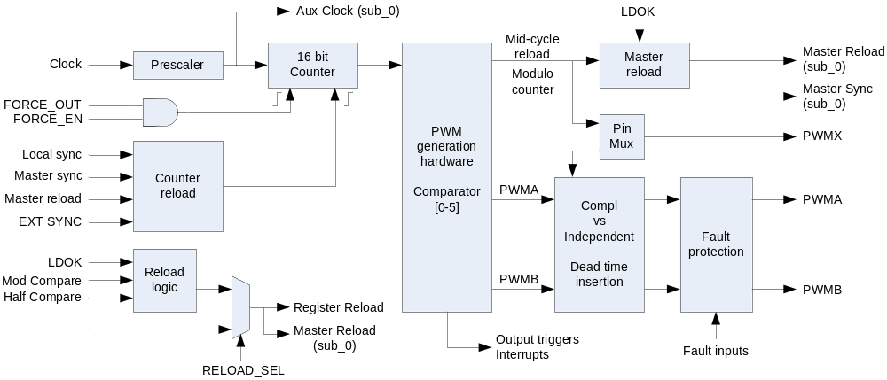
SubModule Block Scheme

Slide 8
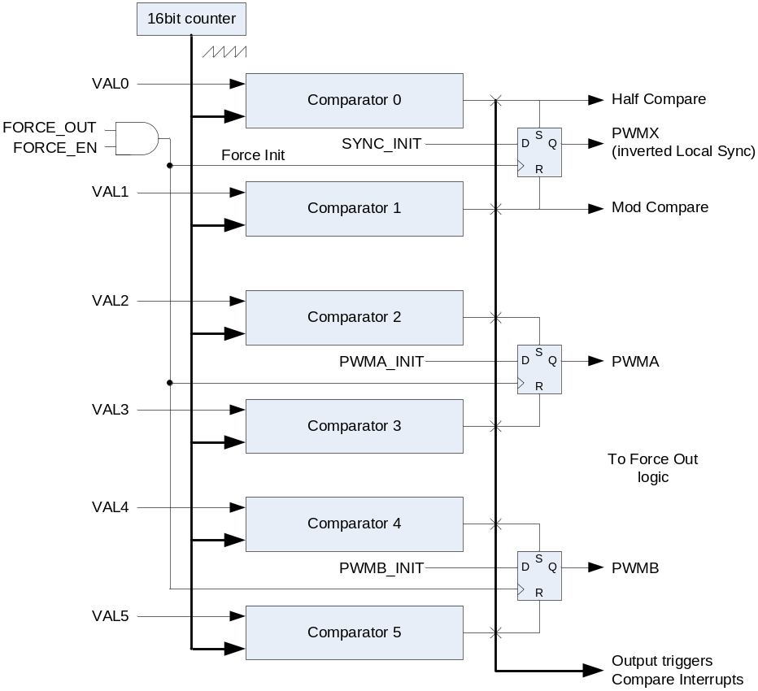
PWM Generation Hardware
Independent control of both PWM edges of the signal
PWM period controlled by Comparator 1
Half compare point controlled by Comparator 0
PWMA edges controlled by Comparator 2 and 3
PWMB edges controlled by Comparator 4 and 5
State of PWM signals can be overridden by FORCE signal

Slide 9
FLEXPWM: Independent or Complementary Channel Operation
PWMA and PWMB can be configured in two ways
  complimentary (CNFG.INDEP flag = 1)
  independent (CNFG.INDEP flag = 0)
    each channel is controlled by its own VALx pair

Slide 10
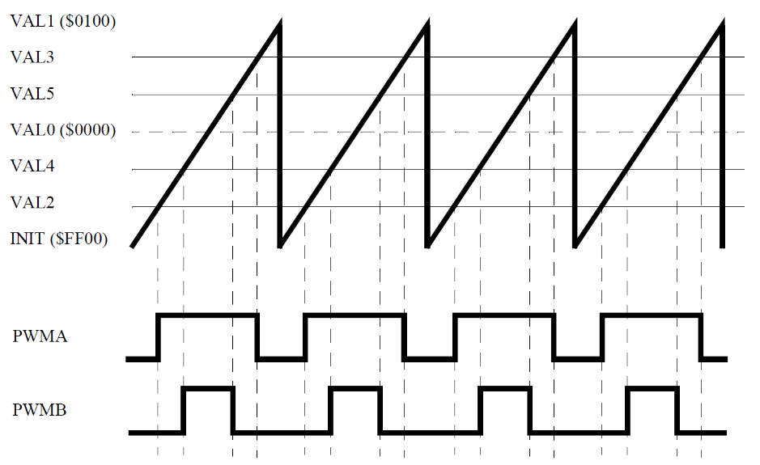
FLEXPWM: Centre Aligned PWMs
Each Timer sub-module has its own timer capable of generating PWM signals on two output pins
The timer only counts in the up direction then resets to INIT value
The turn on edge and the turn off edge determine the pulse width
There is no need to support separate PWM
There is no need to support separate PWM alignment modes since the PWM alignment mode is inherently a function of the turn on and turn off edge values

Slide 11
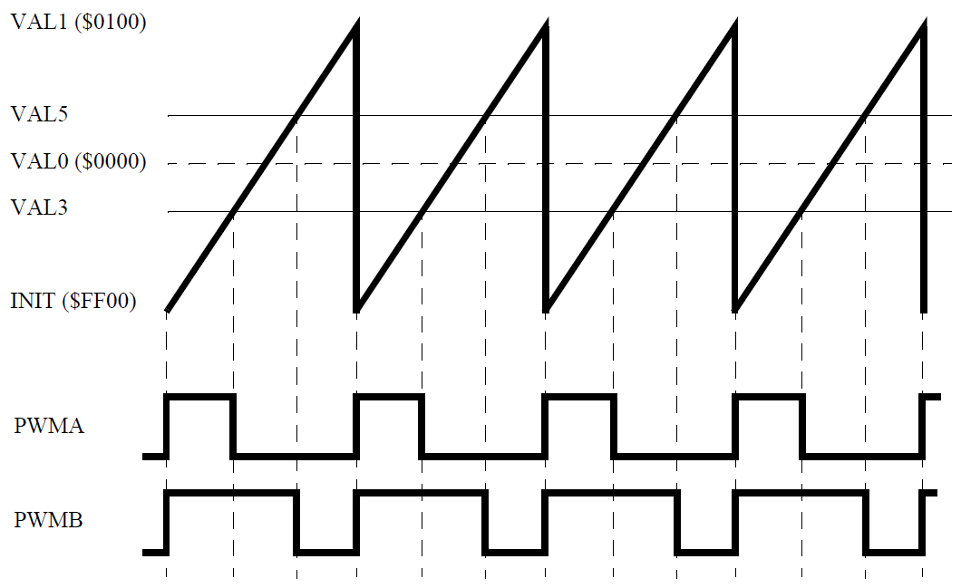
FLEXPWM: Edge Aligned PWMs
The INIT value can be used to edge align the turn on edge.
  only the turn off edge is update periodically to change the pulse width.
This operation simplifies the software interface to the PWM module
  no offset calculations are required to translate the output variable control algorithm to the voltage on an H-Bridge load.

Slide 12
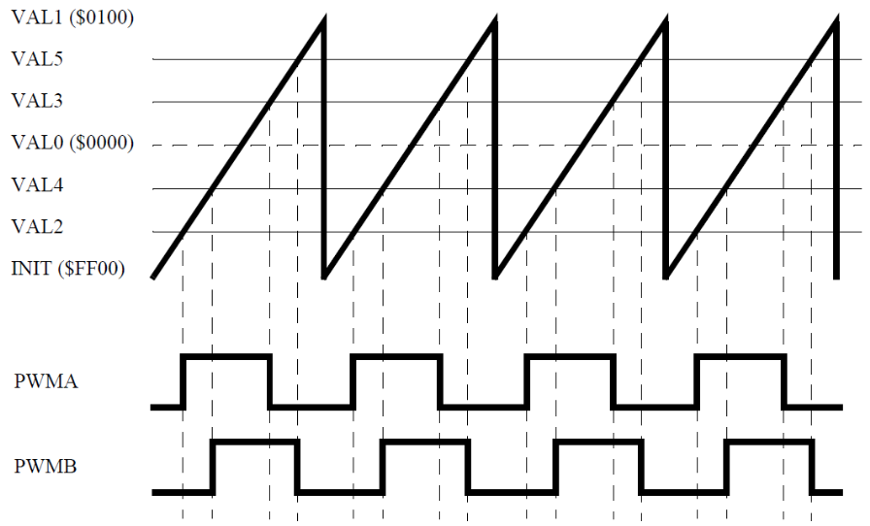
FLEXPWM: Phase Shifted PWMs
The previous section highlighted the software advantages of signed mode, however if numerical biases are applied to different PWM channels the signals will be phase shifted.
Phase switching can open up timing windows between switching edges.
This reduces noise and allows a signal to be sampled by the ADC.
Phase shifting is ideally suited for transformer loads.

Slide 13
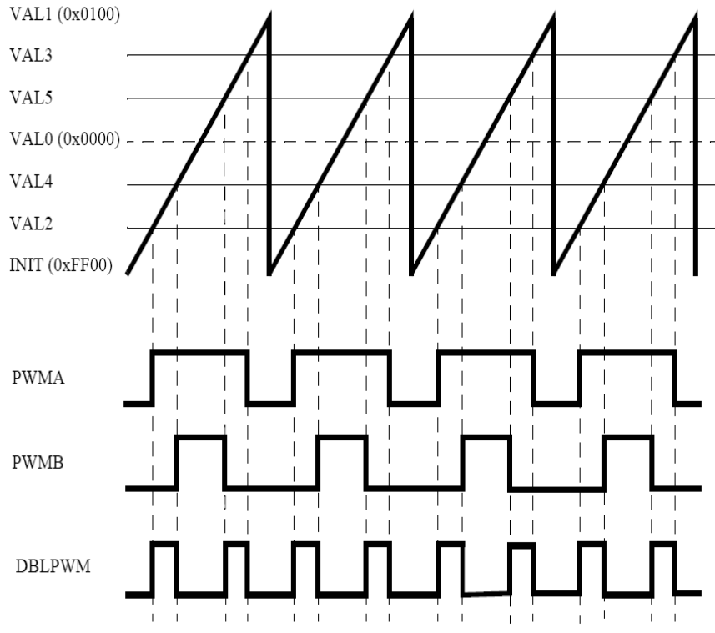
FLEXPWM: Double Shifting PWMs
This supports single shunt current measurement and three phase reconstruction.
This method generates two independent rising edges and two independent falling edges per cycle.
The 2 channels are combined using a XOR to produce the signal opposite.

Slide 14
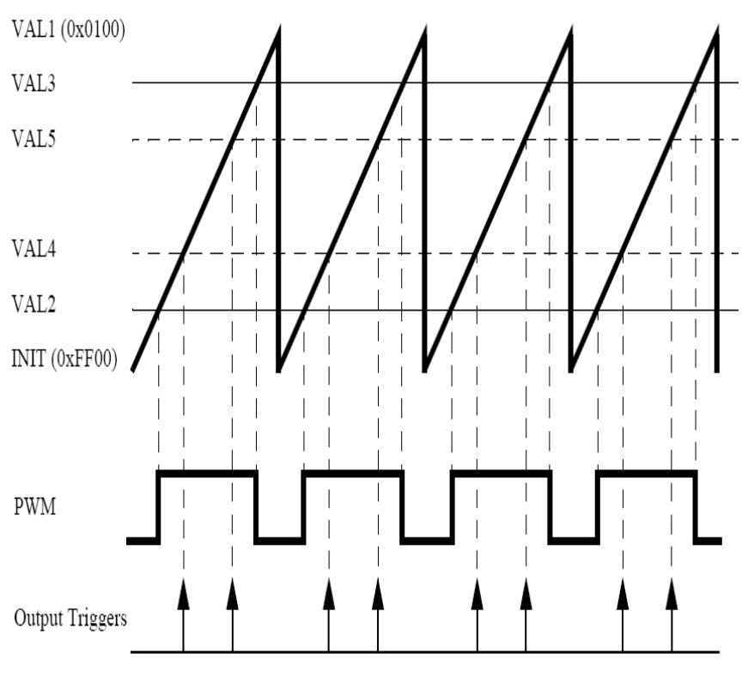
FLEXPWM: ADC Triggering
When the timing of the ADC triggering is critical, it must be scheduled as a hardware event instead of software activated.
Multiple ADC triggers can be generated in hardware per PWM cycle.

Slide 15
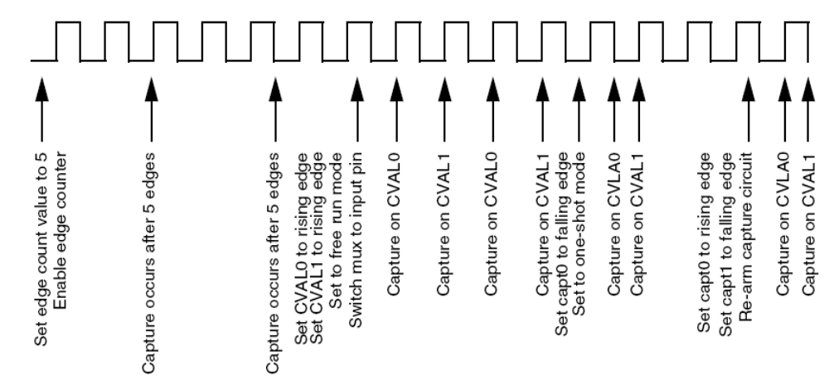
FLEXPWM: Enhanced Capture (Input-Capture)
The PWM channel can be used as an INPUT capture
Free running or one shot mode
Calculate pulse widths
The module can count a specific number of edge events before performing a capture or interrupt.

Slide 16
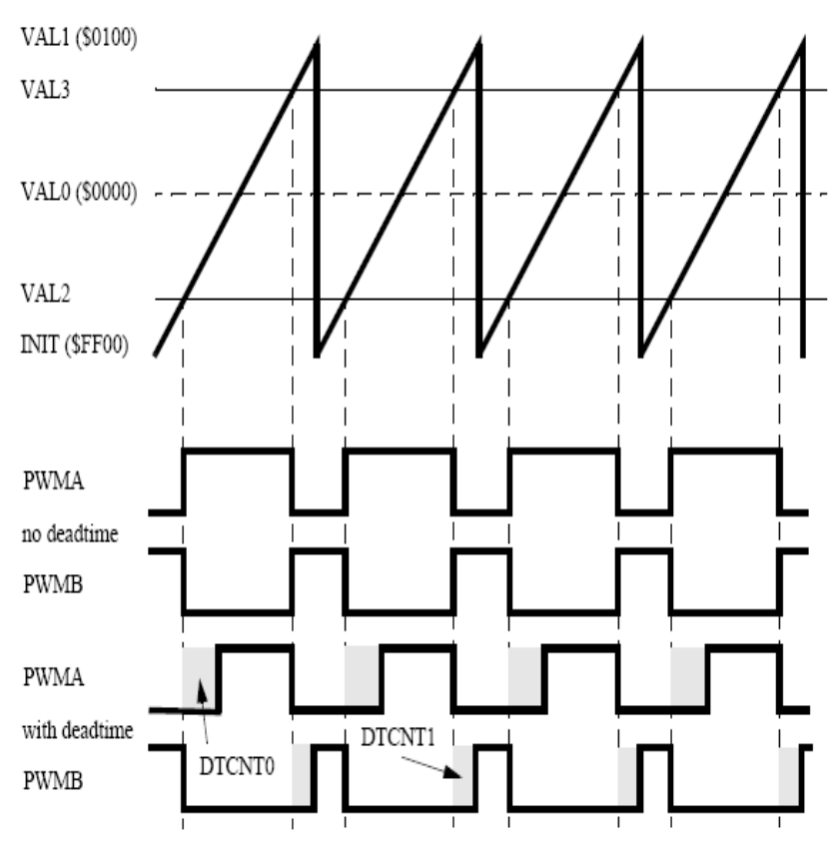
FLEXPWM: Dead-time Insertion
Dead-time is used to create non overlapping complementary signals.
The dead-time generators automatically insert software-selectable activation delays into the pair of PWM outputs.
The dead-time registers (DTCNT0 and DTCNT1) specify the number of IPBus clock cycles to use for dead-time delay.

Slide 17
FLEXPWM: Fault Protection
Fault Protection can control any combination of PWM pins. Faults are generated by a logic one on any of the FAULTx pins.
When a fault occurs and the fault protection hardware disables the PWM outputs, the PWM generator continues to run, only the output pins are forced a chosen state: logic 0, logic 1, or tri-state.
Each fault pins has a programmable filter that can be bypassed.
Automatic Fault clearing re-enables disabled PWM pins when the FAULT pin returns to logic 1 and a new PWM half cycle begins
Manual Fault clearing – software clears the FFLAG
  If FSAFE is cleared then the pins are enabled when the next PWM half cycle begins regardless of the logic level detected by the filter.
  If FSAFE is set then the pins are enabled when the next PWM half cycle begins only if a logic 1 level has been detected by the filter.

Slide 18
BACKUP

Slide 19
FLEXPWM: Signed Mode
The following examples illustrate an additional enhancement to the PWM generation process.
  If the reload value is the 2’s complement of the modulus value, then the PWM generator operates in “signed” mode
  This means that each PWM’s turn on and turn off edge values are also the same number but only different in their sign, the "on" portion of the output signal will be centred around a count value of zero
  Therefore, only one PWM value needs to be calculated in software and then this value and its negative are provided to the sub-module as the turn off and turn on edges respectively

