Slide 1
Leopard Training
Getting Started

Slide 2
Agenda
Introduction
Prerequisites
Creating a FLASH (RAM) application
Hardware setup
Debugging the application
Debugging Hints

Slide 3
Introduction
“Getting started” is based on an example for Internal FLASH Memory
  with minimal modification example can run out of the RAM
Examples are developed using GHS Environment
  concepts are valid with other toolchains
Notes:
The purpose of this document is to introduce hardware and software tools used by a starter kit for SPC56EL60 processors and to show how to use them starting from scratch.
This tutorial is based on two examples, the first one refers to internal RAM memory and the second one refers to internal Flash memory. Tutorial goes from first steps of creating project in Green Hills development environment, through writing the application code and the building process up to setting the hardware environment and debugging the application.
The tutorial explains also how to compile an internal Flash memory application with Diab WindRiver compiler. At the end of this tutorial, one will be able to create its own functional examples and will be prepared to move to more complex applications using wider range of peripherals of the microprocessor.

Slide 4
Prerequisites
Item | Tool | Version | Description
1 | SPC56XX EVB Motherboard | - | Motherboard for SPC56xx processor families
2 | SPC56ELADPT144S Minimodule | - | Mini-module for SPC56EL60 processor
3 | GHS Multi IDE¹ | 5.1.6 | Green Hills development environment
4 | Lauterbach environment TRACE32 | 2.0 | PowerTrace via USB for PowerPC Nexus debug environment supporting SPC56EL60 devices
this training uses GHS, but any other PPC toolchain can be used
Notes:
This tutorial is based on several hardware and software tools. As for software tools, they
have to be installed and licensed if necessary.

Slide 5
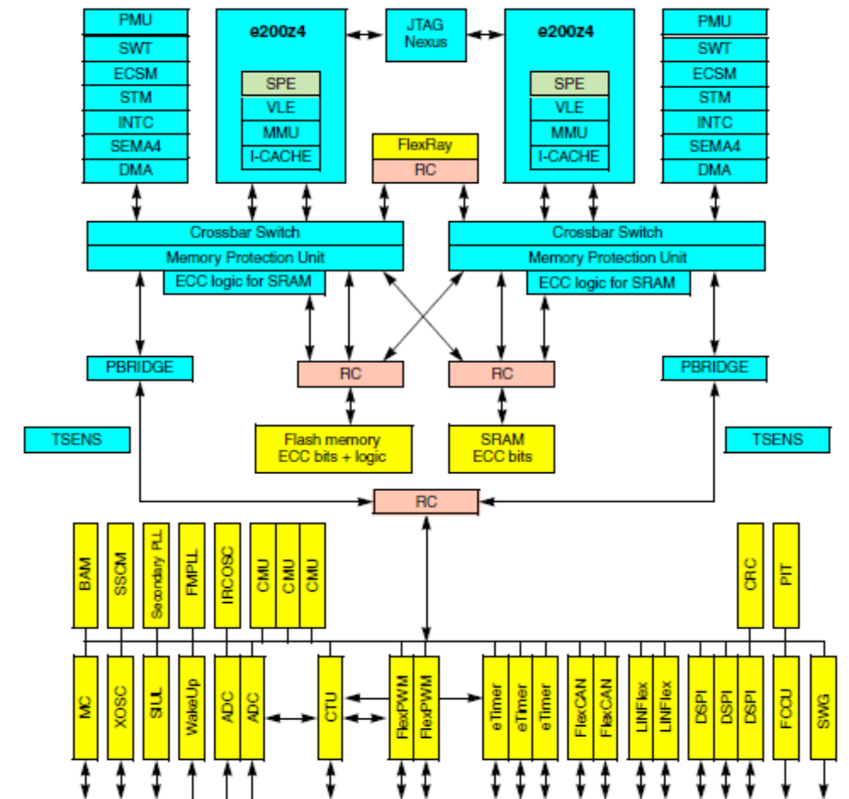
Leopard Block Diagram
ADC – Analog-to-Digital Converter
BAM – Boot Assist Module
CMU – Clock Monitoring Unit
CRC – Cyclic Redundancy Check unit
CTU – Cross Triggering Unit
DMA – Direct Memory Access controller
DSPI – Serial Peripherals Interface
ECC – Error Correction Code
ECSM – Error Correction Status Module
FCCU – Fault Collection and Control Unit
FlexCAN – Controller Area Network controller
FMPLL – Frequency Modulated Phase Locked Loop
INTC – Interrupt Controller
IRCOSC – Internal RC Oscillator
JTAG – Joint Test Action Group interface
MC – Mode Entry, Clock, Reset, & Power
PBRIDGE – Peripheral bridge
PIT – Periodic Interrupt Timer
PMU – Power Management Unit
RC – Redundancy Checker
RTC – Real Time Clock
SEMA4 – Semaphore Unit
SIUL – System Integration Unit Lite
SSCM – System Status and Configuration Module
STM – System Timer Module
SWG – Sine Wave Generator
SWT – Software Watchdog Timer
TSENS – Temperature Sensor
XOSC – Crystal Oscillator

Slide 6
Developing a FLASH application

Slide 7
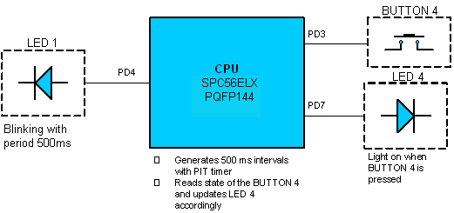
Developing a FLASH application
The following example is taken as reference
Notes:
Built-in editor of GHS MULTI the project manager allows to develop an application code. It is
possible to run it selecting Tools Editor item in the toolbox menu. Subsequently, a file dialog
appears, where you can select the file to edit or to create. In the example presented here a
new file named main.c has been created (please refer to Starter KIT CD). Once confirmed,
an editor is opened with a blank sheet. Of course any editor can be used for creating the
source code.

Slide 8
Leopard Application
An application is composed of four sections:
  Linker file
  Flash boot code
  Application code (“c” code)
  IRQ/exception management

Slide 9
Leopard Application
An application is composed of four sections:
  Linker file
  Flash boot code
  Application code (“c” code)
  IRQ/exception management

Slide 10
FLASH Linker File
Linker file defines memory layout for project
  for example tgt\GHS_SPC56ELX_Linker_FLASH.ld
Basic linker file has three sections:
  memory definition
  constant definition
  partitioning of code and data segments

Slide 11
FLASH Linker File: Memory and Constants definitions
Existing memories
  start addresses
  size
Stack, SRAM and FLASH size
MEMORY
{
  flash_rcw : org = FLASH_BASE_ADDR, len = 0x8
  int_flash : org = FLASH_BASE_ADDR+8, len = FLASH_SIZE-0x8
  int_sram : org = SRAM_BASE_ADDR, len = SRAM_SIZE-STACK_SIZE
  stack_ram : org = (SRAM_BASE_ADDR+SRAM_SIZE-STACK_SIZE), len = STACK_SIZE
}
DEFAULTS
{
  FLASH_SIZE = 1M // 1MB Flash /* Define Flash Size */
  FLASH_BASE_ADDR = 0x0000000 /* Define Flash Base Address */
  /* RCHW Located at beginning of flash */
  SRAM_SIZE = 128K // 128KB SRAM /* Define SRAM Size */
  SRAM_BASE_ADDR = 0x40000000 /* Define SRAM Base Address */
  /* Stack located at end of SRAM */
  STACK_SIZE = 4K // 4KB Stack /* Define Stack Size */
}
Notes:
), and constants (i.e. heap region).

Slide 12
FLASH Linker File: Sections
Define partitioning of code and data segments in memory
SECTIONS
{
  .rcw : {} > flash_rcw
  .vletext_init : {} > int_flash /* VLE Init Code */
  ...
  .vletext : {} > . /* VLE Code */
  .fixaddr : {} > . /* Required for */
  ...
  .xcptn ALIGN(0x10000) : {} > . /* Exception Vector Table (IVPR) - align 64K boundary */
  ...
  .isrvectbl ALIGN(0x800) : {} > . /* ISR Vector Table - must be 2K aligned */
  .data : {} > int_sram /* Initialised Data */
  .bss : {} > . /* Uninitialised Data */
  ...
  .sbss2 : {} > . /* Small Uninitialised Data (Area2)*/
  .stack ALIGN(16) PAD(STACK_SIZE) : {} > stack_ram /* Stack Area */
linker extract showing main sections
Notes:
Last section of the linker file is partitioning of code and data segments in memory. Here it
does not enter the detail of linker file description. The only things to check are target
memories for code segments (.text etc.) and data (.bss, .data etc.). To build everything to
RAM, all partitions should be placed to RAM memories, dram_memory in this example.

Slide 13
FLASH Linker File: Labels
Labels used in Boot file for memory initialization
  /*-------- LABELS USED IN CODE -------------------------------*/
  /* Stack Address Parameters */
  __SP_INIT = ADDR(stack_ram) + SIZEOF(stack_ram);
  /* Interrupt Handler Parameters */
  __IVPR = ADDR(.xcptn);
  /* Labels for Copying Initialised Data from Flash to RAM */
  __DATA_SRAM_ADDR = ADDR(.data);
  __SDATA_SRAM_ADDR = ADDR(.sdata);
  __DATA_SIZE = SIZEOF(.data);
  __SDATA_SIZE = SIZEOF(.sdata);
  __DATA_ROM_ADDR = ADDR(.ROM.data);
  __SDATA_ROM_ADDR = ADDR(.ROM.sdata);
  /* Labels Used for Initializing SRAM ECC */
  _SRAM_SIZE=SRAM_SIZE;
  _SRAM_BASE_ADDR = SRAM_BASE_ADDR;
  /*GHS Labels*/
  ….
}
Address of Stack pointer
Interrupt vector address
Used to manage constants, initialized data, un-initialized data
SRAM parameters used to initialize SRAM Memory
Notes:
Last section of the linker file is partitioning of code and data segments in memory. Here it
does not enter the detail of linker file description. The only things to check are target
memories for code segments (.text etc.) and data (.bss, .data etc.). To build everything to
RAM, all partitions should be placed to RAM memories, dram_memory in this example.

Slide 14
Leopard Application
An application is composed of four sections:
  Linker file
  Flash boot code
  Application code (“c” code)
  IRQ/exception management

Slide 15
FLASH boot file
FLASH boot file contains some important initializations that must be executed during the boot process
Basic boot file includes the following steps:
  Define reset vector
  Initialize all CPU registers (not all e200z4d registers are initialized)
  MMU programming
  Initialize stack and small data section pointers
  RAM initialization
Notes:
Since in this Getting Started example it was defined generic PPC processor and none target
board, next step is to write RAM boot code and modify/substitute standard RAM linker file
with another one that describes application.

Slide 16
FLASH boot file: Typical Configuration flow
Define Reset Vector
Define a bootable sector
Initialize CPU Registers
Leopard Core Initializations
Configure MMU
Initialize SRAM
Initialize Stack pointer
Initialize data pointers provided by linker
Leopard Memory Initializations
Load “data” from FLASH to SRAM
Branch to “main” function
Branch to Application

Slide 17
Register initialization
After reset, core registers must be initialized to a known value to avoid unexpected fault triggered
  All leopard cuts
Cores are linked to a checker which verify their alignment (only in Lock-Step)
  Output of Core_0 is compared to output of Core_1
  A difference in internal register (i.e. GPR5, SPR563) can cause a different output on the 2 cores
core 0
core 1
checker
FCCU

Slide 18
Leopard Boot Sequence
Go to Flash sector 0
All these steps are done by HW
checks if sector is bootable
Is a valid boot identifier
yes
Read starting code address
Code Start
Go to next Flash sector
no
There are unchecked flash sectors ?
Internal Flash is Invalid – BAM is executed
no
yes
Notes:
FLASH boot
the SSCM checks the first half word of each flash memory sector starting at sector 0 until a valid boot identifier is found
If all blocks in the scanned address space of the internal flash are checked and no valid boot identifier is found, then the internal flash is assumed to be invalid and the code stored in the BAM shall be executed.

Slide 19
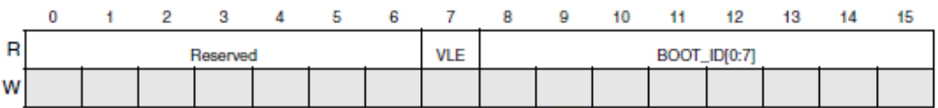
Leopard Reset Configuration Half Word Source (RCHW)
Each boot sector can contain the Reset Configuration Half-Word (RCHW) at offset 0x0.
Reset 0 0 0 0 0 0 0 0 0 0 0 0 0 0 0 0
Selects the VLE or Book E instruction set
0 Selects the classic PowerPC instruction set
1 Selects the VLE instruction set
Valid boot identifier is 0x5A
BOOT_ID:
is used to indicate which block in flash memory contains the boot program
identifies whether the flash memory section is bootable or not

Slide 20
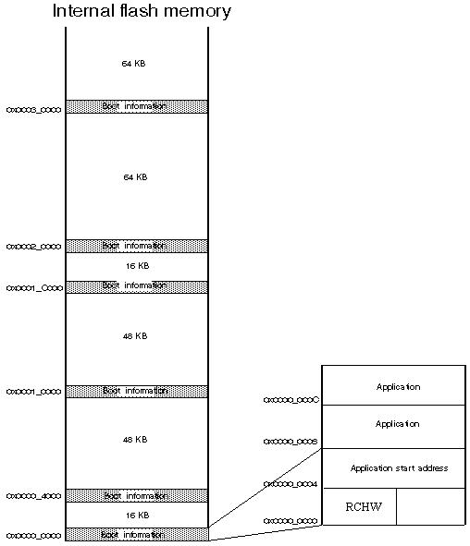
Leopard flash memory partitioning and RCHW search
Picture shows the section where the SCCM looks for a valid RCHW

Slide 21
Leopard Flash boot sectors
Boot sector partitioning
Block | Address
0 | 0x0000_0000
1 | 0x0000_4000
2 | 0x0001_0000
3 | 0x0001_C000
4 | 0x0002_0000
5 | 0x0003_0000

Slide 22
MMU configuration after Reset
During reset, all TLB entries except entry 0 are invalidated
TLB entry 0 is loaded with the following values:
  No Translation
  SIZE= 4KB page size
    starting from bootable sector
  Cache inhibited, non-coherent
  VLE depend on value present on password defined in RCHW section
    for example in this case VLE code is enabled:
      reset_vector:
      .LONG 0x015A0000 # SPC56ELX -External Boot OFF, VLE ON
      .LONG _start # Code starts at _start
Core register initialization and MMU (pages/entry) programming code are located at beginning of flash sector, vle_init (see slide11: “FLASH Linker File: Sections”)
Notes:
Entry is valid
Address space 0
No Translation
SIZE= 4KB page size
Full supervisor mode access allowed
Full user mode access allowed
Cache inhibited, non-coherent
Page is protected from invalidation
VLE depend on value present on password defined in RCHW section

Slide 23
MMU initialization
MMU initialization is strictly dependent on the application
MMU configuration must be done in the first 4KB of used bootable sector
  vletext_init section
SECTIONS
{
  .rcw : {} > flash_rcw
  .vletext_init : {} > int_flash /* VLE Init Code */
  ...
  .vletext : {} > . /* VLE Code */
  .fixaddr : {} > . /* Required for */
  ....
Notes:
4KB means 0xFFF

Slide 24
Initialize Stack and data pointers
User must initialize stack and data pointers
  if embedded libraries provided by compiler are not used
  e_lis r1, __SP_INIT@h ;Initialize stack pointer r1 to
  e_or2i r1, __SP_INIT@l ;value in linker command file.
  e_lis r13, _SDA_BASE_@h ;Initialize r13 to sdata base
  e_or2i r13, _SDA_BASE_@l;(provided by linker).
  e_lis r2, _SDA2_BASE_@h ;Initialize r2 to sdata2 base
  e_or2i r2, _SDA2_BASE_@l;(provided by linker).

Slide 25
Initialize SRAM - ECC
SRAM is protected by ECC
  32-bit data bus plus the 7-bit ECC
  After reset the data is not correlated its signature
Before to read (or to write with 8bit- 16bit-access) SRAM must be initialized
  32-bit write access

Slide 26
Leopard Application
An application is composed of four sections:
  Linker file
  Flash boot code
  Application code (“c” code)
  IRQ/exception management

Slide 27
Developing a FLASH application
Typical Main code:
  void main(void) {
  INIT_Environment();
  INIT_Application();
  while (1){
  PIT0_Event();
  Button4_Event();
  }
  }
Initialize the processor:
Disable WD
Select Clock sources,
Enable peripherals,
Configure CrossBar,
Initialize irqs
Initialize Applic. Peripherals
Verify if timer event is occurred
Verify if external button is pressed and make action
Notes:
Application functionalities are controlled by main() function which calls event
handlers in an endless loop. Before entering in the endless loop, the functions
INIT_Environment() and INIT_Application() are ran.
1. INIT_Environment() : initializes the processor
2. INIT_Application() : initializes the peripherals.

Slide 28
Init Environment
User must initialize processor and choose some settings before real application start:
  Configure watchdog (or disable it if not needed)
  Enable peripherals
  Initialize Mode Entry module
  Choose clock source selection (PLL, IRC)
  Configure Crossbar
Notes:
INIT_Environment function:
void INIT_Environment(void){
DISABLE_Watchdog(); /* Disable SW Watchdog*/
ENABLE_AllPeriph(); /* Enable All Peripherals*/
MC_MODE_INIT(); /* Init Magic Carpet, Pll*/
SET_Aips(); /* Init Aips Module */
/* init result array */
XCPTN_Xmpl();

Slide 29
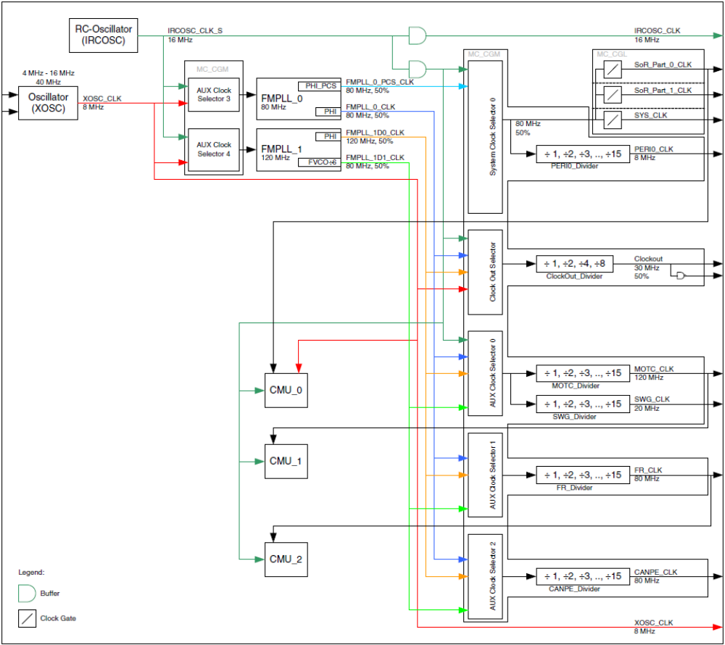
Init Environment: Leopard System Clock Generation

Slide 30
Init Environment: Leopard System Clock Generation
PLL clock selection sources (IRCOSC, XOSC)
System clock selection sources (IRCOSC, PLL0)
Clock Out Selector sources (IRCOSC, XOSC,PLL0, PLL1)
Motor Contr. Perip. And Sine wave gen. clock selector sources: IRCOSC, PLL0(PHI), PLL1(PHI, VCO/6)
Flexray clock selector sources: PLL0, PLL1(PHI, VCO/6)
FlexCAN clock selector sources: PLL0, PLL1

Slide 31
Init Environment: Leopard System Clock Generation
PLL clock selection sources (IRCOSC, XOSC)
System clock selection sources: IRCOSC, PLL0
Clock Out Selector sources (IRCOSC, XOSC,PLL0, PLL1)
Motor Contr. Perip. And Sine wave gen. clock selector sources: IRCOSC, PLL0(PHI), PLL1(PHI, VCO/6)
Flexray clock selector sources: PLL0, PLL1
Can clock selector sources: PLL0, PLL1(PHI, VCO/6)

Slide 32
Init Environment: Leopard System Clock Generation
PLL clock selection sources (IRCOSC, XOSC)
System clock selection sources (IRCOSC, PLL0)
Clock Out Selector sources: IRCOSC, XOSC,PLL0, PLL1
Motor Contr. Perip. And Sine wave gen. clock selector sources: IRCOSC, PLL0, PLL1
Flexray clock selector sources: PLL0, PLL1(PHI, VCO/6)
Can clock selector sources: PLL0, PLL1(PHI, VCO/6)

Slide 33
Init Environment: Typical CGM-ME Configuration flow
Start
Enable all modes
Legend
CGM Module
ME Module
Transition request
Set PLL
Set. Default Configuration
Enable Desired PLL
Enable all periph. clock
Transition
Select Clock sources for FMPLL modules
Setting RUN Configuration Register
Wait for PLL locking
Configure CMU low-high VD
Configure Aux. Clock Selec. and Div.
Transition
Select sys Clock
Set Output Clock
Transition
Transition
End

Slide 34
Init Environment: Recommendation
After any change in Mode Entry, user must wait for transition and verify the status:
For example:
  /* Re-Enter in DRUN mode to update */
  ME.MCTL.R = (DRUN_MODE << 28 | 0x00005AF0);/* Mode & Key */
  ME.MCTL.R = (DRUN_MODE << 28 | 0x0000A50F);/* Mode & Key */
  /* Wait for mode entry to complete */
  while(ME.GS.B.S_MTRANS == 1);
  /* Check DRUN mode has been entered */
  while(ME.GS.B.S_CURRENTMODE != DRUN_MODE);

Slide 35
Init Application
Init application peripherals:
  Setting of periodic interrupt timer (PIT)
  Configuration of general IO pins used for LEDs and buttons
    void INIT_Application(void){
    PIT.PITMCR.R = 1; /* enable periph. & stop timer during debug */
    PIT.CH[0].LDVAL.R = 0x7A1200;/* reload value */
    PIT.CH[0].TFLG.B.TIF = 1; /* clear potential flag */
    PIT.CH[0].TCTRL.B.TEN = 1; /* enable timer */
    /* GPIO configuration */
    SIU.PCR[52].R = 0x0200; /* enable output for LED1 */
    SIU.PCR[51].R = 0x0100; /* enable input for BUTTON4 */
    SIU.PCR[55].R = 0x0200; /* enable output for LED4 */
    }
Notes:
All peripherals are accessible through symbolic names which are defined in a predefined
header file. You need to include Leopard Header file in the source file to use these features.
Given that the header file represents top of header file structure for SPC56EL60 devices
and includes another header file inside (typedef defined), it is recommended to keep them all in one place. For
that reason you must copy SPC56ELX_0101.h and typedefs.h header files from starter kit CD to
source directory created in the project (that is src/Common).

Slide 36
Application handlers
Application handlers:
void PIT0_Event(void){
if (PIT.CH[0].TFLG.B.TIF){
SIU.GPDO[52].B.PDO = ~SIU.GPDO[52].B.PDO;
PIT.CH[0].TFLG.B.TIF = 1;
}
}
void Button4_Event(void){
if (SIU.GPDI[51].B.PDI == 0){
SIU.GPDO[55].B.PDO = 0;
}
else{
SIU.GPDO[55].B.PDO = 1;
}
}
Check Pit Flag
Invert Pin Value
Clear Pit Flag
Notes:
PIT is checked in polling

Slide 37
Leopard Application
An application is composed of four sections:
  Linker file
  Flash boot code
  Application code (“c” code)
  IRQ/exception management

Slide 38
IRQ/exception management
Core and INTC configuration and management
  enable core exceptions
  configure the INTC
  configure irq core registers
  define the IRQ handler
Add a new interrupt
  define priority of the new interrupt
  define the irq routine
  insert the routine in the right position in the vector table

Slide 39
Logical flow to configure/add irqs
Enable Core exceptions
Configure the INTC
Core and INTC configuration and management
configure irq core registers
define the IRQ handler
Add new interrupt
Yes
define irq routine
insert routine in vector table
define priority
No
…

Slide 40
IRQ/exception management
Core and INTC configuration and management
  enable core exceptions
  configure the INTC
  configure irq core registers
  define the IRQ handler
Add a new interrupt
  define priority of the new interrupt
  define the irq routine
  insert the routine in the right position in the vector table

Slide 41
Enable core exceptions
    void enableIrq(void) {
    INTC.CPR.B.PRI = 0;
    asm ("e_lis r3, 0x0002");
    asm ("e_or2i r3, 0x9000");
    asm ("mfmsr r4");
    asm ("se_or r4, r3");
    asm ("mtmsr r4");
    }
Ensure INTC's current priority is 0
Enable external interrupt and exceptions

Slide 42
Configure the INTC
    static void INIT_INTC(void) {
    INTC.MCR.B.HVEN = 0;
    INTC.MCR.B.VTES = 0;
    INTC.IACKR.R = (tU32) &IntcIsrVectorTable[0];
    }
Initialize INTC for software vector mode
Use the default vector table entry offsets of 4 bytes
Use the default vector table entry offsets of 4 bytes
Set INTC ISR vector table base addr

Slide 43
Configure irq core registers
Initialize the IVPR and IVOR4(external interrupts) registers for exceptions
Note: it is recommended to use enable/initialize all exceptions
    void INIT_IrqVectors(void) {
    // IVPR = address base used with IVOR's
    asm ("e_lis r5, __IV_ADDR@h");
    asm ("e_or2i r5, __IV_ADDR@l");
    asm ("mtIVPR r5 ");
    asm ("e_li r5, 0x40");
    asm ("mtIVOR4 r5 ");
    }

Slide 44
IRQ/exception management
Core and INTC configuration and management
  enable core exceptions
  configure the INTC
  configure irq core registers
  define the IRQ handler
Add a new interrupt
  define priority of the new interrupt
  define the irq routine
  insert the routine in the right position in the vector table

Slide 45
Define the irq Handler
IVOR4Handler:
e_stwu r1, -0x50 (r1) ; Create stack frame and store back chain
.long 0x1881110C ; e_stmvsrrw 0x0C (r1)
; Save SRRs on the stack (SRR0, SRR1)
se_stw r3, 0x28 (r1) ; save GPR r3 as we need a working register
e_lis r3, INTC_IACKR@ha ; Load upper half of INTC_IACKR addr. to r3
e_lwz r3, INTC_IACKR@l(r3) ; read the content of INTC_IACKR into r3
se_lwz r3, 0x0(r3) ; read vector table entry to get ISR addr.
wrteei 1 ; Reenable Interrupts
...
.long 0x18011124 ; e_stmvgprw 0x0C (r1) ; Store vol. GPRs on the stack (R0, R3-R12)
se_blrl ; Call C ISR Handler
...
.long 0x18211014 ; e_lmvsprw 0x38 (r1) ; Rest. vol. SPRs from stack(CR,LR,CTR,XER)
mbar 0
wrteei 0 ; Disable Interrupts
...
nop
nop
se_rfi ; End of Interrupt

Slide 46
IRQ/exception management
Core and INTC configuration and management
  enable core exception
  configure the INTC
  configure irq core registers
  define the IRQ handler
Add a new interrupt
  define priority of the new interrupt
  define the irq routine
  insert the routine in the right position in the vector table

Slide 47
SW Irq Application: Set Irq Priority
void SET_Irq_Priority (tU32 IrqNumber, uU8 IrqPriority) {
INTC.PSR[IrqNumber].B.PRI = IrqPriority;
}

Slide 48
SW Irq Application: SW Irq Routine
void ISR_SWIrq(void) {
CLEAR_SWIrq(0);
< ADD...irq routine code >
}
Clear SW IRQ Flag num. 0
User Code

Slide 49
SW Irq Application: Vector Table
#include "typedefs.h"
/*======================================*/
/* PROTOTYPES */
/*======================================*/
void dummy (void);
extern void INIT_SWIrq (void);
/*======================================*/
/* GLOBAL VARIABLES */
/*======================================*/
/* Use next line with Green Hills compile */
#pragma ghs section rodata=".isrvectbl"
// Vector Table. ISRs called are:
const tU32 IntcIsrVectorTable[] = {
(tU32)&INIT_SWIrq, (tU32)&dummy, (tU32)&dummy, (tU32)&dummy, (tU32)&dummy,/* ISRs 00 - 04 */
(tU32)&dummy, (tU32)&dummy, (tU32)&dummy, (tU32)&dummy, (tU32)&dummy, /* ISRs 05 - 09 */
(tU32)&dummy, (tU32)&dummy, (tU32)&dummy, (tU32)&dummy, (tU32)&dummy, /* ISRs 10 - 14 */
(tU32)&dummy, (tU32)&dummy, (tU32)&dummy, (tU32)&dummy, (tU32)&dummy, /* ISRs 15 - 19 */
(tU32)&dummy, (tU32)&dummy, (tU32)&dummy, (tU32)&dummy, (tU32)&dummy, /* ISRs 20 - 24 */
(tU32)&dummy, (tU32)&dummy, (tU32)&dummy, (tU32)&dummy, (tU32)&dummy, /* ISRs 25 - 29 */
(tU32)&dummy, (tU32)&dummy, (tU32)&dummy, (tU32)&dummy, (tU32)&dummy, /* ISRs 30 - 34 */
(tU32)&dummy, (tU32)&dummy, (tU32)&dummy, (tU32)&dummy, (tU32)&dummy, /* ISRs 35 - 39 */
(tU32)&dummy, ...
SW IRQ 0 Handler declaration

Slide 50
Hardware Setup

Slide 51
Hardware Setup
Hardware platform consists of two parts:
  a motherboard (SPC56XX EVB)
  a minimodule (SPC56ELX).

Slide 52
Hardware Setup: Motherboard
Motherboard (SPC56XX EVB) provides common functionality used in most application:
  serial communication interface
  CAN transceivers
  power supply
  buttons
  LEDs and so on

Slide 53
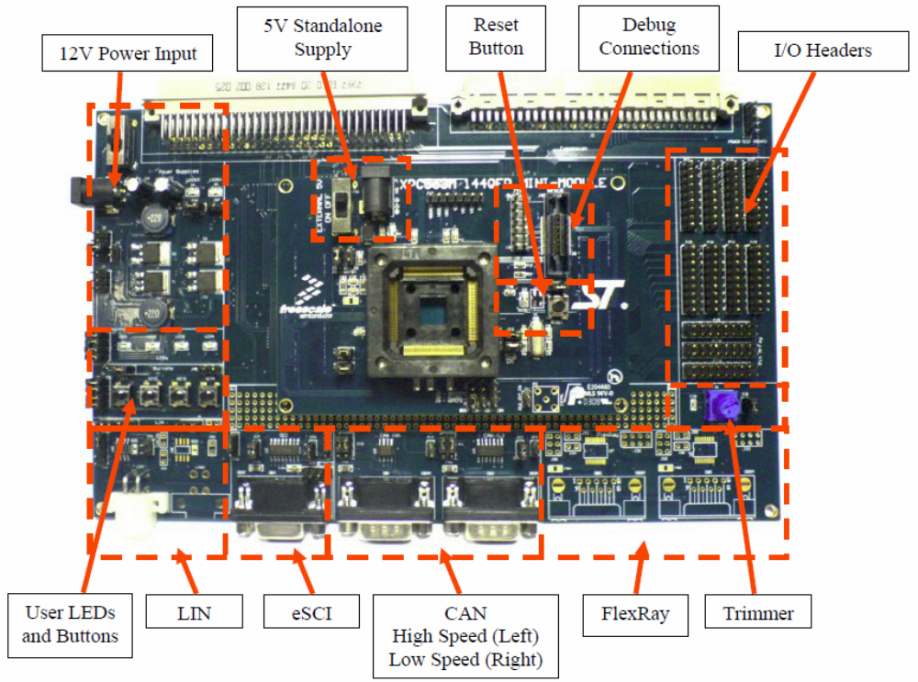
Hardware Setup: SPC56XX Motherboard Setup

Slide 54
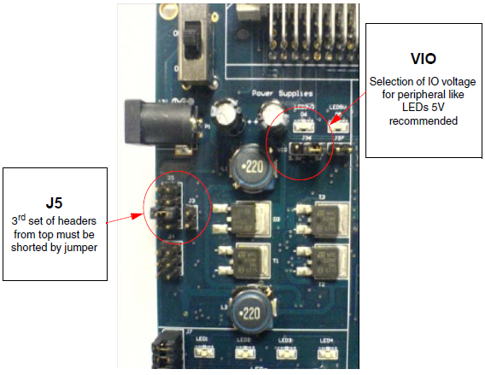
Hardware Setup: Power setup
Notes:
As first step you owe power supply block setting, connection of jumper J5 and VIO

Slide 55
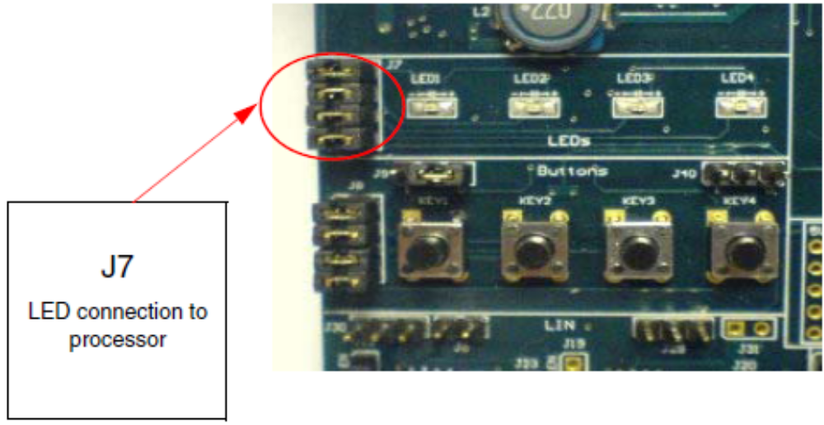
Hardware Setup: Led setup for the application
Notes:
In the example LED1 and LED4 are used. To connect them to the processor, headers 1-2
and 7-8 of J7 jumper array have to be shorted,

Slide 56
Hardware Setup: Minimodule
Minimodule (SPC56ELX). Mini-module provides a minimum setup for the microprocessor:
  socket for the device
  crystal oscillator
  debug interface
Minimodule can be also used without the motherboard

Slide 57
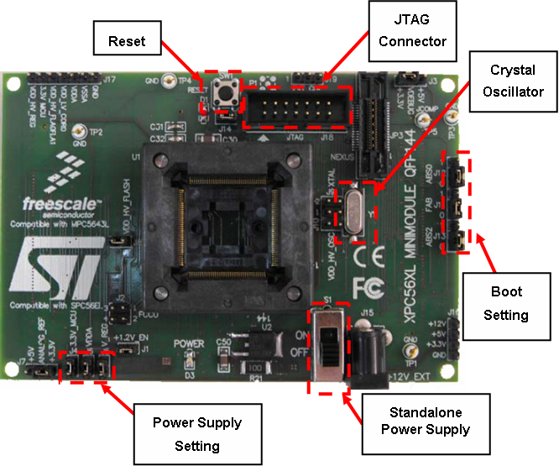
Hardware Setup: Minimodule Setup
Notes:
It is necessary to check the SPC56XL mini-module. Here there are several configuration jumpers who play a role. Figure 19 shows their layout while the list below shows the right setting.
When the mini module is plugged into the motherboard, the power is supplied directly by the motherboard. In this setup, the external power supply input available on the minimodule has not to be used.
When the SPC56XL mini module is used as a stand-alone board, an external +12V power supply must be used. The minimodule obtains its power from the 12VDC Center Positive input barrel connector.

Slide 58
Hardware Setup: Minimodule Setup (Jumper)
Power supplies
  The following jumpers are used to configure the power supply:
  J1 – VDD_LV_COR0 Enable;
  J3 – Debug Port Voltage configuration (V_DEBUG), select from +3.3V and +5V;
  J4 – MCU voltage Enable;
  J5 – VDD_HV_REG Enable;
  J6 – ADC Analog supply voltage Enable;
  J7 – Select Analog supply voltage from +3.3V and +5V;
  J9 – VDD_HV_FLA0FLA1 Enable;
  J10 – VDD_HV_OSC Enable.
Boot configuration
  The following jumpers affect the operation of the processor as it initially comes out of the reset state:
  J11 – FAB configuration, controls whether the processor boots from internal Flash or from a serial interface (CAN, SCI);
  J12 – ABS0 configuration, this jumper configures the ABS[0] pin;
  J13 – ABS2 configuration, this jumper configures ABS[2] pin.
System clock configuration
  The mini module support the usage of crystal clock sources as well as external clock sources:
  J9 – 40MHz crystal clock source enable;
  J10 – External clock source enable.
Reset circuit
  A reset push button “SW1” on the minimodule can be used to reset the processor. The J14 jumper enable the reset circuit.
  For more details connection of evaluation board please see refer to documentation attached in evaluation board kit.

Slide 59
Debugging Hints

Slide 60
Debugging Hint: Memory Debugging
SPC56ELx device has a Memory Management Unit (MMU) that translates from 32-bit effective to 32-bit real addresses.
User must pay attention to dump memory or view peripheral registers with or without MMU intervention.
Lauterbach Hint
  Memory dump with MMU: “d.dump <memory address>”
  Memory dump without MMU: “EA: <memory address>”
  Peripheral registers view with MMU: “per.view <device>.per”
  Peripheral registers without MMU: EA: “per.view <device>.per / dualport”

Slide 61
Debugging Hint: Transition Modes
If the devices cannot complete a transition mode and stays in SAFE Mode, the source of the problem can be find out through Reset Source Analysis and Fault Collection and Control Unit Analysis.
Lauterbach hint
  To allow exit from SAFE state the RGM Status registers is cleaned (it is strongly suggested to find out the source of the fault):
  per.s eanc:0xC3FE4000 %word 0xFFFF
  per.s eanc:0xC3FE4002 %word 0xFFFF

Slide 62
Debugging Hint: Reset Source Analysis
User can debug device reset sources through Reset Generation Module registers:
  Functional Event Status Register (FES)
  Destructive Event Status Register (DES)
if reset is generated by FCCU it is possible to debug these sources through FCCU status registers

Slide 63
Debugging Hint: Exception Handling
User must manage all exceptions provided by device to avoid for example unexpected device reset.
One simple way to do it is to set IVPR register and all IVOR registers to known addresses and then place a breakpoint on these locations.
When an exception is triggered you can debug its source using the respective core registers:
  Machine check syndrome register (MCSR)
  Exception syndrome register (ESR)
  Machine state register (MSR)
  Data exception address register (DEAR)
However it is strongly suggested to handle all exceptions by software.

Slide 64
Debugging Hint: Fault Collection and Control Unit Analysis
The Fault Collection and Control Unit (FCCU) offers a redundant hardware channel to collect errors and to lead the device in a controlled way to a safe state when a failure is present in the device.
Two classes of faults are identified based on the criticism:
  Critical Fault
  Not Critical Fault
In order to read the critical faults you must execute the following read operation sequence:
  to set the OP9 operation (value equal to 9) into the FCCU_CTRL.OPR field
  to wait for the completion of the operation (FCCU_CTRL.OPS field)
  to read the FCCU_CFS0 register
In order to read the non critical faults you must execute the following read operation sequence:
  to set the OP10 operation (value equal to 10) into the FCCU_CTRL.OPR field
  to wait for the completion of the operation (FCCU_CTRL.OPS field)
  to read the FCCU_NCFS0 register

Slide 65
BACKUP
Use GHS Environment to create an SRAM/FLASH Application

Slide 66
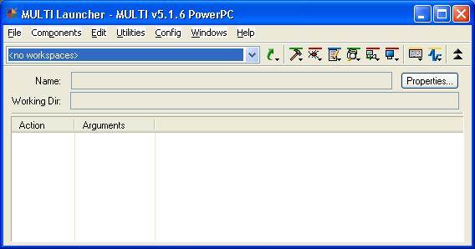
Creating a project
Run MULTI Launcher:
Notes:
This chapter describes how create a project in Green Hills environment. The new project
includes folder structure and proper contents files. It is used as a starting point for both two
examples of getting started tutorial.
Run multi.exe to start Green Hills environment. You can find it in start menu under the Green
Hills software branch or under the GHS installation directory. Figure shows the windows
that appears after running the file above stated.
The project creation consists of two phases:
1. Defining a project: you create a new blank project for his application.
2. Defining a program content: you define the project content

Slide 67
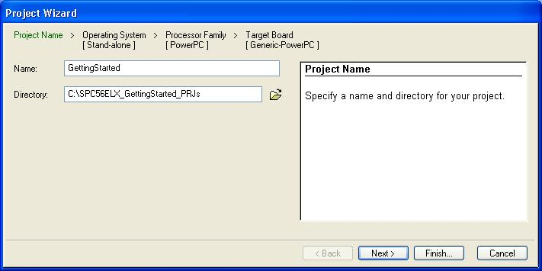
Defining a project (1/3)
Name of main directory
Notes:
You should use the project manager tool to create a new blank project for your application.
You need to select File --> Create New Project for making sure that a popup window wizard
containig an initial project setup appears, see Figure 2.
The project wizard is composed of four steps:
1. Project name: you can specify the name of main directory.
2. Operating system: you can choose the operating system on which the project run.
3. Processor family or target board
a) Processor family: you can select the processor family you want to use.
b) Target board: you can select the target board you want to use.
Step1 - Project name
Figure. shows the window through which you can select the project name, the folder name
and the path in which the project configuration has to be stored.
For this document has been chosen “C:\SPC56ELX_GettingStarted_PRJs” as root path and

Slide 68
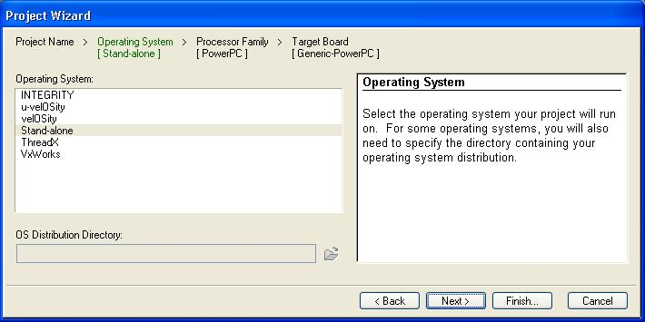
Defining a project (2/3)
Operating system on which the project run
Notes:
2. Step 2 - Operating system
This step allows to choose the operating system on which the project run and the
setting to apply to it.
In this example Stand-alone has been chosen , which means that the application does not
need any operating

Slide 69
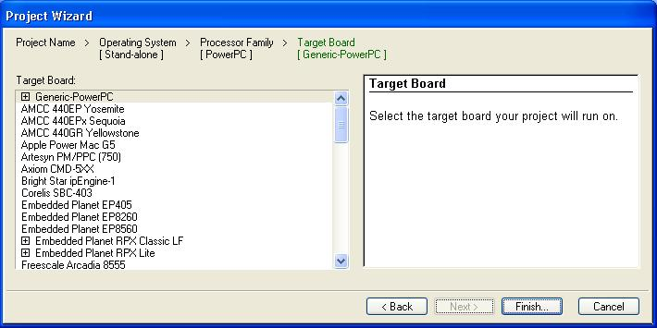
Defining a project (3/3)
Processor family or target board
Notes:
Step 3 - Processor family or target board
You can select the processor family or the target board you want to use, see Figure 4.
Concomitantly with the selection, the project wizard configures some parameters and
selects appropriate files to include in the project structure. The list in Figure 4

Slide 70
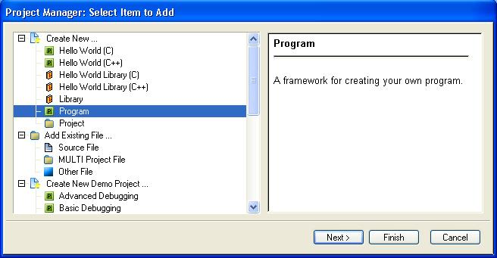
Defining a program content (1/5)
Selection of project type
Notes:
The first phase of creating a new project it has been just completed. Multi has created a
project skeleton with predefined setting and target-specific information. Now the project
wizard continues with the definition of the project content. It is asked several questions
about project type and desired build scheme.
Project manager consists of three steps:
1. Selection of project type
2. Name and directory setting
3. Program layout
1. Step 1 - Selection of project type
First of all it is asked to specify the project type (see Figure 5). The option “Program“
highlighted in blue allows to compile and build a particular application and provide its source
files later on.

Slide 71
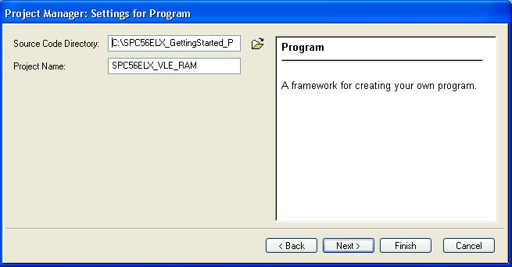
Defining a program content (2/5)
Name and directory setting
Notes:
Step 2 - Name and directory setting
In this step, it is needed to indicate the source files location and the program name
(SPC56ELX_VLE_RAM),

Slide 72
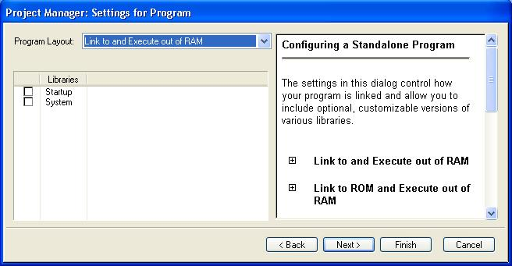
Defining a program content (3/5)
Program Layout
Notes:
Step 3 - Program layout
The last page allows to select the program layout.
In the first example of getting started tutorial, it has been chosen Link to and Execute out
of RAM without checking any of three options below. Selected layout enables to use the
simple JTAG debugging environment without any Flash programming functionality. Anyway,
it is possible to add these features through the wizard as showed in Figure 8, or add/editing
GHS project files.

Slide 73
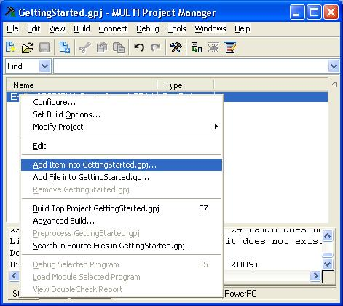
Defining a program content (4/5)
Add Item into prj
Notes:
Now, the project wizard is able to generate the skeleton of the project and to fill it with
appropriate files according with the previous selections. The final project skeleton should
look like the one in slide.

Slide 74
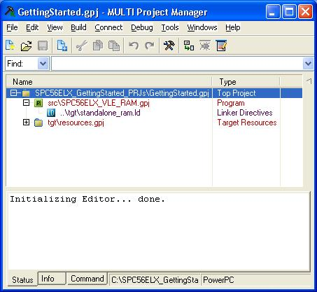
Defining a program content (5/5)
Final project structure

Slide 75
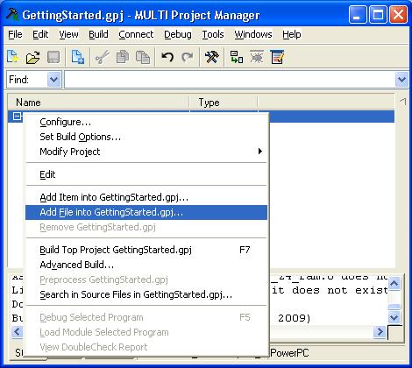
Building the project
Add main.c file to project:
Notes:
You have to add source file main.c into the project (in this way it is possible to add other user
files). Select src\SPC56ELX_VLE_RAM.gpj in the project manager and then click on EDIT
in the toolbar and then “Add File into SPC56ELX_VLE_RAM.gpj” item.
A dialog box appears where you select main.c file. When the file is added, you should see a
project structure.

Slide 76
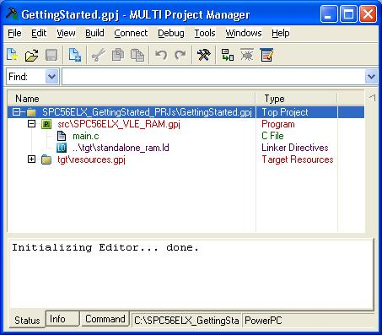
Building the project
When the file is added, you should see a project structure
Notes:
Now it’s possible to add others user files.
Once the source file is inside the project, you can compile it. You check and eventually set
some build parameters, before compiling operation.

Slide 77
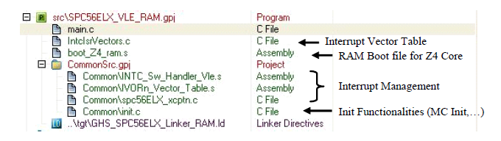
Building the project: Build options
Project tree after that the project file was edited
Notes:
Once that options are set correctly, you can compile source file. Select main.c file in project
manager and click on Build Program SPC56ELX_VLE_RAM item. If compilation process
is without any problem, you see build successful informations in the status window.
Otherwise a detailled window opens and you can read more details about the problems and
double click on an error or a warning.

Slide 78
Building the project: Build options
Open the proper Windows dialog (keep src\SPC56ELX_VLE_RAM.gpj line selected) and choose Edit\Set Build Options.
Manually the edit project file: it’s possible to create/modify the project tree (add/delete user source code, add/delete compile options).

Slide 79
Building the project: Build options in prj file
#!gbuild
primaryTarget=ppc_standalone.tgt
#component top_level_project
[Project]
#-bsp spc56EL # NOT YET Defined by GHS and for this reason it is used Pictus
-bsp spc560
-dwarf2
#Disables the use of SPE and vector floating point instructions by the compiler,
-noSPE
#Generate Default Map file
-map
#No Start file generated by GHS
-nostartfiles
#generate source level debugging information
-g
#Enables VLE code generation and linkage with VLE libraries
-vle
#Enables the generation of DWARF, COFF, or BSD debugging info in the object file
-dual_debug
-DUART_DEBUG
#- Disables all interprocedural optimizations
-Onoipa
#Disables all optimizations and inlining
-Omaxdebug
#No Special Data Area (-nothreshold) -- [default] Disables the special data area optimization
-nothreshold
#Controls whether assembly files with standard extensions such as .s and .asm are preprocessed.
-preprocess_assembly_files
src\SPC56ELX_VLE_RAM.gpj[Program]
-object_dir=objs\GHS
-o images\GHS\ram\spc56ELx_VLE_RAM.elf
-L.\ram_images
tgt\resources.gpj[Project]

Slide 80
Building the project: GHS Build options Hints
-codefactor | Controls the code factoring optimization, which reduces code size by merging redundant sequences of object code at link- time.
-Omax | Controls the aggressiveness with which the compiler will pursue optimizations, without regard for compile time.
-Owholeprogram | Allows program control and data flow to be analyzed at a high level. Speed and size optimizations such as one call-site inlining, interprocedural constant propagation and dead code elimination, and interprocedural alias analysis are performed. This option can improve program speed and size, often simultaneously.
-Osize | Enable all optimizations that improve both size and performance, and special optimizations that improve code size at the expense of performance. Any optimization that is expected to increase code size is disabled. For example, loop unrolling and function inlining are usually not performed when this setting is selected, and some operations may be performed by calling library routines rather than generating inline code.
-Ospeed | Enables all optimizations that improve both size and performance and that improve performance at the expense of size. No optimization expected to sacrifice performance is enabled. This option is recommended for generating the fastest possible code without the use of two-pass inlining.

Slide 81
Building the project: Compile and Build
Select src\SPC56ELX_VLE_RAM.gpj line in the project manager and click on Build Program SPC56ELX_VLE_RAM.elf item.
Output files of build phase are placed in objs folder under objs directory.
The most important file is SPC56ELX_VLE_RAM.elf.

Slide 82
Thanks

