Slide 1
Memory Protection Unit (MPU)

Slide 2
MPU: Introduction - 1
MPU provides hardware access control for all slave port memory accesses
Monitors ALL system bus transactions and compares with pre-programmed memory space “descriptors”
Unlike MMU
provides access control for DMA, FlexRAY in addition to core accesses
memory access control can be as small as 32 bytes
Notes:
Smallest MPU is 4KB

Slide 3
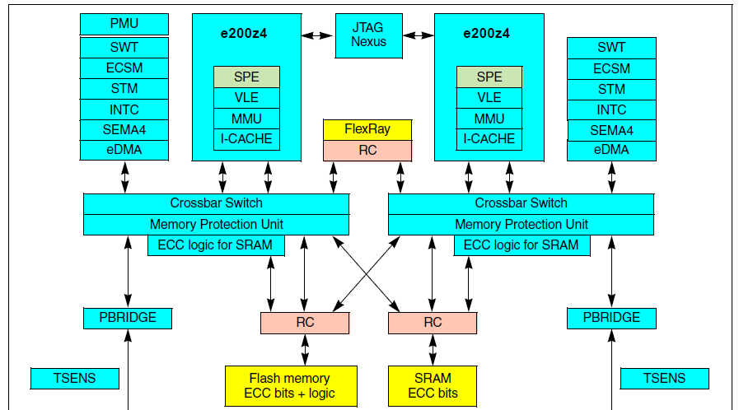
Number of instances
2 instances per safety purpose
User “sees” a single MPU
In LSM

Slide 4
MPU: Introduction - 2
MPU partitions memory into 16 “regions”
16 “Region Descriptors” define memory spaces and their associated access rights
A Protection Error occurs when a memory access is attempted that
is not mapped to a region descriptor, or
does not have sufficient rights in that region
Protection error behavior is defined by master:
Cores – result in Machine Check Exception (ME)
eDMA – eDMA Source or Destination Error which can cause an INTC interrupt
FlexRAY - FlexRAY Controller Host Interface (CHI) illegal system memory access error which can cause an INTC interrupt
Regions may overlap
priority is given to permission granting over access denying

Slide 5
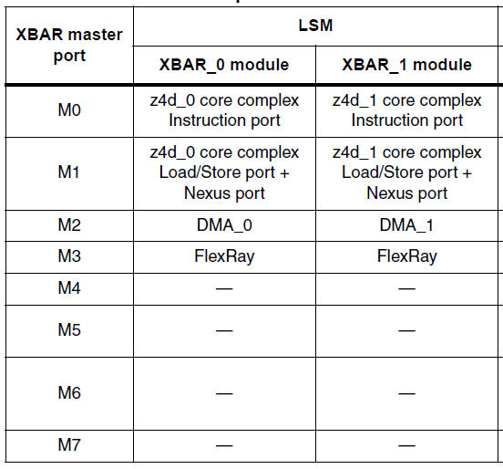
Masters and slaves (a)
Notes:
5

Slide 6
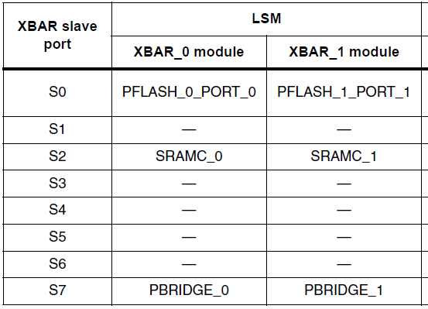
Masters and slaves (b)
Notes:
Two instantiations of the MPU are referred to as MPU_0 (connected to XBAR_0) and MPU_1 (connected to XBAR_1)
Both instantiations are identical and do not differ in LS Mode or DP Mode
6

Slide 7
MPU Features: Memory regions
Support for 16 memory region descriptors
Specification of start and end addresses provide granularity for region sizes from 32 bytes to 4 GB
4 bus masters that support the permissions with independent definitions for supervisor and user mode accesses
For overlapping region descriptors, priority is given to permission granting over access denying as this approach provides more flexibility to system software

Slide 8
MPU Features: Slave Port Connections
MPU monitors every slave port access
using the pre-programmed memory region descriptors
access error
the transition is terminated with an error response
64-bit error registers, one for each AHB slave port, capture
last faulting address,
attributes and “detail” information
Global MPU enable/disable control bit provides a mechanism to easily load region descriptors
while the MPU is disabled all accesses from all bus masters are allowed
Notes:
in the event of an access error
By defaul MPU is disabled

Slide 9
Registers

Slide 10
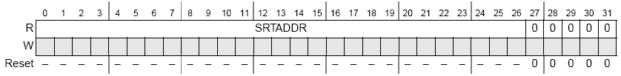
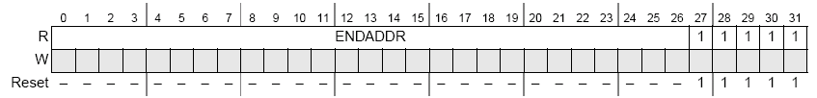
MPU: Region Descriptors - Range
Each of the 16 regions can be between 32bytes and 4GBytes. Size and location is defined in the MPU region descriptor registers MPU_RGDn
Start address of region defined in MPU_RGDn.Word0
Start addresses are aligned on 32-byte boundary
End address of region defined MPU_RGDn.Word1
End addresses are aligned on one less than a 32-byte boundary
Note that there is no hardware error checking to verify ENDADDR >= STARTADDR!
Notes:
Each region is described via 4 registers (RGDx)

Slide 11
MPU: Region Descriptors – Access Control Rights
MPU_RGDn.Word2 defines the access control rights of the memory region
Each Bus Master can have access control defined for:
MnUM – User Mode (Individual control bits for read / write/execute)
MnSM – Supervisor Mode
00 = Read, Write and Execute
01 = Read and execute (No write)
10 = Read and write (no execute)
11 = Same access controls as defined by M0UM
MnPE – Process Identifier Enable
If set, specifies that process identifier and mask defined in MPU_RGDn.Word3 are included in region hit evaluation
Notes:
Core can work either in supervisor or user mode. Usually OS operation are in supervisor mode and normal application is in user mode.
In addition core supports process ID.
PID:
This register is provided to indicate the current process or task identifier. Usually it’s managed by the OS.
MPU supports different configuration for user or supervisor mode. And different configuration depending on the PID.
For each master 3 fields must be configured:

Slide 12
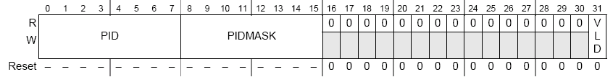
MPU: Region Descriptors – Process Identifier / Mask
MPU_RGDn.Word3 defines
the process identifier and mask
region descriptors valid bit
The Process Identifier (PID) value is combined with the PIDMASK determines if access is granted
The Process Identifier Mask (PIDMASK) enables multiple processor identifiers to be included as part of the region hit determination
If a PIDMASK bit is set, the corresponding bit of the PID is ignored in the comparison
The VLD bit indicates the region descriptor is Valid (see next slide)
Notes:
Access can be granted or denied depending on the PID of the task. For example Task1 of Core0 can access a certain region, but Task2 can’t.
PID mask example:
RGMx.PID = 0x1F
RGMx.PIDMASK = 0x0F
The less importat 4 bit are ignored by the comparison
PID 0x1A, 0x12 can access
PID 0x2A, 0x22 can NOT access

Slide 13
MPU: Region Descriptors – Valid
2 validation flag available:
Global one to disable the whole MPU (MPU_CESR[VLD])
One bit per each description region (MPU_RGDn.Word3[VLD])
Writing to any of the MPU_RGDn.Word[0..2] words will clear the VLD bit of the respective descriptor
region access controls defined by MPU_RGDn.Word2 can be modified without affecting their valid bit by writing to the Alternate Access Control Register, MPU_RGDAACn
Provide an alternate of view of region access controls in MPU_RGDn.Word2
Notes:
2 validation flag available:
Global one to disable the whole MPU (MPU_CESR[VLD])
One bit per each description region

Slide 14
MPU: Alternate Access Control
If only the access rights for an existing region descriptor need to change
a 32-bit write to the alternate version of the access control word (MPU_RGDAACn) would typically be performed
The memory address therefore provides an alternate location for updating MPU_RGDn.Word2
Without affecting the valid bit
The access rights associated with the memory region switch instantaneously to the new value as the IPS write completes.

Slide 15
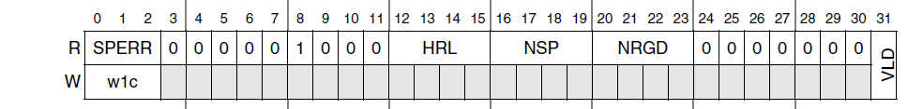
MPU: Errors
An access protection error occurs when either:
Memory reference does not “hit” a memory region, or
The memory reference is flagged as illegal (invalid) in all regions with the hit
Each slave port has two registers containing:
Last faulting address
Attributes
Detail information
The slave port with the error is identified in the control / error status register MPU_CESR[SPERR]
Notes:
SPERR slave port

Slide 16

MPU: Slave Port Access Error Recording (EARn)
There are 3 sets of slave port error recording registers.
When the MPU detects an access error on slave port n, the 32-bit reference address is captured in the MPU Error Address Register MPU_EARn The corresponding bit in the MPU_CESR [SPERR] field is set
Additional information about the failing access is captured in corresponding MPU Error Detail Register
Information in the address and detail error registers remain until reset or the next slave port error is logged

Slide 17
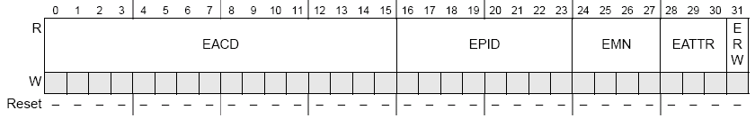
MPU: Slave Port Access Error Recording (EDRn)
Details of an MPU slave port access error are captured in a read only MPU Error Detail Register (MPU_EDRn)
EACD Error Access Control Detail
Indicates which of the 16 MPU regions caused the error. If an error is indicated and this field is 0, then an address miss occurred
EPID Error Process Identification
8-bit process identifier of faulting reference. PID driven by processor cores only!
EMN Error Master Number
4 bit field records logical master that generated the access error
EATTR Error Attributes
Determines mode (user / supervisor) and Access type (Instruction / Data)
ERW Error Read/Write – Signals whether access causing an error was a read or write

Slide 18
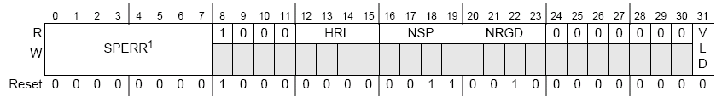
MPU: Read-only Configuration Data
The Control / Error Status Register MPU_CESR provides general configuration information as well as a global MPU enable / disable bit.
SPERR Slave Port error as detailed previously
HRL Hardware Revision Level
Specifies the MPU hardware and definition revision level. Reads as 0 on MPC5516.
NSP Number of slave ports
Number of slave ports connected to MPU. Reads as 3 on MPC5516
NRGD Number of region descriptors
Number of MPU regions. Reads as 0b0010 on Leopard defining 16 MPU regions
VLD Valid bit
Provides a global enable / disable for the MPU
0 = MPU disabled, 1=MPU enabled

Slide 19
Key Points
Notes:
MPU provides hardware access control for all slave port memory accesses
Monitors ALL system bus transactions and compares with pre-programmed memory space “descriptors”
Unlike MMU
provides access control for DMA, FlexRAY in addition to core accesses
memory access control can be as small as 32 bytes
19

Slide 20
Backup

Slide 21
Priority
Overlapping region descriptors
priority is given to permission granting over access denying
this approach provides more flexibility to system software
Application of overlapping regions can reduce the number of descriptors required for a given set of access controls
Notes:
Example RM ver.9 1091

Slide 22
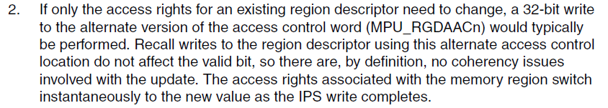
Alternate access

