Slide 1
Leopard eDMA
Version 1.0

Slide 2
eDMA: Background
DMA = Direct Memory Access
DMA controller provides the ability to move data from one memory mapped location to another
Operates in parallel to the central processing unit (CPU) Once configured and initiated
Performs data transfers that would otherwise have been handled by the CPU.
Results in reduced CPU loading and a corresponding increase in system performance
Transfer
Request
Source
ie RAM
0x11112222
DMA reads source data
DMA writes source data to the destination
0x33334444
DMA
Destination
ie SPI TX Reg
0x55556666
0x55556666
0x55556666
0x77778888
0x9999AAAA
DMA Example concept

Slide 3
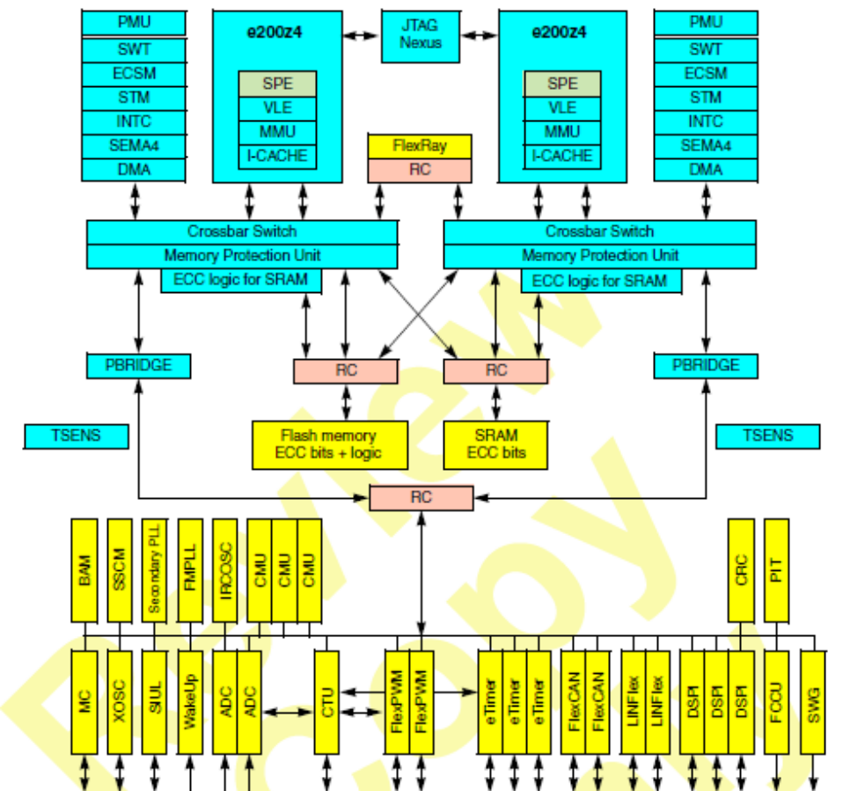
eDMA Introduction: Features
16 DMA channels are implemented on SPC5643Lxx
Each channel will have its DMA source selected by software
- sources are not pre-assigned to peripherals
One DMA engine services all channels
DMA requests can come from:
  a peripheral (e.g., eQADC)
  software initiated
Transfer Control Descriptors define each channel’s transfer
Optional generation of interrupt request on reaching half or all of transfer.
Notes:
From the diagram we can see that the eDMA is a crossbar master

Slide 4
eDMA: Sources
Each DMA channel is tied to a request source through the DMA_MUX
Request sources are interrupt flags that can be also routed to the eDMA
DMA clears flag when the respective transfer has been completed
  Examples:
    DSPI0 Command DSPI_TFFF
    DSPI2 Command DSPI_TFFF
    eTimer_2 Channel0
    LINFlex_0 Receive
    Examine table in ref manual for complete list
Notes:
The MUX will generally be configured once at init only. However it is possible to change as the code executes.
The final 8 sources are always enabled and will generate a DMA request as soon as they are selected

Slide 5
eDMA: Registers (1 of 2)
0 |  |  | 31
Control Register (CR)
Error Status Register (ES)
Ena. Request Reg Low (ERQL)
Ena. Error IRQ Reg Low (EEIL)
Set Enable Request Reg (SERQ) | Clear Enable Request Reg. (CERQ) | Set Enable Error Interrupt Reg. (SEEI) | Clear Enable Error Interrupt Reg. (CEEI)
Clear Interrupt Request Reg. (CINT) | Clear Error Reg. (CERR) | Set Start Bit Reg. (SSRT) | Clear Done Status Bit Reg. (CDNE)
Interrupt Request Low (INTL)
Error Low (ERRL)
HW Request status Low (HRSL)
The eDMA controller implements 16 of potentially 64 channels
Channels must be enabled before
any DMA request is recognized
Errors are caused from a bad configuration or a bus error
8-bit registers for easy modifying of a single channel’s:
- enable request bit
- enable error interrupt bit
- interrupt request (clear only)
- error (clear only)
- TCD start bit (set only)
- TCD done bit (clear only)
Signals the presence of an interrupt request for a channel
Signals the presence of an error on a channel
Notes:
The TCDs must be initialized, but their assignments are done in hardware
By entering the relevant TCD number (0-15) into any of the 8bit registers, the function will be carried out on that TCD

Slide 6
eDMA: Registers and TCD Memory Map (2 of 2)
0 |  |  | 31
Channel 0 Priority Reg. | Channel 1 Priority Reg. | Channel 2 Priority Reg. | Channel 3 Priority Reg.
… | … | … | …
Channel 12 Priority Reg. | Channel 13 Priority Reg. | Channel 14 Priority Reg. | Channel 15 Priority Reg.
16 Transfer Control Descriptor's one per channel 8 words per TCD
Priority Registers (PR) include capability for that channel to be preempted by a higher priority channel and priority assignment

Slide 7
eDMA TCD:Transfer Control Descriptor Introduction
One Transfer Control Descriptor (TCD) for each channel
  Source, Destination addresses
  Separate Size for each read and write access
  Number of transfers per DMA request
  Total number of DMA requests serviced before stop or restart.
  Signed restart address adjustment
    Last Source Address Adjustment and Last Destination Address Adjustment
  Scatter/Gather support

Slide 8
eDMA TCD: Transfer Control Descriptor Registers
Source Address (saddr)
Transfer Attributes (smod, ssize, dmod, dsize) | Signed Source Address Offset (soff)
Signed Minor Loop Offset (smloe, dmod,mloff) | Inner “Minor” Byte Count (nbytes)
Last Source Address Adjustment (slast)
Destination Address (daddr)
Current “Major” Iteration Count (citer) | Signed Destination Address Offset (doff)
Last Destination Address Adjustment (dlast_sga)
Major” Iteration Counter (biter) | Channel Control Status (bwc, linkch, done, active, e_link, e_sg, dreq, int_half, int_maj, start)
  Due to the RCCU before using eDMA is needed to initialize all TCD descriptors to a known value to avoid generation of critical faults
Notes:
TCD is stored in RAM so ALL registers must be initialised before channel is activated.
A TCD is executed when either the START bit is set by software or a peripheral makes a request
NBYTE – number of bytes left to transfer in current minor loop
CITER is the number of the current minor loop
SSIZE source data transfer size (8,16,32,64 and 16/32 byte burst (multiple 32bit sends))
DREQ – disable channel after major loop completes
Offsets are done after a major loop is complete
Dlast_SGA – when in SGA mode, this gives the address of the next memory location from which to get the TCD

Slide 9
eDMA TCD: Loops
Example Memory Array
Current “Major” Loop
Iteration Count (citer)
DMA Request
.
.
.
Minor
Loop
3
2
1
DMA Request
.
.
.
Minor
Loop
Major
Loop
DMA Request
.
.
.
Minor
Loop
Each DMA request initiates one minor loop transfer (iteration) without CPU intervention
DMA arbitration can occur after each minor loop.
  One level of minor loop DMA preemption is allowed
The number of minor loops in a major loop = beginning iteration count (biter).

Slide 10
eDMA TCD: Terms
addr:
starting address
size of one
data transfer
.
.
.
offset: number of bytes added to
current address after each transfer
(often the same value as size)
Minor
Loop
nbytes in minor
loop (often the
same value as size)
Each DMA source and destination has their own:
  addr
  size
  offset
  last
Peripheral queues typically have size and offset equal to nbytes.
.
.
.
Minor
Loop
last: number of bytes added to
current address after major loop
(typically used to loop back)

Slide 11
eDMA TCD: Example – Different Size and Offset
Example: Transferring alternating half-words
  DMA Source: eQADC output queue (in SRAM)
  DMA Destination: DSPI transmit
eQADC Output Queue
addr
A/D Value 1
Time Stamp 1
A/D Value 2
Time Stamp 2
A/D Value 3
Time Stamp 3
size
offset
DSPI
Tx
DMA transfers:
A/D Value 1,
A/D Value 2,
A/D Value 3
Time Stamps are not transferred because each DMA source reads 2 bytes, then increments the source address by 4 bytes.

Slide 12
eDMA TCD: Modulo Feature
Provides the ability to easily implement a circular data queue
  Size of queue is a power of 2
mod, a 5-bit bit field, specifies which lower address bits are allowed to increment from their original value after the address + offset calculation
  all upper address bits remain the same as in the original value.
  If mod = 0 disables modulo feature
Example: source address = 0x12345670; offset is 4 bytes so mod=4, allowing for a 2⁴ byte (16-byte) size queue
Transfer # | Address
1 | 0x12345670
2 | 0x12345674
3 | 0x12345678
4 | 0x1234567C
5 | 0x12345670
6 | 0x12345674
Upper address bits retain their original value.
Circular buffer - address wraps to original value
Notes:
Another example, the mod field would be programmed with a value of 5 if the lower 5 bits are intended to be incremented, allowing for a 32-byte queue.
PRM0
PRM1
PRM2
PRM3
PRM4
PRM5
PRM6
PRM7
0…………31
MOD = 5
Allowing Module 32.
O
O
O
O
TPUC 1
TPUC 2
TPUC n
Transfers Queue Data
to multiple TPU Channels
Module mode may be used when attempting
To configure multiple TPU Channels for the same
Functions in which they utilize the same Parameters.
If we were to monitor the LSB 5 bits of the address in this operation, we will see
Addr as 0, 4, 8, C, 10, 14, 18, 1C, 0, 4, 8, C, 10, 14, 18, 1C, 0,,,,,,etc.

Slide 13
eDMA TCD: Scatter-Gather Feature
Allows a DMA channel to use multiple TCDs
  Enables a DMA channel to scatter the DMA data to multiple destinations or gather it from multiple sources
  Example use: linked list of LIN messages
  Example:
TCD A
(in flash)
TCD B
(in flash)
sga
(Scatter Gather Address)
sga
Sequence:
Initialization: Load TCD A from flash to DMA channel x’s TCD
1st DMA request or START=1: Executes TCD A; TCD B loads automatically
2nd DMA request or START=1: Executes TCD B; TCD A loads automatically
Option: TCD B could auto execute with the 1st DMA request if the TCD’s start bit is set.

Slide 14
eDMA TCD: Channel Linking
A DMA channel can “link” to another DMA channel, i.e, set the start bit of another TCD:
At the end of every minor loop (except the last one)
  And/or, at the end of the major loop
Also enables linked lists
Desired Link Behavior | TCD Control Field Name | Description
Link at end of Minor Loop | citer.e_link | Enable channel-to-channel linking on minor loop completion (current iteration)
 | citer.linkch | Link channel number when linking at end of minor loop (current iteration)
Link at end of Major Loop | major.e_link | Enable channel-to-channel linking on major loop completion
 | major.linkch | Link channel number when linking at end of major loop

Slide 15
eDMA TCD: Other Control & Status Fields (1 of 2)
TCD Control Field Name | Description
start | Control bit to explicitly start channel when using a software initiated DMA service. (Automatically cleared by hardware after service begins.) (Note: Do not set START if DMA request comes from HW)
active | Status bit indicating the channel is currently in execution.
done | Status bit indicating major loop completion. (Set by hardware as CITER reaches 0. Cleared by software if using software initiated DMA service request.)
d_req | Control bit to disable DMA request at end of major loop completion. Clears channel enable bit, DMAERQ, at major loop completion so no additional DMA requests are recognized until channel is enabled again (Important for FIFOs – later)

Slide 16
eDMA TCD: Other Control & Status Fields (2 of 2)
TCD Control Field Name | Description
BWC[0:1] | Control bits for “throttling” bandwidth control of a channel.
e_sg | Control bit to enable scatter-gather feature.
int_half | Control bit to enable interrupt when major loop is half complete (DONE = 0)
int_major | Control bit to enable interrupt when major loop completes (DONE = 1)
BWC - Bandwidth Control
Forces the eDMA to stall after the completion of each read/write access to control the bus request bandwidth seen by the crossbar.
00 No DMA_Engine stalls (for inner loop)
01 Dynamic priority elevation
10 DMA_Engine stalls for 4 cycles after each R/W
11 DMA_Engine stalls for 8 cycles after each R/W
Note:the dynamic priority elevation setting elevates the priority of the eDMA as seen by the cross-bar arbitration switch for the executing channel. Dynamic priority elevation is suppressed during the first two AHB bus cycles.

Slide 17
eDMA TCD: Summary
Transfer Control Descriptor - 32-bytes of local memory.
32-bit Source and Destination addresses
Transfer attributes selects the size increment/decrement options.
Iteration (minor loop) counter – runs to zero every activation.
Source Address (saddr)
Transfer Attributes (smod, ssize, dmod, dsize) | Signed Source Address Offset (soff)
Signed Minor Loop Offset (smloe, ssize, dmod,mloff) | Inner “Minor” Byte Count (nbytes)
Last Source Address Adjustment (slast)
Destination Address (daddr)
Current “Major” Iteration Count (citer) | Signed Destination Address Offset (doff)
Last Destination Address Adjustment (dlast_sga)
“Major” Iteration Counter (biter) | Channel Control Status (bwc, linkch, done, active, e_link, e_sg, dreq, int_half, int_maj, start)
To initiate a software DMA transfer, software must:
set the “start” bit in TCD
later clear the “done” bit in TCD
DMASSTRT – DMA Set Start Request
DMACDONE – DMA Clear Done Status
0
0
0
0
0
0
0
0
0
0
0
0
0
0
0
0
SSTRTQ[6:0]
CDONE[6:0]
A write value of 15, sets corresponding
Start bit in TCD_15 descriptor
A value greater than 63 written will
set or clear Start and Done Bits, respectively
A write value of 15, clears corresponding
Done bit in TCD_15 descriptor

Slide 18
eDMA Registers: Error Status Register
EDMA_ESR – eDMA Error Status Register
VLD
0
0
0
0
0
0
0
0
0
0
0
0
0
0
0
ECX
0
CPE
ERRCHN[5:0]
SAE
SOE
DAE
DOE
NCE
SGE
SBE
DBE
RST:0-----------------------------------------------------------------------------------------------------------------------------------------------------------0
VLD - At least one DMAERR bit is set indicating a valid error exists that has not been cleared.
ECX - Transfer Cancelled
CPE - Channel Priority Error
ERRCHN[5:0] - Error Channel Number
The channel number of the last recorded error.
SAE - Source Address Error
SOE - Source Offset Error
DAE - Destination Address Error
DOE - Destination Offset Error
NCE - Nbytes/Citer Configuration Error
SGE - Scatter/Gather Configuration Error
SBE - Source Bus Error 0 No source bus error.
DBE - Destination Bus Error
If an error is detected on a channel, processing on that channel stops immediately.
The operations of all other channels are unaffected.

Slide 19
eDMA Registers: Setting/Clearing Channel Bits
EDMA_ERQH, EDMA_ERQL – eDMA Enable Request High, Low Registers
ERQ15
ERQ14
ERQ13
ERQ12
ERQ11
ERQ10
ERQ9
ERQ8
ERQ7
ER6
ERQ5
ERQ4
ERQ3
ERQ2
ERQ1
ERQ0
0----------------------------------------------------------------------------------------------------------------------------------------------0
EDMA_CERQR – eDMA Clear Enable Request
EDMA_SERQR – eDMA Set Enable Request
0
0
0
0
0
0
0
0
0
0
0
0
0
0
0
0
CERQ[6:0]
SERQ[6:0]
A write value of 9, clears corresponding
Channel bit in DMAERQ registers
A write value of 7, sets corresponding
Channel bit in DMAERQ registers
Note: A value greater than 63 written to SERQ/CERQ
field will enable/disable all channel in DMAERQ registers

Slide 20
eDMA Registers: Summary – Set/Clear key channel Bits
Channel Control Bit | Register / TCD | Set Bit | Clear Bit
Enable bit | Enable Request Register EDMA_ERQL (chan 0:31), EDMA_ERQH (chan 32:63) | Set Enable Request Register EDMA_SERQR | Clear Enable Request Register EDMA_CERQR
Interrupt Request | Interrupt Request Register EDMA_INTL (chan 0:31), EDMA_INTH (chan 32:63) | - | Clear Interrupt Request Register EDMA_CIRQR
Error Condition Flag | Error Register EDMA_ERL (chan 0:31), EDMA_ERH (chan 32:63) | - | Clear Error Register EDMA_CER
Enable Error Interrupt | Enable Error Interrupt Register EDMA_EEIRL (chan 0:31), EDMA_EEIRH (chan 32:63) | Set Enable Error Interrupt Register EDMA_SEEIR | Clear Enable Error Interrupt Register EDMA_CEEIR
Set START bit to request service by SW | TCD | Set START Bit Register EDMA_SSBR | -
Clear DONE bit by SW | TCD | - | Clear DONE Status Bit Register EDMA_CDSBR
Notes:
IN a similar method, there are 8 bit registers to individually set/clear other flags/enables for each channel

Slide 21
eDMA: Channel Arbitration
Fixed-Priority Arbitration
  Pro: Fastest latency for higher priorities. Prevents lower priority tasks from using too much DMA bandwidth in case of a high priority deadline.
  Con: Potential to use up DMA bandwidth if a channel is always active in highest priority group.
Preemption:
  Normally transfers must complete before another channel can initiate a transfer
  Fixed priority allows one level of preemption
Chan0
Note:
0 is lowest priority
Chan1
Chan2
Chan3
Chan4
Chan5
Chan6
Chan7
Chan8
Chan9
Chan10
Chan11
Chan12
Chan13
Chan14
Chan15
Example: Fixed Chan. Arbitration 4 7 8 5 9 14 2 10 6 15 0 13 11 3 1 12
Notes:
Round robin – eDMA cycles from channel 15 to channel 0 with no regard for priority
In fixed priority mode all active channels must have a unique priority level or an error will occur
Nested preemption not supported

Slide 22
eDMA Registers: Arbitration Controls
EDMA_CR – eDMA Control Register
ERCA – Enable Round-robin Channel Arbitration (default is Fixed-priority Arbitration)
EDBG – Enable Debug (Stalls new channel transfers when debugging)
EDMA_CPRn – eDMA Channel n Priority Register (only applies if ERCA = 0)
R | ECP | 0 | 0 0 |  | CHPRI
W
RST | 0 | 0 | 0 0 ←----------- Same as Channel # (0 to 15) -------→
ECP – Enable Channel n Preemption (by a higher priority channel’s service request)
CHPRI - Channel n Arbitration Priority of 0 (lowest) to 15 if fixed arbitration (ERCA=0)
Notes:
Nested preemption not supported
By the enabling preemption you are allowing that channel to be interrupted should a higher priority DMA channel activate.

